Slide 1
Professional Learning Policy for Teachers and School Staff
School Development Day 2021
Notes:
Slides 1 – 2
Audience: All staff
Purpose: To provide a brief introduction to the new Professional Learning Policy for Teachers and School Staff
This PowerPoint presentation has been prepared to introduce schools to the Professional Learning Policy for Teachers and School Staff that is mandatory from 2021.
The presentation commences with a section for all staff and includes a question and answer session featuring the Secretary, Mark Scott and principal of Homebush West Public School Estelle Southall, and a short video describing the reasons that a new policy has been developed (Case for Change).
This resource may be used as part of school development day activities or in other professional learning activities. The resource can be used flexibly, as needed, in each school context.
The intention is that the slides relating to the whole school could be used on one of the School Development Days, and then each of the more specialised parts either on the School Development Day or at another appropriate time.

Slide 2
Focus Activity: Mark Scott Q&A Presentation
20 MINUTES
The task: to respond to the Secretary’s Q&A session on Professional Learning
View the Secretary’s Q&A video on the PL Activity page
What are three key messages that your group took from the video presentations?
Considering the responses gathered from the whole group:
  Which of these messages most interest you?
  Why?
What implications can you identify for:
  Your school's approach to professional learning?
  Your own professional learning?
Notes:
Audience: ALL STAFF
Purpose of activity
The purpose of this activity is to identify the messages staff took from the video presentation (Case for change video and Mark Scott Q&A session) and consider how this might impact the school's approach to professional learning or influence their own professional learning practice.
This is likely to be the first introduction to the policy and designed for teachers and school staff to know that there is a new professional learning policy that relates to each of them. It is designed to help teachers and school staff to begin to consider how the policy will support them in their development over time, and how this will impact on student learning and the efficiency and effectiveness of the school.
Suggested facilitation instructions
View the Secretary’s Q&A Video on the PL Activities page at: https://education.nsw.gov.au/teaching-and-learning/professional-learning/pl-resources/school-development-days/the-revised-professional-learning-policy-for-teachers-and-school
Ask staff (including non-teaching staff) to divide into small groups to consider the question: What are three key messages that your group took from the video presentation?
Groups share back to the main group.
Construct a list of the key messages identified by the audience (for example, on post-it notes, butcher’s paper, whiteboard, as suits your context and needs)
Divide the main group into pairs or suitably small groups (schools will choose) to discuss: Which of these messages most interest you? Why?
Collect the responses, categorise and display for the whole group.
Again, in small groups consider just one or two messages: What implications are there for:
your school and its approach to professional learning?
your own professional learning?
Next steps
Responses from these activities could be collected and retained to begin to inform subsequent development of the schools professional learning

Slide 3
Professional Learning Policy for Teachers and School Staff
Orientation for school leaders and their teaching teams
Notes:
Slides 3 - 8
Audience: This section is designed for leaders and their teaching teams: this could include stage or faculty teams or other groupings as decided by the school. It could include School Learning Support Officers or other paraprofessionals working in collaboration with teachers.
Purpose: Teams explore the Professional Learning Policy for Teachers and School Staff and the High Impact Professional Learning support website. They will consider how the implementation of the policy impacts/influences professional learning practice in the school.
Teams may wish to revisit the video stimulus offered when the policy was introduced.

Slide 4

Professional Learning Policy for Teachers and School Staff
Informed by evidence, designed to support schools
The policy applies to all school staff, teaching and non-teaching.
The policy recognises three distinct functions:
  High Impact Professional Learning focused on classroom practice and student learning
  Professional learning focused on building an individual's capacity to perform in a specific role
  Mandatory training
Notes:
Audience: School Leaders and teaching teams
Narration
The Professional Learning Policy for Teachers and School Staff is available on the department’s Policy Library website (https://policies.education.nsw.gov.au/policy-library/policies/pd-2004-0017)
The policy applies to all school staff, both teaching and non-teaching.
One of the key features of the policy is the introduction of a model for High Impact Professional Learning. This model is informed by global research. It describes elements that, when in place in a school environment, will enhance the effectiveness of professional learning which is focused on classroom practice.
[One of the important features of the high impact professional learning model is that there is an expectation that collaborative environments will be developed in schools to support the use of data and evidence based practices. The thoughtful use of qualitative and quantitative data will allow schools to understand how teacher professional learning, well implemented in classrooms, impacts on student growth and achievement. As a result, schools will be able to track their progress, and refocus as trends or other demands emerge.}
A second feature of the policy is that it also recognises the wide range of roles in schools with functions outside of the classroom and that professional learning is important to build an individual’s capability to meet the needs of these roles.
[For example, it may include professional learning about changes in technology or systems (eg new timetabling), money or canteen management. It might include participation in conferences or meetings relating to your role. This applies to both teaching and non teaching staff.]
And finally, the policy recognises that mandatory training is an important element - applicable to all staff.

Slide 5
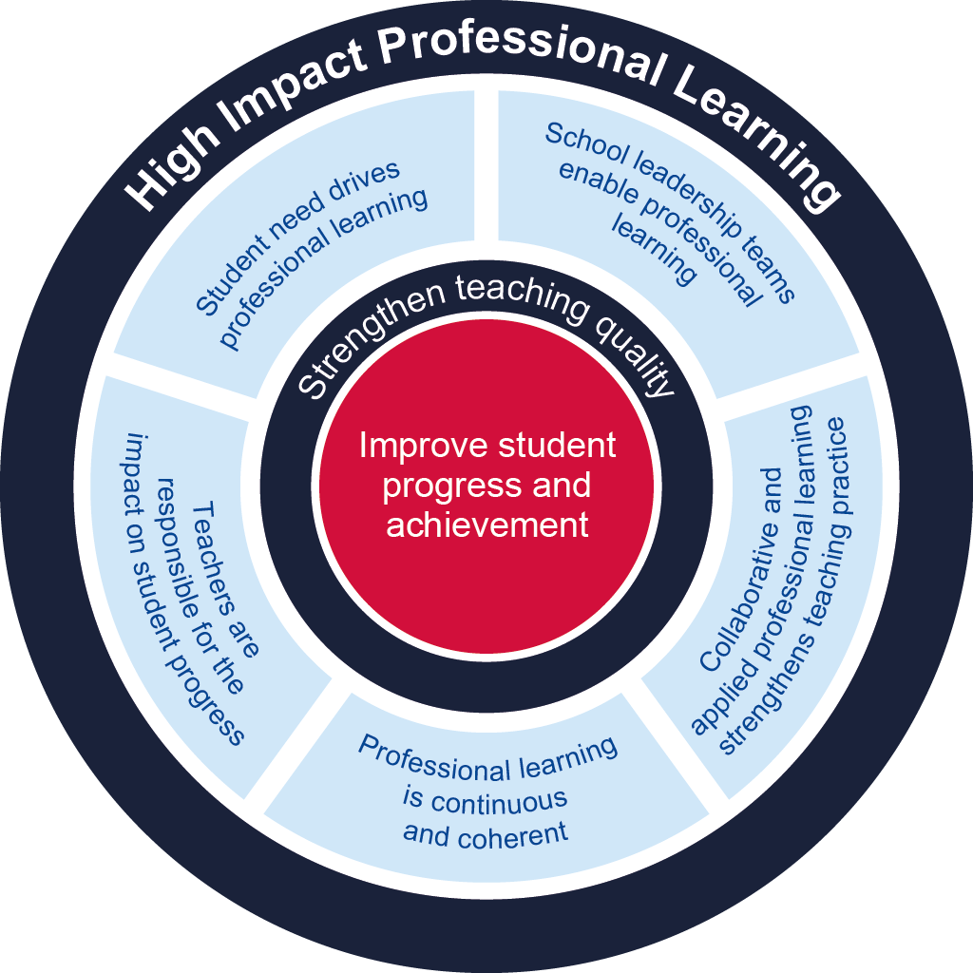
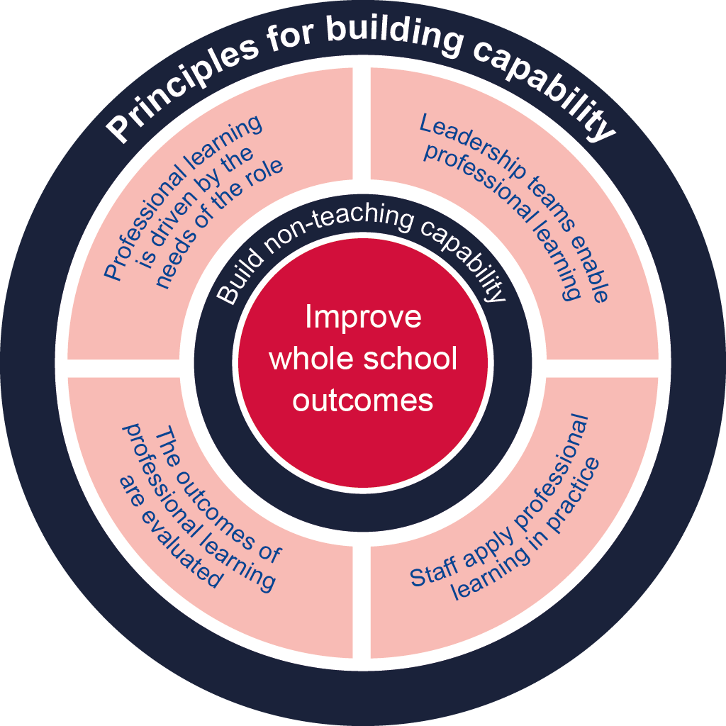
Professional Learning Policy for Teachers and School Staff
What you need to know about the policy
Policy development: PL review, global literature review, policy co-design process and extensive stakeholder engagement
5 HIPL elements strengthen teaching quality and improve student progress and achievement
4 principles for professional learning build individual staff capability
Connects Professional Learning, Performance and Development and School Excellence
Includes mandatory training
Notes:
Audience: School Leaders and teaching teams
Purpose: Explain the key features of the policy.
The policy was developed following a review of research around best practice in teacher professional learning. Investigation of these practices in schools across NSW uncovered a wealth of high impact professional learning approaches already occurring in many schools. But this investigation also highlighted areas where greater consistency could be built.
The 5 high impact professional learning elements described in the policy will help create professional learning environments which strengthen teaching quality in order to improve student progress and achievement
For our non-teaching staff, the 4 principles for professional learning support the building of individual staff capability with roles outside of the classroom.
[Much effort has been made to ensure the policy supports existing policies and procedures such as Performance and Development and School Excellence and that it is useful in providing a framework in every school that supports and advises all staff about what effective professional learning practice looks like.]
The policy can inform conversations about professional learning within the performance and development processes and help in planning for professional learning as part of School Excellence in Action.

Slide 6
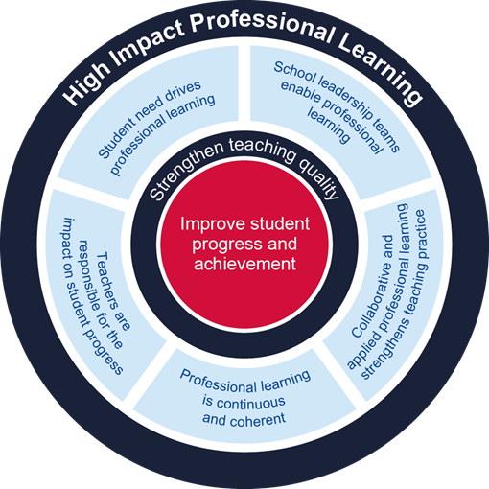
The High Impact Professional Learning model
Five elements focused to improve student progress and achievement
Professional learning is driven by identified student needs
School leadership teams enable professional learning
Collaborative and applied professional learning strengthens teaching practice
Professional learning is continuous and coherent
Teachers and school leaders are responsible for the impact of professional learning on student progress and achievement
Notes:
Audience: School Leaders and teaching teams
Purpose: to increase understanding of the HIPL model
[The High Impact Professional Learning model describes 5 elements that need to be in place in schools to ensure that professional learning can have the highest impact on strengthening teaching quality in order to improve student progress and achievement.]
Let’s take some time now, to unpack the 5 HIPL elements, and start to think about what a HIPL-enabled school looks like.
1. Professional learning is driven by identified student needs – This is a critical element that asks teachers to consider the needs their students when making decisions about the professional learning they choose. It will be important to think about what student data you will use for this, and how you will use it. What does this tell you about where your students are at? Do you have the skills you need to best support them, and if not, what professional learning should you do to meet this gap?
[It ensures that individual and school-level professional learning programs are designed to meet student needs, and that these needs should be identified through analysis of current system, school and classroom data about student progress and achievement.]
[Emerging professional learning needs for teachers may be identified through new educational research, the demands resulting from changes to curriculum and new syllabuses, new policies, Premier’s priorities and in response to trends in high level state wide data. The department responds with initiatives that require teachers to acquire additional skills and knowledge through professional learning.]
[Student needs may also include emerging curriculum demands, learning disability or difficulties, high potential or gifted, literacy, numeracy or local contexts such as those related to identity, wellbeing and community.]
2. School leadership teams enable professional learning – School leaders create the culture and structures that drive inclusive professional learning environments in schools. A shared vision enables learning and growth in every teacher in which new learning is applied to teaching practice. They look for and resource creative solutions to embed professional learning into school routines.
3. Collaborative and applied professional learning strengthens teaching practice – In a HIPL-enabled school we see teachers working and learning together, in collaborative groups, critically challenged, influenced and inspired by expert input that introduces new concepts which shape and strengthen teaching practice.
4. Professional learning is continuous and coherent – Effective professional learning that is aligned to school and individual performance and development goals strengthens our schools and individual teachers. It also promotes professional learning in the everyday life of a teacher as professional learning is clearly connected to strategic improvement plans, performance and development plans and teaching standards.
5. Teachers and school leaders are responsible for the impact of professional learning on student progress and achievement – When you engage in professional learning and apply it in the classroom, you will want to know that your new knowledge and skills has made an impact on your students. Evaluation of student progress following professional learning will enable you to further reflect on and refine your practice.

Slide 7
Professional learning that builds staff capability
Underpinned by four principles
  Professional learning is driven by the needs of the role
  Leadership teams enable professional learning
  Staff are supported to apply professional learning in practice
  The outcomes of professional learning are evaluated
Notes:
Audience: School Leaders and teaching teams
Purpose: Understanding the capability building aspect of the policy
The professional learning of ALL staff in a school is important to ensure our workforce performs efficiently and effectively when serving our school communities and our students.
Professional learning for roles and functions outside of the classroom, including our SASS and other non-teaching staff is underpinned by four principles for building an individual’s capability. These principles may also apply for SOME professional learning for teachers and school leaders .
Principle 1: Professional learning is driven by the needs of the role
Professional learning enables the development of capabilities and skills for individuals in a range of roles within a school. It should be directly relevant to the daily work requirements of staff. It could include mandatory training, and training that is relevant for the role such as in new technologies or compliance requirements.
Principle 2: Leadership teams enable professional learning
Principals and leaders share a vision for all staff to develop and enhance their existing capabilities. In collaboration with their staff they create opportunities to develop staff skills and knowledge within the work that they do.
Principle 3: Staff are supported to apply professional learning in practice
New knowledge and skills gained from professional learning should be applied to work tasks whenever the opportunity arises. This will help address challenges and meet new demands faced in the everyday functions of the role.
Principle 4: The outcomes of professional learning are evaluated
It is important that staff evaluate how professional learning has contributed to their individual growth and the impact on their work, including their overall capability to contribute to their team or school. The data collected through evaluation allows leadership teams to assess the value and effectiveness of the professional learning and inform future planning.

Slide 8
Focus Activity: PL policy, resources and implications
20 MINUTES
The task: to explore the support website and consider your own PL requirements
Access the support website pages at High Impact Professional Learning
Consider the following questions
  What practices are currently in place in your school that support one or more high impact professional learning elements?
  Are there any HIPL elements that you think might need strengthening?
  What is the first step you might take, as a staff, to enact the policy?
Complete the short evaluation at:
http://bit.ly/sdd2021-pl-policy
Notes:
Audience: School Leaders and teaching teams
Purpose of activity
The purpose of this activity is:
to introduce the website and the resources currently available
to generate/ capture the early thinking about the policy in your context
to begin to consider how the Professional Learning Policy for Teachers and School Staff will influence the development of individual PDPs
Suggested facilitation instructions
Link High Impact Professional Learning website: https://education.nsw.gov.au/teaching-and-learning/professional-learning/high-impact-professional-learning
(QR code is on screen)
Provide team with link to High Impact Professional Learning support website and allow staff time to familiarise themselves with the available resources
Ask the team to consider the questions:
What practices are currently in place in your school that supports one or more high impact professional learning elements?
Are there any HIPL elements that you think might need strengthening?
What is the first step you might take, as a staff, to enact the policy?
Record the responses identified for each question and use for further discussion within the team and to provide feedback for the school leadership team
Ask staff to complete the short evaluation at: http://bit.ly/sdd2021-pl-policy
Next steps
Responses from these activities could be collected and retained to begin to inform the subsequent development of the schools professional learning

Slide 9
Professional Learning Policy for Teachers and School Staff
Introducing the High Impact Professional Learning School self-assessment tool to principals and school leadership teams
Notes:
Slides 9 - 14
Audience: School Leadership teams
Purpose: This section is for the use of principals and leadership teams and encourages them to consider how the policy will influence professional learning practice in their school. It introduces the HIPL School-self assessment tool as an optional support to assist in building consistency in professional learning practice in schools.
The introductory videos may be revisited.
The main stimulus for this section is the HIPL School self-assessment tool

Slide 10
Professional Learning Policy for Teachers and School Staff
Informed by evidence, designed to support schools
The policy applies to all school staff, teaching and non-teaching.
The policy recognises three distinct functions:
  High Impact Professional Learning focused on classroom practice and student learning
  Professional learning focused on building an individual's capacity to perform in a specific role
  Mandatory training
Notes:
Audience: Principals and school leadership teams
Narration
The Professional Learning Policy for Teachers and School Staff is available on the department’s Policy Library website (https://policies.education.nsw.gov.au/policy-library/policies/pd-2004-0017)
The policy applies to all school staff, both teaching and non-teaching.
One of the key features of the policy is the introduction of a model for High Impact Professional Learning. This model is informed by global research. It describes elements that, when in place in a school environment, will enhance the effectiveness of professional learning which is focused on classroom practice.
[One of the important features of the high impact professional learning model is that there is an expectation that collaborative environments will be developed in schools to support the use of data and evidence based practices. The thoughtful use of qualitative and quantitative data will allow schools to understand how teacher professional learning, well implemented in classrooms, impacts on student growth and achievement. As a result, schools will be able to track their progress, and refocus as trends or other demands emerge.}
A second feature of the policy is that it also recognises the wide range of roles in schools with functions outside of the classroom and that professional learning is important to build an individual’s capability to meet the needs of these roles.
[For example, it may include professional learning about changes in technology or systems (eg new timetabling), money or canteen management. It might include participation in conferences or meetings relating to your role. This applies to both teaching and non teaching staff.]
And finally, the policy recognises that mandatory training is an important element - applicable to all staff.

Slide 11
Professional Learning Policy for Teachers and School Staff
What you need to know about the policy
Policy development: PL review, global literature review, policy co-design process and extensive stakeholder engagement
5 HIPL elements strengthen teaching quality and improve student progress and achievement
4 principles for professional learning build individual staff capability
Connects Professional Learning, Performance and Development and School Excellence
Includes mandatory training
Notes:
Audience: Principals and school leadership teams
Purpose: Explain the key features of the policy.
The policy was developed following a review of research around best practice in teacher professional learning. Investigation of these practices in schools across NSW uncovered a wealth of high impact professional learning approaches already occurring in many schools. But this investigation also highlighted areas where greater consistency could be built.
The 5 high impact professional learning elements described in the policy will help create professional learning environments which strengthen teaching quality in order to improve student progress and achievement
For our non-teaching staff, the 4 principles for professional learning support the building of individual staff capability with roles outside of the classroom.
[Much effort has been made to ensure the policy supports existing policies and procedures such as Performance and Development and School Excellence and that it is useful in providing a framework in every school that supports and advises all staff about what effective professional learning practice looks like.]
The policy can inform conversations about professional learning within the performance and development processes and help in planning for professional learning as part of School Excellence in Action.

Slide 12
The High Impact Professional Learning model
Five elements focused to improve student progress and achievement
Professional learning is driven by identified student needs
School leadership teams enable professional learning
Collaborative and applied professional learning strengthens teaching practice
Professional learning is continuous and coherent
Teachers and school leaders are responsible for the impact of professional learning on student progress and achievement
Notes:
Audience: Principals and school leadership teams
Purpose: to increase understanding of the HIPL model
[The High Impact Professional Learning model describes 5 elements that need to be in place in schools to ensure that professional learning can have the highest impact on strengthening teaching quality in order to improve student progress and achievement.]
Let’s take some time now, to unpack the 5 HIPL elements, and start to think about what a HIPL-enabled school looks like.
1. Professional learning is driven by identified student needs – This is a critical element that asks teachers to consider the needs their students when making decisions about the professional learning they choose. It will be important to think about what student data you will use for this, and how you will use it. What does this tell you about where your students are at? Do you have the skills you need to best support them, and if not, what professional learning should you do to meet this gap?
[It ensures that individual and school-level professional learning programs are designed to meet student needs, and that these needs should be identified through analysis of current system, school and classroom data about student progress and achievement.]
[Emerging professional learning needs for teachers may be identified through new educational research, the demands resulting from changes to curriculum and new syllabuses, new policies, Premier’s priorities and in response to trends in high level state wide data. The department responds with initiatives that require teachers to acquire additional skills and knowledge through professional learning.]
[Student needs may also include emerging curriculum demands, learning disability or difficulties, high potential or gifted, literacy, numeracy or local contexts such as those related to identity, wellbeing and community.]
2. School leadership teams enable professional learning – School leaders create the culture and structures that drive inclusive professional learning environments in schools. A shared vision enables learning and growth in every teacher in which new learning is applied to teaching practice. They look for and resource creative solutions to embed professional learning into school routines.
3. Collaborative and applied professional learning strengthens teaching practice – In a HIPL-enabled school we see teachers working and learning together, in collaborative groups, critically challenged, influenced and inspired by expert input that introduces new concepts which shape and strengthen teaching practice.
4. Professional learning is continuous and coherent – Effective professional learning that is aligned to school and individual performance and development goals strengthens our schools and individual teachers. It also promotes professional learning in the everyday life of a teacher as professional learning is clearly connected to strategic improvement plans, performance and development plans and teaching standards.
5. Teachers and school leaders are responsible for the impact of professional learning on student progress and achievement – When you engage in professional learning and apply it in the classroom, you will want to know that your new knowledge and skills has made an impact on your students. Evaluation of student progress following professional learning will enable you to further reflect on and refine your practice.

Slide 13
Professional learning that builds staff capability
Underpinned by four principles
  Professional learning is driven by the needs of the role
  Leadership teams enable professional learning
  Staff are supported to apply professional learning in practice
  The outcomes of professional learning are evaluated
Notes:
Audience: Principals and school leadership teams
Purpose: Understanding the capability building aspect of the policy
The professional learning of ALL staff in a school is important to ensure our workforce performs efficiently and effectively when serving our school communities and our students.
Professional learning for roles and functions outside of the classroom, including our SASS and other non-teaching staff is underpinned by four principles for building an individual’s capability. These principles may also apply for SOME professional learning for teachers and school leaders .
Principle 1: Professional learning is driven by the needs of the role
Professional learning enables the development of capabilities and skills for individuals in a range of roles within a school. It should be directly relevant to the daily work requirements of staff. It could include mandatory training, and training that is relevant for the role such as in new technologies or compliance requirements.
Principle 2: Leadership teams enable professional learning
Principals and leaders share a vision for all staff to develop and enhance their existing capabilities. In collaboration with their staff they create opportunities to develop staff skills and knowledge within the work that they do.
Principle 3: Staff are supported to apply professional learning in practice
New knowledge and skills gained from professional learning should be applied to work tasks whenever the opportunity arises. This will help address challenges and meet new demands faced in the everyday functions of the role.
Principle 4: The outcomes of professional learning are evaluated
It is important that staff evaluate how professional learning has contributed to their individual growth and the impact on their work, including their overall capability to contribute to their team or school. The data collected through evaluation allows leadership teams to assess the value and effectiveness of the professional learning and inform future planning.

Slide 14
Focus Activity
20 MINUTES
The task: to explore the HIPL School Self-Assessment tool
Access the HIPL School self-assessment tool on the HIPL support website
  Read the instructions page, noting the three suggested steps
  Access and explore the tool
Refer to STEP 1: Reflect on each theme across the five HIPL elements
  Scan the individual descriptors
  As a group, decide on one theme to explore
  Consider existing practices related to professional learning within your school
As the school leadership team, discuss:
  How useful will the HIPL School self-assessment tool be within your context?
  What opportunities and challenges does this present to the school’s professional learning approaches?
  What are your early thoughts about how you use data and evidence to inform professional learning planning, and how might you improve this?
Complete the short evaluation at:
http://bit.ly/sdd2021-pl-policy
Notes:
Audience: Principals and school leadership teams
Purpose of activity
Think about this activity as just the beginning, an orientation discussion – the timing should suit your context and your needs. The purpose is to begin the thinking – not find all of the answers.
The purpose of this activity is:
to orient the team to the website and its features
to learn about the school self-assessment process
to begin to consider how the school might use the self assessment tool as part of an inquiry process to improve teaching practice and student growth and achievement.
Suggested facilitation instructions
Link to HIPL HIPL School self-assessment tool: https://education.nsw.gov.au/teaching-and-learning/professional-learning/high-impact-professional-learning/self-assessment-tool (QR code is on screen)
Provide team with link to HIPL support website
Ask the team to find the HIPL School Self-Assessment tool
Provide time for team to read the instructions page, noting the three suggested steps
Access and explore the self-assessment tool
Ask the leadership team to consider the questions:
How useful will the HIPL School self-assessment tool be within your context?
What opportunities and challenges does this present to the schools professional learning approaches?
What are your early thoughts about how we use data to inform professional learning planning, and how might we improve this?
Record the responses identified for each question and use to further discussion
Ask staff to complete the short evaluation at: http://bit.ly/sdd2021-pl-policy
Next steps
Responses from these activities could be collected and retained as part of the information gathered to support the subsequent development of the schools professional learning

Slide 15
Professional Learning Policy for Teachers and School Staff
Building the capabilities of
SAMs and non-teaching staff
Notes:
Slides 15 - 19
Audience: SAMs and non-teaching staff.
Purpose: This section explores approaches to professional learning outlined in the policy to support capability development – this may include mandatory training, and professional learning that supports both teaching and non-teaching staff in performing the responsibilities of their roles outside of the classroom.

Slide 16
Professional Learning Policy for Teachers and School Staff
Informed by evidence, designed to support schools
The policy applies to all school staff, teaching and non-teaching.
The policy recognises three distinct functions:
  High Impact Professional Learning focused on classroom practice and student learning
  Professional learning focused on building an individual's capacity to perform in a specific role
  Mandatory training
Notes:
Audience: SAMs and non teaching staff
Narration
The Professional Learning Policy for Teachers and School Staff is available on the department’s Policy Library at (https://policies.education.nsw.gov.au/policy-library/policies/pd-2004-0017)
The policy applies to all school staff, both teaching and non-teaching.
One of the key features of the policy is the introduction of a model for High Impact Professional Learning. This model focuses on action within the classroom environment and relates to the work of teachers however, this approach would also be relevant to School Learning Support Officers and other paraprofessional staff who work in classrooms. This model is informed by global research. It describes elements that, when in place in a school environment, enhance the effectiveness of professional learning focused on classroom practice.
[One of the important features of the high impact professional learning model is that there is an expectation that collaborative environments will be developed in schools to support the use of data and evidence based practices. The thoughtful use of qualitative and quantitative data will allow schools to understand how teacher professional learning, well implemented in classrooms, impacts on student growth and achievement. As a result, schools will be able to track their progress, and refocus as trends or other demands emerge.}
A second feature of the policy is that it recognises the wide range of roles in schools with functions outside of the classroom and that professional learning is important to build an individual’s capability to meet the needs of these roles. This is important for non teaching staff in developing skills that continue to develop them in their role. It is also relevant for teaching staff in terms of fulfilling and developing their roles.
[For example, it may include professional learning about changes in technology or systems (eg new timetabling), money or canteen management. It might include participation in conferences or meetings relating to your role. This applies to both teaching and non teaching staff.]
And finally, the policy recognises that mandatory training is an important element - applicable to all staff.

Slide 17
Professional Learning Policy for Teachers and School Staff
What you need to know about the policy
Policy development: PL review, global literature review, policy co-design process and extensive stakeholder engagement
5 HIPL elements strengthen teaching quality and improve student progress and achievement
4 principles for professional learning build individual staff capability
Connects Professional Learning, Performance and Development and School Excellence
Includes mandatory training
Notes:
Audience: SAMs and non teaching staff
Purpose: Explain the key features of the policy.
The policy was developed following a review of research around best practice in teacher professional learning. Investigation of these practices in schools across NSW uncovered a wealth of high impact professional learning approaches already occurring in many schools. But this investigation also highlighted areas where greater consistency could be built.
The 5 high impact professional learning elements described in the policy will help create professional learning environments which strengthen teaching quality in order to improve student progress and achievement
For our non-teaching staff, the 4 principles for professional learning support the building of individual staff capability with roles outside of the classroom.
[Much effort has been made to ensure the policy supports existing policies and procedures such as Performance and Development and School Excellence and that it is useful in providing a framework in every school that supports and advises all staff about what effective professional learning practice looks like.]
The policy can inform conversations about professional learning within the performance and development processes and help in planning for professional learning as part of School Excellence in Action.

Slide 18
Professional learning that builds staff capability
Underpinned by four principles
  Professional learning is driven by the needs of the role
  Leadership teams enable professional learning
  Staff are supported to apply professional learning in practice
  The outcomes of professional learning are evaluated
Notes:
Audience: SAMs and non teaching staff
Purpose: Understanding the capability building aspect of the policy
The professional learning of ALL staff in a school is important to ensure our workforce performs efficiently and effectively when serving our school communities and our students.
Professional learning for roles and functions outside of the classroom, including our SASS and other non-teaching staff is underpinned by four principles for building an individual’s capability. These principles may also apply for SOME professional learning for teachers and school leaders.
Principle 1: Professional learning is driven by the needs of the role
Professional learning enables the development of capabilities and skills for individuals in a range of roles within a school. It should be directly relevant to the daily work requirements of staff. It could include mandatory training, and training that is relevant for the role such as in new technologies or compliance requirements.
Principle 2: Leadership teams enable professional learning
Principals and leaders share a vision for all staff to develop and enhance their existing capabilities. In collaboration with their staff they create opportunities to develop staff skills and knowledge within the work that they do.
Principle 3: Staff are supported to apply professional learning in practice
New knowledge and skills gained from professional learning should be applied to work tasks whenever the opportunity arises. This will help address challenges and meet new demands faced in the everyday functions of the role.
Principle 4: The outcomes of professional learning are evaluated
It is important that staff evaluate how professional learning has contributed to their individual growth and the impact on their work, including their overall capability to contribute to their team or school. The data collected through evaluation allows leadership teams to assess the value and effectiveness of the professional learning and inform future planning.

Slide 19
Focus Activity
20 MINUTES
The task: to consider professional learning to build capability for non-teaching staff
Discuss existing practices related to professional learning within your school for non-teaching staff.
Access and read through the policy, particularly the principles described at 1.8
Consider the following questions and discuss with your team:
  What opportunities are currently available for your learning?
  What professional learning do you think will help you in your role?
  What would enable you to engage more effectively with professional learning inside the school or externally?
  How do you think you could evaluate the outcome of the professional learning you undertake?
Complete the short evaluation at:
http://bit.ly/sdd2021-pl-policy
Notes:
Audience: SAMs, Non-teaching staff
Purpose of activity
In this activity, non-teaching staff are asked
to consider their learning needs to enhance their work in their role.
to orient non-teaching staff to the policy and its features
to begin to consider what changes will be needed to enable and enhance their professional learning
Preparation notes
Link to the policy: https://policies.education.nsw.gov.au/policy-library/policies/pd-2004-0017?refid=285776 (QR Code is on screen)
Note: This session may be led by the Principal, a member of the school leadership team or the School Administration Manager
In planning for this activity, consider if staff will work individually or in small groups. Depending on the needs of the group, it may be appropriate to divide the team into role specific groups,). For example, staff performing SAO roles, staff in SLSO roles might be grouped, or it might suit the needs of the staff to all work together.
Suggested facilitation instructions
Considering the professional learning accessed previously, ask staff to create a list of enabling and inhibiting conditions at the school: positives and negatives.
Provide team with link to Professional Learning Policy for Teachers and School Staff
Provide time for team to scan the policy, but at least read through and reflect on the principles outlined at 1.8
Looking at the lists created at the beginning of the activity, what are some possible changes that would allow this part of the policy to be implemented.
What do you need to learn to enhance your work?
What do you think you will need to learn in the next say two years? Make a list as a group and see if there are common themes. Keep this information.
How do you think will you evaluate the outcome of professional learning you undertake?
Record the responses identified for each question and provide to the school leadership team for consideration
Ask staff to complete the short evaluation at: http://bit.ly/sdd2021-pl-policy
Next steps
Responses from these activities could be collected and retained as part of the information gathered to support the subsequent development of the schools professional learning

