Slide 1

Science
HSC hub
Physics

Slide 2
Acknowledgement of Country
We would like to pay our respect and acknowledge the traditional custodians of the land on which this film was made, and also pay respect to Elders both past and present.

Slide 3
Deep inside the atom
Inquiry question - How is it known that human understanding of matter is still incomplete?
All images in this resource are in the public domain, unless otherwise indicated.

Slide 4
Syllabus outcomes
Students:
analyse the evidence that suggests –
that protons and neutrons are not fundamental particles
  the existence of subatomic particles other than protons, neutrons and electrons
investigate the Standard Model of matter, including -
  quarks, and the quark composition hadrons
  leptons
  fundamental forces
investigate the operation and role of particle accelerators in obtaining evidence that tests and/or validates aspects of theories, including the Standard Model of matter

Slide 5
Particle physics and the Standard Model
Introduction
particle physics is a branch of physics that explores and explains our world in terms of a small set of particles, the ‘players’ and a set of ‘rules’ for how they interact with one another.
the Standard Model is not actually a model. It is an incredibly successful theory that provides our best description of the subatomic particles and the fundamental forces that drive their interactions.
it was developed in the early 1970’s, and in the decades following the Standard Model has been repeatedly tested using increasingly precise experiments and yet there are no significant discrepancies between the predictions of the theory and the experimental observations.

Slide 6
it has some limitations and there is far more to explore in the world of particle physics. For example, it does not predict the masses of the fermions (quarks and leptons). These, along with some other values, must be measured experimentally and input into the theory in order to make predictions.
despite this, the theory is arguably the most successful scientific theory ever proposed.

Slide 7
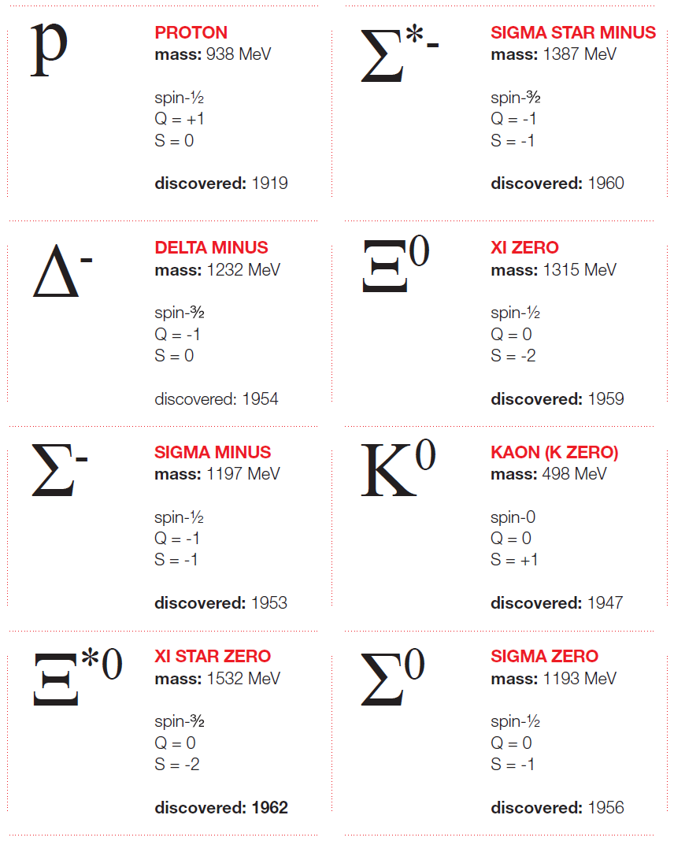
Introducing the Standard Model
Activities for use in the classroom
The following activities could be used to introduce students to the Standard Model.
Taming the particle zoo – Perimeter Institute - guides students through the mounting evidence for and development of the Standard Model. Beginning with the rapid discovery of a 'zoo' of new particles in particle accelerators. Students follow an inquiry process, predicting new particles and maybe winning a Nobel prize.
Image credit: Perimeter Institute

Slide 8
The two activities listed below can be used to explore the many properties and groupings of particles in the Standard Model. These activities instead begin with the fundamental particles and then guide students in seeking patterns and organisation.
Elementary particle cards – S’Cool LAB
Shuffling the particle deck – QuarkNET
The Standard Model - with Harry Cliff (12min) relates development of the Standard Model to the Periodic table. This engaging lecture highlights the observations, evidence and discovery that led to the development and acceptance of the Standard Model.

Slide 9
Introducing the Standard Model
Background information
Why not start with quarks? Teachers investigate a learning unit on the subatomic structure of matter with 12-year-olds explores the effectiveness of a learning unit aimed at introducing students in early stages to an atomic model with quarks and electrons as the fundamental building blocks.
Animated science – AS Physics unit 1 resources
A very detailed presentation outlining the Standard Model and its development. It also contains sample questions and responses. Note: this presentation at times goes beyond the level of detail required to successfully respond to the inquiry question included in the NSW Stage 6 Physics course.

Slide 10
The Higgs discovery explained – CERN (7min)
This is part 1 of 3 short videos produced by physicists at CERN to explain how it is that they knew they had found the Higgs boson in 2012.
The particle adventure
A self guided tour of the Standard Model, particle reactions and the role of particle accelerators and detectors.
What’s the smallest thing in the universe? – Jonathan Butterworth (5min)
A short summary of the Standard Model.
The basics of the Higgs boson - Dave Barney and Steve Goldfarb (6min)
A brief outline of the Higgs boson and its role in the Standard Model.

Slide 11
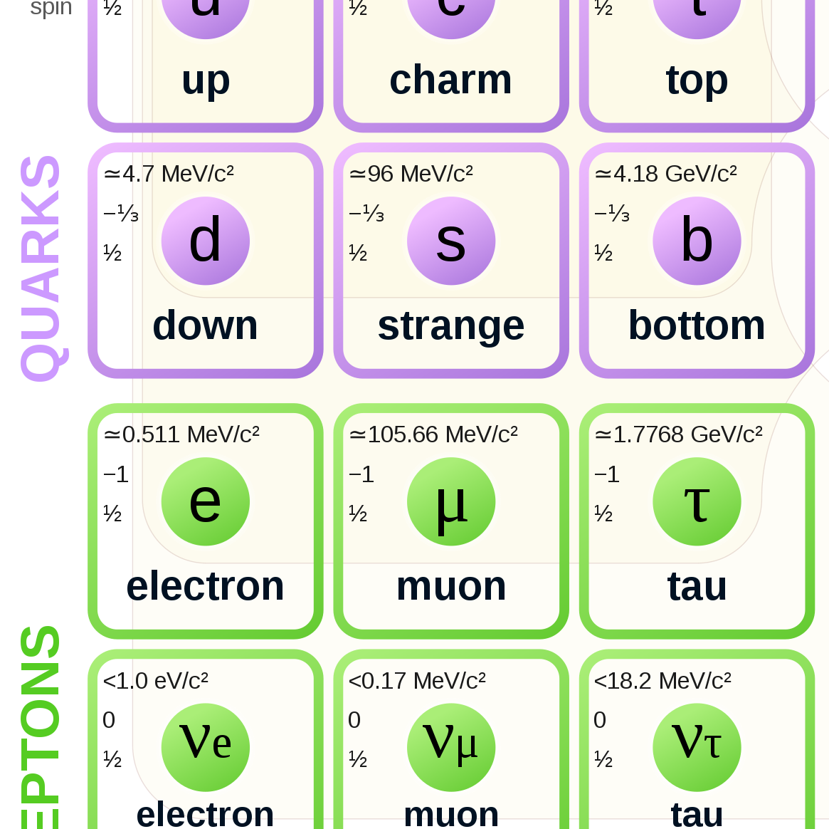
Fundamental particles: Fermions
The players

Slide 12
Fundamental particles
What is a fundamental particle?
fundamental particles (also called elementary particles) are the smallest building blocks of the Universe.
the key characteristic of fundamental particles is that they have no internal structure.
in other words, they are not made up of anything else.
fundamental particles are point-like objects which have properties such as mass, charge and spin.

Slide 13
Fermions
The fermions are the particles that make up all the matter in the universe
almost all the matter in the Universe is made up from only three particles
  up quarks
  down quarks, and
  electrons
of these particles, only electrons can exist own their own. They are the lightest member of a family of particles called leptons
protons and neutrons are not fundamental particles as they composed of up and down quarks.

Slide 14
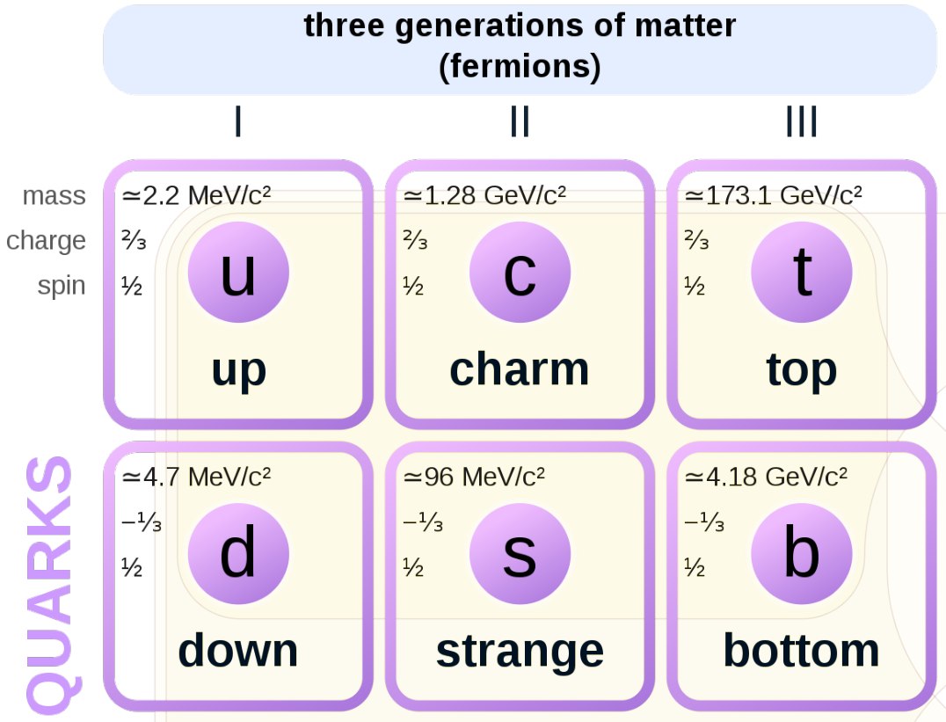
Quarks
only the first generation quarks (up and down quarks) are stable which is why they make up almost all matter.
quarks have fractional charges,
  up quarks = +2/3
  down quarks = -1/3
antiquarks have the same mass but opposite charge, e.g. the charge on an anti-up = -2/3.
the second and third generation quarks are each more massive and less stable than the previous generation

Slide 15
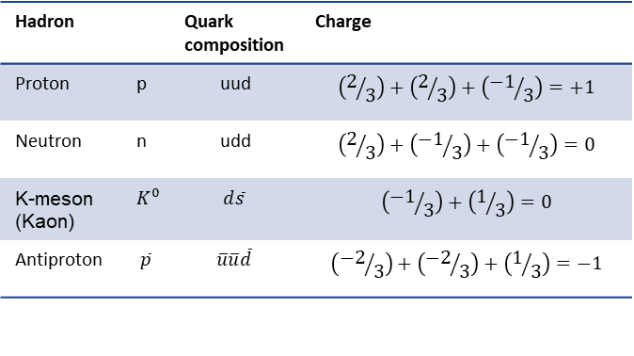
Quark combinations
Quarks must bind together to form particle systems called hadrons.
there are two classes of hadrons, baryons and mesons. Baryons such as protons and neutrons are composed of 3 quarks and mesons are composed of a quark and an antiquark.
the charge of a hadron is equal to the sum of the charges of its composite quarks
some hadrons are listed in the table, make a table showing all the values for net charge that are possible, along with their quark composition.
Can you identify your particles?
Calculating the net charge of a hadron
Hadron |  | Quark composition | Charge
Proton | p | uud | $$\left(2/3\right)+\left(2/3\right)+\left({−1}/3\right)=+1$$
Neutron | n | udd | $$\left(2/3\right)+\left({−1}/3\right)+\left({−1}/3\right)=0$$
K-meson (Kaon) | $$K^{0}$$ | $$d\overline{s}$$ | $$\left({−1}/3\right)+\left(1/3\right)=0$$
Antiproton | $$\overline{p}$$ | $$\overline{u}\overline{u}\overline{d}$$ | $$\left({−2}/3\right)+\left({−2}/3\right)+\left(1/3\right)=−1$$

Slide 16
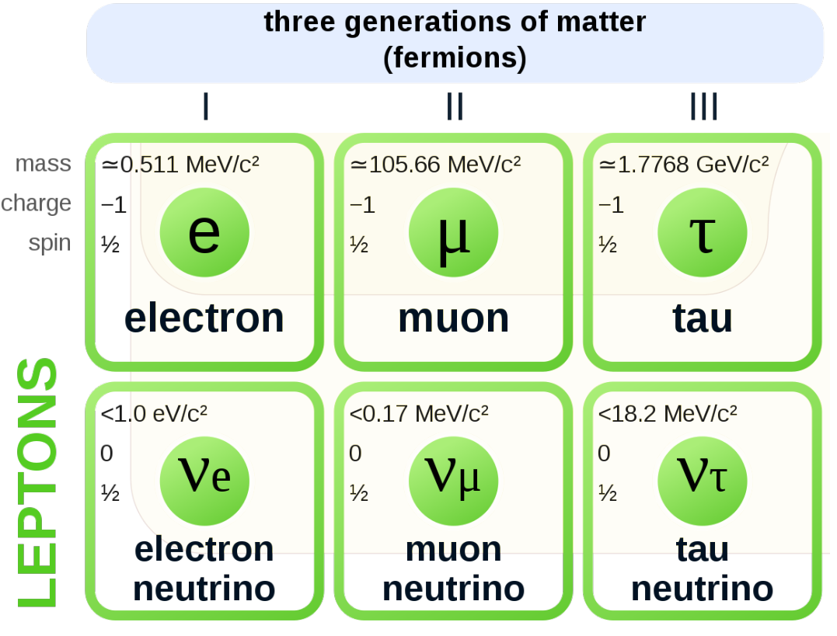
Leptons
these six fundamental particles are collectively referred to as leptons. (from the Greek leptos, meaning ‘thin’ or ‘lightweight’.)
the stable (first generation) leptons are the electron (e⁻) and the electron neutrino (v_{e})
the electron:
  was the first fundamental particle discovered
  has electric charge and can therefore interact via the electromagnetic interaction
the electron and other leptons do not have colour charge and so cannot interact strongly.

Slide 17
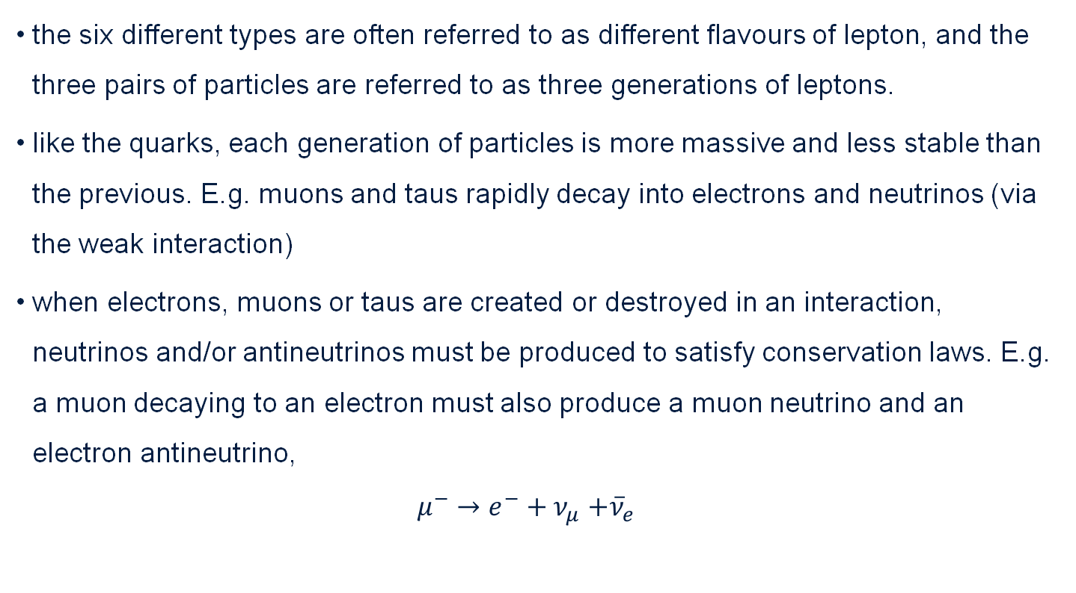
Leptons (continued)
the six different types are often referred to as different flavours of lepton, and the three pairs of particles are referred to as three generations of leptons.
like the quarks, each generation of particles is more massive and less stable than the previous. E.g. muons and taus rapidly decay into electrons and neutrinos (via the weak interaction)
when electrons, muons or taus are created or destroyed in an interaction, neutrinos and/or antineutrinos must be produced to satisfy conservation laws. E.g. a muon decaying to an electron must also produce a muon neutrino and an electron antineutrino,
$μ^{−}{→e^{−}+ν}_{μ}+{\overline{ν}}_{e}$

Slide 18
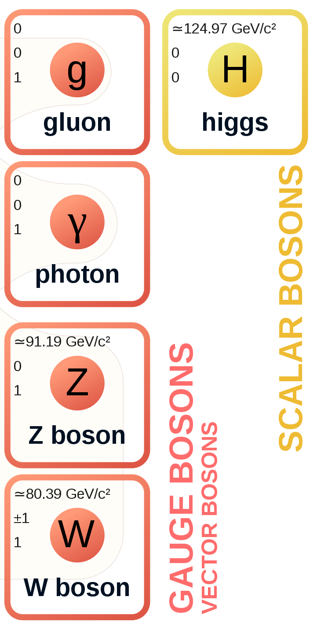
Fundamental forces and their bosons
How do the matter particles interact?
What are the rules?

Slide 19
Fundamental forces
these forces are named as such because they cannot be explained due to the action of another force. For example, friction is not a fundamental force as it can be explained as occurring as a result of the interaction of the electromagnetic forces in one atom with those in another
the next slide shows a summary of their key properties and they are listed in order of strength with the strongest at the top.
gravity really is quite weak, which is just as well, it would be difficult to lift your foot up if it wasn’t

Slide 20
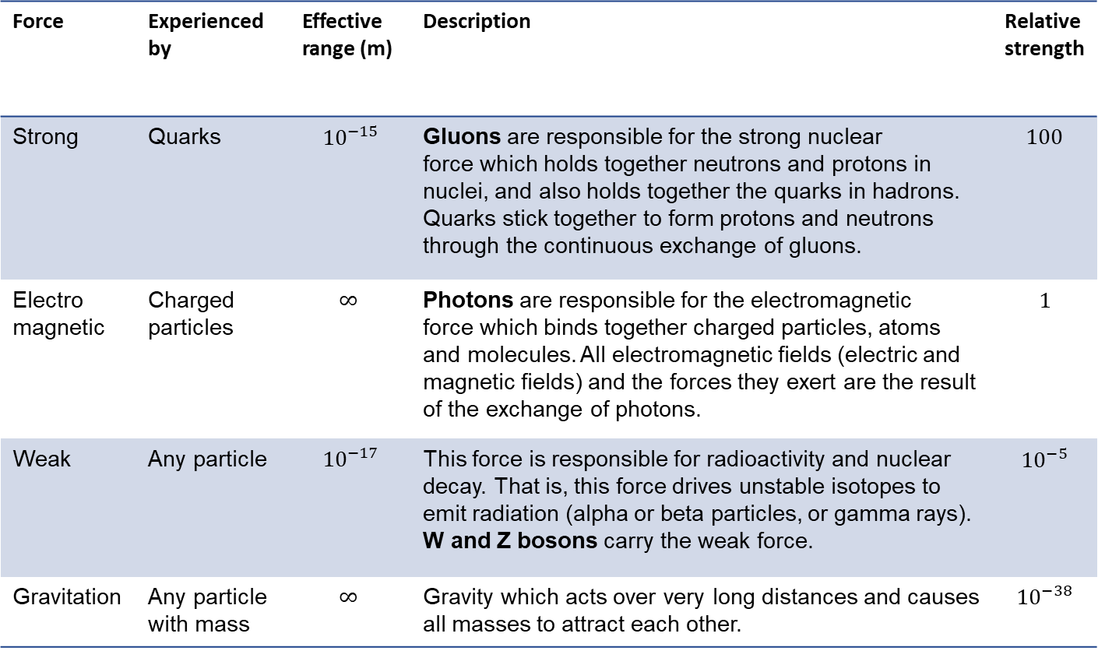
Key properties of forces
Force | Experienced by | Effective range (m) | Description | Relative strength
Strong | Quarks | $${10}^{−15}$$ | Gluons are responsible for the strong nuclear force which holds together neutrons and protons in nuclei, and also holds together the quarks in hadrons. Quarks stick together to form protons and neutrons through the continuous exchange of gluons. | $$100$$
Electro magnetic | Charged particles | $$∞$$ | Photons are responsible for the electromagnetic force which binds together charged particles, atoms and molecules. All electromagnetic fields (electric and magnetic fields) and the forces they exert are the result of the exchange of photons. | $$1$$
Weak | Any particle | $${10}^{−17}$$ | This force is responsible for radioactivity and nuclear decay. That is, this force drives unstable isotopes to emit radiation (alpha or beta particles, or gamma rays). W and Z bosons carry the weak force. | $${10}^{−5}$$
Gravitation | Any particle with mass | $$∞$$ | Gravity which acts over very long distances and causes all masses to attract each other. | $${10}^{−38}$$

Slide 21
Quarks and their combinations
A new type of charge - colour charge
the rules describing how quarks can combine are described in the theory of quantum chromodynamics (QCD), chromo meaning colour in ancient Greek
QCD is one of the two theories describing the fundamental forces in the Standard Model
in addition to electrical charge, each quark has a strong charge
unlike electrical charge which is either positive or negative, the strong charge has three different types
by convention we use colour to describe the strong charge with a quark having either red, green or blue charge and so it is generally referred to as colour charge. They are not actually different colours but the colour provides a useful metaphor for understanding quark behaviour

Slide 22
The strong force
Understanding QCD and the strong force/interaction
each quark has a colour charge, either red, green or blue
antiquarks have colour charges of anti-red, anti-green or anti-blue
quarks can combine in any combination that produces a ‘colour-neutral’ system
like on a colour wheel, colour-neutral systems can be produced by the following combinations
  (red + green + blue)
  (red + anti-red, or blue/anti-blue, etc)
  (anti-red + anti-green + anti-blue)

Slide 23
The colour metaphor applied to the strong interaction/force
particles with colour charge can interact via the colour force
individual quarks within a proton are coloured and so experience extremely strong forces which bind them together.
protons themselves are colour neutral, so two protons do not experience a significant colour force between them unless they are extremely close together. When close, it is the distribution of colour charge within them allows them to interact strongly.
this colour force is now called the strong force or the strong interaction. We say that all particles with colour charge (quarks and the baryons they make up) are strongly interacting, which is to say that they can experience the strong force.
in the Standard Model, the gluon is the force carrier (boson) of the strong force.

Slide 24
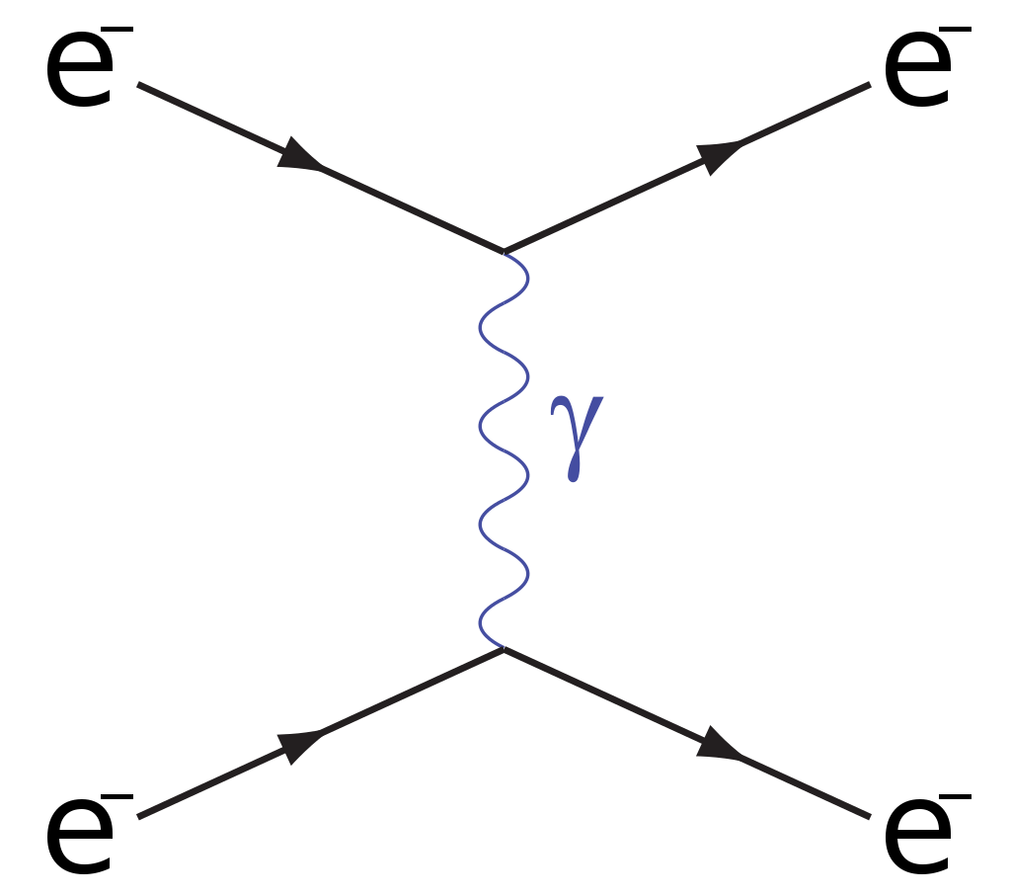
Electromagnetic force
all particles that are electrically charged can interact via the electromagnetic interaction. i.e. they feel the electromagnetic force.
the charge carrier (boson) for the electromagnetic force is the photon.
two electrons are scattered off one another by exchanging a photon as shown in this Feynman diagram.
CC BY-SA 3.0

Slide 25
Weak force
A very strange force indeed
during beta decay, a neutron radioactively decays into a proton and an electron
a neutrino is produced in a fusion reaction in some distant star
when the neutrino reaches Earth, it interacts with a water molecules in Japan’s Super Kamiokande neutrino observatory and produces a flash of light to be detected in one of the 11000 hand made photomultiplier tubes.
these three very different interactions are the result of the weak force.
all fermions (quarks and leptons) can interact via the weak force (they are weakly interacting).

Slide 26
the weak force can exert a push or a pull on a particle but it is generally a transformative force. It is responsible for changing the ‘flavour’ of a quark or lepton e.g. transforming a muon into an electron or an up quark into a charm quark.
weak interactions are improbable and short ranged, with two particles having to get extremely close together in order to interact.
whilst the quarks, baryons and other leptons can interact strongly, neutrinos can only interact via the weak force or gravity which explains why they are so elusive to detect.
the weak interaction involves the exchange of W and Z bosons. Unlike the other force carrying bosons, these bosons have mass.
the electroweak theory explains both the electromagnetic and weak forces and forms part of the Standard Model.

Slide 27
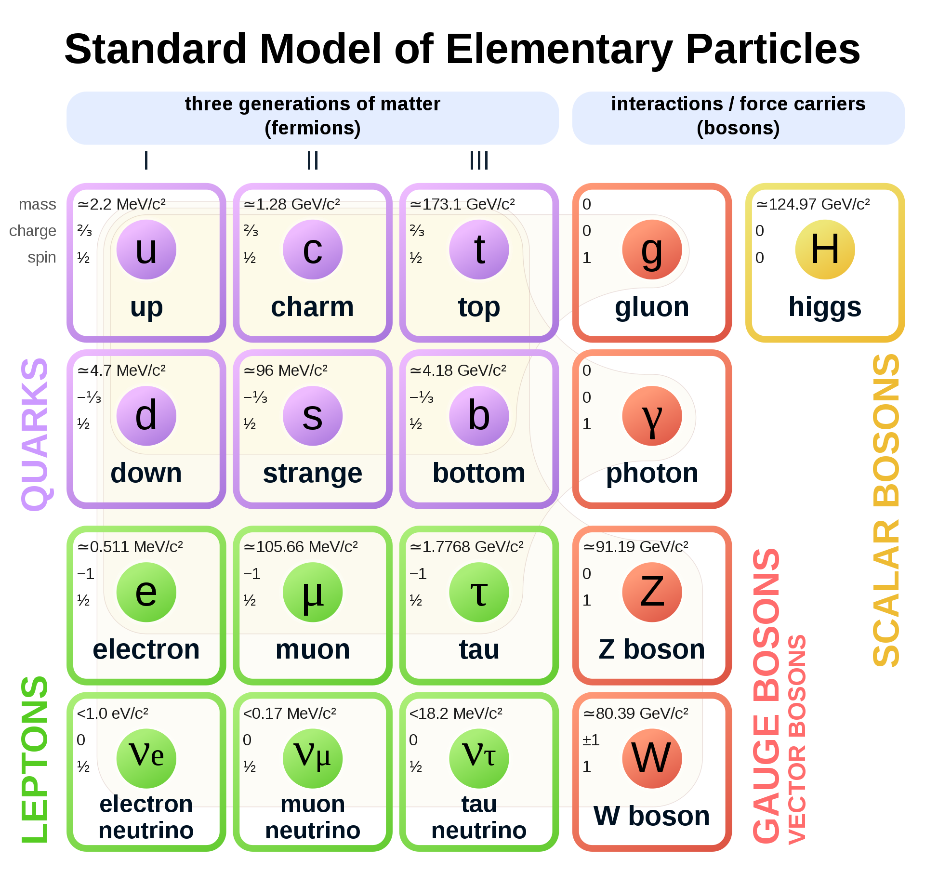
Summary: The Standard Model
The Standard Model describes the fundamental particles and how they interact.
the particles are shown on the right
the rules for how they interact are described by two theories
  the electroweak theory which describes the electromagnetic and weak forces
  QCD which describes the strong force

Slide 28
How do we know?
Investigating the evidence for the Standard Model

Slide 29

How many types of quarks are there?
Standard Model - Fermilab
Watch up to 3.55 minutes for the introduction to quarks.
Leptons – what are three examples of leptons?
When were particle accelerators first used?
Which types of quarks are found in protons and neutrons?
How do we know these particles exist?
Notes:
This video was developed just before the discovery of the Higgs Boson
https://www.youtube.com/watch?v=XYcw8nV_GTs
Introduction to the Standard model of matter and quarks – watch up to 3.55 minutes and ask students to make notes from the video to answer the questions that are on this slide.
Have all the students feedback to ensure everyone has answers to the questions.

Slide 30
Building a hadron
quarks and antiquarks only occur bound together inside hadrons; they have never been observed in isolation. While it may seem like the process of ‘building’ a hadron would be something very complicated (and yes, the underlying physics is indeed complex), there are in fact 3 simple ‘recipes’ to remember.
a hadron can consist of either -
three quarks (in which case it is called a baryon).
three antiquarks (in which case it is called an antibaryon).
one quark and one antiquark (in which case it is called a meson).
Investigate further with: 3D Printable Quark Puzzle: A Model to Build Your Own Particle Systems

Slide 31
Quark summary
Quark | charge
Notes:
Based on the two videos and reading of basic text books – complete the table about the 6 quarks

Slide 32
Summary – possible answers
Quark | Electric charge (e)
up | +2/3
down | -1/3
strange | -1/3
charm | +2/3
top | +2/3
bottom | -1/3

Slide 33
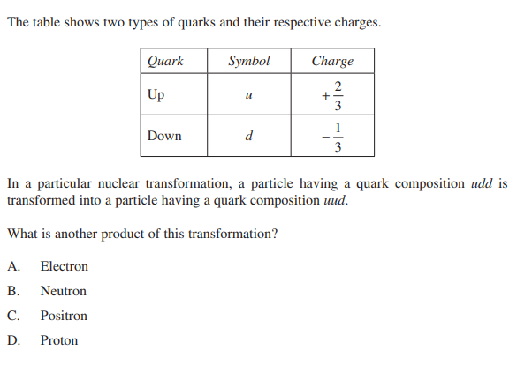
Check understanding
Review this past HSC Question and determine the answer
(2019)
Notes:
2019 HSC – question 12
udd charge is +2/3 + -1/3 + -1/3 = 0
uud charge is +2/3 + +2/3 + -1/3 = +1
To be transformed to a +1 charge an electron (-1) must also be produced so that the overall charge is balanced.

Slide 34
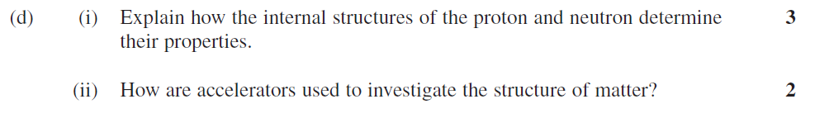
Check understanding
Review this past HSC Question and write a response.
(2012)

Slide 35
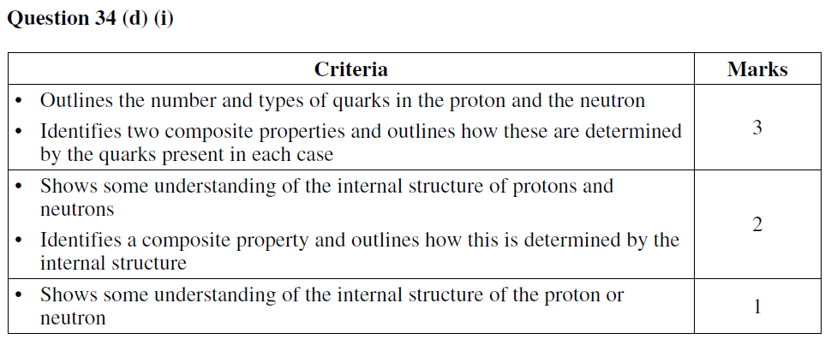
Check understanding
Marking guidelines and sample answers
(2012)
Sample answer:
The proton contains three quarks, two up and one down. The neutron also contains three quarks, two down and one up. The mass of the up and down quarks is very similar, which means that the total masses of the proton and neutron are very similar. The electronic charges of the up and down quark are +2/3 e and –1/3 e respectively. The combination of up and down quarks in the proton leads to a +1 charge, whereas in the neutron this leads to 0 net charge.

Slide 36
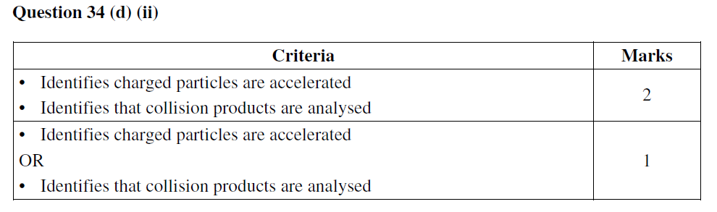
Check understanding
Marking guidelines and sample answers
(2012)
Sample answer:
Scientists use particle accelerators to accelerate electrons (charged particles) at very high energies before crashing them into a target. Using information about the spread and direction of the scattered particles they can deduce information about the matter.

Slide 37
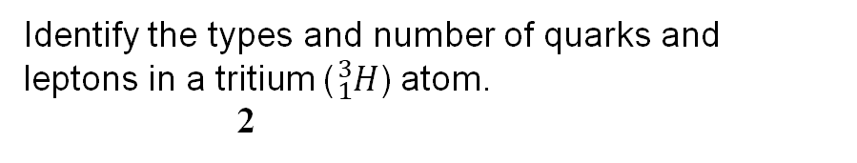
Check understanding
Review this past HSC Question and write a response
(2011)
Identify the types and number of quarks and leptons in a tritium (${}_{1}^{3}H$) atom. 2

Slide 38
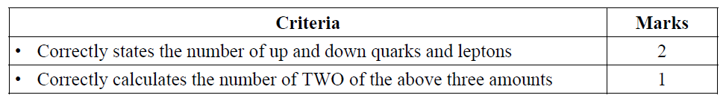
Check understanding
Marking guidelines and sample answers
(2011)
Sample answer:
Tritium contains 1 proton, 2 neutrons and 1 electron.
Protons contain 2 up and 1 down quark.
Neutrons contain 1 up and 2 down quarks.
∴ a tritium atom contains 4 up quarks and 5 down quarks and 1 lepton (the electron).

Slide 39
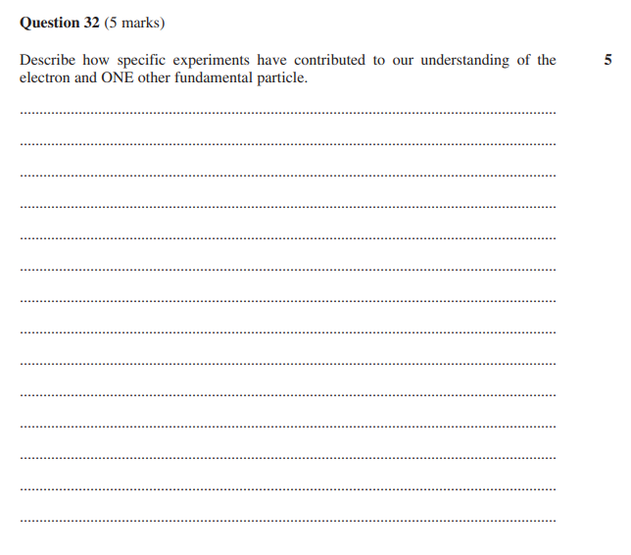
Describe
Provide characteristics and features
2019

Slide 40
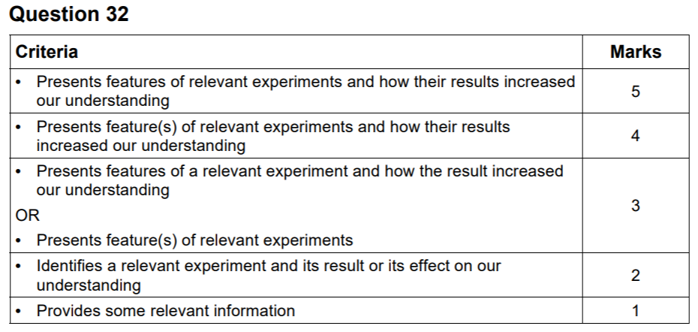
2019
Sample answer:
In an experiment, the velocity of charged oil droplets moving under the influence of gravitational and electric fields was measured. Discrete differences in velocity were observed, providing evidence to determine the charge on an electron. Other fundamental particles include quarks. In one experiment, an accelerated beam of electrons was fired at protons. Scattering patterns produced were interpreted to show that the protons they struck consisted of three smaller particles, later named quarks.
Answers could include:
Experimental evidence showing properties of cathode rays in glass tubes, electron properties such as charge : mass ratio or wave properties. Experiments which revealed information about second or third generation quarks (strange, charm, top, bottom).

Slide 41
Glossary
Terms | Meaning
antibaryon | A subatomic particle composed of three antiquarks. The antimatter counterpart of a baryon. A type of hadron. Examples include the antiproton and antineutron.
antimatter | Every type of matter particle has a corresponding type of antimatter particle which has the same mass but opposite other properties, such as electric charge.
baryon | A subatomic particle composed of three quarks. The matter counterpart of an antibaryon. A type of hadron. Examples include the proton and neutron.
bottom (b) | A type of quark - a fundamental particle with electric charge –e/3. (The bottom quark is sometimes alternatively referred to as 'beauty'.)
charm(c) | A type of quark - a fundamental particle with electric charge +2e/3.
down(d) | A type of quark - a fundamental particle with electric charge –e/3. One of the constituent particles of both the proton and the neutron.

Slide 42
Glossary part 2
Terms | Meaning
electron(e⁻) | One of the component particles from which an atom is made. Electrons have a negative electric charge, and they surround the atom's positively charged nucleus. Electrons carry the electric current in metals. An electron is a fundamental particle (a lepton) with electric charge –e and mass energy about 500 keV. Electrons are produced in beta-minus decay processes.
electron neutrino(_{e}) | A fundamental particle (a lepton) with zero electric charge. It is produced in beta-plus decay along with a positron. Its antiparticle is the electron antineutrino.
Electronvolt (eV) | The unit of energy corresponding to the energy converted when an electron moves through a voltage difference of 1V. The electronvolt is abbreviated to eV and 1 eV = 1.602 × 10⁻¹⁹ J.
flavour | Somewhat whimsical name used to describe the different types of lepton (i.e. electron, electron neutrino, muon, muon neutrino, tauon, tauon neutrino) and the different types of quark (up, down, strange, charm, top, bottom).
generations (of fundamental particles) | The electron and electron neutrino are referred to as first-generation leptons, whereas the up and down quarks are referred to as first-generation quarks.

Slide 43
Glossary part 3
Terms | Meaning
gluon | The quantum of energy associated with the strong interaction. They have a very short range and are never observed in isolation
hadron | A composite particle composed of quarks and/or antiquarks. Baryons are hadrons consisting of three quarks.
meson | A subatomic particle composed of a quark and an antiquark. A type of hadron. Examples of mesons include the pions.
muon (μ⁻) | A fundamental particle (a lepton) with electric charge –e which is similar to an electron but with a mass about 200 times heavier. Its antiparticle is called the antimuon (µ⁺)
muon neutrino | A fundamental particle (a lepton) with zero electric charge. Its corresponding antimatter particle is called the muon antineutrino.
particle system | A composite particle made up of multiple quarks. Protons, neutrons and π-mesons are examples of particle systems.

Slide 44
Acknowledgements
NSW Physics Syllabus © NSW Education Standards Authority (NESA) for and on behalf of the Crown in right of the State of New South Wales 2017.
All examination questions have been sourced from NSW Physics 2019 HSC Exam pack © NSW Education Standards Authority (NESA) for and on behalf of the Crown in right of the State of New South Wales 2019. See the NESA website for additional copyright information. The year of issue is included in each question for your reference.

