Slide 1

Science
HSC hub
Science extension

Slide 2
Acknowledgement of Country
We would like to pay our respect and acknowledge the traditional custodians of the land on which this film was made, and also pay respect to Elders both past and present.

Slide 3

Stage 6 science extension
Module 3
Sample dataset analysis
Notes:
https://commons.wikimedia.org/wiki/File:Titanic_wreck_bow.jpg
Courtesy of NOAA/Institute for Exploration/University of Rhode Island (NOAA/IFE/URI). / Public domain

Slide 4
Inquiry questions
Science extension Module 3
This document contains topic specific content notes to support students. In addition, a detailed dataset and series of investigations to apply the statistical analysis techniques are presented for students to test given and self-initiated hypotheses.
Inquiry question - What tools are used to describe patterns and trends in data?
  Describe the difference between qualitative and quantitative data sets, and methods used for statistical analysis, including but not limited to - descriptive statistics
  Select and use appropriate tools, technologies and/or models in order to manipulate and represent data appropriately for a data set, including but not limited to - spreadsheets

Slide 5
Inquiry question - How does statistical analysis assist in finding meaning in the trends or patterns in data sets?
apply appropriate descriptive statistics to a data set(s), including but not limited to - mean, median and standard deviation
syllabus content - students apply appropriate statistical tests of confidence to a data set(s), including but not limited to - student's t-test, chi-squared test and f-test
use available software to apply statistical tests appropriate to a large data set(s) to assist with the analysis of the data

Slide 6
Acknowledgements
Dataset and content sources
The dataset is available from a number of online sources -
  E Harrell Jr, F., 2002. Datasets < Main < Vanderbilt Biostatistics Wiki. [online] Biostat.mc.vanderbilt.edu. Available at - <http://biostat.mc.vanderbilt.edu/wiki/Main/DataSets> [Accessed 1 June 2020].
  Perrier, A., 2017. Introduction To Titanic Datasets | Packt Hub. [online] Packt Hub. Available at: <https://hub.packtpub.com/introduction-titanic-datasets/> [Accessed 1 June 2020].
  Piech, C., 2016. A Titanic Probability. [online] CS109. Available at: <https://web.stanford.edu/class/archive/cs/cs109/cs109.1166/problem12.html> [Accessed 1 June 2020].

Slide 7
  Public.opendatasoft.com. 2020. Titanic Passengers. [online] Available at: <https://public.opendatasoft.com/explore/dataset/titanic-passengers/table/> [Accessed 1 June 2020].
The hypothesis testing test descriptions and questions were provided by Lisa Wallis from Auburn Girls High School.

Slide 8
The Titanic disaster
What was the Titanic?
The RMS Titanic was a British passenger liner operated by the White Star Line that sank in the North Atlantic Ocean in the early morning hours of 15 April 1912, after striking an iceberg during her maiden voyage from Southampton to New York City. Of the estimated 2,224 passengers and crew aboard, more than 1,500 died, making the sinking one of modern history's deadliest peacetime commercial marine disasters.

Slide 9
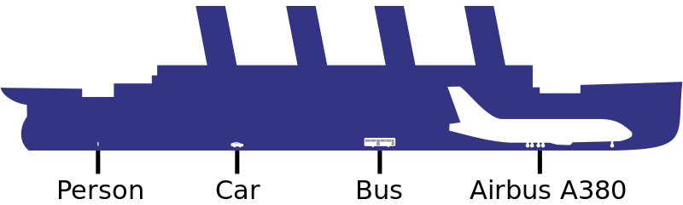
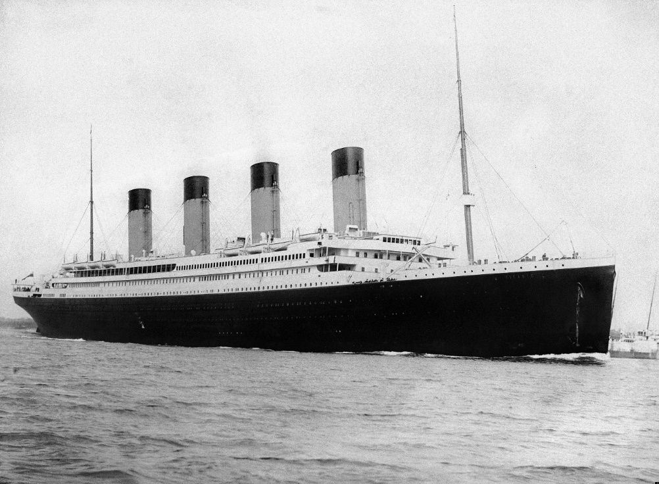
  Length – 269m
  Breadth – 28m
  Draught – 10.54m
  Weight of hull at launching – 22.10 million kg
  Displacement – 47.45 million kg
  Gross – 42.03 million kg
  Net – 19.80 million kg
  Height: 53.34m (the boat deck was 18.29m above the waterline).
  4 funnels (three carried smoke from the furnaces the fourth ventilated the kitchens)
  9 Decks
Notes:
https://en.wikipedia.org/wiki/RMS_Titanic
F.G.O. Stuart (1843-1923) / Public domain
https://commons.wikimedia.org/wiki/File:RMS_Titanic_3.jpg
I, Yzmo / CC BY-SA (http://creativecommons.org/licenses/by-sa/3.0/)
https://commons.wikimedia.org/wiki/File:En_size_titanic.svg

Slide 10

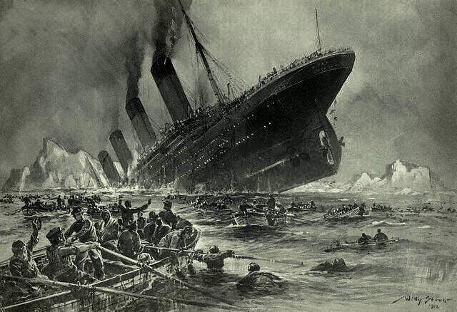
The Titanic disaster
What happened to the Titanic?
At 11:40 p.m. (ship's time) on 14 April, lookout Frederick Fleet spotted an iceberg immediately ahead of Titanic and alerted the bridge. First Officer William Murdoch ordered the ship to be steered around the obstacle and the engines to be stopped, but it was too late; the starboard side of Titanic struck the iceberg, creating a series of holes below the waterline. The hull was not punctured by the iceberg, but rather dented such that the hull's seams buckled and separated, allowing water to seep in.
Notes:
Willy Stöwer, died on 31st May 1931 / Public domain
https://commons.wikimedia.org/wiki/File:St%C3%B6wer_Titanic.jpg
Image originale:en:User:Gary Joseph, en:User:MechBrowman ; image vectorielle:Rogilbert / Public domain
https://commons.wikimedia.org/wiki/File:TitanicRoute.svg

Slide 11
The Titanic disaster
The lifeboats aboard Titanic
The lifeboats had a total capacity enough for only 1,178 persons, if they were fully loaded.
The design of Titanic's lifeboat davits was supposed to enable the stowage and lowering of up to four boats per davit. Although early designs for the ship allowed for this, when the Titanic sailed she only had one boat per davit, apart from boat stations 1 and 2 which also accommodated the collapsible boats.
  Two emergency lifeboats also known as cutters (red), each could carry 40 persons. Numbered 1 on the starboard side and 2 on the port side.
Notes:
https://www.encyclopedia-titanica.org/lifeboat-specifications.html
https://titanicdatabase.fandom.com/wiki/Lifeboats_of_the_RMS_Titanic
Anonymous Harland &amp; Wolff draughtsman / Public domain
https://commons.wikimedia.org/wiki/File:Titanic_Boat_Deck_plan_with_lifeboats.png

Slide 12

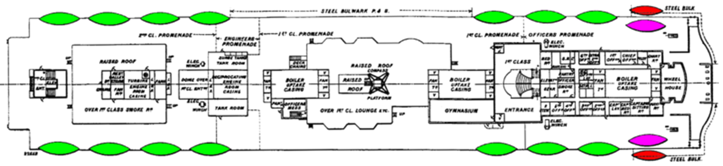


  Fourteen standard lifeboats (green), each could carry 65 persons. Numbered 3-16 bow to stern, even numbers on the port side, odd numbers on the starboard side.
  Four collapsible lifeboats (purple), each could carry 47 persons. Only two are shown in the diagram, A on the starboard side and B on the port side. The other two were located above the officers quarters, C on the starboard side and D on the port side.
STERN
Notes:
https://www.encyclopedia-titanica.org/lifeboat-specifications.html
https://titanicdatabase.fandom.com/wiki/Lifeboats_of_the_RMS_Titanic
Anonymous Harland &amp; Wolff draughtsman / Public domain
https://commons.wikimedia.org/wiki/File:Titanic_Boat_Deck_plan_with_lifeboats.png

Slide 13
The passenger and crew dataset
Explore the available data
Open the supplied dataset either in Microsoft Excel (or Google Sheets, considerations for possible differences in the subsequent instructions for calculations need to be considered)
What range of data and data types are available in this dataset?
Some explanations to help you explore this dataset -
  ticket – the ticket number of the passenger (where available), this allows you to link related passengers with dissimilar surnames even if they stayed in different cabins.
  fare (1912 Pounds) – the fare represented as pounds in 1912 which can be converted to modern day equivalent value and then into any other global currency to relate the relative ticket prices paid by passengers.

Slide 14
  cabin – gives the cabin number (where available) of the passenger (no data available for crew), this allows you to link related passengers with dissimilar surnames. Not all occupants of 3rd class cabins were related as these were typically shared cabins, cross-check with the ticket number to locate linked passengers. The cabin can be located on the RMS Titanic deckplans.
  status – declares the person as a survivor (saved) or fatality (lost) from the RMS Titanic sinking, some passengers made it into a lifeboat but subsequently died before reaching New York and so are identified with a body number.
  lifeboat – gives the identifier of the lifeboat on which the person was a passenger. The location and type of the lifeboat can be located on the RMS Titanic deckplans (boat deck).
  body – gives the identifier (if located and successfully identified) for the body recovered from the wreck location.

Slide 15
The passenger and crew dataset
What stories can you see in the data
When exploring this dataset it is important to remind ourselves this is more than a page of values, these are people, they have stories, they have families. Take some time to explore the dataset and see what stories you can extract about the passengers and crew aboard Titanic. Consider these examples -
Master Shafiq Yūsuf on lifeboat D?
Master As’Ad Tannūs on lifeboat 16?
Sir Cosmo Duff Gordon and the controversy surrounding the lifeboat?
The musicians aboard Titanic?
The “Titanic Twins”, Edmond and Michel Navratil?

Slide 16
What tools are used to describe patterns and trends in data?
Classification of data
Qualitative (also called categorical) data are measures of types and may be represented by a name, symbol, or a number code -
  Nominal values represent discrete units and are used to label variables, that have no quantitative value. Just think of them as labels. Nominal data has no order, therefore if you change the order of its values, the meaning would not change.
    For example – day and night, these nominal values have no value and the order does not change their meaning.
  Ordinal values represent discrete and ordered units. It is therefore nearly the same as nominal data, except that it’s ordering matters.
    For example – like/neutral/dislike on a Likert scale, these ordinal values have no value but their order does define their meaning.
Notes:
Syllabus content: students describe the difference between qualitative and quantitative data sets, and methods used for statistical analysis, including but not limited to: descriptive statistics
Adapted from:
https://towardsdatascience.com/data-types-in-statistics-347e152e8bee

Slide 17
What tools are used to describe patterns and trends in data?
Classification of data
Quantitative data are measures of values or counts and are expressed as numbers -
  Discrete data has values which are distinct and separate and can only take on certain values. This type of data can’t be measured but it can be counted. It basically represents information that can be categorized into a classification.
    For example – The number of children in a family such as 1, 2 or 3 but not 1.5.
  Continuous data represents measurements and therefore their values can’t be counted but they can be measured and described using intervals on the real number line.
    For example – Your height can be 1.56m, 1.91m or any decimal on the scale used.
Notes:
Syllabus content: students describe the difference between qualitative and quantitative data sets, and methods used for statistical analysis, including but not limited to: descriptive statistics
Adapted from:
https://towardsdatascience.com/data-types-in-statistics-347e152e8bee

Slide 18
What tools are used to describe patterns and trends in data?
Spreadsheets and other tools
The remainder of this document will provide instructions for calculations on this dataset using a range of Microsoft Excel formulae, you may wish to explore alternative options which are available to provide similar analysis functions.
  Microsoft Excel (part of the Microsoft Office 365 suite) contains two alternative options for the analysis of this dataset which can be utilised -
    Insert the Analysis ToolPak
    Create a PivotTable
Notes:
Syllabus content: students select and use appropriate tools, technologies and/or models in order to manipulate and represent data appropriately for a data set, including but not limited to: spreadsheets
There are many options to seek assistance with the operation of Microsoft Excel which will be linked at specific slides later in this document. Some excellent online tutorials and help can be found on websites such as:
Mr Excel on YouTube - https://www.youtube.com/channel/UCXbicpVq_ALWG4ijPKsR7ZQ
Excel help and learning on Microsoft - https://support.microsoft.com/en-us/excel
Excel Easy - https://www.excel-easy.com/
Excel Functions - https://www.excelfunctions.net/
ExcelTip - https://www.exceltip.com/
ExcelJet - https://exceljet.net/

Slide 19
  Google Sheets is the Google equivalent of Microsoft Excel and many of the formulae described in this document will work identically between the two products.
    How to use Google Sheets
  Google Data Studio (part of the Google Apps suite) is a powerful data analysis tool with easy to use statistical displays which can be adapted for many types of representations of this dataset
    How to use Google Data Studio
Notes:
Syllabus content: students select and use appropriate tools, technologies and/or models in order to manipulate and represent data appropriately for a data set, including but not limited to: spreadsheets
There are many options to seek assistance with the operation of Microsoft Excel which will be linked at specific slides later in this document. Some excellent online tutorials and help can be found on websites such as:
Mr Excel on YouTube - https://www.youtube.com/channel/UCXbicpVq_ALWG4ijPKsR7ZQ
Excel help and learning on Microsoft - https://support.microsoft.com/en-us/excel
Excel Easy - https://www.excel-easy.com/
Excel Functions - https://www.excelfunctions.net/
ExcelTip - https://www.exceltip.com/
ExcelJet - https://exceljet.net/

Slide 20
What tools are used to describe patterns and trends in data?
Descriptive statistics
Descriptive Statistic | Meaning
Mean | Mean or average is a central tendency of the data i.e. a number around which a whole data is spread out.
Median | Median is the value which divides the data in 2 equal parts i.e. number of terms on right side of it is same as number of terms on left side of it when data is arranged in either ascending or descending order.
Mode | Mode is the term appearing maximum time in data set i.e. term that has highest frequency.
Quartiles | Quartiles are values that divide your data into quarters provided data is sorted in an ascending order. The first quartile (Q1) value is at 25 percentile. Second quartile (Q2) is 50 percentile and third quartile (Q3) is 75 percentile.
Interquartile Range | The range between the first and third quartiles (Q3-Q1) which contains 50% of your data around the median.
Min | The lowest value in the dataset
Max | The highest value in the dataset
Range | Range is the difference between the lowest and highest value in the dataset.
Standard Deviation | Standard deviation is the measurement of average distance between each quantity and mean. That is, how data is spread out from mean.
Notes:
Syllabus content: students describe the difference between qualitative and quantitative data sets, and methods used for statistical analysis, including but not limited to: descriptive statistics
Definitions from:
https://towardsdatascience.com/understanding-descriptive-statistics-c9c2b0641291

Slide 21
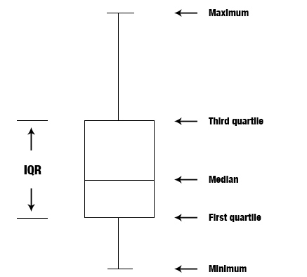
What tools are used to describe patterns and trends in data?
Descriptive statistics
How can we graphically represent this descriptive statistical data?
Box (and whisker) plot – this shows a shaded box containing an indicator for the median and/or mean bordered by the first and third interquartile ranges (the box shows the inner 50% of the dataset) with “whiskers” extending to the max and min of the dataset (showing the outer 50% of the dataset).
Notes:
Syllabus content: students select and use appropriate tools, technologies and/or models in order to manipulate and represent data appropriately for a data set, including but not limited to: spreadsheets
Syllabus content: students describe the difference between qualitative and quantitative data sets, and methods used for statistical analysis, including but not limited to: descriptive statistics
Comparing subsets of a large dataset can be very difficult with only the calculated descriptive statistical values to refer to. It is commonly easier to refer to it in a visual way with the use of various types of graphs. In the case of comparing the ages of people who survived and perished in the Titanic disaster a box plot is useful, other types of graphs may be explored for this comparison and for future comparisons beyond the recommendations in this document.
Types of charts available in Microsoft Excel - https://support.microsoft.com/en-us/office/available-chart-types-in-office-a6187218-807e-4103-9e0a-27cdb19afb90?ui=en-us&rs=en-us&ad=us and https://exceljet.net/chart-types
Image source (modified from):
https://commons.wikimedia.org/wiki/File:Box_plot_description.jpg

Slide 22
How does statistical analysis assist in finding meaning in the trends or patterns in data sets?
Descriptive statistics
Calculate the mean, median, mode, interquartile range, standard deviation and range of the titanic passenger dataset to compare the age of those who survived (Status = Saved) and perished (Status = Lost) in the disaster.
The filters at the top of each column can be used to isolate the dataset by the value in the Status column.
What do these calculations tell us about the dataset?
What does it not let us do?
Descriptive Statistic | Excel Function
Mean | =AVERAGE(cell range)
Median | =MEDIAN(cell range)
Mode | =MODE(cell range)
First quartile | =QUARTILE (cell range,1)
Third quartile | =QUARTILE(cell range,3)
Interquartile Range | =SUM(third quartile – first quartile)
Min | =MIN(cell range)
Max | =MAX(cell range)
Range | =SUM(max-min)
Standard Deviation | =STDEV.P(cell range)
Notes:
Syllabus content: students apply appropriate descriptive statistics to a data set(s), including but not limited to: mean
Syllabus content: students apply appropriate descriptive statistics to a data set(s), including but not limited to: median
Syllabus content: students apply appropriate descriptive statistics to a data set(s), including but not limited to: standard deviation
Syllabus content: students use available software to apply statistical tests appropriate to a large data set(s) to assist with the analysis of the data
Alternative tools to calculate these values can be found online, such as: https://www.socscistatistics.com/descriptive/
Descriptive statistics give an important overview of the data in terms of its central tendency and spread but does not show any details of relationships between the data to infer contributing factors or allow you to test a hypothesis about mortality aboard the Titanic.

Slide 23
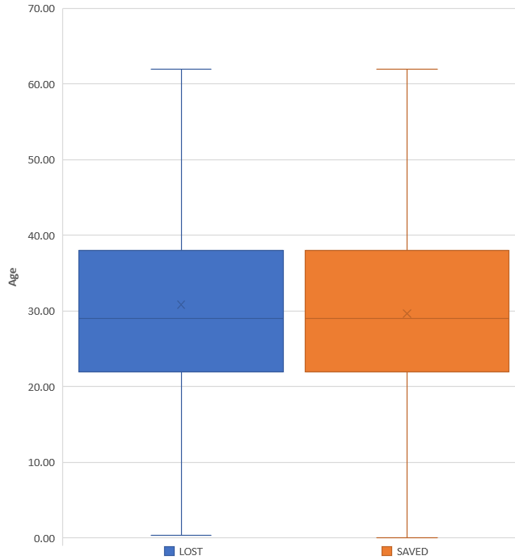
How does statistical analysis assist in finding meaning in the trends or patterns in data sets?
Descriptive statistics
Descriptive Statistic | LOST | SAVED
Mean | 30.86 | 29.70
Median | 29 | 29
Mode | 28 | 24
First quartile | 22 | 22
Third quartile | 38 | 38
Interquartile Range | 16 | 16
Min | 0.33 | 0.17
Max | 74 | 64
Range | 58 | 48
Standard Deviation | 11.88 | 12.86
Notes:
Syllabus content: students apply appropriate descriptive statistics to a data set(s), including but not limited to: mean
Syllabus content: students apply appropriate descriptive statistics to a data set(s), including but not limited to: median
Syllabus content: students apply appropriate descriptive statistics to a data set(s), including but not limited to: standard deviation
Syllabus content: students use available software to apply statistical tests appropriate to a large data set(s) to assist with the analysis of the data
Hopefully your calculations have come up with the same values shown here (decimal values rounded to two decimal places). The box plot displayed has the shaded box containing a line representing the median, cross indicating the mean along with the other features previously mentioned for this chart type.
What can you tell from these calculations and box plot?
Between those lost and saved in the titanic disaster, we can see very limited differences between the two groups using only these descriptive statistical values of the entire population. Both groups have identical interquartile ranges with a very similar mean and identical median. From this view it appears there is no real difference between the ages of those who survived and those who were lost in the titanic disaster. To find out more detail we need to dig a bit further.
Table and image created using MS Excel by author.

Slide 24
How does statistical analysis assist in finding meaning in the trends or patterns in data sets?
Descriptive statistics
Complete the same descriptive statistical analysis and compare subsets of the main dataset such as (many alternative options exist) -
  sex – age of males and females on board?
  class – age of 1st, 2nd and 3rd class passengers?
  type – age of passengers and crew?
What story can be determined through this descriptive statistical analysis?
Notes:
Syllabus content: students apply appropriate descriptive statistics to a data set(s), including but not limited to: mean
Syllabus content: students apply appropriate descriptive statistics to a data set(s), including but not limited to: median
Syllabus content: students apply appropriate descriptive statistics to a data set(s), including but not limited to: standard deviation
Syllabus content: students use available software to apply statistical tests appropriate to a large data set(s) to assist with the analysis of the data

Slide 25
How does statistical analysis assist in finding meaning in the trends or patterns in data sets?
Hypothesis testing
Hypotheses cannot be proved through experiments. Instead, they are only disproved, this is the principle of falsification. Performing experiments to prove a hypothesis is risky because observation bias and theory-laden observations can produce false outcomes. As a result, an incorrect hypothesis may be supported or a correct hypothesis may be rejected.
A hypothesis test is a rule that specifies whether to accept or reject a claim about a population depending on the evidence provided by a sample of data. A hypothesis test examines two opposing hypotheses about a population -
  The null hypothesis is the statement being tested. Usually the null hypothesis is a statement of "no effect" or "no difference“.
  The alternative hypothesis is the statement you want to be able to conclude is true based on evidence provided by the sample data.
Notes:
Source:
https://support.minitab.com/en-us/minitab-express/1/help-and-how-to/basic-statistics/inference/supporting-topics/basics/what-is-a-hypothesis-test/

Slide 26
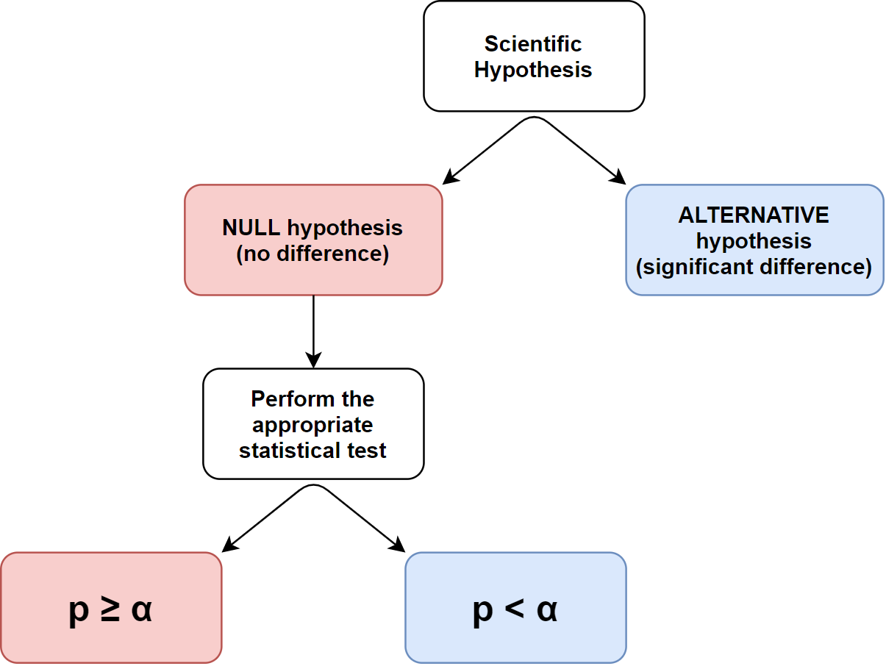
How does statistical analysis assist in finding meaning in the trends or patterns in data sets?
p and α values
Based on the sample data, the test determines whether to reject or accept the null hypothesis. You use a p-value, to make the determination.
p-value - the probability that the null hypothesis is true.
α-value - also called the significant value or the critical value. It indicates the threshold or cut-off against which the p-value is compared.
Result | Outcome | Hence | Meaning
p < α | The null hypothesis is false - reject the null hypothesis | Accept the alternate hypothesis | Result (scientific hypothesis) is statistically significant
p ≥ α | The null hypothesis is true – accept the null hypothesis | Reject alternate hypothesis | Result (scientific hypothesis) is statistically not significant
Notes:
Flowchart image created by Author

Slide 27
How does statistical analysis assist in finding meaning in the trends or patterns in data sets?
Selecting the α value
  α = 0.05 is the most commonly used value, this indicates that you are searching for a 95% probability of the null hypothesis being rejected
  Alternative alpha values include:
    α = 0.10, this indicates that you are searching for a 90% probability of the null hypothesis being rejected
    α = 0.01, this indicates that you are searching for a 99% probability of the null hypothesis being rejected
Notes:
Syllabus content: students apply appropriate statistical tests of confidence to a data set(s), including but not limited to: Student's t-test
Syllabus content: students apply appropriate statistical tests of confidence to a data set(s), including but not limited to: Chi-squared test
Syllabus content: students apply appropriate statistical tests of confidence to a data set(s), including but not limited to: F-test

Slide 28
How does statistical analysis assist in finding meaning in the trends or patterns in data sets?
1-tailed and 2-tailed p values
1-tailed and 2-tailed p-values in statistical tests define the type of difference which is required by the hypothesis. In some cases we are looking for any difference between the populations and in others we are looking for a directional difference – either less than or greater than -
  1-tailed: the scientific hypothesis is directional and indicates one level of comparison (treatment is significantly ‘greater than’ or ‘less than’ a control)
  2-tailed: the scientific hypothesis is non-directional and indicates two or more levels of comparison (treatment is significantly ‘different to’ a control)
Hypothesis | Type of hypothesis | p-value
The mean of the treatment sample is different from the mean of the control sample. | Non-directional, all types of differences are considered | 2-tailed
The mean of the treatment sample is greater than the mean of the control sample. | Directional, only 1 type of difference (greater than) is considered | 1-tailed
The mean of the treatment sample is less than the mean of the control sample. | Directional, only 1 type of difference (less than) is considered | 1-tailed
Notes:
Syllabus content: students apply appropriate statistical tests of confidence to a data set(s), including but not limited to: Student's t-test
Syllabus content: students apply appropriate statistical tests of confidence to a data set(s), including but not limited to: Chi-squared test
Syllabus content: students apply appropriate statistical tests of confidence to a data set(s), including but not limited to: F-test
Syllabus content: students use available software to apply statistical tests appropriate to a large data set(s) to assist with the analysis of the data
Source:
https://support.minitab.com/en-us/minitab-express/1/help-and-how-to/basic-statistics/inference/supporting-topics/basics/what-is-a-hypothesis-test/

Slide 29
How does statistical analysis assist in finding meaning in the trends or patterns in data sets?
Selecting a statistical test
  The F-test is used first to determine if the variance between two datasets is significantly different, this result is then used to determine which type of t-test is undertaken to determine a difference between the means. Especially in systems which are commonly highly variable (a higher degree of noise in the data) such as measurements of living systems, the need to determine if the variation between two datasets to be compared is critical. The natural variations in some parameters will make quantities like means and medians meaningless meaning that a t-test is not possible. Therefore, comparing the variances, rather than the means, is better for such systems.
Notes:
Syllabus content: students apply appropriate statistical tests of confidence to a data set(s), including but not limited to: F-test

Slide 30
  The F-test result is always in reference to the null hypothesis (equal variance between the datasets), where the p value is less than the α value means that you must reject the null hypothesis. This means the two datasets have unequal variance.
  The F-test is clearly explained in LearnChemE the meaning of an F-test and instructions on how to easily complete the F-test in excel are available online.

Slide 31
How does statistical analysis assist in finding meaning in the trends or patterns in data sets?
Student’s t-test
  The t-test is a statistical test of whether two sample means (averages) are equal. This test is appropriate when the variances of the two populations are equal. There are two forms of the t-test:
    Unpaired or independent t-test is assumed that the two samples are independent, knowing something about one does not affect what we know about the other. For example, the average heights of men and women, are independent, since knowing the height of a particular man tells us nothing about the height of any particular woman.
Notes:
Syllabus content: students apply appropriate statistical tests of confidence to a data set(s), including but not limited to: Student's t-test
https://statisticalanalysisconsulting.com/the-t-test/

Slide 32
    Paired or dependant t-test means that the two samples are related, for example, the length of people’s right and left feet are dependent, because knowing the size of a right foot tells us a lot about the size of the left foot.
  The t-test result is always in reference to the null hypothesis (no difference between the means), where the p value is less than the α value it means that you must reject the null hypothesis. This means the two dataset means are not significantly different..
  The student’s t-test is clearly explained in Bozemann Science Students’ t-test and instructions on how to easily complete the t-test in excel are available online.

Slide 33
How does statistical analysis assist in finding meaning in the trends or patterns in data sets?
Chi-squared test
  The Chi-squared test is a statistical test of categorical data. It is used to determine if the observed data (frequencies) are similar to what is predicted for a system. For any categorical dataset, if no differences are present, the predicted frequency would be equal in each of the categories. In the Chi-squared test, we are looking to determine if the deviation of the observed distribution is statistically significant from the predicted distribution. The p value, in comparison to the selected α value, will allow you to determine if the difference between the observed and predicted data is significantly different.
Notes:
Syllabus content: students apply appropriate statistical tests of confidence to a data set(s), including but not limited to: Chi-squared test

Slide 34
  The Chi-squared test result is always in reference to the null hypothesis (no significant difference in the frequencies), where the p value is less than the α value this means that you must reject the null hypothesis. This means the distribution between the categories is significantly different.
  The chi-squared test is clearly explained in Bozemann Science Chi-squared Test and instructions on how to easily complete the Chi-squared test in excel are available online.

Slide 35
How does statistical analysis assist in finding meaning in the trends or patterns in data sets?
Hypothesis testing #1
Is there a difference in the average age of survivors versus those who died?
Step | Result
NULL hypothesis | There is no difference in the average age of survivors and fatalities
Determine the data to be extracted | AGE of each population for those LOST and SAVED from the titanic dataset stored separately
Calculation of the aggregate data | α = 0.05 (95%) The extracted data was compared using the F-test with a result of 0.012 showing the two populations did not have the same variance.
Calculation of the test result | Using excel and the formula as “=T.TEST(saved ages,lost ages,2,3)” which asks excel to calculate the a two-tailed t-test result of the two populations which have an unequal variance (the welch’s t-test). p = 0.044
Interpret the test result
Notes:
Syllabus content: students apply appropriate statistical tests of confidence to a data set(s), including but not limited to: Student's t-test
Syllabus content: students apply appropriate statistical tests of confidence to a data set(s), including but not limited to: F-test

Slide 36
How does statistical analysis assist in finding meaning in the trends or patterns in data sets?
Hypothesis testing #2
Did passenger class affect survival?
Step | Result
NULL hypothesis | Passenger class had no effect on the likelihood of survival
Determine the data to be extracted | Proportions of each passenger CLASS who were SAVED and who were LOST
Calculation of the aggregate data | α = 0.05 (95%) 1st class (n = 324) – 62.04% saved, 37.96% lost 2nd class (n = 284) – 41.55% saved, 58.45% lost 3rd class (n = 709) – 25.53% saved, 74.47% lost Total (n = 1317) – 37.97% saved, 62.03% lost
Calculation of the test result | Perform a Chi-squared test
Interpret the test result
Notes:
Syllabus content: students apply appropriate statistical tests of confidence to a data set(s), including but not limited to: Chi-squared test

Slide 37
How does statistical analysis assist in finding meaning in the trends or patterns in data sets?
Hypothesis testing #3
Were females more likely to survive than males?
Step | Result
NULL hypothesis | There is no difference in the survival of males and females
Determine the data to be extracted | The SEX of those who were SAVED and LOST
Calculation of the aggregate data
Calculation of the test result
Interpret the test result
Notes:
Syllabus content: students apply appropriate statistical tests of confidence to a data set(s), including but not limited to: Student's t-test
Syllabus content: students apply appropriate statistical tests of confidence to a data set(s), including but not limited to: Chi-squared test
Syllabus content: students apply appropriate statistical tests of confidence to a data set(s), including but not limited to: F-test

Slide 38
How does statistical analysis assist in finding meaning in the trends or patterns in data sets?
Hypothesis testing #4
Were children more likely to survive than adults?
Step | Result
NULL hypothesis | There is no difference in the survival of children
Determine the data to be extracted
Calculation of the aggregate data
Calculation of the test result
Interpret the test result
Notes:
Syllabus content: students apply appropriate statistical tests of confidence to a data set(s), including but not limited to: Student's t-test
Syllabus content: students apply appropriate statistical tests of confidence to a data set(s), including but not limited to: Chi-squared test
Syllabus content: students apply appropriate statistical tests of confidence to a data set(s), including but not limited to: F-test

Slide 39
How does statistical analysis assist in finding meaning in the trends or patterns in data sets?
Hypothesis testing #5
Did the city of embarkation affect the survivability?
Step | Result
NULL hypothesis
Determine the data to be extracted
Calculation of the aggregate data
Calculation of the test result
Interpret the test result
Notes:
Syllabus content: students apply appropriate statistical tests of confidence to a data set(s), including but not limited to: Student's t-test
Syllabus content: students apply appropriate statistical tests of confidence to a data set(s), including but not limited to: Chi-squared test
Syllabus content: students apply appropriate statistical tests of confidence to a data set(s), including but not limited to: F-test

Slide 40
How does statistical analysis assist in finding meaning in the trends or patterns in data sets?
Hypothesis testing #6
Develop your own scientific hypothesis to test -
  What is a question you could ask to interrogate this dataset further?
  Develop an appropriate null hypothesis to test
  Determine an appropriate α value
Determine the data to be extracted for the null hypothesis, what types of data processing do you require to make the dataset suitable for this analysis?
Perform an appropriate statistical test for your data type(s). Calculate the p-value.
Interpret the statistical test result -
  Is the p-value above, below or equal to the α-value you selected?
  Does this result support or reject your null hypothesis?
Notes:
Syllabus content: students apply appropriate statistical tests of confidence to a data set(s), including but not limited to: Student's t-test
Syllabus content: students apply appropriate statistical tests of confidence to a data set(s), including but not limited to: Chi-squared test
Syllabus content: students apply appropriate statistical tests of confidence to a data set(s), including but not limited to: F-test

Slide 41
How does statistical analysis assist in finding meaning in the trends or patterns in data sets?
Hypothesis testing #6
Some examples if needed -
  Did they call a passenger roll when loading the lifeboats? This could be observed through the survivability of passengers based on the alphabetical order of surnames.
  Did women with children get on to the lifeboats first? This could be tested by scrutinising the data for families (aggregate by surname and/or ticket number) and lifeboat number being present or blank.
  Did passengers who attended their nearest lifeboat station have a greater chance of survival? This is more complex but for passengers with cabin numbers and lifeboat numbers cross-checked against the deck plans and survival.

Slide 42
Acknowledgements
NSW Science Extension Syllabus © NSW Education Standards Authority (NESA) for and on behalf of the Crown in right of the State of New South Wales 2017.

