Slide 1

HSC hub
Science Extension – Influence of ethical thinking on scientific practice
Notes:
Welcome to this session on the influence of ethical thinking on scientific practice. This resource is based on Module 1 of the Science Extension syllabus

Slide 2
Acknowledgement of Country
I would like to pay my respect and acknowledge the traditional custodians of the land on which this meeting takes place, and also pay respect to Elders both past and present

Slide 3
Aboriginal and Torres Strait Islander peoples are advised that this video may contain the images, voices and names of people who have passed away

Slide 4
Science Extension Module 1
The influences on Science
Inquiry question: What currently influences scientific thinking?
Students analyse the influence of ethical frameworks on scientific research over time, including but not limited to:
  human experimentation
  experimentation on animals
  biobanks
  use of research data
Notes:
This resource supports the inquiry question in Module 1 that explores influences on modern science. Specifically, this presentation examines how ethical influences have shaped scientific practice.

Slide 5
Ethics, morality and the law
Introduction
Ethics
Morality
Good/bad standards set by communities or societies
Personal norms, influenced by groups and societies
Law
Enforceable standards of behaviour for communities
The law, ethics and morality all influence our behaviours. They apply to both personal and professional behaviours.
Notes:
Consider the following scenario: imagine you are driving a car and are approaching a traffic intersection. The light has just turned red. What do you do? You will, I hope, come to a stop at the intersection. Now, think about your reasons for stopping at the intersection – did you do it because it is illegal to cross the intersection when the light is red? Or did you think about safety issues of not following the traffic signals? What if, after having stopped at the intersection, you notice that no other vehicles are approaching the intersection – will you be tempted to cross the intersection even though the lights are still red?
Since we live in societies among many other people, our behaviours will affect the people around us. The decisions we make may also affect the other living things with whom we share the planet, as well as affect its environments. Therefore, in all societies, rules of behavior and norms are developed in the interest of the greater good. Essentially, there are three influences on human behaviour:
Morality refers to personal or community values, where behaviours may be considered to be good, bad, virtuous or evil.
Ethics refers to the principles that govern our behaviours and action. Put simply, ethics allows us to answer questions like “what should I do in a particular situation?”. Ethical principles are usually defined by defined entities, for example, professional bodies.
Laws: laws are enforceable standards of behaviour

Slide 6
Ethics, morality and the law
Introduction
The only ethical principle which has made science possible is that the truth shall be told all the time. If we do not penalise false statements made in error, we open up the way, don't you see, for false statements by intention. And of course a false statement of fact, made deliberately, is the most serious crime a scientist can commit.
C. P. Snow, The Search,
Charles Scribner's Sons, New York, revised edition, 1959
Notes:
Scientific ethics is concerned with the truth and integrity of scientific practice. The processes used to conduct investigations, analyse and communicate the findings should all be based on honesty. That honesty is one of the most powerful features of science.

Slide 7
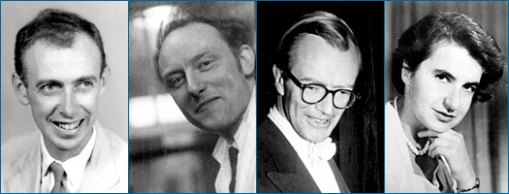
Ethically-questionable practices - 1
Introduction
This team of scientists deciphered the structure of DNA.
Is the behaviour of the scientists ethically acceptable?
The discoverers of the structure of DNA
Image credit: University of California Museum of Paleontology's Understanding Science (http://www.understandingscience.org)
Notes:
Maurice Wilkins showed James Watson the X-ray crystallography image (photo 51). Although it was Rosalind Franklin (and not Maurice Wilkins) who obtained photo 51, she was not aware that Watson had seen it (Wilkins showed Watson the photo on a day when Franklin was not at work). There is little doubt that photo 51 allowed Watson and Crick to work out the structure of DNA. While Watson and Crick published their findings in a famous scientific paper, they did not acknowledge Rosalind’s work, Watson, Crick and Wilkins received the 1962 Nobel Prize in Physiology or Medicine.

Slide 8
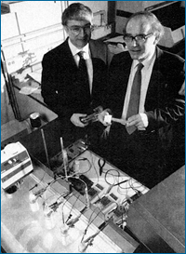
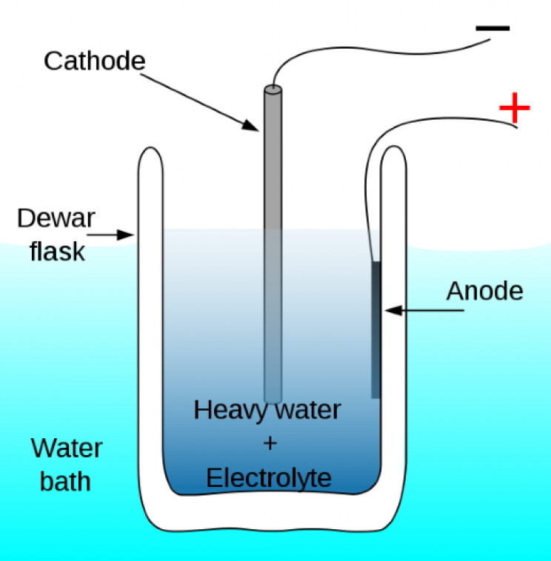
Ethically-questionable practices - 2
Introduction
This team of scientists claimed to have performed cold fusion (generating energy from radioactive fusion reaction at ambient temperatures).
Read their story below and decide if their behaviour is ethically acceptable,
Fleishmann and Pons
Image credit: University of California Museum of Paleontology's Understanding Science (http://www.understandingscience.org)
Cold fusion, CC BY-SA 3.0 (Pbroks13)
Notes:
The case of cold fusion shows another aspect of questionable scientific ethics. Stanley Pons and Martin Fleischmann at the University of Utah concluded that they had found evidence of deuterium fusion occurring at room temperature (this was a ‘holy grail’ of energy research). Rather than publishing their findings in a peer-reviewed journal, they announced their findings at a press conference. However, other scientists could not replicate Pons and Fleischmann’s experiments. A few weeks later, the U.S. Department of Energy concluded that Pons and Fleischmann had not achieved cold fusion. Although their work was not considered to be scientific fraud, it was unethical as they did not follow the scientific process.

Slide 9
History of ethics in research
Nuremberg Code (1947) – 10 principles that focus on risk-benefits and informed consent
Helsinki Declaration (1964) – research to be reviewed by an independent committee
Belmont Declaration (USA, 1978) – principles of justice
Federal Policy for the Protection of Human Subjects

Slide 10
Scientific Ethics
Introduction
Decision-making process for science
Developed by scientists, in consultation with the community
Notes:
How do we make ethical decisions in science?
We need to use a set of guidelines to help us make such decisions. Such guidelines do exist and have been developed by scientists. They considered all aspects of the scientific process and developed guidelines to ensure professional honesty and integrity. Other members of the community also helped to shape scientific ethics. We will explore this further in the upcoming slides.

Slide 11
Ethical frameworks
Students analyse the influence of ethical frameworks on scientific research over time
The principle of autonomy
The principle of no maleficence
The principle of beneficence
The principle of justice
The principle of confidentiality
The principle of non-deception
Notes:
Scientific ethics is based on a set of universally-accepted principles, which are referred to as ‘ethical frameworks’. Let us look at these further in the next slide.

Slide 12
Ethical frameworks
Students analyse the influence of ethical frameworks on scientific research over time
Use a dictionary to search for the meanings of the terms in this table
Term | Meaning
Autonomy
Maleficence
Beneficence
Justice
Confidentiality
Deception
Notes:
You must understand the meanings of these terms. Look up their definitions using a dictionary – do not guess their meanings.

Slide 13
Ethical frameworks
Students analyse the influence of ethical frameworks on scientific research over time
Use a dictionary to search for the meanings of the terms in this table
Term | Meaning
Autonomy | Freedom from external control or influence
Maleficence | The act of committing harm or evil
Beneficence | An act of charity, mercy, and kindness with a strong connotation of doing good
Justice | The quality of being just, impartial, or fair
Confidentiality | Respect for privacy
Deception | Resorting to falsehood
Notes:
Now that you know the meanings of these terms, we will look at how they are used in scientific ethical frameworks.

Slide 14
Ethical frameworks
Students analyse the influence of ethical frameworks on scientific research over time
The principle of autonomy: making voluntary and informed decisions (i.e. capacity to act intentionally, with understanding, and without controlling influences)
The principle of no maleficence: No subject in a study is intentionally harmed or injured, either through acts of commission or omission
The principle of beneficence: Produce beneficial outcomes & positive steps are taken to prevent and to remove harm from the patient
The principle of justice: Equal access to care, benefits, compensation
The principle of confidentiality: maintaining anonymity and privacy.
The principle of non-deception: maintaining open and truthful communications
Notes:
This slide expands on each framework. Read the definition of each ethical framework. If the meanings are not clear, check with your teacher. In the remainder of this presentation, we shall explore the ethical frameworks that apply to different areas of scientific research.

Slide 15
Human experimentation
Notes:
In this section, we will look at the ethical principles which apply to human experimentation

Slide 16
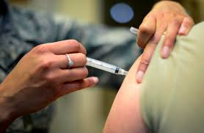
Human experimentation
Students analyse the influence of ethical frameworks on scientific research over time, including but not limited to human experimentation
Q: What is human experimentation?
A: Human experimentation research refers to scientific investigation that involves human beings as research subjects. The investigations can be either interventional or observational.
Vaccination, Public domain
Notes:
Human experimentation refers to scientific investigations of humans (it excludes studies in other areas, such as social science, education, etc.). Human experimentation may involve manipulation (e.g. clinical trials), or be purely observational. The history of human experimentation is a mixed one. Although our knowledge of human biology advanced in leaps and bounds through experimentation, many of those studies will not be conducted in the original manner today.

Slide 17
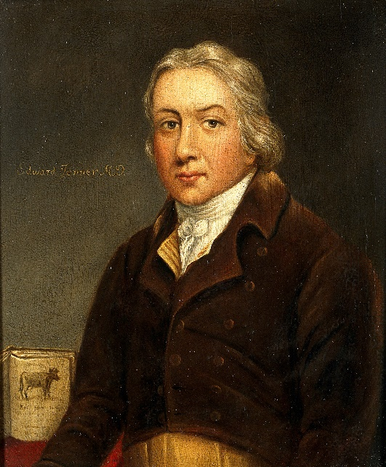
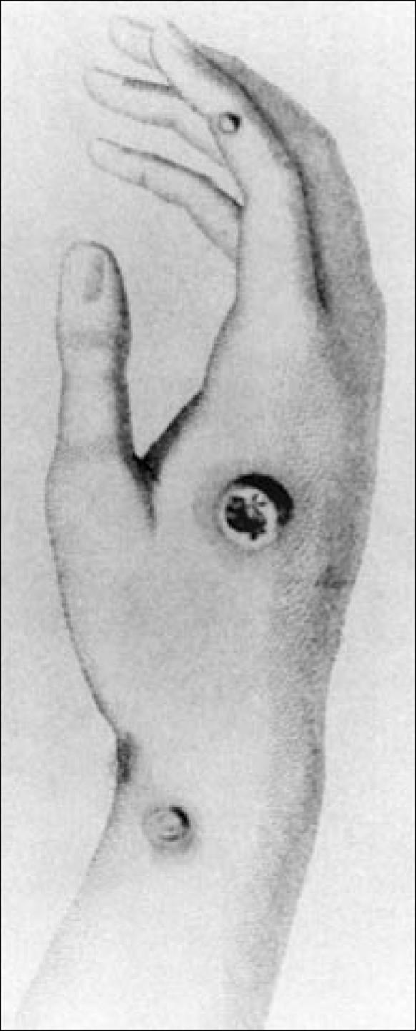
Human experimentation
Students analyse the influence of ethical frameworks on scientific research over time, including but not limited to human experimentation
“In May 1796, Edward Jenner found a young dairymaid, Sarah Nelms, who had fresh cowpox lesions on her hands and arms. On May 14, 1796, using matter from Nelms' lesions, he inoculated an 8-year-old boy, James Phipps. Subsequently, the boy developed mild fever and discomfort in the axillae. Nine days after the procedure he felt cold and had lost his appetite, but on the next day he was much better. In July 1796, Jenner inoculated the boy again, this time with matter from a fresh smallpox lesion. No disease developed, and Jenner concluded that protection was complete.”
Jenner, Creative Commons Attribution 4.0 International (Wellcome Images)
The hand of Sarah Nelms
(image from publication)
Riedel S. (2005). Edward Jenner and the history of smallpox and vaccination. Proceedings (Baylor University. Medical Center), 18(1), 21–25.
Notes:
For example, vaccination is a powerful medical therapy that has improved the human condition worldwide. The English doctor, Edward Jenner, is credited with the first scientific demonstration of vaccination (strictly speaking, Jenner’s method is called variolation). However, by today’s standards, Jenner’s studies on variolation would be considered to be unethical.

Slide 18
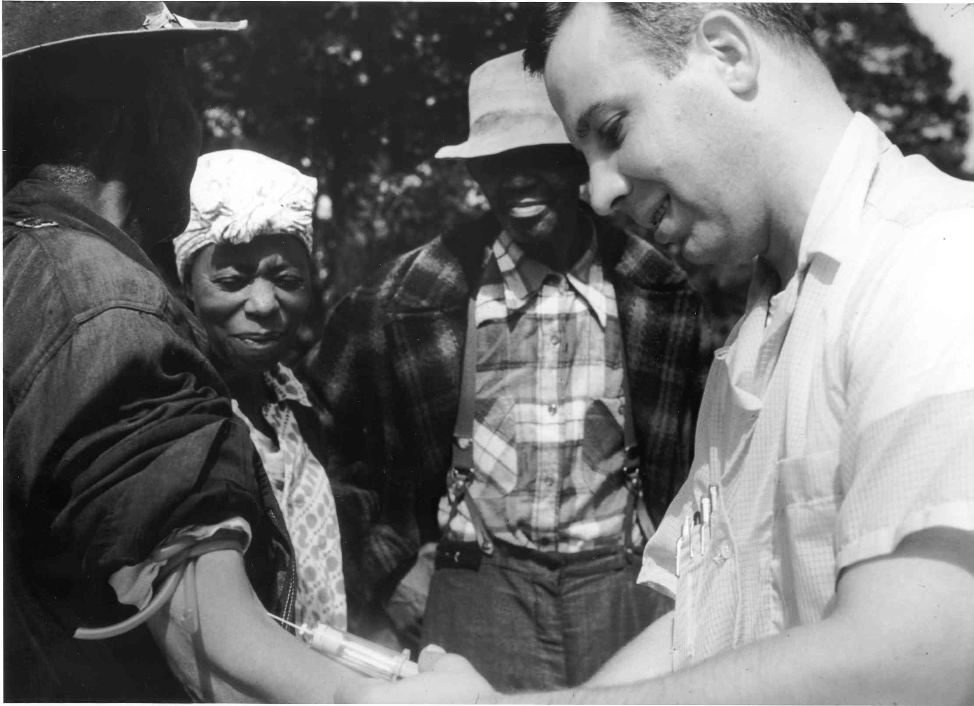
Human experimentation
Students analyse the influence of ethical frameworks on scientific research over time, including but not limited to human experimentation
The Tuskegee Study of Untreated Syphilis was a 40 years-long (1932 and 1972) experiment in the America, conducted between by the US Public Health Service.
This experiment raised numerous ethical issues regarding human experimentation.
Read a summary of the study at this site: USPHS Syphilis Study.
Tuskegee Experiment, Public Domain
Notes:
When the details of the Tuskegee Study of Untreated Syphilis experiment was revealed to the public, it raised an uproar internationally. In this study, 399 syphilitic 201 non-syphilitic African-American men were part of a study to determine the physiological effects of syphilis infections on humans. After reading the synopsis of the research on the website indicated in the slide, you may notice the following:
The participants were not told that they were involved in a human experiment.
The participants were given inducements to take part in the experiment.
The participants were denied treatment for syphilis infections, even though the treatment became available during the study.
Based on this information, what ethical frameworks (slide 14) do you think have been violated?

Slide 19
Ethics of human research - Australia
Students analyse the influence of ethical frameworks on scientific research over time, including but not limited to human experimentation
In Australia, the National Health and Medical Research Council develops the frameworks for research involving humans. This is called The National Statement on Ethical Conduct in Human Research (2007) (National Statement (2007).
The statement focuses on:
  Research merit and integrity
  Justice, including beneficence
  Non-maleficence & Beneficence
  Respect (for example - in decision making or providing consent)
Notes:
All human experimentation in Australia is governed by the ethical frameworks developed by the National Health and Medical Research Council, also referred to as the NHMRC. These ethical frameworks are based on the same principles of universal ethics described in slide 14. The four key frameworks are indicated in this slide. We will unpack these in the next slide.

Slide 20
Ethics of human research - Australia
Students analyse the influence of ethical frameworks on scientific research over time, including but not limited to human experimentation
Ethical principle | What it means
Research merit and integrity | Any research that is conducted on humans must be scientifically sound. The research should be justifiable based on its potential value.
Justice, including beneficence | The research should be just: the process of recruiting participants is fair there is no unfair burden of participation in research on particular groups there is a fair distribution of the benefits of participation in research there is no exploitation of participants in the conduct of research there is fair access to the benefits of research
Non-maleficence & Beneficence | The likely benefit of the research must justify any risks of harm or discomfort to participants. minimise the risks of harm or discomfort to participants clarifying for participants the potential benefits and risks of the research ensure the welfare of the participants in the research context if the risks cannot be justified, then the research must be stopped or suspended
Respect | Respect the welfare, beliefs, perceptions, customs and cultural heritage, of those involved in research. privacy, confidentiality and cultural sensitivities of the participants fulfil all agreements allow participants to make their own decisions, without coercion or inducements
National Statement on Ethical Conduct in Human Research (2007) - Updated 2018
Notes:
Study the descriptions of the ethical principles governing human research in Australia. When you have done so, review the cases described in slides 17 and 18. Discuss the ethical concerns of those cases using the framework described in this slide.

Slide 21
Human Research Ethics Committees (HRECs)
Students analyse the influence of ethical frameworks on scientific research over time, including but not limited to human experimentation
In Australia, at institutions that undertake human research, all research proposals must be approved by the HREC. Human research cannot be conducted without an ethics permit is not obtained.
HERCs consist of researchers, non-researchers and community members.
The HRECs evaluate applications based on:
  How is the research question/theme identified or developed?
  How do the research methods align with the research aims?
  How will the researchers and the participants engage with one another?
  How will the research data or information be collected, stored, and used?
  How will the results or outcomes be communicated?
  What will happen to the data and information upon completion of the project?
Notes:
HRECs are found at all institutions were human research is conducted. Before any human research can be conducted, the researchers must apply for an ethics permit from their institutional HRECs. In their application, they must provide their reasons for conducting the research, as well as their research methodology. The HREC committee will evaluate the research proposal and seek clarification on issues, such as those listed on this slide.
After they are satisfied that the research meets all the ethical guidelines, they will issue a permit to the research group to carry out the research. There are severe consequences for conducting research without the ethics permits, or for breaching the ethics guidelines.

Slide 22
Animal experimentation
Notes:
In this section, we will look at the ethical principles which apply to animal experimentation

Slide 23
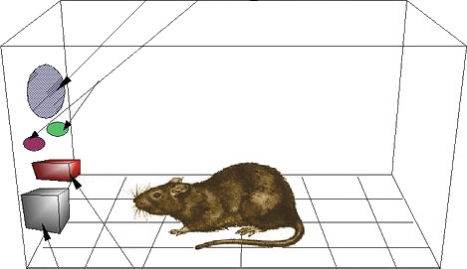
Using animals in experiments – research perspectives
Students analyse the influence of ethical frameworks on scientific research over time, including but not limited to experimentation on animals
Experiments with animals have been conducted in areas such as biomedicine, veterinary science, psychology and behavioural studies.
Animals are used in experiments:
  To understand animal biology (e.g. veterinary science)
  As models to understand human biology
Animal-human similarities
Experiments with animals, CC BY 2.0
(Rosenfeld Media)
Notes:
Several ethical frameworks also govern the use of animals in research. Animals are used in many areas of study. The reasons for using animals in experimentation are two-fold:
To learn about the biology and behaviour of the animals themselves – this is important for veterinary science, agriculture, management of wildlife (e.g. zoos, aquaria, parks) and conservation.
To use animals as models of human biology – since there are many biochemical, physiological and genetic similarities between many animals and humans, animal models can provide a wealth of information about how human biology works. This is described further in the next slide.

Slide 24
Using animals in experiments – biomedical research
Students analyse the influence of ethical frameworks on scientific research over time, including but not limited to experimentation on animals
There are several reasons why animals are used for biomedical research:
  Animals are biologically very similar to humans (mice and humans share more than 98% genetic similarity)
  Animals are susceptible to many of the same health problems as humans – cancer, diabetes, heart disease, etc.
  With a shorter life cycle than humans, animal models can be studied throughout their whole life span and across several generations.
Why animal research? - Stanford
Notes:
This slide highlights the important reasons for using animals in biomedical research.

Slide 25
Using animals in experiments – types of research
Students analyse the influence of ethical frameworks on scientific research over time, including but not limited to experimentation on animals
Types of research involving animals
Research that advances scientific knowledge (for example - understanding genetic, physiological and biochemical mechanisms).
Research that uses animals in toxicity testing.
Research that uses animals as models to study the mechanisms of human disease and to develop interventions.
Notes:
This slide describes the three areas of research in which animal experimentations occur.

Slide 26
Using animals in experiments – caring for animals
Students analyse the influence of ethical frameworks on scientific research over time, including but not limited to experimentation on animals
The care of animals used in experiments is important both scientifically and ethically.
Uncared animals produce aberrant results.
The ethical framework regarding animal use in experiments applies to vertebrates.
Notes:
There are both scientific and ethical imperatives for looking after animals in research. Animals that are not cared for usually experience stress, which tend to affect other physiological systems. This may lead to anomalous results, as well as results that are not reproducible.
The ethical frameworks for animal experimentation apply to vertebrate animals. These are animals with backbones (fish, amphibians, reptiles, birds and mammals). This is because vertebrates can experience pain, while current evidence suggests that invertebrates do not experience pain.

Slide 27
Using animals in experiments – Animal Ethics Committees
Students analyse the influence of ethical frameworks on scientific research over time, including but not limited to experimentation on animals
While human experimentation is regulated at a national level (NHMRC), animal experimentation is regulated at state level.
Animal Ethics Committees (AECs) issue permits for research involving animals
Notes:
In Australia, individual states and territories are responsible for overseeing animal ethics. As for human experimentation, institutions must have Animal Ethics Committees to review all research involving vertebrate animals. Researchers must obtain ethics permits to conduct their research.
AECs focus on the care of animals in experiments, as well as the disposal of animals after the investigations are completed. There are strict guidelines on how animals should be housed, fed, cleaned and maintained during the investigations. If animals are to be euthanased, then the researchers must use approved methods to kill the animals. These methods have been approved by expert committees so as to reduce the stress and pain burden on animals

Slide 28
Using animals in experiments – 3Rs
Students analyse the influence of ethical frameworks on scientific research over time, including but not limited to experimentation on animals
Researchers should apply the 3Rs rule when designing experiments involving animals:
  The Replacement of animals with other methods (for example - cell cultures, tissue banks, abattoir materials).
  The Reduction in the number of animals used.
  The Refinement of techniques used to minimise the adverse impact on animals.
Notes:
The 3R rule was devised to reduce reliance on the use of animals in experiments:
Replacement of animals with other methods – where possible, viable alternatives to the use of animals should be explored.
Reduction in the number of animals used – researchers should use the minimum number of animals in their experiments. There are statistical models that they can use to determine the minimum number of animals that can be used in an experiment without affecting the reliability and validity of their findings.
Refinement of techniques used to minimise the adverse impact on animals – researchers should always use the latest findings regarding the manipulation of animals so as to minimise pain and stress on them.

Slide 29
Animals in research – the road to medical discoveries
Students analyse the influence of ethical frameworks on scientific research over time, including but not limited to experimentation on animals
Non-animal research
Small animal research
Large animal research
Phase I – III clinical trials
Phase IV clinical trial
In Vitro
In Silico
Mouse, Rat, Rabbits
Primates, Pigs
Human trials, with increasing numbers of participants
After-market study
Notes:
This slide shows a pathway for the discovery of new medical treatments. In vitro and in silico refer to studies that are conducted with cell or tissue cultures, or to discoveries made with molecular arrays and computer simulations. Small animal research is usually the starting point for the development of a new therapeutic. Once it is proven, then the therapeutic is tested on large animals. Large animal studies provide important information about physiological responses to the therapeutic. Only when its potential is realised in large animals will the product be used in human experiments (clinical trials). Both animal and human ethics apply at multiple stages in this discovery pipeline.

Slide 30
Biobanks
Notes:
In this section, we will look at the ethical principles which apply to biobanks

Slide 31
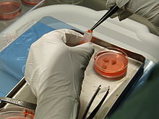
Biobanks
Students analyse the influence of ethical frameworks on scientific research over time, including but not limited to biobanks
Biobanks are collections of biospecimens or human genetic information that can be used for research purposes (NHMRC).
All items are carefully catalogued so that the origin and other features of the samples are documented
Scientists can access the samples for research purposes
Preserving biological materials in liquid nitrogen, CC BY-SA 3.0 (Wzsuzsanna3)
Notes:
Biomedical researchers often need access to biological samples for their experiments. In some types of research, they may need access to samples from specific sectors of the population (e.g. for disease tissues). Biobanks are repositories of biological samples that researchers can use. To ensure that researchers have access to all relevant information about the samples in the biobanks, there is a detailed cataloguing process for all samples. Information about the type, origin, date of collection and other information are kept in a database. The tissue samples are stored in various ways, but usually in cold storage (-70ºC or liquid nitrogen). One example of the use of biobank materials is the research conducted by the Kathleen Cuningham Foundation National Consortium for Research on Familial Breast Cancer (KConFaB). There, the researchers are looking to determine the:
· population rates of mutations in breast cancer genes;
· kinds of mutations that predispose to breast and ovarian cancer;
· risk of breast and other types of cancer;
· age at which cancers occur; and
· effect of lifestyle and environmental factors on the risk of developing cancer and age of onset.
More than 100 research projects worldwide rely on samples from this biobank.

Slide 32
Biobanks – ethical issues
Students analyse the influence of ethical frameworks on scientific research over time, including but not limited to biobanks
Some of the issues around the use of biobanks include:
  Informed consent of the donors (no coercion)
  Sensitive collection of samples from vulnerable donors (aged, disabled, young)
  Privacy of personal and medical information
  Commercialisation and sharing of benefits
Notes:
Many ethical issues surround the collection, maintenance and use of the materials in biobanks. Some of those issues are listed on this slide.
Informed consent – all donors must be willing participants who have been informed about how their donated samples may be used. Proper communications should also be set up between the biobanks and the donors. Most importantly, no one must be compelled to donate samples. Vulnerable donors, including those who cannot make informed decisions, need to be respected and protected. Where relevant, cultural sensitivities must be taken into account.
The information contained in biobanks must be treated confidentially. The privacy of donors must be respected. Most biobanks have coded identification systems where confidential information is not released, except as required by the researchers.
Some research activities may result in commercially-valuable discoveries. Biobanks must ensure that the benefits of research and development are shared with all people involved, in accordance with the law.

Slide 33
Research data
Notes:
In this section, we will look at the ethical principles which apply to the use of research data

Slide 34

Research data
Students analyse the influence of ethical frameworks on scientific research over time, including but not limited to the use of research data
Research data is shared and communicated via various means:
  Peer-reviewed publications
  Conference presentations
  Data repositories
Research funding bodies generally require researchers to share their research finding openly.
Data which are confidential, or which have national security implications should not be openly shared.
Sharing research data, Creative Commons Attribution-Share Alike 4.0 International (Gaelen Pinnock)
Notes:
The communication of research findings is at the core of the scientific enterprise. Research data, once verified, are the raw materials of scientific knowledge construction. For scientists, the generation and publication of scientific data are the hallmarks of professionalism. Peer-reviewed publications are the primary means of such communications, but scientists also use other forms of communications. Most research funding agencies, such as the Australian Research Council and the National Health and Medical Research Council require scientists to publish the data they generate through funded research programs. When applying for such funding, scientists have to indicate how they plan to publicise their findings. This creates transparency, and the community can see the benefits of supporting scientific research.
Sometimes, research may produce data that should not be openly shared. For example, research that has military or security implications, or data that may be used to achieve harmful ends (e.g. bioterrorism) should not be published. Furthermore, discoveries with commercial potential will not be published (at least, critical data may not be revealed).

Slide 35
Research data
Students analyse the influence of ethical frameworks on scientific research over time, including but not limited to the use of research data
Data sharing is beneficial, as it:
  Encourages further scientific enquiry and promotes innovation.
  Leads to new collaborations between data users and data creators.
  Maximises transparency and accountability.
  Reduces the cost of duplicating data collection.
Notes:
There are many benefits to sharing data, as indicated on this slide.

Slide 36
Research data
Students analyse the influence of ethical frameworks on scientific research over time, including but not limited to the use of research data
The ethics of data sharing centres on the following questions:
  What data or information are required to achieve the objectives of the project?
  How and by whom will the data or information be generated, collected and accessed?
  How and by whom will the data or information be used and analysed?
  Will the data or information be disclosed or shared and, if so, with whom?
  How will the data or information be stored and disposed of?
  What are the risks associated with the collection, use and management of data or information and how can they be minimised?
  What is the likelihood and severity of any harm/s that might result?
Notes:
This slide lists some of the ethical issues that surround the use and sharing of research data. This is a complicated area of research, but governing bodies have developed ethical frameworks for some of the issues. These frameworks may be better understood if we consider a research scenario. Let us image a large research project which involves several laboratories around the world collaborating to achieving the research goals (the ATLAS project on the Large Hadron Collider has more than 5,000 researchers collaborating!). Each group has its own area of specialisation and will be responsible for a portion of the project. In such a scenario, who makes the decisions about running the project? How will disputes be resolved? Who will be the lead authors in any publications that may follow? The ethical frameworks provide guidance on these issues.
For example, only those scientists who have directly contributed to the design, conduct and analyses of the investigation can be authors in the publications. Before the commencement of the project, the researchers must agree on how data will be collected and shared. One commonly-used approach is a Materials Transfer Agreement (MTA), a document that outlines all the steps of collaboration, and signed by all parties.

Slide 37
Summary

Slide 38
Ethical principles of conducting scientific inquiries
What are the general ethical principles that scientists must abide by?
Honestly reporting of scientific data;
Carefully recording and analysing experimental results to avoid error;
Openly sharing methods, data, and interpretations through publications and presentations;
Validating results through replication and collaboration with peers;
Properly crediting sources of information, data, and ideas;
Fulfilling moral obligations to society in general, and, in some disciplines, responsibly weighing the rights of human and animal subjects.
Notes:
This slide provides a summary of the ethical frameworks that scientists abide by. They have been developed by scientists. Breaches of the frameworks often result in those scientists being unable to engage in research. Honesty and integrity are two key words that enshrine scientific ethics.

Slide 39
Case studies
Notes:
In the next few slides, there are some examples of research scenarios where the ethical principles are questioned. Read through each scenario and then indicate the ethical issues highlighted in them. Compare your answers with the sample answers to check your thinking. Remember, use the frameworks in slide 14, as well as the concepts described in human experimentation, animal experimentation, biobanks and the research data sections to guide your decision-making process.

Slide 40
Case 1 – The Tuskegee Study of Untreated Syphilis
Question (Adapted from Resnick, D.B (2015). What is ethics in research and why is it important?)
A major study to develop treatments for syphilis was carried out on unsuspecting civilians (1932-1972). The subjects (participants) were mostly illiterate blacks from Tuskegee, Alabama (USA). 399 men with latent syphilis and a control group of 201 others who were free of the disease were told that they were being treated for “bad blood”. The men were monitored by health workers but only given placebos such as aspirin and mineral supplements, despite the fact penicillin became the recommended treatment for syphilis in 1947. Researchers convinced local physicians in Macon County not to treat the participants, and research was done at the Tuskegee Institute. By the time the study was terminated, 28 participants had perished from syphilis, 100 more had passed away from related complications, at least 40 spouses had been diagnosed with it and the disease had been passed to 19 children at birth.

Slide 41
Case 1 – The Tuskegee Study of Untreated Syphilis
Answer
There was no informed consent.
The participants were not informed of all the known dangers.
The participants had to agree to an autopsy after their death to have their funeral costs covered.
Scientists denied treatment to some patients, so as to observe the individual dangers and fatal progression of the disease.
Participants were not given the cure, even when it was widely known and easily available.
The designers used a misleading advertisement: The researchers advertised for participants with the slogan; "Last Chance for Special Free Treatment".
The experiment was at the time seen as potentially beneficial for the humankind, but did not consider the harm caused to individuals and their families

Slide 42
Case 2 – Incomplete data collection
Question (Adapted from Resnick, D.B (2015). What is ethics in research and why is it important?)
The research protocol for a study of a drug on hypertension required the administration of the drug at different doses to 50 laboratory mice, with chemical and behavioural tests to determine the toxic effects of the drug. Tom had almost finished with the experiment for Dr Q. He had only five mice left to test. However, he wanted to finish his work in time to go on a holiday with his friends, who were leaving that night. He had injected the drug in all 50 mice but had not completed all the tests. He, therefore, decides to extrapolate from the 45 completed results to produce the five additional results.

Slide 43
Case 2 – Incomplete data collection
Answer
Many different research ethics policies would hold that Tom has acted unethically by fabricating data (dishonesty). His actions would constitute a form of research misconduct, which is defined as "fabrication, falsification, or plagiarism" (or FFP). It is important to remember, however, that misconduct occurs when researchers intend to deceive: errors related to sloppiness, poor record keeping, miscalculations, bias, self-deception, and even negligence do not constitute misconduct. Also, reasonable disagreements about research methods, procedures, and interpretations do not constitute research misconduct.

Slide 44
Case 3 – reporting errors
Question
Dr T has just discovered a mathematical error in his paper that has been accepted for publication in a journal. The error does not affect the overall results of his research, but it is potentially misleading. The journal has just gone to press, so it is too late to revise the error before it appears in print. To avoid embarrassment, Dr T decides to ignore the error.

Slide 45
Case 3 – reporting errors
Answer
Dr T's error is not misconduct nor is his decision to take no action to correct the error (the critical consideration is that the error does not affect the findings reported in his paper). Dr T should tell the journal (and any co-authors) about the mistake and consider publishing a correction or errata. Failing to publish a correction would be unethical because it would violate norms relating to honesty and objectivity in research.

Slide 46
Case 4 – Research data
Question (Adapted from Resnick, D.B (2015). What is ethics in research and why is it important?)
Dr Wexford is the principal investigator of a large, epidemiological study on the health of 10,000 agricultural workers. She has an impressive dataset that includes information on demographics, environmental exposures, diet, genetics, and various disease outcomes such as cancer, Parkinson’s disease (PD), and ALS. She has just published a paper on the relationship between pesticide exposure and PD in a prestigious journal. She is planning to publish many other papers from her dataset. She receives a request from another research team that wants access to her complete dataset. They are interested in examining the relationship between pesticide exposures and skin cancer. Dr Wexford was also planning to conduct a study on this topic. What is the ethically-appropriate course of action for Dr Wexford?

Slide 47
Case 4 – Research data
Answer
Some issues to consider:
  Dr Wexford is ethically-obliged to share research data.
  Dr Wexford may be required to share her data under the rules of her research grant or the research institution where she is working.
  What happens if the other research group publishes papers with Dr Wexford’s data before she can do so?
  How will the request affect Dr Wexford’s intellectual property ownership of data?
  ANSWER IS CONTINUED IN THE NEXT SLIDE

Slide 48
Case 4 – reporting errors
Answer
Dr Wexford could agree to share the data, albeit under certain conditions. Some conditions that may be imposed on the use of her data could include:
  Pre-defined uses of the data – the other research team states explicitly how Dr Wexford’s data will be used.
  Publication plans – the other research team indicates any plans they may have to communicate their work (which involves the use of Dr Wexford’s data), such as journal publications, conference proceedings and storing data in repositories.
  Authorship – the other research team agrees to include Dr Wexford and her team members in any publication arising from the use of her data.
  Collaboration – the other research team and Dr Wexford agree to collaborate on subsequent research involving her data formally.
  Intellectual property – this will require legal and binding agreements between the institutions involved. For example, the intellectual property arising from work conducted at Dr Wexford’s University may be owned by the institution. In such cases, intellectual property issues will be negotiated by Dr Wexford’s University and the other research team’s institution.

Slide 49
Case 5 – animal experiments
You are a member of an Animal Ethics Committee. Evaluate the following research proposal.
A research group at your University has developed a possible treatment for prostate cancer. The group proposes to investigate the potential benefits of using nanotechnology to deliver an anti-cancer drug to prostate cancer tissues. To determine its efficacy, the researchers will carry out the investigation using mice.
The experimental design uses four groups of mice that have been genetically engineered to develop prostate cancer. Group 1 has 25 mice that will be injected with a predefined dose of the therapeutic drug that is coupled to nanoparticles. Group 2 has 25 mice that will receive the same dose of the drug, but without the nanoparticles. Group 3 contains 25 mice that receive the nanoparticles, but no drugs. Group 4 includes 25 mice that will not receive any treatment (no therapeutic drug or nanoparticles but will be injected with normal saline solution). Throughout the experiment, the mice will receive water and food, as described in animal maintenance protocols. They will also be monitored for signs of disease or distress (such mice will be humanely euthanised). One week after receiving the treatments, all mice will be sacrificed by carbon dioxide asphyxiation and their prostate tissues examined for progression of the disease.
Continued on the next slide

Slide 50
Case 5 – animal experiments
Fill in the table and then answer the question below.
Risk and benefits | Answer
Benefits for humans (how will humans benefit from this research?)
Benefits for animals (how will animals benefit from this research?)
Risks for humans (what are the risks to humans from this research)
Risks for animals (what are the risks to humans from this research)
Is the project approved? Using scientific and ethical reasoning, justify your decision.

Slide 51
Case 6 – animal experiments
You are a member of an Animal Ethics Committee. Evaluate the following research proposal.
A research group at your University wants to determine the use of the drug ecstasy (methamphetamine) in parties. They propose to use rats, which will be maintained in a high-temperature enclosure (that mimics the high-temperature environments of party rooms). The rats can consume ecstasy solutions by pressing down on a lever in their cages. The rats will also be surgically-implanted with a catheter that allows the researchers to determine the quantity and frequency of ecstasy consumption. The experimental group consists of rats that will be maintained at 30ºC, while the control group contains an identical number of rats which will be maintained at 23ºC. All animals will be provided with food and water according to standard protocols. They will also be observed for distress (for example, hyperthermia – in which case, they will be humanely sacrificed). At the end of the experiment, all animals will be euthanised using standard procedures.
Adapted from Cornish, JL, Clemens, KJ. Thompson, MR, Callaghan, PD, Dawson, B & McGregor, IS, High ambient temperature increases intravenous methamphetamine self-administration on fixed and progressive ratio schedules in rats J Psychopharmacol (2008) 22(1) 100-110
Continued on the next slide

Slide 52
Case 6 – animal experiments
Fill in the table and then answer the question below
Risk and benefits | Comments
Benefits for humans (how will humans benefit from this research?)
Benefits for animals (how will animals benefit from this research?)
Risks for humans (what are the risks to humans from this research)
Risks for animals (what are the risks to humans from this research)
Is the project approved? Using scientific and ethical reasoning, justify your decision.

Slide 53
Acknowledgements
Science Extension © NSW Education Standards Authority (NESA) for and on behalf of the Crown in right of the State of New South Wales 2017. See the NESA website for additional copyright information.

Slide 54
© State of New South Wales (Department of Education), 2019 The copyright material published on this website is subject to the Copyright Act 1968 (Cth), and is owned by the NSW Department of Education or, where indicated, by a party other than the NSW Department of Education.

