Slide 1

HSC hub
Science Extension – The Foundations of Scientific Thinking
Notes:
Welcome to this session on the Foundations of Scientific Thinking. This resource is based on Module 1 of the Science Extension syllabus

Slide 2
Acknowledgement of Country
I would like to pay my respect and acknowledge the traditional custodians of the land on which this meeting takes place, and also pay respect to Elders both past and present

Slide 3
Aboriginal and Torres Strait Islander peoples are advised that this video may contain the images, voices and names of people who have passed away

Slide 4
Science Extension Module 1
The Development of Modern Science
Inquiry question: How have philosophical arguments influenced the development of modern scientific research?
Students:
  explore epistemology and alternative ways of knowing, for example the development of navigation
  describe the influence of empiricism on scientific inquiry
  compare induction and deduction with reference to scientific inquiry
  assess parsimony/Occam’s razor and its influence on the development of science
  analyse the importance of falsifiability in scientific research
  evaluate the significance of confirmation bias, including theory-dependence of observation
  use historical examples to evaluate the contribution of cultural observational knowledge and its relationship to science, including:
    post – 49000 BCE, exemplified by Aboriginal cultures
    pre – 1500 CE, exemplified by Greek and Egyptian cultures and those of the Asia region
  select one example from the following list to analyse the paradigm shift and how evidence is used to support new theories to explain phenomena and their consequences
    Lavoisier and oxygen
    Einstein and general relativity
    Wegener and continental drift, leading to plate tectonics
    McClintock and transposable elements, commonly known as ‘jumping genes’
Notes:
This resource covers the first inquiry question in Module 1. The inquiry question focuses on the development of scientific thinking. That is, it examines the historical and philosophical basis of the way science is conducted these days.

Slide 5
Science Extension Module 1
The Development of Modern Science
Inquiry question: How have philosophical arguments influenced the development of modern scientific research?
Students:
  explore epistemology and alternative ways of knowing, for example the development of navigation
  describe the influence of empiricism on scientific inquiry
  compare induction and deduction with reference to scientific inquiry
  assess parsimony/Occam’s razor and its influence on the development of science
  analyse the importance of falsifiability in scientific research
  evaluate the significance of confirmation bias, including theory-dependence of observation
  use historical examples to evaluate the contribution of cultural observational knowledge and its relationship to science, including:
    post – 49000 BCE, exemplified by Aboriginal cultures
    pre – 1500 CE, exemplified by Greek and Egyptian cultures and those of the Asia region
  select one example from the following list to analyse the paradigm shift and how evidence is used to support new theories to explain phenomena and their consequences
    Lavoisier and oxygen
    Einstein and general relativity
    Wegener and continental drift, leading to plate tectonics
    McClintock and transposable elements, commonly known as ‘jumping genes’
Western/European cultures
Other cultures
Notes:
The way science is conducted in most parts of the world is based on Western philosophical thinking. This refers to the content shown in orange font. However, all cultures in the world also developed knowledge systems about the natural world. Therefore, while modern science is largely influenced by Western schools of thought, other cultures have also impacted modern science. That content is addressed in the points shown in blue font.

Slide 6
Epistemology of science
Students explore epistemology
Epistemology
  Branch of philosophy that deals with the nature of knowledge
  Theory of knowledge
  How we know what we know?
Nature of knowledge
Scope of knowledge
Production of knowledge
What is science?
What are the limits of science?
How is scientific knowledge generated?
Knowledge is the awareness and understanding of particular aspects of reality.
Notes:
The word ‘epistemology’ refers to the ways that we use to construct knowledge. Put simply, ‘how do we know what we know’. Take a moment to think about something you know – for example, a sport, a recipe or something you may have learned at school. How did you develop your understanding of that? Where did you gather the information that became your knowledge? What experiences contributed to you constructing your knowledge?
The epistemology of science generally explores three aspects of knowledge construction:
The nature of scientific knowledge – what distinguishes science from non-science?
The scope of scientific knowledge – what are the limits of science? Are there things that are beyond the scope of scientific investigation?
Production of scientific knowledge – how do scientists conduct their inquiries? What are the processes of science? How is data and information converted into scientific knowledge?

Slide 7
Epistemology of science: the language of science
Students explore epistemology
Theories: In science, a broad, natural explanation for a wide range of phenomena.
Hypotheses: A tentative explanation for a narrow set of phenomena.
Models: physical, mathematical or computer simulation representations of scientific ideas.
Laws: relationship between variables of a system. Often represented as mathematical equations.
Theory
Hypothesis
Model
Law
Notes:
Scientific knowledge is described in the form of scientific laws, models, hypotheses and theories. They differ in their scope (breadth) of explanation, rather than the degree of truth or uncertainty.
Theories are concise, coherent, systematic, predictive, and broadly applicable, often integrating and generalizing many hypotheses. Theories accepted by the scientific community are generally strongly supported by many different lines of evidence-but even theories may be modified or overturned if warranted by new evidence and perspectives.
Hypotheses are based on prior experience, scientific background knowledge, preliminary observations, and logic.
Models can mean several different things (e.g., an idea about how something works or a physical model of a system that can be used for testing or demonstrative purposes). Models are both explanatory and predictive.
Laws refer to a generalization about data and is a compact way of describing what we'd expect to happen in a particular situation.
Theories, hypotheses, models and laws are dynamic and can change over time, as more evidence accumulates.

Slide 8
Alternative ways of knowing
Explore epistemology and alternative ways of knowing
Emotion – feeling, as opposed to reasoning
Faith/Belief – trust or confidence
Imagination - forming new ideas, or images or concepts of external objects not present to the senses.
Intuition - a form of knowledge that appears in consciousness without obvious deliberation
Language - a system of communication used by a particular country or community.
Memory - the faculty by which the brain encodes, stores, and retrieves information.
Reason - a basis or cause, as for some belief, action, fact, event
Sense perception - understanding gained through the use of one of the senses such as sight, taste, touch or hearing
Notes:
There are many ways of knowing. Each way of knowing helps us to construct knowledge and meaning of the natural world. This slide lists some of the ways through which people learn. Take a moment to read through the list and then reflect on how you may have used these ways of learning in your life.

Slide 9
Alternative ways of knowing
Students explore epistemology and alternative ways of knowing
Emotion – Can/should we control our emotions? Are emotions the enemy of, or necessary for, good reasoning?
Faith/Belief – Can theistic beliefs be considered knowledge because they are produced by a special cognitive faculty or “divine sense”? Does faith meet a psychological need?
Imagination - What is the role of imagination in producing knowledge about a real world? Can imagination reveal truths that reality hides?
Intuition - Are there certain things that you have to know before being able to learn anything at all? Should you trust your intuition?
Language - How does language shape knowledge? Is the importance of language cultural?
Memory - Can we know things which are beyond our personal present experience? Can our beliefs contaminate our memory?
Reason - What is the difference between reason and logic? How reliable is inductive reasoning?
Sense perception - How can we know if our senses are reliable? What is the role of expectation or theory in sense perception?
Notes:
This slide lists some questions that may be asked of the alternative ways of knowing. Each way of knowing has strengths and weaknesses for constructing knowledge. Reflect on the questions and then use your experience to answer them. Use the table in the next slide to record your answers.

Slide 10
Alternative ways of knowing
Students explore epistemology and alternative ways of knowing
Ways of knowing | Strengths | Weaknesses
Emotion
Faith/Belief
Imagination
Intuition
Language
Memory
Reason
Sense perception
Ways of knowing template
Notes:
Use this template to reflect on the strengths and weaknesses of each way of knowing. Illustrate your responses with examples that you have experienced in your life.

Slide 11
The history of navigation
Explore epistemology and alternative ways of knowing, for example the development of navigation
Early travellers relied on their senses (sense perception) to observe landforms, wind speed and direction, tides and measures of distance to navigate (observational knowledge). Celestial navigation using the positions of stars, constellations and the sun also served as navigational aids. In those times, travel was restricted to short distances, or to coastal areas.
With advances in measuring techniques (and geometry), accurate maps were created. Such calculations indicated that the Earth was a sphere. The altitude of the North Star provided latitudinal information. These are examples of knowledge constructed through memory, language (communication through oral stories, written accounts and maps) and reasoning.
Notes:
The history of navigation shows how people have used the alternatives ways of knowing to construct knowledge about the world. Historical records suggest that the early traveller did not travel far from home, and sea voyages were restricted to coastal waters. This was because people relied on sensory perception to develop their understanding of the world. Later, other ways of knowing expanded people’s knowledge of the world, which helped travellers. Reasoning, through measurements and calculations, helped people construct knowledge of distant places. Developments in geometry were important for discoveries such as the curvature of the Earth, time and seasons. Stellar navigation was critical for navigating across long distances. This new knowledge was transmitted in different ways: as oral stories, written documents and scaled maps. Memory, language and reasoning were important ways of knowledge in the development of navigation.

Slide 12
The history of navigation
Explore epistemology and alternative ways of knowing, for example the development of navigation
Later, navigational instruments extended the powers of sense perception. The compass was an important tool to orientate travellers to the magnetic north (works at night as well). Other instruments, such as the astrolabe, Sextant, chronometer and Chip Log were designed to identify locations in 3-dimensional space. The information from these instruments was used to produce highly refined maps (ways of knowing: reasoning, imagination, intuition, language).
Modern navigation uses radar, gyroscopic compasses and the GPS to provide positional and kinematic (e.g. speed and acceleration) information.
Polynesians used natural navigation aids such as the stars, ocean currents, and wind patterns. They used non-physical devices such as songs and stories for memorizing the properties of stars, islands, and navigational routes
Notes:
The information gathered through sense perception was limited. Instruments were invented to extended the powers of sense perception. As technology improved, newer instruments, such as the astrolabe, sextant and chronometers were developed to provide navigational information in space and time. Imagination and intuition added to the alternative ways of knowing that help to construct knowledge about navigation.

Slide 13

How thinking shapes science
Empiricism, Parsimony, Falsification, Confirmation bias, Theory-dependent observations, Scientific paradigms
Notes:
The alternative ways of thinking have contributed to scientific epistemology. Over time, some ways of thinking have become more important than others in constructing scientific knowledge. This was driven by the different schools of philosophy that have shaped science. We will discuss these in the remainder of the presentation.

Slide 14
Empiricism
The need for experience and evidence

Slide 15
The origins of science
Philosophy
Students explore epistemology
Other schools of philosophy
Natural philosophy
Philosophy (“love of wisdom”)
Natural philosophy is the study of nature & the physical universe (14th/15th century)
Science is derived from natural philosophy (19th century)
PhD degree: Doctor of Philosophy
Natural Science
Modern Science
Notes:
Science is derived from philosophy. The term ‘philosophy’ means the love of wisdom. One branch of philosophy focuses on developing explanations of the natural world. This branch was called ‘natural philosophy’. Around the 15th century, natural philosophers began to redefine how knowledge of the natural world should be constructed. Natural philosophy was the beginning of science. In the 19th century, the British philosopher, William Whewell, coined the term ‘science’ to describe the type of inquiries undertaken by the natural philosophers. Eventually, the term science became distinct from other branches of inquiries (such as philosophy, religion, etc). As an example of the common roots of science and philosophy, the highest research degree awarded by Universities around the world is the Doctor of Philosophy, even in science. After a person receives a PhD degree, they are allowed to use the title “doctor” (medical science is the exception to this rule).

Slide 16
Empiricism
Describe the influence of empiricism on scientific inquiry
Empiricism is the theory that the origin of all knowledge is sense experience. It emphasizes the role of experience and evidence, especially sensory perception (i.e. based on experience).
Implications for science:
  Conclusions are empirically based on evidence of the senses (including instruments)
  Evidence, obtained from observations and experiments
  All hypotheses and theories must be tested against observations of the natural world.
Notes:
Empiricism is a branch of philosophy that emphasises ‘prior experience’. Empiricists say that we can only construct knowledge after collecting information through our senses. Sensory information extended to information collected using instruments. Therefore, observations are important for knowledge construction. The information collected through observation eventually becomes evidence and explanations for natural phenomena. Over time, the evidence and explanations become knowledge.
Empiricism was crucial for separation of natural philosophy from the other branches of philosophy. It came to define modern science. Most scientific knowledge is empirical. Empiricism demands that all scientific information be based on evidence and tested through observations or experimentation.
Note (science extension students do not need to know this – it is provided only as additional information): in philosophy, rationalism contrasts with empiricism. Rationalism suggests that there are some universal truths that exist and that these ‘can be assumed to be true”. Mathematics uses rationalistic thinking a lot. For example, the angles of a triangle add up to 180º. Or 3+4=7. These ‘truths’ are defined.

Slide 17
Empiricism
Compare induction and deduction with reference to scientific inquiry
Empiricism has given rise to two main types of reasoning in science: induction and deduction
Both describe different ways of constructing scientific knowledge
Empiricism
Induction
From specific to the general
Deduction
From the general to the specifics
Philosophy
Type of Reasoning
What it means
In practice
Observation before theory
Theory before observation
Notes:
There are two main types of reasoning in science, and both are based on empiricism. These are ‘induction’ and ‘deduction’.
Induction is the process of generalisation. After collecting information about specific events, generalisations are drawn. They describe the broad applications of the conclusions. In science, inductive reasoning allows explanations of related phenomena to be constructed.
Deduction is the process of deriving specific knowledge from broad ideas. Therefore, deductive reasoning is often used to make predictions

Slide 18
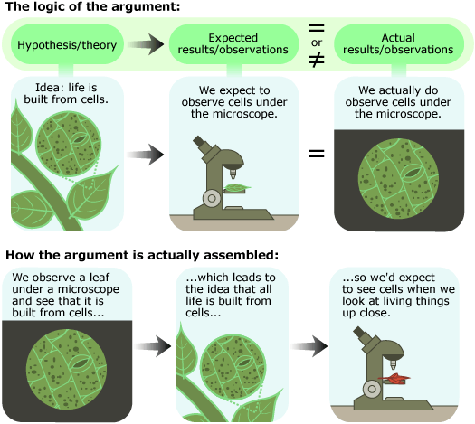
Induction vs deduction
Compare induction and deduction with reference to scientific inquiry
Induction
Cell Theory
Cell Theory
Deduction
Image credit: University of California Museum of Paleontology's Understanding Science (http://www.understandingscience.org)
Notes:
Here is a comparison of inductive and deductive reasoning in science.
The top panel illustrates inductive thinking. When a leaf is examined under a microscope, it is seen to be composed of cells. Examining the leaves of many plants shows the same conclusion. Therefore, through inductive reasoning, we may conclude that all plants are composed of cells. In doing so, the definite conclusion of each observation is used to synthesise a generalisation – the Cell Theory. Theories are big ideas in science – broad explanation of natural phenomena.
The lower panel illustrates deductive thinking. Here, we start with a big idea – that of the Cell Theory, which states that all plants are composed of cells. Suppose you have come across a new and unknown type of plant. Based on the Cell Theory, you predict that the unknown plant is composed of cells. This prediction is called a hypothesis. You then conduct an experiment, where you observe that the plant is indeed composed of cells. In this case, we have moved from a general instance (the Cell Theory) to a specific conclusion (that the new, unknown plant is composed of cells).

Slide 19
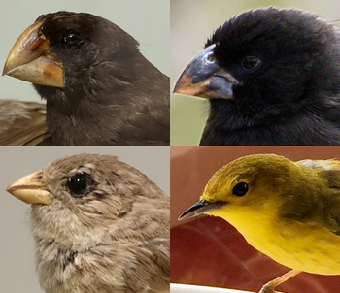
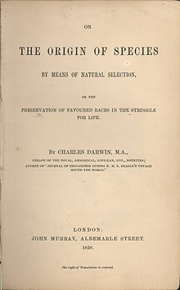
Inductive reasoning - Evolution
Compare induction and deduction with reference to scientific inquiry
Darwinian evolution, CC BY-SA 4.0 (Kiwi Rex)
Origin of Species, public domain
Observations
Individuals in a population vary in their traits
Some traits are heritable
A population produces more offspring than needed
Competition between members of a population is inevitable
Species are suited to their environments
Inferences
Individuals with inherited traits that are more suited to the local environment are more likely to survive than those that are not (fitness)
The survivors will pass on their traits to the next generation (reproductive success)
Theory
Theory of Evolution by Natural Selection
Notes:
Many of the big ideas or theories in science are the products of inductive thinking. This example shows Charles Darwin’s inductive thinking on populations of organisms.
Darwin makes several discrete observations about how individuals in a population are adapted to their environments (for example the beaks of different populations of finches show different shapes).
Based on the five observations shown on the slide, Darwin makes two inferences.
After many such inferences, Darwin develops a new big idea, which generalises how populations change over time. This is known as the Theory of Evolution by Natural Selection.

Slide 20

Inductive Reasoning – Scientific laws
Compare induction and deduction with reference to scientific inquiry
$F= \frac{GMm}{r^{2}}$
$Q=mc∆T$
$f^{′}= \frac{(θ_{wave}+ θ_{observer})}{(θ_{wave}− θ_{source})}$
$F= \frac{1}{4πε_{o}}\frac{q_{1}q_{2}}{r^{2}}$
$t= \frac{t_{0}}{\sqrt{(1−\frac{v^{2}}{c^{2}})}}$
$n= \frac{m}{MM}$
$∆G^{0}= ∆H^{0} −T∆S^{o}$
$PV=nRT$
$pK_{a}=−\log_{10}[K_{a}]$
$pH=−\log_{10}[H^{+}]$
Notes:
Scientific Laws describe the relationships between the variables of a system. They are usually expressed in the form of mathematical equations. This slide shows equations in the Chemistry and Physics datasheets.
Scientific laws are examples of inductive reasoning.

Slide 21
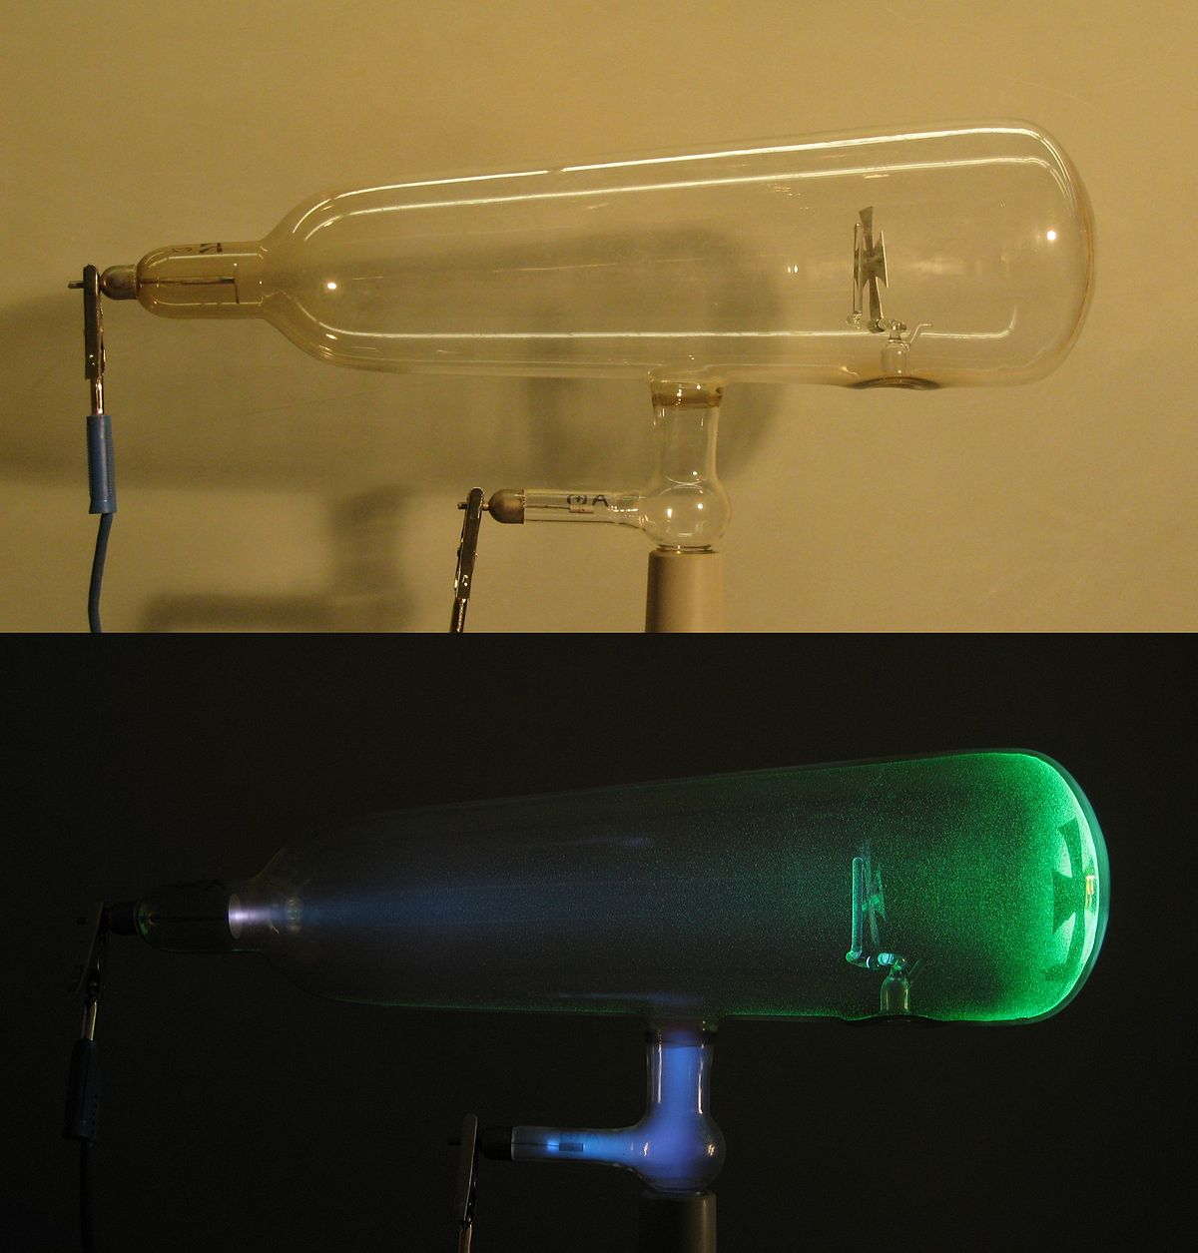
Deductive reasoning – discovery of the electron
Compare induction and deduction with reference to scientific inquiry
Theory
All matter is made up of indivisible particles called atoms
Observation 1
Cathode rays are a stream of negatively-charged particles
Observation 2
The mass of the cathode ray particles are 1/1000 of the mass of hydrogen atoms
Conclusion
Atoms are not indivisible – the are composed of negative particles (electrons) and positive particles
Modified Theory
Plum-pudding model of the atom
Cathode Ray Tube, CC BY-SA 3.0 (D-Kuru)
Notes:
The discovery of the electron by J.J. Thomson is an example of deductive thinking. While studying the nature of cathode rays, Thomson was exploring the basis of the Atomic Theory. In the 19th and early 20th centuries, it was thought that atoms were electrically-neutral and indivisible constituents of matter. However, through careful experimentation and data analyses, Thomson discovered that atoms were composed of subatomic particles. One type of subatomic particle was negatively charged and was called the electron. As a result of his discoveries, the Atomic theory was modified.

Slide 22
Reflection: Empiricism, induction and deduction
Describe how empirical thinking underlies your scientific research project, or a research area that your are familiar with.
Explain your use of inductive or deductive reasoning (or both) in your research project.

Slide 23
Parsimony and Occam’s razor
Simplicity in science
Notes:
Next, we will look at Parsimony and Occam’s Razor.

Slide 24
Parsimony & Occam's razor
Assess parsimony/Occam’s razor and its influence on the development of science
A heuristic* tool attributed to William of Occam
  Plurality must never be posited without necessity
  What can be explained by the assumption of fewer things is vainly explained by the assumption of more things
Q. What does it mean?
  A. Other things being equal, simpler explanations are generally better than more complex ones
Keep It Simple
*Heuristic: a strategy that can be used to help make decisions. A rule-of-thumb.
Notes:
William of Occam was an English friar who live in the 12/13th centuries. Although he did not invent the phrase, he used the phrase “Plurality must never be posited without necessity” frequently in his writings. Many thinkers before Occam, including the Greek philosophers Aristotle and Ptolemy, have made statement similar to this. A modern-day statement of Occam’s razor is “Other things being equal, simpler explanations are generally better than more complex ones”.
Occam’s phrase is called a razor because it helps to ‘shave away’ the unnecessary parts of a discussion so that we can focus on the main argument.
Occam’s razor is also referred to as a heuristic tool, as it is a tool to help make decisions. This is explored further in the next slide.

Slide 25
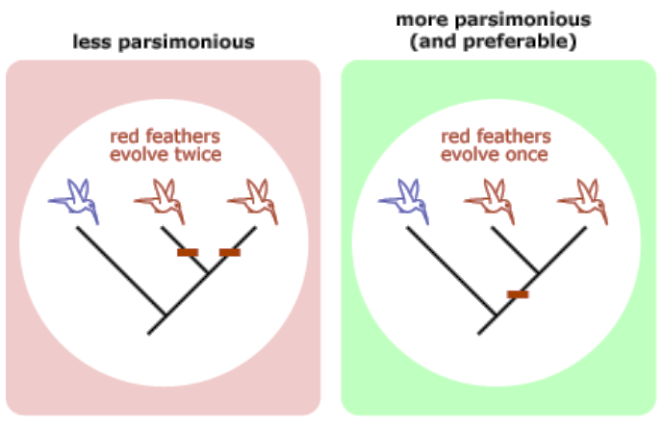
Parsimony and Occam’s razor: competing ideas
Assess parsimony/Occam’s razor and its influence on the development of science
Science works with competing ideas.
Occam’s razor provides a tool for selecting the best idea from the pool of competing ideas: simplicity.
Fewer assumptions & fewer exceptions
Parsimony
The red bars indicate genetic mutations that result in the development of red coloured feathers.
Red features evolved twice – 200 changes
Red features evolved once – 70 changes
Image credit: University of California Museum of Paleontology's Understanding Science (http://www.understandingscience.org)
Notes:
Science works with competing ideas. That means that when scientists are trying to develop explanations of some phenomenon, the devise alternative hypothesis. Sometimes, after testing those hypotheses, there may be more than one plausible hypothesis for a phenomenon. In those situations, using Occam’s razor may be useful. Occam’s razor says that if the competing hypotheses are equivalent, then the simpler hypothesis is the best explanation for the phenomenon.
The example shown in the slides describes the evolution of red features in a species of birds. There are two similar models proposed: the model on the left suggests that, from a common ancestral population, the birds with blue feathers branched off to form a unique species. Then a second group of birds branched off, after which it developed red feathers. Finally, the remaining group of birds also developed red feathers. In the second model, the blue-feathered group branched off initially. The remaining birds evolved red feathers, but then separated into two groups after that. Both evolutionary models are plausible. However, the first model is more complex – it requires 200 genetic changes and suggests that the red feathers feature evolved twice. The second model is simpler – it requires only 70 genetic changes and suggests that the red features feature evolved only once. Therefore, according to Occam’s razor, the second model is simpler and is the better hypothesis to explain this phenomenon.
When competing ideas are present, those that require fewer assumptions and have fewer exceptions are the preferred ideas.

Slide 26
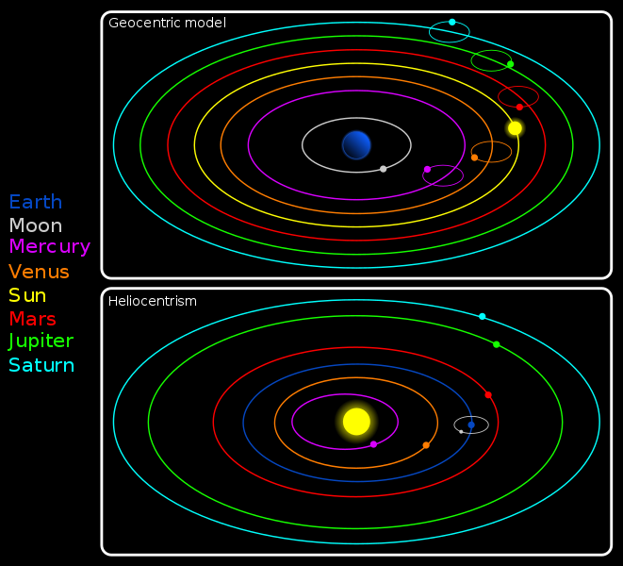
PARSIMONY – HELIOCENTRISM & GEOCENTRISM
Assess parsimony/Occam’s razor and its influence on the development of science
Geocentric (Ptolemy) vs heliocentric (Copernicus) models – Ptolemy used epicycles to explain the retrograde motion of Venus. The Copernican model did not require this.
Geocentrism and Heliocentrism, Creative Commons Attribution-Share Alike 2.5 Generic (Nico Lang)
Notes:
There are many historical examples of the use of Occam’s razor. Before the 16th century, the geocentric model of the solar system (Earth at the centre of the solar system) was dominant. Then, this was replaced with the heliocentric model (Sun in the centre). The geocentric model required a number of complicated features (e.g. epicycles) to explain some unusual phenomena (such as the retrograde motion of Venus). The heliocentric model did not require such features and is thus a simpler model.

Slide 27
OTHER EXAMPLES OF PARSIMONY
Assess parsimony/Occam’s razor and its influence on the development of science
    Caloric Theory of Heat vs Mechanical Theory of Heat (Thermodynamics)
    Classical Mechanics vs Quantum Theory (wave-particle duality)
    Colour vision in animals
Notes:
Here are other examples of complicated hypotheses of science being replaced with simpler theories If you would like to find out more about these topics, click on the links shown on this slide.

Slide 28
Competing ideas
Assess parsimony/Occam’s razor and its influence on the development of science
Scientists do not use Occam’s razor exclusively when accepting ideas in science.
Most important factor: evidence
Other consideration:
  Are some ideas more testable than others?
  Are some ideas better at producing broader explanations?
  Are some ideas a better fit with existing ideas?
  Are some ideas better at generating new areas for investigation?
Notes:
However, simplicity should not be the only criterion for accepting or rejecting ideas in science. Scientists consider many other factors, the most important of which is the supporting evidence for those ideas. Ideas, that are experimentally testable, have broader explanatory powers, are a better fit with other existing ideas and which can generate new ideas, are some of the factors that scientists consider when selecting ideas.

Slide 29
Reflection: Occam’s Razor
Consider your field of research (that is your research project). What are some competing hypotheses in that field? Explain how Occam’s Razor can be used to select a hypothesis from a set of competing hypotheses.

Slide 30
Falsifiability
A method to distinguish science from non-science
Notes:
Next, let us explore Falsifiability.

Slide 31
Falsifiability
Analyse the importance of falsifiability in scientific research
Derived from deductive reasoning and formalised as hypothesis testing.
Scientific hypotheses are valid only if they are falsifiable.
Distinguishes science from non-science
  For example Creation science (Intelligent Design) premises are non-falsifiable → Non-scientific
Has implications for the structure of hypotheses
Idea
Falsifiable
Not falsifiable
Scientific
Not scientific
Notes:
Falsifiability is a method of developing scientific knowledge. It is a type of deductive reasoning. It claims that all scientific ideas should be falsifiable through testing (for example, through experimentation). If an idea cannot be falsified, then it cannot be scientific. For example, creation science or intelligent design are not considered to be scientific because you cannot test their ideas.
While not everything agrees with the principle of falsification, falsification impacted on two aspects of science:
Differentiating scientific ideas from non-scientific ideas
A method to test and verify scientific ideas.
We will explore these ideas in the next few slides.

Slide 32
Falsifiability
Analyse the importance of falsifiability in scientific research
Theory
Hypothesis
Observation/Experimentation
Theory
Competing hypotheses & predictions
Perform experiments to collect data
Conclusion
Analyse the data: does the evidence support the hypothesis?
Hypotheses can never be proven true
Hypotheses can only be
  Rejected
  Not rejected
Steps
What do we do?
Notes:
Falsification has given rise to one method of testing and verifying scientific ideas. This is known as hypothesis testing.
Hypotheses are tentative explanations of a narrow set of related phenomena. For example, consider the hypothesis “particulate pollution in the atmosphere increases the incidence of asthma”. This hypothesis proposes an explanation for the increased incidence of asthma. It is a tentative explanation that is based on observations, but needs to be verified. In other words, the hypothesis needs to be tested.
To test the hypothesis, a controlled experiment must be conducted and the data generated in that experiment analysed.
Two important features of hypotheses are that:
Hypotheses cannot be proven to be true – they can only be falsified (this is because of the falsification principle).
Hypotheses can only be rejected (if they are NOT supported by evidence) or not rejected (if the evidence supports the hypothesis).
These are important features of hypotheses to bear in mind. The goal of hypothesis testing is to reject what is false (not supported by evidence).

Slide 33
Falsifiability
Analyse the importance of falsifiability in scientific research
If a hypothesis cannot be rejected, it doesn’t mean that the hypothesis is true (it is not false).
A hypothesis that is not rejected will be subject to further tests.
What does the data say? | What does it mean?
Supports the prediction in the hypothesis | The hypothesis cannot be rejected
Does not support the prediction in the hypothesis | The hypothesis can be rejected
Note: rejected = falsified
Notes:
This slide reiterates the core message from the previous slide:
Hypotheses are either rejected or not rejected, depending on the underlying evidence.
When a hypothesis is not rejected, it is then subjected to further rounds of testing.
It is only when the hypothesis has stood firm in the face of numerous testing that the underlying scientific concept becomes part of the scientific paradigm (an accepted idea in science).

Slide 34
Falsifiability – hypothesis testing
Analyse the importance of falsifiability in scientific research
Scientific hypothesis
Null hypothesis
Alternate hypothesis
Conduct experiment, collect data, perform statistical test
Reject/not reject hypothesis
Inferential statistical tests are used to determine the strength of evidence for hypotheses. This is discussed in Module 3.
Notes:
Often, hypothesis testing also involves the statistical analysis of experimental data. So, it is not simply the data collected in an investigation that is used to verify hypotheses, but the quality of the data. We discuss statistical analysis in Module 3, but you do need to understand that the basis for that lies in the principle of falsification.

Slide 35
Reflection: Falsifiability
Describe how you have attempted to incorporate the principles of falsifiability in the design of your investigation (that is your scientific research project).

Slide 36
Confirmation bias &
Theory-dependent observations
Objectivity and independence in science
Notes:
Next, we will look at Confirmation bias & Theory-dependent observations.

Slide 37
Confirmation bias
Evaluate the significance of confirmation bias, including theory-dependence of observation
Observations are an important element of scientific inquiry. Inferences can be influenced by:
  Confirmation bias
  Theory-laden observation
Confirmation bias: the tendency to search for or interpret information in a way that confirms one’s preconceptions
Theory-dependent observations: how previous experiences, beliefs and assumptions affect the inferences drawn from observations
Notes:
No matter whether we use inductive or deductive reasoning, observations are important. The quality of observations is crucial for initiating inquiries and investigations. Consider Marshall and Warren’s study on the microbial cause of gastric ulcers. The observation that Helicobacter pylori are frequently associated with gastric ulcers was a crucial observation that led to the discovery that that bacterium caused the disease. Another important aspect of observations is the analyses of data. Identifying patterns and trends in experimental data is critical for finding evidence that may support the hypotheses.
Observations lead to inferences. Inferences are the tentative conclusions reached from observations. Confirmation bias and theory-dependent observations can impact on the inferences drawn from investigations. As shown on this slide:
Confirmation bias: the tendency to search for or interpret information in a way that confirms one’s preconceptions
Theory-dependent observations: how previous experiences, beliefs and assumptions affect the inferences drawn from observations
We will unpack these further in the next few slides.

Slide 38
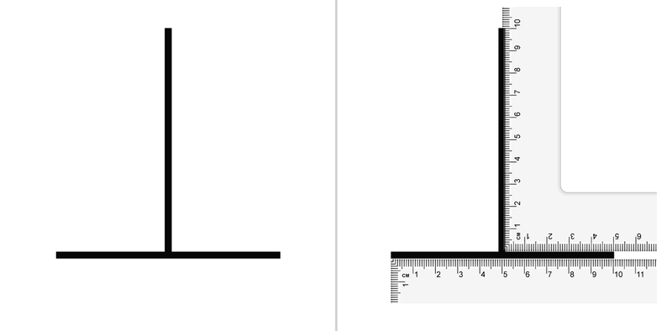
Theory-dependent observations
Evaluate the significance of confirmation bias, including theory-dependence of observation
Optical illusions provide clues about how we ‘interpret’ what we observe.
Our previous experiences influence our observations
Optical illusions
The image on this slide is in the public domain
Notes:
Let’s start with theory-dependent observations. As the name suggests, this phrase refers to observations that are dependent on theories. It means that prior knowledge of scientific theories may influence that inferences that we draw from observations. This extended to the ways that we analyse and interpret observations. Optical illusions are often used to illustrate theory-dependent observations. In the picture shown in the slide, the image on the left shows two lines, one vertical and the other horizontal. On initial inspection, the vertical line appears to be longer than the horizontal line. Yet, when measured, both lines are of the same length. Although this example is simplistic, it illustrates how the initial interpretations we make of our observations may be misleading and require further inquiry. Therefore, how we interpret observations is dependent on prior experience.

Slide 39
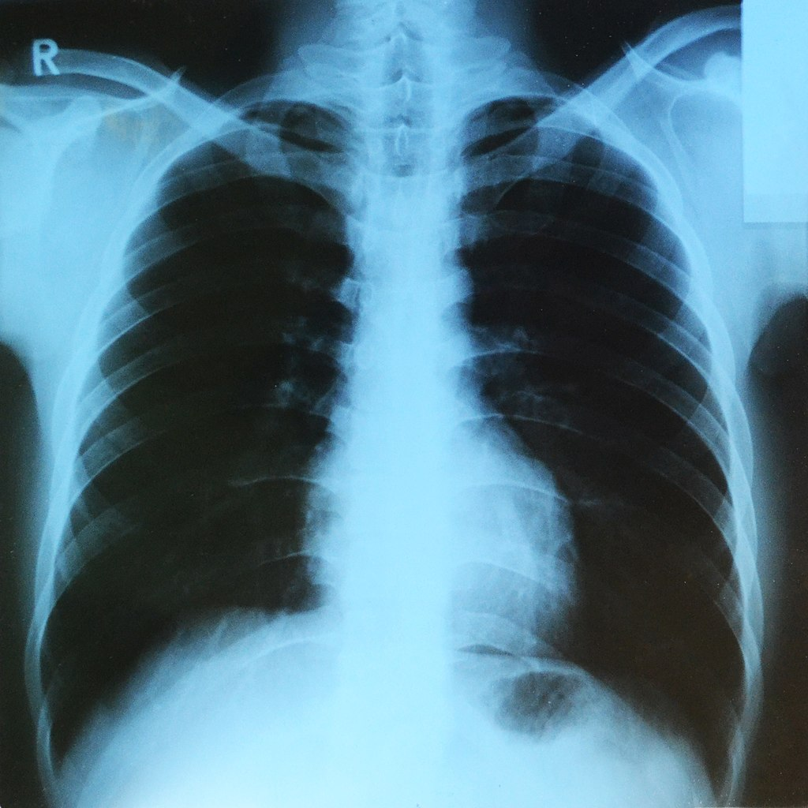
Theory-dependent observations
Evaluate the significance of confirmation bias, including theory-dependence of observation
Theory dependence may interfere with objective observations
However, theory-dependence also provides the experienced observer with an ‘expert eye’ – for example a radiologist diagnosing disease conditions or injuries when viewing X-rays
Chest X-ray, CC BY-SA 4.0 (Sudraben)
Notes:
Theory-dependent observations play an important role in the way ‘experts’ interpret information. For example, an X-ray image may not be informative to the untrained person, but to an experienced radiologist, the same image may be very informative. The radiologist may be able to pick up certain conditions or pathologies, because of his/her past learning and experiences. Theory-laden observations may also be responsible for professional intuition, where the expert practitioner may be able to arrive at certain conclusion without conducting much analysis.

Slide 40
Theory-dependent observations
Evaluate the significance of confirmation bias, including theory-dependence of observation
Theory influences observations and conclusions
Field | Contrasting conclusions
Mechanics | Newton: mass is constant | Einstein: mass changes with velocity
Mechanics | Aristotle: larger objects fall faster | Galileo: all objects fall at the same speed
Astronomy | Ptolemy: moving sun | Copernicus: stationary sun
Chemistry | Priestly: phlogiston | Lavoisier: oxygen
Notes:
Theory-laden observations can lead people to derive different conclusion from the same set of observations. As shown on this table, in many scientific fields, scientists have come to different conclusions while studying the same phenomena. In some instances, those conclusions have been wrong (e.g. Aristotle, Ptolemy). In other instances the different conclusion describe different aspects of the same phenomena (Newton and Einstein).

Slide 41
Confirmation bias
Evaluate the significance of confirmation bias, including theory-dependence of observation
Confirmation bias can occur when experiments are poorly designed or when data is not critically-analysed
Negative controls and blind controls (blind, double-blind and triple-blind) should be used in experimental designs
Experiments should be designed to disprove hypotheses, not to prove them
Exploratory research is not confirmatory
Correlation should not be misinterpreted as causation
Notes:
Confirmation bias is not a good thing in science. As the name suggests, it is a form of bias. That bias improperly confirms a researcher’s belief about the outcome of an inquiry. There are many reasons why confirmation bias may occur in a scientific investigation. Some of the reasons are listed on this slide.
Poor experimental design or data is a major cause of confirmation bias. Sometime, preliminary studies are interpreted as confirmatory studies. For example, in a recent article, it was claimed that bald men are more likely to be afflicted with Covid-19 disease. This was only an observation is a couple of hospitals, and not the result of a well-designed investigation. Confirmation bias may also occur when correlation is confused with cause-and-effect.

Slide 42
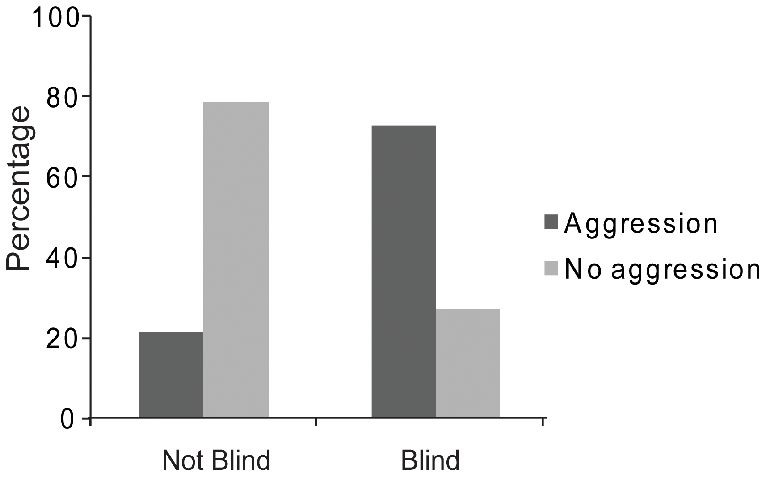
Confirmation bias
Evaluate the significance of confirmation bias, including theory-dependence of observation
Ants are more aggressive to ants from other nests than to those from their own nest
A study of 79 publications showed that 71% were non-blinded studies, and confirmed the assumption.
The blinded studies (29%) disproved the assumption.
van Wilgenburg E, Elgar MA. Confirmation bias in studies of nestmate recognition: a cautionary note for research into the behaviour of animals. PloS one. 2013 Jan 23;8(1):e53548.
Notes:
Here is an example of confirmation bias in the scientific literature. It is generally assumed by biologists that ants are more aggressive to ants from neighbouring nests than to those from their own nest. A research team in Melbourne decided to examine the scientific papers on the nesting behaviour of ants. They looked at 79 publications, and noticed that only 29% of those were designed as blinded-studies. Blinded studies are controlled-experiments. In other words, 79% of the published studies did not use a proper experimental design. The researchers also noted that the studies that were not controlled-experiments, the assumption of ant behaviour was identified. However, in the controlled-experiment studies, the reverse was observed. This occurred because in the uncontrolled studies, the researchers did not check for aggressive behaviour within each nest. They simply assumed that ants were less aggressive towards nest mates, compared to ants from other nests. Thus, the poor experimental design of those studies resulted in a confirmation bias.

Slide 43
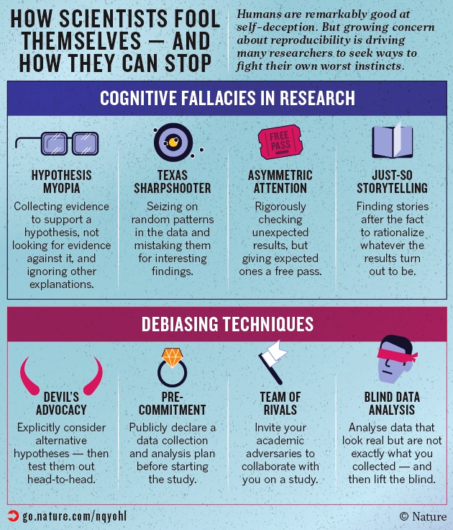
Confirmation bias – fooling ourselves
Evaluate the significance of confirmation bias, including theory-dependence of observation
Types of confirmation bias in science
How to avoid confirmation bias in science
Nuzzo, R, Nature How scientists fool themselves – and how they can stop. 526, 182–185
Notes:
This slides summaries the different types of confirmation biases that can influence scientific research. In addition, there are some strategies that scientists can use to minimise the effects of cognitive bias. Most importantly, science relies on the peer-review process to identify and minimise such biases.

Slide 44
Reflection: Confirmation bias and theory-laden observations
Describe your scientific research project, and the expected outcomes of your investigation. Explain the steps you have taken to avoid confirmation bias, including any assumptions you have made in your project.
Consider your field of research. Provide examples of theory-laden observations that are evident in the literature in your research area.

Slide 45
Paradigm shifts & scientific revolutions
How major advances occur in science
Notes:
In the next part, we will look at how scientific knowledge changes over time.

Slide 46
Thomas Kuhn & scientific revolutions
Select one example from the following list to analyse the paradigm shift and how evidence is used to support new theories to explain phenomena and their consequences
Scientific Paradigm
Normal Science
Puzzle-solving science
“research firmly based on past discoveries”
“anomalies that do not fit into established theories”
Scientific paradigm: distinct set of concepts or thought patterns, including theories, research methods, postulates, and standards for what constitutes legitimate contributions to a field
Notes:
Thomas Kuhn was a science philosopher who explored scientific epistemology. For any scientific discipline, the set of concepts, theories, research methods and postulates used by scientists makes up the paradigm of that discipline. Kuhn said that the scientific paradigm consists of normal science and puzzle-solving science. Normal science is everyday science, where scientists conduct inquiries into the paradigm, for example, by verifying hypotheses. The ‘discoveries’ of normal science are expected findings, based on the prevailing paradigm. Over time, anomalies will appear in the prevailing paradigms. Those anomalies are referred to as puzzle-solving science. Scientists then conduct investigations to understand the anomalies. The discoveries in the puzzle-solving sciences are unexpected and lead to paradigm shifts (also called scientific revolutions). We will explore these ideas further in the subsequent slides

Slide 47
Paradigm shifts
Select one example from the following list to analyse the paradigm shift and how evidence is used to support new theories to explain phenomena and their consequences
3. Revolution– paradigm shift
For example germ theory of disease
1. Normal Science – widely accepted theories
For example Lamarckian evolution, Miasma theory of disease
3
The structure of scientific revolutions
1
2
2. Crisis – observations that cannot be explained by current theories
For example Koch’s experiments with anthrax
Notes:
According to Kuhn, paradigm shift occur in 3 stages:
In Stage 1, normal science dominates. Scientists go about verifying the prevailing concepts through observation and experimentation. During this stage, hypotheses that are supported by evidence will be retained, while those that are not, are rejected. This builds into a body of scientific knowledge that forms the paradigms for the various scientific disciplines.
In Stage 2, scientists note that there are anomalies to the prevailing paradigms. Anomalies are experimental data or observations that cannot be explained by contemporary concepts.
In Stage 3, the anomalies force scientists to search for new explanations. When identified, the new concepts, ideas and explanation result is a paradigm shift.

Slide 48
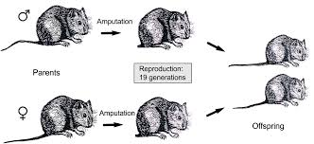
Paradigm shifts
Select one example from the following list to analyse the paradigm shift and how evidence is used to support new theories to explain phenomena and their consequences
Lamarck: Inheritance of acquired characters
Weissman experiment on rat tails
Darwin:
Evolution by Natural Selection
Normal Science
Crisis
Paradigm shift
Niklas KJ, Kutschera U. Amphimixis and the individual in evolving populations: does Weismann’s Doctrine apply to all, most or a few organisms?. Naturwissenschaften. 2014 May 1;101(5):357-72.
Notes:
This slide illustrates the 3 stages of paradigm shifts:
The prevailing view of how populations change over time is the model proposed by Lamarck. According to him, the events that an individual experiences in its lifetime will be transmitted to the offspring. This model is called the Inheritance of Acquired Characters. For example, the children of a person engaged in physical labour will develop a stronger physique.
There were many anomalies that could not be explained by this paradigm. One such anomaly is the experiment conducted by the German biologist, August Weissman. He took a population of rats and amputated their tails. Those rats were allowed to breed. All of the offspring had normal tails. Once again, he amputated their tails and bred them. He did this for 19 generations, but all of the offspring in every generation had normal tails. Therefore, this observation was an anomaly to the theory of the Inheritance of Acquired Characters.
Charles Darwin then proposed the Theory of Evolution by Natural Selection, which was a different model to the Inheritance of Acquired Characters. Eventually the paradigms of evolutionary biology shifted, and Lamarck’s theory was discarded. Darwin’s theory of evolution, together with advances in genetics and cell biology, changed our understanding of inheritance of biological traits in populations.

Slide 49
Paradigm shift – theory replacement
Select one example from the following list to analyse the paradigm shift and how evidence is used to support new theories to explain phenomena and their consequences
Geocentrism and Heliocentrism, Creative Commons Attribution-Share Alike 2.5 Generic (Nico Lang)
The geocentric model of the solar system was replaced with the heliocentric model
Notes:
When anomalies appear in a scientific discipline, there are 2 ways by which paradigm shifts may occur. This slide shows one way – theory replacement. This describes the situation when a new theory replaces an old theory. In modelling the arrangements and movements of planets, the geocentric model was replaced with the heliocentric model.

Slide 50
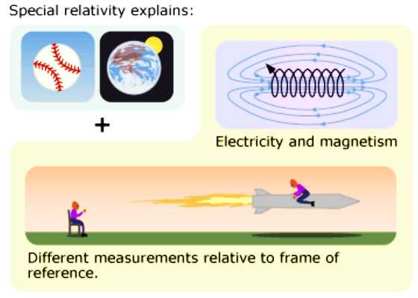
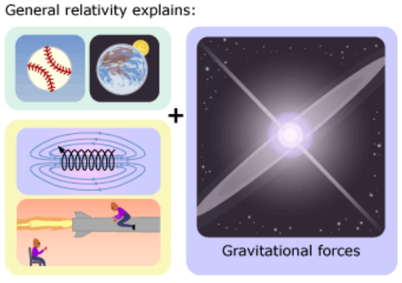
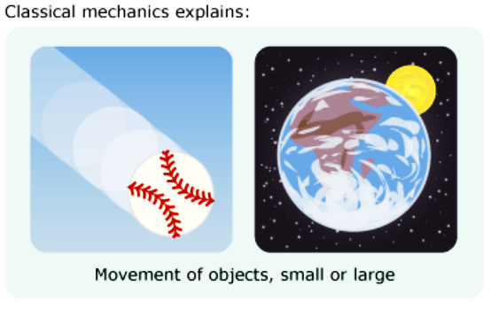
Paradigm shift – theory modification
Select one example from the following list to analyse the paradigm shift and how evidence is used to support new theories to explain phenomena and their consequences
Changing theories
Newtonian model of gravitation was modified by Einstein’s theories of relativity
Image credit: University of California Museum of Paleontology's Understanding Science (http://www.understandingscience.org)
Notes:
The second method by which paradigm shifts occur is called theory modification. Here, the old theory is not replaced, but modified. In the example shown on this slide, the paradigms of Newtonian mechanics was modified to include Einstein’s theories of relativity. Both theories are relevant and valid, but are used to describe different systems.

Slide 51

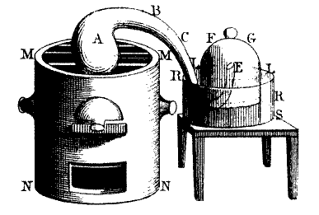
Paradigm shift
Analyse the paradigm shift: Lavoisier and oxygen
Phlogiston was a property of flammable substances. Phlogiston was lost to the air when substances burned
Old Theory
Charcoal (with phlogiston) lost the phlogiston to the air when burned.
Crisis
However, metals (e.g. mercury) gained weight when heated.
Lavoisier and oxygen, Public domain
Paradigm Shift: new theory
Mercury gained weight when converted to mercuric oxide. An equivalent weight of air was lost during that process.
When mercuric oxide decomposed, the loss in weight was gained by air.
The loss in weight during mercuric oxide decomposition was due to the release of a gas, oxygen
Notes:
A major paradigm shift occurred in chemistry in the 17th century. During the Renaissance era, scientists were interested in the chemistry of combustion reactions. Scientists knew that some substances were flammable or combustible. Also, when these substances burned, there was a loss of mass. For example, when a piece of charcoal is burned, the remaining residue (ash) is lighter than the original piece of charcoal. The prevailing view at that time was that something from the charcoal was lost to the air during the combustion. This substance was called phlogiston (a concept developed by the German scientist, Georg Ernst Stahl, in the early 18th century). According to the phlogiston theory, it is phlogiston that makes substances flammable. During combustion, phlogiston is transferred from the burning substance to the air. Once transferred, the original substance is no long combustible. We (and all living things) have phlogiston and lose it to the air when we breathe.
One of the anomalies with the phlogiston theory came with the combustion of metals. When combusted, metals gained mass. The English chemist, Joseph Priestly, was studying the burning of mercury (a metal). During combustion, mercury becomes oxidised to form mercuric oxide. Mercuric oxide is heavier than mercury. Priestly concluded that phlogiston from the air had transferred to the mercury. The air had become ‘dephlogisticated’. Dephlogisticated air is not capable of supporting life. Priestly then heated the mercuric oxide. When combusted, mercuric oxide decomposes to form mercury. Priestly explained that phlogiston moved from the air to the mercury during this reaction. The remaining air did not contain phlogiston and was called dephlogisticated air. The dephlogisticated air could support life (and make a candle flame shine brighter).
Priestly travelled to Paris to visit the renowned French chemist, Anton Lavoisier. There, Priestly repeated his experiments with the combustion of mercury. However, Lavoisier did not believe in the phlogiston theory. He had conducted a number of experiments himself, which cast doubt on the phlogiston theory. To Lavoisier, the phlogiston could not explain many properties of combustion reactions. After listening to Priestley’s experiments with mercury, Lavoisier repeated the experiments himself. However, he used the experimental set up shown in this slide to measure accurately the gain and loss in mass that occurred during combustion. He noted that the massed gained by mercury during combustion was exactly the mass of air that was lost in the reaction. Similarly, when mercuric oxide was heated to form mercury, the loss is mass is exactly the same as the gain in the mass of air. Therefore, the concluded that it was not phlogiston that was involved in combustion, but a component of air itself. Lavoisier went further and concluded that the gas produced from the decomposition is a component of acids – he called it oxygen (from the Greek: ‘acid producer’).
Lavoisier’s work transformed scientists’ understanding of combustion. All combustion reactions involved interactions with oxygen. During combustion, oxygen in the atmosphere combines with chemical to form oxides. In addition, Lavoisier believed that measurement through experimentation should form the evidence base for scientific ideas. Do you remember from the earlier slides what type of reasoning this represents? It is empiricism (the need for evidence) and induction (generalisation from specific observations)?

Slide 52
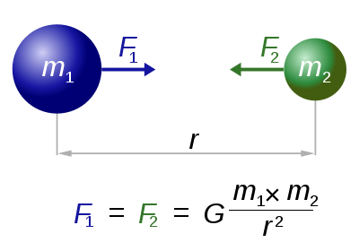
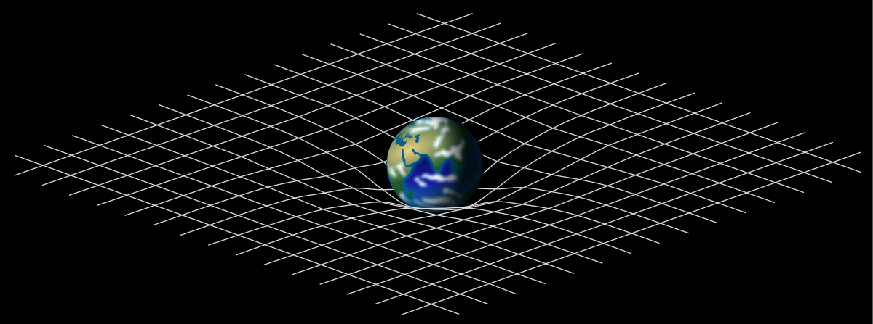
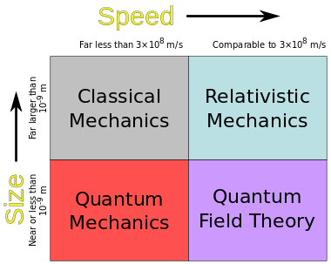
Paradigm shift
Analyse the paradigm shift: Einstein and relativity
Gravitation, Creative Commons Attribution 3.0 (Dennis Nilsson)
Old Theory
Crisis
Electromagnetic waves do not behave as predicted by Newtonian physics
Space and time are not ‘absolutes’.
Space-time, Creative Commons Attribution-Share Alike 3.0 (David Blair)
Physics theories, Creative Commons Attribution-Share Alike 3.0 (Lodog)
Special relativity: all phenomena other than those involving gravitation
General relativity: phenomena involving gravitation
Gravity is the result of the bending of space-time
Paradigm Shift: new theory
Notes:
Both Galileo and Newton laid the foundations of classical mechanics. Classical mechanics describes the motion of macroscopic (large) objects, including those that are at rest. This movement is described in terms of the masses of objects, and the forces acting on it. Parameters such as distance, speed, time, space characterise the properties of a moving body. They were very successful because if we know some initial conditions of a moving body, then we can predict certain future outcomes, based on the principles of classical mechanics. For example, if the speed of a moving object is known, we can calculate the time taken for the object to travel a certain distance. Classical mechanics applied equally to everything, everyone and everywhere: for example, Newton’s 2nd Law of motion (F = ma) equally applicable on the moon as it is on the Earth. Many aspects of modern society are based on the principles of classical mechanics, for example, calculating travel times.
Despite the success of classical mechanics, scientists noted that it could not explain some specific types of phenomena, for example, very small objects (e.g. atoms), very large objects (e.g. stars), or objects moving very fast (near the speed of light). Indeed, Newtonian mechanics was incompatible with Maxwell’s description of electromagnetism.
Einstein explored some of these anomalies using a combination of ideas in physics and mathematics. Special relativity describes the physics of particles and waves moving at, or close to, the speed of light. On the other hand, general relativity deals with the physics of large objects (gravitation). Relativity did not displace the principles of Newtonian physics, but modified them. For example, special relativity describes an equation for calculating the momentum of a particle that is moving close to the speed of light. However, for a particle that is moving at slower speeds, Einstein’s equation for special relativity approximates to the equation for momentum in classical mechanics. Special relativity also introduced new concepts in physics, such as length contraction, time dilation, relativistic mass, a universal speed limit, and mass–energy equivalence (E=mc²). General relativity extends Newton’s Theory of Universal Gravitation. According to Newton’s model, gravity is an attractive force between two objects. However, General Relativity extends that idea to describe gravitation as the warping of space-time around massive objects. Indeed, some aspects of classical mechanics are seen to be an approximation of special relativity at low velocities, and special relativity is an approximation of general relativity in low gravitational fields.

Slide 53
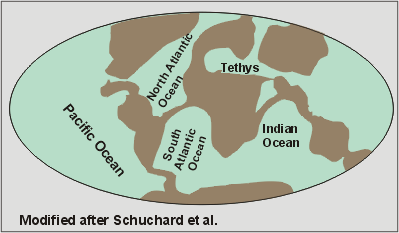
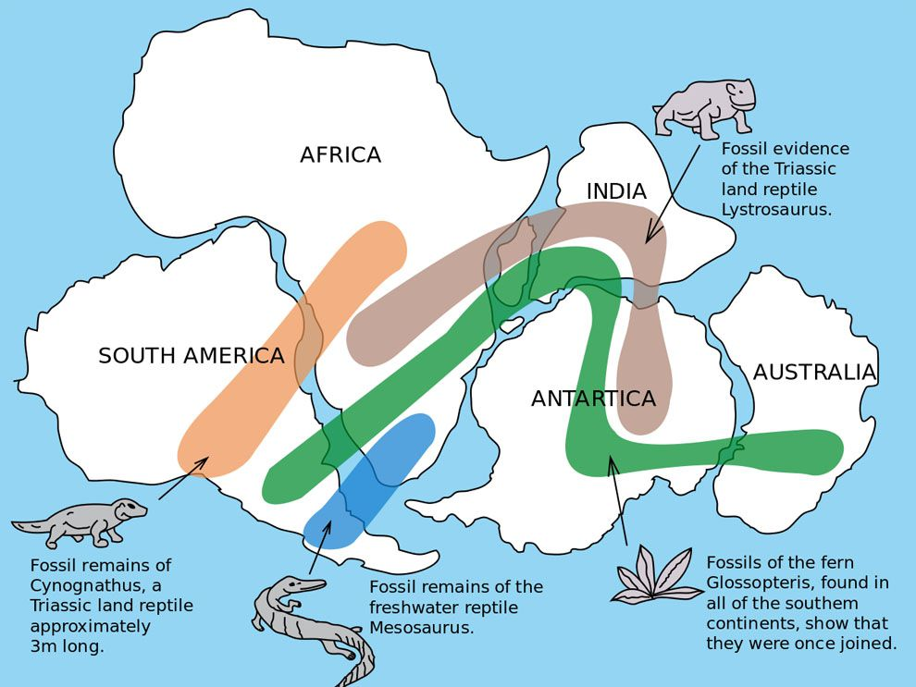
Paradigm shift
Analyse the paradigm shift: Wegener and continental drift, leading to plate tectonics
Old Theory
Land bridges, Public Domain
Land bridges between continents
Crisis
Continental margins
Fossils, vegetation and landform continuums across continents
Pangea, Public Domain
Paradigm Shift: new theory
Wegener: Continental Drift Theory – continents are crustal plates that move in the asthenosphere
Supported by Plate Tectonics
Notes:
What did the Earth look like in the distant past? Early cartographers in the 17th century had noted that the margins of the South American and African continents were complementary, suggesting that they were once joined together. Before the 20th century, the prevailing theory about the formation of continents was the Contraction Theory. According to this theory, the Earth was a hot molten rocky planet when it formed. As it cooled down, the continents formed. During that process, mountain ranges formed. Also, oceans began to cover the low lying areas. In the various geological eras, some land masses went under the oceans, while others were raised from the ocean floors. The locations of the continents, once formed, remained unchanged to this day.
As geologists, geographers and surveyors collected data about various physical features of the Earth, anomalies about the Contraction Theory abounded. For example, when geologists measure the surface areas of the mountain ranges on Earth, they realised the vast amount of landmass on those features could not be explained by contraction. As measuring devices become more reliable, it was apparent that the distances between cities were not fixed or not as predicted from astronomical data.
Although he was not the first person to describe it, Wegener developed the most comprehensive account of Continental Drift. According to this theory, continents are not fixed structures, but move on Earth’s surface. Wegener developed the idea of a single, large continental landmass, called Pangea, in Earth’s geological history. This accounts for the distribution of similar fossils on currently separated continents. Over time, the continents moved apart and formed the present-day continents. Occasionally, landmasses crashed into each other, forming mountain ranges such as the Himalayas. However, his theory was initially rejected by many scientists, because he did not provide a mechanism for continental drift. Later, other research provided evidence to support continental drift. This came to be called Plate Tectonics. According to Plate Tectonic, the continental landmasses are parts of the Earth’s crust that is the outmost part of the mantle (called the asthenosphere). Heated by the Earth’s core, the convection currents in the mantle cause the movement of the tectonic plates. Seafloor spreading indicates how new crust if formed, just as other geological processes (e.g. subduction) explain the loss of crust. Many other lines of evidence have supported continental drift and plate tectonics. Data from satellites that orbit the Earth confirm the movement of landmasses. For example, the tectonic plate that Australia sits on is moving north (towards the equator) by about 7 cm per year. The new paradigm of continental drift and plate tectonic are at the centre of modern research, such as GPS and developments in seismology.

Slide 54
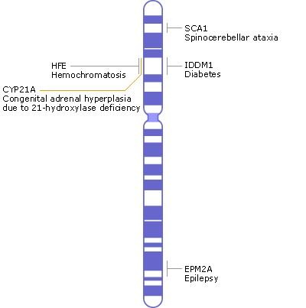
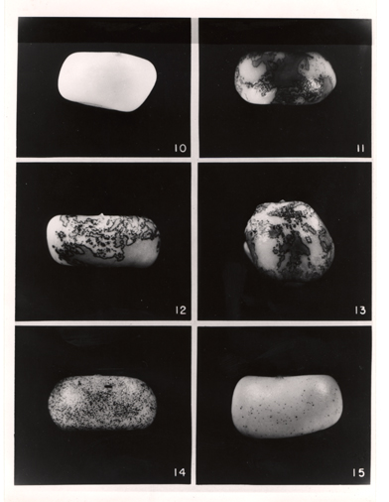
Paradigm shift
Analyse the paradigm shift: McClintock and transposable elements, commonly known as ‘jumping genes’
Genes occupy fixed locations in DNA and are inherited in predictable patterns
Old Theory
Chromosome map, Public Domain
Colour inheritance in corn does not follow predictable inheritance patterns
DNA sequences seem to change locations
Crisis
Colour variation in corn, Public Domain
Paradigm Shift: new theory
Some DNA sequences do not occupy fixed locations.
These are called transposable elements (transposons)
Transposons can disrupt the expression of genes
Notes:
The 20th century saw spectacular advances in the field of genetics. In a little more than a century, we went from developing the basic rules of inheritance to sequencing the human genome. Gregor Mendel established some of principles of inheritance, which suggested that genetic information was passed from parents to offspring in specific ways. The units of genetic information are called genes, and Mendel’s discoveries started a concerted effort to identify genes in different organisms. By the 1940s, it was accepted that genes were located on large pieces of DNA called chromosomes. This idea was called the Chromosome Theory of Inheritance. In some organisms, scientists were able to identify the locations of genes on specific chromosomes. This led to the development of chromosome maps, such as the one shown in this slide. This led to the generally-accepted idea that genes occupied fixed locations of chromosomes.
Barbara McClintock was a geneticist who studied the genetics of corn. Each kernel of a corn cob is a distinct progeny (the result of separate fertilisation). It means that scientists studying the genetic system of corn can produce large amounts of data for analysis. McClintock was interested in the inheritance of colour in corn. Her initial experiments indicated that the inheritance of colour in corn did not follow the established principles. She noticed that, while most of the kernels in a cob was of the same colour (yellow-white), some kernels had a ‘speckled’ or ‘mottled’ appearance (this looks like black or brown spots in a kernel). McClintock examined the cells of each speckled kernel under the microscope observed that while most cells of a kernel were yellow-white, some cells were black or brown, thus giving rise to the speckled appearance. After conducting extensive genetic analyses, McClintock concluded that the spots occurred because the gene responsible for yellow-white colour had been ‘disrupted’ in some cells of a kernel. As a result, those cells did not express the yellow-white colour gene and appeared visually as darkened spots in the kernel (the cells that had the normal yellow-white colour gene produced that colour in the kernel). Further work by McClintock showed that the disruption of the yellow-white colour gene was caused by a new stretch of DNA that had moved from another part of the chromosome and inserted itself into the yellow-white colour gene. In scientific terminology, this type of movement is called transposition. Therefore the piece of DNA that moves from one part of the chromosome to another is called a transposon (or a mobile genetic element).
The idea that parts of chromosomes can move was revolutionary and was not accepted by most scientists. While geneticists knew of a phenomenon known as crossing over (which occurs during a specialised type of cell division involved in the production of gametes), the concept of a dynamic genome that changes the locations of genes or affects the expression of genes was a paradigm shift. More evidence of transposons emerged in the 1970s and 80s, and the existence of transposons is now an accepted theory in genetics. Analysis of the human genome indicated that 50% of the genome is composed of transposons. Although scientists are only beginning to understand the role of transposons in genomes, research is revealing the role of transposons in disease processes, multicellular development, as well as creating new genes (raw materials for evolutionary change).

Slide 55
Reflection: Paradigm shift
Describe the current paradigms in your field of research (What are the prevailing concepts?).
Using examples from the literature, describe some paradigm shifts that have occurred in your field of research.

Slide 56
Cultural observational knowledge
How knowledge construction in other cultures have influenced science
Notes:
In the final part of this lesson sequence, we will look at how knowledge construction in other cultures have influenced science.

Slide 57
Science is part of culture, and how ... science is done largely depends on the culture in which it is practised
Iaccarino M. (2003). Science and culture. Western science could learn a thing or two from the way science is done in other cultures. EMBO reports, 4(3), 220–223.

Slide 58
Cultural observational knowledge
Use historical examples to evaluate the contribution of cultural observational knowledge and its relationship to science
All cultures have developed systems for constructing knowledge about the natural world
Also referred to as traditional knowledge
Knowledge construction has a strong cultural influence, including scientific knowledge
Commonality: Observations → Inferences
Little formalised experimental system
Cultural knowledge has added to scientific knowledge
Notes:
Furthermore, many of those knowledge systems have influenced the development of scientific knowledge.
Knowledge construction is closely linked with cultural constructs. This means that knowledge construction depends on the languages used in a society, the cultural practices and other factors. In the preceding slides, we looked at how scientific knowledge is constructed. We examined the central role of empiricism, reasoning tools (such as induction and deduction), Occam’s razor, falsification, confirmation bias and paradigm shifts in developing scientific knowledge. Most of the scientific research and knowledge construction that happens around the world is largely the product of European schools of thought.
However, all cultures in the world have systems for constructing knowledge. In every culture, knowledge is constructed and communicated in ways that are specific to those cultures. For example, the knowledge systems in indigenous societies are called Traditional Knowledge. Many governments are now tapping into traditional knowledge systems, as those systems have developed different, but relevant, explanations of natural phenomena.
As with science, cultural observational knowledge is based on developing inferences from observations. However, there is little or no experimentation such as that seen in science. Over the years, cultural observational knowledge has made significant contributions to scientific advancement.

Slide 59
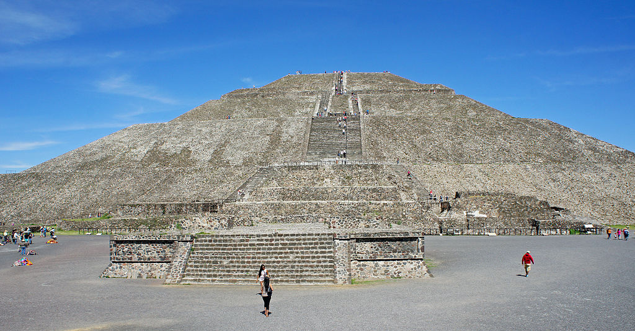
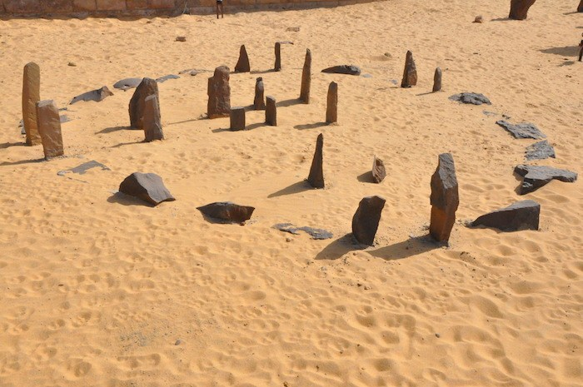
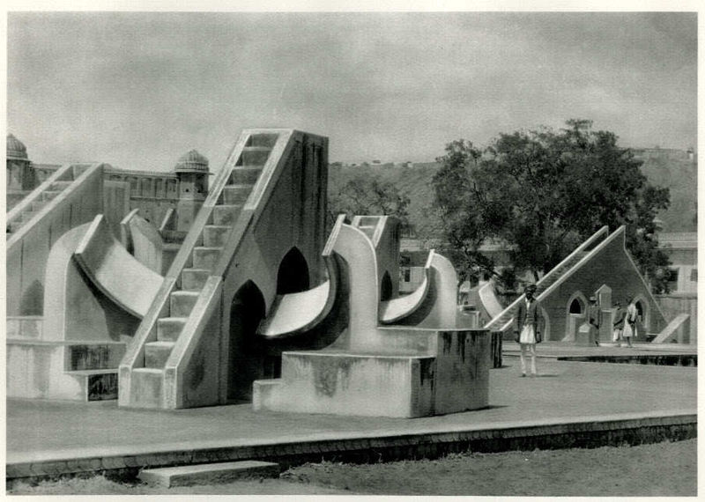
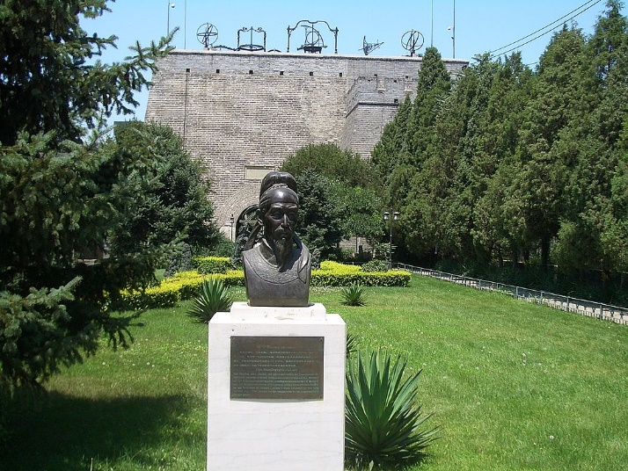
Cultural observational knowledge - astronomy
Use historical examples to evaluate the contribution of cultural observational knowledge and its relationship to science
Astronomy is common to many cultures
(agriculture, seasons, trade & travel)
Sun Temple, Yucatan, Mexico, CC BY-SA 4.0
Nabta Playa, Egypt, CC BY-SA 3.0
Jantar Mantar, India, Public Domain
Beijing, China, CC BY-SA 3.0
Notes:
One example of cultural observational knowledge that is common to many societies is astronomy. People around the world realised that many natural phenomena can be attributed to astronomical events. For example, changes in the seasons, weather and tides were associated with the positions of the sun and the moon in the sky. Agriculture was dependent on seasonal information. The patterns of stars (constellations) in the sky could provide positional and directional information for travel. Therefore, many cultures developed systems for measuring and analysing astronomical data. As shown in this slide, observatories have been identified in ancient Mexican (Mayan), Egyptian, Indian and Chinese societies. Much of this information has been used to construct knowledge of the Earth (for travel and trade) and astronomical phenomena.

Slide 60

Aboriginal traditional knowledge
Evaluate the contribution of cultural observational knowledge and its relationship to science, post – 49000 BCE, exemplified by Aboriginal cultures
Emu in the sky, CC BY 2.5
Aboriginal and Torres Strait Islander societies had people who observed and interpreted the night sky. This body of knowledge was called “Reading the Stars”.
Knowledge is transmitted in the oral tradition (which has survived natural disasters and social upheavals).
Notes:
The indigenous cultures in Australia are ancient and have existed in this continent for more than 60,000 years. There were more than 400 Aboriginal nations in Australia. There were different languages and cultural practices in those societies. They constructed knowledge of natural phenomena and transmitted that knowledge mainly in the oral tradition. For example, Aboriginal societies studied the night sky and developed mythical tales of constellations and other astronomical phenomena.

Slide 61
Aboriginal traditional knowledge
Evaluate the contribution of cultural observational knowledge and its relationship to science, post – 49000 BCE, exemplified by Aboriginal cultures
Some examples of Aboriginal and Torres Strait Islanders’ traditional knowledge (astronomy)
  Celestial navigation – sea and land travel; towns and highway networks
  Constellations – time (clocks)
  Positions of the setting sun, solstices and equinoxes – seasons
  Twinkling of stars – weather prediction
  Stellar positions – inform breeding, fledging, birthing, and migration patterns of various animals, as well as flowering plants and food courses
Notes:
The emu in the sky describes the region of the Milky Way that is adjacent to the Southern Cross, and forms part of the Dreaming narrative about creation. Other stories were built around the Pleiades system and the Orion constellations. In addition to mythologies, the night sky also provided information for seasonal changes, and as guideposts for celestial navigation. Time, calendars and information about seasons were developed using astronomical knowledge. Some other uses of astronomical knowledge in Aboriginal societies are indicated in this slide.

Slide 62
Aboriginal traditional knowledge
Evaluate the contribution of cultural observational knowledge and its relationship to science, post – 49000 BCE, exemplified by Aboriginal cultures
Some examples of Aboriginal and Torres Strait Islanders’ traditional knowledge (non-astronomy)
  Fire and interrelationships among matter and species in ecosystems (Traditional Ecological Knowledge)
    Indigenous rangers in south east Arnhem Land in the Northern Territory are applying Aboriginal ecological knowledge to manage country as part of the South East Arnhem Land Fire Abatement Project (SEALFA ).
  Water conversation and groundwater use
  Bush medicine
Notes:
Aboriginal societies also developed extensive knowledge about local Australian ecosystems. This knowledge is referred to as Traditional Ecological Knowledge. That knowledge is currently used in Australian states and territories for managing ecosystems and landcare. Their understanding of the role of bushfires in the functioning of local ecosystems is proving to be critical for modern fire management systems. Another area of traditional knowledge that has received scrutiny is bush medicine. Traditional knowledge is being used to identify new substances from native plants that have medicinal and therapeutic value, including antibiotics, antimicrobials and antiviral products. Thus, contemporary society benefits from traditional knowledge as it become integrated with scientific knowledge.
The use of traditional knowledge for the development of medicinal, therapeutic or health products has implications for commercialisation practices and intellectual properties.

Slide 63
Influence of other cultural knowledge on science
Evaluate the contribution of cultural observational knowledge and its relationship to science, including:
pre – 1500 CE, exemplified by Greek and Egyptian cultures and those of the Asia region
Many cultures constructed knowledge of the natural world.
Arabic traders brought the knowledge of those cultures to the Middle East, and expanded on it.
Islamic science was introduced to Renaissance Europe, where it became the foundation of Western science.
Egyptian
Greek
Indian
Islamic science
Western science
Chinese
7th-15th centuries
14th-17th centuries: Renaissance
17th century onwards: Modern science
Persian
Notes:
All civilisations developed knowledge of natural phenomena. As shown in this slide, the cultural observational knowledge of many civilisations influenced the development of modern science. The Islamic cultures of the Middle Ages amalgamated and advanced the knowledge systems of those civilisations and formed the basis of scientific development in Renaissance Europe.

Slide 64
Influence of other cultural knowledge on science
Evaluate the contribution of cultural observational knowledge and its relationship to science, including:
pre – 1500 CE, exemplified by Greek and Egyptian cultures and those of the Asia region
Greece: parallax measurements and geometry; geocentric and heliocentric models of the solar system
Egypt: curvature of the Earth (Aristachus), calendar, brewing, agriculture
India: metallurgy, surgery, medicine, mathematics, astronomy
China: metallurgy, printing, explosives, paper, irrigation, acupuncture
Islamic: medicine, physics, chemistry, biology, astronomy
Notes:
This slide shows some significant developments in cultural observational knowledge that have contributed to modern scientific knowledge. As different societies interact, knowledge is exchanged. Cultural observational knowledge either forms the basis for initiating new scientific investigations or becomes integrated with scientific knowledge.

Slide 65
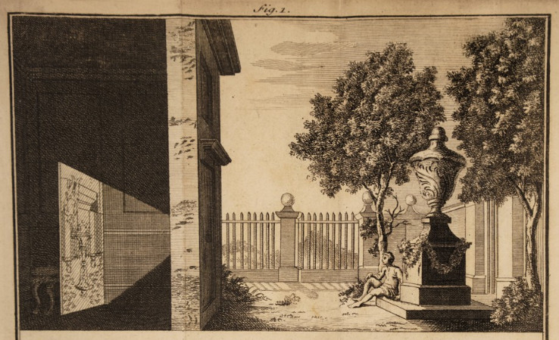
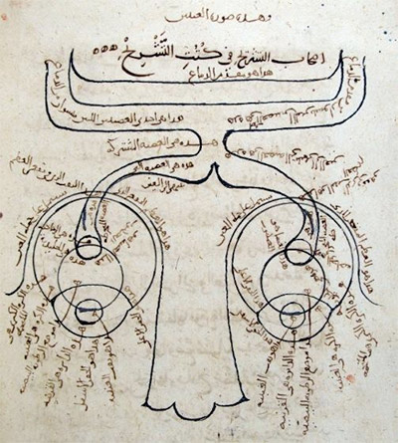
Influence of other cultural knowledge on science
Evaluate the contribution of cultural observational knowledge and its relationship to science, including pre – 1500 CE, exemplified by Greek and Egyptian cultures and those of the Asia region
Al-Hasan Ibn al-Haytham observed that light coming through a tiny hole travelled in straight lines and projected an image onto the opposite wall
After further investigations, he concluded the vision occurs because of reflected light entering eyes (published a Book of Optics).
He investigated nature through experiments
His discoveries were the basis of modern optics
Camera obscura, Public Domain
Drawing of eye, Public Domain
Notes:
Here is an example of cultural observations that enhanced scientific understanding of natural phenomena. During the Middle Ages, the Islamic world was a centre of learning. As a result of military conquests and trading relations, Islamic cultures in the Middle East and North Africa had access to knowledge and data from many parts of the world. Islamic scholars translated the works of the ancient Greeks, Romans and Egyptians. They assembled information about scientific discoveries from far-off places, such as India and China. Universities in the Middle East were highly-regarded centres of learning.
Al-Hasan Ibn al-Haytham was an Arab scientist and mathematician, who lived in Bagdad (around 1000 A.D.). One of his areas of interest was the nature of light. The prevailing view of vision was that our eyes emitted light, which illuminated the objects around us (like a torch light). Al-Hasan Ibn al-Haytham realised that we see objects only because of external light that is reflected off objects (our eyes do not emit light). He believed that knowledge should be developed from evidence and experience (does this remind you of empiricism?). He conducted experiments on light with flat and curved mirrors, including concave and convex lenses. He discovered the camera obscura, or the pin hole camera. After conducting experiments with the pinhole camera, Al-Hasan Ibn al-Haytham realised that the image formed in a camera is inverted. He used the same reasoning to conclude that the images formed in our eyes are also inverted, but that the brain ‘corrects’ the inversion. He published his findings in a book titled ‘Book of Optics’. Later, this book was translated into Latin and influenced research in the field of Optics. For example, after reading this book, the German scientist Johannes Kepler conducted his own investigations on the workings of the eye and concluded that the role of the lens was to focus the light rays that enter the eye.

Slide 66

Influence of other cultural knowledge on science
Evaluate the contribution of cultural observational knowledge and its relationship to science, including pre – 1500 CE, exemplified by Greek and Egyptian cultures and those of the Asia region
Herbal preparations against malaria: “A Handbook of Prescriptions for Emergencies” by Ge Hong (Jin Dynasty, 284-346 AD)
You-You Tu (China Academy of Traditional Chinese Medicine) tested extracts of more than 2000 herbs.
Cold extracts of Artemisia annua L was effective against malaria caused by P. vivax and P. falciparum
Artemisinin Therapy is currently widely used, saving many lives, mostly of children in Africa (reduces the intensity of malaria in Africa due to its anti-gametocyte activity)
You-You Tu: Nobel Prize in Physiology or Medicine (2015)
Artemisia, CC BY-SA 3.0
Liao F. (2009). Discovery of Artemisinin (Qinghaosu). Molecules, 14(12), 5362–5366.
Notes:
Another example of the contribution of cultural observational knowledge to science is the discovery of the anti-malarial compound, Artemisinin. A Chinese literary work, dating back to ~300 A.D., suggested that preparations of the herb may provide protection against malaria. You-You Tu decided to extract the active ingredient from this plant so as to develop the substance as a therapeutic. After many years of sustained effort, Tu isolated the extract and showed that it was effective against both types of malarial parasites. Tu then proceeded to determine the chemical structure of the active ingredient, which as called Artemisinin (after the scientific name of the herb). Artemisinin is now part of the established anti-malarial therapy used around the world to treat the condition. Research is also underway to develop new therapeutics, based on the molecular structure of Artemisinin. For her efforts, Yu received the Nobel Prize in Medicine or Physiology in 2015.

Slide 67
Reflection: Cultural Observational Knowledge
Has cultural observational knowledge influenced the development of your field of research? Illustrate your answer with examples of such influence.

Slide 68
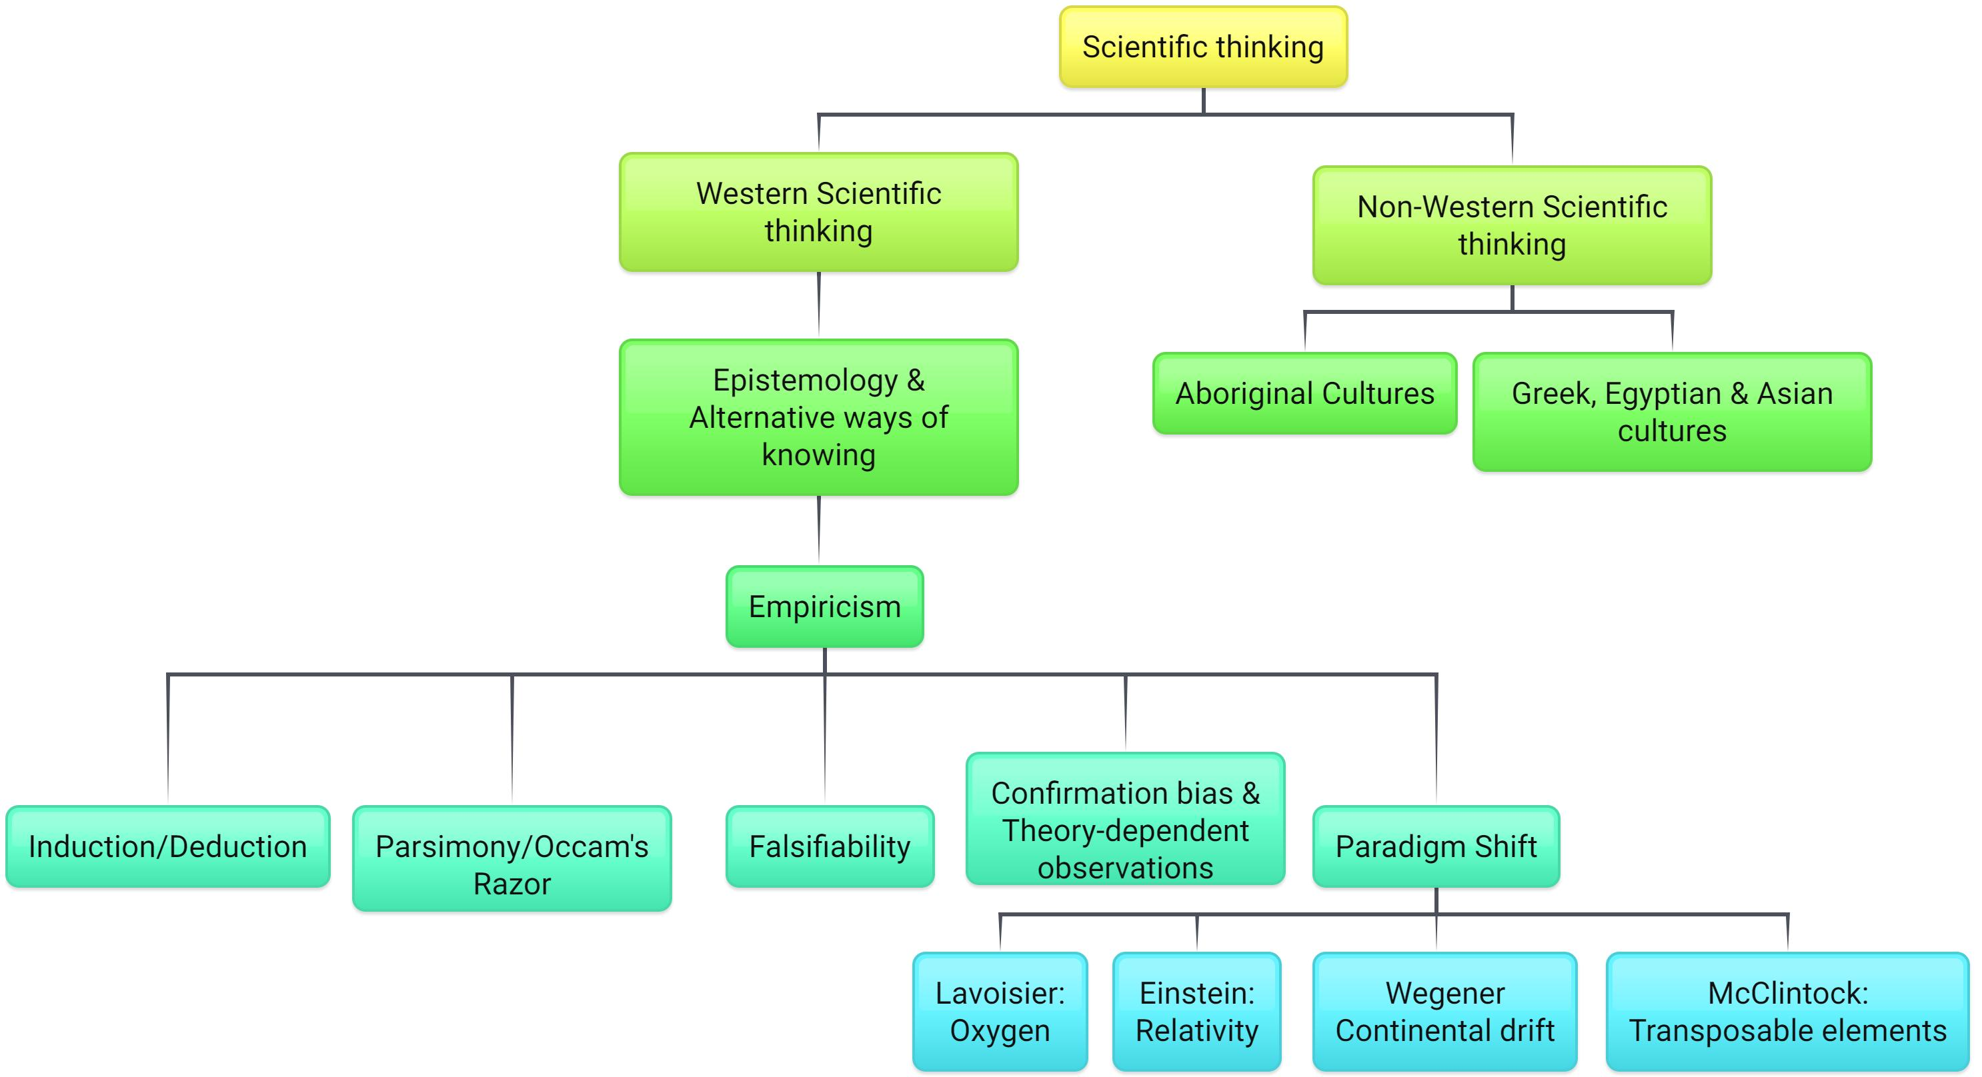
Summary
Notes:
This brings us to the end of this learning resource on the Foundations of Scientific Thinking. In summary, modern scientific practice is based on philosophical thinking that developed over many centuries in Europe, as well as the cultural observational knowledge of many societies around the world. Modern science is a powerful method of inquiry. The findings of scientific inquiry eventually develop in a dynamic body of knowledge, known as science. Empiricism was a strong force that shapes scientific inquiry – the emphasis on evidence and experience is central to the development of scientific understanding.

Slide 69
Acknowledgements
Science Extension Stage 6 syllabus (2017) © NSW Education Standards Authority (NESA) for and on behalf of the Crown in right of the State of New South Wales 2017. See the NESA website for additional copyright information.

Slide 70
© State of New South Wales (Department of Education), 2019 The copyright material published on this website is subject to the Copyright Act 1968 (Cth), and is owned by the NSW Department of Education or, where indicated, by a party other than the NSW Department of Education.

