Slide 1
Stage 6 Chemistry
Module 8 IQ2
How is information about the reactivity and structure of organic compounds obtained?

Slide 2
How is information about the reactivity and structure of organic compounds obtained?
Inquiry question - How is information about the reactivity and structure of organic compounds obtained?
This document contains topic specific content notes to support students. In addition, several self-assessment opportunities are presented for this inquiry question with HSC-style items allowing students to review their responses with regard to the marking criteria.

Slide 3
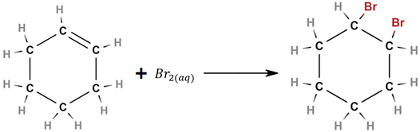
How is information about the reactivity and structure of organic compounds obtained?
Chemical Tests - alkenes
The bromine test for unsaturation is an addition reaction using bromine to give the corresponding ‘dihalo’ product such as cyclohexene giving 1,2-dibromocyclohexane:
This reaction is also photosensitive, bromine can react and substitute for hydrogen on alkanes in the presence of UV light giving a false positive result. It is therefore important to protect the test from light.
Notes:
Syllabus content: students conduct qualitative investigations to test for the presence in organic molecules of the following functional groups: carbon–carbon double bonds
Metalanguage: unsaturation is the feature of a compound that is not saturated (with hydrogen), meaning that at least one carbon-carbon double and/or triple bond is present.
Molecular images generated using:
Bergwerf, H., 2020. Molview. [online] MolView. Available at: <http://molview.org/> [Accessed 15 June 2020].

Slide 4
How is information about the reactivity and structure of organic compounds obtained?
Chemical Tests - alkenes
Positive result – the decolourisation of the bromine water due to the consumption of bromine. This indicates the presence of a double bond in the test substance.
Negative result – the orange/brown colour is retained with no reaction occurring. This indicates the absence of a double bond in the test substance.
Insert image from https://chem.libretexts.org/@api/deki/files/126591/Nichols_Screenshot_6-4-20.png?revision=1
Notes:
Syllabus content: students conduct qualitative investigations to test for the presence in organic molecules of the following functional groups: carbon–carbon double bonds
In this qualitative chemical test for unsaturation (alkenes) the unknown hydrocarbon is treated with a small amount of bromine water which is a deep orange/brown colour. A positive test result is the decolourisation of the bromine water indicating the presence of an alkene, if the colour remains this is a negative result indicating no alkenes are present. If the bromine water is older it may have a yellow appearance or even be colourless to begin with, these solutions are unsuitable for this test and fresh bromine water solutions needs to be obtained.
Metalanguage: decolourisation is the colour fades to colourless.
Bromine water test result image credit:
https://chem.libretexts.org/Bookshelves/Organic_Chemistry/Book%3A_Organic_Chemistry_Lab_Techniques_(Nichols)/06%3A_Miscellaneous_Techniques/6.03%3A_Chemical_Tests/6.3.0D%3A_6.3D%3A_Individual_Tests

Slide 5

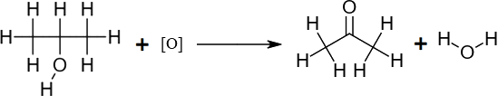
How is information about the reactivity and structure of organic compounds obtained?
Chemical Tests - alkanols
Oxidation test for primary alcohols will produce the corresponding aldehyde such as propan-1-ol produces propanal:
Oxidation test for secondary alcohols will produce the corresponding ketone such as propan-2-ol to propanone:
Notes:
Syllabus content: students conduct qualitative investigations to test for the presence in organic molecules of the following functional groups: hydroxyl groups
[O] in the equations represent an oxidising agent, which could be acidified potassium permanganate (H⁺/KMnO₄) or acidified potassium dichromate (H⁺/K₂Cr₂O₇) among many others. This same reaction was part of the content in module 7 IQ4 with the oxidation reactions of the alcohol homologous series.
Metalanguage:
Corresponding: 2 compounds with the same length of carbon chain
primary and secondary alcohols: primary alcohols are those with 1 carbon atom bonded to the carbon that is attached to the OH functional group . Secondary alcohols have 2 carbon atoms bonded to the carbon attached to the OH functional group.
Hydroxyl group is –OH. It is the functional group of the alcohol homologous series.
Molecular images generated using:
Bergwerf, H., 2020. Molview. [online] MolView. Available at: <http://molview.org/> [Accessed 15 June 2020].

Slide 6
How is information about the reactivity and structure of organic compounds obtained?
Chemical Tests - alkanols
Positive result – the orange dichromate ion oxidises the alcohol and changes to a blue/green colour (see diagram below). This indicates the presence of a primary or secondary alcohol in the test substance.
Negative result – the orange colour is retained with no reaction occurring. This indicates the absence of a primary or secondary alcohol in the test substance.
Insert images from https://chem.libretexts.org/@api/deki/files/126593/Nichols_Screenshot_6-4-22.png?revision=1
Insert image from https://www.chemguide.co.uk/inorganic/transition/dichrzndiag.gif
Notes:
Syllabus content: students conduct qualitative investigations to test for the presence in organic molecules of the following functional groups: hydroxyl groups
The dichromate oxidation test positive is not always that clear, sometimes it appears as just a ring of green/blue and can be difficult to interpret, it is important the dichromate reagent is used sparingly so the intense orange colour does not disguise the observation of a positive test result. Care must also be taken as aldehydes in the test sample can also oxidise with this test and will give a false positive oxidation test result as they will oxidise to their corresponding carboxylic acid.
Metalanguage: presence/absence means is there/not there
Image credit:
https://chem.libretexts.org/Bookshelves/Organic_Chemistry/Book%3A_Organic_Chemistry_Lab_Techniques_(Nichols)/06%3A_Miscellaneous_Techniques/6.03%3A_Chemical_Tests/6.3.0D%3A_6.3D%3A_Individual_Tests
https://www.chemguide.co.uk/inorganic/transition/chromium.html

Slide 7
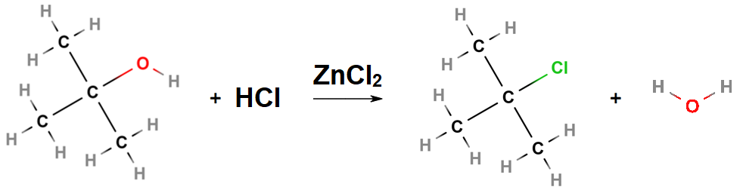
How is information about the reactivity and structure of organic compounds obtained?
Chemical Tests - alkanols
The oxidation test is unable to detect a tertiary alcohol due to the absence of the hydrogen on the same carbon as the hydroxyl (OH) functional group. An alternative test for water soluble tertiary and secondary alcohols is the Lucas test which uses zinc(II) chloride and concentrated hydrochloric acid to perform a substitution reaction producing the corresponding chloroalkane such as 2-methylpropan-2-ol producing 2-chloro-2-methylpropane and water:
Notes:
Syllabus content: students conduct qualitative investigations to test for the presence in organic molecules of the following functional groups: hydroxyl groups
A similar reaction was part of the content in module 7 IQ4 with the substitution reactions of the alcohol homologous series. Tertiary alcohols will react very quickly with secondary alcohols taking a bit more time, primary alcohols will not react with the Lucas reagent. Water insoluble alcohols can also give a false positive due to the formation of an aqueous and non-aqueous layer.
Metalanguage: three carbon atoms are bonded to the carbon attached to the OH functional group
Molecular images generated using:
Bergwerf, H., 2020. Molview. [online] MolView. Available at: <http://molview.org/> [Accessed 15 June 2020].

Slide 8
How is information about the reactivity and structure of organic compounds obtained?
Chemical Tests - alkanols
Positive result – the Lucas test produces a cloudy solution indicating the production of the insoluble chloroalkane in the aqueous solution. This indicates the presence of a tertiary (fast reaction) or secondary alcohol (slow reaction) in the test substance.
Negative result – The solution remains clear with no cloudy appearance. This indicates the absence of a tertiary or secondary alcohol in the test substance.
Insert image from https://chem.libretexts.org/@api/deki/files/126641/Nichols_Screenshot_6-4-31.png?revision=1
Notes:
Syllabus content: students conduct qualitative investigations to test for the presence in organic molecules of the following functional groups: hydroxyl groups
Image credit:
https://chem.libretexts.org/Bookshelves/Organic_Chemistry/Book%3A_Organic_Chemistry_Lab_Techniques_(Nichols)/06%3A_Miscellaneous_Techniques/6.03%3A_Chemical_Tests/6.3.0D%3A_6.3D%3A_Individual_Tests

Slide 9
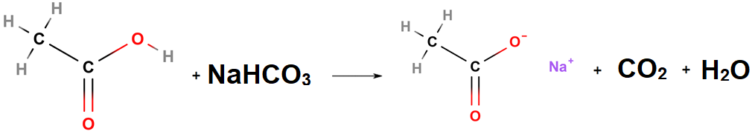
How is information about the reactivity and structure of organic compounds obtained?
Chemical Tests – carboxylic acids
Carboxylic acids are weak acids and in solution will have the corresponding weak acid pH. A suitable coloured indicator can be used for this which gives a resulting colour for a pH < 7. This would indicate the presence of a carboxylic acid.
The sodium hydrogen carbonate (or sodium carbonate) test gives off CO₂ as gas bubbles through the neutralisation reaction with the carboxylic acid such as ethanoic acid reacting with sodium hydrogen carbonate to produce sodium ethanoate, carbon dioxide and water:
Notes:
Syllabus content: students conduct qualitative investigations to test for the presence in organic molecules of the following functional groups: carboxylic acids (ACSCH130)
Caution with pH testing as amines are basic so it is important to use the correct indicator for an acid pH and not simply looking for a colour change.
Molecular images generated using:
Bergwerf, H., 2020. Molview. [online] MolView. Available at: <http://molview.org/> [Accessed 15 June 2020].

Slide 10
How is information about the reactivity and structure of organic compounds obtained?
Chemical Tests – carboxylic acids
Positive result – the carbonate test produces a bubbles of carbon dioxide gas from the neutralisation reaction. This indicates the presence of a carboxylic acid in the test substance.
Negative result – the solution does not produce bubbles as no reaction occurs. This indicates the absence of a carboxylic acid in the test substance.
Insert image from https://chem.libretexts.org/@api/deki/files/126589/Nichols_Screenshot_6-4-18.png?revision=1
Notes:
Syllabus content: students conduct qualitative investigations to test for the presence in organic molecules of the following functional groups: carboxylic acids (ACSCH130)
The limewater confirmation test can also be used to confirm the gas being produced is actually carbon dioxide, this test uses a sidearm test tube to pipe off the gas being produced in this reaction into a solution of calcium hydroxide (limewater). Carbon dioxide will react with the calcium hydroxide in solution to form a white insoluble precipitate of calcium carbonate as a positive test result for carbon dioxide gas.
Image credit:
https://chem.libretexts.org/Bookshelves/Organic_Chemistry/Book%3A_Organic_Chemistry_Lab_Techniques_(Nichols)/06%3A_Miscellaneous_Techniques/6.03%3A_Chemical_Tests/6.3.0D%3A_6.3D%3A_Individual_Tests

Slide 11
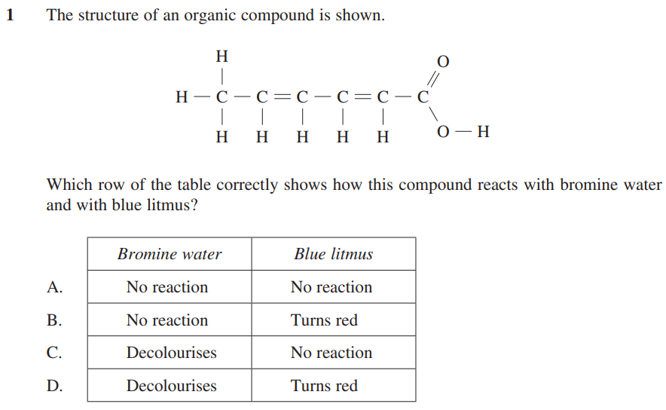
Exam question
Chemistry specimen exam Q1
Notes:
Specimen exam question 1 answer is D
What functional groups are present? Alkenes and carboxylic acid
Which of the qualitative chemical tests will give positive tests for these groups? Bromine turns colourless in the presence of alkenes and blue litmus is an acid indicator which turns red in the presence of an acidic solution.
A and B do not respond to bromine test so do not account for the alkenes groups which are present.
C does not respond to litmus test so does not account for the carboxylic acid group which is present.
Image credit:
https://syllabus.nesa.nsw.edu.au/assets/chemistry/files/sample-questions-new-hsc-chemistry-exam-2019.pdf

Slide 12
How is information about the reactivity and structure of organic compounds obtained?
Instrumental analysis – NMR
Insert images from
https://www.researchgate.net/publication/266562962/figure/fig2/AS:269824999817226@1441342701921/Simplified-diagram-of-a-nuclear-magnetic-resonance-spectrometer-At-the-heart-of-the-1H.png
and
http://www.chem.ucalgary.ca/courses/351/Carey5th/Ch13/1303.gif
Notes:
Syllabus content: students investigate the processes used to analyse the structure of simple organic compounds addressed in the course, including but not limited to: proton and carbon-13 NMR
A nucleus is a small spinning positive charge due to the protons and so generates a teeny tiny magnetic field of its own. Some nuclei do not have the right type of spin and are “NMR silent” meaning this instrument is unable to analyse them.
The sample compound is placed in a very strong magnetic field, which forces NMR active nuclei (such as hydrogen-1 and carbon-13) to align with (parallel) or against (antiparallel) to the external magnetic field. Each nucleus experiences a slightly different magnetic field depending on their position in the organic compound. A very specific radio frequency pulse from the NMR can cause these nuclei to flip alignment. The radio frequency required for a nucleus to flip is characteristic of its position in the compound. As each flipped nucleus relaxes to its original alignment, it releases energy which can be detected by the instrument and used to record a spectrum of frequency vs amplitude. The same type of nuclei in different positions around the compound will produce peaks at different positions in the spectrum. Equivalent nuclei are those with magnetic environments that are identical in every way and can’t be distinguished from each other based on relative position. Non-equivalent nuclei are those with magnetic environments that are not identical in one or more ways and can be distinguished based on relative position in the spectrum produced.
Image credit:
https://www.researchgate.net/figure/Simplified-diagram-of-a-nuclear-magnetic-resonance-spectrometer-At-the-heart-of-the-1H_fig2_266562962
https://sites.google.com/a/tamaki.ac.nz/mrs-smallwood-s-science-site/spectroscopy/nuclear-magnetic-resonance-nmr

Slide 13
How is information about the reactivity and structure of organic compounds obtained?
Instrumental analysis – Proton NMR
Insert image from https://www.compoundchem.com/2015/02/24/proton-nmr/
Notes:
Syllabus content: students investigate the processes used to analyse the structure of simple organic compounds addressed in the course, including but not limited to: proton NMR
Typical peaks are produced in a proton NMR spectra based on the position of the hydrogen in an organic compound, these peaks can be used to identify the relative number and position of the hydrogen nuclei. Hydrogen spectra will typically show peaks split into multiple peaks due to the influence of adjacent hydrogen nuclei on the spin. The n+1 rule is used to identify the number of adjacent hydrogens- in a “triplet” peak there are 3 peaks, so this peak represents hydrogens which are adjacent to 2 other hydrogen nuclei. This information is vital to identifying which peaks correspond to specific hydrogen nuclei. In some cases you are able to determine the area underneath the peaks (the integration operation is computed) which is useful to give the number ratio of nuclei represented by each peak.
Image credit:
https://www.compoundchem.com/2015/02/24/proton-nmr/

Slide 14
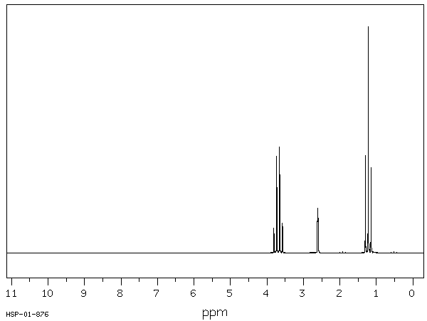
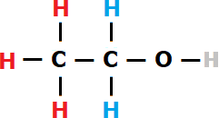
How is information about the reactivity and structure of organic compounds obtained?
Instrumental analysis – Proton NMR
Proton NMR spectra for ethanol
Notes:
Syllabus content: students investigate the processes used to analyse the structure of simple organic compounds addressed in the course, including but not limited to: proton NMR
The colours of each hydrogen atom in the diagram represents the different environments in which the nucleus exists, this is the types of structures which hold hydrogen atoms. In the diagram for ethanol there are three different hydrogen environments (colour coded red, blue and grey).
The three red hydrogens attached to the CH₃ carbon, furthest from the alcohol functional group on the left, are equivalent (1st environment). The two blue hydrogens attached to the CH₂ carbon in the middle, where that carbon atom is connected to carbon with the alcohol functional group are equivalent (2nd environment). The grey lone hydrogen is attached to the oxygen as part of the alcohol functional group on the right (3rd environment). Using the n+1 rule we can determine which peak is which hydrogen environment in the Proton NMR spectrum for ethanol:
The three red hydrogen nuclei of the 1st environment are adjacent to the two blue hydrogen nuclei of the 2nd environment, this peak would be expected to split into 2+1 peaks, looking for the triplet peak we can see this at ~1.2ppm.
The two blue hydrogen nuclei of the 2nd environment is adjacent to the three red hydrogen nuclei of the 1st environment but not adjacent to the lone green hydrogen of the 3rd environment due to the shielding effect of the oxygen nuclei which separates them (this is also the same for amines with shielding from the nitrogen atom). This peak would be expected to split into 3+1 peaks, looking for the quartet peak we can see this at ~3.6ppm.
The lone grey hydrogen of the 3rd environment is not adjacent to any other hydrogen atoms due to the shielding effect of the oxygen. This peak would be expected to split into 0+1 peaks, looking for the singlet peak we can see this at ~2.5ppm.
Molecular images generated using:
Bergwerf, H., 2020. Molview. [online] MolView. Available at: <http://molview.org/> [Accessed 15 June 2020].
Image credit:
https://sdbs.db.aist.go.jp/sdbs/cgi-bin/cre_frame_disp.cgi?sdbsno=1300
https://commons.wikimedia.org/wiki/File:Ethanol-structure.svg

Slide 15
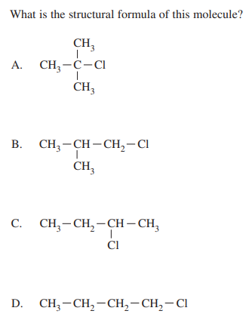
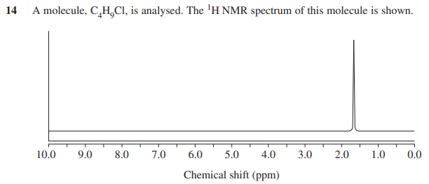
Exam question
2019 Chemistry exam Q14
Notes:
2019 exam question 14 answer is A
What type of spectrum is this question presenting? This is a PROTON NMR.
The peak data is not included in the data sheet provided, however, in this case it is not needed as there is only one peak meaning that all the hydrogens are considered equivalent. The formula provided is correct for each of the four options.
B = 3 environments CH3, CH2 and CH would produce three peaks split accordingly to the n+1 rule
C = 3 environments CH3, CH2 and CH would produce three peaks split accordingly to the n+1 rule
D = 4 environments CH3 and each CH2 would have slightly different peaks due to the relative distance from the Cl. This would produce four peaks split accordingly to the n+1 rule
A has all CH3 groups with each being the same, each are equidistant from Cl so influence is equivalent across all. One peak would be produced in the resulting spectrum as shown in this question.
Image credit:
https://educationstandards.nsw.edu.au/wps/portal/nesa/resource-finder/hsc-exam-papers/2019/chemistry-2019-hsc-exam-pack

Slide 16
How is information about the reactivity and structure of organic compounds obtained?
Instrumental analysis – 13C NMR
Insert image from
https://www.compoundchem.com/2015/04/07/carbon-13-nmr/
Notes:
Syllabus content: students investigate the processes used to analyse the structure of simple organic compounds addressed in the course, including but not limited to: carbon-13 NMR
Typical peaks are produced in a carbon-13 NMR spectra based on the position of the carbon-13 in an organic compound, these peaks can be used to identify the relative number and position of the carbon-13 nuclei. Carbon-13 spectra will not show peaks split into multiple peaks as with hydrogen-1 as the relative abundance of carbon-13 is very low so the likelihood that two carbon-13 nuclei are adjacent is very low. The number of peaks indicates a minimum number of carbons which are present in the compound. For example, three peaks would tell you there are a minimum of three carbons in the structure being analysed, there could be more than three where carbons are equivalent and share a common peak shift but there will certainly not be less than the number of peaks present in the spectrum.
Image credit:
https://www.compoundchem.com/2015/04/07/carbon-13-nmr/

Slide 17
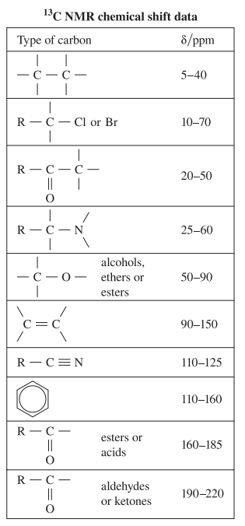
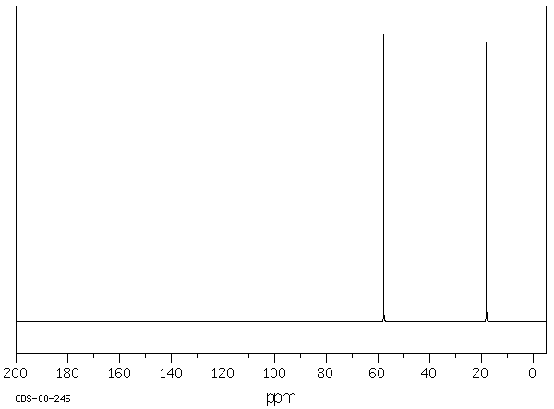
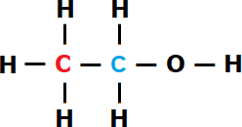
How is information about the reactivity and structure of organic compounds obtained?
Instrumental analysis – 13C NMR
Carbon-13 NMR spectra for ethanol
Notes:
Syllabus content: students investigate the processes used to analyse the structure of simple organic compounds addressed in the course, including but not limited to: carbon-13 NMR
The colours of each carbon atom represent the different environments in which the nucleus exists. In the diagram for ethanol there are two carbon environments (coloured red and blue). The red carbon of the left side CH₃ group furthest from the alcohol functional group is the 1st environment. The blue carbon of the right side CH₂OH group attached to the alcohol functional group is the 2nd carbon environment. These non-identical carbon environments will show up in the spectrum as two peaks. Due to the absence of peak splitting it is important to compare the peak positions to the reference table in the data sheet as shown:
The red CH₃ carbon on the left would be expected to show a peak of 5-40ppm, in this spectrum there is a peak at ~18ppm which is within this range and is therefore assigned to this carbon.
The blue CH₂OH carbon on the right would be expected to show a peak of 50-90ppm for a carbon connected to an alcohol functional group, the peak at ~58ppm falls within this range and is therefore assigned to this carbon.
Molecular images generated using:
Bergwerf, H., 2020. Molview. [online] MolView. Available at: <http://molview.org/> [Accessed 15 June 2020].
Image credit:
https://sdbs.db.aist.go.jp/sdbs/cgi-bin/cre_frame_disp.cgi?sdbsno=1300
https://www.educationstandards.nsw.edu.au/wps/wcm/connect/98664936-221f-4c49-88e1-d002ec69285c/chemistry-data-sheet-2017-02.pdf?MOD=AJPERES&CVID=
https://commons.wikimedia.org/wiki/File:Ethanol-structure.svg

Slide 18
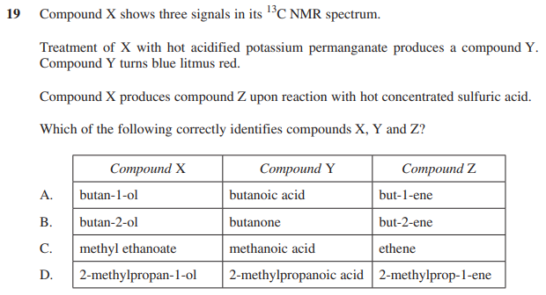
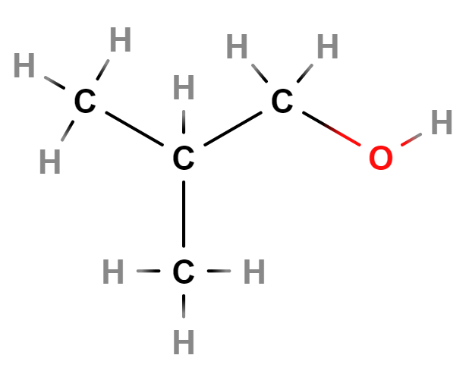
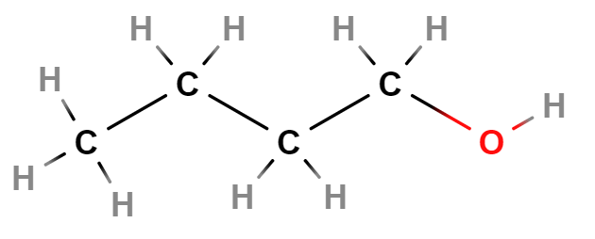
Exam question
2019 Chemistry exam Q19
Notes:
2019 exam question 19 answer is D
Four key pieces of information are given for the identities of these unknown compounds:
Carbon NMR of compound X produces 3 signals (peaks) means that this compound has 3 types of carbon environments (minimum 3 carbon chain).
X can be oxidised to Y via the use of potassium permanganate as an oxidising agent
Y is acidic because it turns blue litmus paper red – indicating that Y must be a carboxylic acid, this then implies that X is either a primary alcohol or aldehyde
X can be dehydrated to Z through the use of sulfuric acid (important to see this is X turning into Z and not Y turning into Z which can confuse the answer to this question)
Using this information remove the options with inconsistencies based on the chemical tests first and then look at the carbon-13 NMR data to identify X.
A = X as butan-1-ol does oxidise to Y as butanoic acid (via two steps of oxidation) which is acidic and X does dehydrate to Z as but-1-ene – this option is valid with the chemical test data given
B = Y as butanone is a ketone and is the oxidation product of X as butan-2-ol. Butanone would not be acidic so would not turn blue litmus paper red. This option can be excluded.
C = X as methyl ethanoate is an ester and would not oxidise to give Y as methanoic acid, nor does it dehydrate to give Z as ethene. This option can be excluded.
D = X as 2-methylpropan-1-ol does oxidise to Y as 2-methylpropanoic acid (via two steps of oxidation) which is acidic. X does dehydrate to Z as 2-methylprop-1-ene – this option is valid with the chemical test data given.
A or D? Which of butan-1-ol and 2-methylpropanol gives 3 carbon environments as indicated by the carbon-13 NMR data?
Butan-1-ol would have one signal per carbon as it moves more distant from the polar OH end of the carbon chain, this would produce 4 signals one per carbon.
2-methylpropanol has two carbons in CH3 groups which are equivalent so these peaks merge to give only 3 signals – CH3, CH2 and CH carbons. D is the correct answer based on all this data.
Molecular images generated using:
Bergwerf, H., 2020. Molview. [online] MolView. Available at: <http://molview.org/> [Accessed 15 June 2020].
Image credit:
https://educationstandards.nsw.edu.au/wps/portal/nesa/resource-finder/hsc-exam-papers/2019/chemistry-2019-hsc-exam-pack

Slide 19
How is information about the reactivity and structure of organic compounds obtained?
Instrumental analysis - MS
Insert image from https://www.compoundchem.com/2015/05/07/mass-spectrometry/
Notes:
Syllabus content: students investigate the processes used to analyse the structure of simple organic compounds addressed in the course, including but not limited to: mass spectrometry
In a mass spectrometer (MS) the sample organic compound is first ionised by an electron gun inside a vacuum, the ions produced by the sample will typically fragment into a variety of different sizes pieces, with some types of fragments more likely to form when certain structures and functional groups in the sample compound are present. The fragments are drawn through the MS by electric fields and accelerated towards a mass selector. Using a mass selector such as a magnetic sector (there are also other types) the ions are forced around a curved path where a strong magnetic field is applied. Due to the charge on the fragment ions and their respective masses they are drawn around the curved path on slightly different trajectories (this can be likened to lighter and heavier vehicles travelling around a curved road). The strength of the magnetic field is swept through a range to focus a specific mass ion onto the detector at the end of the path. As each ion strikes the detector it is recorded as a graph of the mass/charge ratio to the abundance of that ion in the sample.
Other links of interest:
https://users.wfu.edu/~kingag/223L/procedures-handouts/common%20MS%20fragment%20ions.pdf
https://www.chemguide.co.uk/analysis/masspec/fragment.html
Image credit:
https://www.compoundchem.com/2015/05/07/mass-spectrometry/

Slide 20
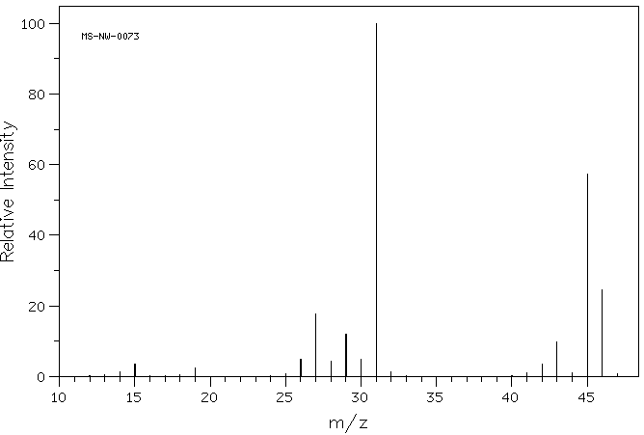
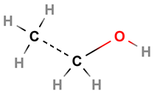
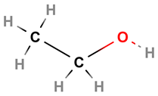
How is information about the reactivity and structure of organic compounds obtained?
Instrumental analysis - MS
Insert image from http://1.bp.blogspot.com/-XiWYmeLgdQU/TaOuwS_kf6I/AAAAAAAAAAs/7GWHoThoo5E/s320/magnetic+sector+analyser.JPG
Mass spectrum for ethanol
M+ @ m/z = 46
Notes:
Syllabus content: students investigate the processes used to analyse the structure of simple organic compounds addressed in the course, including but not limited to: mass spectrometry
Three peaks are given special names as they are particularly useful for the identity of the organic compound:
M+ peak – this is the largest mass and represents the complete ionised compound that has not fragmented, the m/z represents the molecular weight of the complete compound. This is visible at m/z = 46 for ethanol. In some cases, the molecular ion is so unstable that they all fragment before reaching the detector, it is therefore the molecular weight is not always the largest mass peak.
M+1 peak – this is sometimes present and represents the complete ionised compound with the inclusion of a carbon-13 nucleus in the structure giving the extra mass unit, typically a much smaller peak intensity to the m+ peak. This is not visible in the spectrum for ethanol.
Base peak – this is the largest intensity peak being the most common fragment mass produced, this is used to scale the entire spectrum diagram where the base peak has an intensity of 100. This is visible at m/z = 31 for ethanol.
How do you identify these peaks to be coming from ethanol? Look for pairs of peaks that add to the m+ peak value (lower m/z peaks are the fragments of the m+ peak). Look at what the fragmentation split is between the two parts of the pair. Starting at each end of the spectrum is usually an easier strategy:.
m/z 45 + m/z 1 = m/z 46 (m+). The m/z 45 peak is quite large indicating it is a particularly common fragment. This is the loss of the hydrogen atom from the OH functional group (m/z = 1 peak not shown in these spectra as this type of mass analyser can not work with the lightest ions)
m/z 15 + m/z 31 = m/z 46 (m+). The m/z = 31 is the base peak so the most common fragment produced. This represents the loss of the CH3 group (m/z 15) paired with the rest of the compound as CH2OH (m/z = 31)
Putting this information together, what compound has a molecular weight of 46gmol-1 and would produce the peak pairs identified above? The base peak of m/z = 31 is common for primary alcohols and other peaks are always indicative of specific functional groups, see the lists online at:
https://users.wfu.edu/~kingag/223L/procedures-handouts/common%20MS%20fragment%20ions.pdf
https://www.chemguide.co.uk/analysis/masspec/fragment.html
Another way of approaching this analysis could be:
The base peak at m/z 31 is easier to identify by instead referring to it as the [M-15] peak. The loss of 15 mass units is easier to identify as the CH₃ leaving group rather than trying to identify the m/z 31 peak directly. By identifying the fragment removed the remaining [CH₂OH]⁺ ion can be more easily identified which is the base peak ion for ethanol. This also accounts for the peak at m/z 15 as the [CH₃]⁺ leaving group. The m/z 31 peak is a very common base peak for primary alcohols due to the stability of this ion when fragmented from the rest of the molecular ion.
The peak at m/z 45 can be referred to as [M-1], this where the alcohol hydrogen atom has fragmented leaving behind the [CH₃CH₂O]⁺ ion. This is a very commonly observed peak for alcohols.
The peak at m/z 28 can be referred to as [M-18], this where the alcohol OH has fragmented and the ion steals a hydrogen from the adjacent carbon creating water and leaving behind the [CH₃CH]⁺ ion. No peak is observed for water at m/z 18 as it is not charged so can not be influenced by the MS magnetic field. This is a very commonly observed peak for alcohols.
Molecular images generated using:
Bergwerf, H., 2020. Molview. [online] MolView. Available at: <http://molview.org/> [Accessed 15 June 2020].
Image credit:
http://orgchemguide.blogspot.com/2011/04/magnetic-deflection-or-sector-mass.html
https://sdbs.db.aist.go.jp/sdbs/cgi-bin/cre_frame_disp.cgi?sdbsno=1300

Slide 21
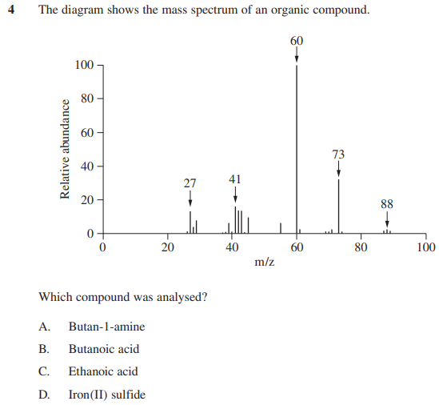
Exam question
2019 Chemistry exam Q4
Notes:
2019 exam question 4 answer is B
This diagram is from a mass spectrometer. It is important to note this does not relate to the data sheet despite the similar appearance to a carbon-13 NMR spectrum.
Eliminate the options which are not reasonable:
D is an inorganic compound, they are not normally analysed by a mass spectrometer and do not fit this inquiry question which is for the analysis of organic compounds. Despite the molecular weight being 87.9 (88) which is equal to the m+ peak this would not fragment to produce the many fragment sizes as shown and so this option is excluded.
C is ethanoic acid with a molecular weight of 60 which is too light for the m+ peak shown in this spectrum. No peaks are possible greater than the molecular weight of the in-tact compound.
A is butylamine with a molecular weight 73 which is also too light for m+ peak.
B is butanoic acid and has a molecular weight of 88g/mol which is correct for the m+ and is the only reasonable option.
Image credit:
https://educationstandards.nsw.edu.au/wps/portal/nesa/resource-finder/hsc-exam-papers/2019/chemistry-2019-hsc-exam-pack

Slide 22
How is information about the reactivity and structure of organic compounds obtained?
Instrumental analysis - IR
Insert image from https://www.compoundchem.com/2015/02/05/irspectroscopy/
Notes:
Syllabus content: students investigate the processes used to analyse the structure of simple organic compounds addressed in the course, including but not limited to: infrared spectroscopy (ACSCH130)
Infrared (IR) spectroscopy is an instrumental technique which produces the infrared wavelength absorbance pattern, the output graph is typically shown as the inverse, transmittance pattern, the peaks ‘hang downwards’ from the upper limit which is no absorbance equal to complete transmittance of the infrared light. IR causes either stretching or bending of the bonds between nuclei when they are excited by the frequency of IR they absorb. Peaks can be strong or weak (relating to their height of the peak in the spectrum) and sharp or broad (relating to the peak width in the spectrum). To the right of the spectrum at 1500-500cm⁻¹ is the ‘fingerprint region’. This contains a large mixture of absorbance peaks, although peaks in this region could be used to identify bonds it is typically ignored and only used for final confirmation of a compound’s identity when comparing to a database of known spectra. IR spectroscopy can be used to identify an unknown pure compound or determine the purity of a sample. Specific functional groups can be identified from the peaks in reference to a known table to peak absorbance's.
An important difference to recognise with this technique to the others previously addressed is that IR is looking at the bonds not the nuclei as with NMR or ions as with MS.
Image credit:
https://www.compoundchem.com/2015/02/05/irspectroscopy/

Slide 23
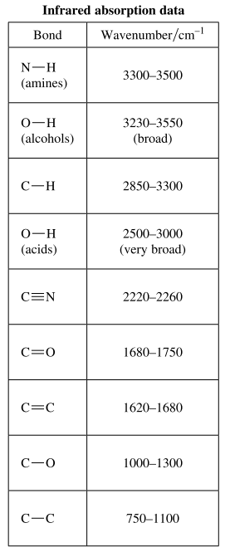
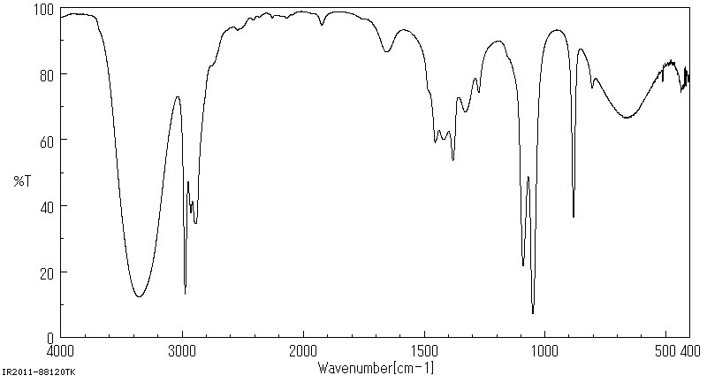
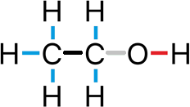
How is information about the reactivity and structure of organic compounds obtained?
Instrumental analysis - IR
IR spectrum for ethanol
Notes:
Syllabus content: students investigate the processes used to analyse the structure of simple organic compounds addressed in the course, including but not limited to: infrared spectroscopy (ACSCH130)
Refer to the peaks in the data sheet to help identify the peaks in the provided IR spectrum. In order to identify the peaks we can look for the more obvious peaks that are easier to begin with. Look for “tongues” and “swords” in particular, big broad peak on the left (looks like a tongue) of the spectrum is indicative of an OH functional group which could be from an alcohol or a carboxylic acid. In more complex examples this peak is a pain as it can be so broad it masks other peaks in the region such as amines. A sword is the carbonyl or C=O group which is normally strong and narrow (looks like a sword) at ~1680-1750cm-1. Using these two pieces of information it can be determined:
If there is a tongue and no sword the compound is likely to be an alcohol
If there is a sword and no tongue the compound is likely to be an aldehyde or ketone (aldehydes also have big peaks at ~2700-2800 to identify them separate to ketones which do not have them but this is not part of the data sheet)
If there is a tongue and a sword the compound is likely to be a carboxylic acid
If there is neither a tongue or a sword the compound can not be any oxygen containing organic compounds (can not be an alcohol, aldehyde, ketone, carboxylic acid or amide), you then can consider a smaller groups of possibilities from the remaining peak possibilities in the data sheet
To identify ethanol from this spectrum, bonds are colour coded to the corresponding coloured arrows in the IR spectrum:
The C-H bond has a characteristic IR peak at 2850-3300cm⁻¹ and are typically observed in all organic compounds. These peaks are shown in this spectrum at 2850-3000cm⁻¹ and are coloured blue.
The C-C bond gives a peak at 750-1100cm⁻¹ and again are typically observed in all organic compounds. These peaks are shown in this spectrum at 900cm⁻¹ and are coloured black.
The C-O single bond gives a peak at 1000-1300cm⁻¹ and this peak is shown at 1050-1100cm⁻¹. and are coloured grey.
The O-H bond is an obvious peak (the tongue) unlike any other, typically being very broad due to the wide IR absorbance range of this bond. The absorbance of the OH bond depends on the nature of the functional group it is attached to, either as an alcohol or part of a carboxylic acid. Alcohols give a broad peak at 3230-3550cm⁻¹. This peak is shown in this spectrum at 3400cm⁻¹ and are coloured red.
Image credit:
https://sdbs.db.aist.go.jp/sdbs/cgi-bin/cre_frame_disp.cgi?sdbsno=1300
https://www.educationstandards.nsw.edu.au/wps/wcm/connect/98664936-221f-4c49-88e1-d002ec69285c/chemistry-data-sheet-2017-02.pdf?MOD=AJPERES&CVID=
https://commons.wikimedia.org/wiki/File:Ethanol-structure.svg

Slide 24
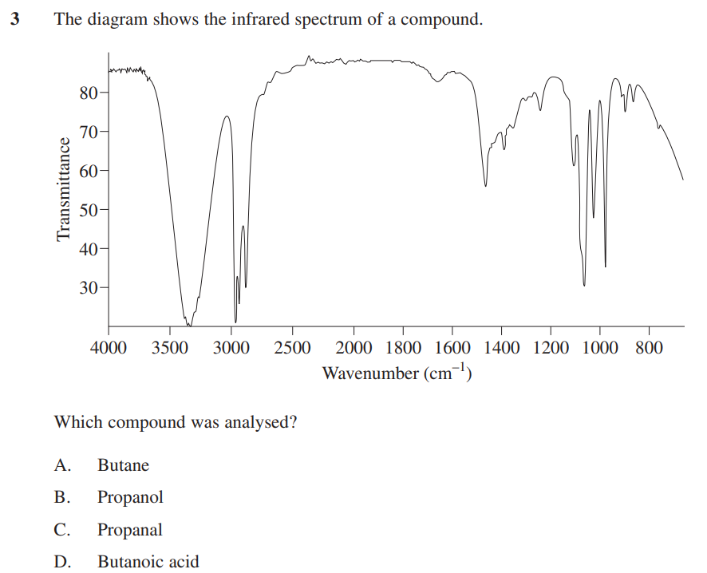
Exam question
Chemistry specimen exam Q3
Notes:
Specimen exam question 3 answer is B
In this IR spectrum, remember to refer to the data sheet if needed. Which peaks are present? There is a tongue but no sword so an OH group is suggested, but no C=O means we have an alcohol (can not be a carboxylic acid without a sword).
A is an alkane does not give a tongue in any of their spectra
C is an aldehyde which would have a sword and no tongue, opposite to the situation in this spectrum
D is a carboxylic acid, which requires a tongue and a sword, with no sword present this is not possible
Image credit:
https://syllabus.nesa.nsw.edu.au/assets/chemistry/files/sample-questions-new-hsc-chemistry-exam-2019.pdf

Slide 25
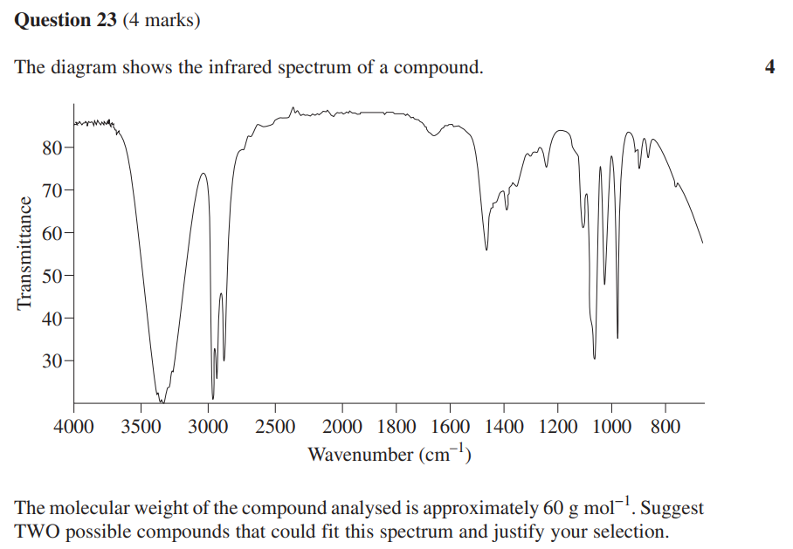
Exam question
Chemistry specimen exam Q23
Notes:
Specimen exam question 23
In this question you are presented with an IR spectrum which shows a selection of peaks. It can be seen there is a large tongue on the left side indicating the presence of an OH functional group but with no sword this can only be the spectrum for an alcohol.
The question also indicates the molecular weight of this organic compound is approximately 60gmol-1 with the response required to suggest two different compounds using the data provided to justify your suggestions. Considering we know this compound must be an alcohol we are looking at the chain or positional isomers only of an alcohol with a molecular weight of 60gmol-1.
Propanol C3H8O has the mass – (12.01x3)+(1.008x8)+16 = 60.094 so approximately 60gmol-1 as shown in the question. What are two possible isomers of propanol which would suit the response in this question? Propan-1-ol and propan-2-ol are the only possibilities with this data. Propanol positional isomers have the same molecular weight and would both produce a similar IR spectrum due to the same types of bonds present in the organic compound. Slight differences in the fingerprint region would be used to identify the difference between these isomers in IR spectra.
Image credit:
https://syllabus.nesa.nsw.edu.au/assets/chemistry/files/sample-questions-new-hsc-chemistry-exam-2019.pdf

Slide 26
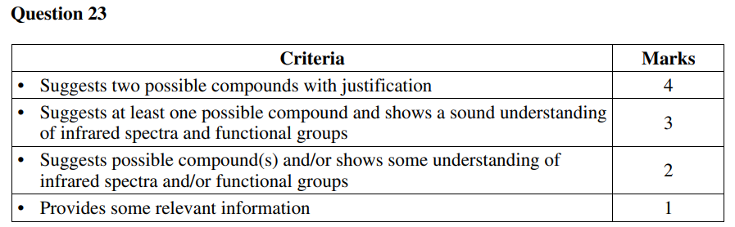
Exam question
Chemistry specimen exam Q23
Notes:
Marking scheme for specimen exam question 23.
Image credit:
https://syllabus.nesa.nsw.edu.au/assets/chemistry/files/sample-questions-new-hsc-chemistry-exam-2019.pdf

Slide 27
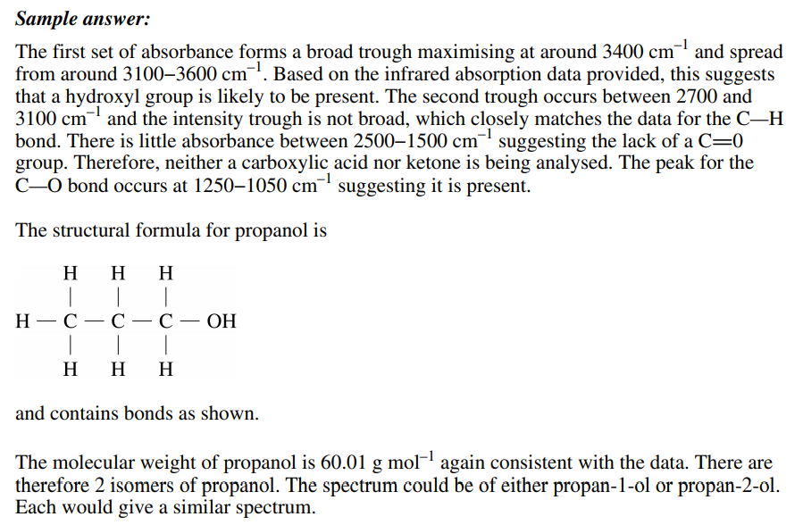
Exam question
Chemistry specimen exam Q23
Notes:
Sample answer for specimen exam question 23
Note the use of actual data from the spectrum. Specific evidence should be provided as justification where possible.
Image credit:
https://syllabus.nesa.nsw.edu.au/assets/chemistry/files/sample-questions-new-hsc-chemistry-exam-2019.pdf

Slide 28
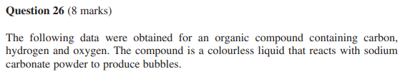
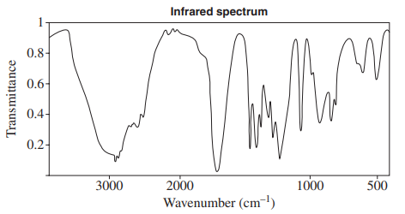
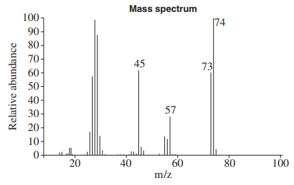
Exam question
2019 Chemistry exam Q26
Notes:
This question is very long and spans over a number of slides, the stimulus information is over this slide and the next and provides spectra for IR, Mass Spec, Hydrogen-1 and Carbon-13 NMR.
The question indicates the compound comprises of carbon, hydrogen and oxygen (no other elements, excludes amines/amides as there is no nitrogen and hydrocarbons as there is oxygen present) which gives a positive result to the sodium carbonate test indicating it is a carboxylic acid. In the IR spectrum there is a tongue (2900cm-1) and a sword (~1700cm-1) which indicates the presence of both an OH and C=O functional group, further supporting the presence of a carboxylic acid functional group in this unknown compound. The MS spectrum shows an m+ ion at m/z = 74 which indicates the molecular weight of this compound, limiting our choices further. Other peaks shown include m/z = 73 so a loss of one mass unit, a hydrogen which is typical from a carboxylic acid or an alcohol. The peak at m/z = 45 is a typical fragment for carboxylic acids being the COOH fragment. The peak at m/z = 57 will be used to confirm our structure as its identity is not as obvious yet.
Image credit:
https://educationstandards.nsw.edu.au/wps/portal/nesa/resource-finder/hsc-exam-papers/2019/chemistry-2019-hsc-exam-pack

Slide 29
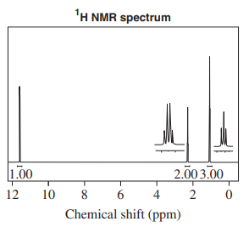
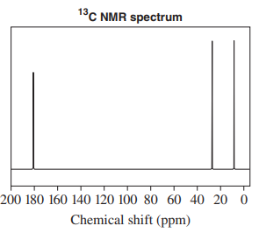
Exam question
2019 Chemistry exam Q26
Notes:
This question continues from the previous slide, the question is repeated here and this stimulus information is in addition to the previous slide.
The hydrogen-1 NMR shows three peaks meaning there are three hydrogen environments with two of the peaks showing peak splitting into a triplet at ~1ppm and a quartet at ~2ppm (the split peaks are shown in a magnified view adjacent to the peak to highlight the peak splitting which would normally only be visible at a smaller scale), the values underneath the peaks show the relative area under each peak which can be used to give the relative numbers of hydrogen-1 nuclei they represent. This data is telling us that this compound has:
~1ppm – 3 hydrogens (area under the peak) which are adjacent to 2 other hydrogens (n+1 rule with triplet peak)
~2ppm – 2 hydrogens (area under the peak) which are adjacent to 3 other hydrogens (n+1 rule with quartet peak)
~11.5ppm – 1 hydrogen (area under the peak) which is not adjacent to any other hydrogens (n+1 rule with singlet peak)
The carbon-13 NMR also shows three peaks (minimum of three carbons in this structure), in these spectra there is no peak splitting normally observed, we can use the data sheet to identify the types of carbons each peak could represent:
~10ppm – hydrocarbon chain C
~25ppm – hydrocarbon chain C
~180ppm – alcohol functional group C
Image credit:
https://educationstandards.nsw.edu.au/wps/portal/nesa/resource-finder/hsc-exam-papers/2019/chemistry-2019-hsc-exam-pack

Slide 30
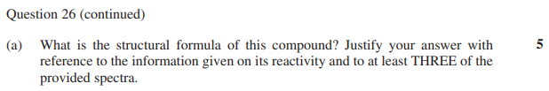
Exam question
2019 Chemistry exam Q26
Strategies to determine the structure with the provided spectra could include:
  Record your observations and inferences for each spectrum and the chemical reactivity data provided. What can you see that provides some of the information about the structure?
  Analyse this information to provide a prediction of the identity of the structure
  Provide reasons to justify your prediction based on the observations and inferences taken from the information provided.
This question and a range of others of this type are fully explained in the accompanying problem set for module 8.
Notes:
Strategies to determine the structure with the provided spectra could include:
Record your specific observations and inferences for each spectrum and the chemical reactivity data provided
Analyse this information to provide a prediction of the identity of the structure
Provide reasons to justify your prediction based on the observations and inferences taken from the information provided.
Ensure you provide the answer as a structural formulae
This question and a range of others of this type are fully explained in the accompanying problem set for module 8.
Image credit:
https://educationstandards.nsw.edu.au/wps/portal/nesa/resource-finder/hsc-exam-papers/2019/chemistry-2019-hsc-exam-pack

Slide 31
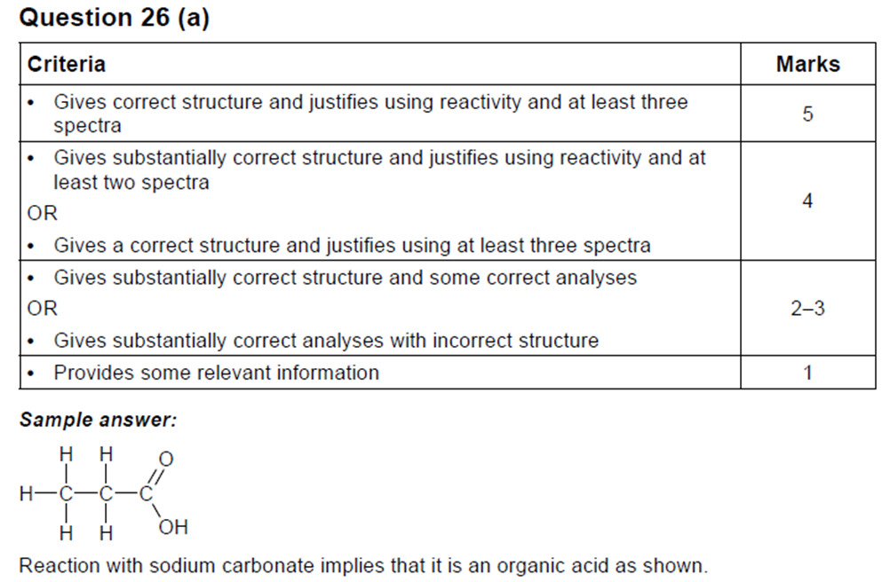
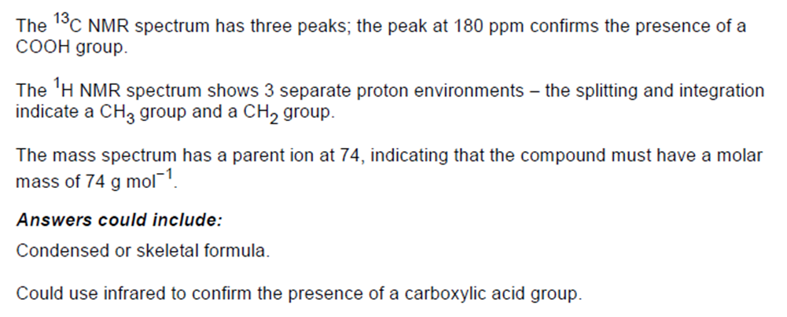
Exam question
2019 Chemistry exam Q26
Notes:
Combining at least three of the justifications based on the IR/MS/NMR data with the chemical information provided in the question is vital to fully justify the structure of propanoic acid as the candidate for this unknown organic substance being analysed.
Image credit:
https://educationstandards.nsw.edu.au/wps/portal/nesa/resource-finder/hsc-exam-papers/2019/chemistry-2019-hsc-exam-pack

Slide 32
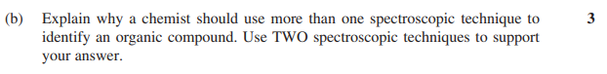
Exam question
2019 Chemistry exam Q26
IR will show the types of functional groups but gives no information on how they are connected on the carbon chain or how long the particular carbon chain is, this technique is really only going to tell you to which homologous series the sample belongs.
MS will show the molecular weight and fragment ion molecular weights and although these can be indicative of specific functional groups and positions on a carbon chain it is frequently not clear enough for a complete identification.
Hydrogen-1 NMR will show the hydrogen environments, relative numbers of nuclei (peak area) and adjacent nuclei (peak splitting) to aid in the determination of a structure but it does not show the carbon chain arrangement that would be needed to determine the full structure.
Carbon-13 NMR will show the carbon environments to aid in the determination of a structure but lacks some key details on the relative positions of the carbon nuclei that would be needed to determine the full structure.
Notes:
This question which follows on from the unknown identification in part A is asking why we need more than one type of analysis. To plan your response, consider describing the use of spectroscopic techniques to identify organic compounds and their limitations. After describing the techniques, you should explain why more than one is required to narrow/confirm the identity of organic compounds.
It is important that here that we talk about what each method does not show us when used individually so we can adequately explain the need to consider the several types of analyses which were presented in the previous part to this question. A minimum of two techniques are required in this response, all four are presented here.
At a minimum, simple organic structures can be determined manually through the use of a combination of:
IR and MS to identify functional groups and molecular weights of fragments
Hydrogen-1 and Carbon-13 NMR to identify the core placement of the carbon chain and associated hydrogen nuclei, reference charts allow us to determine other nuclei present based on the peak locations in both spectra
IR and carbon-13 NMR to identify the function groups and the carbon chain to which they are connected
The main issue with any single analysis is that only parts of the information are obtained, there is always a gap in the information or inconclusive data which requires additional investigation to fill in the gaps or confirm the structure with multiple corroborating analyses. In more complex structures all these techniques may be required in order to fully identify the structure being analysed.
In reality, these spectra are primarily analysed by comparison to a computer database, unless the compound being analysed is a newly developed compound for which no existing known spectra is available in the database. The computer will search the database for a match to the spectra obtained in the analysis and suggest the closest matches available. Even partial matches can be useful in determining the structure of a newly developed compound as it can give clues to the main components and give the researcher a head start in the identification process.
Image credit:
https://educationstandards.nsw.edu.au/wps/portal/nesa/resource-finder/hsc-exam-papers/2019/chemistry-2019-hsc-exam-pack

Slide 33
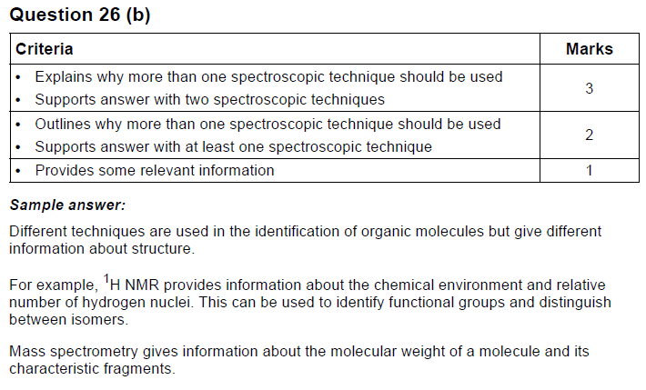
Exam question
2019 Chemistry exam Q26
Notes:
Marking scheme for HSC Chemistry 2019 exam question 26.
Image credit:
https://educationstandards.nsw.edu.au/wps/portal/nesa/resource-finder/hsc-exam-papers/2019/chemistry-2019-hsc-exam-pack

Slide 34
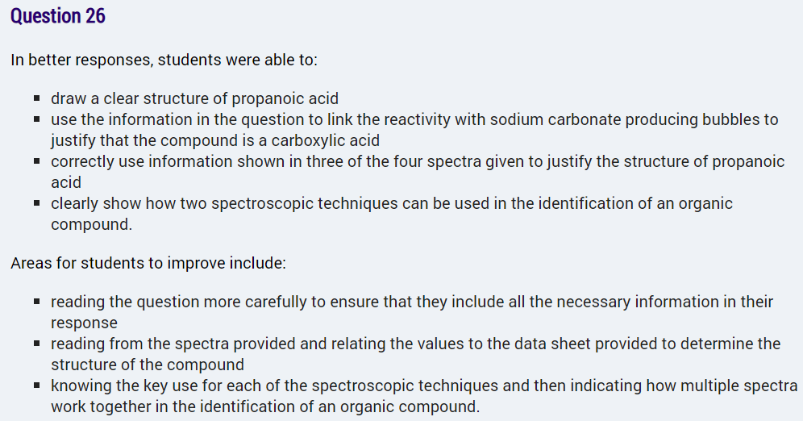
Exam question
2019 Chemistry exam Q26
Notes:
Marker feedback for HSC Chemistry 2019 exam question 26.
Image credit:
https://educationstandards.nsw.edu.au/wps/portal/nesa/resource-finder/hsc-exam-papers/2019/chemistry-2019-hsc-exam-pack

