Slide 1
Introduction to vectors and scalars
Resource of the week – Science Curriculum Team
Notes:
Please note: all the images (snips of vectors and photographs) in this document have been created by the author unless captioned and referenced.

Slide 2
Contents
Description | Slide number
Overview | Slide 3
Information for teachers | Slide 4
Introduction | Slide 6
Outcomes | Slide 7
Notes to teachers | Slide 8
Student slides | Slide 9
Learning intentions and success criteria | Slide 10
Station slides | Slide 11
Challenge activity | Slide 21
Sample answers | Slide 31
Additional information | Slide 55
Support and alignment | Slide 56
References | Slide 58
Further reading | Slide 61
Appendix | Slide 62
Notes:
This slide contains a table of contents

Slide 3
Overview
Stage and Learning Area:
Stage 6 physics
Description:
This resource has been designed to address the outcome.
Inquiry question:
How is the motion of an object moving in a straight line described and predicted?
Students:
Describe uniform straight-line (rectilinear) motion and uniformly accelerated motion through:
qualitative descriptions
the use of scalar and vector quantities (ACSPH060)
calculate the relative velocity of 2 objects moving along the same line using vector analysis.
Inquiry question:
How is the motion of an object that changes its direction of movement on a plane described?
Students:
represent the distance and displacement of objects moving on a horizontal plane using:
vector addition.
Duration:
While timing will vary based on the mode of delivery, differentiation strategies employed and class or school context, this series of activities should take approximately 2 x 50-minute lessons. Read and Watch could be allocated as pre-lesson homework to reduce the activity duration to one 50-minute lesson.
Notes:
This slide contains an overview of the task

Slide 4
Information for teachers – part 1
This resource has been designed to support the development of an understanding of the use of vectors and scalars in rectilinear motion. Students will develop their independent learning and collaborative skills while working through stations that move through the Bloom’s taxonomy framework of learning.
A variety of options for learning is also used to enhance engagement and assist learning.
Notes:
This slide contains information for teachers.

Slide 5
Information for teachers – part 2
What is station lab?
These station labs are a set of workstations that utilise different options for learning, literacy and numeracy activities across Bloom’s taxonomy framework.
The stations are designed to be used as an independent or group learning activity, however they can also be used as an activity to consolidate learning.
Although these activities are designed to be student-led, explicit teaching of content knowledge is still required. It is recommended that explicit teaching is used at the Watch and Read stations. Active teacher support is recommended at the remaining stations.
The stations Watch and Read should be completed first as the content knowledge is contained here.
It does not matter in which order the remaining 6 stations are completed. Students will complete stations in different time frames. It is suggested that 2 sets of cards be printed and placed around the room allowing students to move about stations as they complete each task. The students can work at their own pace and select the order in which they complete the activities.
It is suggested that student collaboration be encouraged as they learn and support others in the class.
Differentiation: It is not necessary for all learners to complete all stations if time does not permit. If this is the case the students can choose the activities that they complete. EAL/D learners may require vocabulary support to complete these tasks.
Notes:
This slide contains information for teachers.

Slide 6
Introduction
This learning sequence allows students to develop an understanding of vectors and scalars and their application in rectilinear motion.
Students should be able to describe uniform straight-line motion before they begin this task. Students should be provided opportunities to do this using their preferred mode of communication.
Knowledge and understanding of the concept will be developed throughout the lesson as they undertake a variety of tasks that will consolidate learning and provide opportunities to apply their learning.
The content also links with the working scientifically skills of the Stage 6 physics course as communication and predicting skills are developed.
Notes:
This slide contains an introduction to the learning sequence.

Slide 7
Outcomes
PH11/12-1 –
develops and evaluates questions and hypotheses for scientific investigation
PH11/12-6 –
solves scientific problems using primary and secondary data, critical thinking skills and scientific processes
PH11/12-7 –
communicates scientific understanding using suitable language and terminology for a specific audience or purpose
PH11-8 –
describes and analyses motion in terms of scalar and vector quantities in two dimensions and makes quantitative measurements and calculations for distance, displacement, speed, velocity and acceleration
Outcomes referred to in this document are from Physics Stage 6 Syllabus © 2017 NSW Education Standards Authority (NESA) for and on behalf of the Crown in right of the State of New South Wales.
Notes:
This slide contains the outcomes addressed in this resource.

Slide 8
Note to teachers
Print 2 sets of the student slides and place around the room for students to complete (laminating the cards or placing them in a plastic envelope will protect them for reuse).
See the notes on the station slides for special information about the station, for example, required equipment.
Make sure that students complete Watch and Read first, or that you have taught the concept before completing the stations. This may be completed as a class activity to save resources.
Students work through the stations at their own pace.
Differentiation: Some students may not complete the challenge activity if time does not permit. Some students may need support to complete some of the challenge activities. Allow student choice in the completion of activities if this is the case. A glossary has been included in the appendix to support student vocabulary development.
Extension opportunity: Students who work through the stations quickly are encouraged to extend their problem-solving, creativity, critical thinking skills and learning through the Create activity.
Notes:
This slide contains notes to teachers.

Slide 9
Introduction to vectors and scalars – student stations
Student copy
Notes:
This slide indicates the beginning of student stations slides.

Slide 10
Learning Intentions and Success Criteria
Students:
Describe rectilinear motion in terms of vectors and scalars.
Students can/will:
define a vector and a scalar
describe similarities and differences between vectors and scalars
draw vectors
add vectors in the same line
solve simple problems involving vectors.
Differentiation consideration: Learning intentions should not be differentiated. All students need access to the same core content, big ideas and concepts. Differentiation should be evident in the success criteria, or the activities/support needed to achieve the success criteria (Wiliam and Leahy, 2015). Teachers may co-construct the success criteria with students or adjust them to suit their class context, for example, using the strategies and resources for curriculum planning on the Science K–12 Curriculum page webpage
Notes:
This slide contains the learning intentions and success criteria.
These should be explained to the students at the start of the lesson.

Slide 11
Watch
Complete Watch and Read before you attempt the other stations
Watch the videos: Introduction to Tip-to-Tail Vector Addition, Vectors and Scalars (10:26) and The difference between Vectors and Scalars, Introduction and Basics (8:35)
Complete the following:
List the key differences between a vector and a scalar.
Identify 2 scalars and two vectors that can be used to describe rectilinear motion.
Use a diagram to show how vectors are represented using 2 examples.
Explain how vectors and scalars are used to describe rectilinear motion.
Explain how vectors are added together in rectilinear motion.
If you are still unsure and want some more information, here are some more videos to watch:
What are Vector and Scalar Quantities? (4:22) up to time 1 minute 4 seconds, Scalar Quantity and Vector Quantity/Physics/Don't Memorise (2:22) and Differences between Scalar Quantity and Vector Quantity (2:39).
Notes:
Explicit teaching is recommended at this station.
Students will require access to a laptop for this station.
This station may take longer than expected if students need to watch more than the two YouTube videos.
It should be one of the first stations completed.
Availability of teaching and learning resources may cause this activity to be completed as a whole class activity.
Students requiring extra support may watch the extra YouTube videos together to collaborate or with teacher support. A notetaking scaffold may be provided to support students with this skill. Consider providing students with a word bank or glossary of key terms to support vocabulary development.

Slide 12
Read
Complete Watch and Read before you attempt the other stations
Instructions:
Access the Scalar and Vector Explanation (Study Smarter) website, you may need to sign up for the free app.
Read the information on the website, (from the top of the page down to and including ‘head-to-tail’ rule).
Make short notes.
Check your understanding using the flashcards on the website.
Notes:
Explicit teaching is recommended at this station.
Students will need access to a laptop for this activity.
Students will need to log in to a free account with Study Smarter to access the material.
A scaffold or graphic organiser for notetaking may be provided to support students with this skill. Consider the use of immersive reader to support student comprehension.

Slide 13

Write
You should have completed Watch and Read before you attempt this station
Answer the questions below using full sentences.
A mass on a spring is stretched as shown in the diagram on the right.
Describe the motion of the mass, over one complete oscillation, after it is released.
Why is it important that direction is used when describing motion?
Use another example of motion to explain why or when the use of vectors is important.
Use examples to explain the differences between vectors and scalars.
‘Tip-to-tail’ is a technique used to add vectors. Use diagrams to explain vector addition.
Figure 1 – mass stretching a spring by Alexandrov O (24 Jun 2007), public domain, Wikimedia commons
Notes:
Students are encouraged to develop their writing skills in this station, encourage full sentences with detailed responses. Students could be encouraged to discuss their responses in pairs before writing to develop their writing skills. Sentence starters or cloze passages could be provided to further support students with literacy and writing skills.
The apparatus could be set up as a demonstration at this station.

Slide 14
Organise
You should have completed Watch and Read before you attempt this station
Sort the cards and organise them into a logical system.​
Notes:
The next slide contains the cards to be cut and mixed up. Students should be able to organise the cards into a table

Slide 15

Organise it table
Vector | Scalar
Contains a magnitude and a direction | Contains a magnitude only
May be 1, 2 or 3 dimensional | 1 dimensional only
Can be changed by changing a direction or magnitude | Can be changed only by changing magnitude
For example: 20 m North | For example: 20 m
Acceleration, displacement, force | Distance, speed, energy, time
Figure 1 – table of vectors and scalars
Notes:
Cut this table into cells and shuffle for students to reorganise.
It may be useful to have extra copies of these cards.

Slide 16



Calculate
You should have completed Watch and Read before you attempt this station.
Instructions:
Use vectors to represent the following quantities. Calculate the resultant.
  2 m North + 2 m North.
  25 ms⁻¹ West + 42 ms⁻¹ East.
  5 km South + 2 km South + 10 km North.
  A student ran an average pace of 7.4 ms⁻¹. Is it possible to draw a vector to show their velocity? Explain.
A remote-control boat is floating in the creek. The boat has a velocity of 5 ms⁻¹ East. If the creek is flowing 2 ms⁻¹ East, what is the velocity of the boat. Show your calculations using a vector diagram.
Add the vectors below:
$$+$$
Challenge: Use vectors to determine the velocity of the boat on the creek in question 2 if it is moving with a velocity of 5 ms-1 North. Show all your working.
Notes:
Students will need a ruler to complete this activity.
Appropriate responses may be modeled to support students with cause-and-effect statements. Layout for showing calculations should be modeled to encourage the development of full working out.

Slide 17
Visualise
You should have completed Watch and Read before you attempt this station
Instructions:
Use vector diagrams to represent the following quantities.
  2 m South of the canteen door.
  A girl is riding her bike down a steep hill and reaches a velocity of 65 kmh⁻¹ downhill.
  Usain Bolt’s acceleration from the starting block has been measured as 9.5 ms⁻² forward.
2. Alistair walks 500 m East to his friend’s house. They then walk 1 km East until they get to school. Draw a vector diagram to show the final displacement of the two boys.
3.
Draw a vector diagram to represent the displacement of a swimmer who has finished swimming a 50 m race in an Olympic pool.
The swimmer now competes in a 100 m race. Use vector diagrams to show the final displacement.
4. Sara runs around the block. If the short sides of the block are 500 m and the long sides are 700 m. Draw diagrams to show:
the distance she has run.
her displacement at the end of the run.
Notes:
Student’s will require a ruler to complete this station accurately. Some students may not be familiar with Usain Bolt, background information may need to be provided for these students.

Slide 18
Investigate
You should have completed Watch and Read before you attempt this station
Instructions:
Carry out the investigation on the back of this card to determine whether the order of adding vectors is important.
Summarise your findings.
Notes:
Students will require a large space, masking tape and a metre rule. A student worksheet is on the next slide.
Teachers may choose to supply a claim – evidence – reasoning scaffold to students to support this activity.

Slide 19
Adding vectors worksheet
In each of the following steps, place tape on the floor to represent each displacement vector
See
Mark a cross (“X”) on the ground with masking tape.
Start at “X”. Create a vector that represents 2.5 m North.
At the end of this vector, add a new vector that is 2.0 m West.
At the end of this vector, add a third vector that is 2.0 m South.
Finally, add a vector which is 2.0 m East.
Measure your resultant vector in both magnitude and direction.
Think
How are displacement vectors added?
Wonder
What would happen if you added the vectors in a different order?
Try this out.
Notes:
This slide contains a worksheet for the "Investigate" station.

Slide 20
Create
You should have completed Watch and Read before you attempt this station
Instructions:
Demonstrate your understanding of scalars, vectors and addition of vectors in one dimension by creating a mini-lesson for a Year 10 student.
The following must be included:
  definitions
  similarities and differences
  examples
  how they are represented
  how they are added (the process)
  how they are utilised in physics.
Your mini-lesson may take the form of a video, a podcast recording, a PowerPoint presentation, an interactive or other approved by your teacher.
The mini-lesson should be created in 10–15 minutes.
Notes:
Encourage students to think creatively to develop their creativity, critical thinking and problem-solving skills as well as consolidate their learning. Teachers may choose to supply a scaffold for students to showing the audience, purpose and structure of a mini lesson.

Slide 21
Challenge activity
To add a level of competition and fun to this activity, create a treasure hunt.
On the back of each card add one of the challenge questions below.
The students will solve the problem and create a vector.
When students have collected all 8 vectors, they can add the vectors to find the treasure. All units should be changed to metres for the treasure hunt. This will also consolidate the learning in Investigate, that the order of addition of vectors does not alter the result.
To conduct the treasure hunt, you will need to identify a start point within your classroom and hide the ‘treasure’ at the end point. Alternatively, you could scale up the vectors and conduct the treasure hunt in the school playground.
Notes:
Challenge activity seven requires students to add vectors in 2-dimensions. This is an extension activity and some students may need guidance with these problems. Students are encouraged to work individually on the challenge tasks, however, may work in pairs according to teacher discretion.

Slide 22

Challenge activity 1
Add the vectors:
50 cm North
1 m South
2 m South
6 m South
4 m North
1.5 m North
Notes:
This slide contains Challenge activity 1

Slide 23
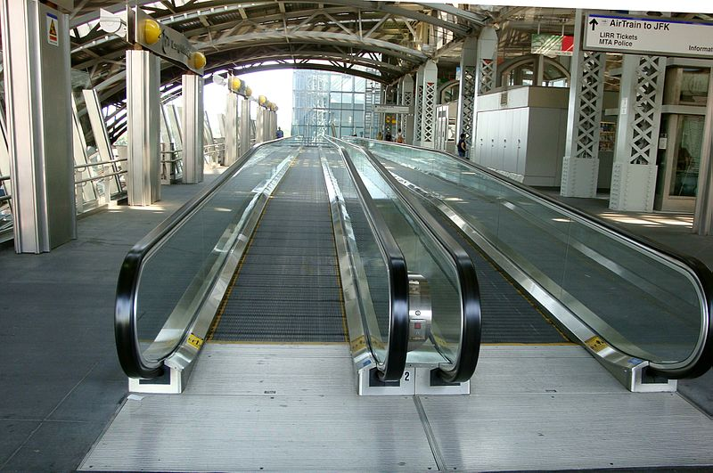
Challenge activity 2
A student is running late for the plane. They are running toward gate 42 (North) with a velocity of 2 ms-1. The travellator has a velocity of 1 ms-1, also in the direction of gate 42. What will be the velocity of the student if they choose to run along the travellator?
GK tramrunner, Moving Walkway at Jamaica Station (LIRR) in Queens, New York, licenced under creative commons attribution-share alike 4.0
Notes:
This slide contains Challenge activity 2

Slide 24
Challenge activity 3
What is the displacement of an 800 m runner at the finish line of the race?
Notes:
This slide contains Challenge activity 3

Slide 25
Challenge activity 4
A soccer ball has a velocity of 2 ms-1 North. After it is kicked, it has a velocity of 4 ms-1 South. What is the change in its velocity?
Notes:
This is a challenging question and may need support as it involves subtraction of vectors. Students are encouraged to problem solve this.

Slide 26



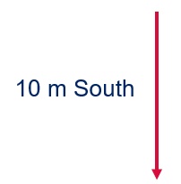
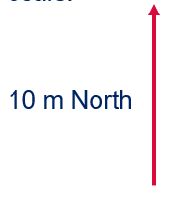
Challenge activity 5
Add the following vectors. Note they are not drawn to scale.
Notes:
This slide contains Challenge activity 5

Slide 27
Challenge activity 6
Scruffy the dog is running backwards and forwards between his owner and a cat that he really wants to chase. He runs: 2 m toward the cat, 1 m back toward his owner, 3 m toward the cat, 2 m back to the owner, 3 m toward the cat. If the cat is 5 m North of the owner, does the dog reach the cat? Justify your answer using vector diagrams.
Notes:
This slide contains Challenge activity 6

Slide 28
Challenge activity 7
Add the following vectors:
2 m North
5 m South
1 m West
6 m North
1 m East
Notes:
This challenge activity determines ability to extend their understanding of vector addition from one dimension to two dimensions. Encourage students to use their problem-solving skills when completing this activity.

Slide 29
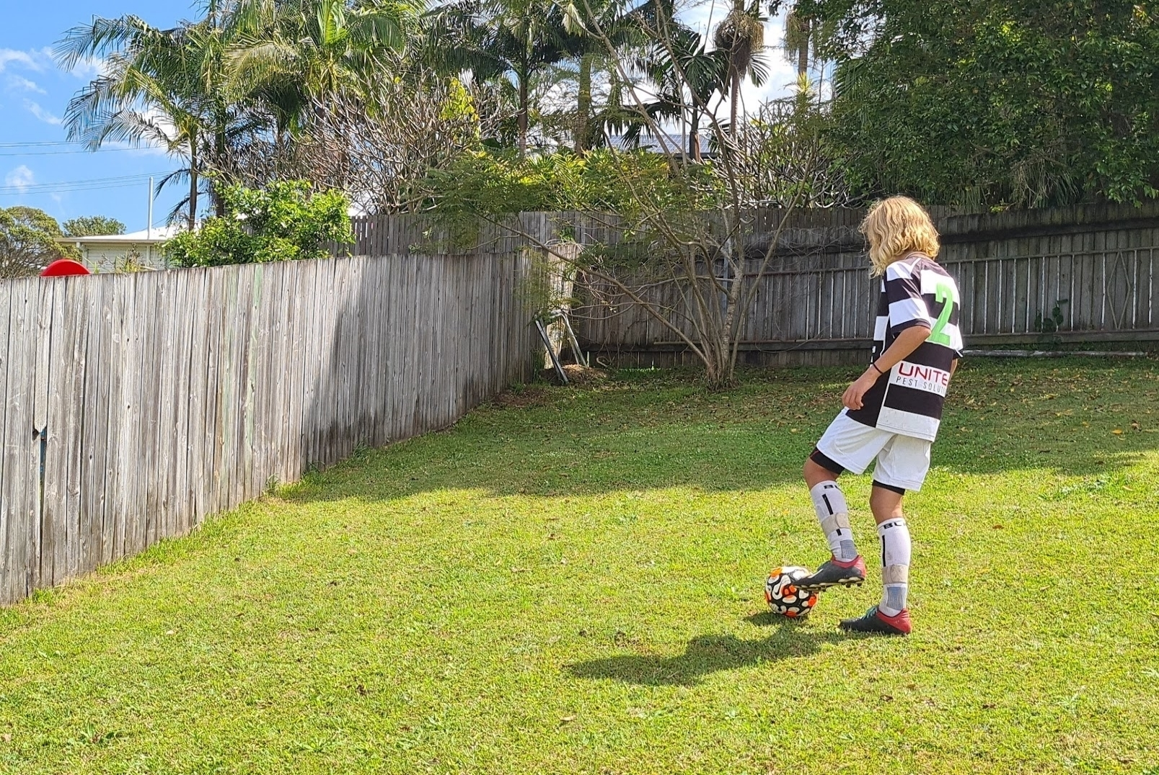
Challenge activity 8
A child is kicking a ball against a wall. The wall is 5 m South of the child and the ball rebounds 8 m after hitting the wall. What is the displacement of the ball when it stops rolling?
5 m South
Figure 2 – boy kicking a soccer ball against a fence with a displacement vector of 5m South added. Image created by author.
Notes:
This slide contains Challenge activity 8

Slide 30
End of student slides
Suggested answers
Notes:
This slide contains indicates the end of student slides.

Slide 31
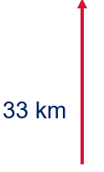

Watch – sample answers – part 1
List the key differences between a vector and a scalar? A vector has a magnitude and a direction while a scalar has magnitude only; a scalar is 1-dimensional while a vector can be 1, 2 or 3-dimensional.
Identify 2 scalars and two vectors that can be used to describe rectilinear motion.
Scalar | Vector
Speed | Velocity
Distance | Displacement
Time | Force
Use a diagram to show how vectors are represented using two examples.
5 ms-1 East.
33 km North.
Notes:
This slide contains suggested answers for "Watch".
Student responses may vary in format for short answer response questions, however, all vector representations should be diagrams.

Slide 32
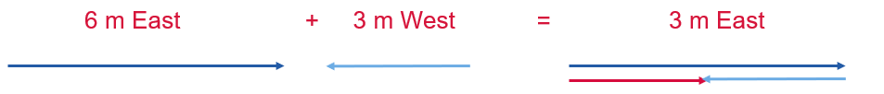
Watch – sample answers – part 2
Explain how vectors and scalars are used to describe rectilinear motion. Scalars are used to describe magnitudes only, with no direction. They describe the magnitude of motion only. Vectors are used to describe the motion in a straight line from the start point to the end point, including a direction.
Explain how vectors can be added together in rectilinear motion. Vectors can be added tip-to-tail. A vector is drawn, as an arrow to scale. The vector to be added to it is drawn such that the tail of the second vector touches the tip of the first. The resultant is an arrow drawn from the tail of the first vector to the tip of the last vector.
Notes:
This slide contains suggested answers for "Watch".

Slide 33
Read sample answers
Sample answers
Student notes will vary
Notes:
This slide contains suggested answers

Slide 34
Write – sample answers – part 1
Answer the questions below using full sentences.
Why do we describe rectilinear motion in terms of vectors and scalars? Vectors and scalars are used to describe rectilinear motion because they allow us to distinguish between quantities that require a direction and those that do not. For example, it is important to note the direction of motion of the spring in moving up and down.
Use examples to explain the differences between vectors and scalars. Scalars are quantities that contain a magnitude only. For example, a distance of 2 m or a time of 34 s. A vector is a quantity that contains both a magnitude and a direction. For example, a displacement of 2 m North or a velocity of 11 ms-1 West.
Explain when and why direction is important when describing motion. Including direction is important when describing vector quantities such as displacement, velocity and acceleration as it allows us to accurately describe the motion. It also allows us to correctly add and subtract the quantities.
Notes:
This slide contains suggested answers for "Write".

Slide 35


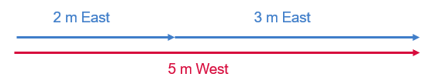
Write – sample answers – part 2
‘Tip-to-tail’ is a technique used to add vectors. Use diagrams to explain vector addition.
The first vector is drawn to scale.
The second vector is drawn to scale so that the end of the second vector touches the tip of the first vector.
The resultant vector is an arrow from the start point of the first vector to the tip of the second vector.
Notes:
This slide contains suggested answers for "Write".

Slide 36

Organise – sample answers
The information should be organised into a table.
Vector | Scalar
Contains a magnitude and a direction | Contains a magnitude only
May be one, two or three dimensional | One dimensional only
Can be changed by changing a direction or magnitude | Can be changed only by changing magnitude
For example: 20m North | For example: 20m
Acceleration, displacement, force | Distance, speed, energy, time
Figure 1 – table of vectors and scalars
Notes:
This slide contains suggested answers for "Organise".

Slide 37
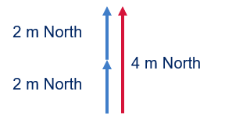
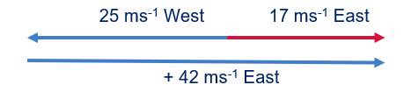
Calculate – sample answers – part 1
Use vectors to represent the following quantities. Calculate the resultant.
        2 m North + 2 m North.
        The resultant is 4 m North.
        25 ms-1 West + 42 ms-1 East.
        The resultant is 17 ms-1 East.
Notes:
This slide contains suggested answers for "Calculate".

Slide 38
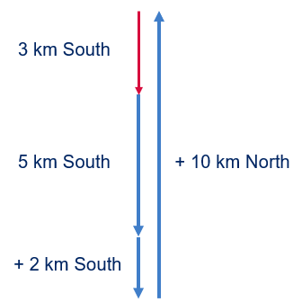
Calculate – sample answers – part 2
        5 km South + 2 km South + 10 km North.
        A student ran an average pace of 7.4 ms-1. Is it possible to draw a vector to show their velocity? Explain.
        This quantity is a scalar as it has a magnitude but no direction. A vector cannot be drawn because we cannot determine the direction from the information available.
Notes:
This slide contains suggested answers for "Calculate".

Slide 39

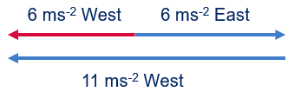
Calculate – sample answers – part 3
A remote-control boat is floating in the creek. The boat has a velocity of 5 ms-1 East. If the creek is flowing 2 ms-1 East, what is the velocity of the boat. Show your calculations using a vector diagram.
The resultant velocity of the boat is 7 ms-1 East.
Add the vectors below:
The resultant velocity is 6 ms-2 West.
Notes:
This slide contains suggested answers for "Calculate".

Slide 40
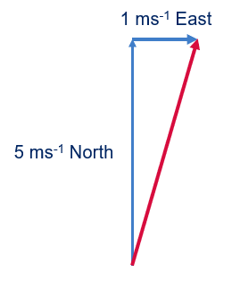
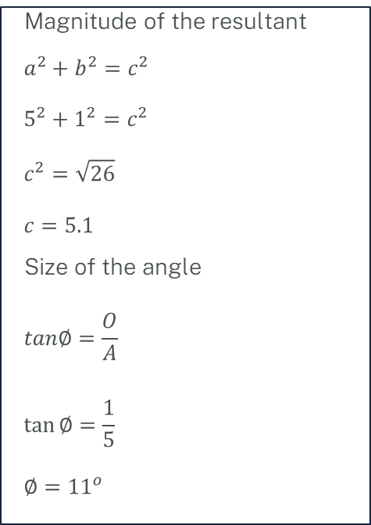
Calculate – sample answers – part 4
Challenge: Use vectors to determine the velocity of the boat on the creek in question 2 if it is moving with a velocity of 5 ms⁻¹ North. Show all your working.
Magnitude of the resultant
$$a^{2}+b^{2}=c^{2}$$
$$5^{2}+1^{2}=c^{2}$$
$$c^{2}=\sqrt{26}$$
$$c=5.1$$
Size of the angle
$$tan∅=\frac{O}{A}$$
$$\tan{∅=\frac{1}{5}}$$
$$∅={11}^{o}$$
The velocity of the boat is 5.1 ms⁻¹ 11º E of N.
Notes:
Students may present this answer as a true bearing.

Slide 41

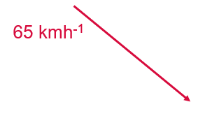

Visualise – sample answers – part 1
Use vector diagrams to represent the following quantities.
        A displacement of 2 m South.
        A girl is riding her bike down a steep hill and reaches a velocity of 65 kmh-1 downhill.
        Usain Bolt’s acceleration from the starting block has been measured as 9.5 ms-2 forward.
Notes:
This slide contains suggested answers for "Visualise".

Slide 42

Visualise – sample answers – part 2
Alistair walks 500 m East to his friend’s house. They then walk 1 km East until they get to school. Draw a vector diagram to show the final displacement of the 2 boys.
The final displacement of the boys is 1500m.
        Draw a vector diagram to represent the displacement of a swimmer who has finished swimming a 50 m race in an Olympic pool.
        The swimmer now competes in a 100 m race. Use vector diagrams to show the final displacement.
The final displacement is 0 m.
Notes:
This slide contains suggested answers for "Visualise".

Slide 43
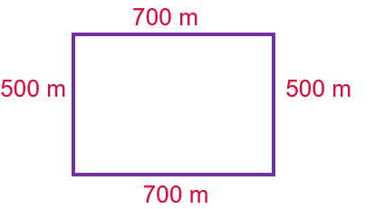
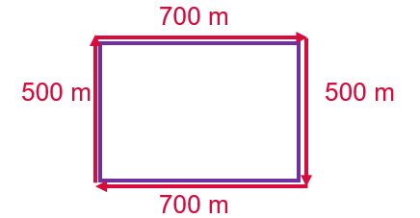
Visualise – sample answers – part 3
Sara runs around the block. If the short sides of the block are 500 m and the long sides are 700 m. Draw diagrams to show:
the distance she has run.
her displacement at the end of the run.
The total distance run is
700 + 500 + 700+ 500 =2400 m
The displacement at the end of the run is
0 m
Notes:
This slide contains suggested answers for "Visualise".

Slide 44
The displacement at the end of the run is 0 m
Sample answers
Carry out the investigation to determine whether the order of adding vectors matters.
Summarise your findings.
The order in which the vectors is added does not matter.
Notes:
This slide contains suggested answers for "Investigate".

Slide 45
Adding vectors worksheet – sample answers
In each of the following steps, place tape on the floor to represent each displacement vector
See
The resultant should be 0.5 m N.
Think
The order of addition of vectors is not important. This is a good discussion point.
Wonder
This will result in a variety of student results. Encourage problem solving and critical thinking.
Notes:
This slide contains suggested answers for "Investigate".

Slide 46
Create – sample answers
Demonstrate your understanding of scalars, vectors and addition of vectors in one dimension by creating a mini-lesson for a Year 10 student.
The following must be included:
  definitions
  similarities and differences
  examples
  how they are represented
  how they are added
  how they are utilised in physics.
Your mini-lesson may take the form of a video, a podcast recording, a PowerPoint presentation, an interactive or other approved by your teacher.
The mini-lesson should be created in 10–15 minutes.
There are a variety of possibilities for sample answers for this task.
Notes:
This slide contains suggested answers for "Create".

Slide 47
Challenge activity 1 – sample answers
Add the vectors: 50 cm North, 1 m South, 2 m South, 6 m South, 4 m North, 1.5 m North.
3 m South.
Notes:
This slide contains suggested answers for Challenge 1.

Slide 48
Challenge activity 2 – sample answers
A student is running late for the plane. They are running toward gate 42 with a velocity of 2 ms⁻¹. The travellator has a velocity of 1 ms⁻¹, also in the direction of gate 42. What will be the velocity of the student if they choose to run along the travellator?
3 ms⁻¹ North (students use the vector 3 m North for use in the activity).
Notes:
This slide contains suggested answers for Challenge 2.

Slide 49
Challenge activity 3 – sample answers
What is the displacement of an 800 m runner at the finish line of the race?
0 m.
Notes:
This slide contains suggested answers for Challenge 3.

Slide 50
Challenge activity 4 – sample answers
A soccer ball has a velocity of 2 ms⁻¹ North. After it is kicked, it has a velocity of 4 ms⁻¹ South. What is the change in its velocity?
6 ms⁻¹ South.
Notes:
This slide contains suggested answers for Challenge 4.

Slide 51
Challenge activity 5 – sample answers
Add the following vectors. Note they are not drawn to scale.
3 m North.
Notes:
This slide contains suggested answers for Challenge 5.

Slide 52
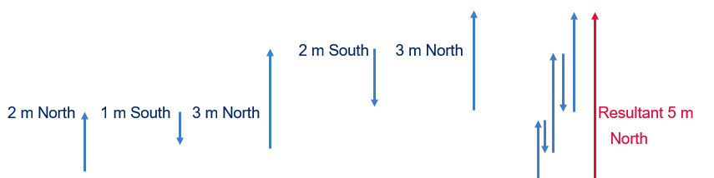
Challenge activity 6 – sample answers
Scruffy the dog is running backwards and forwards between his owner and a cat that he really wants to chase. He runs: 2 m toward the cat, 1 m back toward his owner, 3 m toward the cat, 2 m back to the owner, 3 m toward the cat. If the cat is 5 m North of the owner, does the dog reach the cat? Justify your answer using vector diagrams.
Yes, it reaches a displacement of 5 m North so it will reach the cat.
Notes:
This slide contains suggested answers for Challenge 6.

Slide 53
Challenge activity 7 – sample answers
Add the following vectors:
2 m North
5 m South
1 m West
6 m North
1 m East.
Answer: 1 m North.
Notes:
This challenge activity determines ability to extend their understanding of vector addition from one dimension to two dimensions. Encourage students to use their problem-solving skills when completing this activity.

Slide 54
Challenge activity 8 – sample answers
A child is kicking a ball against a wall. The wall is 5 m South of the child, the ball rebounds 8 m. How far is the ball from the child when it stops rolling?
Answer: 3 m North
Challenge result = 6 m North
5 m South
Figure 2 – boy kicking a soccer ball against a fence with a displacement vector of 5 m South added. Image created by author.
Notes:
This slide contains suggested answers for Challenge 8.

Slide 55
Additional Information
Support and alignment
Reference
Notes:
This slide contains additional information.

Slide 56
Support and alignment – part 1
Resource evaluation and support: All curriculum resources are prepared through a rigorous process. Resources are periodically reviewed as part of our ongoing evaluation plan to ensure currency, relevance and effectiveness. For additional support or advice, or to provide feedback, contact the Science Curriculum team by Science–12@det.nsw.edu.au.
Differentiation: Further advice to support Aboriginal and Torres Strait Islander students, EAL/D students, students with a disability and/or additional needs and High Potential and gifted students can be found on the Planning programming and assessing 7–12 webpage.
Assessment: further advice to support formative assessment is available on the Planning programming and assessing 7–12 webpage.
Professional learning: Relevant professional learning is available on the Science Statewide Staffroom and HSC Professional Learning. Stage 6 Literacy in context provides further advice to teachers to improve student writing.
Notes:
This slide contains information on support and alignment.

Slide 57
Support and alignment – part 2
Related resources: Further resources to support Stage 6 Physics can be found on the HSC hub and the Science K–12 Curriculum page.
Consulted with: Inclusive Education, Multicultural Education, Literacy and Numeracy and subject matter experts.
Alignment to system priorities and/or needs: School Excellence Policy, School Success Model.
Alignment to the School Excellence Framework: This resource supports the School Excellence Framework elements of curriculum (curriculum provision) and effective classroom practice (lesson planning, explicit teaching).
Alignment to Australian Professional Teaching Standards: This resource supports teachers to address Australian Professional Teaching Standards 1.5.2, 2.1.2, 2.5.2.
Updated: 10 Jan 24
Notes:
This slide contains information on support and alignment.

Slide 58
References – part 1
This presentation contains NSW Curriculum and syllabus content. The NSW Curriculum is developed by the NSW Education Standards Authority. This content is prepared by NESA for and on behalf of the Crown in the right of the State of New South Wales. The material is protected by Crown copyright.
Please refer to the NESA Copyright Disclaimer for more information https://educationstandards.nsw.edu.au/wps/portal/nesa/mini-footer/copyright.
NESA holds the only official and up-to-date versions of the NSW Curriculum and syllabus documents. Please visit the NSW Education Standards Authority (NESA) website https://educationstandards.nsw.edu.au/wps/portal/nesa/home and the NSW Curriculum website https://curriculum.nsw.edu.au.
NSW Physics Syllabus © 2017 NSW Education Standards Authority (NESA) for and on behalf of the Crown in right of the State of New South Wales
© 2021 NSW Education Standards Authority. This document contains NSW Curriculum and syllabus content. The NSW Curriculum is developed by the NSW Education Standards Authority. This content is prepared by NESA for and on behalf of the Crown in right of the State of New South Wales. The material is protected by Crown copyright.
Please refer to the NESA Copyright Disclaimer for more information.
NESA (NSW Education Standards Authority) (2022) ‘Proficient Teacher: Standard descriptors’, The Standards, NESA website, accessed 13 Sep 2022
State of New South Wales (Department of Education) and CESE (Centre for Education Statistics and Evaluation) (2020a) ‘What works best: 2020 update’, CESE, NSW Department of Education, accessed 13 Sep 2022.
State of New South Wales (Department of Education) and CESE (Centre for Education Statistics and Evaluation) (2020b) ‘What works best in practice’, CESE, NSW Department of Education, accessed 13 Sep 2022.
Notes:
Students will need to log in to a free account with Study Smarter to access the material.

Slide 59
References – part 2
Academic Gain Tutorials (23 August 2021) 'Differences between Scalar Quantity and Vector Quantity' [video]’, Academic Gain Tutorials, YouTube, accessed 14 September 2022.
CESE (Centre for Education Statistics and Evaluation) (2020a) What works best in practice, NSW Department of Education, cese.nsw.gov.au.
CESE (Centre for Education Statistics and Evaluation) (2020b) What works best: 2020 update, NSW Department of Education, cese.nsw.gov.au.
dcaulf (22 November 2011) 'The difference between Vectors and Scalars, Introduction and Basics [video]' , dcaulf, YouTube, accessed 14 September 2022.
Don’t Memorise (15 May 2017) 'Scalar Quantity and Vector Quantity/Physics/Don't Memorise' [video]’, Don’t Memorise, YouTube, accessed 14 September 2022.
Flipping Physics (6 March 2014) 'Introduction to Tip-to-Tail Vector Addition, Vectors and Scalars' [video]’, Flipping Physics, YouTube, accessed 12 September 2022.
Notes:
Students will need to log in to a free account with Study Smarter to access the material.

Slide 60
References – part 3
Free Animated Education (2 March 2019) 'What are Vector and Scalar Quantities' [video]’, Free Animated Education, YouTube, accessed 14 September 2022.
Henderson T (24 Apr 2014) Scalars and Vectors, The Physics Classroom Website, accessed 14 September 2022.
Henderson T (24 Apr 2014) Vector Diagrams, The Physics Classroom Website, accessed 14 September 2022.
Study Smarter (29 May 2018) Scalar and Vector [website], Study Smarter, accessed 14 September 2022.
Notes:
Students will need to log in to a free account with Study Smarter to access the material.

Slide 61
Further reading
State of New South Wales (Department of Education)(2022) Literacy and numeracy priorities, NSW Department of Education, accessed 24 February 2023.
State of New South Wales (Department of Education)(2022) Literacy and numeracy, NSW Department of Education, accessed 24 February 2023.

Slide 62
Appendix – part 1
Glossary: This glossary can be used to support student learning.
Word | Meaning
Scalar | A quantity that has a size (magnitude) only. For example: mass. Mass is a scalar because it does not have a direction.
Vector | A quantity that has a size (magnitude) and a direction. For example: force. A force has a size and is applied in a given direction.
Magnitude | The size of a quantity. For example: a mass is 3 kg. The magnitude is 3.
Distance | How far an object has moved from its starting point. It is a scalar, so it does not have a direction included. For example: 6 metres
Displacement | How far an object is from its starting point in a straight line. For example: 6 metres; North
Mass | The amount of matter in an object. For example: the mass of the car is 1500 kg.

Slide 63
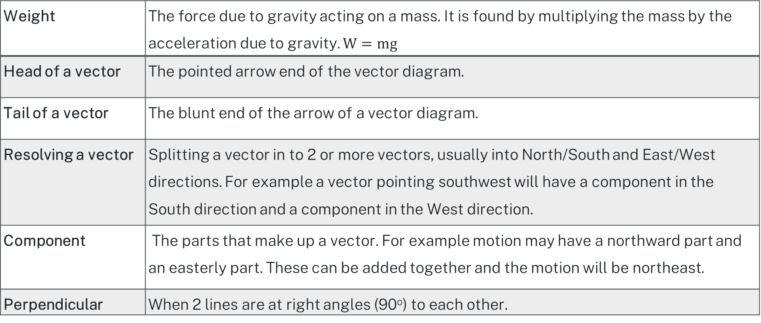
Appendix – part 2
Glossary: This glossary can be used to support student learning.
Weight | The force due to gravity acting on a mass. It is found by multiplying the mass by the acceleration due to gravity. $W=mg$
Head of a vector | The pointed arrow end of the vector diagram.
Tail of a vector | The blunt end of the arrow of a vector diagram.
Resolving a vector | Splitting a vector in to 2 or more vectors, usually into North/South and East/West directions. For example a vector pointing southwest will have a component in the South direction and a component in the West direction.
Component | The parts that make up a vector. For example motion may have a northward part and an easterly part. These can be added together and the motion will be northeast.
Perpendicular | When 2 lines are at right angles (90º) to each other.

Slide 64
Copyright
© State of New South Wales (Department of Education), 2024
The copyright material published in this resource is subject to the Copyright Act 1968 (Cth) and is owned by the NSW Department of Education or, where indicated, by a party other than the NSW Department of Education (third-party material).
Copyright material available in this resource and owned by the NSW Department of Education is licensed under a Creative Commons Attribution 4.0 International (CC BY 4.0) licence.
This licence allows you to share and adapt the material for any purpose, even commercially.
Attribution should be given to © State of New South Wales (Department of Education), 2023.
Material in this resource not available under a Creative Commons licence:
the NSW Department of Education logo, other logos and trademark-protected material
Material owned by a third party that has been reproduced with permission. You will need to obtain permission from the third party to reuse its material.
Links to third-party material and websites
Please note that the provided (reading/viewing material/list/links/texts) are a suggestion only and implies no endorsement, by the New South Wales Department of Education, of any author, publisher, or book title. School principals and teachers are best placed to assess the suitability of resources that would complement the curriculum and reflect the needs and interests of their students.
If you use the links provided in this document to access a third party’s website, you acknowledge that the terms of use, including licence terms set out on the third-party’s website apply to the use which may be made of the materials on that third-party website or where permitted by the Copyright Act 1968 (Cth). The department accepts no responsibility for content on third-party websites.

