Slide 1
Science and technology Learning Sequence – Stage 3
Student activity resources

Slide 2
Activity 1
Student resources

Slide 3

Instruction
Earth and the solar system
You will learn that the Earth is part of a system known as the solar system. It is the only planet in the solar system that’s known to have water (Jupiter’s moon Europa may have frozen water, but this has yet to be confirmed). Because of this, Earth is the only planet with life. Through research you will find more interesting information and then have a choice to present your understandings from a few different options. You will use this rubric to guide you in the development of your product.

Slide 4

Share / submit
Research Product Rubric: Earth and the solar system
Choice of infographic, artwork, data table, written report, video, Power Point, speech, model, prototype or in a multi-modal form.

Slide 5
Share / submit
Category | Awesome | Great | Good | Need some help
Organisation | Information is very organised with well-constructed content easily seen in your chosen product. | Information is organised where content helps convey the information. | Information is organised, but some content is missing. | The information appears to be disorganised.
Creativity | Diagrams and illustrations are creative in their design, neat, accurate and add to the reader's understanding of the topic. | Diagrams and illustrations are accurate and add to the reader's understanding of the topic. | Diagrams and illustrations are neat and accurate and sometimes add to the reader's understanding of the topic. | Diagrams and illustrations are not accurate OR do not add to the reader's understanding of the topic.
Quality of Information | Information clearly relates to the solar system. It includes several supporting details and/or examples. | Information clearly relates to the solar system. It provides 1-2 supporting details and/or examples. | Information clearly relates to the solar system. No details and/or examples are given. | Information has little or nothing to do with the solar system.
Mechanics | No grammatical, spelling or punctuation errors. | Almost no grammatical, spelling or punctuation errors | A few grammatical, spelling, or punctuation errors. | Many grammatical, spelling, or punctuation errors.
Completed product Infographic, artwork, data table, written report, speech or model | Product is complete and shows clear, logical relationships between all content and annotations. | Product is complete and shows clear, logical relationships between most of the content and annotations. | Product is complete and shows, logical relationships between some of the content and annotations. | Product has not been completed.

Slide 6

Observe or find
Research
Use the NASA website to discover and research. Complete the table and take additional notes if required.
https://www.nasa.gov/topics/solarsystem/index.html

Slide 7

Write
Questions | Answers
What is a planet?
Name some planets
Which planets in our solar system are rocky planets?
Which planets in our solar system are gas giants?
What do all planets in our solar system have in common?
What are dwarf planets?
What is Kepler?

Slide 8

Brainstorm/think
Demonstrate your learning
You are now required to demonstrate your learning of the solar system by teaching what you have learned to someone else.
You will be creating a resource that will help you get your messages clearly to your audience.
Choose the information that you have found and decide which is most important to publish.
Brainstorm some ideas of how you would like to present your information.
Check and see what time and resources you have available to you and whether you need help from an adult.

Slide 9
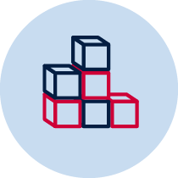
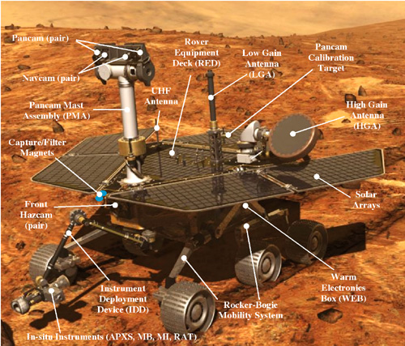
Create
Demonstrate your learning
You may choose to use an infographic, artwork, data table, written report, speech, prototype or model to represent the solar system. You may even decide to create a space craft that would be suitable to either travel through the solar system or on a planet of your choice. Remember to make it as detailed as possible so the person you are teaching has all the facts. You must create a detailed drawing with annotations, or draft an outline of how you are going to create your product first. This must accompany your final product.
Image credit: https://www.jpl.nasa.gov/infographics/infographic.view.php?id=10729

Slide 10

Record
Refining your product
It is now time to share your great work. Use what you have created to help you demonstrate your new knowledge. Your work should have all the information you need to inform your audience about our solar system. Choose an audience that is accessible to you and present your learning. Try to get feedback from them to further improve your product.
Take a photo, scan or develop a digital file to upload to our shared space for further feedback from your peers and the teacher.

Slide 11

Reflection
Please complete these question starters.
 | Your answers
I really enjoyed...
I learned a lot about...
I could improve ...
I’m still wondering about ...

