Slide 1
The nature of historical inquiry in schools
Australian Curriculum K-10

Slide 2
What is ‘historical inquiry’?
  It involves the retrieval, comprehension and interpretation of sources, with judgement guided by principles that are intrinsic to the discipline.
  It involves the creation of a product, often given the generic name ‘historical narrative’ (which may actually be a recount, explanation or exposition; written, oral or visual)
Notes:
Acara

Slide 3
What is ‘historical inquiry’ continued
  Historical inquiry in the digital age can include primary source materials– there are so many online resources, including easy to use databases.
  We must not forget the importance of secondary source material. Historical inquiry involves the use and production of historical narratives:
  “… the importance of narrative structures, [is that they] provide the framework within which questions are posed and answers developed.”
  (Pendry, Husbands, Arthur & Davidson, 1998, p.147)

Slide 4
What historical inquiry learning is not!
It does not involve asking students to “research ‘x’ on the internet”
It is not just gathering information – it involves design, collection, analysis, evaluation and production
It is complex combination of structured learning with intentional opportunities for students to create, design, imagine and develop new possibilities.

Slide 5
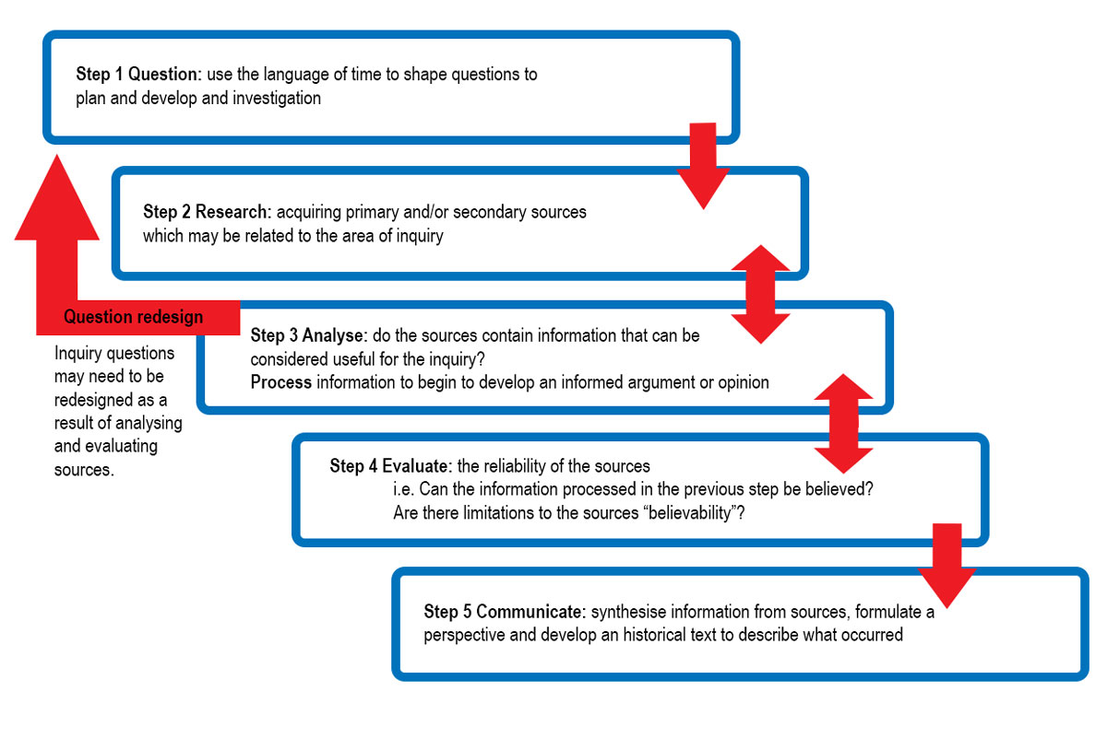
Process of historical inquiry using the History K-10 Syllabus

Slide 6
Historical inquiry step #1
Questioning
Typically teachers will set an inquiry question designed to direct the learning
At times options of questions may be provided
More capable students may be asked to design their own inquiry question/s
(as is the case with History Extension major research projects)
Notes:
Example: Key Inquiry Question

Slide 7
Historical inquiry step #2
Research
Students collect and organise information from primary and secondary sources
Directing students to resources will be determined by factors such as age, ability, literacy/numeracy levels and student interest. Resource guidance is a great place to differentiate learning.
  Sources may include:
Books
Websites
Documentaries
Oral histories
Online archives and databases
Artefacts
Documents
Sites
Celebrations/commemorations
Cultural/artistic artefacts
Image databases
Buildings
Notes:
Example: Key Inquiry Question

Slide 8
Historical inquiry step #3
Analyse: do the sources contain information that can be considered useful for this inquiry?
It sounds so simple but students often find this judgment to be a challenge… encourage them to think:
  What is the core content that needs to be addressed in a response to this question?
  Does the source’s content relates substantially to the ‘core content’?
  … AND THEN REFLECT ON USEFULNESS.
Notes:
Example: Key Inquiry Question

Slide 9
Usefulness
Source Usefulness
Author: A primary source may be considered useful if it: is produced by a first hand witness to the past is produced by a significant historical figure A secondary source may be considered useful it is: produced by an expert historian includes a point-of-view which adds to our understanding of perspectives
2. Reliability: A reliable source is often useful because it contains information that can be believed An unreliable source can still be useful if it provides an insight into the thinking of individuals or groups
3. Information quantity: Does the source contain a lot of information relevant to the topic? Are there relevant dates, names, places or data?
4. Empathy: Does the source help us to empathise with the lives of people in the past?
Notes:
Example: Key Inquiry Question

Slide 10
Historical inquiry step #4
Evaluate: the reliability of the sources
(i.e. Can the information processed in the previous step be believed?
Are there limitations to the sources ‘believability’?)
Reliability
Source Reliabilty
Is the author to be believed? Would the author’s situation create a bias?
What is the purpose of the text? Does this affect its ‘believability’
Who was the intended audience? Could this affect its ‘believability’?
Does the language indicate potential ‘unbelievability’? Emotive language – may indicate bias Formal register/ ‘textbook’ tone – may indicate reliability Is the text dominated by facts or opinions?
Notes:
Example: Key Inquiry Question

Slide 11
Historical inquiry step #5
Communicate:
Some sample historical texts:
ES1 : Present an oral report on an aspect of family heritage.
Stage 1: Use presentation software to communicate an understanding of change and continuity in the area of family traditions OR leisure time OR communication
Stage 2: Using an appropriate diagram (and publishing software): Describe and explain the effects of British colonisation on Australia
Stage 3: With reference to written and pictorial sources, Investigate the significance of ONE event in the struggle for rights and freedoms of Aboriginal and Torres Strait Islander peoples
Stage 4: Use the process of historical inquiry to examine at least ONE historical controversy or mystery. Include an explanation of the mystery (500 words) and a process diary outlining your investigation.
Stage 5: Answer the following in a full essay structure: Assess the impacts of various progressive ideas and movements from the period 1750-1918 on the history of Australia and the world.
Notes:
Example: Key Inquiry Question

