Slide 1
“The Castle”
Themes

Slide 2
Themes in
“The Castle”
What it is: A theme may be regarded as the message or even the moral of a text
Why it is important: To give greater insight into what is valued by a culture to then identify, accept or challenge

Slide 3
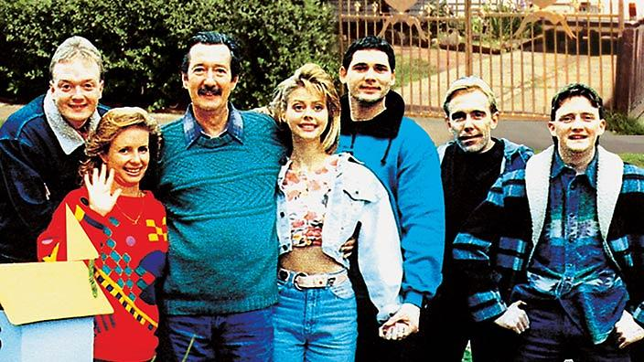
Why “The Castle” is important
Summary: Directed by Rob Sitch, “The Castle” is a film that follows the story of an Australian family struggling to keep their home after receiving a compulsory notice from the government who requires the land to expand the airport. Through the family’s quest for justice, this film highlights the importance of connection to family and friends, being grateful for what we all have, and pursuing what is deemed “right” and “a fair go” in Australia.
Related image:

Slide 4
Theme 1: Australian Identity
Summary of theme:
Related image:

Slide 5
Theme 2: Family
Summary of theme:
Related image:

Slide 6
Theme 3: Class and Culture
Summary of theme:
Related image:

Slide 7
Theme 4: Land Rights
Summary of theme:
Related image:

Slide 8
Theme 5: Community

Slide 9
Theme 6: Multiculturalism
Summary of theme:
Related image:

