Slide 1
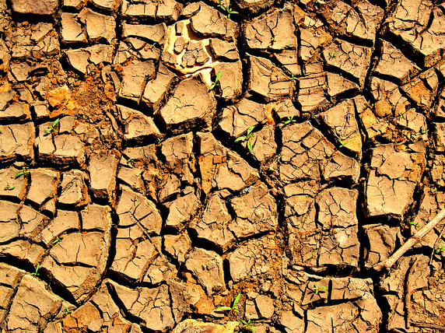
Feedback to improve student learning
Directed
Improvement &
Reflection
Time
‘Dirt’ by Joe Lodge

Slide 2
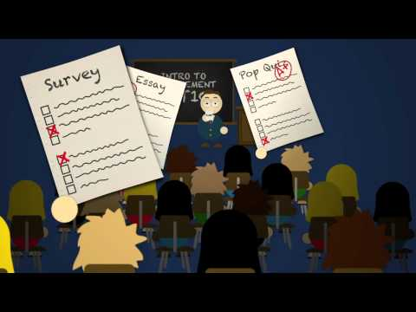
FEEDBACK
Why bother when they just chuck it in the bin or ignore it and go straight to the mark?

Slide 3
What is feedback?
Much of the research literature around formative assessment points to the importance of feedback to students as part of the learning process. Sadler (1989, 77) argues that formative assessment is "specifically intended to provide feedback on performance to improve and accelerate learning”.
Feedback is information provided to students that is used by them to alter the gap between their current performance and the ideal. If comments are not or cannot be used by students to alter the gap, then those comments do not constitute feedback!
Notes:
Ensure they know the difference between formative assessment and summative. Discuss the idea of feed-forward and the importance of drafting and editing.

Slide 4
Which are “feedback”? Which examples give better feedback than others?
You have not put much effort into this , John.
You will need to improve the structure of your exposition and work on the analysis section (H) of your WHY paragraphs before your final copy.
Good work, Maddie. An interesting piece of research, but it needs a Bibliography.
A lovely project but you haven’t included information on all topics.
Your opinion is clearly stated but you have not supported it with much factual data, nor have you used persuasive devices to sway your audience’s opinions.
Notes:
Discuss these and the difference if it is a draft or the final work ie. They are much more useful if it is a draft and they can then work on it further.

Slide 5
What makes good feedback?
It helps clarify what good performance is (goals, criteria, expected standards)
facilitates the development of self-assessment (reflection) in learning
delivers high quality information to students about their learning
encourages teacher and peer dialogue around learning
provides opportunities to close the gap between current and desired performance
provides information to teachers that can be used to help shape future teaching

Slide 6
Usable feedback should contain:
descriptions of the features of the students’ work (what has been done and/or not done)
evaluative judgements/comments linked to criteria and standards that indicate the features of the work that add to or detract from its quality (how well things have been done)
suggestions of alternative approaches that would lead to improvement
explanations, or directions to resources, that demonstrate an improved possible approach that the student could use, and
motivating comments (praise, encouragement etc.) that indicate that an aspect of the work is praiseworthy and explains why the element being praised is good.

Slide 7
Good feedback practices
Write (handwritten) comments on students' essays, reports, etc. Use language at the student’s level.
Provide face-to-face feedback, where you discuss students' work with them, individually or in small groups.
Email feedback on drafts directly to students. This can help ensure that the feedback is timely.
Use model answers: these can show students a lot of detail which can be self-explanatory to them, allowing them to compare the model answers with their own work and see what they've missed out or got wrong.

Slide 8
Be specific about the type of feedback you are providing
Comments should consider these five aspects:
Structure: "Your abstract should be placed before your table of contents."
Organisation: "Good problem statement. Where is your outline?"
Language/punctuation: "(1) Word choice could be more accurate. (2) Start a new paragraph each time the speaker changes for dialogue."
Conventions: "Which reference system are you using? Some of your references are inconsistent."
Content: "The structure of materials, rationale, functions and operation is good, but there is no mention of the process you undertook to generate these ideas."

Slide 9
Getting students to make use of feedback
Ensure that students and teachers have a shared understanding of what feedback is, and what it is for. Students may struggle to understand assessment criteria and the academic language used in feedback, so make sure you communicate clearly.
Be explicit about the details of feedback processes and expectations. Ensure that students understand why they are getting feedback and how their learning can benefit from their reflecting, and acting, on feedback (Scott, 2008).
Encourage and specifically teach self & peer editing.

Slide 10
The importance of DIRT
"It cannot simply be assumed that when students are ‘given feedback' they will know what to do with it" (Sadler, 1998, 78)
D.I.R.T (yes… another acronym…sorry)
DIRT stands for ‘Dedicated Improvement and Reflection Time’.
The evidence about the importance of quality feedback is well founded. Put simply, feedback and DIRT are essential bedfellows. If we give great feedback, with specific targets to improve, then DIRT is the crucial next step to deal with that feedback.

Slide 11
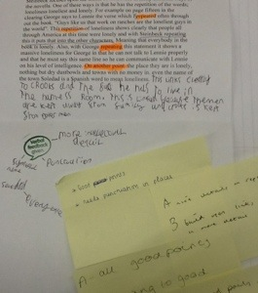

Drafting, Feedback & DIRT
Oral feedback is important too.
Teacher or Peers read a draft
of work, then give verbal feedback.
Student then writes down the
main points needed for improve-
ment and begins to re-draft.
This may be done more than once.
Final (summative) marking should
take into account how well they have
acted on the feedback.
You will need to teach
Peer-editing Techniques to the
class.

Slide 12
Modelling - Before, during or after….
To develop an understanding of what is required regarding assessment and feedback, you can, for example:
annotate and distribute a range of sample student responses on the same task to illustrate different levels of performance (high , middle, low)
use annotated examples as a basis for class discussion
let students undertake their own assessments of unannotated examples, justifying the kind of feedback and/or grades they would give, and perhaps annotating the examples for use in a future class

Slide 13
Engage students by getting them to…
Re-read their work and the feedback and write down 2 things they will focus on improving in their next piece of work. (Hand this in to the teacher who checks if they do.)
Groups (high, mid, low) compare their work and feedback to the whole group on what aspects were needed to achieve higher marks and what was missing in lower responses.
Give them feedback on (& maybe mark) drafts and get them to use this in improving the final product. Ensure marking guides include this aspect (for example. ….. has considered feedback from draft and applied this to their work.)

Slide 14
Ensure consistency of feedback among teaching staff
Hold a meeting with all teachers who will be marking assessments to agree on assessment criteria and feedback (type and level of detail).
Provide markers and students with model student responses (high, mid, low) from a past assessment task to indicate what you are expecting, in terms of both structure and level of detail.
Provide markers with a standardised marking criteria sheet with a rubric to indicate what is being marked and what constitutes a good, fair or poor answer.

Slide 15
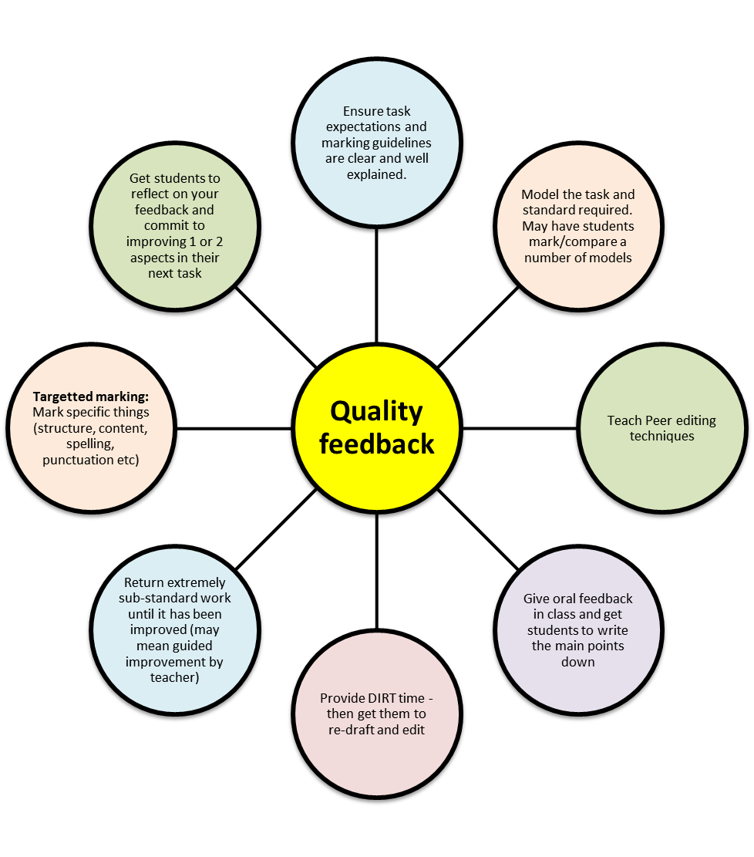
Quality Feedback Mindmap

Slide 16
Bibliography
Dylan Wiliam: Feedback on learning: https://www.youtube.com/watch?v=n7Ox5aoZ4ww
Feedback to improve student learning: http://www.flinders.edu.au/teaching/teaching-strategies/assessment/feedback/
Giving Assessment Feedback: http://teaching.unsw.edu.au/assessment-feedback
Hunting English: http://www.huntingenglish.com/2013/10/12/dirty-work/ http://www.huntingenglish.com/2013/06/16/improving-written-feedback/
Peer Editing Symbols: http://mrssimonscy.wikispaces.com/file/view/Editing+Symbols.pdf
Effective Feedback and Formative Assessment: http://www.youtube.com/watch?v=1Tihrg7nBos

