Slide 1
Plath and Hughes
- their relationship
Group ?
Notes:
NB: Use this slideshow as a model for the students prior to giving them the Core Classwork1 (CC1) task.
The Theme has been deliberately left plain. Teacher/ students may modify as suits them.

Slide 2
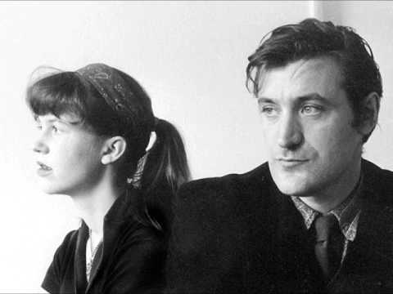
Focus Questions:
What insights are gained about Hughes and Plath from listening to the interview and reading about their life together?
What do we learn of their meeting, relationship, life together and poetry?
Notes:
URL here - https://www.youtube.com/watch?v=Vqhsnk6vY8E

Slide 3
Meeting:
February 1956 - Sylvia knew of Ted before their first meeting. She said “ I had read some of these poems in this magazine, and I was so impressed I wanted to meet him”
Both were at the same celebration gathering that was being held by Ted’s friends in honour of his poems being published in a magazine, St Botolph’s Review (1) - did Plath go there intentionally to meet Ted? (in some articles there is mention of Ted kissing her hard / passionately and Sylvia biting his cheek - intense first meeting)
The first three months of their relationship were intense, with more dates and a trip to London together. Within about 3 months of courtship, including Ted spending money on Sylvia, and numerous poems being written to each other, they found themselves married.
There are reports that whilst Sylvia was taken with Ted, he also felt the same and would spend time underneath her window throwing small stones to try to catch her attention - thus proving a mutual attraction.
Many poems were for each other and by each other. They were not intended to be published. However, 15 of these passionate love letters sent by Sylvia have been published by Frieda Hughes in The Telegraph in 2017 (2)
Notes:
1 https://www.telegraph.co.uk/news/obituaries/5886550/Ted-Hughes.html
2 https://www.telegraph.co.uk/news/2017/09/22/dearest-teddy-sylvia-plaths-love-letters-ted-hughes-published/

Slide 4
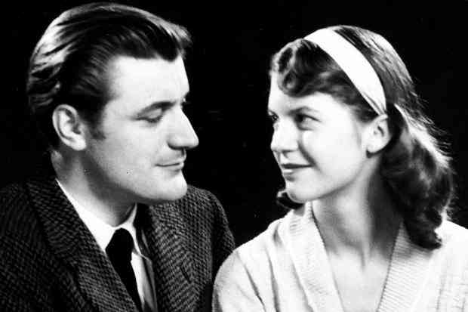
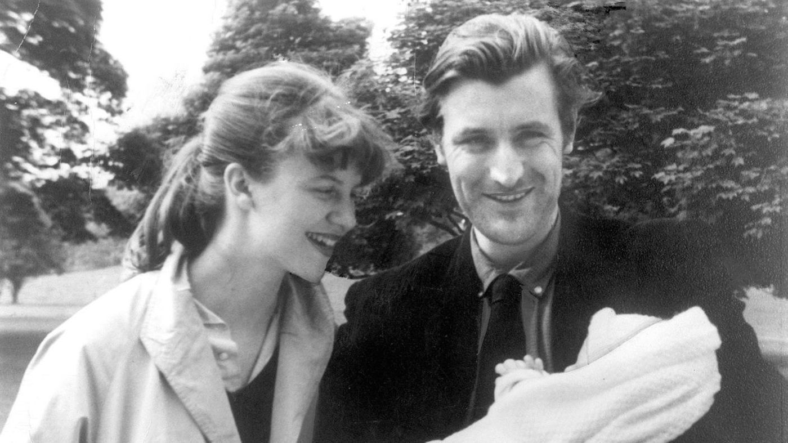
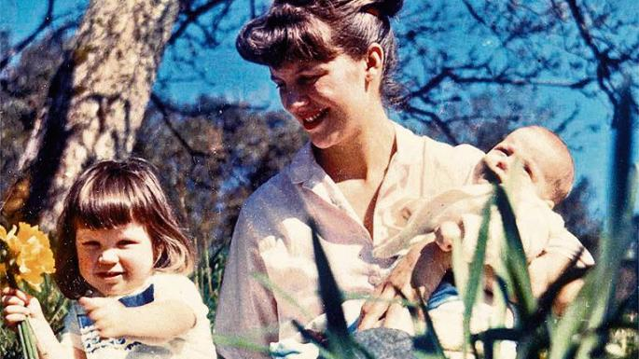
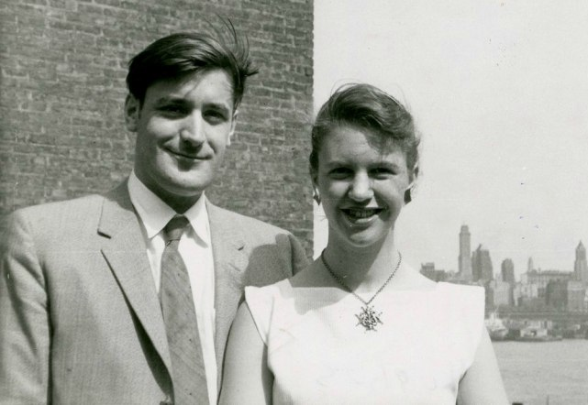
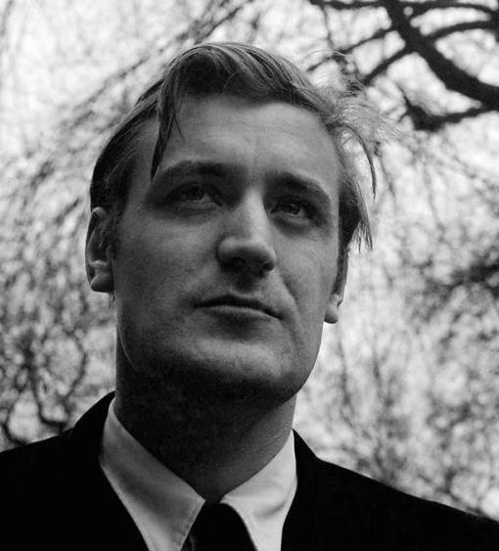
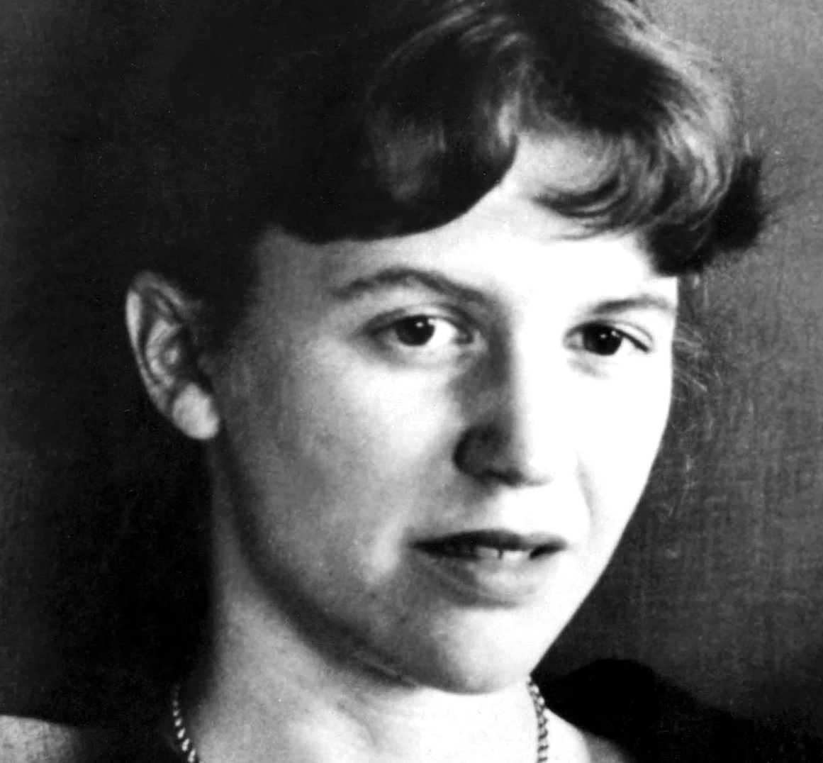
Photos of Plath and Hughes
2
1
3
4
5
6
Notes:
Put URL for each picture on Bibliography to avoid copyright issues.
http://www.minimaetmoralia.it/wp/ted-hughes/
http://www.latimes.com/books/la-et-jc-plath-hughes-auction-20180321-story.html#
https://www.thetimes.co.uk/article/sylvia-plath-s-daughter-sells-relics-of-a-lost-love-sg6hdgt6j
https://www.bookstr.com/sylvia-plath-and-ted-hughes-poems-uncovered
https://www.theguardian.com/books/2017/apr/11/unseen-sylvia-plath-letters-claim-domestic-abuse-by-ted-hughes
https://www.theparisreview.org/interviews/1669/ted-hughes-the-art-of-poetry-no-71-ted-hughes

Slide 5
Relationship:
Both felt that their marriage overtook the need to write poems for each other - that the poetry allowed them to be free to do other work and to focus on other subjects.
Sylvia didn’t believe that she would be writing what she was, or as much as she was without Ted’s support. He was a literary mentor to Sylvia, and in a letter written to her mother shortly after their marriage, she wrote “Even as he sees into my poems and will work with me to make me a woman poet like the world will gape at.” (3)
Ted believed that they were very alike in many ways, same tempo & rhythm, but also that they were completely different where they “met in an imaginary world.”
Notes:
3 https://www.jstor.org/stable/44377057?seq=1#page_scan_tab_contents
4 https://www.telegraph.co.uk/news/obituaries/5886550/Ted-Hughes.html
5 https://www.telegraph.co.uk/culture/books/bookreviews/9854932/Mad-Girls-Love-Song-Sylvia-Plath-and-Life-Before-Ted-by-Andrew-Wilson-review.html

Slide 6
Relationship continued:
“From the beginning it was, and for some years continues to be an extremely close, intertwined relationship. Each gave the other much in the way of literary models, criticism, stimulus and support.” (4)
Ted was able to be with other people and still write, whilst Sylvia had to be by herself and she was often distracted by those around her.
Articles state that Sylvia was boy mad in her youth and appeared to have a succession of men in her life before Ted - (it could be questioned as to whether she had an obsessive personality or wanted a father figure in her life?) Was she “desperate for experience, terrified of commitment and the relation of wifehood to writing, but too competitive to let go of her conventional goals. She felt fear, yet did it anyway” (5)
In the interview Sylvia states that she was a happy, content child who believed in magic, elves and fairies. She goes on to say that this changed when she was about 9 years old. Whilst she doesn’t specifically name the cause of her change in attitude we know that her father died when she was 8 years old.
Notes:
3 https://www.jstor.org/stable/44377057?seq=1#page_scan_tab_contents
4 https://www.telegraph.co.uk/news/obituaries/5886550/Ted-Hughes.html
5 https://www.telegraph.co.uk/culture/books/bookreviews/9854932/Mad-Girls-Love-Song-Sylvia-Plath-and-Life-Before-Ted-by-Andrew-Wilson-review.html

Slide 7
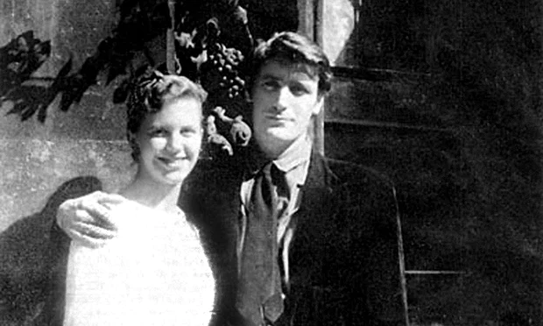
Life Together:
Whilst already writing her own poems before they got together, they were able to use not only their life together as an inspiration for their poetry, but also the experiences that each had when growing up and their way of looking at these experiences as inspiration.
There are claims, especially from feminist groups, of Ted’s mistreatment of Sylvia, his sexual encounters with numerous other women, his gallivanting and attending parties whilst she was at home with their children led her to suicide (6)
Their marriage lasted 7 years before they separated in July 1962
It could be argued that their relationship was doomed from the very beginning, with it being said that “Ted and Sylvia were twin stars shining and spinning together, but too fierce to be able to hold on to each other” (7)
7
Notes:
6 http://www.slate.com/articles/news_and_politics/the_gist/1998/03/sylvia_plath_and_ted_hughes.html
7 https://www.theguardian.com/books/2015/oct/11/ted-hughes-the-unauthorised-life-review-jonathan-bate-sylvia-plath-carol-orchard-assia-wevill
Image 7 https://www.independent.co.uk/news/people/ted-hughes-new-biography-claims-the-poet-was-in-bed-with-a-lover-the-day-sylvia-plath-died-a6669521.html

Slide 8
Poetry:
Ted and Sylvia were writing poetry, and were published poets before they ever met.
Both drew upon their childhood experiences growing up, albeit in completely different surroundings and circumstances, to write their poetry. Eg. Ted - the rural English countryside, animals and moving from the country to an industrial area when he was 7, Sylvia - the USA, seaside, her family and her enforced piano lessons. Sylvia said that when she began to write she wrote about “...all those subjects which are absolute gifts to the person who doesn't have any interior experience to write about.” (8) In her later years she wrote about things that she found interesting. She was influenced by the Confessional poetry of Robert Lowell and Anne Sexton because they wrote about “peculiar, private and taboo subjects” (8)
Despite there being some similarities in their poetry, (subject matter - animals and rural landscapes, similar syntax and how it is used) these are approached from different angles and treated in a different way by both Ted and Sylvia.
Ted said that he was heavily influenced by Beethoven, more than he has ever been influenced by any other artist, in any medium. Whilst this may not have influenced his writing, it influenced his imagination. This in turn, had an impact on Sylvia, who could not carry a tune, which made her feel unhappy, but she learned an appreciation of music, especially Beethoven, from Ted.
Notes:
8 http://www.english.illinois.edu/maps/poets/m_r/plath/orrinterview.htm

Slide 9
Some Considerations:
This interview was recorded in 1961, we are listening to it in 2018 / 2019 when we know of the events that lead to the death of Sylvia 11th February 1963 (only 2 years after the recording). Does this change our attitude to what we are listening to? Does this make us question the validity of their story / of their love for one another?
Sylvia appears a level headed, successful, published poet, wife and mother. Ted, the successful published poet, husband and father. We know that Sylvia suffered depression and that Ted was not the model husband with his wandering ways. Therefore, how reliable is the impression given in this interview?
Sylvia, in the interview gives the impression of being like other housewives and mothers, but in other articles she claims she found it difficult to combine the two. She wanted to be a mother and housewife but was scared by it.
Notes:
9 https://www.theguardian.com/books/2000/mar/18/tedhughes.sylviaplath

Slide 10
Some Considerations continued:
“ Sylvia Plath predicted on the day after she met Ted Hughes that their relationship would lead to her death, according to extracts from her diaries” (9) Was their relationship doomed from the beginning?
There are many contradicting articles, written by people with their own agendas, so an accurate picture which gives us a greater understanding may never be known. However, is this relevant? Does this diminish their poetry? Does this make their personal and professional relationship any less valid? Does this make the conversations between the poems any less meaningful?
Hughes’ Birthday Letters was published in 1998, before his death from cancer. It deliberately responds to and reinterprets some of her poems from Ariel. Why may he have chosen this timing?
Notes:
9 https://www.theguardian.com/books/2000/mar/18/tedhughes.sylviaplath

Slide 11
Bibliography
Interview - sylvia plath ted hughes interview 1961 youtube video
Mad Girl’s Love Song: Sylvia Plath and Life Before Ted by Andrew Wilson: review
Love, loathing and life with Ted Hughes
Ted Hughes Obituaries
'Dearest Teddy': Sylvia Plath's love letters to Ted Hughes published for the first time
Sylvia Plath and Ted Hughes by Franklin Foer
Ted Hughes: The Unauthorised Life review – a man smouldering with life

Slide 12
Bibliography Continued
The poetry of courtship: Plath and Hughes caught on tape
The Poet as Wife: Sylvia Plath's Marraige Poems- Carole Stone
A 1962 Sylvia Plath Interview with Peter Orr

Slide 13
Bibliography - Images
LA MITOLOGIA DELL’ASSENZA: TED HUGHES E LE BIRTHDAY LETTERS
Sylvia Plath and Ted Hughes rarities garner big bids in London auction
Sylvia Plath’s daughter sells relics of a lost love
Unseen & Unpublished Sylvia Plath Poems Discovered
Unseen Sylvia Plath letters claim domestic abuse by Ted Hughes
Ted Hughes, The Art of Poetry No. 71
Ted Hughes: New biography claims the poet was in bed with a lover the day Sylvia Plath died

