Slide 1
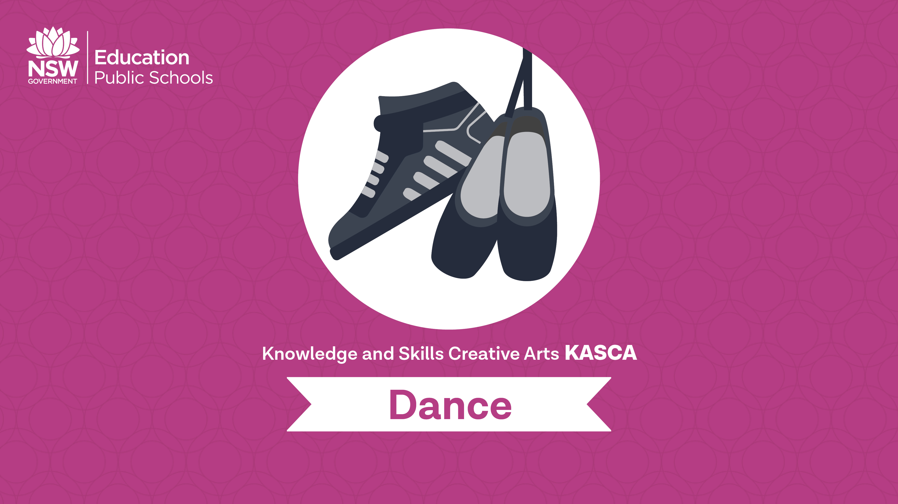
Safe dance practice

Slide 2
Safe dance practice includes
Warm up and cool down
Stretching
Alignment
Body awareness
Body capabilities and limitations
Causes, prevention and treatment of injury
Body maintenance

Slide 3
Effective warm up
10 - 15 minutes of continuous movement that increases in difficulty, involving large muscle groups. These large muscle groups include: quadriceps, hamstrings, calf complex, muscles of lower back, shoulders, adductors, etc.
It is more useful if the warm up is specific to joints and muscles you’re intending to use, angles intended to use, and the speed you intend to move.
Note: The benefits of a warm up are completely lost after 45 minutes of standing/sitting still, therefore it’s important to stay warm throughout class.

Slide 4
What are some warm up examples?
Jogging
High knees
Star jumps
Roll downs, warming up the spine
Discuss and name some more warm up examples.
Remember it is anything to warm up the feet, calves and increase your heart rate.

Slide 5
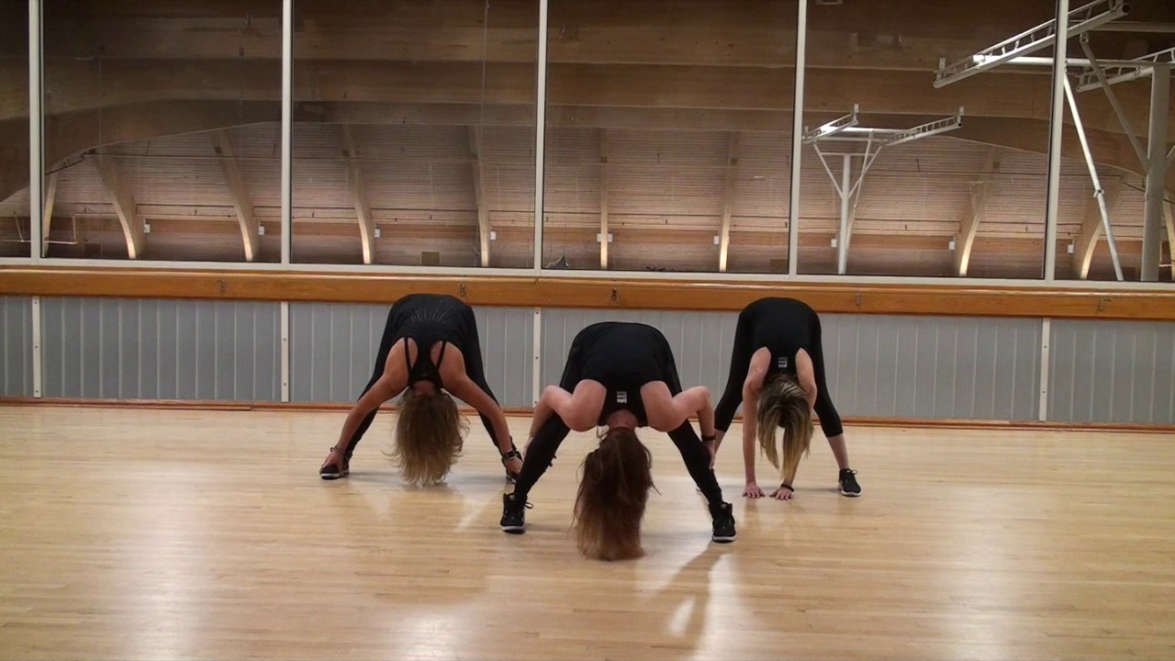
Why should we cool down?
Cooling down returns the blood to the heart
It allows the metabolic waste products (like lactic acid) to move rapidly throughout the body. Ever felt sore the following day after dancing or playing sport? This is due to the lactic acid that remains in your muscles after you suddenly stop activity. Deep stretches whilst cooling down helps to decrease this effect.
Deep stretches during a cool down is the best time to increase your flexibility.
Cooling down should happen gradually.
Notes:
Image one: https://i.ytimg.com/vi/Adq1XlOMMLI/maxresdefault.jpg

Slide 6

Cool down examples
Deep stretches: such as splits, calf stretch, quadriceps stretch, etc. Holding stretches for 30 seconds will help maintain your flexibility, holding for 1 minute will increase it.
Deep breathing: Breathing returns the oxygen into your blood which allows the heart rate to go back to its regular pace.
Walking around the room at a regular pace. It’s important to not stop suddenly after physical activity. You can slow your activity down by simply walking around at a regular pace to enable your heart rate to settle.
Use the internet to research 5 alternative cool-downs.
With your partner develop a cool down exercise and run the class through it.

Slide 7
Body awareness
Body awareness is being constantly aware of what your body is doing in dance. This includes how it is moving and the space it is taking. This can also be referred to as spatial awareness. Body awareness also refers to knowing your own personal capabilities and limitations in dance.
Building this awareness will improve a dancers ability to create shape and form

Slide 8
Body awareness test
With each of the following exercises, estimate what your results will be. This will allow you to develop your knowledge on your capabilities and limitations within dance.
1. How long can you balance on a rise for?
Two Feet:
Right Foot:
Left Foot:
Notes:
Image one: https://upload.wikimedia.org/wikipedia/commons/3/35/Elvis_Presley_Jailhouse_Rock.jpg

Slide 9
Body awareness test…
How long can you hold the plank position for? How long can you hold a side plank for?
Right side:
Left side:
How long can you balance for on both feet with your eyes closed?
How well can you touch your toes standing? Hands in line with: Knee, Shin or Toes.
How well can you touch your toes sitting? Hands in line with: Knee, Shin or Toes.
How long can you hold a V-Sit for?
How long can you do a wall-sit for?
Can you do the right leg splits?

Slide 10
Body awareness test…
Can you do the left leg splits?
Can you do the middle splits?
How many push ups on your knees can you do without stopping?
How many push ups on your feet can you do without stopping?
How many times can you rotate between a plank extended on your arms, changing to your elbows, and back up to your arms? Each change is worth 1 rep. Count the reps:
How many dips can you do?
How many burpees can you do in 1 minute?
Reflection: In your process diary, write a TEEEC paragraph on your capabilities and limitations.

Slide 11
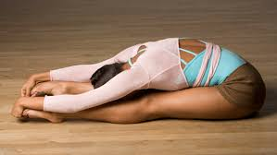
Stretching
Discuss as a group the aim of stretching. Write a TEEEC paragraph in your process diary about the aim and importance.
Different reasons could include:
Flexibility
Injury prevention
Warming up muscles
Research the definitions of stretching and flexibility.
Notes:
Image one: http://files.dancemedia.com/dancemagazine/Wrong_Stretch.jpg

Slide 12
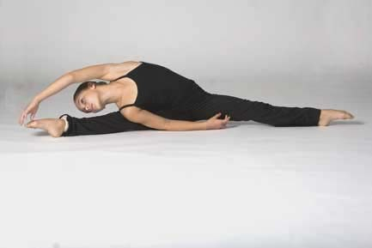
The four types of stretches
1. Static:
Gradual stretching of a muscle to a position of comfort where it is sustained for 10-20 seconds.
Sustain the stretch- this stretches both the muscle and the connective tissue.
List the types of static stretches you know and do in dance classes.

Slide 13
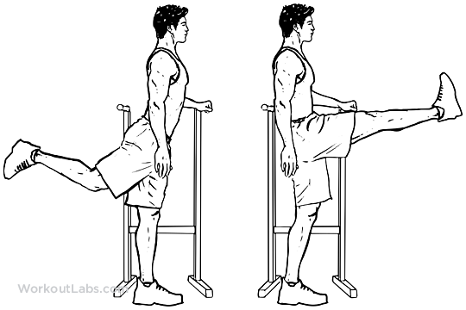
The four types of stretches
2. Dynamic (Range of motion)
Moving a muscle through its full range of motion with increasing repetitive movements.
List the types of dynamic stretches you know and do in dance classes.
Notes:
Image one: http://workoutlabs.com/wp-content/uploads/watermarked/Forward_Leg_Hip_Swings_M_WorkoutLabs.png

Slide 14
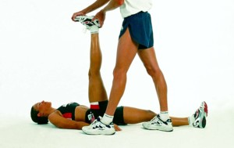
The four types of stretches
3. PNF (Proprioceptive Neuromuscular Facilitation)
A stretch that is repeated: hold for 7-10 seconds, relax for 3 seconds, move into further range and hold for another 10 seconds. Repeat this three times.
This is a safe stretch if done sensibly.
List the types of PNF stretches you know and do in dance classes.
Notes:
Image one: http://stretchcoach.com/wp-content/uploads/pnf-stretch_1.jpg

Slide 15
The four types of stretches
4. Ballistic
Ballistic stretching uses bouncing movements to push your body past its normal range of motion.
These stretches are fast, rapid movements, repeating a bouncing motion.
As dancers, we prefer not to use these, as they are unsafe dance practice when not done correctly.

Slide 16
Alignment
  Alignment refers to the posture and position of the body while dancing or preparing to dance. Healthy alignment is key for the execution of choreography. It is necessary for balance, muscle development, and prevention of injury in dance. Poor alignment puts stresses and strains on the joints and muscles of the lower back and legs.
  Summarise the information above, by choosing 10 of the most important words, and rewriting several sentences in your own words.
Notes:
Image one: http://www.jonathanrosenbaum.net/wp-content/uploads/2017/05/SaturdayNightFever-solo.jpeg

Slide 17
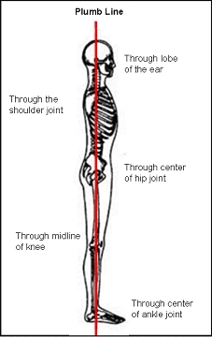
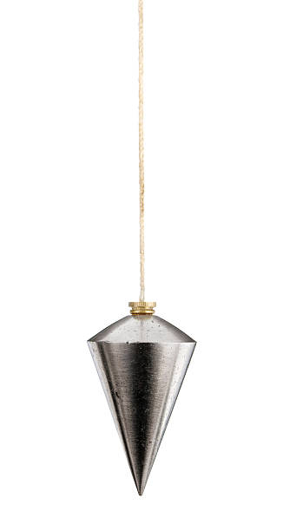
The plumb line
Ear lobe
Mid point of the shoulder
Center of the hip
Back of the knee
Ankle bone
Notes:
Image one: https://dancestudentspace.files.wordpress.com/2014/08/plumb-line.jpg?w=227
Image two: https://www.google.com.au/search?rlz=1C1CHBF_enAU771AU771&biw=1038&bih=575&tbm=isch&sa=1&ei=uHlkWoGtIIqA8gXT_LvIDg&q=plumb+line&oq=plumb+line&gs_l=psy-ab.3..0l10.882233.883466.0.883536.10.6.0.0.0.0.331.331.3-1.1.0....0...1c.1.64.psy-ab..9.1.330....0.8re2AV_YBI0#imgrc=-jC6l3RKVaRgSM:

Slide 18
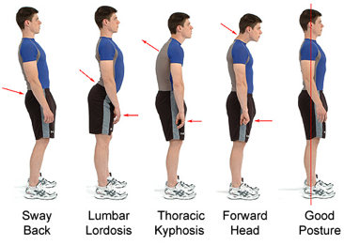
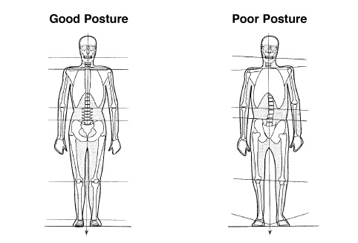
Posture analysis
In pairs, analyse your posture by checking the following levels are correct.
Write a reflection in your process diary on your own posture.
Notes:
Image one: http://activephysiohealth.com.au/wp-content/uploads/2015/09/thumbnail.png
Image two: http://wellnessmovementcenter.com/wp-content/uploads/2016/08/good_bad-posture-copy.jpg

Slide 19
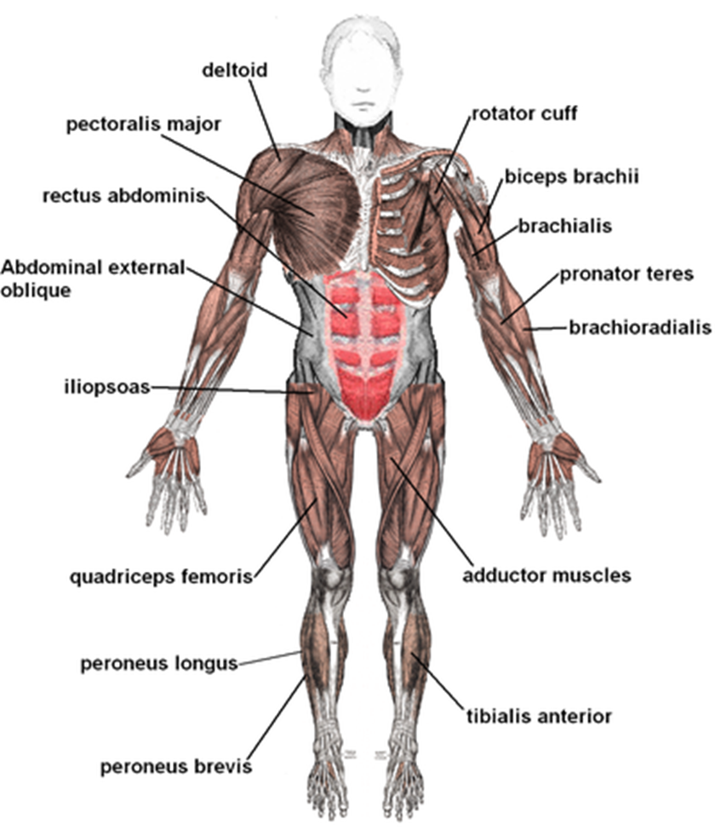
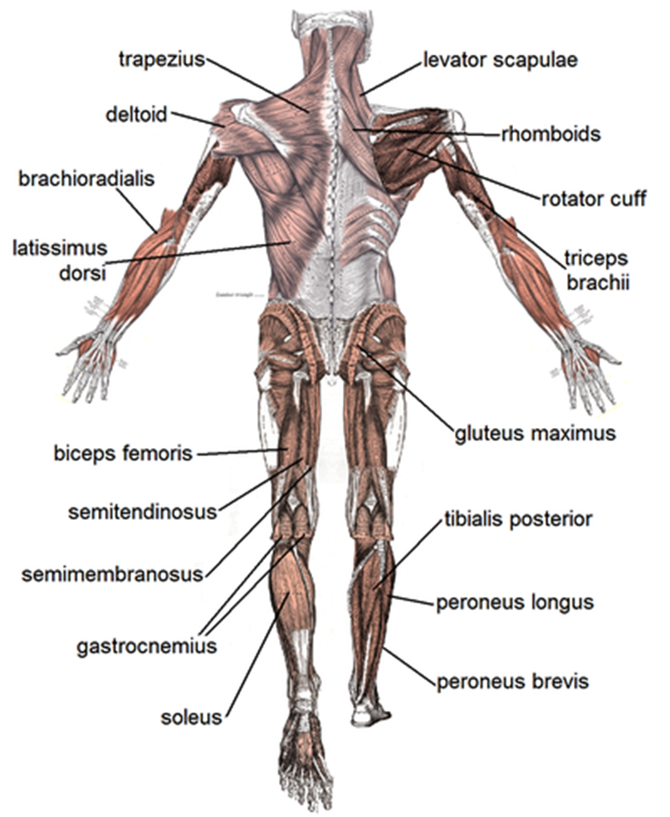
Muscles
Muscles produce force and cause motion
Muscles provide the strength a dancer needs
Muscle strength prevents injuries
There are around 650 muscles in the human body
Voluntary muscles are muscles in which you control movement
Involuntary muscles are not under your conscious control, eg: heart, muscles in the stomach
Notes:
Image one: http://assets.nydailynews.com/polopoly_fs/1.2771789.1473193608!/img/httpImage/image.jpg_gen/derivatives/gallery_320/jake-t-austin-jenna-johnson.jpg
Image two: https://i.ytimg.com/vi/4yEOcUqRz7o/maxresdefault.jpg
Image three: http://assets.danceinforma.com/public/assets/mce/Chelsea_News/SYTYCD_Top_10_contestant_Paul_Karmiryan_and_all-star_Witney_Carson_in_a_Cha_Cha_routine.jpg

Slide 20
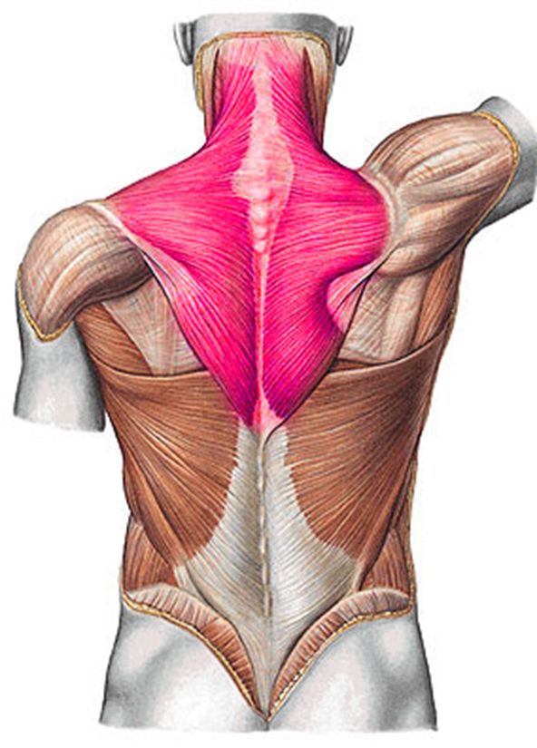
Major muscles of the upper limb
Trapezius:
From the neck, across the shoulders and down the middle of the back.
Actions: Elevates clavicle, rotates the scapula, elevates or depresses the scapula, and extends the head.

Slide 21
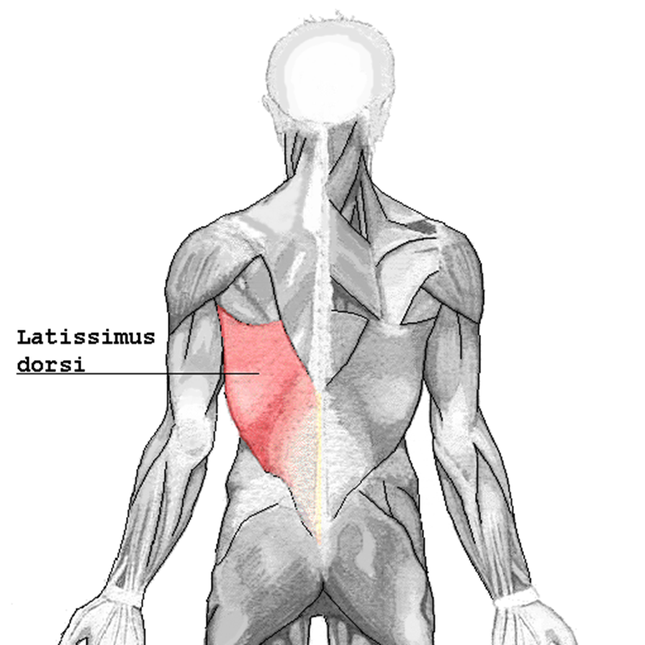
Major muscles of the upper limb
Latissimus dorsi
Under the arms
Actions: extends, rotates the arm. Draws the arm backwards. Gives the back support.

Slide 22
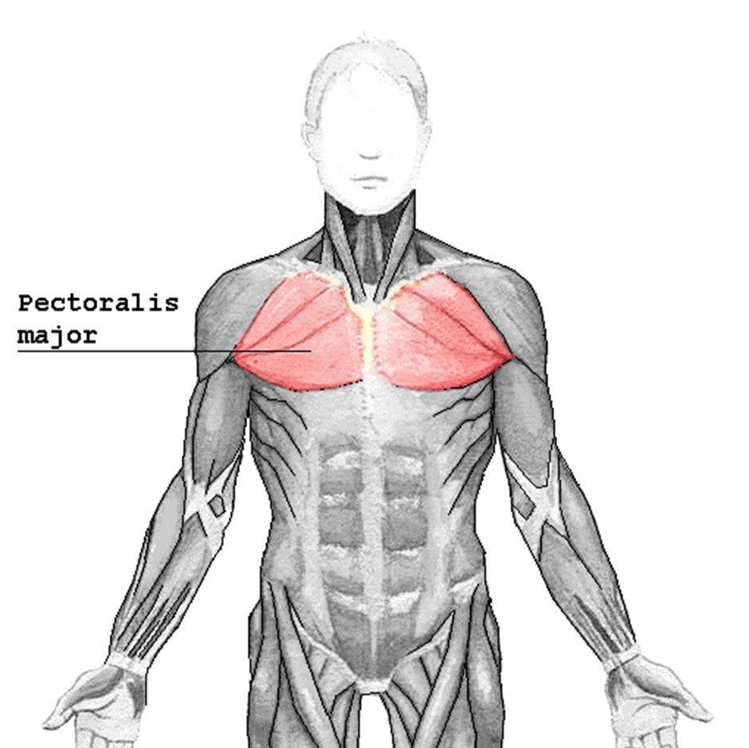
Major muscles of the upper limb
Pectoralis major
Runs across the chest
Action: Helps flexion of the arm

Slide 23
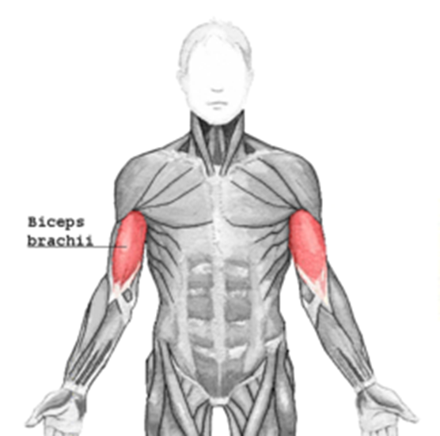
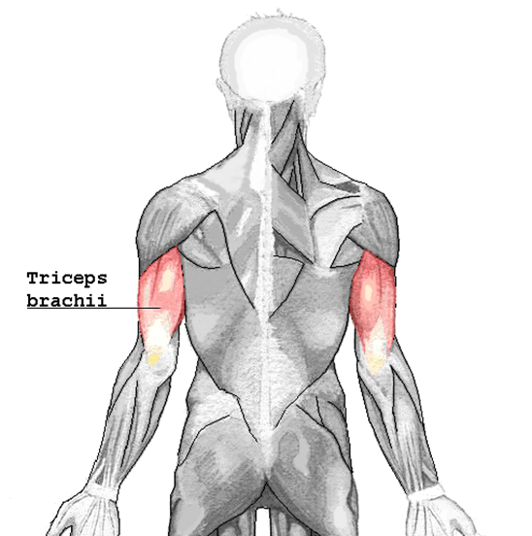
Major muscles of the upper limb
Biceps
On the anterior (front) of the arm
Actions: flexes the arm
Triceps
On the posterior (back) of the upper arm
Actions: extends the arm

Slide 24
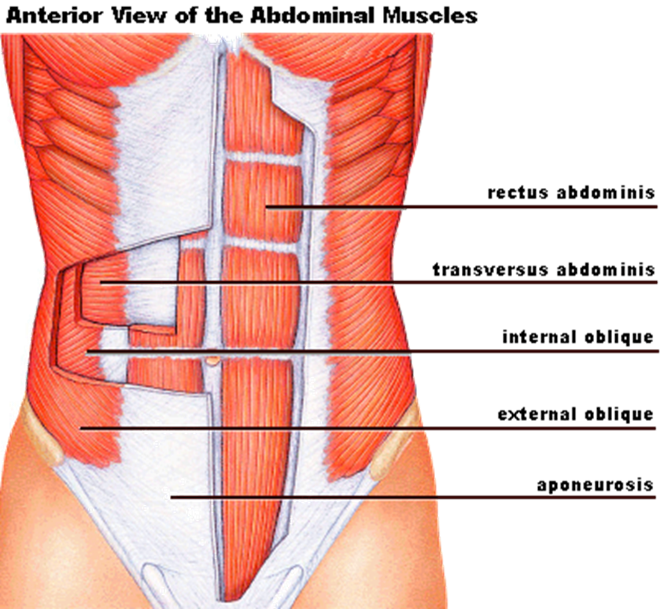
Major muscles of the abdominal wall
RECTUS ABDOMINIS: More commonly known as the ‘6 pack’
EXTERNAL OBLIQUES: On the sides of the trunk
INTERNAL OBLIQUES: Same as external but deeper
TRANSVERSE ABDOMINIS: Compresses the abdomen- most important for core strength
Actions: together they all act to flex the spine, compress the abdomen and bend the spine laterally.

Slide 25
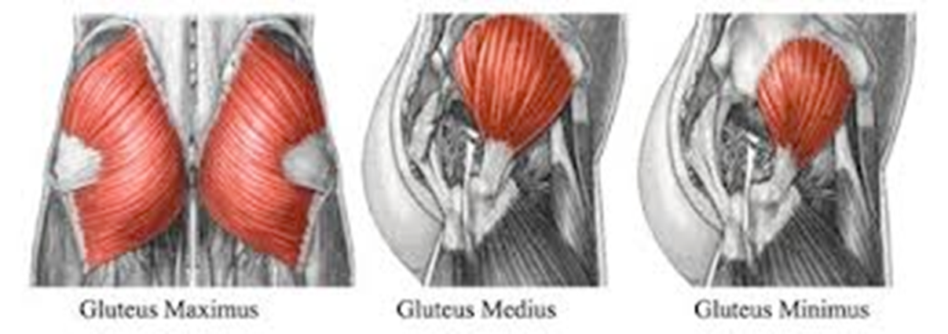
Major muscles of the buttocks
Gluteus maximus:
Connects lower back to thighs
Is the largest muscle in the body
Action: Extends flexed hip, works with abdominals for alignment and posture
Gluteus medius and gluteus minimus:
Also connects the lower back and thighs, though deeper than the gluteus maximus
Actions: maintains pelvic alignment (if it is weak you will sink into the hip)

Slide 26
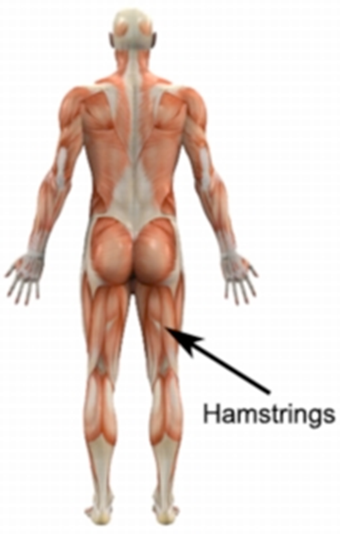
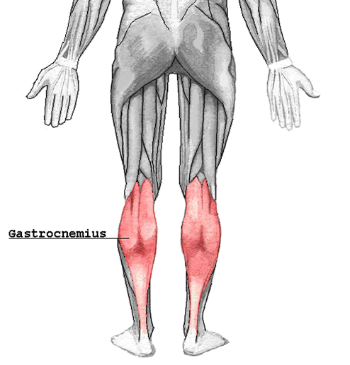
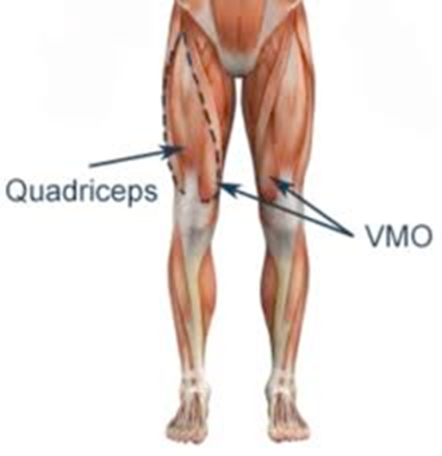
Major muscles of the legs
Quadriceps:
Runs from the hip flexors to the knee extensors
Actions: Important for patella alignment, flexes the hip, therefore used for kicks to the front, jumps, etc
Hamstrings:
On the back of the thigh
Actions: Extends the hip, flexes the knee. Controls posture, used for working through jumps and flexibility
Gastrocnemius
Known as the ‘calf’ muscle
Actions: Flexes the knee. Used for walking, rises, jumps.

Slide 27
Major muscles
Working in small groups develop a stretch for each of the muscles explored.
Write a stretching and strengthening program to build and develop these muscles.

Slide 28
Environmental factors
TEMPERATURE: 22 degrees is the ideal temp. If cold, injuries may occur, such as tears. If too hot, may cause sweating resulting in loss of water= loss of electrolytes, resulting in muscle cramps, fatigue and injury.
FLOOR CONSTRUCTION: Sprung floor is ideal, however this is unchangeable.
FLOOR SURFACE: Use of rosin will build up in uneven places which can cause injury. Carpet can cause carpet burns, and is harder to turn on. This needs care.
Write a TEEEC paragraph on the importance of environmental factors.

Slide 29
Causes of injury
Inadequate warm up:
Shortened/Absent warm-up
Body needs to be kept warm during class
Effectiveness of warm-up leaves quickly
After 45 minutes- most if not all of the benefits are gone
Lack of specific warm up:
Warm up needs to be specific to the style you are about to perform
Poor pre-season conditioning:
If you’re unwell or have an injury at the beginning of the dancing term, you need to take it slow- build up the system.
If you do have an injury- have it addressed and take care of it, or this will simply cause more injuries further on.
Stay physically fit- don’t have four weeks off, then straight back into it.

Slide 30
Causes of injury
Scheduling of classes, rehearsals and performances:
Make sure preparation is adequate prior to performances
When on tour- difficult for preparation because of the lack of facilities
Improper performance of technique:
  Responsibility to understand correct techniques and usage.
  Need to be aware of physical capabilities and limitations of your own body- body maintenance.

Slide 31
Causes of injury
Commencing dance training late:
When starting late it is hard to gain the required facility.
Intensity of training (catching up if having started late) can cause injury.
Result of starting late to catch up: excessing training, fatigue, etc.
Development of muscle imbalances:
  Faulty technique
  If training well- muscles should develop simultaneously, (spend the same amount of time on both sides)

Slide 32
Type of injury
  Haematoma:
  Damage to a blood vessel with bleeding into the tissues
  Mildest form is known as a bruise
  Treatment:
  First 72 hours- no heat
  Cold pack to control bleeding
  Massage around the damaged area (not directly on)

Slide 33
Type of injury
  Muscle and tendon strain:
  Characterised by immense pain- cramping and spasms
  Treatment:
  Cold pack to control pain, cramping and spasms
  Ligament sprains and tears:
  Causes pain, swelling and a reduction in movement
  Treatment:
  4 – 12 weeks rehabilitation- depending on severity of the sprain or tear

Slide 34
Type of injury
  Tendonitis:
  Inflammation of the tendon resulting from overuse or faulty alignment
  Treatment:
  Cold pack to settle the inflammation
  Correct the faulty technique that caused it
  4 – 6 weeks rehabilitation
  Stress fracture:
  Hairline cracks in the bone, caused by overuse
  Treatment:
  Correct the faulty technique that caused the injury
  4 – 6 weeks rehabilitation

Slide 35
Type of injury
  Bursitis:
  Inflammation of the bursa (little fluid sacks)
  Caused by repeated jumps on hard floors
  Treatment:
  Cold pack to settle the inflammation
  Correct the faulty technique that caused it
  Research one of these injuries in further detail and present your report to the class.

