Slide 1

The 27th letter

Slide 2

What is this symbol?
Write a definition in your blog/visual design journal of what you think this is,
and how it is used. DO NOT research this yet.
Notes:
https://upload.wikimedia.org/wikipedia/commons/thumb/1/1b/Ampersand.svg/2000px-Ampersand.svg.png accessed 10/12/2017

Slide 3

And Per se, and
Ampersand was originally the latin word et, which means And.
The ligature (2 or more joined letters) of E and T, form a single letter.
It has now evolved into the letter form/symbol that we know today
Its name literally means and per se, (i.e. &) and.
Notes:
https://upload.wikimedia.org/wikipedia/commons/thumb/8/80/Ampersand_Evolution.svg/2000px-Ampersand_Evolution.svg.png accessed 10/12/2017

Slide 4
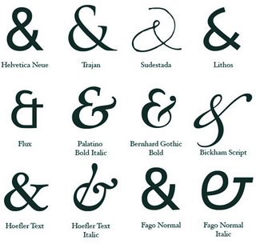
Typographer Jan Tschichold traced the origins of the ampersand from roman times to present.
The symbols on the right show indicate how the design has developed over time.
Notes:
http://1.bp.blogspot.com/-u5ePhTrGWlU/T-SNamBqoJI/AAAAAAAABRY/YbmUG9CqKTo/s1600/ampersand.jpg accessed 10/12/2017

Slide 5
Ampersand: Pompei 79AD
In your visual design journal/blog answer the question -
What are the similarities and differences between this symbol compared to the modern ampersand ?
Notes:
http://www.shadycharacters.co.uk/wp/wp-content/uploads/2011/06/pompeii.jpg accessed 10/12/2017

Slide 6
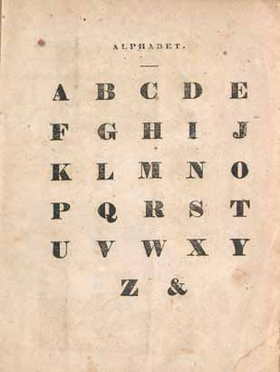
The 27th letter
By the 18th century, the ampersand had been added to the alphabet.
Student’s would recite the alphabet and include it as the 27th letter after z.
Do you remember reciting the alphabet?
In the 18th century students said 'And per se, and’ at the end.
Notes:
http://1.bp.blogspot.com/-u5ePhTrGWlU/T-SNamBqoJI/AAAAAAAABRY/YbmUG9CqKTo/s1600/ampersand.jpg accessed 10/12/2017

Slide 7

The Ampersand
Watch and discuss:
Chalking Points – History of the & (the Ampersand)
The 27th Letter: Ampersand
Make some sketches of an ampersand in your visual design journal and upload them to your blog.

Slide 8

The 27th letter competition
In 1947, James Bond and Ian Fleming created a competition for a 27th letter.
Recently the competition has been resurrected and can be entered by professional designers and everyday lovers of typography.
Read through the information on the Ian Fleming website, taking notes for your blog.
Study the rules and create an entry for the competition.
Document the process in your blog.
Notes:
Think about entering
http://www.ianfleming.com/27th-letter-competition/ accessed 10/12/2017
entry
https://www.thebookcollector.co.uk/the-27th-letter-rules accessed 10/12/2017

Slide 9
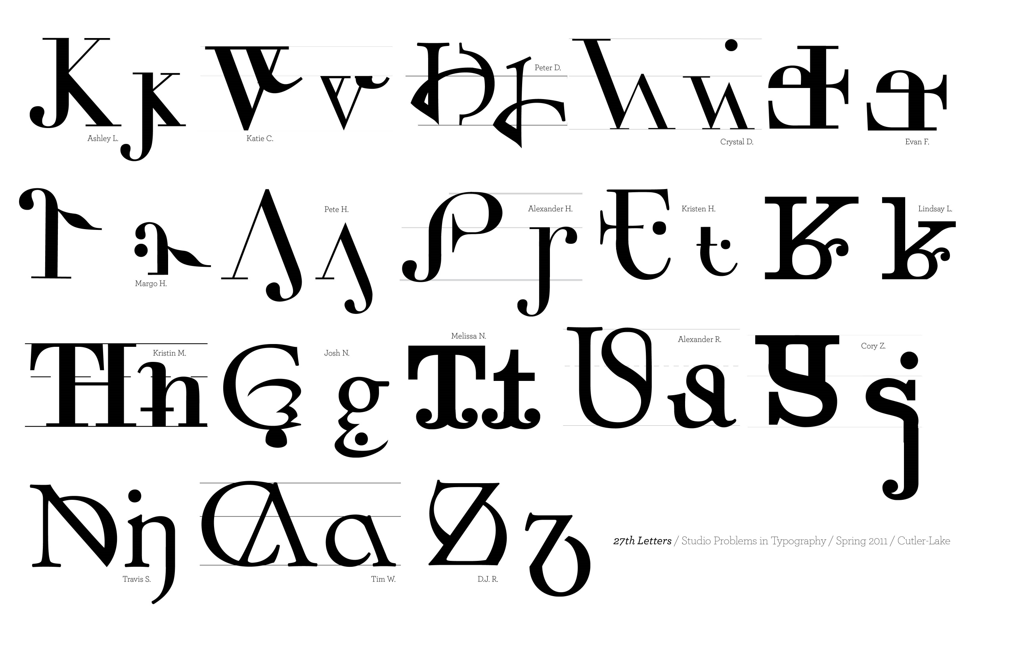
Candidates for the 27th letter
These are some of the designs for a new 27th letter.
Notes:
https://delineationofdesign.files.wordpress.com/2011/03/student27thletterssp11.jpg accessed 10/12/2017

Slide 10

George Hughes
The designer George Hughes looked into making a letter for the sound 'f’ which is made by the letters 'ph'.
What words do you know that use 'ph' to make an 'f’ sound?
Brainstorm some a list of other letter combinations with similar sounds.
Select your favourite and design a new letter.
Notes:
http://nebula.wsimg.com/4e81cebb76ed5decf3ed81ba78f282fb?AccessKeyId=EF52F3F57E402A7175EB&disposition=0&alloworigin=1 accessed 10/12/2017

Slide 11
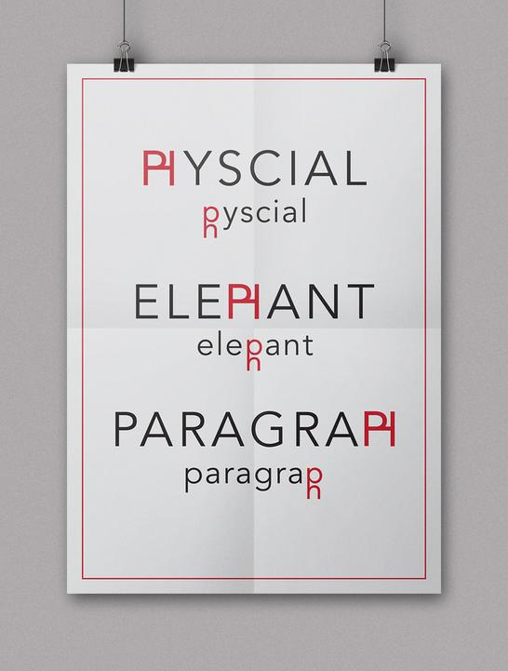
http://www.georgehughesdesign.com/27th-letter.html
Copyright © George Hughes Design. All rights reserved.
Notes:
Copyright © George Hughes Design. All rights reserved.
http://www.georgehughesdesign.com/27th-letter.html accessed 10/12/2017

