Slide 1

Ligatures

Slide 2
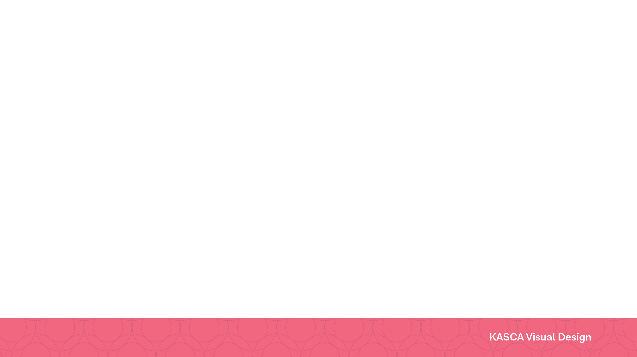
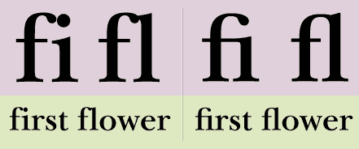
What is a ligature?
Look carefully at the first flower images below.
Answer the following in your visual design journal/blog:
What are the similarities and differences between the version on the left, compared to the version on the right?
Which version to you prefer and why?
Notes:
https://www.fonts.com/content/learning/fontology/level-3/signs-and-symbols/ligatures-1 accessed 10/12/2017

Slide 3
Ligatures are more visually appealing due to the way the letters flow and join together. This makes them easier to read and less crowded than other letters.

Slide 4
Gothic blackletter
Early manuscripts contained many joined letters.
This can be seen in the picture to the right. For example, look for the double 'ff’s and 'fi'.
Notes:
https://upload.wikimedia.org/wikipedia/commons/thumb/4/46/Calligraphy.malmesbury.bible.arp.jpg/1024px-Calligraphy.malmesbury.bible.arp.jpg accessed 10/12/2017

Slide 5
Identify and blog
In your visual design journal or blog:
create a table with the symbols to the right.
identify and define them.
write down any reasons they may have changed over time.
Notes:
https://upload.wikimedia.org/wikipedia/commons/thumb/6/6e/Ligatures.svg/555px-Ligatures.svg.png accessed 10/12/2017

Slide 6
Movable type
When the printed press was invented and used, ligatures were used. Typesetters would place a single block for printing, instead of 2 or 3.
Watch the short film Farewell – ETAOIN SHRDLU – 1978 (00:29:19).
Notes:
https://upload.wikimedia.org/wikipedia/commons/8/8b/Long_S-I_Garamond_sort_001.png accessed 10/12/2017

Slide 7
Ampersand
The ampersand began as a ligature of the letters 'e' and 't', before developing into a stand alone letter and word.
Notes:
http://nowiknow.com/wp-content/uploads/1_hobo-code.jpg accessed 10/12/2017

Slide 8
W w
The 'w' literally means double 'u'.
The Anglo Saxons developed the ‘w’ in the13 century by joining two 'v’s together.
Two ‘v’s made the sound of a ‘w’ in the 13th century.
This then became the single letter ‘w’ we know and use today.
Notes:
https://upload.wikimedia.org/wikipedia/commons/4/4d/Latin_W.png accessed 10/12/2017

Slide 9
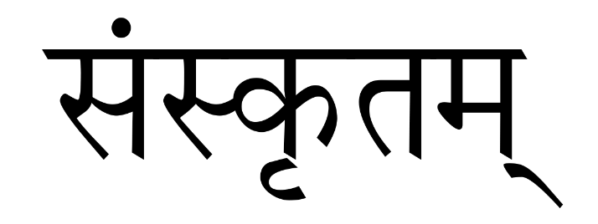
Non latin languages
Ligatures and conjoined letters to make words are common in many other languages such as Sanskrit, Arabic and forms of Asian calligraphy.
Notes:
https://simple.wikipedia.org/wiki/Sanskrit accessed 10/12/2017 – translation Sanskrit - written in Devanagari.

Slide 10
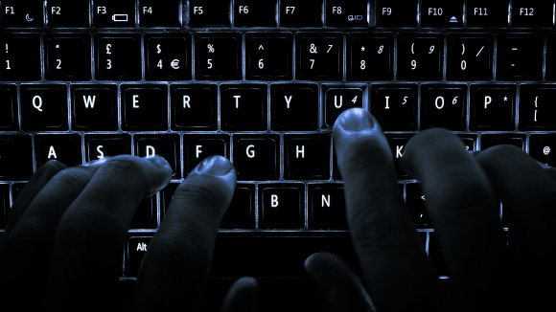
Qwerty
Qwerty is the arrangement of keys on the top line on a keyboard.
Ligatures are rarely used in print anymore.
Technology is consistently evolving. As the qwerty keyboard replaced the ligature, a new technology will replace our current desktop publishers.
Notes:
Tyepwriter image: http://italychronicles.com/wp-content/uploads/2010/09/Valentine-typewriter-red.jpg accessed 10/12/2017
QWERTY image: https://blog.wikimedia.org/2016/07/27/wikipedia-language-search/ accessed 15/01/2018

Slide 11
Over to you
Here are two examples of how ligatures can still be a valuable tool in Modern typography.
Create your own ligatures using by combining 2 letters to visually enhance the word.
Notes:
https://cdncms.fonts.net/images/11e480c620df0c14/fontology_ligatures_6.gif accessed 10/12/2017

