Slide 1

LEAP!
Level up your skills in section II - overview
Writing about HSC visual arts
Creative arts curriculum team
Notes:
Jump Sky Man - Free photo on Pixabay

Slide 2
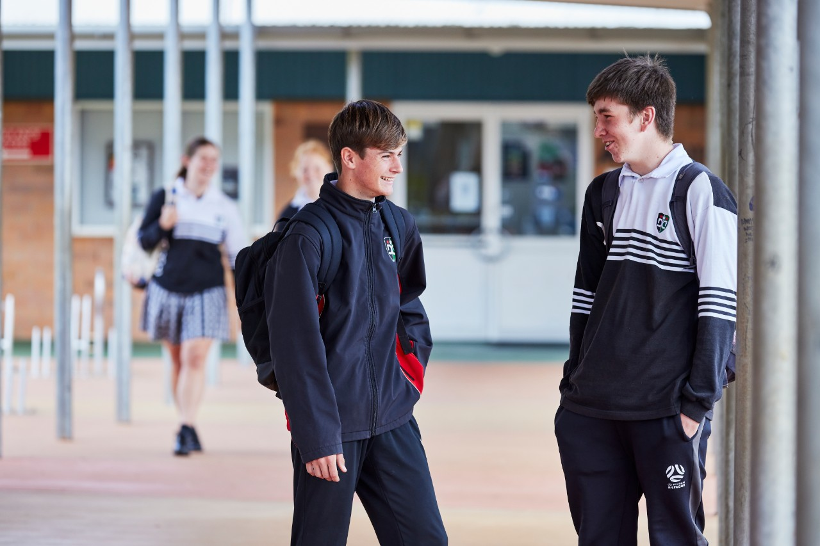
Purpose
The visual arts HSC written examination consists of 2 parts: section I and section II. The purpose of this student learning guide is to help you construct a well-informed, extended response for section II.
By completing the activities and integrating your case study knowledge, you will be better prepared to answer a section II question.
2

Slide 3

Overview – student learning guide
This student learning guide provides a scaffolded model which will help you to link your case study knowledge to aspects of syllabus content. This enables you to be well prepared to select and respond to section II questions in the visual arts HSC examination.
In this student learning guide, you will learn about using scaffolds to write an effective examination response. This will include:
using scaffolds to write an introduction, body paragraphs, and a conclusion
using connecting verbs to connect ideas and concepts together
moving from a descriptive to interpretive response
developing visual arts vocabulary.

Slide 4
Overview of section II
Section II consists of 6 questions, including 2 questions from each of the 3 syllabus content areas. As you prepare for the examination, remember:
you need to choose only one question to answer
this question is worth 25 marks and should take approximately 45 minutes to complete
the expected length of a response is approximately 1000 words.
In section II, your answer will be assessed on how well you:
present an informed point of view
apply your understanding of the different aspects of content (practice, conceptual framework, and the frames)
use relevant examples.

Slide 5
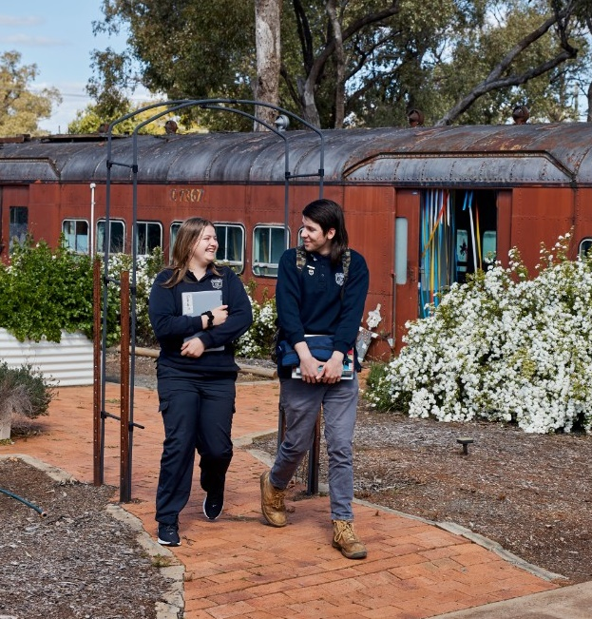
Overview of section II continued
Further information can be found in the visual arts 2021 HSC exam pack.
In your section II response, you will need to:
present a persuasive argument and interpretation of case study content
integrate syllabus content knowledge to support your argument
  practice – artmaking, art criticism and art history
  frames – subjective, structural, cultural, and postmodern
  conceptual framework – the agencies of the artworld, including artist, artwork, world, and audience
include artists and artworks as examples that are appropriate to the examination question.

Slide 6

What do I need to get started?
Access the section II questions in the Visual Arts 2017 HSC exam pack.
LEAP! Level up your skills in section II: preparing for the visual arts HSC written examination PowerPoints.
A device to work on the tasks digitally. If a device is not available, it can also be completed with a pen and paper.

Slide 7
Using this resource
To learn more about section II and how to answer the examination questions you can:
work through the PowerPoints in order​
use the PowerPoint names to navigate to the information/tasks you need.​
​This resource includes the overview and LEAP lessons.
The overview covers:
LEAP lessons cover:
      general advice
      essay structure
      selecting the right question.
      preparing case study research and summaries.
      breaking down the question
      planning in the examination
      writing an introductory paragraph
      writing the body of an extended response
      writing conclusions
      improving language
      completing your own extended response
7

Slide 8


General advice for section II
Constructing an informed point of view requires you to present factual information from your case studies, as well as persuasive writing.

Slide 9

Factual information
The inclusion of factual information from your case study will provide evidence and authenticity in your response.
Factual information includes:
the artist – their name, country of origin, and the time and place they worked
the artwork – the title of the work, the form of the work, and material properties
syllabus content – the words and terms used to identify practice in the artworld
art concepts – ideas about art, techniques, styles, and art movements
quotes – from informed audience members such as artists, art critics, art historians, curators, judges, and gallery owners.

Slide 10

Persuasive writing
Good persuasive writing blends fact and opinion seamlessly together, forming a response which reinforces your argument.
Persuasive writing:
aims to persuade, or convince, the reader that your argument is correct
helps to make your point of view logical and complex
suggests a highly developed understanding of the visual arts, in line with the marking guidelines
relies on interpretation rather than description.

Slide 11

General advice for section II continued
How you write is just as important as what you write about in an essay. To enhance your response, always:
use formal language instead of colloquial (slang) language
write in third person (no “I think”)
use subject-specific language, including visual arts syllabus words and terms
use direct, concise sentences rather than long sentences that attempt to link 3 or 4 ideas together
divide longer sentences into 2 shorter sentences to make your point clear.

Slide 12

Selecting the right question
Choosing a section II examination question that best matches your case study knowledge ensures your chosen artists and artworks strongly support your point of view or argument.
It is important to identify the concepts in common between the examination questions and your case study knowledge.
Section II consists of 6 extended response questions, including 2 questions from each of the 3 syllabus content areas (practice, frames, and conceptual framework). You must choose only one question to answer. This question is worth 25 marks.

Slide 13

Selecting the right question – part 1
There are the 6 extended response questions from the Visual Arts 2017 HSC exam pack. Note that they are divided into 3 syllabus areas over the next 3 slides.
Practice
Question 4
Investigate the changing roles of art galleries and art museums. In your answer, refer to specific artists and/or curators and/or exhibitions and/or art critics and/or art historians.
Question 5
“An artist’s practice is still shaped by their gender.”
Discuss this statement, referring to specific artists and artworks in your answer.
Highlight the key words in questions 4 and 5 that relate to the content area ‘practice’.

Slide 14
Selecting the right question – part 2
Conceptual Framework
Question 6
Explain how the interrelationship between physical site-specific artworks and the resulting documentation communicates meaning to an audience. In your answer, refer to specific artists and artworks.
Question 7
Examine how artists have used artworks to challenge social and political views in innovative ways. In your answer, refer to specific artists and artworks.
Highlight the key words in questions 6 and 7 that relate to the content area ‘conceptual framework’.

Slide 15
Selecting the right question – part 3
Frames
Question 8
Contemporary art can provide a valuable yet unsettling critique of society. Discuss this statement, referring to specific artists and artworks in your answer.
Question 9
“Nature is not only all that’s visible to the eye; it also includes the inner pictures of the soul” Edvard Munch.
With reference to this quotation, analyse how artists distort reality to represent personal and psychological experiences in their artworks. In your answer, refer to specific artists and artworks.
Highlight the key words in questions 8 and 9 that relate to the content area ‘frames’.

Slide 16
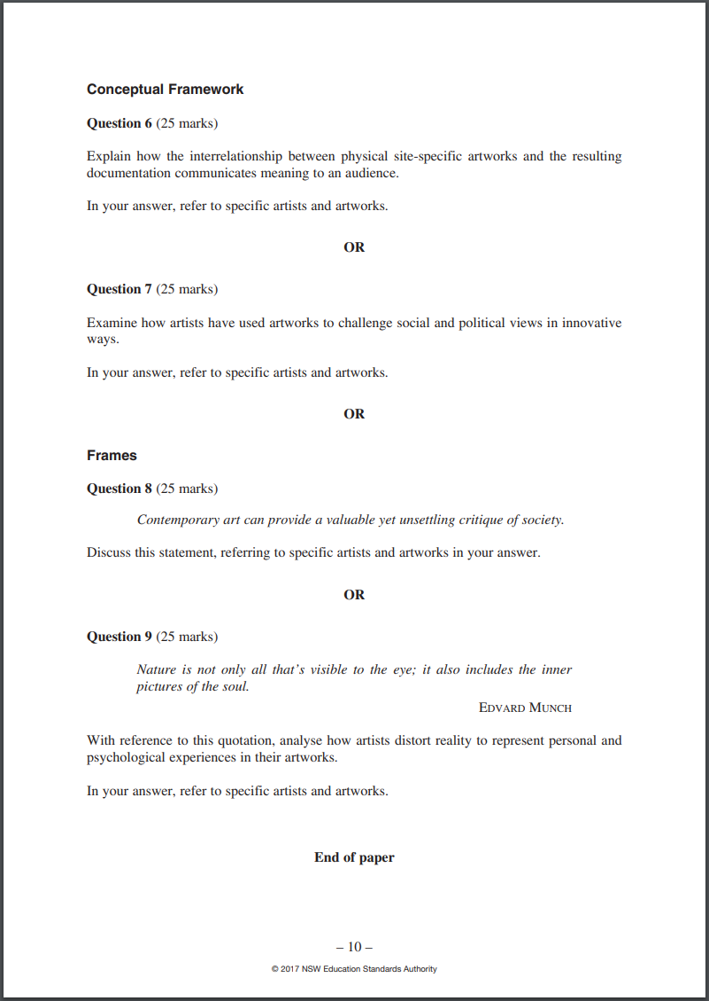
Selecting the right question
HSC questions are designed to be broad and general in their concepts so they can be answered by each student. They will not match your case studies exactly.
Hint: You need to look for a question that covers similar concepts or ideas about art that you have covered in your case studies. For instance, if you have completed a case study on feminism, or the human body, then question 5 from the 2017 paper may be a good question to attempt. However, if you have completed a case study on artists as agents for change, then either question 7 or 8 would be more suitable.

Slide 17
Selecting the right question task
1. List all the case studies that you have completed in class.
2. Select the question(s) from the Visual Arts HSC exam paper 2017 which best match your case study knowledge.
Note – you will be using this question throughout this student learning guide.
3. Identify the concepts found in your case study which will help you answer the question.
(add your response here)
(add your response here)
(add your response here)

Slide 18

Preparing case study research
Organising your research from your case study by concepts, themes, artists, and artworks aids examination preparation. This ensures a well-informed response that is relevant to the syllabus content being examined.
To prepare for the examination, you will need to collect research and summaries of the artists, artworks, and art movements covered in case studies. You also need to identify how these artists can be used as evidence. Identify each artist’s ideas, concepts about art, and the relevant syllabus content areas to demonstrate an informed point of view.
Each time you write an extended response, you will need to carefully select the most appropriate artists and artworks for each question, based on your case study knowledge.

Slide 19

Summaries
It is important that you make summaries of the artists you feel most confident to write about in your response. You may have written about these artists in previous examinations, or assessments. You can reuse some artists across the 3 syllabus areas.
Quotes from your chosen artist, or art critics, act as powerful evidence in presenting an informed point of view.
You will need to source these quotes during your preparation.

Slide 20
Summaries continued
Summary information should be grouped into syllabus content areas and case studies, as well across multiple syllabus content areas. You may find artists used in a cultural frame essay can also be useful for a question on the relationship between artists, world, or the audience in the conceptual framework. The number of artists and artworks used as evidence can vary. This learning resource uses knowledge of 3 artists as evidence. However, it is also possible to use a different number of artists and artworks.
Hint: It is a good idea to prepare summaries for written examinations for a range of 5-6 artists, across time and place.
Organise your information about each artist, or art movement, in paragraphs and use sub-headings that link back to the syllabus concepts. Try to include 3-4 key concepts. For example, gender, social concerns, or political art for each case study.

Slide 21
Preparing summaries
Complete the table on the next slide based on artists drawn from your case studies. The first row in the example below has been filled in to provide a model for you to follow.
In column 5, identify the questions from the Visual Arts 2017 HSC exam pack you could answer, using your listed artists and artworks. Ensure you include the question you selected in selecting the right question task.
In column 6, source a quote from the artist, or art critic, that can act as evidence.
Table 1: Preparing case studies information task example
Artists – List artists useful as evidence in your identified question | Artworks – List artwork to use as evidence | Concepts – Identify case study concepts for each artist. For example, gender, social, or political issues | Syllabus areas – Identify where these artists/artworks fit in the syllabus. There should be multiple areas. | 2017 Section II questions – Match the Section II questions to your artists, syllabus area, concepts and themes | Quotes as evidence – Source quotes from artists/art writers as evidence of point of view
Goya | ‘The Third of May, 1808’ | Art as social commentary, politics, artists as agents of change, war, innovation | Cultural frame, artist/world, artist practice | Q7 | ‘The first big picture that was revolutionary in every sense of the word, in style, in subject, and intention’. Kenneth Clark

Slide 22
Prepare your summaries
Table 2: Preparing case studies information task
Artists – List artists useful as evidence in your identified question | Artworks – List artwork to use as evidence | Concepts – Identify case study concepts for each artist. For example, gender, social, or political issues | Syllabus areas – Identify where these artists/artworks fit in the syllabus. There should be multiple areas. | 2017 Section II questions – Match the Section II questions to your artists, syllabus area, concepts and themes | Quotes as evidence – Source quotes from artists/art writers as evidence of point of view
Goya | ‘The Third of May, 1808’ | Art as social commentary, politics, artists as agents of change, war, innovation | Cultural frame, artist/world, artists’ practice | Q7 | ‘The first big picture that was revolutionary in every sense of the word, in style, in subject, and intention’. Kenneth Clark
(add artist) | (add artwork) | (add case study) | (add syllabus links) | (add 2017 question) | (add sourced quote)
(add artist) | (add artwork) | (add case study) | (add syllabus links) | (add 2017 question) | (add sourced quote)
(add artist) | (add artwork) | (add case study) | (add syllabus links) | (add 2017 question) | (add sourced quote)
(add artist) | (add artwork) | (add case study) | (add syllabus links) | (add 2017 question) | (add sourced quote)
(add artist) | (add artwork) | (add case study) | (add syllabus links) | (add 2017 question) | (add sourced quote)

Slide 23
References for LEAP! – Level up your skills in section II
Links to third-party material and websites
If you use the links provided in this document to access a third-party's website, you acknowledge that the terms of use, including license terms set out on the third-party's website apply to the use which may be made of the materials on that third-party website or were permitted by the Copyright Act 1968 (Cth). The department accepts no responsibility for content on third-party websites.
All material © State of New South Wales (Department of Education), 2021 unless otherwise indicated. All other material used by permission or under license.
Glossary of Key Words@ NSW Education Standards Authority (NESA) for and on behalf of the Crown in right of the State of New South Wales, [2008] accessed 25/10/2022.
Pixabay (2017) Jump for joy [image] accessed 23/02/23
Visual Arts Stage 6 Syllabus © 2016 NSW Education Standards Authority (NESA) for and on behalf of the Crown in right of the State of New South Wales.
Visual Arts HSC exam pack 2021 © NSW Education Standards Authority (NESA) for and on behalf of the Crown in right of the State of New South Wales, [2021] accessed 25/10/2022.
Visual Arts HSC exam pack 2017 @NSW Education Standards Authority (NESA) for and on behalf of the Crown in right of the State of New South Wales, [2017] accessed 25/10/2022.
Visual Arts | NSW Education Standards @NSW Education Standards Authority (NESA) for and on behalf of the Crown in right of the State of New South Wales, [2017] accessed 25/10/2022.
Learning Hub Learning Hub | Writing paragraphs with PEEL [website] accessed 25/10/2022.

