Slide 1

LEAP!
Level up your skills in section II– improving language skills
Writing about HSC visual arts
Creative arts curriculum team
Notes:
Jump Sky Man - Free photo on Pixabay

Slide 2
LEAP lessons introduction
LEAP lessons are structured in 4 parts.
Learn – provides information about topic.
Example – provides an example response, often using a scaffold.
Apply – apply your learning to answer a section II question
Practise – key points to remember when you practise in the future for assessment and examination preparation.
Breaking down the question
L
E
A
P
Learn
Example
Apply
Practise

Slide 3
Learn – connecting verbs bank
Below is a table of connecting words suitable for a visual arts extended response. The suggested column includes synonyms for ‘shows’, the extended column includes more sophisticated word choices that may imply intention or judgement. The supplementary column offers phrases to introduce concepts.
L
Table 23: Connecting words
Learn
Suggested | Extended | Supplementary
suggests | creates | positions the audience as…
emphasises | constructs | presents a vison of….
captures | recalls | creates a lens of…
represents | connects | draws us into…
demonstrates | explores | acts as a pivot between…
depicts | evaluates | serves as a symbol of…
expresses | reminds | infers the concept of …
communicates | locates | invites the audience to consider…
highlights | privileges | shifts away from…
reveals | challenges | offers a different perspective of…
illustrates | informs | evocatively highlights…
implies | promotes | acts as recognitions of…
conveys | questions | draws the audience into a…
examines | evokes | hints at a connection between…
Connecting verbs will help you to link your ideas and concepts together in a cohesive way, which reinforces your argument. Using connecting verbs allows you to be more precise about the relationship between 2 connected concepts.

Slide 4

Example – planning your response
E
Highlight where connecting verbs and phrases have been used in the Connecting verbs activity. Look at how these words and phrases connect either the artist intention or the audience response to the artists’ choice of techniques. Some connecting verbs have been highlighted in bold as a guide.
It may be helpful to have a copy of table 23 on the previous slide open when you are completing this activity.
Example

Slide 5
Apply – connecting verbs
A
Edit 2 of your own paragraph sentences from your completed Table 17 – PEEL paragraph, using connecting verbs from the table above. If you feel confident, experiment with the phrases in the supplementary column.
Apply
Write your 2 edited sentences here.

Slide 6
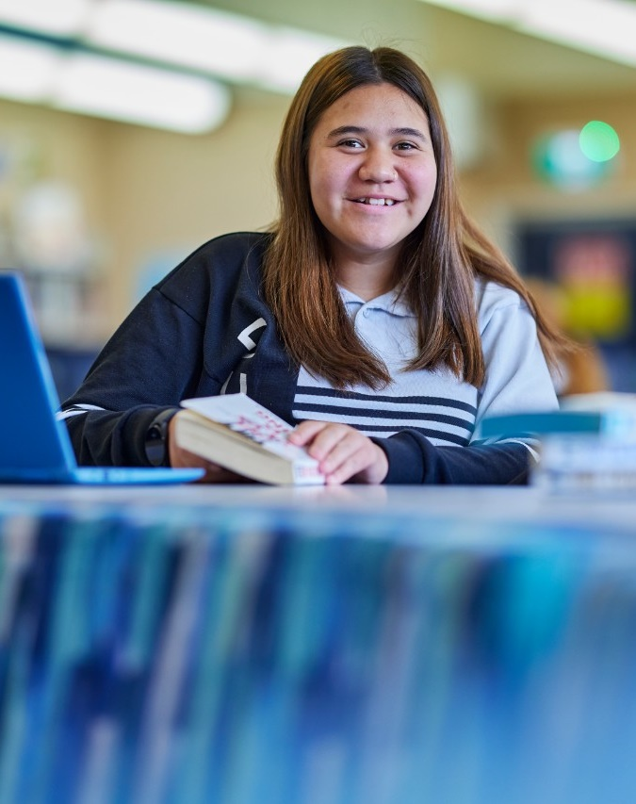
Practise – connecting verbs
P
The tips below are suggestions you may use to practise the skills and knowledge in this LEAP lesson.
Keep a copy of the connecting verbs bank to refer to when you are practising writing responses for section II.
After any writing activity review your work for opportunities to refine the connecting verbs.
Practise

Slide 7
References for LEAP! – Level up your skills in section II
Links to third-party material and websites
If you use the links provided in this document to access a third-party's website, you acknowledge that the terms of use, including license terms set out on the third-party's website apply to the use which may be made of the materials on that third-party website or were permitted by the Copyright Act 1968 (Cth). The department accepts no responsibility for content on third-party websites.
All material © State of New South Wales (Department of Education), 2021 unless otherwise indicated. All other material used by permission or under license.
Glossary of Key Words@ NSW Education Standards Authority (NESA) for and on behalf of the Crown in right of the State of New South Wales, [2008] accessed 25/10/2022.
Pixabay (2017) Jump for joy [image] accessed 23/02/23
Visual Arts Stage 6 Syllabus © 2016 NSW Education Standards Authority (NESA) for and on behalf of the Crown in right of the State of New South Wales.
Visual Arts HSC exam pack 2021 © NSW Education Standards Authority (NESA) for and on behalf of the Crown in right of the State of New South Wales, [2021] accessed 25/10/2022.
Visual Arts HSC exam pack 2017 @NSW Education Standards Authority (NESA) for and on behalf of the Crown in right of the State of New South Wales, [2017] accessed 25/10/2022.
Visual Arts | NSW Education Standards @NSW Education Standards Authority (NESA) for and on behalf of the Crown in right of the State of New South Wales, [2017] accessed 25/10/2022.
Learning Hub Learning Hub | Writing paragraphs with PEEL [website] accessed 25/10/2022.

