Slide 1
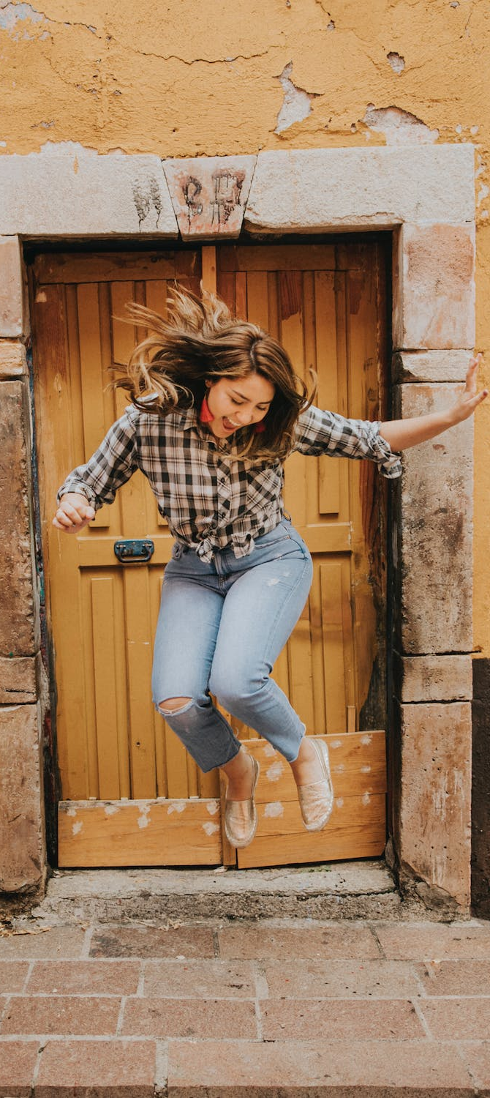
LEAP!
Level up your skills in section I – scaffold the body of your response
Writing about HSC visual arts
Creative arts curriculum team
Notes:
https://www.pexels.com/photo/woman-in-black-and-white-plaid-shirt-and-blue-denim-jeans-jumping-on-brown-concrete-floor-3680771/

Slide 2
LEAP lessons introduction
LEAP lessons are structured in 4 parts.
Learn – provides information about topic.
Example – provides an example response to a question, often using a scaffold.
Apply – apply your learning to answer a question.
Practise – practise your new skills and knowledge by answering a new question in more depth.
The body of your response
L
E
A
P
Learn
Example
Apply
Practise
2

Slide 3
Learn – scaffold the body of your response – part 1
L
In this activity you will learn how to:
​structure a paragraph
expand your points to answer the question thoroughly.
This learning resource uses the PEEL paragraph scaffold. Organise and expand on the KCI technique used in the planning activities to construct your body paragraphs for section I using a PEEL paragraph.
A scaffold allows you to lay out the individual elements of your response in a concise but structured way. Section I responses should be grouped into paragraphs containing related ideas and concepts. All the information on each artwork should form a paragraph. Examination responses should connect each paragraph to the question’s concept and your main argument, as discussed in your introductory sentence(s).
Learn
This can be used once the steps outlined in breaking down the question and planning are completed.

Slide 4
Learn – scaffold the body of your response – part 2
L
The PEEL scaffold below is used to create concise paragraphs which effectively connect your point of view about the concepts found in the question to the evidence found in the citation and visual properties of the plate to your wider art world knowledge and your understanding of syllabus content.
Learn
Table 17: PEEL scaffold
Paragraph part | Paragraph element
Point | Introduce and make the point in a topic sentence.
Explain | The second sentence of the paragraph should extend the ideas of the first sentence by elaborating your argument, using persuasive writing.
Evidence/examples | Example or evidence. This could be from a plate, citation, source material, quote, or a paraphrase from a recognised source.
Link | Link back to the question.

Slide 5
Learn – PEEL paragraph breakdown
L
In the PEEL scaffold there are several elements you can include in each step. By including all elements, you will help your response move from being a descriptive response to an interpretative response. You will need to adjust the elements of the paragraphs according to the syllabus content being examined and key words of the question.
Learn
Table 18: Breakdown of elements of PEEL scaffold
Part | Elements of paragraph incorporating KCI
Point | State the main point clearly identifying concepts and syllabus content embedded in the question.
Explain/ evidence | Explain and connect the concepts of the question to the factual information provided in the source material and citation as evidence of your point of view. This will include the materials, techniques, forms, time, place and any supplementary information included in the plate’s booklet.
Explain/ evidence | Provide evidence of your point of view by connecting the concepts found in question to citation and visual properties of the plate(s). This may include techniques, symbolism, composition, materials, intention, style as further evidence of the point of the paragraph.
Evidence | Provide evidence of possible interpretations of meaning within the artwork and link back to concept found in the question. Use QIC (connect question/image/citation). Refer to title as a hint to interpret meaning, where possible.
Link | One sentence that links the point of the paragraph back to the question. This must explain how your point addresses the question, using words such as ‘thus’, ‘in this way’ or ‘ultimately’ to start the sentence. Note: In question 1 this would be the concluding sentence as the question usually only refers to one artist/ artwork.

Slide 6
Example – PEEL paragraphs – part 1
E
Question 2 (8 marks)
Refer to plate 2 on page 2 and plate 3 on page 3 of the plates booklet to answer
Compare how El Greco and Feng Mengbo have explored the use of light and space in their artworks to create meaning.
Example
Question 2 starts with the word ‘compare’ so it needs cross references between the two plates to fulfill this demand. It refers to 2 artworks (plates) as source material and requires critical analysis and evaluation of both plates to persuade and convince the examiner.
In the example response each paragraph is dedicated to a plate referred to in the question while also comparing to the other plate found in the source material. It also includes an introduction and conclusion sentence referencing both artworks.
It makes at least 3 well-argued points in each paragraph, with each paragraph 150-170 words in length making a total of around 360 words altogether.

Slide 7
Example – PEEL paragraphs – part 2
Here is an example of a PEEL body paragraph for El Greco and Plate 2, for question 2.
El Greco used dramatic light and confined space to create allegorical meanings in plate 2. The artist used conventional western materials and form in his oil painting on canvas. An ape and a foolishly grinning man watch on as a young boy lights a candle, their faces glow in dramatic lighting. This figurative painting uses dramatic light and dark, aimed at a religious 16th century Spanish audience, familiar with his symbolic visual language. Using a traditional triangular composition, he tightly crops his figures in a dark space. This illusion of confined space emphasises the foreground only, conveying drama and mystery. Unlike Feng Mengbo’s interactive digital work, El Greco’s conventional materials and scale ensured the work remained a precious, permanent reminder of layered meanings. The title reinforces the meaning with symbolic references to the boy, fool and ape. El Greco’s use of dramatic chiaroscuro to model human form creates the focal point of the image. El Greco employs traditional but dramatic chiaroscuro and closed space, to provoke a powerful response to his allegorical meanings.

Slide 8
Apply – PEEL paragraphs incorporating KCI – part 1
A
Table 16 incorporates the KCI technique used in planning into the PEEL scaffold. Words are outlined in bold to highlight PEEL and KCI.
You need to copy each sentence in the example on the previous slide and paste the text into column 4 of the table 16. It may be helpful to copy and paste both the text and table into a word document.
Select sentences that best represent the information in columns 2 and 3 and paste them into column 4. There are 2 examples of this task using two sentences from the El Greco paragraph in column 3, in row 1 (point) and row 3 (explain/evidence).
You can place more than one sentence against each PEEL paragraph part.
Apply
Click here to access
Table 16 – PEEL and KCI scaffold.

Slide 9
Apply – PEEL paragraphs incorporating KCI – part 2
It’s time to answer question 1 using the ‘PEEL paragraph incorporating KCI’ scaffold. Read the tips below before continuing onto the next slide to complete the activity.
This question 1 example is worth 5 marks.
Under examination conditions this response should take only 8 minutes.
It starts with the word, ‘how’, and refers to one artwork. It therefore requires less depth and detail than question 2.
Your response should:
include at least 3 well-argued points
be 150-180 words in length
be written concisely
be a short introductory sentence, a body paragraph, and a short conclusion sentence.

Slide 10
Apply – PEEL paragraphs incorporating KCI – part 3
A
Question 1 (5 marks)
Refer to plate 1 on page 1 of the plates booklet to answer question 1.
How does Lin Onus incorporate both the traditional and the contemporary in his artmaking practice?
Apply
1. Complete columns 3 and 4 in table 18 – question 1 PEEL paragraph incorporating KCI.
2. Cut and paste your responses from the 4th column of table 18 underneath your introductory sentence on the Response to question 1 and 3 Word document to continue to build your response.
3. Read, review and edit your question 1 response as required to ensure it flows, is concise, covers the syllabus area and concepts inferred of the question and uses evidence from the citation information and visual properties. It should be 150-180 words.

Slide 11
Practise – PEEL paragraphs incorporating KCI – part 1
P
It’s time to answer question 3 using the ‘PEEL paragraph incorporating KCI’ scaffold. Read the tips below before continuing on to the next slide to complete the activity.
Practise
It starts with the word, ‘analyse’, and refers to one artwork. It requires you to analyse and interpret all plates in relation to the question, using persuasive and convincing evidence drawn from the citation and plates.
This question 3 response should:
include 3 well-argued points with evidence in each body paragraph, making 8-9 points in total.
be 450-500 words in length, with each body paragraph around 140-150 words.
include short introductory paragraph, a body paragraph for each plate, and a short conclusion paragraph.
This question 3 example is worth 12 marks.
Under examination conditions this response should take 21 minutes.

Slide 12
Practise – PEEL paragraphs incorporating KCI – part 2
P
Question 3
Refer to plates 4, 5 and 6 on pages 4, 5 and 6 of the plates booklet to answer question 3.
Analyse the relationships between the artworks and the audience for plates 4, 5 and 6.
Practise
1. Complete columns 3 and 4 in table 19 – question 3 PEEL paragraph incorporating KCI.
2. Cut and paste your responses from the 4th column of table 19 underneath your introductory sentence on the Response to question 1 and 3 Word document.
3. Read, review and edit your question 3 response as required to ensure it flows, is concise, covers the syllabus area and concepts inferred of the question and uses evidence from the citation information and visual properties. It should be 150-180 words.

Slide 13
References
Links to third-party material and websites
If you use the links provided in this document to access a third-party's website, you acknowledge that the terms of use, including license terms set out on the third-party's website apply to the use which may be made of the materials on that third-party website or were permitted by the Copyright Act 1968 (Cth). The department accepts no responsibility for content on third-party websites.
All material © State of New South Wales (Department of Education), 2021 unless otherwise indicated. All other material used by permission or under licence.
NSW Education Standards Authority (NESA) Glossary of Key Words NESA website, accessed 03/02/2023.
NSW Education Standards Authority (NESA) Visual Arts 2017 HSC exam pack NESA website, accessed 03/02/2023.
Visual Arts HSC exam paper 2017 © NSW Education Standards Authority (NESA) for and on behalf of the Crown in right of the State of New South Wales, [2017] accessed 03/02/2023.
Visual Arts Stage 6 syllabus 2016 © NSW Education Standards Authority (NESA) for and on behalf of the Crown in right of the State of New South Wales, [2016] accessed 03/02/2023.
Pexels (2022) Woman jumping [image] accessed 11/02/2023.

