Slide 1
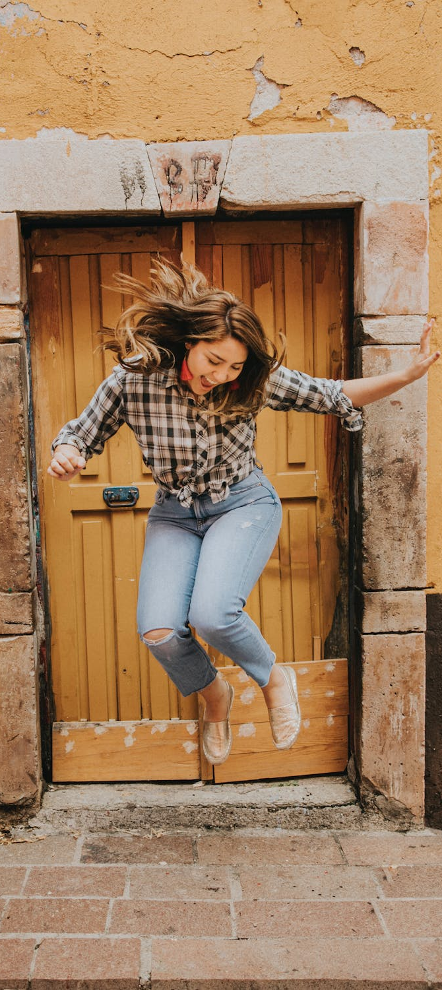
LEAP!
Level up your skills in section I – review and edit responses
Writing about HSC visual arts
Creative arts curriculum team
Notes:
https://www.pexels.com/photo/woman-in-black-and-white-plaid-shirt-and-blue-denim-jeans-jumping-on-brown-concrete-floor-3680771/

Slide 2
LEAP lessons introduction
LEAP lessons are structured in 4 parts.
Learn – provides information about topic.
Example – provides an example response to a question, often using a scaffold.
Apply – apply your learning to answer a question.
Practise – practise your new skills and knowledge by answering a new question in more depth.
Review and edit responses
L
E
A
P
Learn
Example
Apply
Practise
2

Slide 3
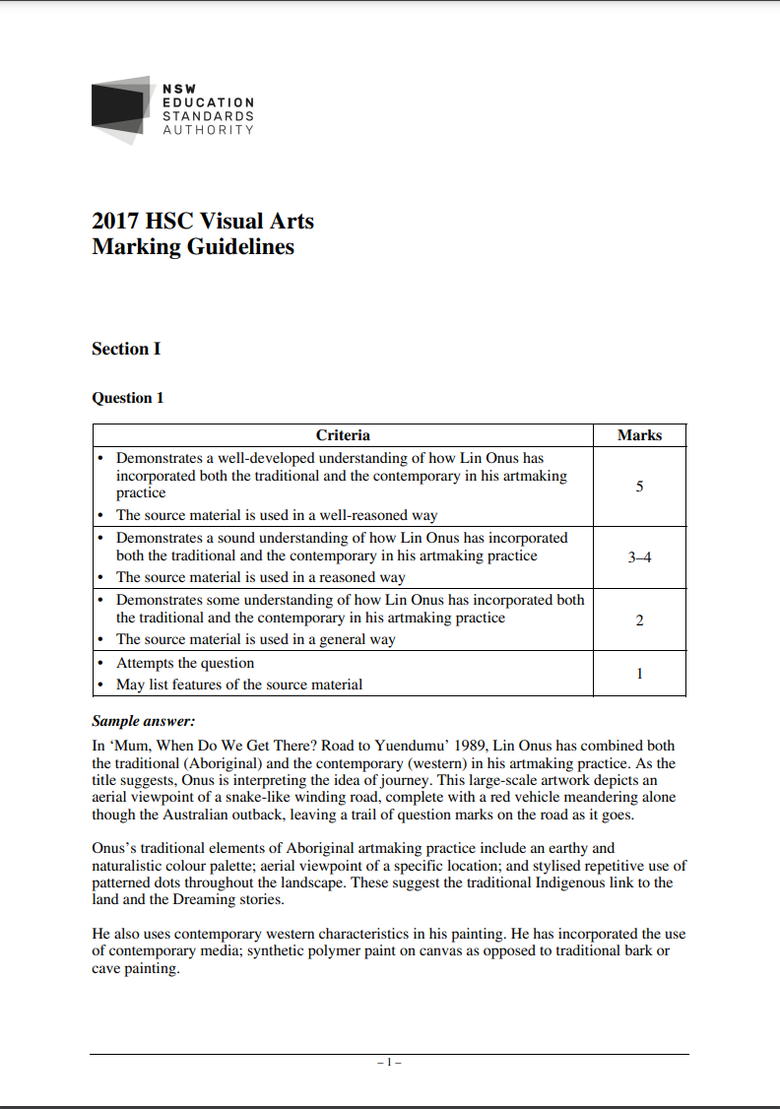
Learn – review and edit section 1 responses
L
Assessing your answers to HSC section I questions against the marking guidelines provided by NESA can provide valuable information about how to improve your responses in the future.
In this activity, you will learn how to:
review your responses against the marking guidelines
develop and apply feedback based on the marking guidelines
Improve the quality of your responses.
Learn

Slide 4
Learn – review and edit section 1 responses
L
Marking guidelines are developed by NESA in conjunction with each examination paper to be used by markers to guide their marking of a student's response. These are presented as a table form with criteria against each mark or mark range. Sample answers are also sometimes provided in the guidelines.
Learn

Slide 5
Example – review and edit section 1 responses
See how the example response for question 2 has been assessed against the making guidelines.
The response has been reviewed in a 2-step process.
Response is read through carefully and all evidence is identified and coded with the appropriate colour and/or bold.
The evidence is re-read and aligned to the most appropriate criteria level in the marking guidelines. The discriminating terms that indicate criteria level have been underlined in the Example response review using the marking guidelines. Generally, there will be a criteria level that at least half the evidence aligns to. This is a good indication of where the response sits based on the marking guidelines.
If the evidence is split over multiple criteria levels, award the mark range aligned with most of the evidence. When other evidence is sitting in the criteria level above or below, this is a sign that the mark awarded could be in the higher or lower end of the mark range. For example, if most of the evidence in a response is sitting in criteria level 3 and there are some evidence points in level 4 and 1 evidence point level 2, the response would be considered as meeting the upper range of the criteria level 3-mark range.
E
Example

Slide 6
Apply and practise – review and edit section 1 responses
A
Refer to ‘Response to question 1 and 3’ to review your work against the 2017 marking guidelines and edit by completing the steps below.
1
2
3
4
Apply
1. Review your responses against the visual arts marking guidelines 2017. Assess your response against the mark ranges provided by highlighting evidence from your response that meets the criteria.
2. Read the marking criteria and the dot points below each question under the headings ‘Answers could include’. Some questions also provide sample answers which may or may not be of use.
3. Edit and improve your response based on these marking guidelines and dot points, ensuring you stay within the suggested word limits provided earlier in this document.
4. Re-read your completed response to ensure it flows well. Add words to connect paragraphs as required. This may include: ‘furthermore’, ultimately’, ‘additionally’ or ‘in conclusion’.
P
Practise

Slide 7
References
Links to third-party material and websites
If you use the links provided in this document to access a third-party's website, you acknowledge that the terms of use, including license terms set out on the third-party's website apply to the use which may be made of the materials on that third-party website or were permitted by the Copyright Act 1968 (Cth). The department accepts no responsibility for content on third-party websites.
All material © State of New South Wales (Department of Education), 2021 unless otherwise indicated. All other material used by permission or under licence.
NSW Education Standards Authority (NESA) Glossary of Key Words NESA website, accessed 03/02/2023.
NSW Education Standards Authority (NESA) Visual Arts 2017 HSC exam pack NESA website, accessed 03/02/2023.
Visual Arts HSC exam paper 2017 © NSW Education Standards Authority (NESA) for and on behalf of the Crown in right of the State of New South Wales, [2017] accessed 03/02/2023.
Visual Arts Stage 6 syllabus 2016 © NSW Education Standards Authority (NESA) for and on behalf of the Crown in right of the State of New South Wales, [2016] accessed 03/02/2023.
Pexels (2022) Woman jumping [image] accessed 11/02/2023.

