Slide 1
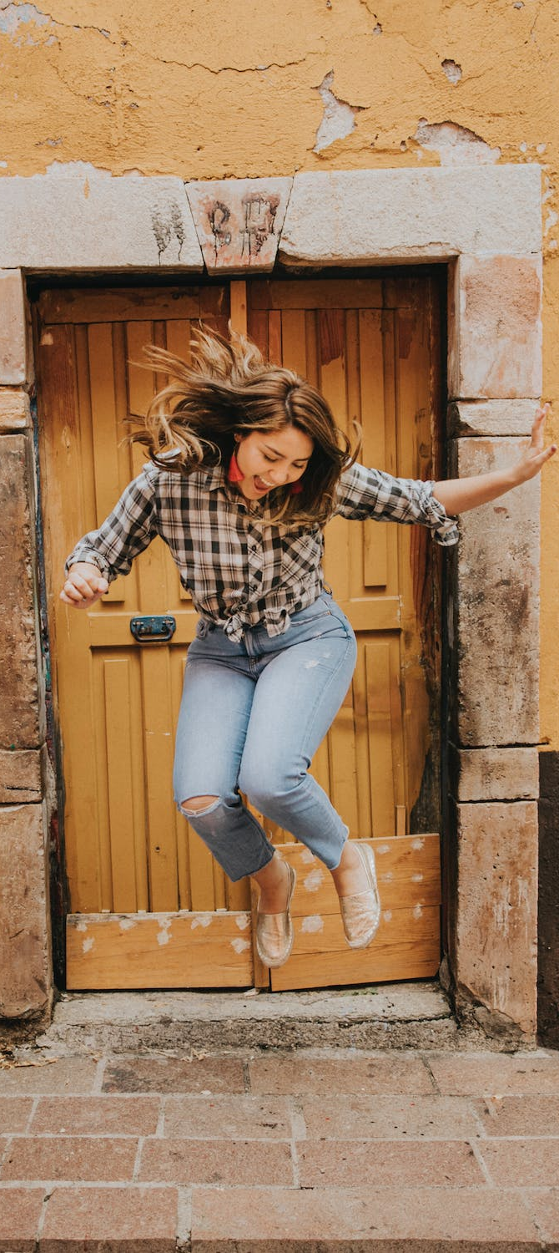
LEAP!
Level up your skills in section I – planning your response
Writing about HSC visual arts
Creative arts curriculum team
Notes:
https://www.pexels.com/photo/woman-in-black-and-white-plaid-shirt-and-blue-denim-jeans-jumping-on-brown-concrete-floor-3680771/

Slide 2
LEAP lessons introduction
LEAP lessons are structured in 4 parts.
Learn – provides information about topic.
Example – provides an example response to a question, often using a scaffold.
Apply – apply your learning to answer a question.
Practise – practise your new skills and knowledge by answering a new question in more depth.
Planning your response
L
E
A
P
Learn
Example
Apply
Practise
2

Slide 3
Learn – planning your response
L
In this activity, you will learn how to:
include all parts of the question in your response
plan a response.
Plan your response by breaking down the question into parts. This helps to organise and structure your knowledge in a concise and well-reasoned way and present an informed point of view.
Learn

Slide 4
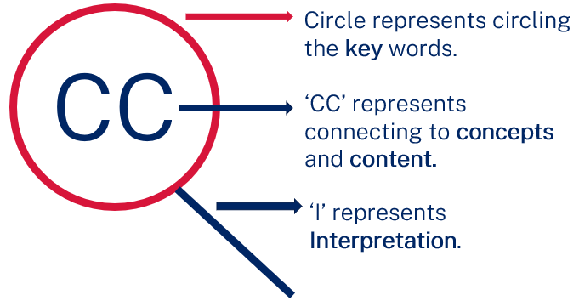
Learn – planning your response – part 1
L
Plan your response by breaking down the question into parts. This helps to organise and structure your knowledge in a concise and well-reasoned way and present an informed point of view.
KCI magnifying glass explained
Learn
In examination conditions, writing a plan should only take 30 seconds before responding to each question. This activity is designed to give you a strategy to practise extracting the information you need to plan your response. Initially it may take you longer to plan your response. Keep practising until you can plan quickly, with brief notes for each question.

Slide 5
Learn – planning your response – part 2
Table 8: KCI planning steps
Step and symbol | Explanation
Key words | Circle the question’s key words, including the: question verb to direct your response syllabus content area (conceptual framework, frames or practice) question’s concept. Hint: refer to subject-specific words from your visual arts word bank
Connect to concepts and content CC | Connect: concepts to references – plate(s) and source material syllabus content to references – plate(s) and source material.
Interpret | Interpret meaning or main idea within the artwork. The title may provide a hint to the meaning as well.
L
Learn
Hint: To remember the steps required in the planning stage, use the acronym KCI, as outlined in table 6: key words, connect the question’s concepts to the citation, connect the question’s concepts to the plate, interpret meaning, or the main ideas, within the artwork.

Slide 6
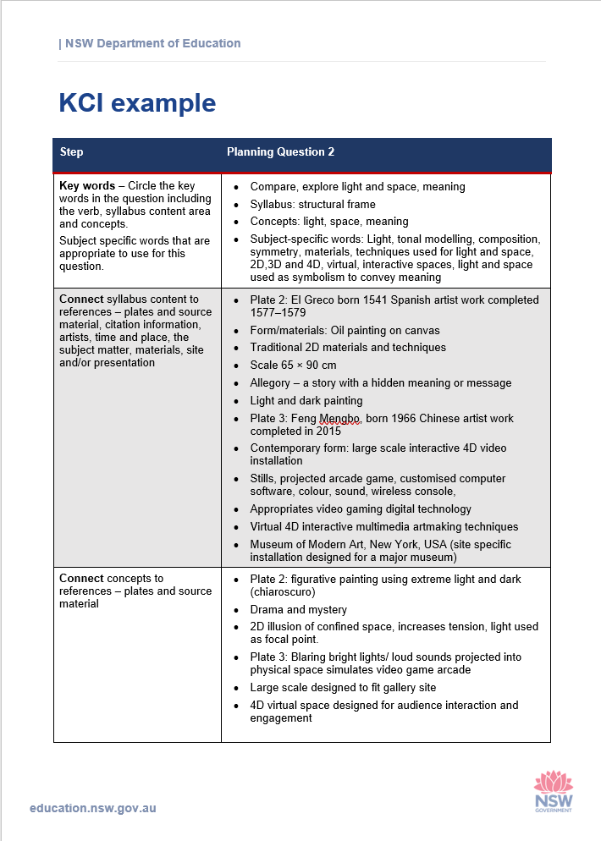
Example – planning your response using KCI
E
Click here to see a completed KCI table for question 2 of the 2017 Visual arts HSC examination paper.
Example
Hint: Remember, under examination conditions, a plan would be written directly on the plate’s booklet, annotating the citation and plates, and underling key words.
Complete this task by annotating the plates and accompanying source material as you would under examination conditions, where possible. Refer to task 1 – visual arts word bank when planning your response.

Slide 7
Apply – planning your response using KCI
Question 1 (5 marks)
Refer to plate 1 on page 1 of the plates booklet to answer question 1.
How does Lin Onus incorporate both the traditional and the contemporary in his artmaking practice?
A
Table 9: Planning your response to question 1
Apply
Step | Question 1
Key words – circle the key words in the question including the verb, syllabus content area and concepts. Subject specific words that are appropriate to use for this question. | (add response)
Connect syllabus content to references – plates and source material, citation information, artists, time and place, the subject matter, materials, site and/or presentation. | (add response)
Connect concepts to references – plates and source material. | (add response)
Interpret meaning, or main idea, within the artwork. Refer to title as a hint. | (add response)
In this task, you will plan a response to question 1 from the 2017 HSC visual arts written examination, using the acronym KCI in table 9. Use dot points to outline your plan.

Slide 8
Practise – planning your response using KCI
Question 3
Refer to plates 4, 5 and 6 on pages 4, 5 and 6 of the plates booklet to answer question 3.
Analyse the relationships between the artworks and the audience for plates 4, 5 and 6.
P
Table 10: Planning your response to question 3
Practice
Step | Question 3
Key words – circle the key words in the question including the verb, syllabus content area and concepts. Subject specific words that are appropriate to use for this question. | (add response)
Connect syllabus content to references – plates and source material, citation information, artists, time and place, the subject matter, materials, site and/or presentation. | (add response)
Connect concepts to references – plates and source material. | (add response)
Interpret meaning, or main idea, within the artwork. Refer to title as a hint. | (add response)
In this task, you will plan a response to question 3 from the 2017 HSC visual arts written examination, using the acronym KCI in table 10. Use dot points to outline your plan.

Slide 9
References
Links to third-party material and websites
If you use the links provided in this document to access a third-party's website, you acknowledge that the terms of use, including license terms set out on the third-party's website apply to the use which may be made of the materials on that third-party website or were permitted by the Copyright Act 1968 (Cth). The department accepts no responsibility for content on third-party websites.
All material © State of New South Wales (Department of Education), 2021 unless otherwise indicated. All other material used by permission or under licence.
NSW Education Standards Authority (NESA) Glossary of Key Words NESA website, accessed 03/02/2023.
NSW Education Standards Authority (NESA) Visual Arts 2017 HSC exam pack NESA website, accessed 03/02/2023.
Visual Arts HSC exam paper 2017 © NSW Education Standards Authority (NESA) for and on behalf of the Crown in right of the State of New South Wales, [2017] accessed 03/02/2023.
Visual Arts Stage 6 syllabus 2016 © NSW Education Standards Authority (NESA) for and on behalf of the Crown in right of the State of New South Wales, [2016] accessed 03/02/2023.
Pexels (2022) Woman jumping [image] accessed 11/02/2023.

