Slide 1

LEAP!
Level up your skills in section I – overview
Writing about HSC visual arts
Creative arts curriculum team

Slide 2
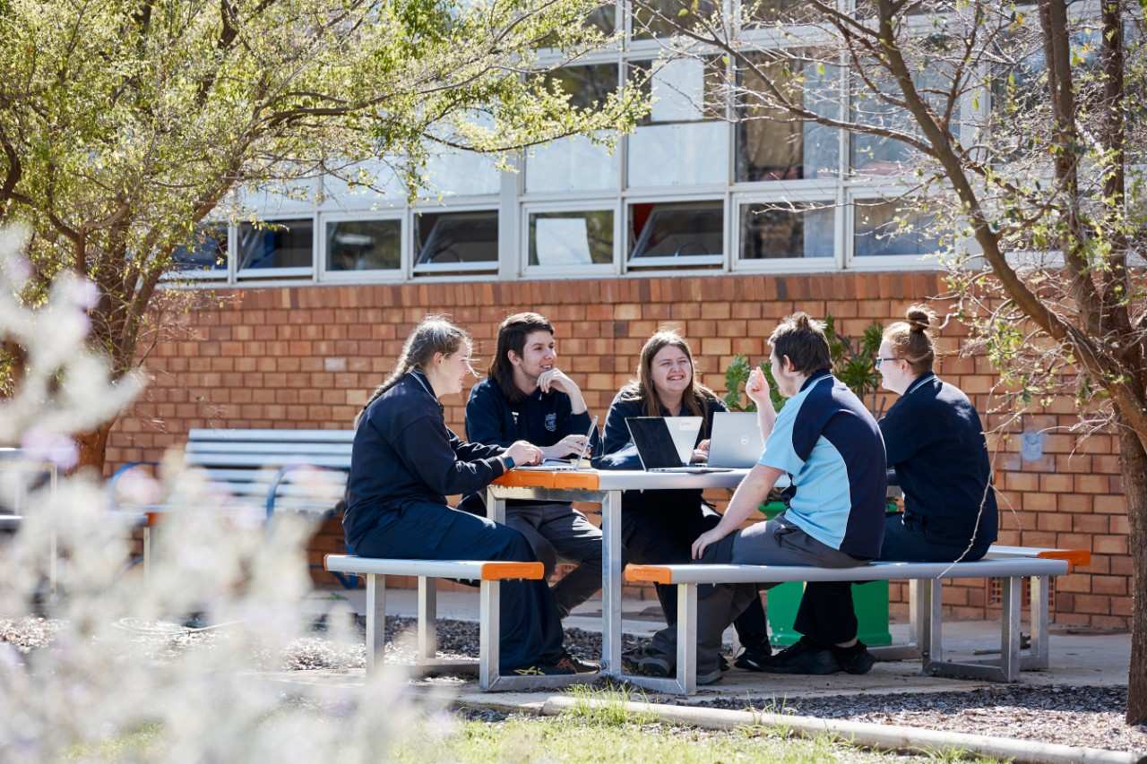
Purpose
The purpose of this student learning guide is to help you write insightful, concise and well-informed section I responses for the visual arts HSC written examination. By reading the information and completing the activities, you will learn how to apply your knowledge and understanding of the visual arts syllabus to answer each question in section I of the examination.

Slide 3

Overview
In this learning guide, you will unpack the demands of a section I question. This involves:
understanding the requirements of questions 1, 2 and 3 in section I
developing a summary of subject-specific terms
breaking down each question into parts
planning your written response
deconstructing a modelled response
producing a response
reviewing and refining the response against the marking guidelines.

Slide 4

What do I need to get started?
To make the most of this resource you will need:
to access the plates and other source material in the Visual Arts 2017 HSC exam pack
LEAP! Level up your skills in section I resources
a device to work on the tasks digitally, if a device is not available it can also be completed with a pen and paper.

Slide 5
Using this resource
This resource includes the overview and LEAP lessons over a series of PowerPoints.
To learn more about section I and how to answer the examination questions you can:
      work through the PowerPoints in order
      use the PowerPoint names to navigate to the information/tasks you need.

Slide 6
Resource contents
The overview covers:
LEAP lessons cover:
Extra information:
      general advice
      section I requirements
      plates booklet
      writing a response.
      preparing to write a response
      breaking down the question
      planning your response
      deconstructing a modelled response
      introductory sentence(s)
      scaffold the body of your response
      concluding sentence(s)
      review and refine.
      further advice for section I
      advice for teachers.

Slide 7

General advice – part 1
Section I:
is worth 25 marks in total and consists of three short response questions
each questions mark value is different and usually increases from question 1 to 3
you must complete all three questions
allow 45 minutes to complete this section of the examination.
questions are based on three content areas from the Stage 6 visual arts syllabus
  practice: artmaking; art criticism and art history
  frames: subjective; structural; cultural; postmodern
  conceptual framework: artist; artwork; world; audience.
In section I of the visual arts examination, you will be required to:
apply your knowledge and deep understanding of the syllabus content to interpret the question
use the plates and source material as evidence to support your point of view.

Slide 8
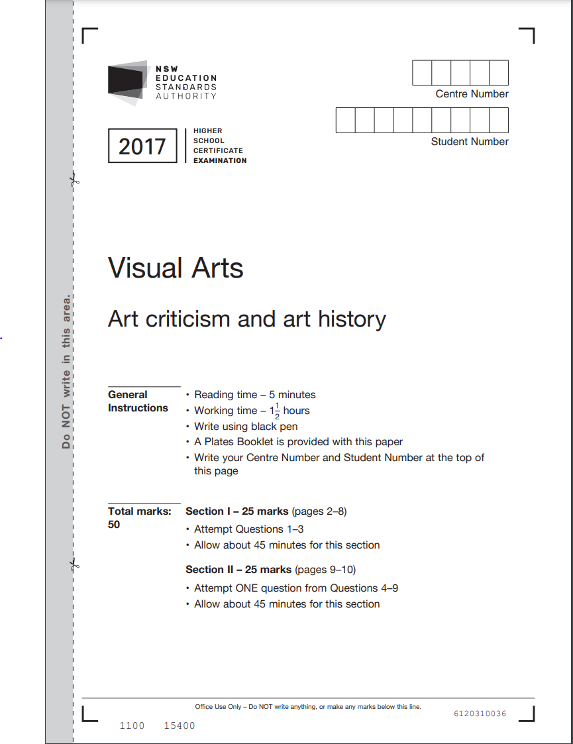
General advice – part 2
In section I, your answer will be assessed on how well you:
write in a concise and well-reasoned way
present an informed point of view
use the plates and any other source material provided to inform your response.
Your response will be assessed against the examination rubric and marking criteria. Examples of these marking guidelines can be found in the visual arts 2017 HSC exam pack.

Slide 9

Section I guidelines
Section I responses need to be written in a concise and well-reasoned way. The length and detail of your response should be based on the mark and suggested times of each question, which are outlined at the top of the examination paper. It is essential that you keep to the suggested time limits, as the mark values can alter from year to year. Example time limits are provided for reference. The table in the next slide summarises the general parameters of each question. These are guidelines, not mandated requirements to support you in responding.

Slide 10
Section I answer guidelines
Table 1 – section I question guidelines
Question | Mark value range | Question verb examples | Number of source material/s | Response structure | Number of points | Length in words | Time to respond (approx.)
1 | 3–5 | Basic such as, describe, identify, what, how, or outline. | 1 | 1 paragraph, with a short introductory sentence and concluding sentence. | 3 | 130–200 | 8 minutes
2 | 7–9 | In-depth such as analyse or explain. | 2–3 | 1 introductory sentence, 2 paragraphs, 1 concluding sentence. | 5–6 | 250–350 | 16 minutes
3 | 12–15 | Sustained such as analyse, evaluate, compare, or explain. | 3–4 | Short introduction, body paragraphs and conclusion (mini essay). | 8–9 | 400–500 | 21 minutes
Total | 25 |  |  |  |  |  | 45 minutes

Slide 11

Section I requirements continued
The suggested time limits can be found at the beginning of section I. It will look like this:
Section I 25 marks
Attempt questions 1–3
Allow about 45 minutes for this section
Allow about 8 minutes for question 1
Allow about 16 minutes for question 2
Allow about 21 minutes for question 3
Hint 1 –
Timed practises are really helpful.
Hint 2 –
Consider wearing a watch to keep track of the time in your exam.
Hint 3 –
Smart watches are not allowed in the HSC examination. Use a standard watch instead.

Slide 12
Plates booklet – part 1
Each question in section I refers to plates (images) and source material, which are found in the plates booklet of the visual arts HSC written examination. This is the evidence you need to include in your response. Interpret the plates by applying your knowledge of syllabus content, and artworld concepts, identified in the question.
Did you know?
A section I question is sometimes referred to as an ‘unseen plate’. The plates and source material will generally be unfamiliar and not an artist you may have previously studied. To correctly answer the question, you need to interpret the plates through your knowledge of syllabus content. For example, if the question includes references to an artist, or the world, you will apply your knowledge of the conceptual framework in your response.

Slide 13

Plates booklet – part 2
The plates booklet includes source material which can take the form of:
photographic images (plates) of artworks
documentation of the artist’s studio, installation, or exhibition
preliminary sketches, research material, quotations about the artwork
a citation.
To learn more about citations go to the next slide.

Slide 14
Plates booklet – citation
Citations provide factual information about the artwork represented in the plate. A citation details contextual information, such as – the artist’s name, title of the work, physical size, length of time (for video), date of production, medium, location, country of origin.
In your answers refer to the citation information. The title can help you understand the meaning of the work. Choice of medium, expressive form, materials, and techniques can influence an artist’s actions. The date and location identify the time and place in which the work was made, or exhibited, and inform how audiences view and interpret the artwork.

Slide 15
Writing a section I response – part 1
In a section I response, you will present an informed point of view by demonstrating your knowledge and understanding of visual arts, and making connections between syllabus content, questions, plates, and source material.
For more on
factual information go to slide 16
An informed point of view is an interpretation supported by facts. Factual information is based on evidence from syllabus content and source material, while persuasive writing convinces the audience of your point of view. Good persuasive writing blends fact and opinion seamlessly together, to reinforce your argument.
For more on
persuasive writing go to slide 17

Slide 16

Factual information
Factual information includes referencing:
plates and source material linked to the question
citation information – the artist's name, country of origin, time and place they worked, artwork title, expressive form and dimensions of the work
syllabus content – practice, frames and conceptual framework
the artist’s technique, ideas, or career history
source material, including quotes from an artist, or art critic.

Slide 17

Persuasive writing
Persuasive writing:
aims to convince the reader that your point of view is correct
helps to make a logical and complex argument in your response
shows a highly developed understanding of the visual arts
relies on interpretation rather than description.

Slide 18

Writing a section I response – part 2
How you write is just as important as what you write in each response. Always:
use formal language
write in third person
use subject-specific language, including visual arts syllabus words and terms
make your sentences direct and concise
divide longer sentences into two shorter sentences that link ideas together
construct a response using a scaffolded writing structure.

Slide 19
References
Links to third-party material and websites
If you use the links provided in this document to access a third-party's website, you acknowledge that the terms of use, including license terms set out on the third-party's website apply to the use which may be made of the materials on that third-party website or were permitted by the Copyright Act 1968 (Cth). The department accepts no responsibility for content on third-party websites.
All material © State of New South Wales (Department of Education), 2021 unless otherwise indicated. All other material used by permission or under licence.
NSW Education Standards Authority (NESA) Glossary of Key Words NESA website, accessed 03/02/2023.
NSW Education Standards Authority (NESA) Visual Arts 2017 HSC exam pack NESA website, accessed 03/02/2023.
Visual Arts HSC exam paper 2017 © NSW Education Standards Authority (NESA) for and on behalf of the Crown in right of the State of New South Wales, [2017] accessed 03/02/2023.
Visual Arts Stage 6 syllabus 2016 © NSW Education Standards Authority (NESA) for and on behalf of the Crown in right of the State of New South Wales, [2016] accessed 03/02/2023.
Pexels (2022) Woman jumping [image] accessed 11/02/2023.

