Slide 1
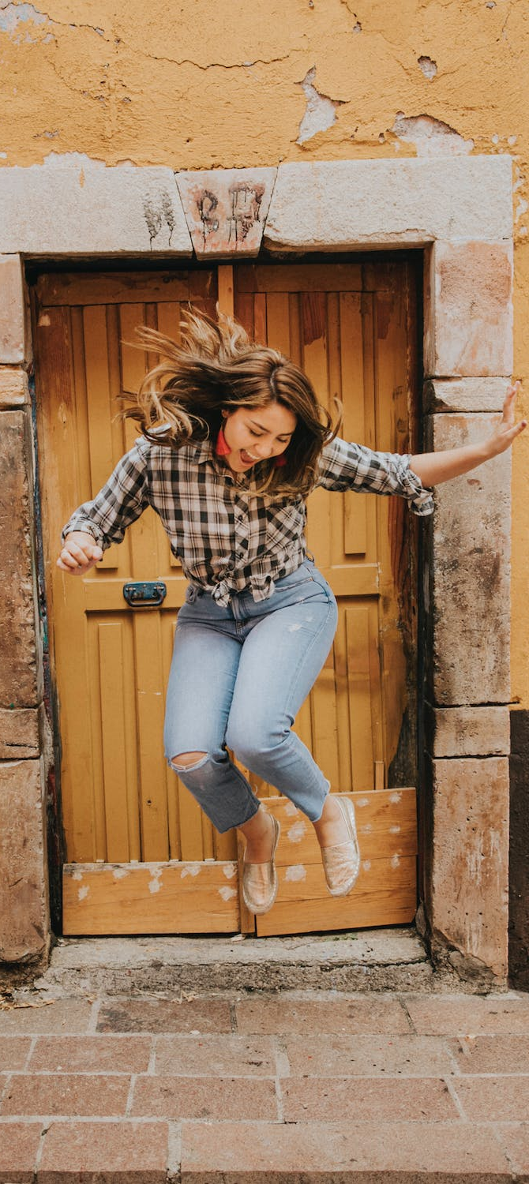
LEAP!
Level up your skills in section I – further advice for developing section I responses
Writing about HSC visual arts
Creative arts curriculum team
Notes:
https://www.pexels.com/photo/woman-in-black-and-white-plaid-shirt-and-blue-denim-jeans-jumping-on-brown-concrete-floor-3680771/

Slide 2
Further advice for developing section I responses
It is worthwhile to familiarise yourself with the format of the examination paper and practice a lot of section I questions as possible. You can do this by accessing previous examination papers and then assessing your responses against the marking guidelines. Mark your practice responses against the marking guidelines. These additional exam resources, including past exams, marking guidelines, and feedback on the written exam, can be found on the NESA visual arts website.
When you first practise answering questions have a hard copy or the electronic file of preparing to write a response open. Refer to it in the planning stage. Review the syllabus word bank when writing your responses as it will give you the language required for better responses.
Once you have mastered the brainstorming, KCI planning and PEEL scaffolds found in this learning guide, hand write practice questions and responses under timed examination conditions. You need to be able to complete question 1, question 2, and question 3 responses under exam conditions in the recommended writing time for each question. These can be found at the beginning of each examination. All three questions should be completed in 45 minutes. Assess your responses against the marking guidelines. Use your assessment to identify areas you can improve on and edit your work to refine skills and understanding for future responses.

Slide 3
References
Links to third-party material and websites
If you use the links provided in this document to access a third-party's website, you acknowledge that the terms of use, including license terms set out on the third-party's website apply to the use which may be made of the materials on that third-party website or were permitted by the Copyright Act 1968 (Cth). The department accepts no responsibility for content on third-party websites.
All material © State of New South Wales (Department of Education), 2021 unless otherwise indicated. All other material used by permission or under licence.
NSW Education Standards Authority (NESA) Glossary of Key Words NESA website, accessed 03/02/2023.
NSW Education Standards Authority (NESA) Visual Arts 2017 HSC exam pack NESA website, accessed 03/02/2023.
Visual Arts HSC exam paper 2017 © NSW Education Standards Authority (NESA) for and on behalf of the Crown in right of the State of New South Wales, [2017] accessed 03/02/2023.
Visual Arts Stage 6 syllabus 2016 © NSW Education Standards Authority (NESA) for and on behalf of the Crown in right of the State of New South Wales, [2016] accessed 03/02/2023.
Pexels (2022) Woman jumping [image] accessed 11/02/2023.

