Slide 1
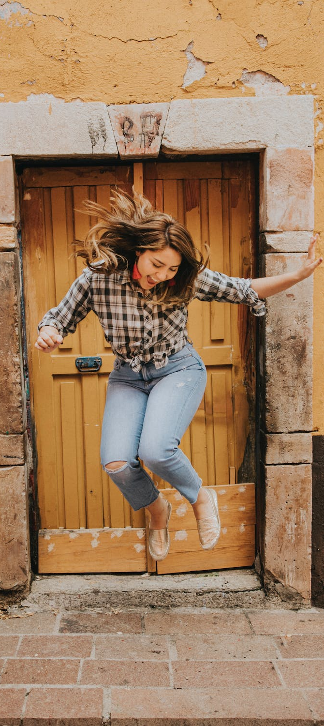
LEAP!
Level up your skills in section I – concluding sentence(s)
Writing about HSC visual arts
Creative arts curriculum team
Notes:
https://www.pexels.com/photo/woman-in-black-and-white-plaid-shirt-and-blue-denim-jeans-jumping-on-brown-concrete-floor-3680771/

Slide 2
LEAP lessons introduction
LEAP lessons are structured in 4 parts.
Learn – provides information about topic.
Example – provides an example response to a question, often using a scaffold.
Apply – apply your learning to answer a question.
Practise – practise your new skills and knowledge by answering a new question in more depth.
Concluding sentence(s)
L
E
A
P
Learn
Example
Apply
Practise
2

Slide 3

Learn – concluding sentence(s)
A conclusion summarises your point of view and addresses:
the question’s concept
links to syllabus content
source material.
It is an opportunity to restate your argument. It is important to not introduce any new arguments or knowledge in your conclusion.
In this activity you will:
include an evaluative statement that briefly summarises how each of the artworks found in the plates provide evidence for your arguments
conclude the response by reinforcing your main argument, using the language of the question.
The length and complexity of concluding sentence(s) vary according to the mark value of the question.
L
Learn

Slide 4
Example – concluding sentence(s)
To develop a concluding sentence you can use the ‘concluding sentence scaffold’ below.
Table 20 is a completed scaffold with example responses that can be included in the concluding sentence for question 2 of the visual arts HSC exam paper 2017. The plates referred to in question 2 are found on page 12 and 13 of the visual arts 2017 HSC exam pack.
E
Example
Table 20: Concluding sentence scaffold example
Question 2 (8 marks)
Refer to plate 2 on page 2 and plate 3 on page 3 of the plates booklet to answer
Compare how El Greco and Feng Mengbo have explored the use of light and space in their artworks to create meaning.
Sentence elements | Model response
Key words of the question | Conversely (compares both artists), light, space
Artworks/plates | El Greco, Feng Mengbo
Point of view | El Greco: illusion of light and space through masterly oil painting techniques Feng Mengbo: a large scale, interactive virtual world projections of actual light into physical space.

Slide 5

Example – concluding sentence(s) continued
E
Each of the example responses from table 20 have been combined into the concluding sentence below.
While El Greco creates the illusion of light and space through masterly oil painting techniques, conversely Feng Mengbo has constructed a large scale, interactive virtual world created through projections of actual light into physical space.
Example
Concluding statements for question 2 should:
reinforce how each of the artworks, and other source material, support the point of view, or argument, in your response
explicitly show how you have addressed the question’s main concept and key words.
For example, this may involve comparing how both artworks represent each artists’ world.

Slide 6
Apply – concluding sentence(s)
A
Now complete a concluding sentence for question 1, using the table on the next slide.
Question 1 (5 marks)
Refer to plate 1 on page 1 of the plates booklet to answer question 1.
How does Lin Onus incorporate both the traditional and the contemporary in his artmaking practice?
Apply
Plates are available here:
2017 visual arts HSC examination kit
Hint: For question 1, write a short concluding statement, restating how the plate artwork(s) acts as evidence to support your point of view in response to the question’s main idea, or concept.

Slide 7
Apply – concluding sentence(s) continued
A
Table 21: Concluding sentence question 1
Sentence elements | Your response
Key words of the question | (your response)
Artists/artworks | (your response)
Point of view | (your response)
Apply
Put these elements together to create a concise concluding sentence and write it in the ‘Response to questions 1 and 3’ Word document.

Slide 8
Practise – concluding sentence(s)
P
As question 3 is more like a mini essay, you will have more points to summarise in your conclusion and this can require more than 1 sentence. Complete concluding sentences for question 3, using the table on the next slide.
Practise
Question 3 (12 marks)
Refer to plates 4, 5 and 6 on pages 4, 5 and 6 of the plates booklet to answer question 3.
Analyse the relationships between the artworks and the audience for plates 4, 5 and 6.
Plates are available here:
2017 visual arts HSC examination kit
Hint: For question 3, write concluding sentences. Identify and explicitly state your main argument, as outlined in the body section of your response, the evidence used to support your argument and how this addressed the concept found in the question.
Note the difference in scaffolds between questions 1 and 3.
You can access plate 5
from the Art Gallery NSW website

Slide 9
Practise – concluding sentence(s) continued
P
Complete an introductory sentence for question 3.
Table 22: Concluding sentence to question 3
Sentence elements | Your response
Key words of the question | (your response)
Syllabus link | (your response)
Artists/artworks | (your response)
Point of view | (your response)
Practise
Put these elements together to create a concise concluding sentences and write it in the ‘Response to questions 1 and 3’ Word document.

Slide 10
References
Links to third-party material and websites
If you use the links provided in this document to access a third-party's website, you acknowledge that the terms of use, including license terms set out on the third-party's website apply to the use which may be made of the materials on that third-party website or were permitted by the Copyright Act 1968 (Cth). The department accepts no responsibility for content on third-party websites.
All material © State of New South Wales (Department of Education), 2021 unless otherwise indicated. All other material used by permission or under licence.
NSW Education Standards Authority (NESA) Glossary of Key Words NESA website, accessed 03/02/2023.
NSW Education Standards Authority (NESA) Visual Arts 2017 HSC exam pack NESA website, accessed 03/02/2023.
Visual Arts HSC exam paper 2017 © NSW Education Standards Authority (NESA) for and on behalf of the Crown in right of the State of New South Wales, [2017] accessed 03/02/2023.
Visual Arts Stage 6 syllabus 2016 © NSW Education Standards Authority (NESA) for and on behalf of the Crown in right of the State of New South Wales, [2016] accessed 03/02/2023.
Pexels (2022) Woman jumping [image] accessed 11/02/2023.

