Slide 1

LEAP!
Level up your skills in section I – breaking down the question
Writing about HSC visual arts
Creative arts curriculum team
Notes:
https://www.pexels.com/photo/woman-in-black-and-white-plaid-shirt-and-blue-denim-jeans-jumping-on-brown-concrete-floor-3680771/

Slide 2
LEAP lessons introduction
LEAP lessons are structured in 4 parts.
Learn – provides information about the topic.
Example – provides an example response to a question, often using a scaffold.
Apply – apply your learning to answer a question.
Practise – practise your new skills and knowledge by answering a new question in more depth.
Breaking down the question
L
E
A
P
Learn
Example
Apply
Practise

Slide 3
Learn – breaking down the question
L
For this activity, you will learn to:
unpack the demands of the question
identify each part of the question, including key verbs, syllabus content, concepts, reference to plates and source material
define the key word at the beginning of a question
connect the question’s concept to a syllabus area
Section I questions consist of four parts: reference to source material, key words, syllabus content, and concepts. Breaking down a question into its parts helps you understand what needs to be addressed in your response.
Learn
references to source material
The next 4 slides provide more information on:
key verbs
syllabus content
concepts

Slide 4
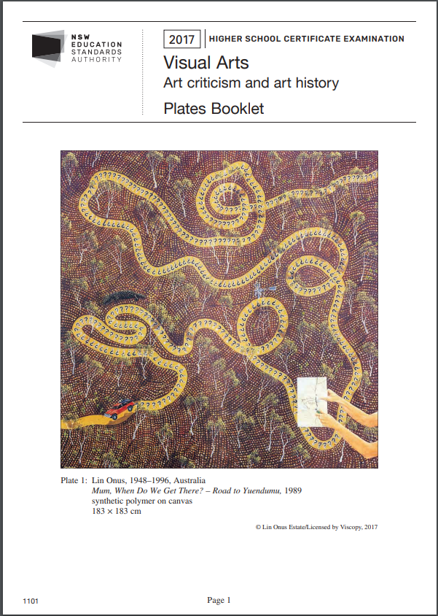
Learn – reference to source material
The plates booklet provides source material and plates (images) about specific artists and artworks.
A question will ask you to refer to the plates booklet to answer the question. For example, ‘Refer to Plate 2 on page 2 and Plate 3 on page 3 of the Plates Booklet to answer Question 2’.
In your response, you need to directly reference and interpret each piece of source material to support your argument.
Artwork image here
Citation here

Slide 5
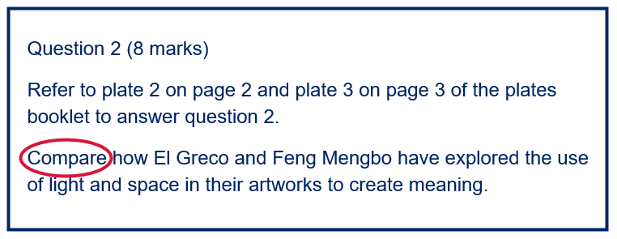
Learn – key verbs
Key words, verbs or task words, are common to many HSC subjects and their meanings are explained in NESA’s A Glossary of Key Words.
Key verbs, such as: ‘compare’, ‘explain’, ‘discuss’, are action words, instructing you on how answer the question. In the example to the right, the circled word ‘compare’ is the key verb in the question.
Question 1 requires less elaboration in a response than questions 2 and 3 and uses more direct key words such as: ‘how’, ‘describe’, or ‘outline’.

Slide 6
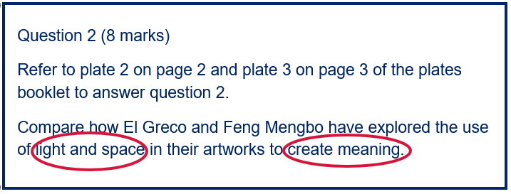
Learn – syllabus content
Syllabus content determines the point of view used to interpret the question’s concept and source material.
You will need to identify terms associated with an aspect of content.
For example, if the question asks you to explain how artists express ideas in personal ways, this relates to the subjective frame, as ‘personal’ is connected to subjective qualities.
In the example to the right, the circled words ‘light and space’ and ‘create meaning’ are clues to the area of syllabus content.
Which syllabus content area is light, space and creating meaning related to?
Check your answer below.
Answer: Structural frame

Slide 7
Learn – concepts
Concepts are ideas about art from the artworld. Section I questions use subject-specific language to refer to art concepts, such as traditional or contemporary practice, or the use of light.
These concepts may refer directly to a syllabus area or may be inferred.
Examples of different section I examination questions have been included in task 2. The visual arts word bank task will help you connect the concepts to a specific area of the syllabus.
Question 2 (8 marks)
Refer to plate 2 on page 2 and plate 3 on page 3 of the plates booklet to answer question 2.
Compare how El Greco and Feng Mengbo have explored the use of light and space in their artworks to create meaning.

Slide 8
Example – breaking down the question
Table 5: Breaking down the question – example
E
Steps | Question 2 (2017 HSC)
Reference to source material | Refer to plate 2 on page 2 and plate 3 on page 3 of the plates booklet and the accompanying source material to answer question 2.
Key verb: What is the key word in this question? Refer to NESA’s A Glossary of Key Words to rewrite in your own words. | ‘Compare’ means looking at what is similar or different
Artist/artwork – use the dates in the citation to consider whether the artist’s practice is historical or contemporary. | El Greco (historical artist) and Feng Mengbo (contemporary artist)
Concept: what concept/s does the question refer to? | Explored use of light and space/ to create meaning
Explain what syllabus content area the question is focused on? Practice, frames or conceptual framework. You will find concepts attached to a syllabus area once you complete Task 1 – visual arts word bank | Frames – structural frame. Light and space are structural qualities artists can use to communicate meaning. Therefore, the question focuses on the structural frame.
Rewrite the question in your own words to ensure you understand and address all aspects of the question. | What is similar and different about how and why both artists use the structural elements of light and space to communicate their meanings and concepts.
Example
The example response in table 5 identifies and unpacks the components of question 2. In the last row the question is rewritten to incorporate these points.
Hint: Practise breaking down the question under timed examination conditions as part of the planning stage.
Question 2 (8 marks)
Refer to plate 2 on page 2 and plate 3 on page 3 of the plates booklet to answer question 2.
Compare how El Greco and Feng Mengbo have explored the use of light and space in their artworks to create meaning.

Slide 9
Apply – breaking down the question
Table 6 - Breaking down question 1
A
Steps | Question 1 (2017 HSC)
Reference to source material | (add response)
Key verb: What is the key word in this question? Refer to NESA’s A Glossary of Key Words to rewrite in your own words. | (add response)
Artist/artwork | (add response)
Concept: what concept/s does the question refer to? | (add response)
Explain what syllabus content area the question is focused on? Practice, frames or conceptual framework. You will find concepts attached to a syllabus area once you complete Task 1 – visual arts word bank | (add response)
Rewrite the question in your own words to ensure you understand and address all aspects of the question. | (add response)
Apply
Use table 6 to break down question 1 from the 2017 visual arts HSC examination paper.
Refer to the Visual arts HSC exam paper 2017 for the plates and source material for question 1.
Question 1 (5 marks)
Refer to plate 1 on page 1 of the plates booklet to answer question 1.
How does Lin Onus incorporate both the traditional and the contemporary in his artmaking practice?

Slide 10
Practise – breaking down the question
Table 7 - Breaking down question 3
P
Steps | Question 3 (2017 HSC)
Reference to source material | (add response)
Key verb: What is the key word in this question? Refer to NESA’s A Glossary of Key Words to rewrite in your own words. | (add response)
Artist/artwork | (add response)
Concept: what concept/s does the question refer to? | (add response)
Explain what syllabus content area the question is focused on? Practice, frames or conceptual framework. You will find concepts attached to a syllabus area once you complete Task 1 – visual arts word bank | (add response)
Rewrite the question in your own words to ensure you understand and address all aspects of the question. | (add response)
Practise
Use table 7 to break down question 3 from the 2017 visual arts HSC examination paper.
Refer to the Visual arts HSC exam paper 2017 for the plates and source material for question 3.
Question 3 (12 marks)
Refer to plates 4, 5 and 6 on pages 4, 5 and 6 of the plates booklet to answer question 3.
Analyse the relationships between the artworks and the audience for Plates 4, 5 and 6.

Slide 11
References
Links to third-party material and websites
If you use the links provided in this document to access a third-party's website, you acknowledge that the terms of use, including license terms set out on the third-party's website apply to the use which may be made of the materials on that third-party website or were permitted by the Copyright Act 1968 (Cth). The department accepts no responsibility for content on third-party websites.
All material © State of New South Wales (Department of Education), 2021 unless otherwise indicated. All other material used by permission or under licence.
NSW Education Standards Authority (NESA) Glossary of Key Words NESA website, accessed 03/02/2023.
NSW Education Standards Authority (NESA) Visual Arts 2017 HSC exam pack NESA website, accessed 03/02/2023.
Visual Arts HSC exam paper 2017 © NSW Education Standards Authority (NESA) for and on behalf of the Crown in right of the State of New South Wales, [2017] accessed 03/02/2023.
Visual Arts Stage 6 syllabus 2016 © NSW Education Standards Authority (NESA) for and on behalf of the Crown in right of the State of New South Wales, [2016] accessed 03/02/2023.
Pexels (2022) Woman jumping [image] accessed 11/02/2023.

