Slide 1

Grid Systems

Slide 2
Typographic grids
Watch the video Beginning Graphic Design: Layout & Composition (00:05:14)
taking notes in your visual design journal or blog.
Write definitions and provide examples on the following terms:
Layout
Composition
  proximity
  white space
  alignment
  contrast
  repetition

Slide 3
Jan Tshichold
Born in 1902, died 1974 Germany/Switzerland.
Tshichold was a book designer and typographer.
He was influenced by the Bauhaus – a German art school.
Lead a movement called “the new topography” that created rules and simplified the typographic layout.
Tshichold’s favourite typeface was Sans serif.
Research and describe
Find an example of Tschichold’s work.
In your visual design journal/blog explain the layout and composition addressing each element as per your definitions.
Notes:
https://upload.wikimedia.org/wikipedia/commons/a/ad/Jan_Tschichold_%281963%29_by_Erling_Mandelmann.jpg accessed 10/12/2017

Slide 4
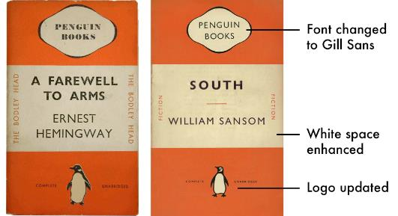
Penguin books
Penguins Books were established in 1935.
Each page was laid out and set by hand, with movable type compositors.
Tschichold used a typeface created by Eric Gill’s called Gill sans typeface when designing for Penguin books.
Each letter of the title must be spaced evenly.
He also a grid system detailing the rules for the internal pages.
Activity
Write a list of a compositor’s tools from the Letterpress commons website.
Using the internet, write a blog listing the composition rules for Penguin Books design by Tschichold.
Notes:
http://www.thewritersacademy.co.uk/wp-content/uploads/2017/04/After-1950.png accessed 10/12/2017
https://www.webopedia.com/FIG/kerning_graphic.gif accessed 10/12/2017

Slide 5
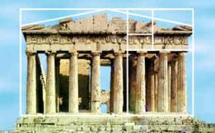
The Golden section
The Golden section or ratio, has been used in art and design for a long time.
The Ancient Greeks famously used the ratio in their architecture and design. You can see how it was used in the Parthenon through the pictures on the right.
It was thought to be a sacred proportion and represented perfection and beauty.
Numerically, the ratio for the golden section is 1 : 1.618.
Designers use the golden ratio as a method of dividing pages into sections, making a grid for text and images.
Notes:
https://learn.canva.com/wp-content/uploads/2015/10/113-tb-728x0.jpg accessed 10/12/2017
https://www.mathsisfun.com/numbers/images/parthenon-golden-ratio.jpg accessed 10/12/2017

Slide 6
Multi-column Grid
Multi-column grids are used to create a flexible layout space.
Images and text can spread over more than one vertical space.
Not all spaces need to be filled.
Multiple pages can share a similar structure.
Notes:
http://thinkingwithtype.com/images/Thinking_with_Type_Grid_5.gif accessed 10/12/2017

Slide 7
Hang line, modular & baseline grids
Using the websites Thinking with type and Envatotuts+ Design Theory, research and answer the following questions in your visual design journal or blog.
What is the purpose of a hang line?
Define and describe the function of the modular grid.
How does the baseline grid differ to the hang line or modular grid?
Notes:
https://i.pinimg.com/736x/50/e7/9c/50e79cd49e011305bda149a0792bfc44--presentation-boards-presentation-skills.jpg accessed 10/12/2017

Slide 8
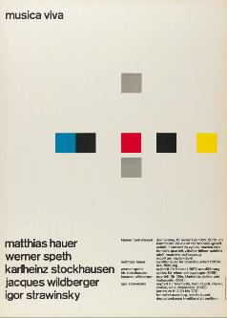
Modular grid
In the 50s and 60s, Swiss designers such as Joseph Müller-Brockmann and Karl Gerstner developed a modular grid by dividing the page horizontally and vertically.
This grid style was most suitable for magazines.
Within this structure, the amount of images and text are governed by the size of each module.
Images and text can take up more than one space with unlimited variations.
Notes:
https://upload.wikimedia.org/wikipedia/commons/thumb/2/2d/Van_de_Graaf_canon_in_book_design.svg/499px-Van_de_Graaf_canon_in_book_design.svg.png accessed 10/12/2017
http://www.typetoken.net/wp-content/uploads/2014/02/JMB-TT5.jpg accessed 10/12/2017

