Slide 1

Pioneers of modern dance

Slide 2
What is modern dance?
Watch the following YouTube clip and discuss they key points of how
Modern dance has evolved throughout time:
http://www.youtube.com/watch?v=OyEEdb9sZZ4
Summarise and reword the following points, creating a TEEEC paragraph about modern dance.
Modern dance evolved from the desire to rebel.
It is ever changing and evolving.
What is a pioneer?
Someone who is willing to stack everything on an idea, concept or change. They explored aspects of dance that were essential to them.
What was it that influenced modern dance?
Ballet was a huge influence on modern dance as the pioneers aimed to rebel against it.
Modern dance represents freedom of humanity and self expression.

Slide 3
Who are the pioneers?
Isadora Duncan
Loie Fuller
Ruth St. Denis and Ted Shawn
Martha Graham
Alvin Ailey
William Forsythe
Graeme Murphy (Sydney Dance Company)

Slide 4
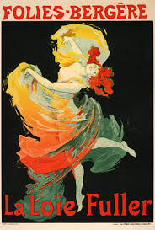
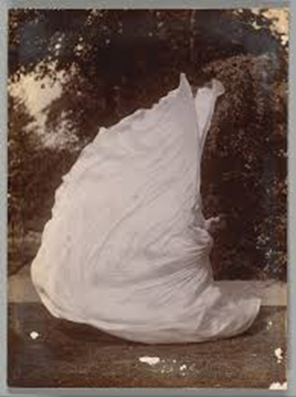
Loie Fuller
  Watch this clip and describe what you recognise about Loie Fuller’s choreographic style.
  Discuss what life would have been like in the 1890s?
  What would Loie Fuller’s style of dance done for society at this time?
  Summarise the following information on the next two pages into your own words:
Loie Fuller is known as the most innovative dancer.
She was born in 1862 and died in 1928.
Her dancing began to become famous in the 1890s.
She was inspired by impressionist artists such as Monet who experimented with the impact of light in their Paintings.

Slide 5
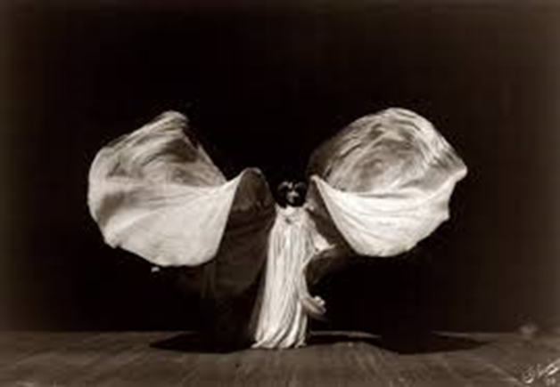
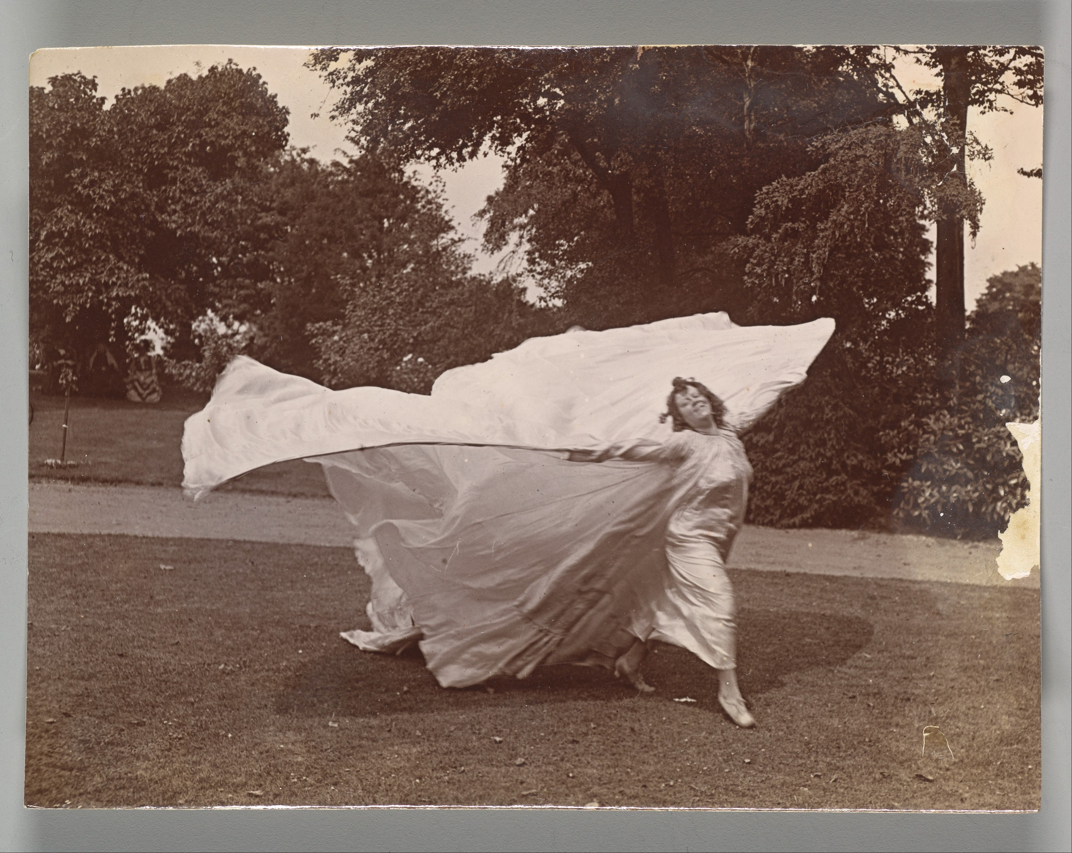
Loie Fuller …
She introduced the ‘magic of light’ into dance.
She transferred her body impulses into the fabric, making swirls and designs in the air.
Coloured lights were shone onto the cloth making a spectacular sight.
Fuller began her theatrical career as a child actress. She later choreographed and performed dances in burlesque, vaudeville and circus shows.
Fuller developed her own natural movement and improvisation techniques.
She became famous in America through works such as Serpentine Dance in 1981.
Fuller’s pioneering work attracted the attention, respect, and friendship of many French artists and scientists.

Slide 6
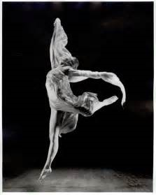
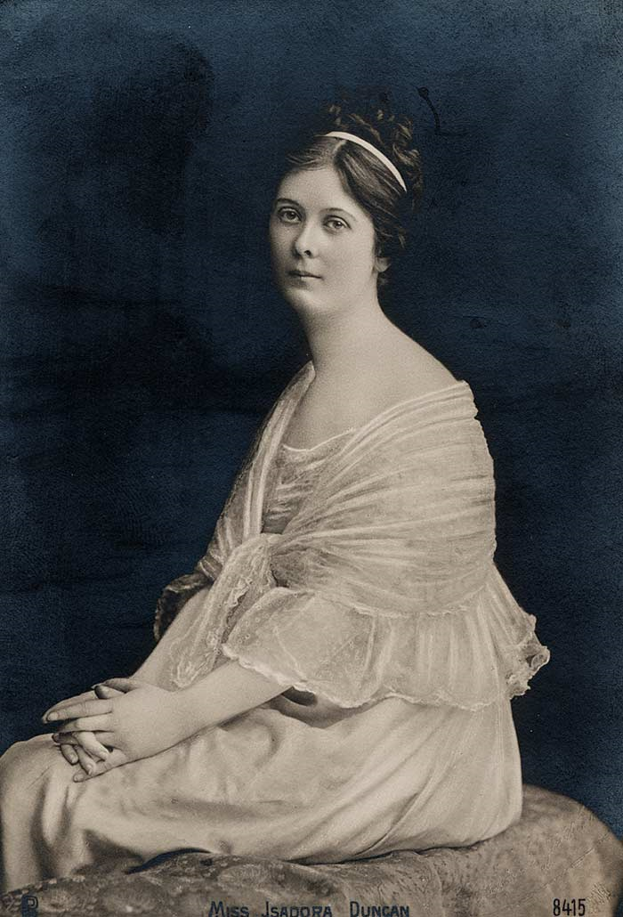
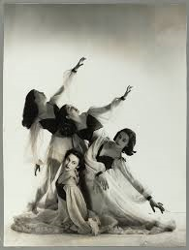
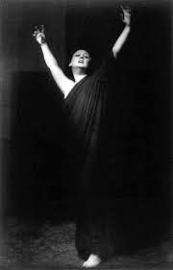
Isadora Duncan
  Watch this YouTube clip and evaluate Duncan’s influences to her choreographic style:
  Watch this YouTube clip and describe the style of movement. Make sure to comment on all aspects of the performance including the elements of production.
Notes:
Image one: https://6247daisy.files.wordpress.com/2010/06/isadora20duncan.jpg

Slide 7
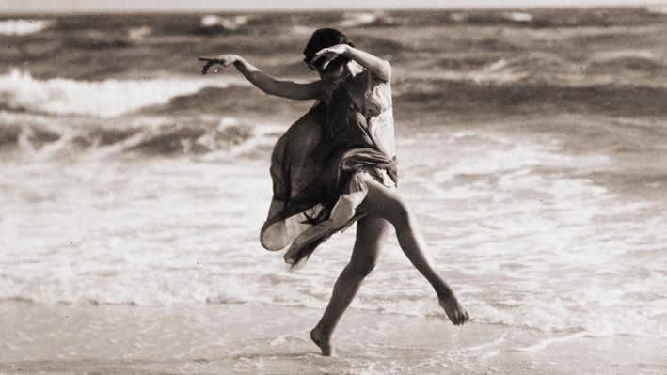

Isadora Duncan …
Isadora rebelled against the constraints of the ballet class she attended at 12 years old.
She performed improvisations that were inspired by the wind and the sea.
The way she used filtered fabric on her body made her so popular during the time.
She dealt with current events with a freedom of spirit, (such as the Russian revolution,) when she danced in Russia in 1921.

Slide 8
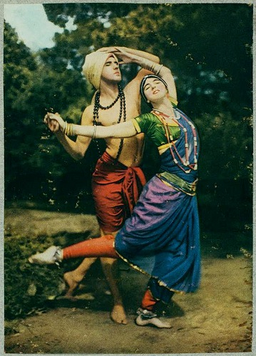
Ruth St. Denis & Ted Shawn
  Watch the following YouTube clips and write a TEEEC paragraph, with the following information included:
  Describe what it was that Ruth and Ted developed?
  Try and describe the movement quality you have viewed.
  How did this style of dance influence America in the early 1900s?
  Background information video
  Example of Denis’ choreography video

Slide 9
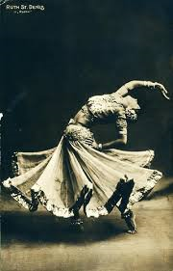
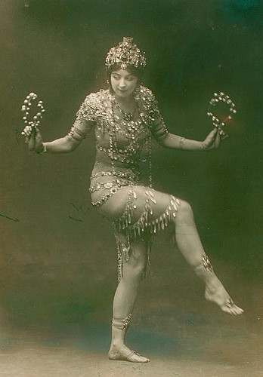
Ruth St. Denis & Ted Shawn …
Choose 10 words from the following dot points that you believe to be the most important. Summarise this information into 3 sentences, while utilising nominalisations! (Making your writing sound more sophisticated)
Ruth St. Denis was a graceful dancer, and skilled at using veils and scarfs.
She studied Hindu art and philosophy.
Many of her productions had a religious theme.
Ted Shawn was Ruth’s pupil, then became her partner & husband.
Together they were a great team. Shawn’s choreography had a sturdy clean style, while Ruth’s had quite a sinuous quality to it.
They opened a school in 1915 in L.A. to earn good money and acquire good dancers. It was called ‘Denishawn’.
They believed dance should be spiritual instead of simply entertaining.

Slide 10
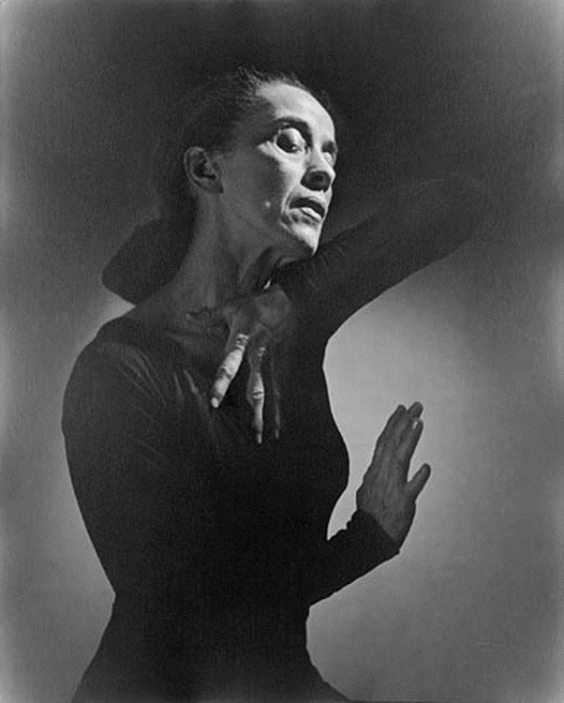
Martha Graham
  Martha Graham developed a dance technique that broke the mould of classical ballet and pioneered the field of modern dance.
Watch Martha Graham’s Choreography and Floor Work write a TEEEC paragraph in your work book, including the following information:
T: Topic Sentence
E: Expand
E: Example
E: Explain
C: Connect
What do you notice about Martha Graham’s modern technique?
Try and describe the movement quality?
What is her aim in her choreography?

Slide 11
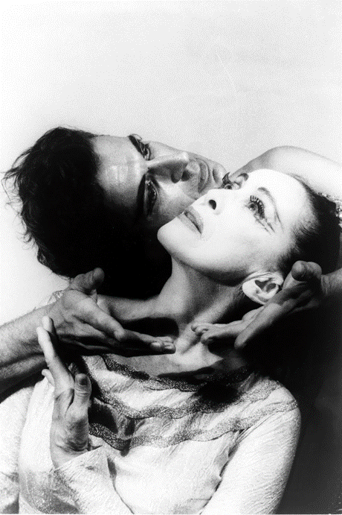
Martha Graham …
Summarise the following notes into your workbooks:
She is the single most influential figure in modern dance.
Graham toured and performed in the Denishawn company in 1919.
Her main purpose in her works was to show inner feelings (e.g. grief, love etc)
She believed breathing was the main source of dance and movement.
Dance technique
Martha Graham (1894–1991) is considered the mother of modern dance. She created a form of modern dance technique, choreographed over 150 works during her lifetime, and has had a remarkable impact on the entire field of modern dance. Her technique's deviation from classical ballet and use of specific body movements such as the contraction, release, and spiral have had profound influence on the development of modern dance.

Slide 12
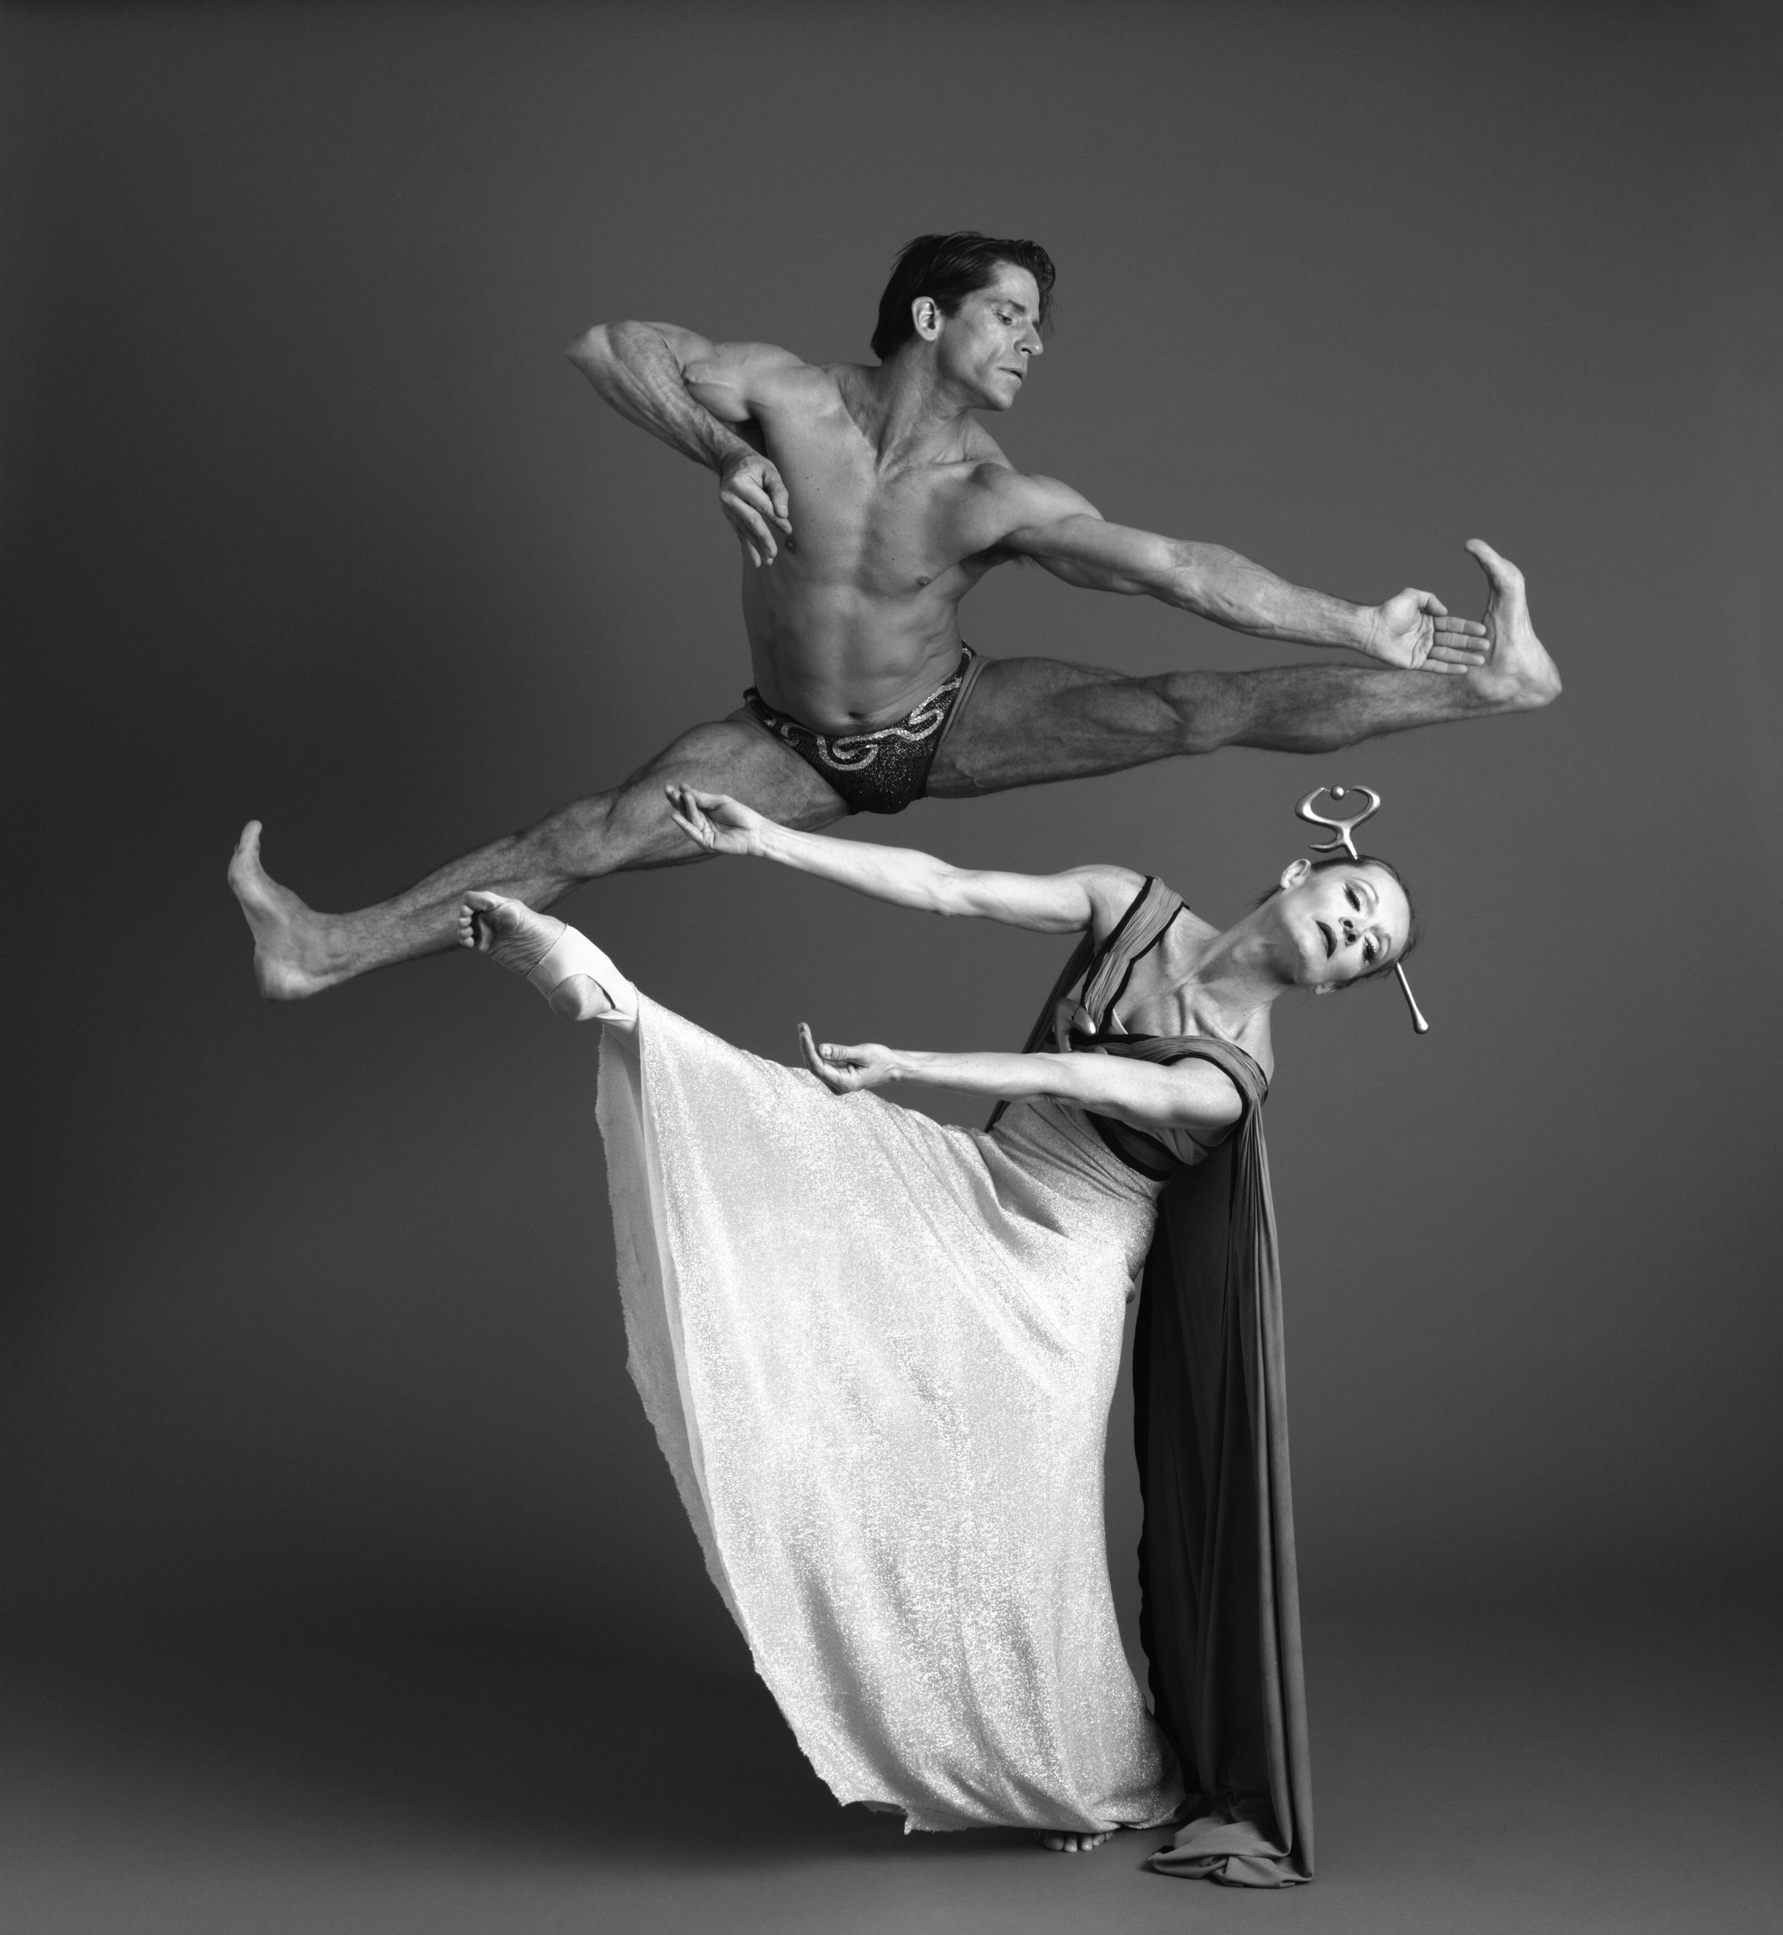
Martha Graham …
The contraction
The contraction serves as the foundation of Graham technique. Graham developed the idea from observing the physical manifestation of grief in the body. It is one of the fundamental characteristics of her choreography and as such, most of Graham exercises were created with the contraction in mind. While Graham was the creator of the contraction, the move has become a staple of modern dance and has been used, altered, and redefined by many subsequent choreographers.
Watch the Martha Graham contraction video.
Notes:
Images: https://userscontent2.emaze.com/images/493ab550-787a-469c-b59c-8f57ae9d00ff/b483a671-689e-40fe-9794-433fcc103eec.jpg

Slide 13
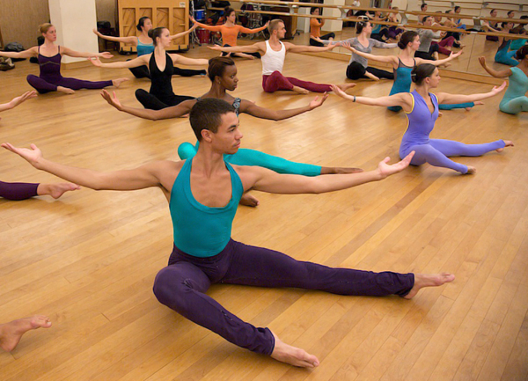
Martha Graham …
The release technique
The release is the counter to the contraction. It occurs on the inhalation of breath. A release also begins from the pelvis and travels up the spine to return the torso to a neutral, straight position.
A second type of release, called the high release occurs when a dancer opens their breastbone to the sky and seems to rest their torso on an invisible shelf beneath the shoulder blades. The rib cage maintains alignment over the hips with no break in the lower back. The head remains in line with the spine.
Notes:
Images: http://assets.danceinforma.com/public/assets/mce/Chelsea_News/Martha_Graham_School_of_Contemporary_Dance.jpg

Slide 14
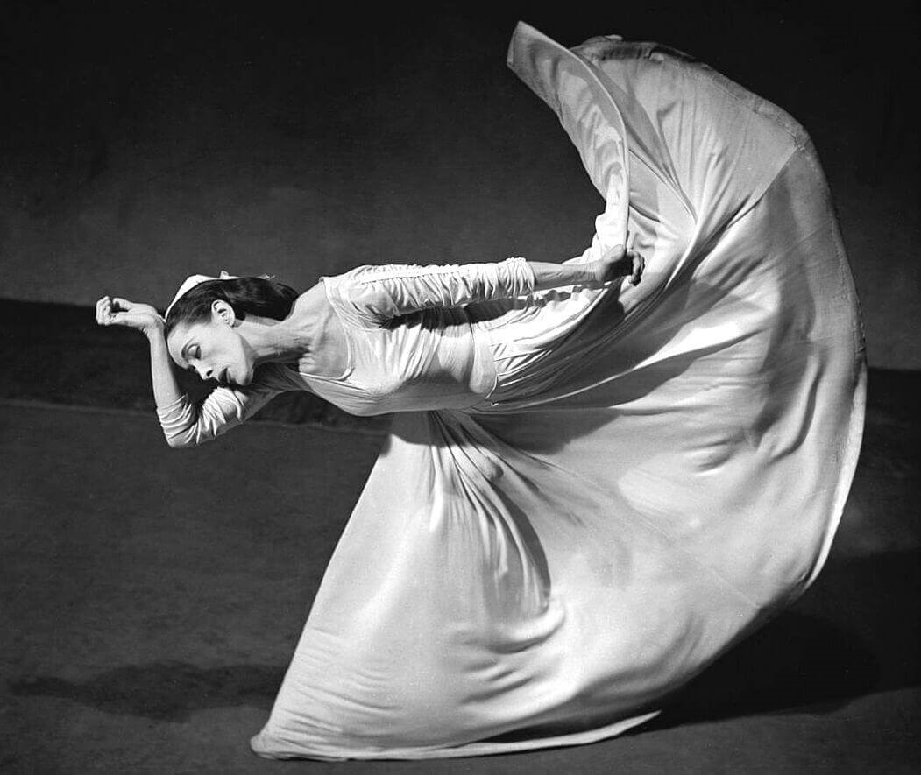
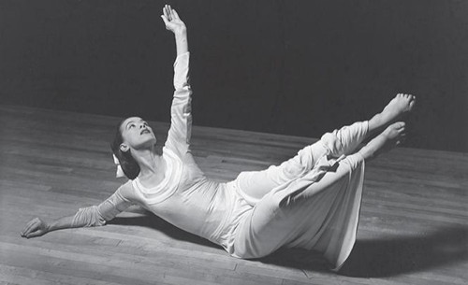
Martha Graham …
Create a TEEEC paragraph on Graham from your notes, answering the following question:
Who is Martha Graham and why was her technique so influential?
T: Topic Sentence
E: Expand
E: Example
E: Explain
C: Connect
Notes:
Images: http://www.artsbeatla.com/wp-content/uploads/2015/04/Martha-Graham-2.jpg

Slide 15
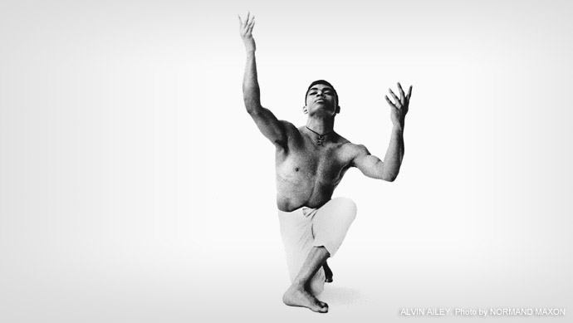
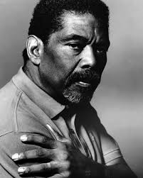
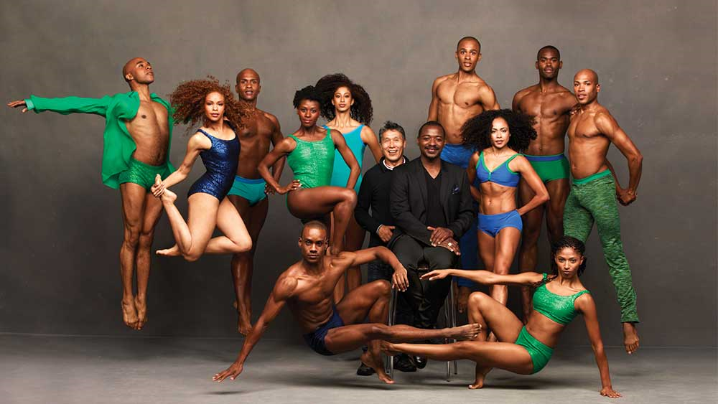
Alvin Ailey
Alvin Ailey American Dance Theatre grew from a now-fabled performance in March 1958 at the 92nd Street Y in New York City. Led by Alvin Ailey and a group of young African-American modern dancers, that performance changed forever the perception of American dance. The Ailey company has gone on to perform for an estimated 25 million people at theatres in 48 states and 71 countries on six continents -- as well as millions more through television broadcast.
In 2008, the company became known as ‘a vital American cultural ambassador to the world’ (US congressional resolution) that celebrates the uniqueness of the African-American cultural experience and the preservation and enrichment of the American modern dance heritage.
Notes:
Images:
http://pressroom.alvinailey.org/alvin-ailey-american-dance-theater/directors/alvin-ailey
http://kentakepage.com/alvin-ailey-cultural-ambassador-to-the-world/
http://lincolncenteratthemovies.org/productions/alvin-ailey-american-dance-theater

Slide 16
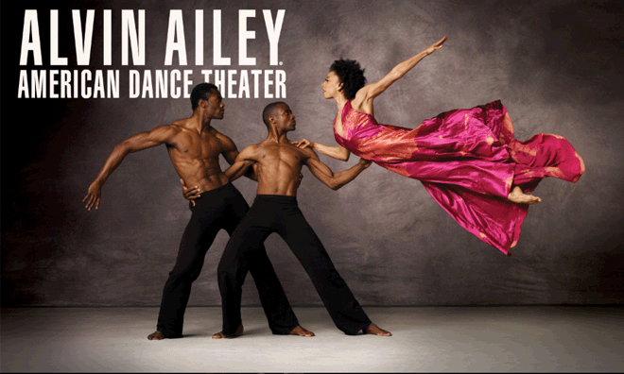
Alvin Ailey …
Watch the you tube video and describe what it was you noticed about the Alvin Ailey Dance Company that is different to others.
  Alvin Ailey Dance Company
  Alvin Ailey choreography
The company has earned a reputation as one of the most acclaimed international ambassadors of American culture.
It promotes the uniqueness of the African-American cultural experience and the preservation and enrichment of the American modern dance.
Notes:
Image: https://vonari.net/class-at-alvin-ailey-american-dance-theatre/

Slide 17

William Forsythe
American dancer and choreographer.
Pioneer of Modern dance by integrating ballet and visual arts within modern dance.
Forsythe creates ‘installations’ of art.
He began is career by choreographing Classical Ballet’s.
  Forsythe is recognised as one of the world’s foremost choreographers.
  His work is acknowledged for reorienting the practice of ballet from it’s identification with classical repertoire to a dynamic 21st century art form.
  William Forsythe opened his own company; “The Forsythe Company” in 2005. The company produces works within the areas of performance, installation, film, and educational media.
Notes:
Image: https://www.sydneydancecompany.com/people/collaborators/william-forsythe/#.WhT7V7puI2w

Slide 18
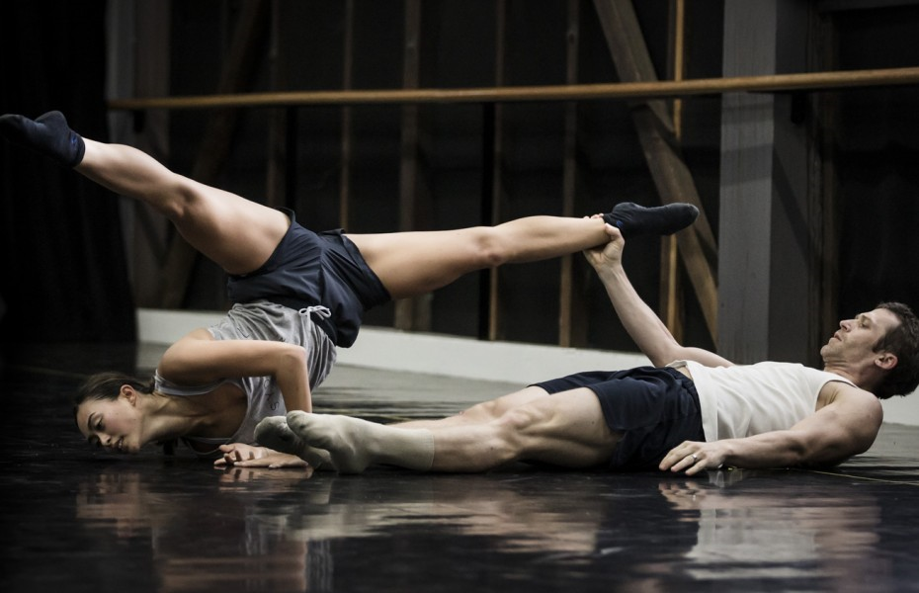
William Forsythe …
Watch the following works by Forsythe and answer the following questions in your work book:
One flat thing
1. What do you think the work is trying to communicate?
2. How does the use of tables effect this performance ?
3. What is your opinion of this work?
Give reasons either way.
Work two
1. How has Forsythe used lines to generate movement?
2. How does this create original movement?
3. What is your opinion of this choreographic style?
Give reasons either way.
Notes:
Image: https://www.sydneydancecompany.com/video-inside-william-forsythes-quintett/#.WhT7pbpuI2w

Slide 19
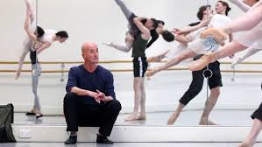
Graeme Murphy
  Murphy began his career as a student at the Australian Ballet School at the age of fourteen.
  Murphy and his company marketed dance to a wider audience, and brought contemporary dance into a more commercial environment.
  Murphy has been at the forefront of Australian and international dance as a choreographer and director for nearly four decades and has received critical acclaim globally.
  In 1976, Murphy was appointed Artistic Director of Sydney Dance Company, and held this position until 2007. During his 31-year tenure, he created more than 50 works, including 30 full length productions.
  In your work book, write down observations on what you recognized in this is video:
describe the dance style
does it include a lot of partner work/solo?
is it aesthetically pleasing?
what meaning can you draw form the work?
Notes:
Image: https://alchetron.com/Graeme-Murphy

Slide 20
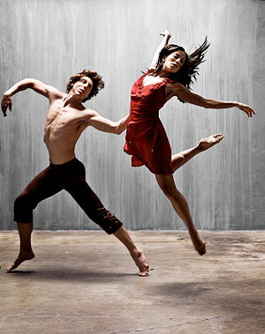
Modern dance today
In your work book, answer the following questions:
how has modern dance changed throughout time?
describe the style of modern dance now.
Watch the videos below and explain how the story is being communicated. Give an example of the movement that develops this.
Fix you
Gravity

