Slide 1
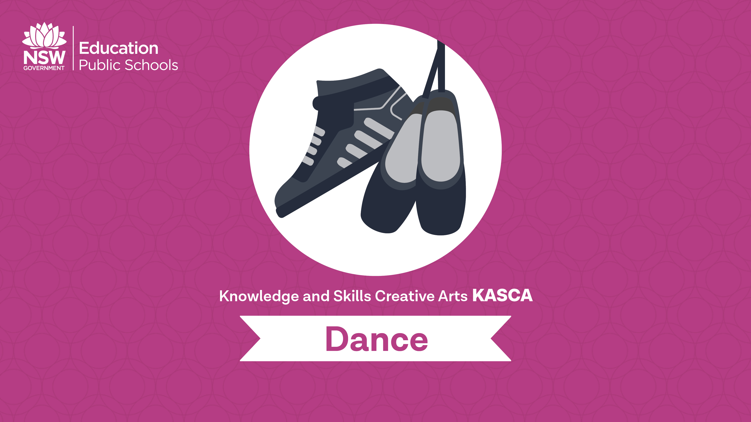
Dance through the ages

Slide 2
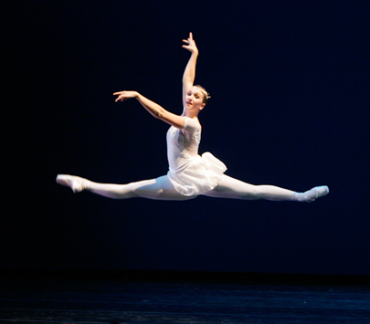
Ballet
From the early 1600s to today…
Classical ballet
Ballet d’action
Romantic ballet
Modern ballet
Notes:
Image one: https://upload.wikimedia.org/wikipedia/commons/3/35/Elvis_Presley_Jailhouse_Rock.jpg

Slide 3
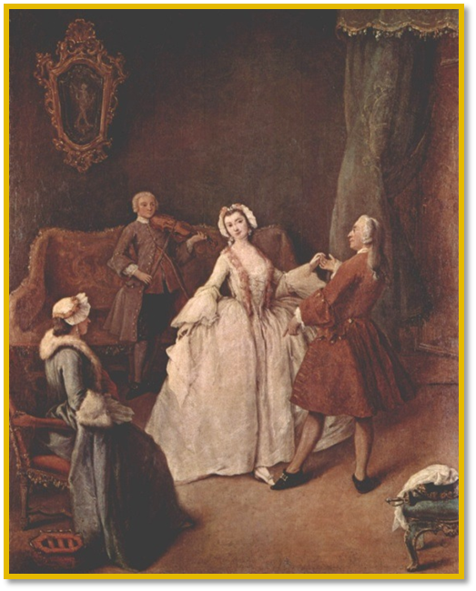
Classical Ballet
  Summarise the following information into your own words, for each of the following slides. Choose the 10 most important words on each slide, to help you make your own sentences.
  Classical ballet had its beginnings in 1661.
  The kings and queens had the most power over society in the 1600’s when ballet began.
They wanted to show political power and impress their guests, by creating spectacles of dance. These ballet’s were performed by members of the royal court.
The movement of ballet was considered simple and graceful. Focus was placed on the use of floor patterns, rather then the actual choreography. Dance was performed for entertainment purposes, not for self enjoyment of the dancers. The movement quality was no where near as technical as it is now. The costumes were also incredibly different, with a bodice and long dress worn by the ballerinas.
Notes:
Image one: https://upload.wikimedia.org/wikipedia/commons/3/35/Elvis_Presley_Jailhouse_Rock.jpg

Slide 4
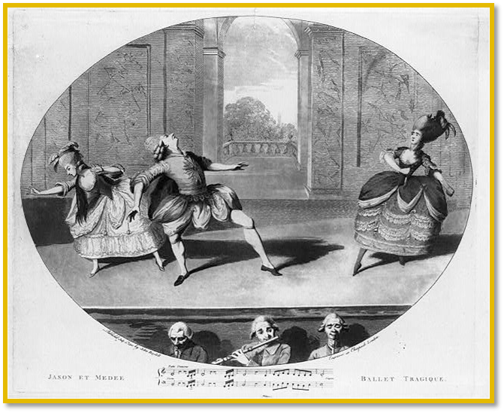
Ballet d’action
The development of Ballet d`action was introduced in the eighteenth century (1700s) and finally saw the introduction of professional dancers.
This allowed more difficult movement to be developed. The ballet d’action style also introduced the use of pantomimic gestures to convey meaning or emotion. These steps and gestures were choreographed to express characters within the ballet, and assist in developing the narrative.
In the 1700’s dance moved from the courts to the theatre, introducing a more professional atmosphere.

Slide 5
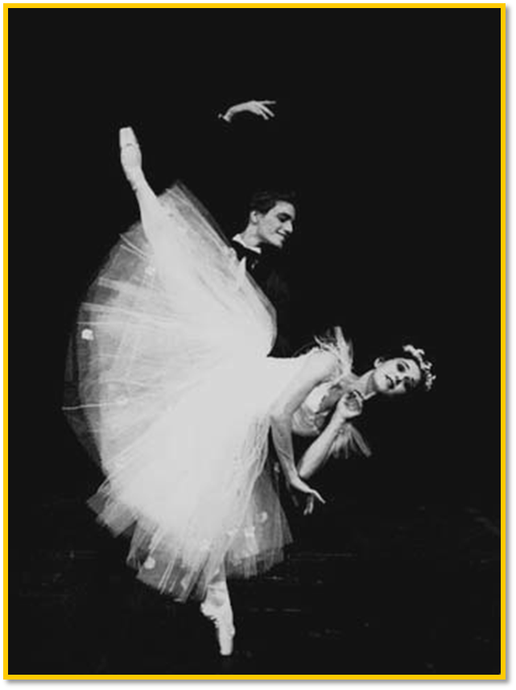
Romantic ballet
The Romantic Movement encompassed all art forms. It was reflected in music, poetry, literature, painting and ballet, emerging in the early to mid nineteenth century (1800s).
Romanticism in ballet explored the supernatural and the exotic.
This era of ballet introduced new and exciting possibilities, suspending ballerina’s by wires to show the idea of flight. Ballerinas seemed to defy gravity, being converted into supernatural and mythical beings.
In the 1800s, the women became more important in dance then then men. Females had the main role, as males were always a supporting role, to lift the ballerina, showing the idea of weightlessness. Men demonstrated power, strength and the ability to leap to greater heights.
Attention given to set design and costuming, helping create the narrative. The skirts became a little shorter, and more tutu like, now showing some leg and pointe shoes were introduced. Composers began writing music specifically for the ballet. During the romantic era ballet acquired a prestige and dignity the has remained to this day.
Notes:
https://vonari.net/class-at-alvin-ailey-american-dance-theatre/

Slide 6
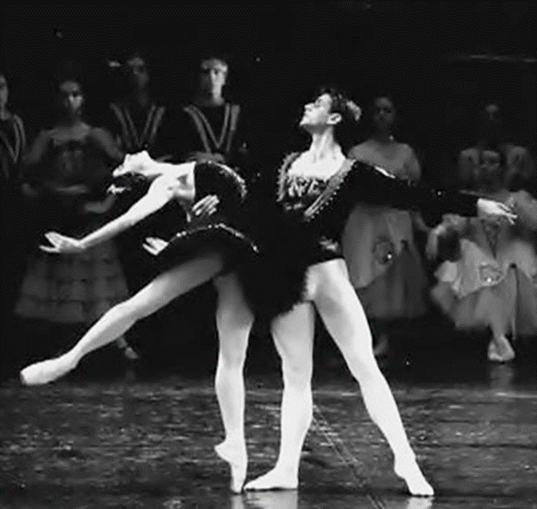
Classical ballet cont.
Within the 1900s, French ballet companies continued to flourish. They slowly began to move away from the romantic styles and ideals, focusing more on technical ability and excellence.
The male dancer was given leaps, jumps and turns that were high and spectacular. The female dancer was given the task of performing 32 fouettes without moving from the spot.
The ballet became all about the dancers technical ability. The ballet tutu became shorter so that the full effect of the dancers technique could be appreciated.
Notes:
https://www.sydneydancecompany.com/people/collaborators/william-forsythe/#.WhT7V7puI2w

Slide 7
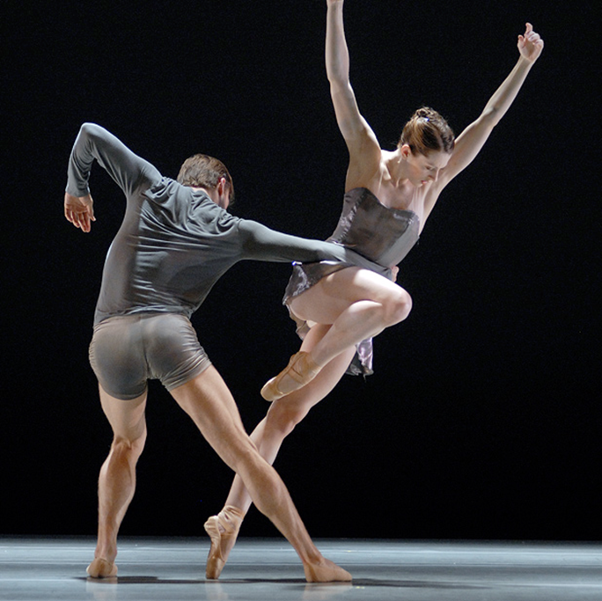
Modern ballet
  Although the traditional style of classical ballet still exists, it has now developed into a more modern style. George Balanchine is often considered to have been the first pioneer of modern or contemporary ballet. The style of dance he developed, which is a mixture of classical ballet and today's contemporary ballet, is known as neoclassical ballet.
  Modern ballet now incorporates flexed hands (and occasionally feet), turned-in legs, off-centered positions and non-traditional costumes, such as leotards and tunics instead of tutus, to distance the work from the classical and romantic ballet traditions.
  Using your summarised notes, and with watching the following two clips, write a TEEEC paragraph discussing how ballet has progressed over time:
  Swan lake: The black swan
  Modern ballet: So you think you can dance
Notes:
https://www.sydneydancecompany.com/video-inside-william-forsythes-quintett/#.WhT7pbpuI2w

Slide 8
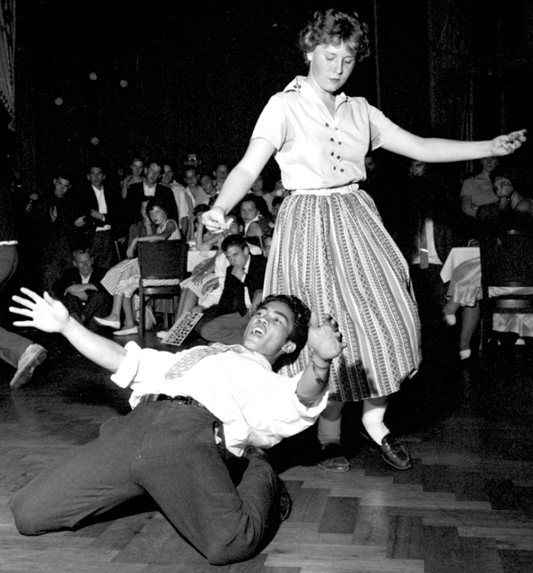
The 1950s, 60s and 70s
From rock ‘n’ roll to disco…
Notes:
Image one: https://upload.wikimedia.org/wikipedia/commons/3/35/Elvis_Presley_Jailhouse_Rock.jpg

Slide 9
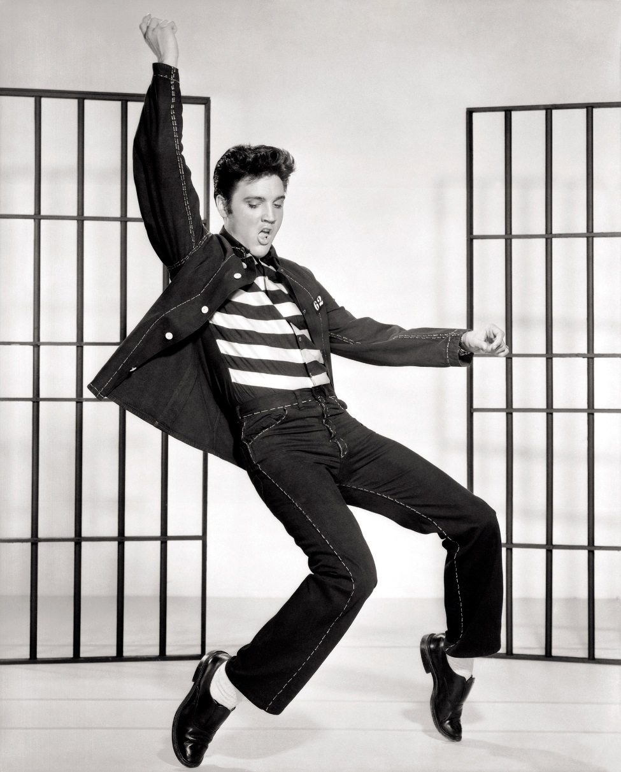
1950s: Rock ‘n’ roll
Society in the 1950s:
In the fifties young people became aware of fashion, music, pop stars and political and social issues. Many teenagers were financially independent of their parents and wanted their own kind of music, fashion and dances. It was important to parents that they gave their children opportunities.
The fifties offered opportunities for teenagers to question the values of society and began to questioning the values of their parents. Young people were demanding levels of freedom never before experienced by their age group.
Rock ‘n’ Roll was aimed directly at the youth market and became its voice, expressing the hopes, fears and rebelliousness of young people who were eager to break away from their parents.
The stars of this era included: Buddy Holly, Elvis Presley and Bill Haley and the Comets.
Notes:
Image one: https://upload.wikimedia.org/wikipedia/commons/3/35/Elvis_Presley_Jailhouse_Rock.jpg

Slide 10
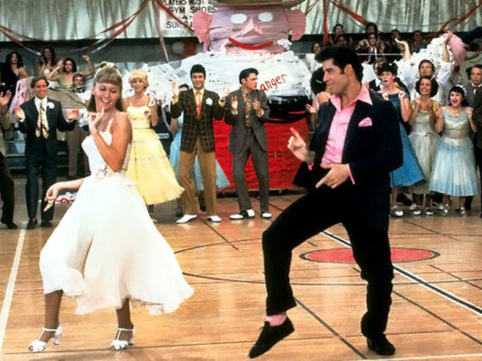
1950s dance style
Young people started expressing individuality and freedom in dance, particularly through rock ‘n’ roll dancing where men and women faced each other but no longer danced cheek to cheek with the man controlling the path of his partner.
To their parents, rock ‘n’ roll seemed wild and uncontrollable. Performers such as Elvis Presley were provocative on stage and campaigns against rock ‘n’ roll appeared on television in America. Many churches taught that it was evil, but this opposition did little to dim its popularity and young people became even more enthusiastic. Girls fainted at concerts and teenagers dressed like their favourite singers.
Watch the attached youtube clip from Grease and write a TEEEC paragraph on how the costumes, music and dance style embodies the era of the 1950s:
Born to hand jive
Notes:
Image one: http://cdn.playbuzz.com/cdn/37434a10-4ff8-424c-961c-14ce5b4a1381/3e1f337f-9279-4aa7-91df-933ee6f2390b_560_420.jpg

Slide 11
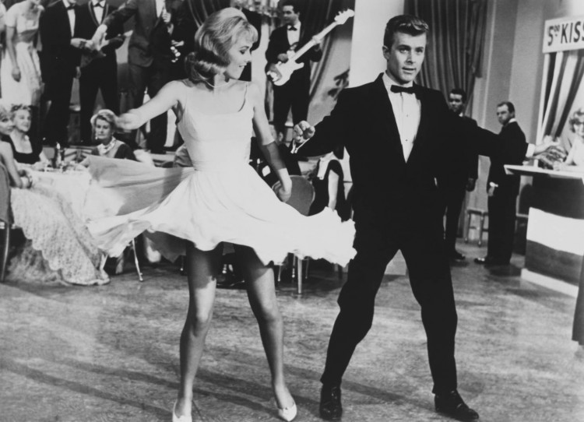
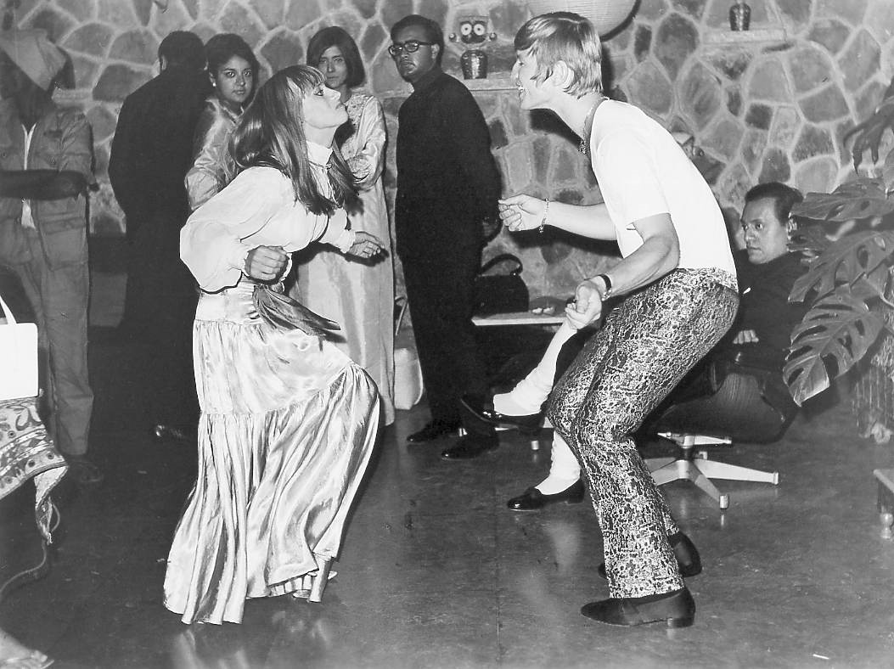
1960s
Predicting activity:
By using the visual images in this slide, discuss what you think dance in the 1960’s would have been like.
Notes:
Image one: http://4.bp.blogspot.com/-mfdVmS9kZqY/UHxiCoQfP5I/AAAAAAAAHE4/vGtOw-hXvvc/s1600/rita.jpg
Image two: http://globalgoodgroup.com/wp-content/uploads/2013/03/twist-e1363883235734.jpg

Slide 12
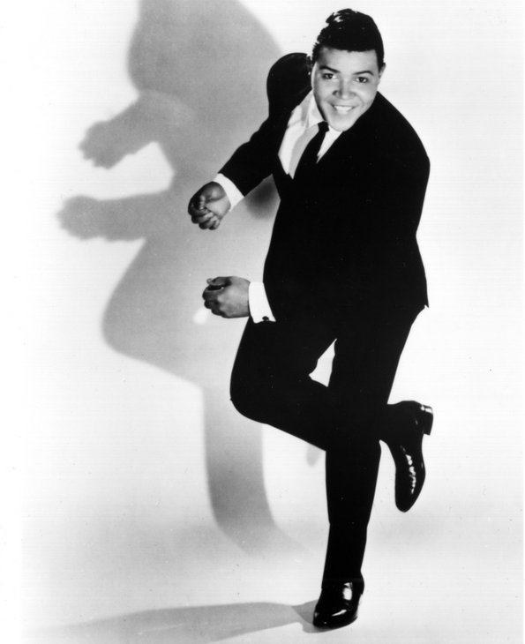
The sixties
Use the following information and youtube clip to write a TEEEC paragraph on the Sixties and The Twist:
The Twist
The sixties had seen teenagers grasp personal freedom. The changes in society were reflected in dance through a less structured rock ‘n’ roll and the introduction of the Twist where individuals could dance without a partner. Partners did not touch each other.
Chubby Checker introduced this dance craze and he described it as: “Imagine you’ve just stepped out of the shower and you’re drying your back with a towel. At the same time you’re stubbing out a cigarette with your foot”. The Twist changed the way people danced from that time forward. It was possible to get up and dance with a group of friends, with a partner or individually. No longer did girls have to wait to be asked to dance.
Notes:
Image one: https://i.pinimg.com/originals/0b/bb/5e/0bbb5ea1cf0bb1e2b80de37172144c05.jpg

Slide 13
TEEEC example:
Topic Sentence
Expand
Example
Explain
Connect
The sixties allowed a new and innovative style of dance to emerge. Dance became more expressive for the individual, as partners no longer touched each other. This is evident in the move, ‘The Twist’, introduced by Chubby Checker. Checker enabled people to dance in groups, with a partner, or individually through creating this movement. This movement enhanced freedom within dance.

Slide 14
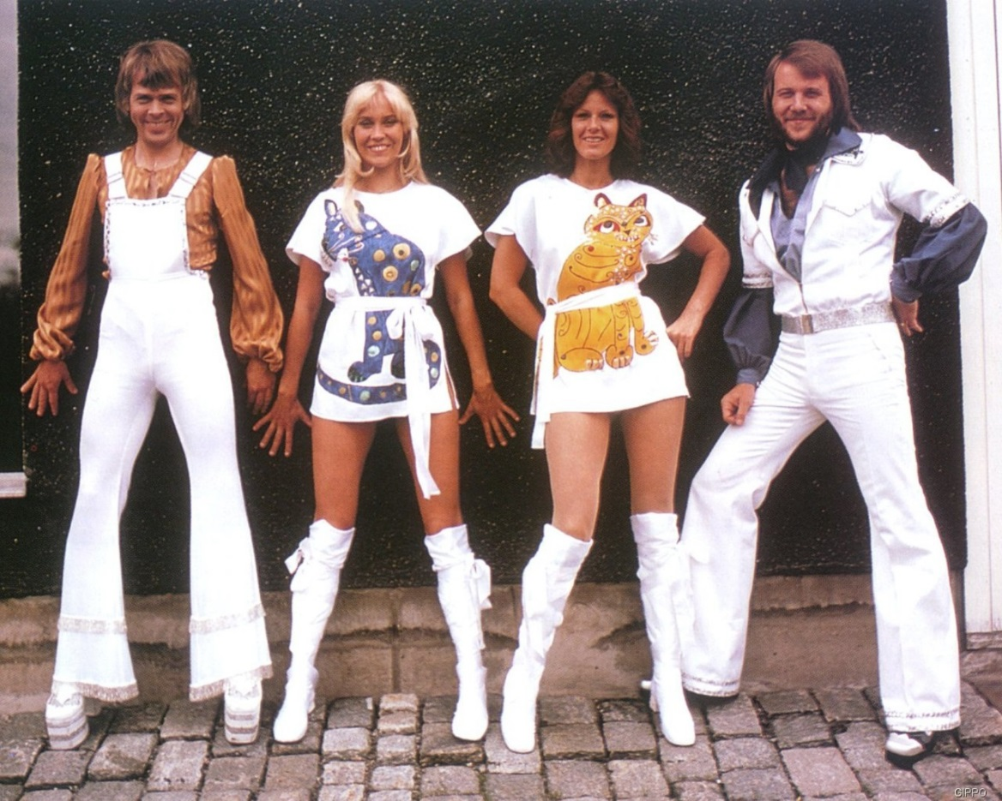

1970s: Disco
Summarising activity:
Write down 10 key words from the following three paragraphs. Use those key words as prompts to summarise the text in your own words.
Dance could be almost anything in the seventies. Hippies would move about waving their arms in response to the music, rock became less structured and people could dance alone in a freeform manner.
Film influenced dance more than ever. Videos were released to sell music. The film Saturday Night Fever introduced disco dancing. Disco, however, was quite structured with simple formations requiring set movements. It was performed in large groups.
During the 1970’s – nightspots, where young people could go and dance to the latest recorded hits – became very popular. These discotheques, or ‘discos’ for short, consisted essentially of a dance floor, a turntable for playing records, a DJ and his or her microphone, and a light show with a mirror ball to create the necessary atmosphere
Notes:
Image one: https://burglaralarmbritain.files.wordpress.com/2012/08/abba.jpg
Image two: http://6iee.com/526621.html

Slide 15
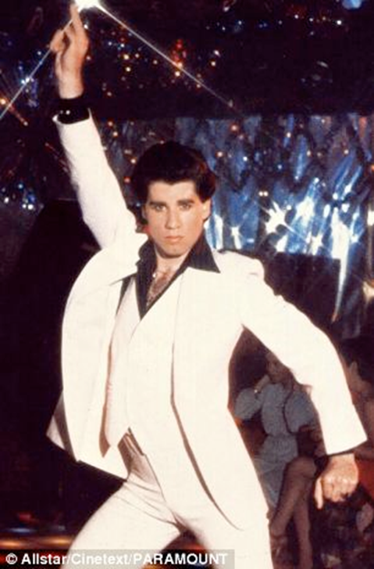
1970s dance style
Watch the following clip from Saturday Night Fever and discuss how dance has changed from the 1970’s to the 21st century.
Saturday Night Fever
Notes:
Image one: http://www.jonathanrosenbaum.net/wp-content/uploads/2017/05/SaturdayNightFever-solo.jpeg

Slide 16
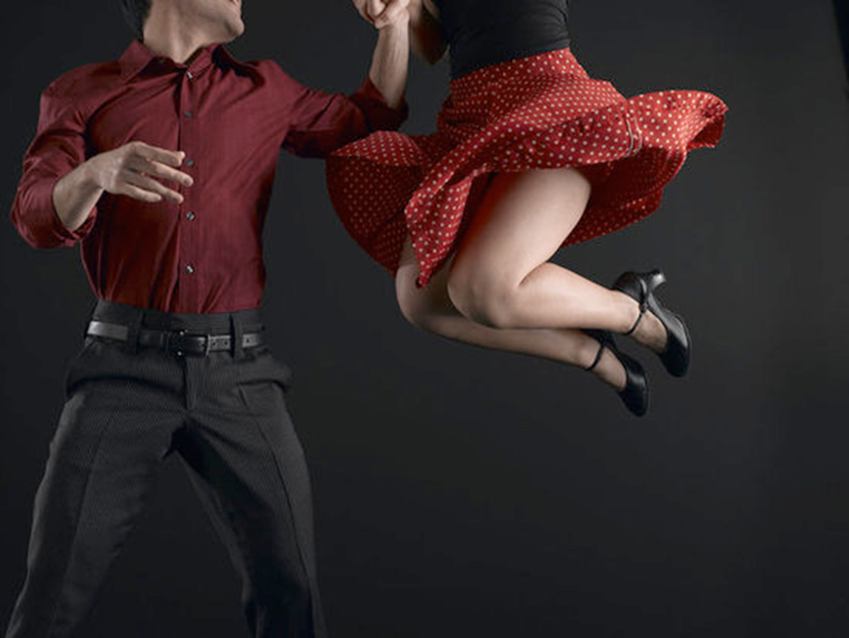
Social dance
How social dance progressed:
Rock ‘n’ roll
The quickstep
The charleston
The waltz
The cha cha
The jive
Salsa
Notes:
Image one: https://upload.wikimedia.org/wikipedia/commons/3/35/Elvis_Presley_Jailhouse_Rock.jpg

Slide 17
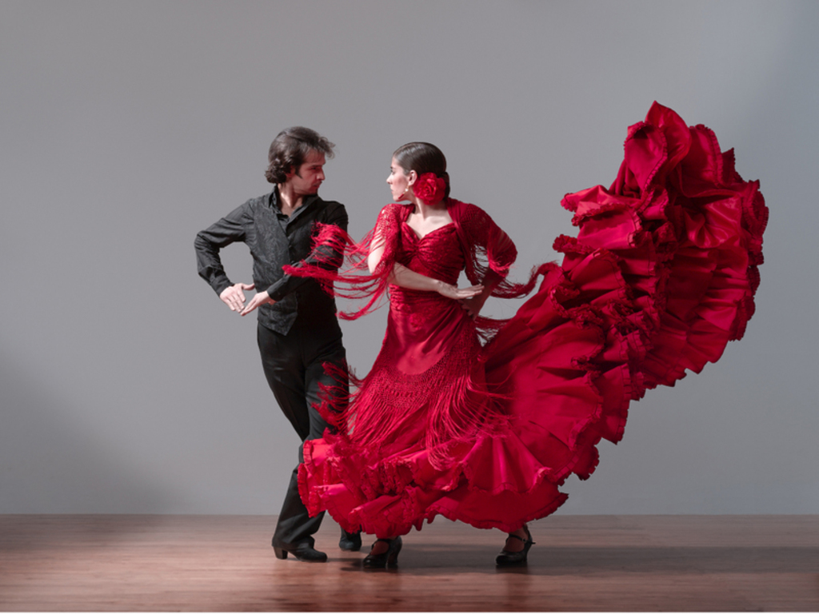
Social dance cont.
Summarise the following dot points into your workbook. Use 10 key words from the points to then create three of your own sentences.
Social dance is a major category of dance styles, where socializing are the primary focuses of the dancing. Social dances can be danced with a variety of partners and still be led and followed in a relaxed, easy atmosphere.
Some people with very limited ability will enjoy moving around a dance floor at a wedding or similar social occasion. However at the other end of the scale, people with advanced skills may participate in competitions or exhibition dancing.
Many social dances are partner dances. In fact, quite often when spoken about social dances, ballroom or other partner dances are kept in mind.
Notes:
Image one: http://wsjunction.org/wp-content/uploads/2014/08/flamenco.jpg

Slide 18
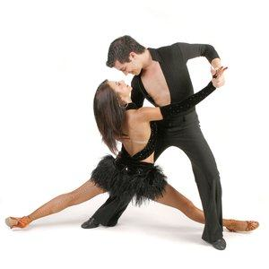
Types of social dance
Login to Kahoot and link the images with the correct style of social dance.
Kahoot https://play.kahoot.it/#/k/519c3a36-fac7-41d6-b022-3a41e6b17695
Notes:
Image one: https://www.ballroomdancingunlimited.com/wp-content/uploads/2014/09/social-dance-styles1.jpg

Slide 19
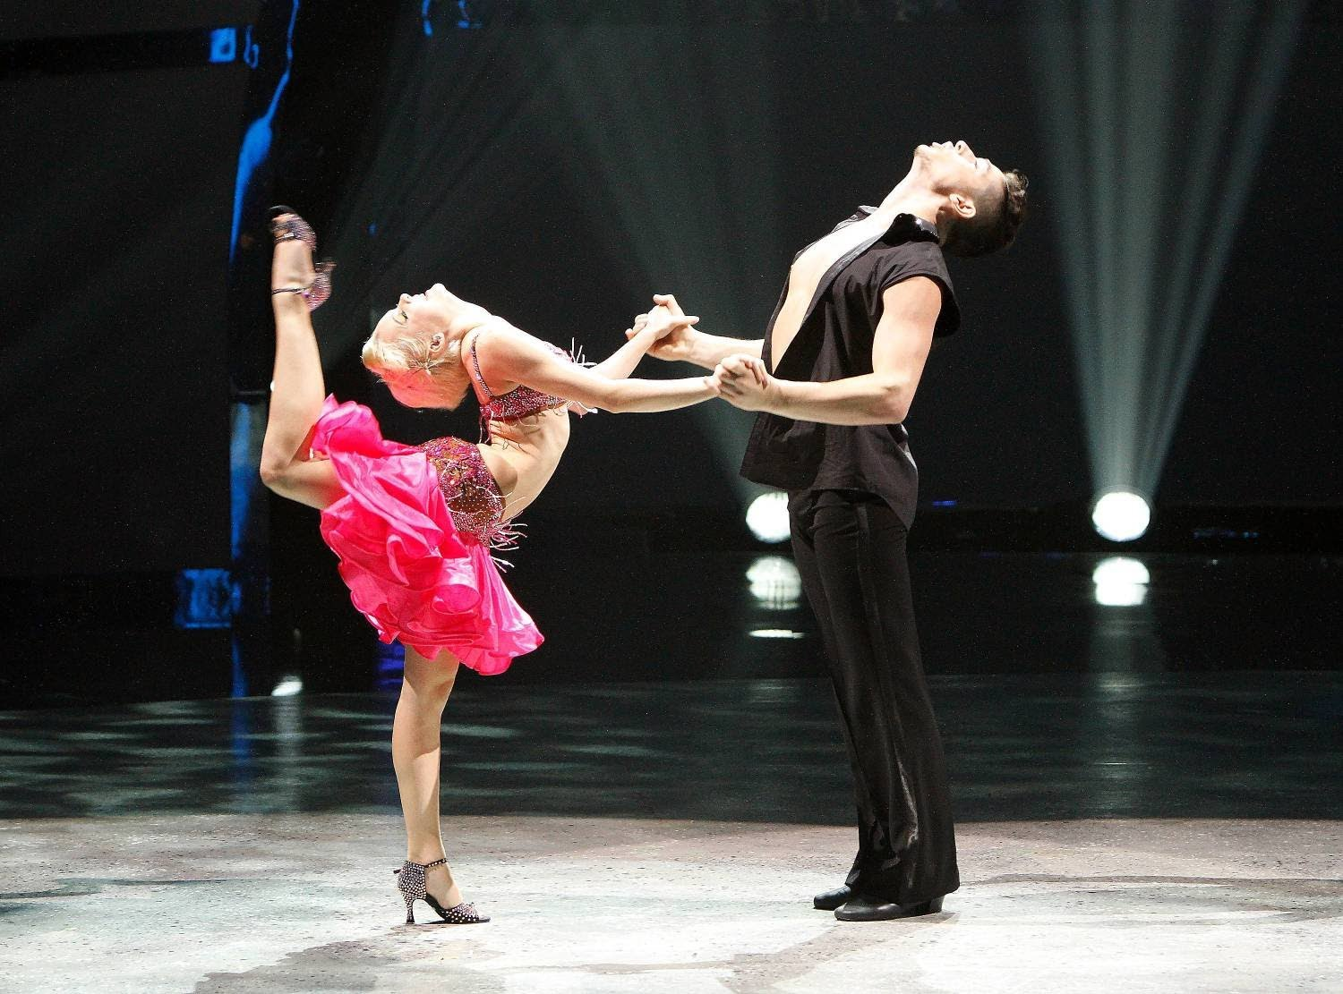
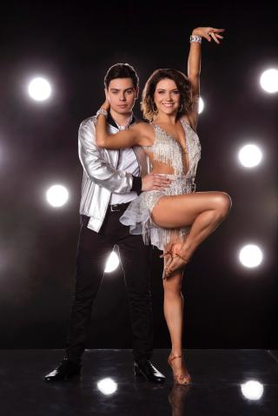
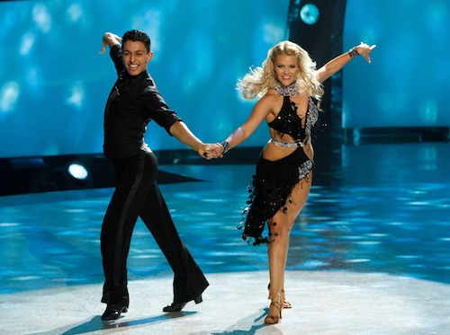
Clips on social dance
Watch the following clips on the various styles of social dance and discuss the differences. Explore what makes each of these unique? Which is your favourite and why?
The cha cha
The waltz
The jive
The Charleston
The quickstep
Rock ‘n’ roll
Salsa
Notes:
Image one: http://assets.nydailynews.com/polopoly_fs/1.2771789.1473193608!/img/httpImage/image.jpg_gen/derivatives/gallery_320/jake-t-austin-jenna-johnson.jpg
Image two: https://i.ytimg.com/vi/4yEOcUqRz7o/maxresdefault.jpg
Image three: http://assets.danceinforma.com/public/assets/mce/Chelsea_News/SYTYCD_Top_10_contestant_Paul_Karmiryan_and_all-star_Witney_Carson_in_a_Cha_Cha_routine.jpg

Slide 20
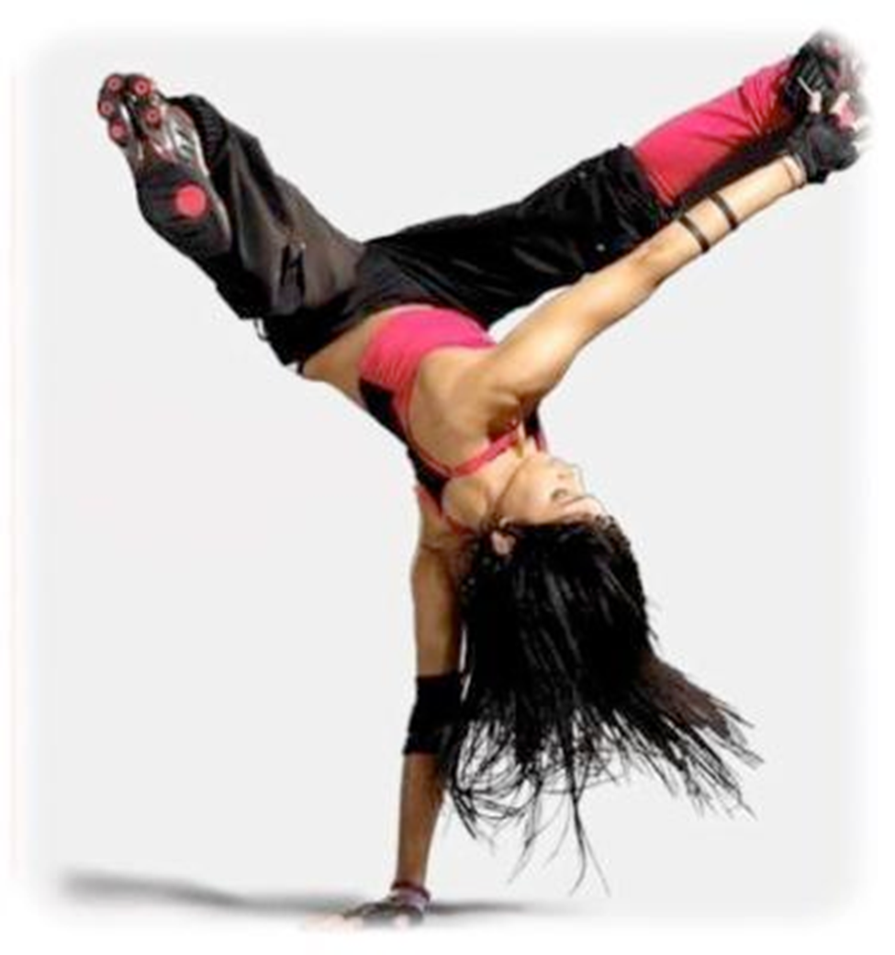
Street dancing
The different styles of street dancing, and how it became so popular in mainstream society…
Notes:
Image one: https://upload.wikimedia.org/wikipedia/commons/3/35/Elvis_Presley_Jailhouse_Rock.jpg

Slide 21
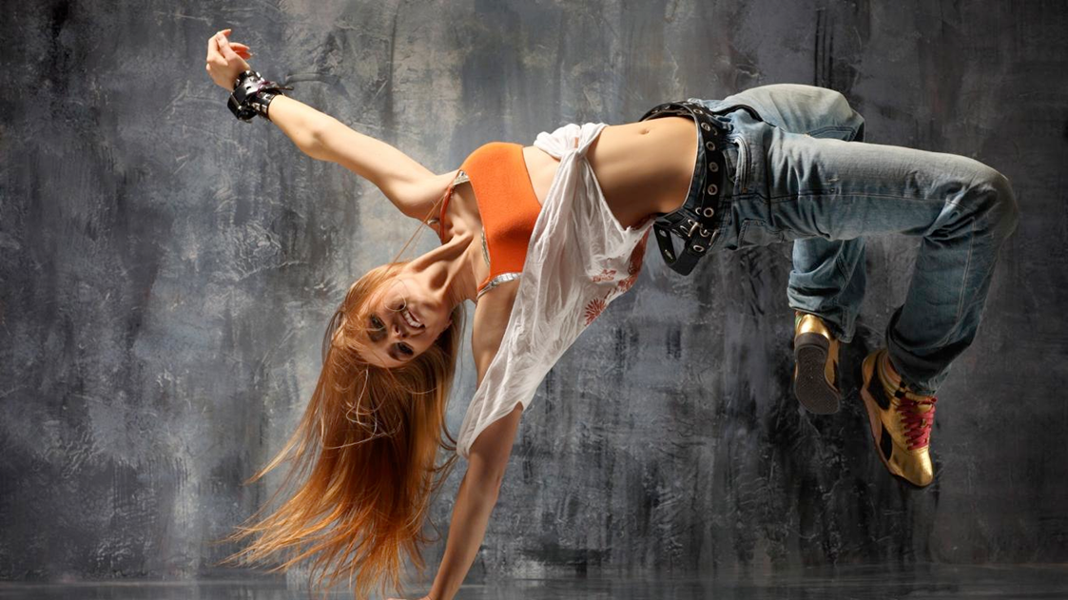
Street dancing cont.
Street dancing refers to any style of dance that evolved outside of dance studios in any available open space such as streets, dance parties, parks, school yards, raves and nightclubs.
They are often improvisational and social in nature, encouraging interaction and contact with spectators and other dancers.
Examples of street dancing include:
B-boying or breakdancing: Originating in New York city during the early 1970s
The Melbourne shuffle: A club dance that originated in the late 1980s in the underground rave music scene in Melbourne, AUS.
Hip hop: One of the most popular styles of street dancing today. This style became so common that commercialised versions were professionally developed and performed in music videos. Hip hop includes the techniques of popping and locking.
Notes:
https://alchetron.com/Graeme-Murphy

Slide 22
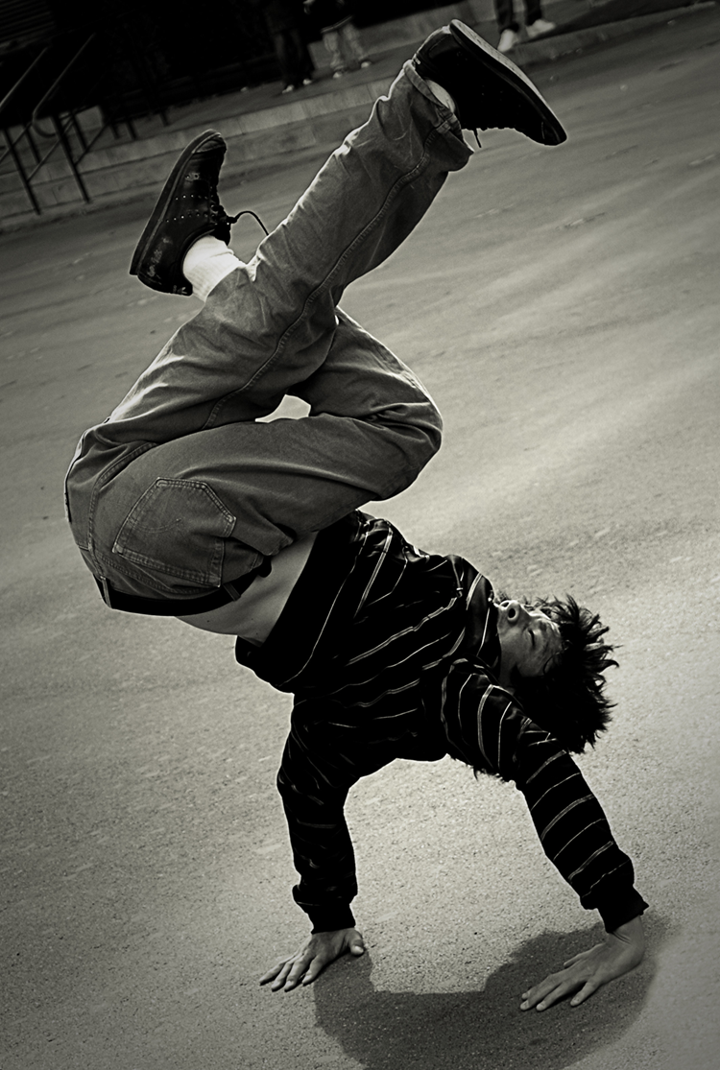
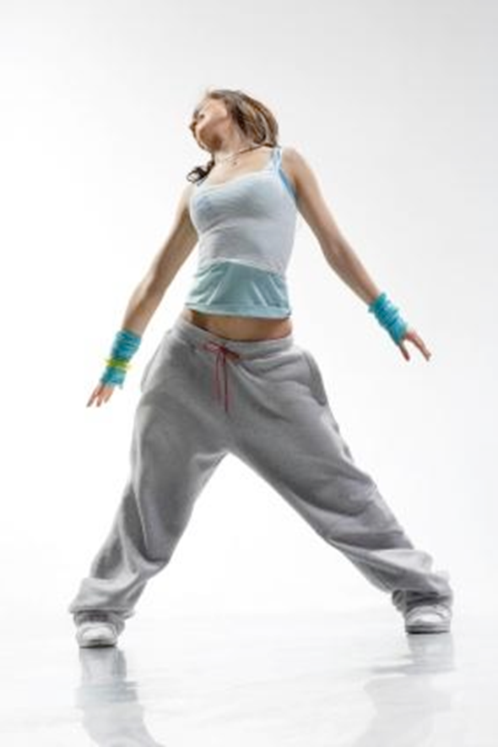
Street dancing clips
Watch each of the following clips on street dancing and write a TEEEC paragraph on why the movement is so successful. Discuss the movement quality and how the elements of production assist in the overall performance:
Timomatic- Freestyle
Freestyle battle- World of dance
Timomatic- Pass out
The company
Notes:
https://alchetron.com/Graeme-Murphy

