Slide 1

Constructing a composition work

Slide 2
We will explore
Motif
Motif into phrase
Transitions
Sections
Repetition
Variation and contrast
Abstraction

Slide 3
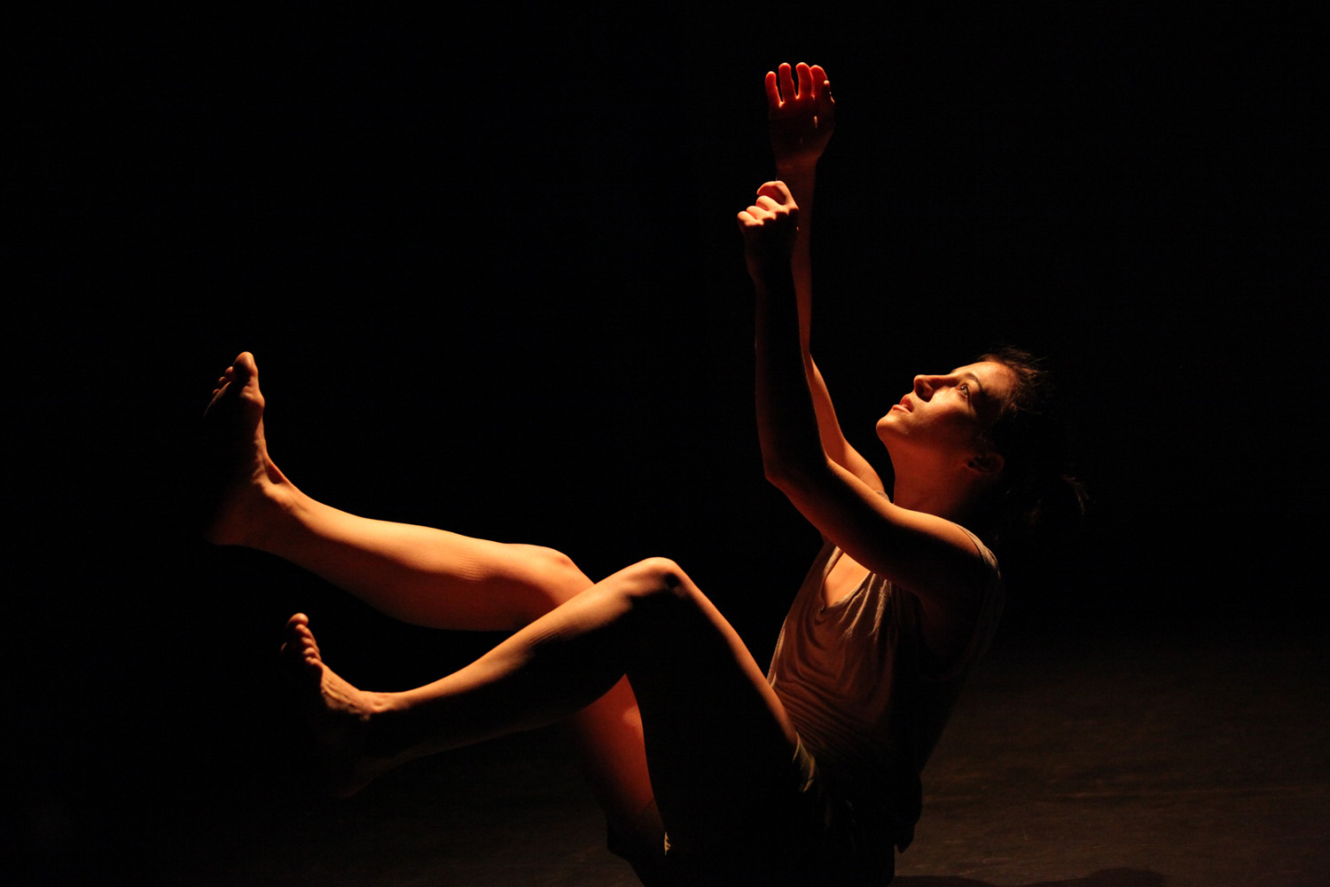
What is a motif?
A motif is a recurring sequence of four to eight counts in length, that represents the intent (idea) of the dance.
It is generally symbolic or gestural movement based from your concept or intent.
A motif is one of the first movements we see in a dance.
All other movements dance are developed from a motif.
Notes:
Image one: http://oberon481.typepad.com/.a/6a00d8341c4e3853ef0162fd1312a0970d-pi

Slide 4
Motif development
Once you have your intent (idea/story) selected, it is time to start creating your motif!
Task one
  Gesture: brainstorm three gestures that are literal representations of your intent. This could include waving, yawning, collapsing, shaking a hand, pushing, checking the time, wiping the brow, etc. Whatever it is, it has to relate to your intent!
  Connect each gesture through a linking movement. You should now have a six to eight count phrase. This is now your motif.
  Explain and perform your motif for the rest of the class.
  Discuss and write an entry in your process diary on the success of developing your motif.

Slide 5
Motif into phrase
Task two
Abstract (manipulate/change) your motif to create a longer phrase by using several of the elements of dance below.
  Space: level, shape, dimension, direction, planes or pathways
  Time: metre, tempo, phrasing, accent, rhythmic patterns or stillness.
  Dynamics: release of energy, weight/force or qualities of movement (sustained, suspended, swinging, collapsing, vibratory and percussive movements).
Write which elements you selected for your motif and explain and why you chose those particular ones in your process diaries.
Perform your motifs to the class.
Thinking about your favourite performance (it does not have to be yours), write a process diary entry about the use of space, time and dynamics in the motif.

Slide 6
Transitions
When you create a transition from one phrase or section to another, it must be purposeful and relevant to the intent and movement quality.
Consider the following when creating your transition:
locomotor movement travelling to a new stage space for a new section
gestural movement exploring your intent to show the transition
use of levels and direction to create engagement.
Task three
Imagine you have a completed work of three different sections. Discuss in pairs what your intent would be, and therefore what each different section would be about. Create a transition of eight counts, explaining each movement and what it represents, moving from one section to the next.
Perform these transitions for the class, and discuss the purpose of each movement.
Write an entry in your process diary on the success of the transitions and what you could add or alter next time.

Slide 7
Sections
When creating a composition you will have a minimum of two and a maximum of five sections within your work, depending on the structure or choreographic form you choose.
We will explore the different structures in the next PowerPoint, however, it is important to know that each section must be different from the others.
Why is it important to have differences in your sections?
What would be different between the sections?
How would the meaning change?
How would the movement change?
What would change within the elements of dance?
And what is the overall purpose of showing these differences within the sections?
View the clip on So you think you can dance- contemporary duo and describe the different sections.
Task four
Discuss in pairs your same intent from the previous task, or make up a new intent. Using this intent discuss how you could create different sections, and different movement qualities within the sections, to explore the chosen intent.

Slide 8
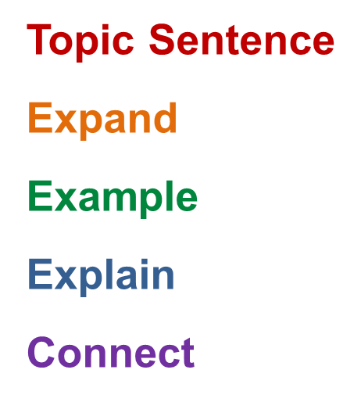
Repetition
What is repetition? Discuss this in a dance concept.
Why would repetition be important to a dance work?
How would you successfully utilise repetition in your work?
Task five
Watch the clip on Hallelujah- So you think you can dance and discuss the use of repetition in the work. How has it added to the work?
Write a TEEEC paragraph on the success of this.

Slide 9
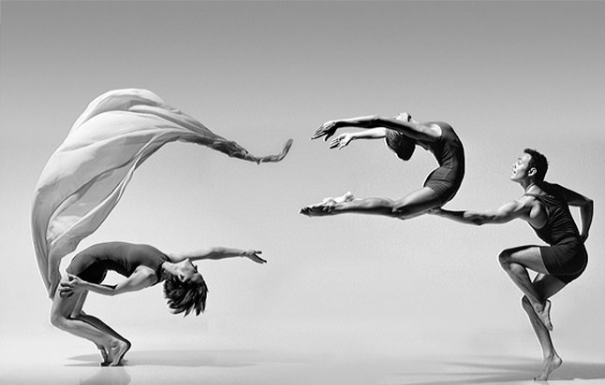
Variation and contrast
What is variation and contrast?
What is the purpose of using variation and contrast in your composition work?
Task six
Watch the clip from So you think you can dance- Halo and discuss the contrast in the work.
Write a TEEEC paragraph describing the change in dynamic styles and how this adds to the overall unity of the work.
Notes:
Image one: https://c1.staticflickr.com/2/1641/25808095920_b0a9eb68f5_b.jpg

Slide 10
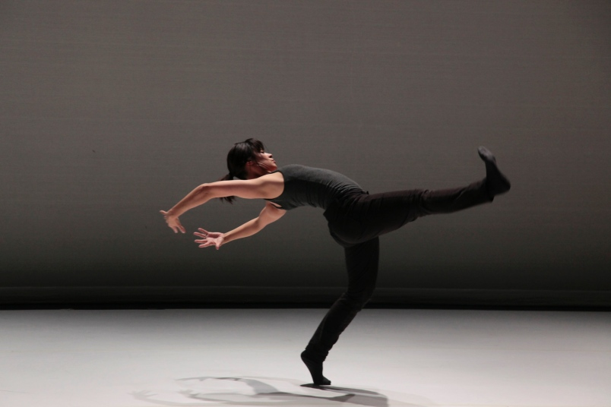
What is abstraction?
Abstraction means how to manipulate your choreography.
There are many ways to abstract your movement, exploring space, time and dynamics, which we will go through in a later PowerPoint.
Once you have your motif, phrases, and sections of movements planned, manipulate your choreography to create engagement within your work.
Notes:
Image one: http://images.glaciermedia.ca/polopoly_fs/1.23060700.1507674031!/fileImage/httpImage/image.jpg_gen/derivatives/landscape_804/workspace-iii-the-response.jpg

