Slide 1
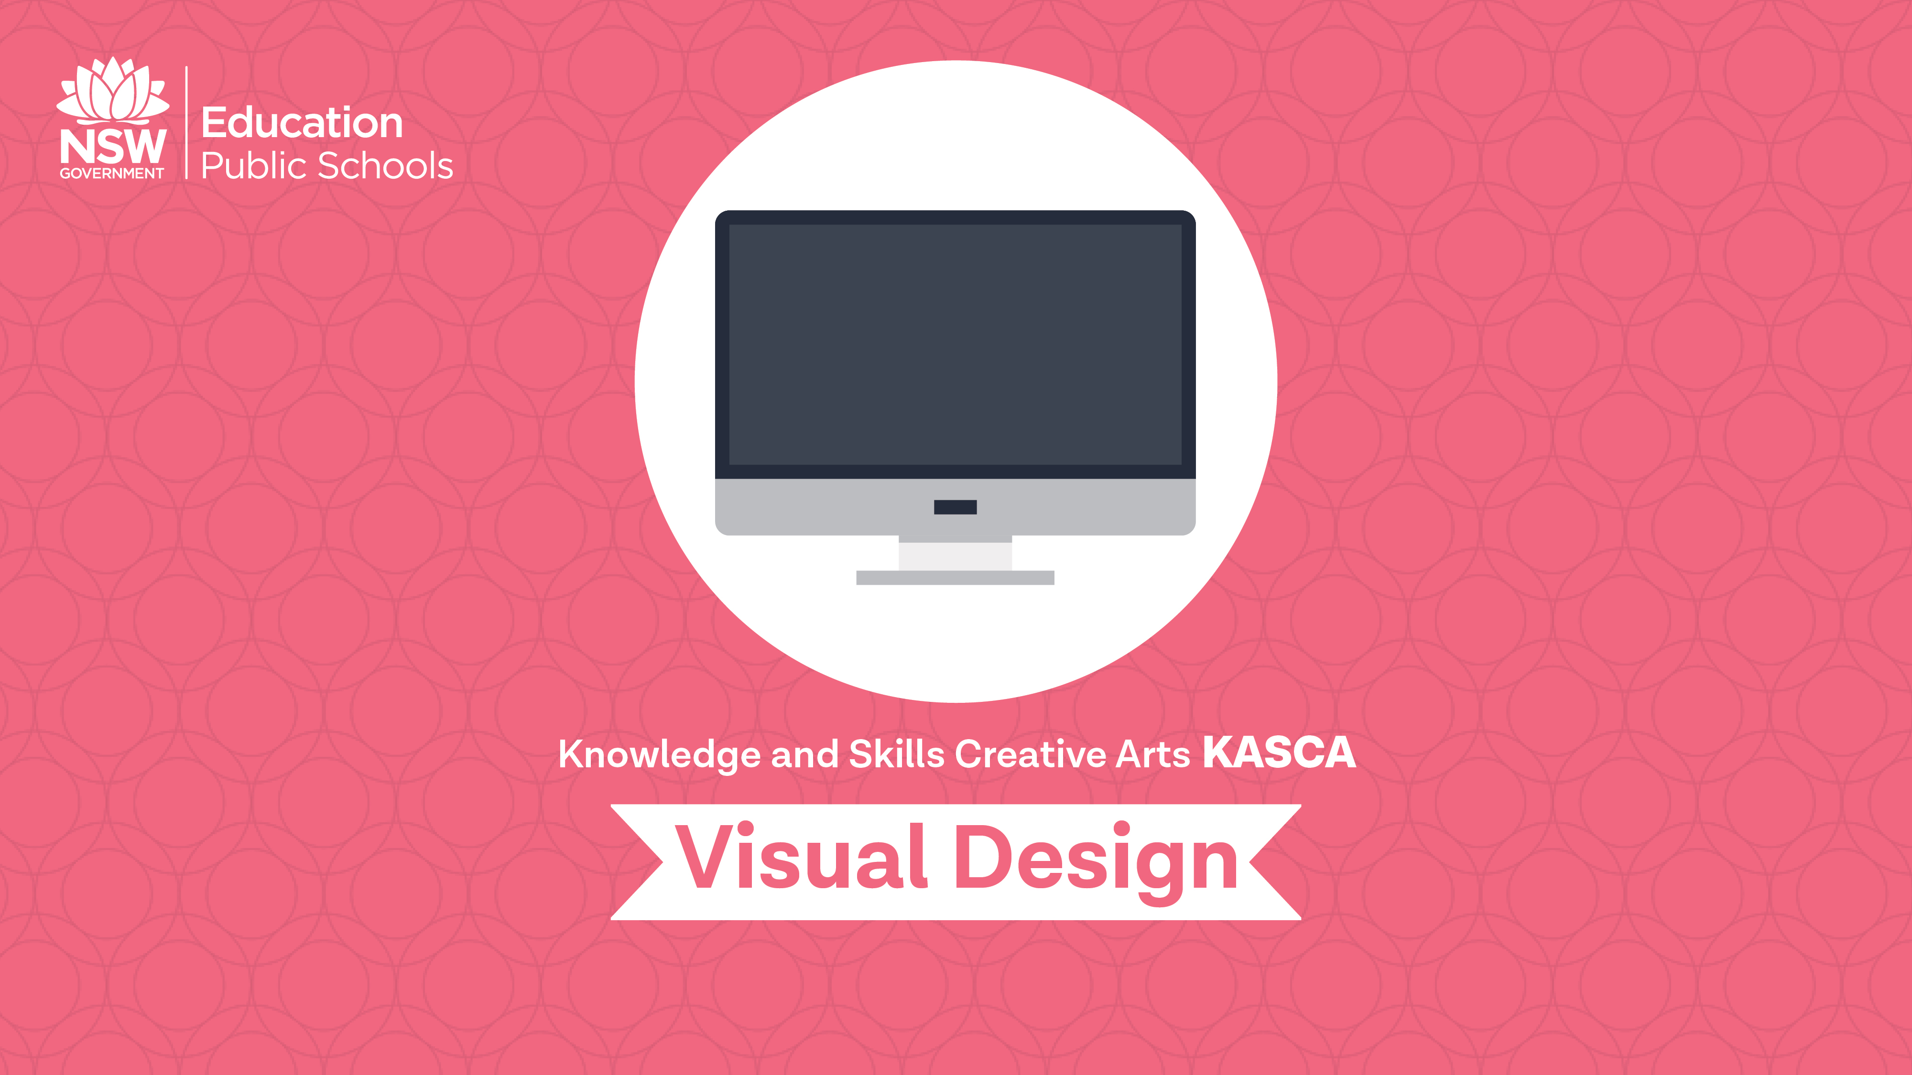
Illuminated manuscripts

Slide 2
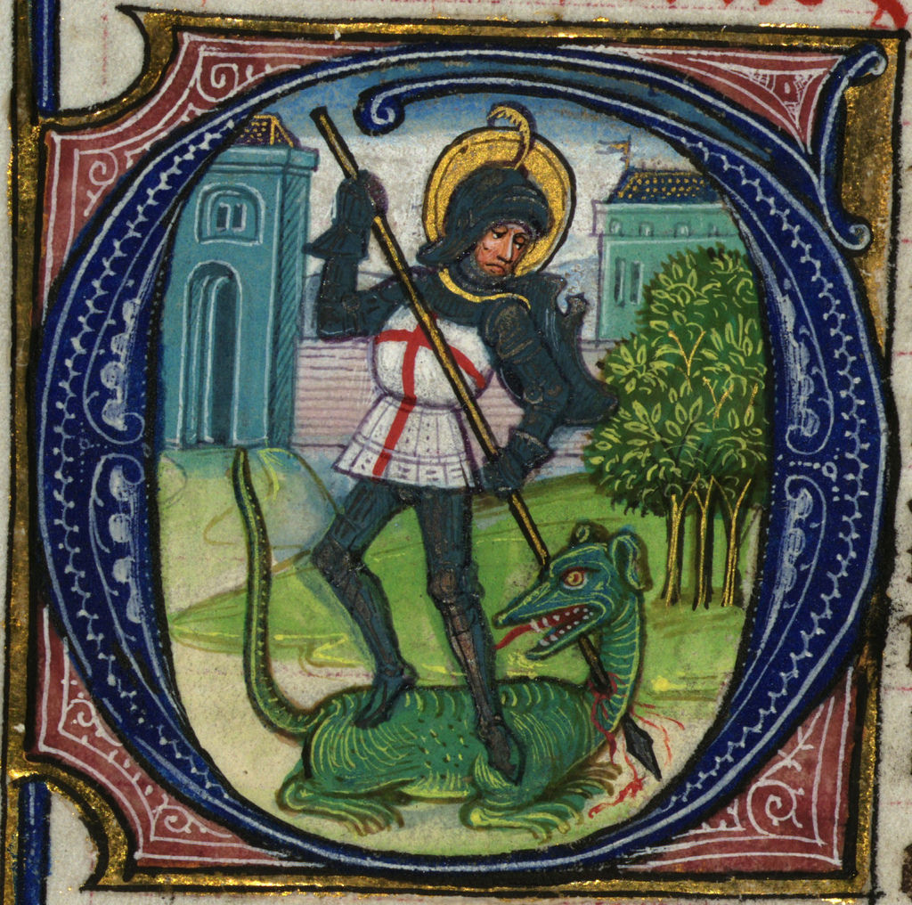
What is an illuminated manuscript?
Watch the videos
Making illuminated Manuscripts (00:06:13)
The Structure of a Medieval Manuscript (00:02:08).
Summarise the main points in your visual design journal or blog.
Notes:
https://media1.britannica.com/eb-media/75/136775-004-856ECAEF.jpg accessed 10/12/2017

Slide 3
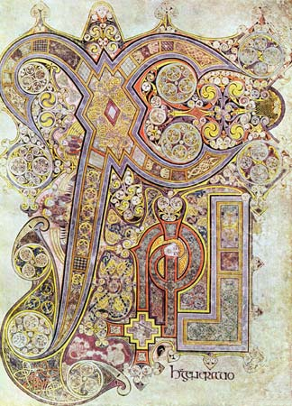
The word manuscript originates from the words meaning ‘handwritten”.
Manuscripts were painstakingly copied by scribes on parchment or vellum, using quills.
The inks and colours were made from ground pigments, such as lamp black carbon, minerals or rocks.
Until the 1200s, Monks in monasteries made the manuscripts for religious reasons, but also to reproduce Greek and Roman texts.
Sometimes monks would travel in pairs to copy a book from another monastery. While one person scribed, the other would illuminated.
Notes:
Image one: http://www.latimes.com/local/obituaries/archives/la-me-bob-fosse-19870924-20160622-snap-story.html
Image two: https://www.pinterest.com.au/pin/136515432430189887/?lp=true accessed 10/12/2017

Slide 4
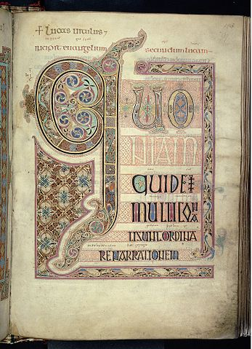
The 'illumination' comes from the application of gold to the pages which made them look like they glowed.
The picture to the right is of the opening page of St Luke's Gospel 715 AD, in the Lindisfarne Gospels. It is made from ink, pigments and gold on vellum.
Notes:
https://commons.wikimedia.org/wiki/File:Lindisfarne_Gospels_folio_139r.jpg accessed 10/12/2017

Slide 5
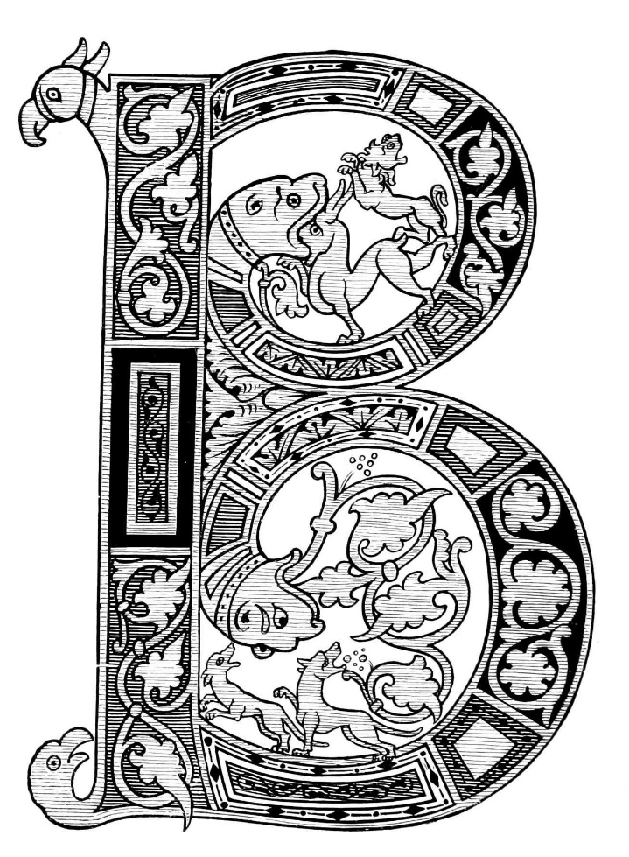
The illustrated pages were made up of decorated letters, borders and large and miniature images that helped people follow the text. This assisted those who couldn’t read to understand what was being told through the text.
Illuminated manuscripts continued to be made until the 1450s when Gutenberg invented movable type and the printing press. Printing meant books could be mass produced.
Notes:
https://upload.wikimedia.org/wikipedia/commons/a/ad/Illuminated_Manuscripts_%28Middleton%29_figure11.jpg accessed 10/12/2017

Slide 6
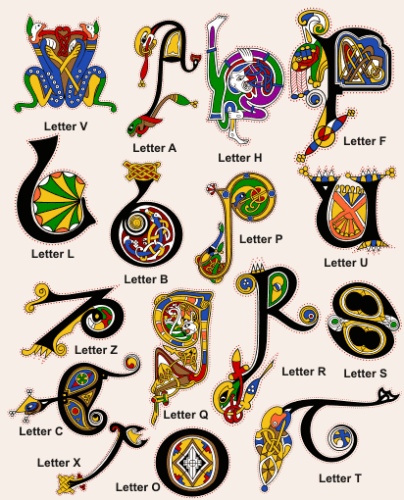
Here are some examples of illuminated letters.
Notes:
https://i.gr-assets.com/images/S/compressed.photo.goodreads.com/hostedimages/1380428085i/856274.gif accessed 10/12/2017

Slide 7
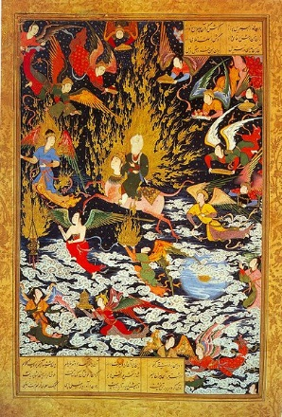
The ascent of Muhammad to heaven (mi'rāj)
This illuminated manuscript was made sometime between 1539 and 1543.
It is opaque watercolor and ink on paper.
The size is 28.7 × 18.6 cm (11.3 × 7.3 in).
Illuminated scripts were common in all cultures and combine images and text to communicate religious and non religious stories.
Use the internet to find some examples of manuscripts from other cultures. Write about them in your visual design journal/blog.
Notes:
The ascent of Muhammad to heaven (mi'rāj)
between 1539 and 1543
opaque watercolor and ink on paper
28.7 × 18.6 cm (11.3 × 7.3 in) accessed 10/12/2017

Slide 8
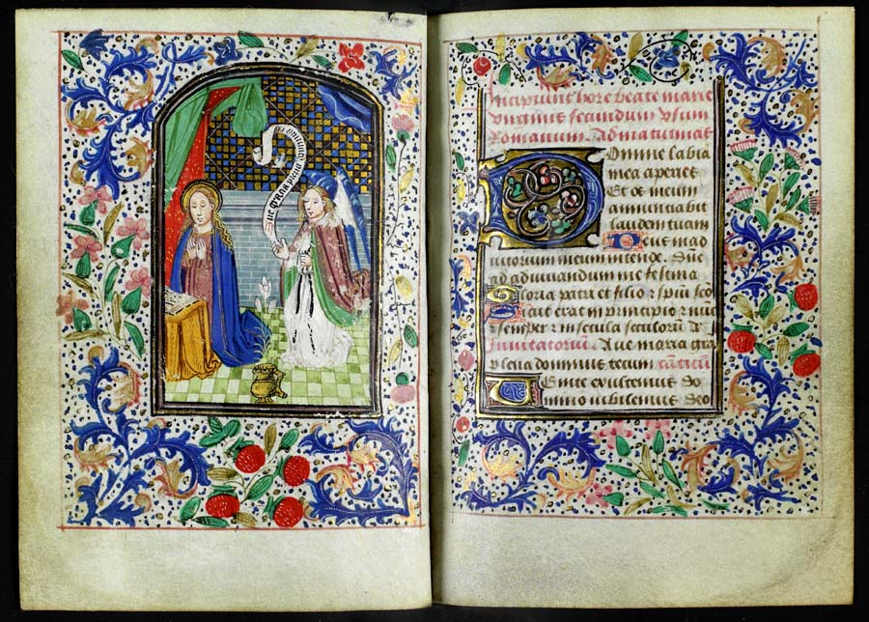
Book of hours
Using the internet, go to the Glasgow University library special collections department website and read through the page with information about the Book of Hours.
Research and answer the following in your visual design journal/blog:
Why is this manuscript called the ‘Book of hours’?
What was the purpose of the book of hours?
How is repetition used in the images?
Brainstorm five modern organisational tools that could be changed to an illuminated manuscript
Watch the video The Medieval Calendar (00:04:29).
Notes:
Image from http://special.lib.gla.ac.uk/exhibns/month/dec2006.html, accessed 18/01/2018

Slide 9
Compare and contrast
Use the Comparing manuscript illustrations printed handout or view the links below to complete this activity.
Made in 1290-1310: Two men before a King and a man speaking to a family
Made in about 1405 by The Virgil Master - Alchandreus presents his work to a King
Compare the two manuscripts and answer the questions in your visual design journal/blog:
What are the similarities and differences between the two manuscripts?
Are there any images or symbols that have remained the same?
How have illuminated manuscripts developed over time?
How could they be used in the future?

Slide 10
Graeme Base - Animalia
Research and answer the following in your visual design journal/blog:
Compose a one page biography for Graeme Base.
Write a TEEEC paragraph on Graeme Base’s art style, famous artworks and creative process.
What makes his work unique, yet similar to illuminated manuscripts?
Design a ten page children's book based on Graeme Base’s works.
Notes:
http://graemebase.com/wp-content/uploads/coveronly_0006_Layer-Comp-7.png accessed 10/12/2017

Slide 11
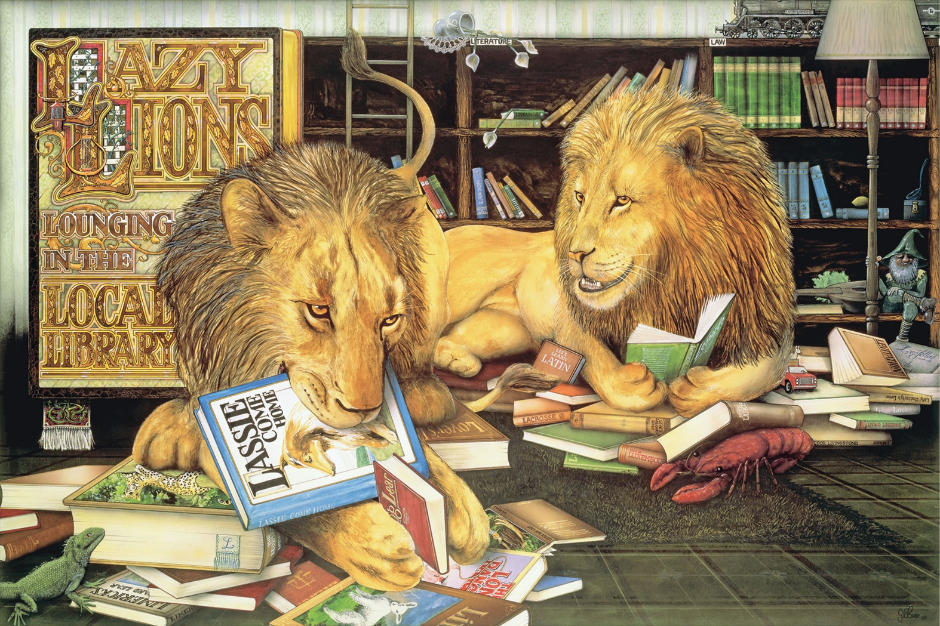
Watch the video Interview with Children’s Author Graeme Base (00:02:55)
Find out more about Graeme Base at: http://graemebase.com/about-graeme/
Notes:
http://graemebase.com/wp-content/uploads/coveronly_0006_Layer-Comp-7.png accessed 10/12/2017

Slide 12
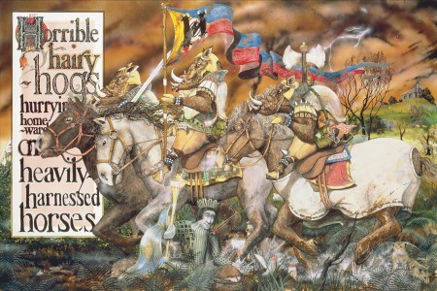
Notes:
http://graemebase.com/wp-content/uploads/HORRIBLE-HAIRY-HOGS-450x300.jpg accessed 10/12/2017

