Slide 1

Choreographic forms

Slide 2
We will explore the different choreographic forms:
Structures
narrative form
binary form
ternary form
rondo form.
Choreographic techniques
canon.

Slide 3
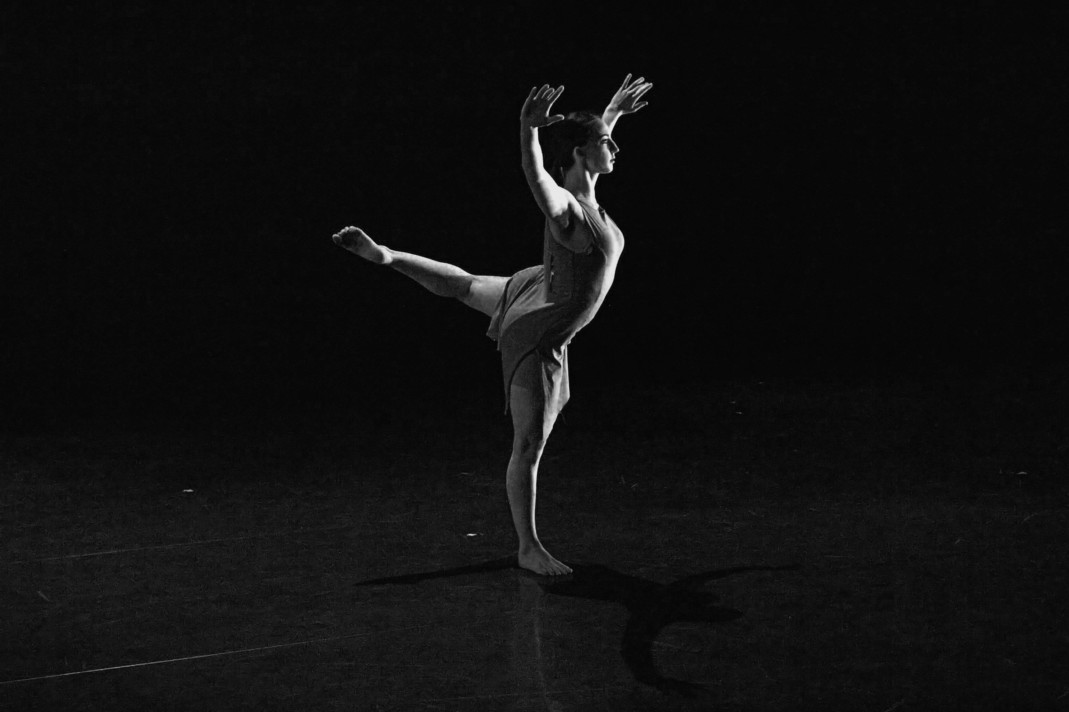
Choreographic forms
What is a choreographic form?
Choreographic forms structure a dance work and their music. A normal pop song usually is structured with a simple verse/chorus form. However, when we create compositions, we aim to show the structure through the music, movement qualities and use of stage space.
Notes:
Image one: http://ryersonfolio.com/the-shapes-and-forms-of-choreographic-works/

Slide 4
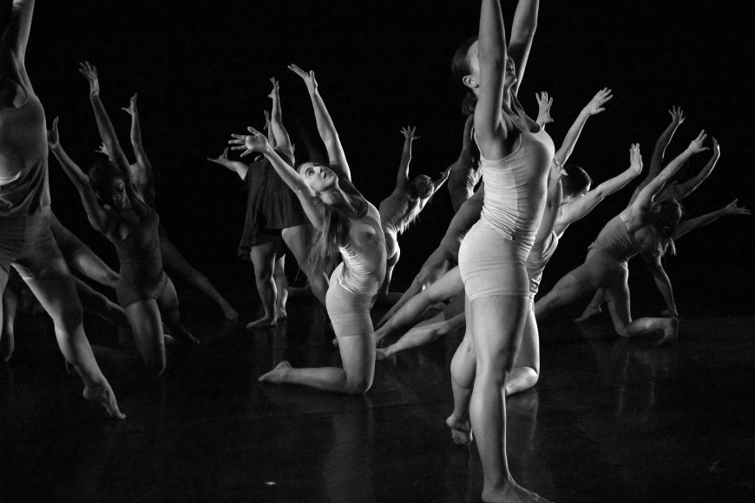
Narrative form
This tells a story, and usually has three sections: A B C.
Each section conveys a different part of the story.
Task
In pairs, compose a story.
Break down your story into 3 sections in your process diary.
Watch So you think you can dance- Dreaming with a broken heart and discuss the narrative form.
Write a process diary entry discussing the success of the narrative form within the work.
Your turn!
Notes:
Image one: http://ryersonfolio.com/the-shapes-and-forms-of-choreographic-works/

Slide 5
Binary form
Binary form has two sections, A B.
The two sections are very different to each other, particularly in meaning and movement quality.
Task
Discuss various ideas you could explore through binary form. In pairs, choose one idea and develop a separate motif for each of the two sections, A and B. Remembering both sections movement has to be original and convey the difference within the intent.
Perform this for the class. Discuss as a group the success in other pairs motifs to show the two different sections. Apply constructive feedback to your motif.
Write a process diary entry on today’s task.

Slide 6
Ternary form
Ternary form has three sections, A B A. The first and last sections are very similar in movement qualities, representing the same idea.
Example
A- Someone is alone, scared and captured, shown through small soft movements.
B- The person fights to escape, shown through sharp and hard movements.
A- They are recaptured and alone again, shown through small soft movements.
Task
View So you think you can dance- Fix you and discuss in pairs the success of the intent. Describe the movement quality conveying both section A’s.
Discuss what other elements within composition could be used to enhance ternary form, aside from movement quality?
Write a process diary reflecting on the dance from above, and the benefits of using Ternary form.

Slide 7
Rondo form
This has several sections, but keeps coming back to the same theme in A in between each section:
A B A C A D A Each time, section A has the same meaning.
Task
In pairs or groups of three, discuss a story and meaning you could explore within rondo form.
Brainstorm what would occur in each section. Remember - it must come back to the same central theme in section A each time.
Make a list of a few different story options.
Present one idea to the class. As a group discuss the possibilities within each pairs ideas.
Choose one of the story's created by another group. Choreograph a performance based on that story in Rondo form.
Perform for the class.
Reflect in your process diary addressing the use of the Rondo form in a classmate’s performance, and your own.

Slide 8
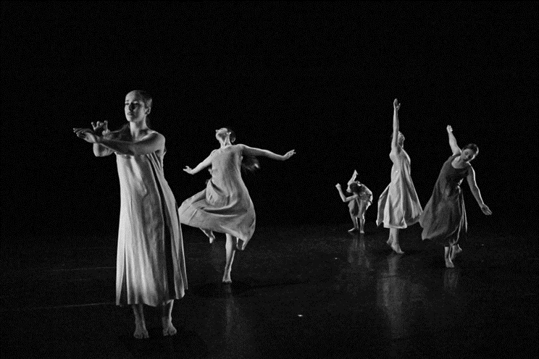
Canon
What is a Canon?
Why are Canons used in dance?
Task
Watch Cry me a river- dance video and discuss the successful use of canon.
In small groups of three or four, create your own canon sequence. What did/didn’t work?
Write a TEEEC paragraph on the technique. Discuss how you could use canon in your dance. Do you think it could be overused?
Notes:
Image one: http://ryersonfolio.com/the-shapes-and-forms-of-choreographic-works/

