Slide 1

Weeping woman self-portrait

Slide 2
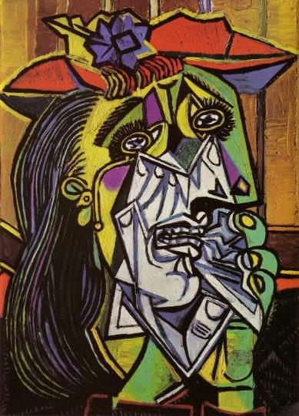
Abstraction
  Abstraction (from the Latin abs, meaning away from and trahere, meaning to draw) is the process of taking away or removing characteristics from something in order to reduce it to a set of essential characteristics. Therefore, an abstraction means non-representational forms.
Notes:
Image: http://bit.ly/2k2jtUi

Slide 3

Pablo Picasso, Weeping Woman, 1937.
  Watch the weeping woman video whilst completing a think/share/compare table outlined below.
  Think – List 5 interesting facts that you think about when you first look at the artwork.
  Share – With your partner, compare facts and note any differences you had between the two of you.
  Compare – As a class, what facts were discovered about the cultural context of the artwork that you have not already noted?
Notes:
Image: http://bit.ly/2k2jtUi

Slide 4
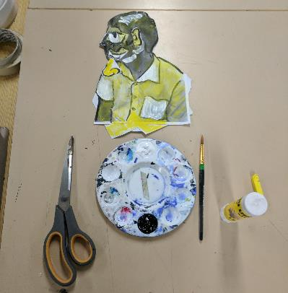
Today you are going to start this artwork
All you need is:
1x A4 forward facing self-portrait printout
1x A4 profile side facing self-portrait printout
1x A4 art paper
scissors
glue
black paint
white paint
a fine brush
one coloured dry pastel.

Slide 5
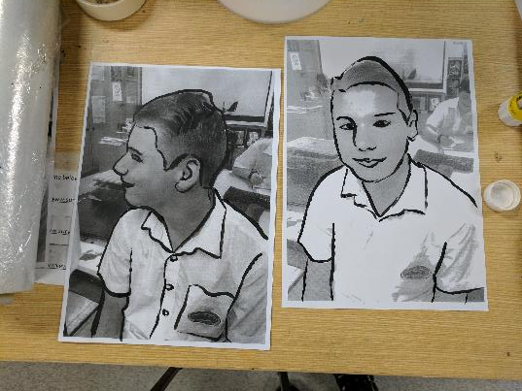
Use the fine paintbrush and black paint to outline the main features of both printouts.

Slide 6
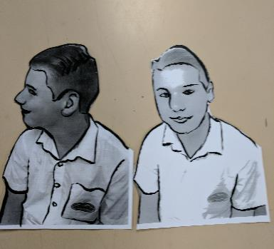
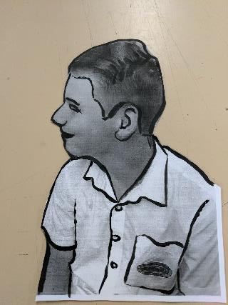
Cut out the backgrounds.

Slide 7
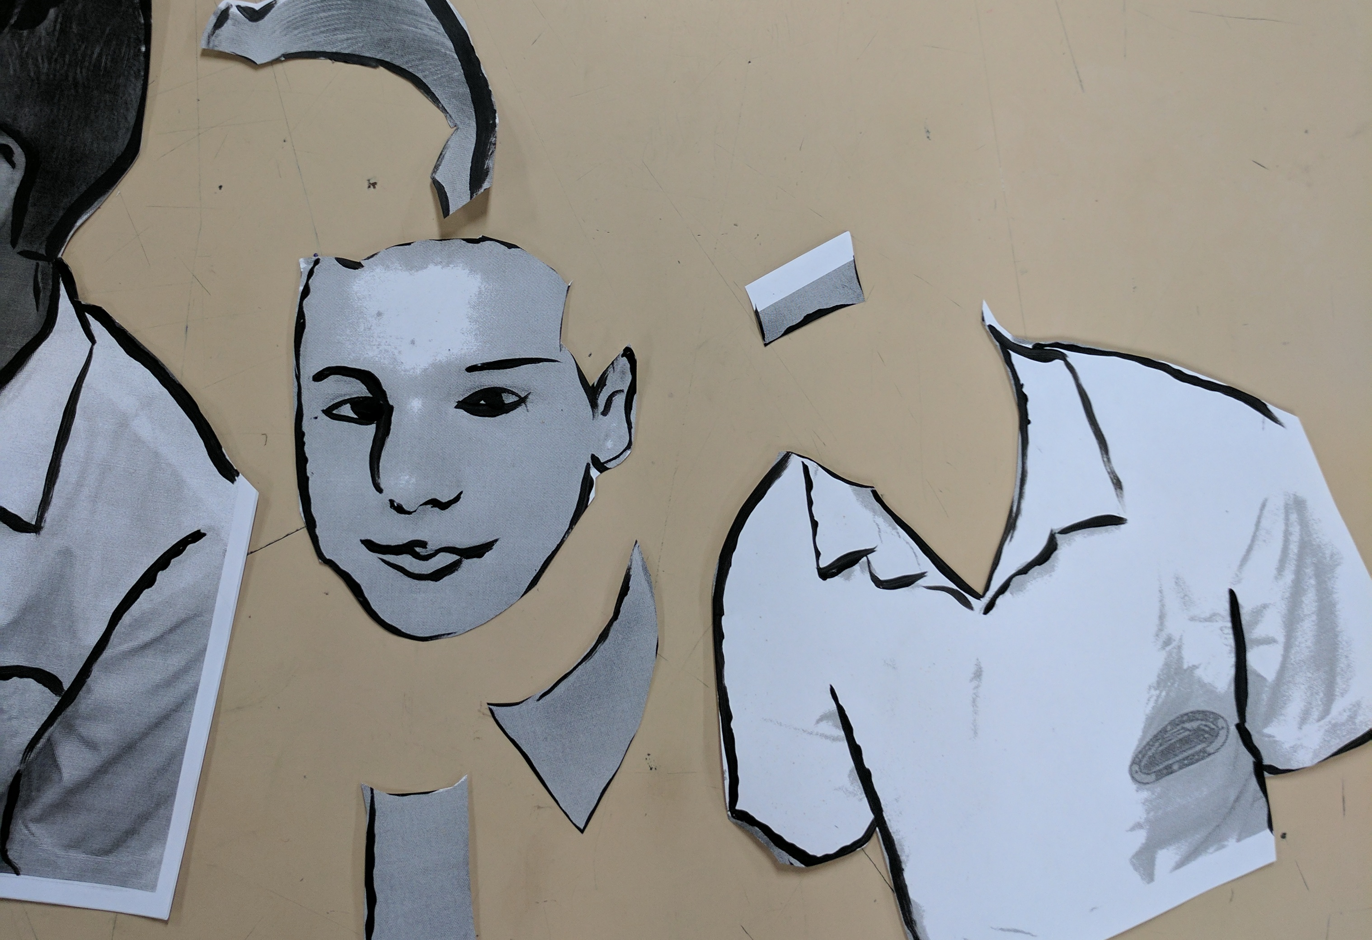
With the forward facing portrait
  Cut out the shapes you outlined and then paste them on to the back of your side-facing profile printout.
Notes:
Image one: https://6247daisy.files.wordpress.com/2010/06/isadora20duncan.jpg

Slide 8
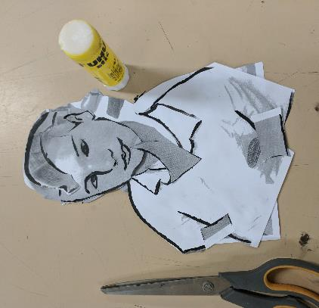
With the forward facing portrait …
  Stick the shapes that you have cut on the back of the other image in an abstract manner.
  Leave this side for now.
Notes:
Image one: https://6247daisy.files.wordpress.com/2010/06/isadora20duncan.jpg

Slide 9
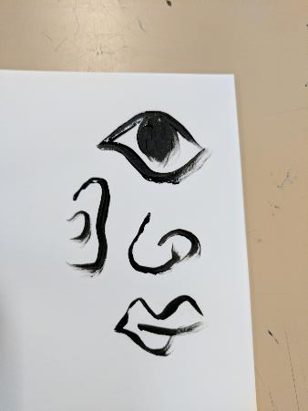
On a separate sheet of paper …
Design your own facial features using the black paint. Anything from eyes, nose, ears, mouth, hair, eyebrows, etc… As many as you like.

Slide 10
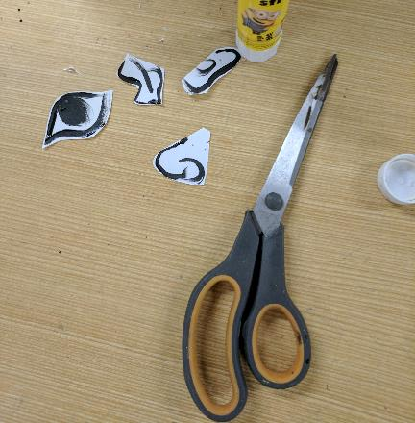
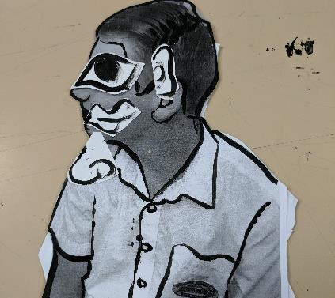
Cut them out and…
  Stick them on the side-facing profile portrait, in an abstract manner.

Slide 11
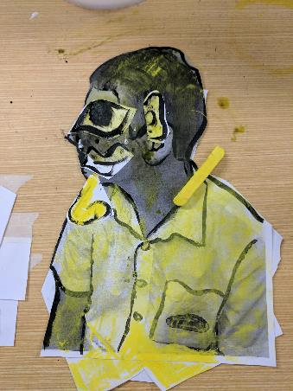
Use the dry coloured pastel
To colour your image in different tones. Lightly smudge over some sections and darkly colour others.
(You do not have to cover the entire image)

Slide 12
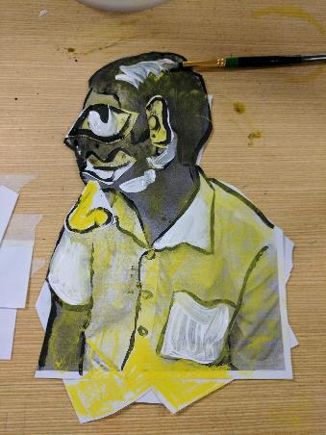
Use the fine brush and white paint
  To add contrast to the colour and shapes and play with the composition of your work.
  Do not cover your whole profile, just add light tone.

Slide 13
Place on the rack to dry, you have finished for today… Well done.
  When you come back next lesson, use the same materials to create an abstract representation on the back.
  This work can be hung on a string from the roof in exhibition.

