Slide 1

K-12 Career Learning Framework
Empowering staff to embed learning in the curriculum to improve post-school outcomes for every student
Career and Workplace Learning
Career Programs
April 2024

Slide 2

Purpose of resources
The K-12 Career Education Framework and Career Learning professional learning is designed to be used by school leaders, curriculum leaders and careers advisers. The resource aims to inform school communities on the key concepts of the career education framework and the importance of embedding career learning in all curriculum delivered.
The resource includes the slides and speaker notes to support the delivery of the professional learning.
In addition, the series of reflection questions are designed to stimulate discussion within schools and/or within smaller groups.
Notes:
This slide is hidden and is used to inform presenters on the purpose of the resource.

Slide 3
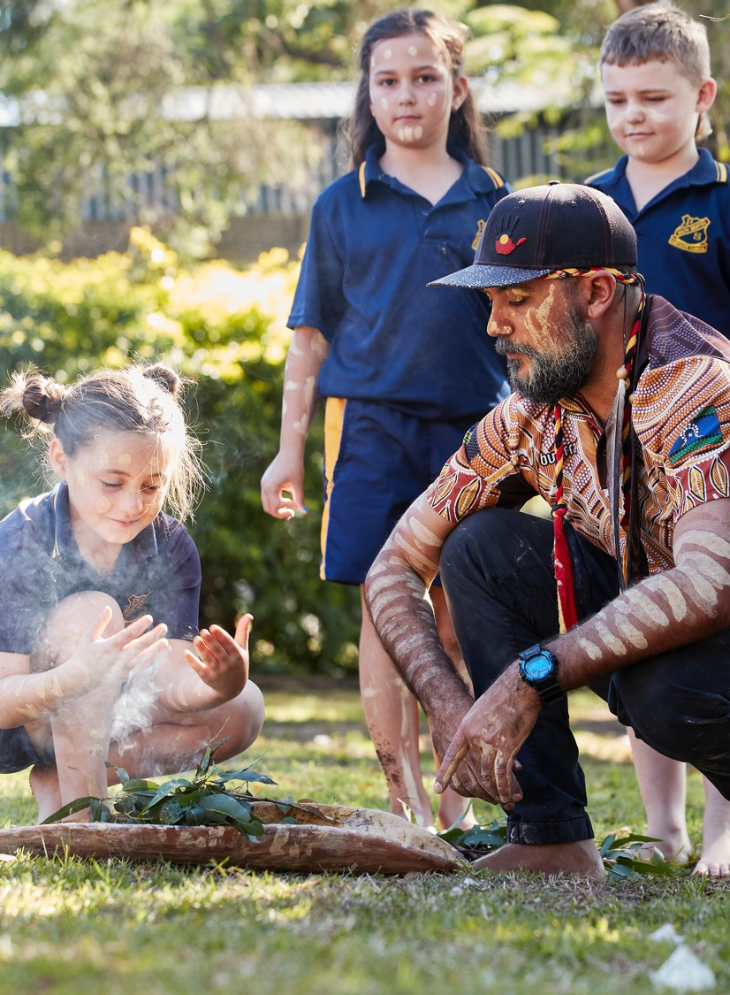
Acknowledgement of Country
We recognise the Ongoing Custodians of the lands and waterways where we work and live. We pay respect to Elders past and present as ongoing teachers of knowledge, songlines and stories.
We strive to ensure every Aboriginal and Torres Strait Islander learner in NSW achieves their potential through education.
Notes:
Use the acknowledgement provide or personalise in accordance with the lands on which you are presenting.

Slide 4

K – 12 Career Learning Framework
Career learning describes the ongoing lifelong process of managing learning, work and life.
It requires the skills and knowledge to plan and make informed decisions about education, training and career choices.
Notes:
How do we define career learning within the department. In simply terms:
“Career learning describes the ongoing lifelong process of managing learning, work and life. It requires the skills and knowledge to plan and make informed decisions about education, training and career choices.”
During this presentation we are going to examine the department’s K-12 Career Learning Framework, the link between the framework and the Australian Blueprint for Career Development and the NSW Education Standard Authority’s curriculum. In addition, we will look at how everyone plays a part in career learning within their classroom.
We will finish with a series of reflection questions to start discussion within the <insert school or team>.

Slide 5
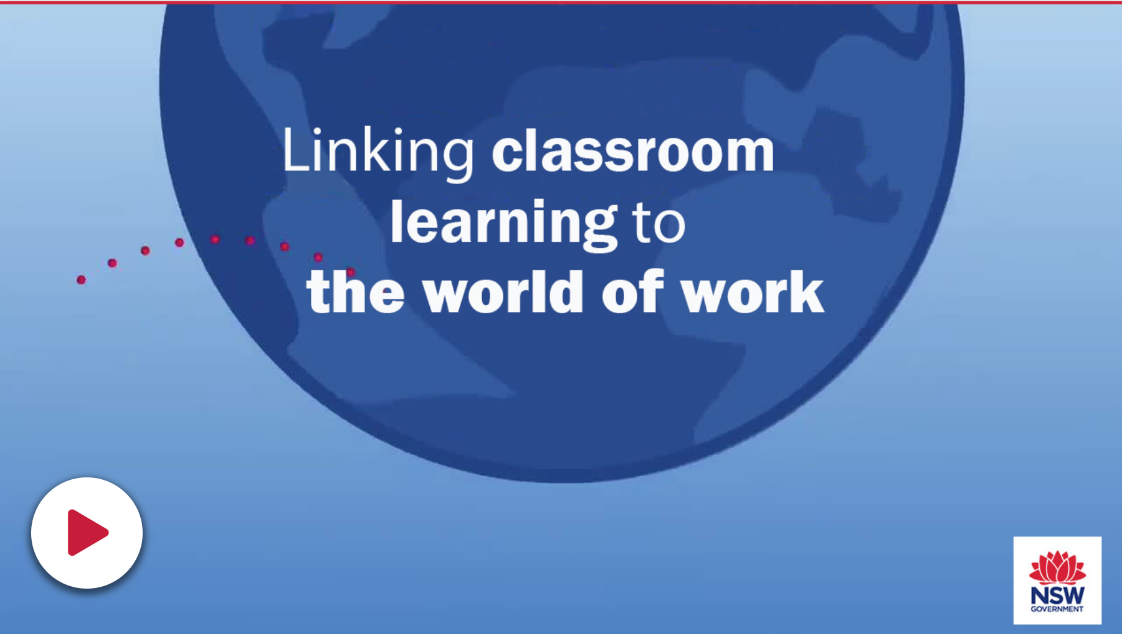

K-12 Career Learning Framework
What is the K-12 Career Learning Framework and who is it for?
K-12 Career Learning Framework web page
Notes:
The NSW Department of Education has developed the K-12 Career Learning Framework to inform senior leaders, curriculum leaders, careers advisers, transition advisers and classroom teachers. It also informs local employers, businesses and industry working with schools to contribute to career learning experiences, pathways employability and enterprise education.
The framework supports students with access to quality career related learning. These career learning experiences build aspiration about future learning and life choices, and the capacity to identify, explore and manage career and life decisions.
The framework is designed to keep it simple and articulate general themes for stages of learning that align to stages of career development articulated in the Australian Blueprint for Career Development: - Personal Management, Learning and Work Exploration, and Career Building.
Resources supporting schools in implementing the framework to embed career learning activities across the stages of schooling can be accessed through the Universal Resource Hub.
The short video we are about to watch introduces the K-12 Career Learning Framework
Note: Click the play button or press space bar to start the video.

Slide 6

Australian Blueprint for Career Development
What is the Blueprint?
used to design, implement and evaluate career development programs
identifies skills, attitudes and knowledge needed to make sound choices and to effectively manage their careers
enables people in a position to support careers and transitions to work with a nationally consistent set of career management competencies to better manage their lives, learning and work
K-12 Career Learning Framework draws upon the principles outlined in the Australian Blueprint for Career Development.
Notes:
What is the Australian Blueprint for Career Development?
The Blueprint is a framework that was commissioned by the National Careers Institute in 2022 and the work was undertaken by the Career Industry Council of Australia (CICA).
The Blueprint can be used to design, implement and evaluate career development programs for young people and adults. It identifies the skills, attitudes and knowledge that individuals need to make sound choices and to effectively manage their careers.
The Blueprint enables teachers, parents, career development practitioners, employment service providers, employers or others who are in a position to support people’s careers and transitions, to work with a nationally consistent set of career management competencies which will help all Australians to better manage their lives, learning and work.
At its core, the K-12 Career Learning Framework draws upon the principles outlined in the Australian Blueprint for Career Development in the context of the NSW Department of Education. The department has mapped the

Slide 7

Preparing students through career learning
Setting the scene
Career learning should start young, encouraging children’s curiosity about the working world and helping them to draw connections between what they do in the classroom and who they might become as an adult
The most important decisions students make about their investment in education do not come at the end of schooling
Career learning has an important role to play in motivating young people to work hard at school
Career readiness is everyone’s responsibility
Notes:
Career learning allows young people to discover and explore, building a growth mindset as they become curious and draw connections to what they are doing now to the future and how that connects with the life beyond school.
Career learning conversations and activities included earlier in schooling and embedded within curriculum will further support the career education classes and targeted programs that are evident in Years 9-12 and support career advisers working within NSW public schools.

Slide 8

Implementing K-12 Career Education
Why a K-12 approach?
The key objective is to raise the career aspirations of all students and to enhance career education across K-12.
The implementation of a K-12 career education approach in schools aligns to the framework and supports Our Plan for NSW Public Education and the Rural and Remote Education Strategy.
The approach aims to support smoother transitions from primary to high schools, provide career development opportunities, improve student retention and link with the industry and community.
Schools are supported through curriculum and career learning resources, webinars and professional learning opportunities.
Notes:
Career learning allows young people to discover and explore, building a growth mindset as they become curious and draw connections to what they are doing now to the future and how that connects with the life beyond school.
Career learning conversations and activities included earlier in schooling and embedded within curriculum will further support the career education classes and targeted programs that are evident in Years 9-12 and support career advisers working within NSW public schools.

Slide 9

NSW Education Standards Authority
Learning for life beyond school is supported when subjects are delivered to students in a way that they can understand how the content is relevant to career pathways and work settings. NESA (NSW Education Standards Authority) syllabuses identify work and enterprise as important learning across the curriculum content for all students.
"provide a flexible structure within which students can prepare for: – further education and training – employment – full and active participation as citizens"
Notes:
NESA work with the NSW community to drive improvements in student achievement. They set syllabuses, assessments, teaching and school standards for all schools in NSW.
NESA is working to reform curriculum based on recommendations from all stakeholders. Priorities identified for the early, middle, and later years of schooling are to:
Build strong foundations for future learning – new English and Mathematics syllabuses for Kindergarten to Year 2.
Provide more time for teaching – reducing the hours teachers spend on extra-curricular topics and issues, and compliance requirements.
Strengthen post-school pathways – new learning areas for Years 11 and 12 that clearly link learning to future employment and study options.
Develop a new curriculum – new syllabuses focused on what is essential to know and do in the early and middle years of schooling, and key learning areas in the senior years.

Slide 10
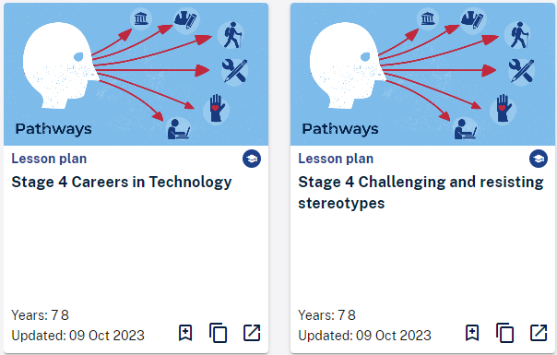
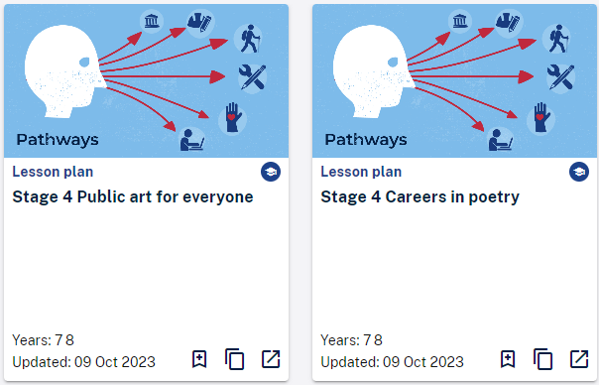


Universal Resources Hub - URH
Universal Resources Hub provides staff with access to quality assured teaching and learning resources.
Classroom teachers and curriculum leaders can use the URH “pathways” teaching and learning resources to inform how career learning can be integrated into their teaching practice.
Add the URH to your My essentials.
Notes:
Universal Resources Hub provides staff with access to quality assured teaching, learning and school improvement resources.
Classroom teachers and curriculum leaders can use the URH “pathways” teaching and learning resources to inform how career learning can be integrated into their teaching practice.
You are encouraged to the URH to your My essentials. If you haven’t already done so simply click on “Add new essential”, locate the “Universal Resources Hub” and click add.

Slide 11
Curriculum resource development
NESA’s syllabus outcomes have been developed to enrich teaching through career learning activities.
Career learning resources can be embedded into existing teaching programs.
This is not extra work for teachers!
Teachers are provided with useful career-related terminology and weblinks to support learning.
Students are challenged to reflect on values and attitudes and build and apply skills.
The Universal Resources Hub (URH) - a central place to access & share quality-assured resources.
Notes:
The curriculum resources have been developed in collaboration with experienced teachers, curriculum leaders and education support. The resources are aligned to KLA syllabus outcomes and have been developed to enrich teaching through career learning activities. In developing the resources:
curriculum outcomes and career related roles are identified,
classroom activities are developed to meet outcomes and highlight career opportunities.
unit of work are presented in a template that sets out all required information and links.
The teaching and learning resource is ready to fit into a teacher’s program when identified outcomes are due to be covered.
The career learning resources can be embedded into existing teaching programs and include career related terminology, exploration and experiences to support student learning.
This is not extra work for teachers! Units of work are based on outcomes to be delivered but have a careers focus.
Students are challenged and provided with opportunities to develop deep understanding, reflect on values and attitudes and build and apply skills that will support their planning.
The Universal Resources Hub provides a central place for teaching & school-based staff to access quality-assured resources. The hub offers hundreds of teaching, learning & school improvement resources,. More are being added all the time with additional career learning in curriculum being developed.

Slide 12

Careers conversations count
Teachers are:
role models
often the first point of contact for students
are making/can make links to careers in your teaching area
If done well, embedding career learning into your subject teaching can increase the relevance of, and interest in, your subject and help you answer those awkward but persistent questions from students
Notes:
Career conversations can be used to help students make informed choices about occupations that suit their personalities, interests and preferences.
Taking the opportunity to have these conversations with students will assist them to imagine and critically analyse future paths.
Career conversations will help students explore genuine opportunities post school.

Slide 13

Reflection Questions
How can the K-12 Career Education Framework support the aspirations of all students within the school?
What current approaches are currently used within the school/team to embed career learning in the curriculum?
How do you engage in career conversations with students in your class?
What subject-centred approaches may be implemented across the school or within the team in the next twelve months?
What additional supports may be required?
Notes:
This series of reflection questions are designed to stimulate discussion within our school and/or across smaller groups.

