Slide 1


Wiradjuri Activities
Languages Week
2023
WIRADJURI LESSON INTERACTIVE DIGITAL RESOURCE
NSW Department of Education

Slide 2
Activity: Quiz
1. How many different Indigenous language groups are there in Australia?
2. How many letters are used in Wiradjuri?
3. How many Wiradjuri letters begin words?
4. How many vowels are there in Wiradjuri?
5. What goes first in a Wiradjuri sentence?
WIRADJURI LESSON INTERACTIVE DIGITAL RESOURCE
NSW Department of Education

Slide 3
Activity: Quiz Answers
1. Over 250
2. 13
3. 7
4. 3 long vowels and 3 short vowels
5. The most important information
WIRADJURI LESSON INTERACTIVE DIGITAL RESOURCE
NSW Department of Education

Slide 4
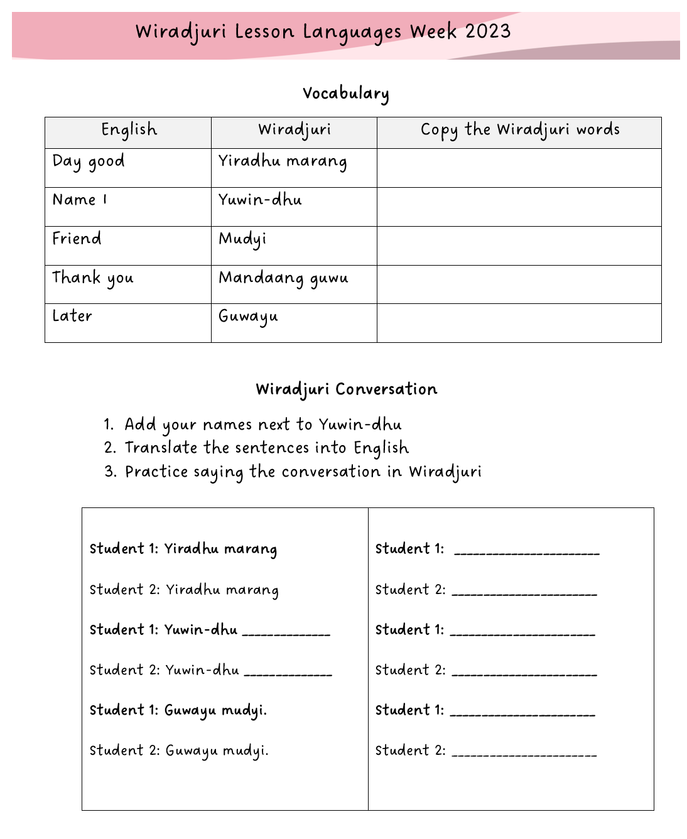
Activities
1. Read and write the Wiradjuri words
2. Translate the conversation into English
3. Practice saying the conversation with a partner
WIRADJURI LESSON INTERACTIVE DIGITAL RESOURCE
NSW Department of Education

Slide 5
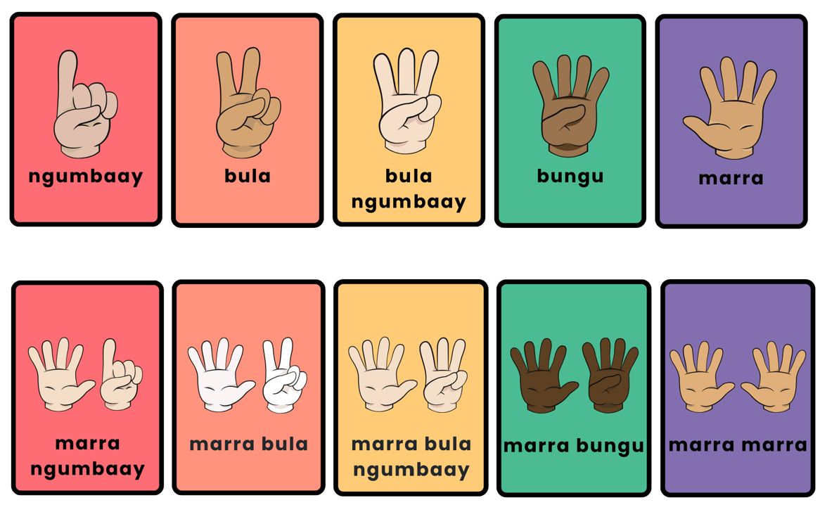
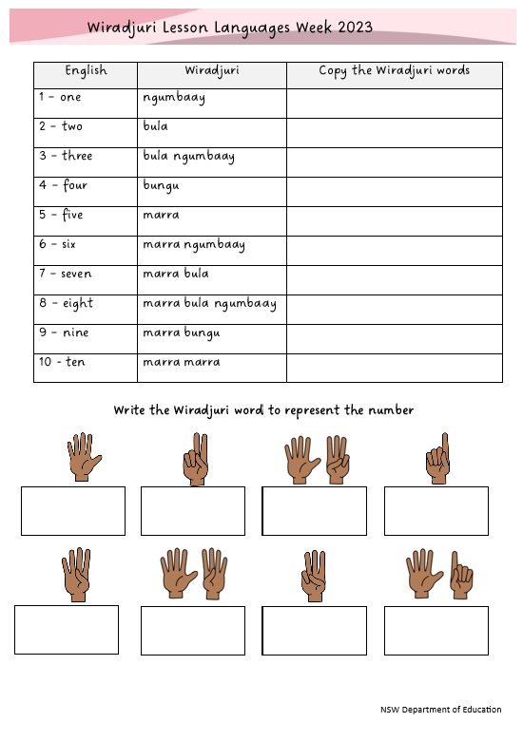
Activities
Play memory or fish
3. Complete the worksheet
WIRADJURI LESSON INTERACTIVE DIGITAL RESOURCE
2. Make a Wiradjuri
Numbers book
NSW Department of Education

Slide 6
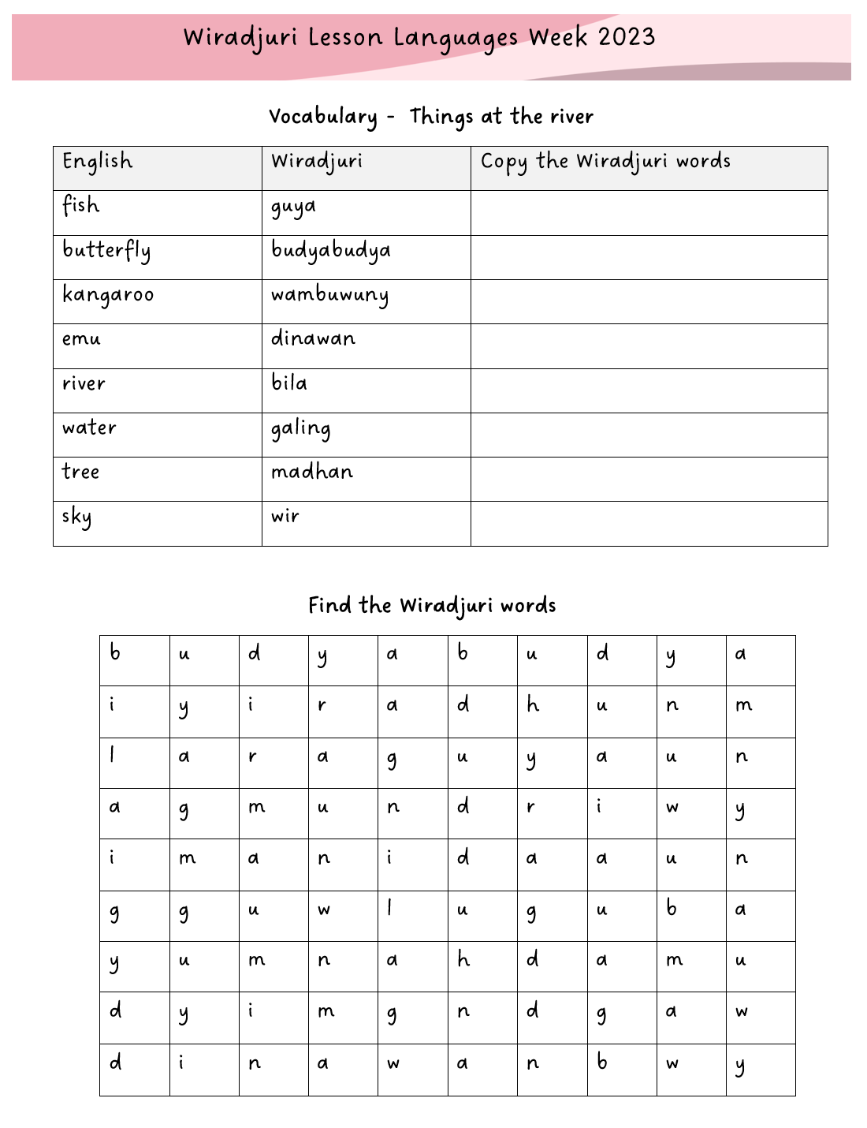
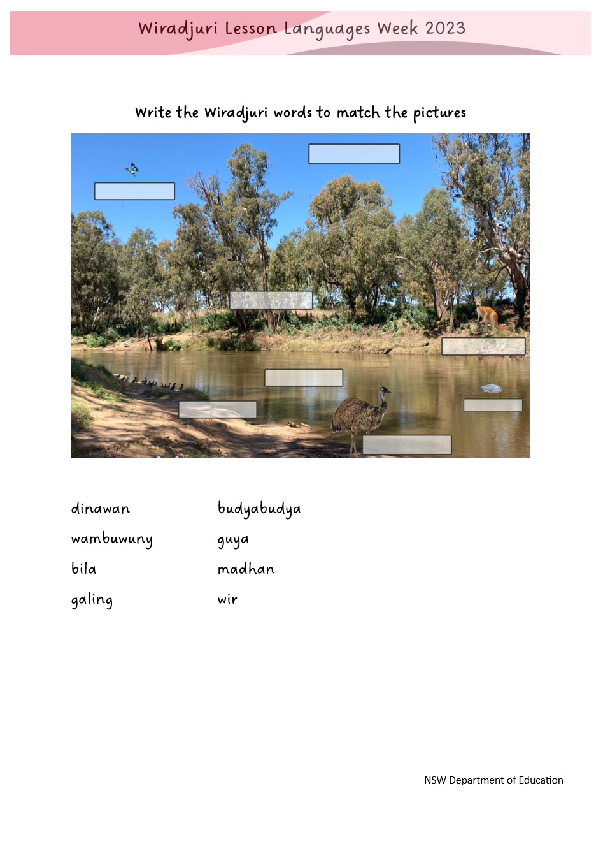
Activity
1. Worksheet
WIRADJURI LESSON INTERACTIVE DIGITAL RESOURCE
NSW Department of Education

Slide 7
Mandaang guwu
Guwayu
WIRADJURI LESSON INTERACTIVE DIGITAL RESOURCE
NSW Department of Education

