Slide 1
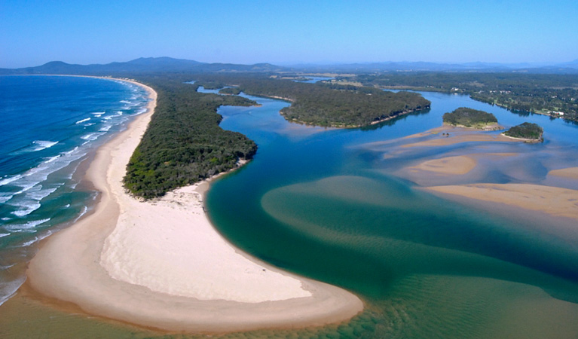

The River is Flowing

Slide 2

Bindarray jurriiyay,
Jurriiyay barrwayay.
Bindarray jurriiyay,
Warrii gaagalgu.
Miimi ngaanya manila!
Junuy ngaya yaam yidaa.
Bindarray jurriiyay,
Warrii gaagalgu.
The river is flowing,
Flowing and growing.
The river is flowing,
Down to the sea.
Mother nature carry me!
A child I will always be.
The river is flowing,
Down to the sea.

Slide 3


Biiwayay
Reproduced by Kerrie ann Jarrett AECG Project Officer with permission from the copyright owner

