Slide 1



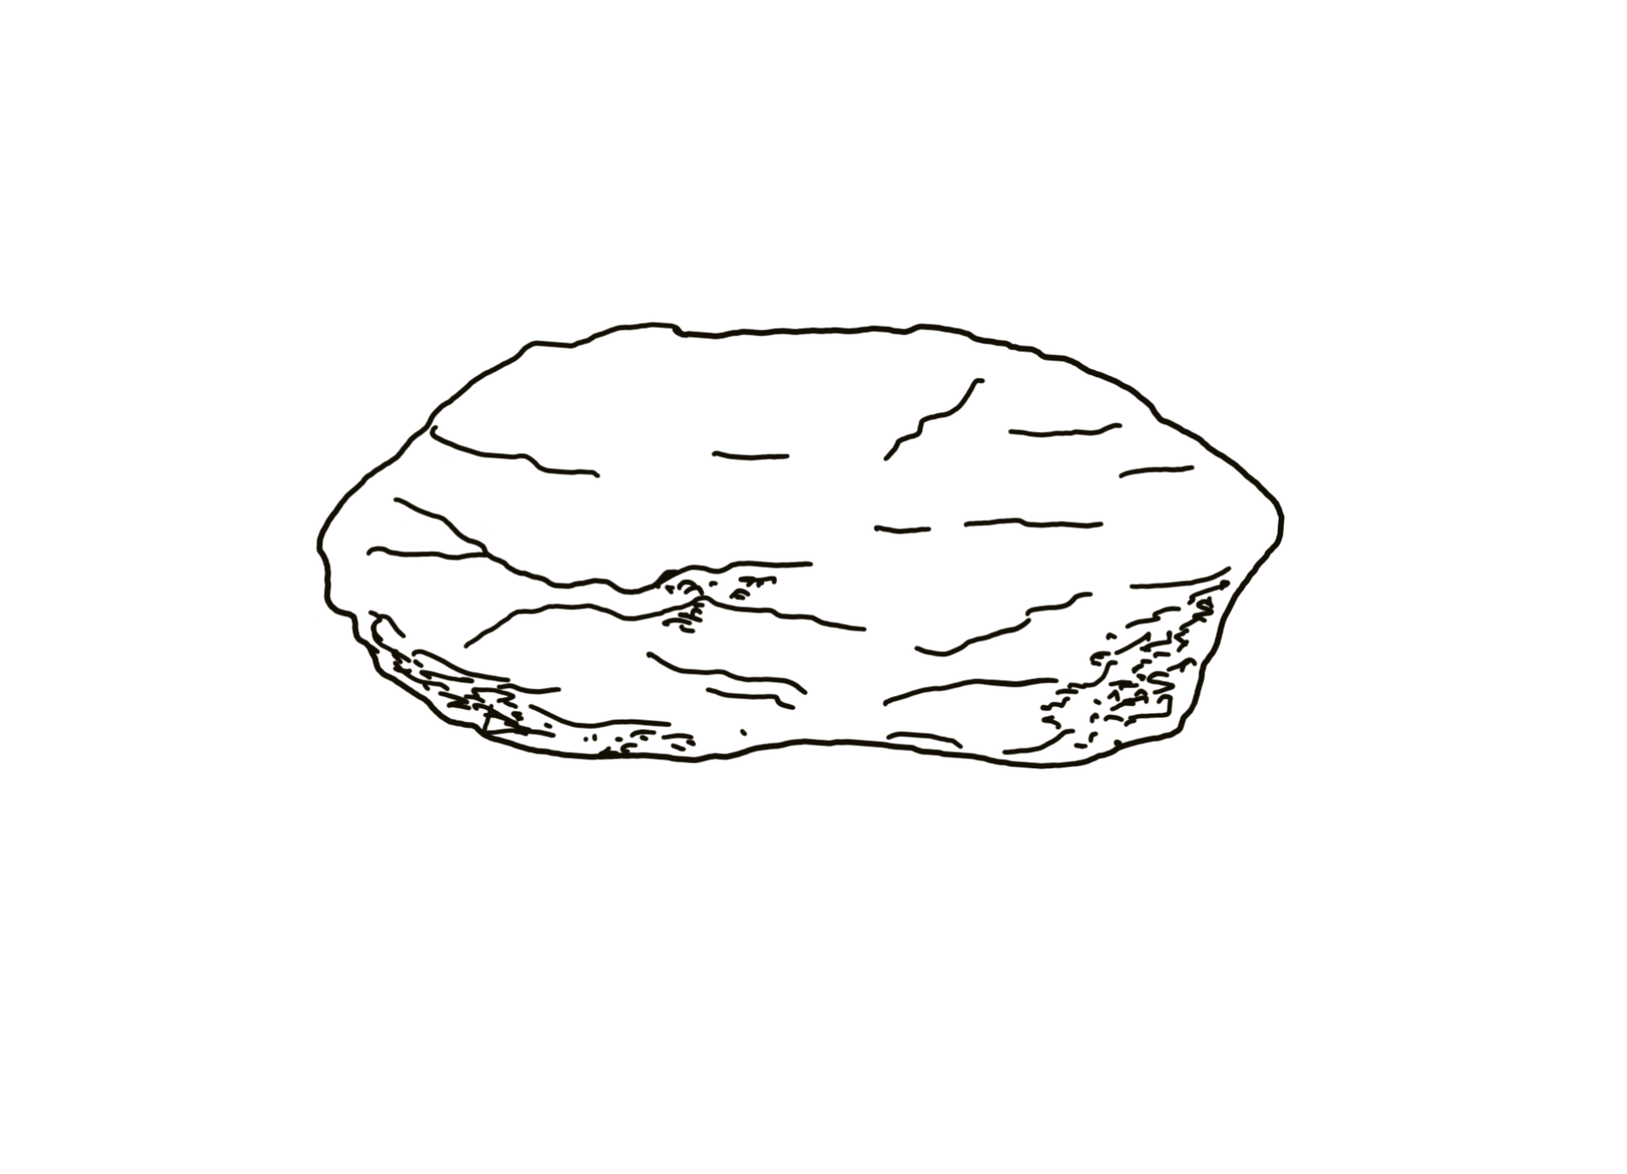


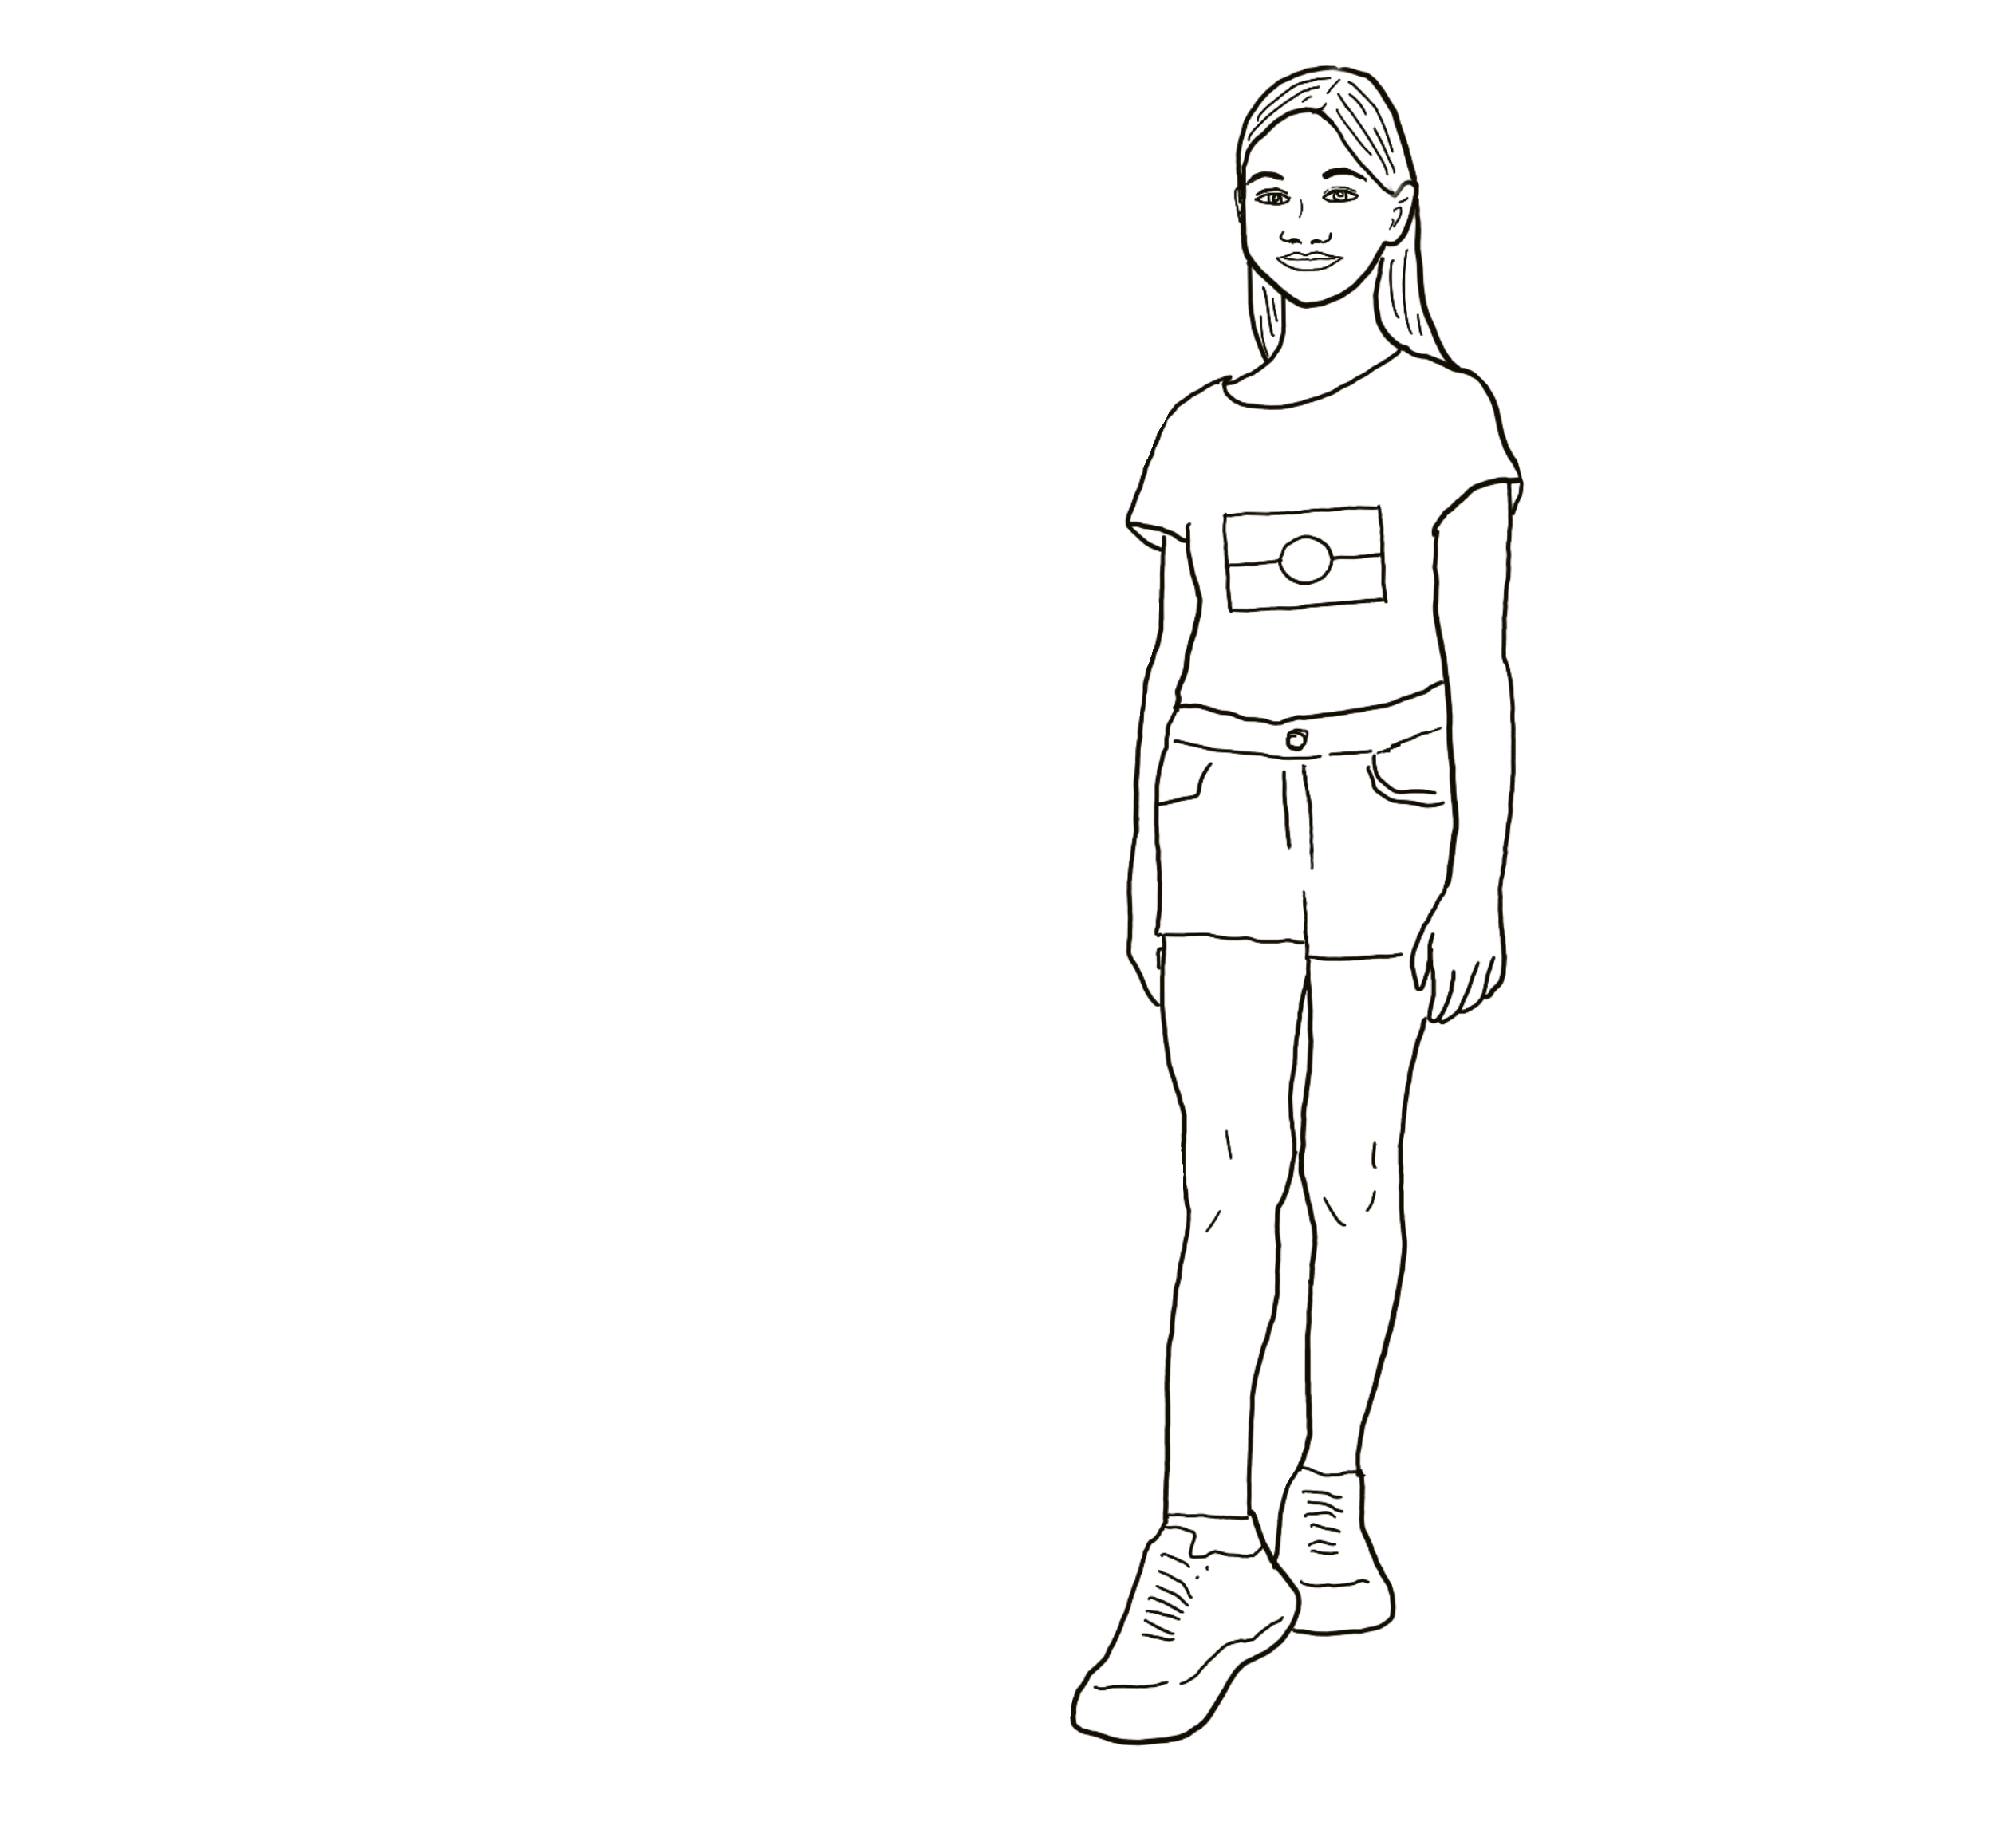

Colour, copy and paste images 4, 5, 6 onto a new slide in a layout of your choosing.
Colour, copy and paste images 1, 2, 3 into your slide.
Following the lesson, move images 1, 2, 3 to proposed locations.
1
4
2
5
YINABILDANHI LESSON INTERACTIVE DIGITAL RESOURCE
3
6
NSW Department of Education

