Slide 1
General foods and drinks

Slide 2
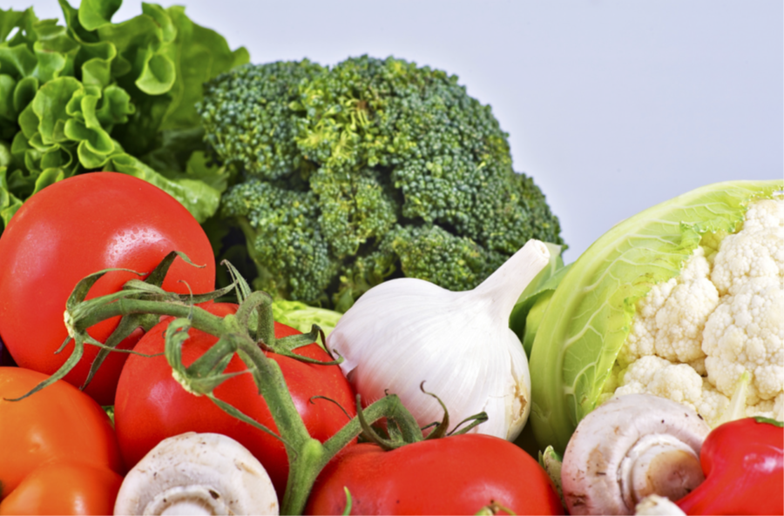

Gemüse
Notes:
Gemüse
(Note – even though ‘vegetables’ is plural in English, in German it is singular – similar to ‘fruit’ in English, which is singular, even when referring to more than one piece of fruit.)

Slide 3
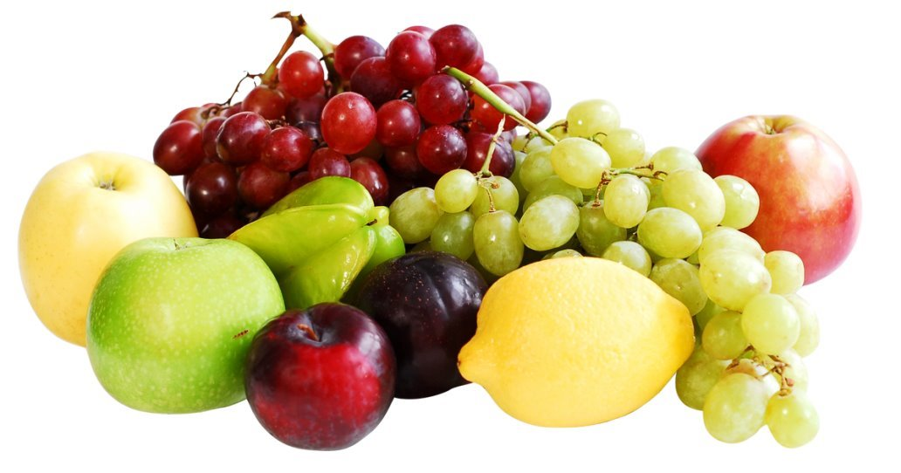
Obst
Notes:
Obst

Slide 4

Wasser
Notes:
Wasser

Slide 5

Kaffee
Notes:
Kaffee

Slide 6
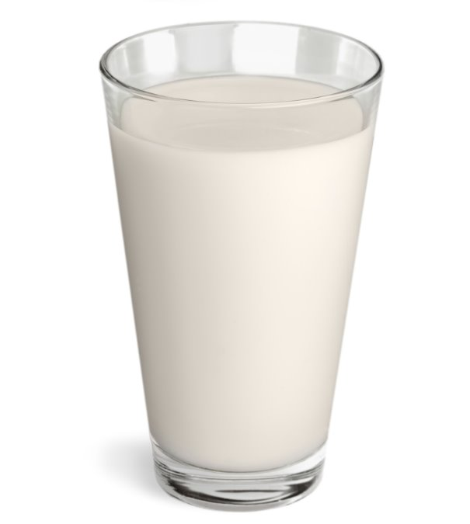
Milch
Notes:
Milch

Slide 7

Tee
Notes:
Tee

Slide 8
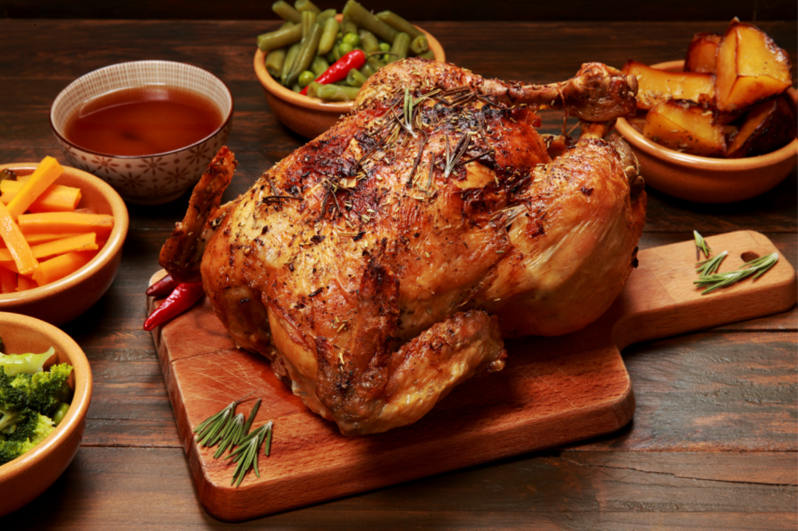
Hähnchen
Notes:
Hähnchen

Slide 9
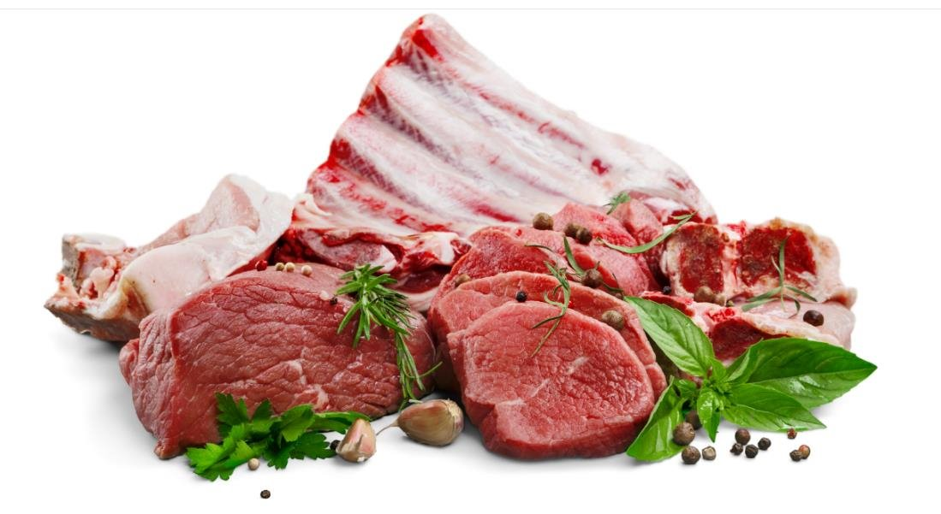
Fleisch
Notes:
Fleisch

Slide 10
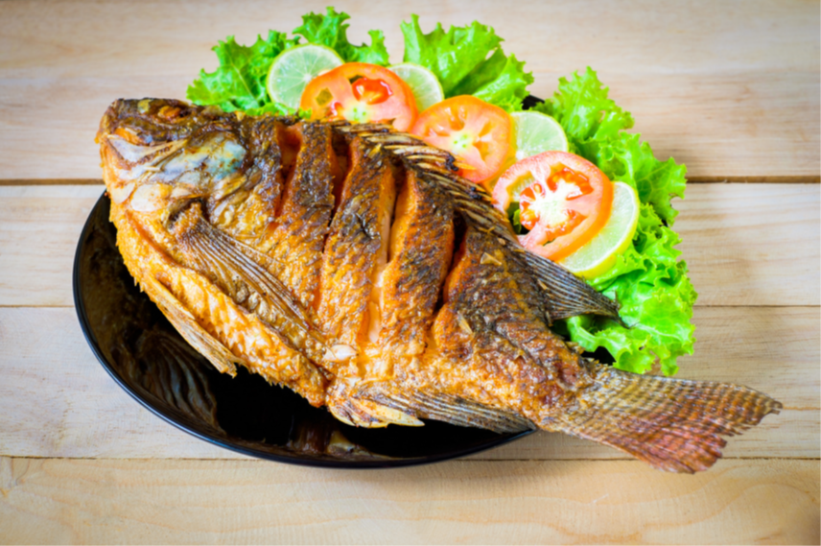
Fisch
Notes:
Fisch

Slide 11
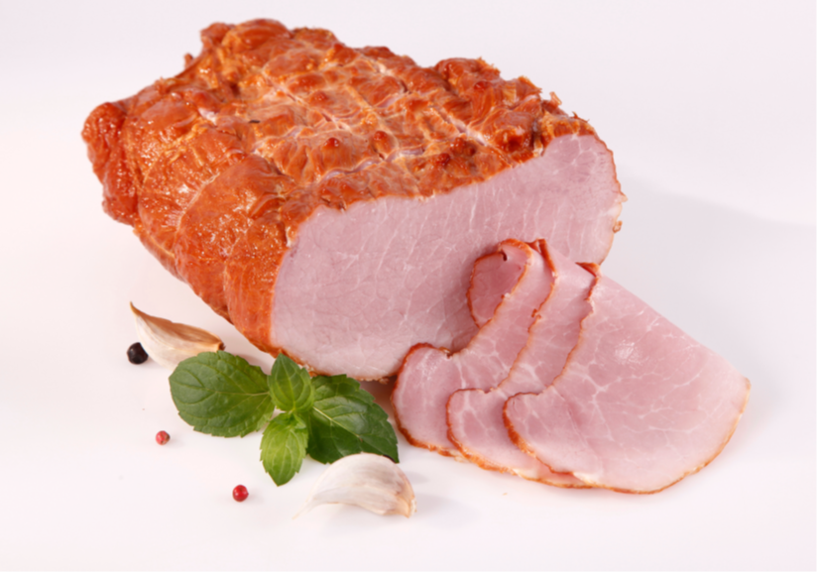
Schinken
Notes:
Schinken

Slide 12
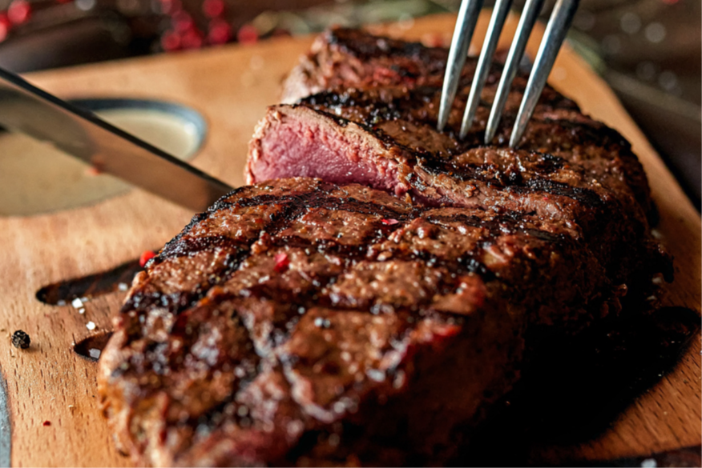
Steak
Notes:
Steak

Slide 13
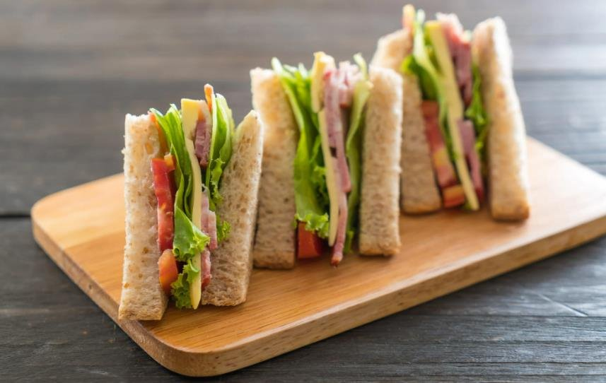

Sandwiches
Notes:
Sandwiches

Slide 14
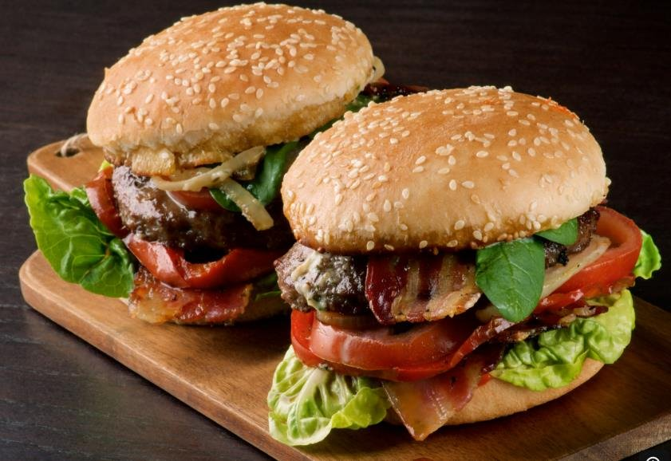
Hamburger
Notes:
Hamburger

Slide 15
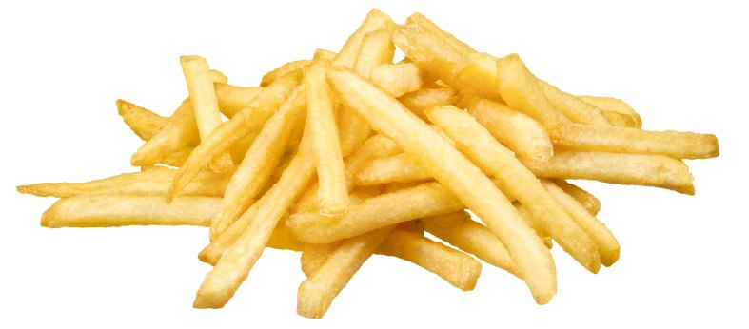
Pommes frites
Notes:
Pommes frites

Slide 16
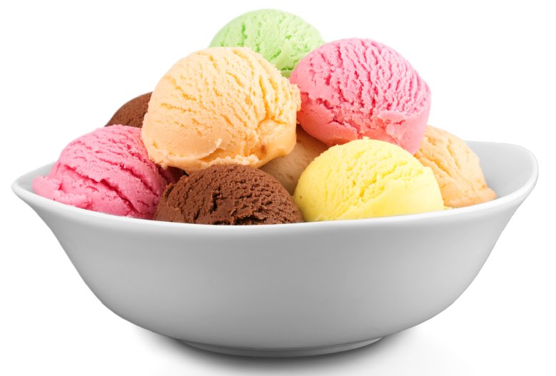
Eis
Notes:
Eis

Slide 17
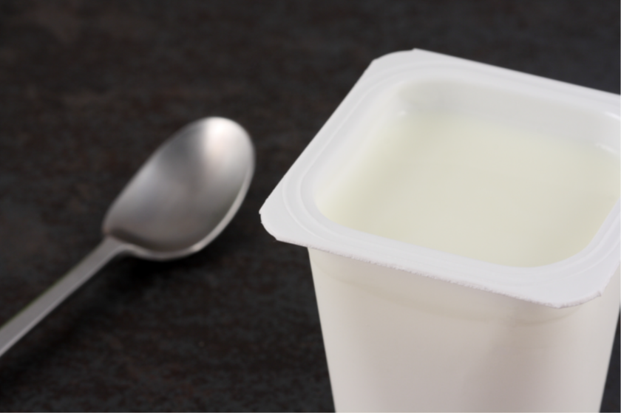
Joghurt
Notes:
Joghurt

Slide 18

Eier
Notes:
Eier

Slide 19

Schokolade
Notes:
Schokolade

Slide 20
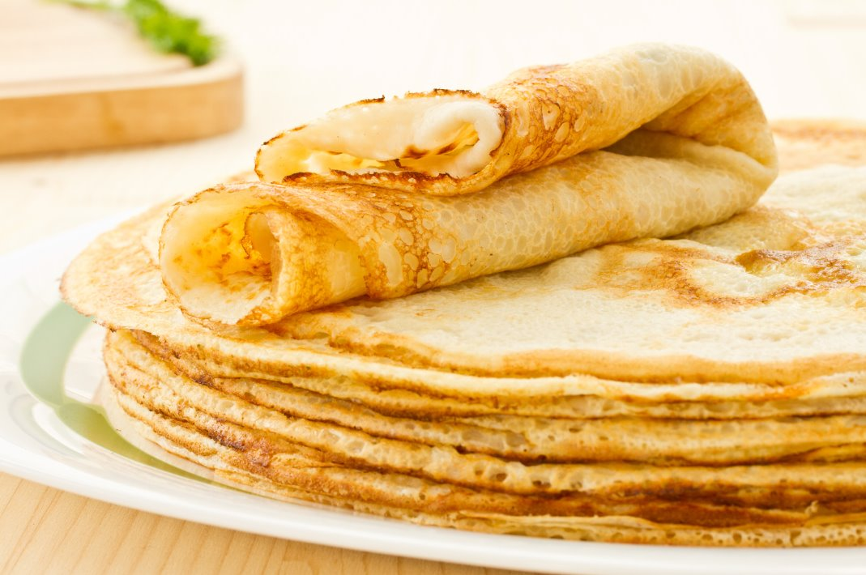
Pfannkuchen
Notes:
Pfannkuchen

Slide 21
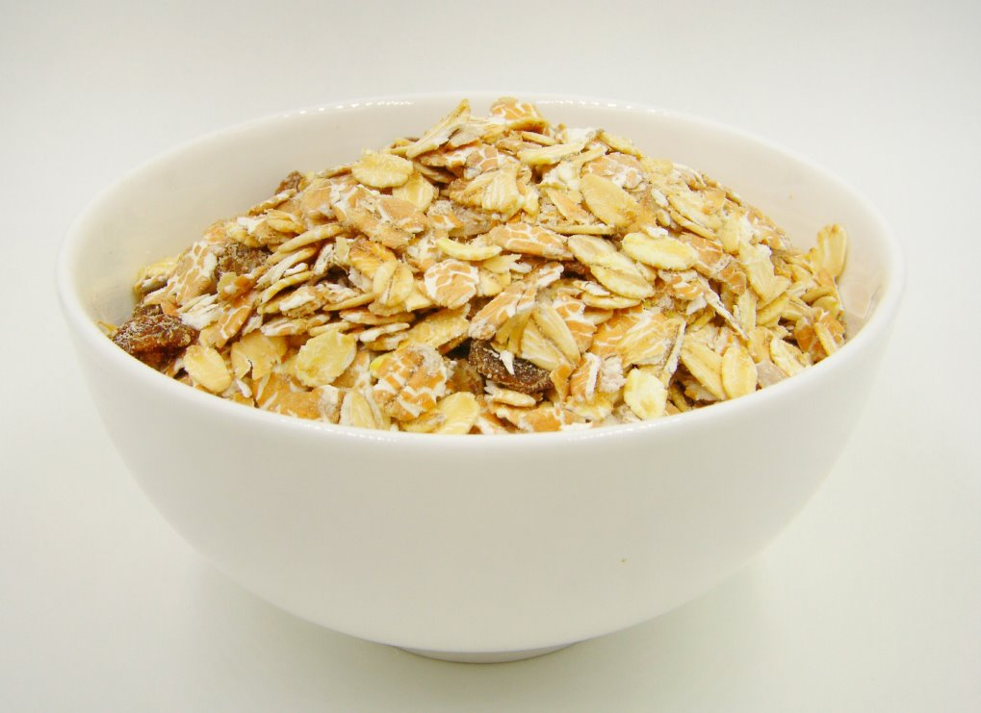
Müsli
Notes:
Müsli

Slide 22
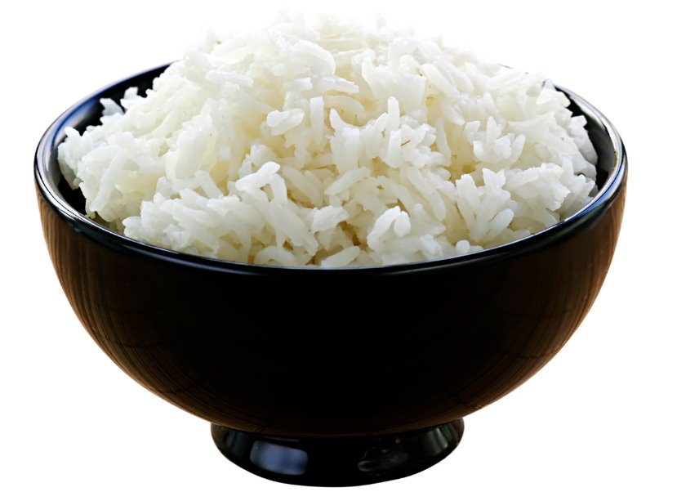
Reis
Notes:
Reis

Slide 23
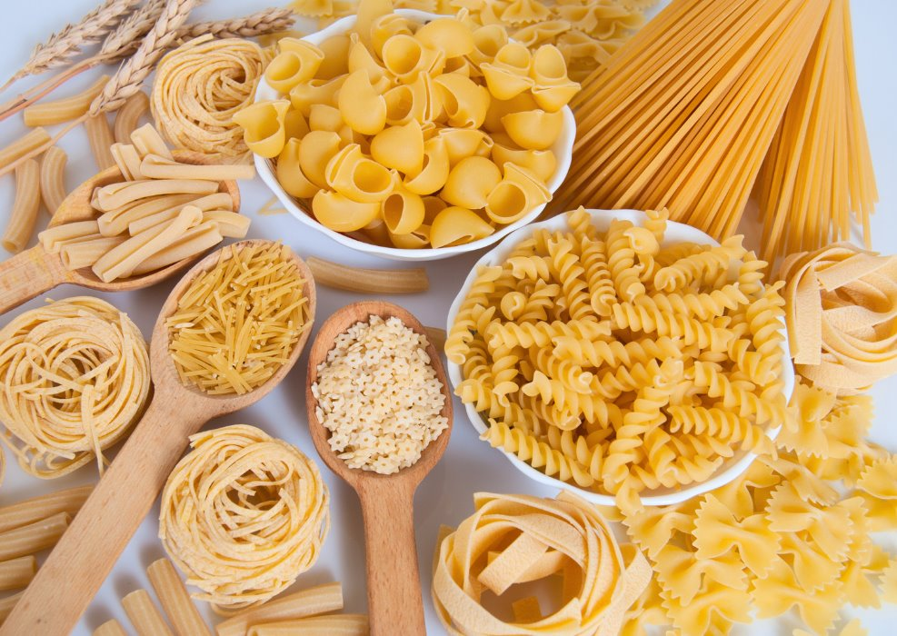
Nudeln
Notes:
Nudeln

Slide 24
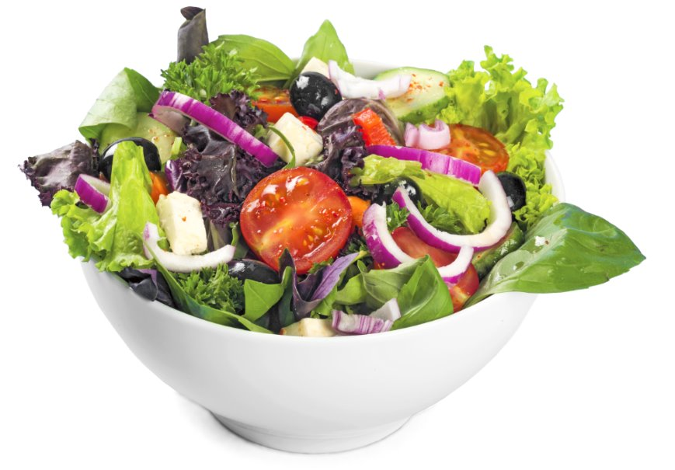
Salat
Notes:
Salat

Slide 25
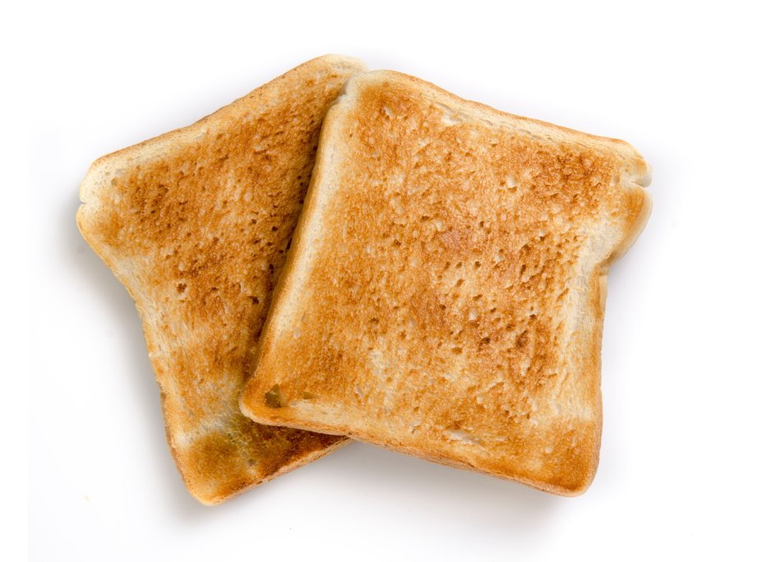
Toast
Notes:
Toast

Slide 26

Saft
Notes:
Saft

Slide 27
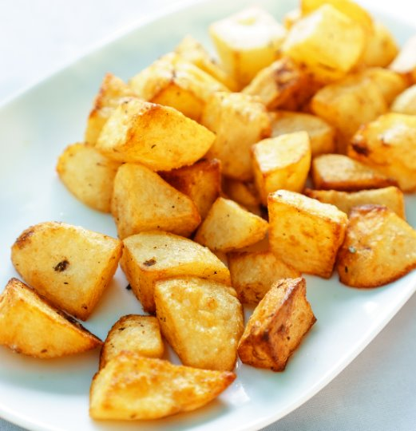
Kartoffeln
Notes:
Kartoffeln

Slide 28
Copyright
© State of New South Wales (Department of Education), 2024
The copyright material published in this resource is subject to the Copyright Act 1968 (Cth) and is owned by the NSW Department of Education or, where indicated, by a party other than the NSW Department of Education (third-party material).
Copyright material available in this resource and owned by the NSW Department of Education is licensed under a Creative Commons Attribution 4.0 International (CC BY 4.0) licence.
This licence allows you to share and adapt the material for any purpose, even commercially.
Attribution should be given to © State of New South Wales (Department of Education), 2024.
Material in this resource not available under a Creative Commons licence:
the NSW Department of Education logo, other logos and trademark-protected material
material owned by a third party that has been reproduced with permission. You will need to obtain permission from the third party to reuse its material.
Links to third-party material and websites
Please note that the provided (reading/viewing material/list/links/texts) are a suggestion only and implies no endorsement, by the New South Wales Department of Education, of any author, publisher, or book title. School principals and teachers are best placed to assess the suitability of resources that would complement the curriculum and reflect the needs and interests of their students.
If you use the links provided in this document to access a third-party's website, you acknowledge that the terms of use, including licence terms set out on the third-party's website apply to the use which may be made of the materials on that third-party website or where permitted by the Copyright Act 1968 (Cth). The department accepts no responsibility for content on third-party websites.
Notes:
Slide not shared

