Slide 1
Adjectives for taste

Slide 2
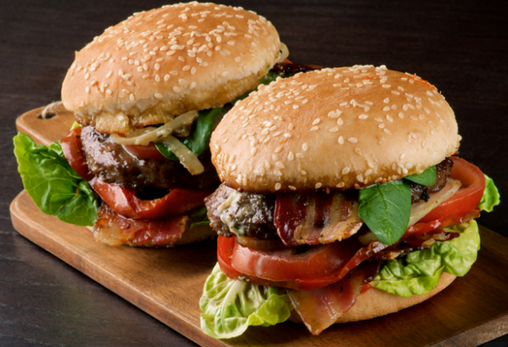
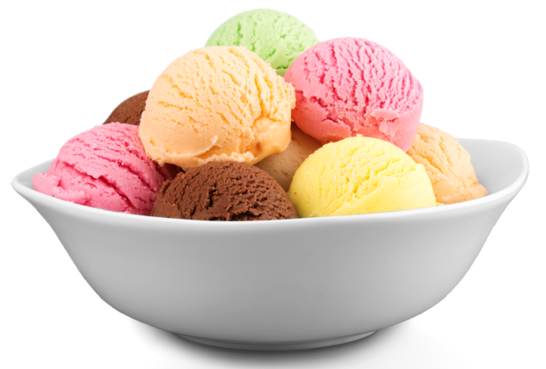
lecker
Notes:
delicious

Slide 3
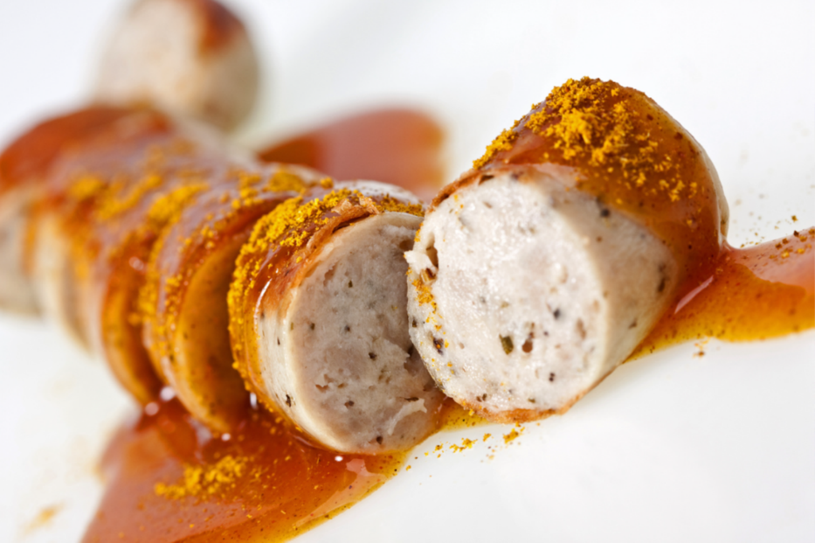
eklig
Notes:
yukky

Slide 4
salzig
Notes:
salty

Slide 5
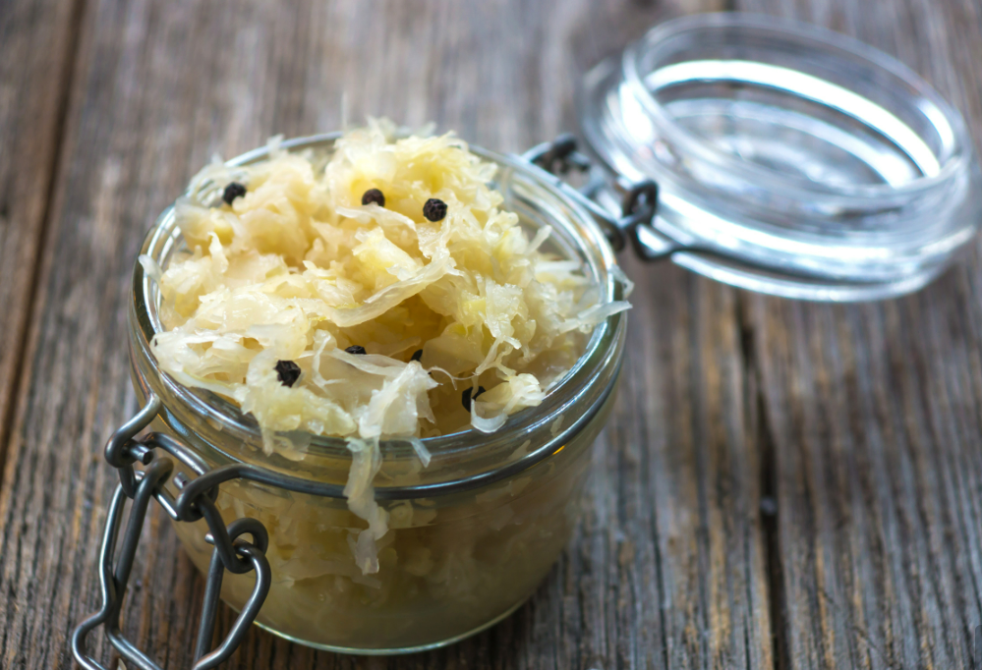
sauer
Notes:
sour

Slide 6

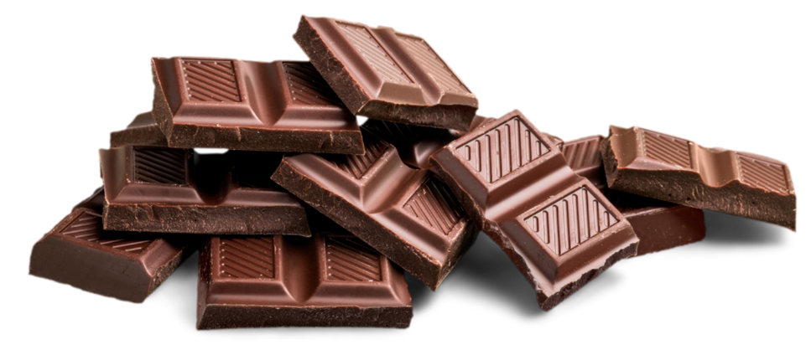
süß
Notes:
sweet

Slide 7
würzig
Notes:
spicy (made with spices, as opposed to hot and spicy).

Slide 8
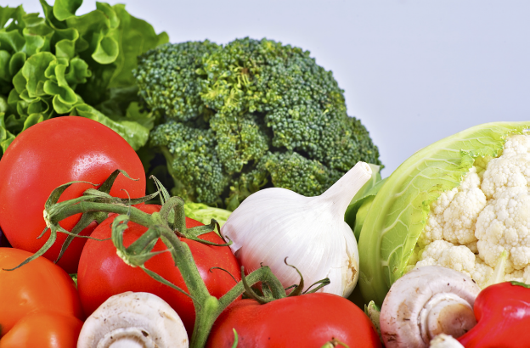
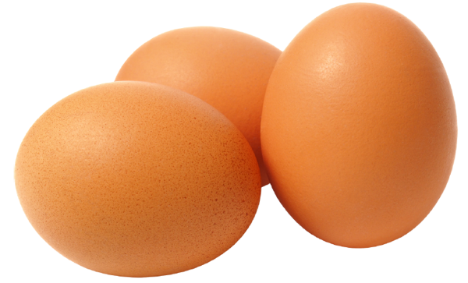
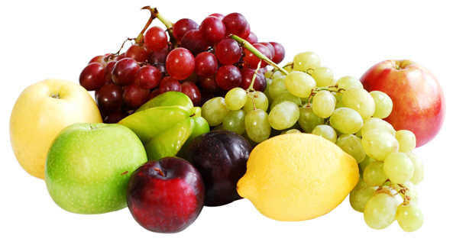
gesund
Notes:
healthy

Slide 9
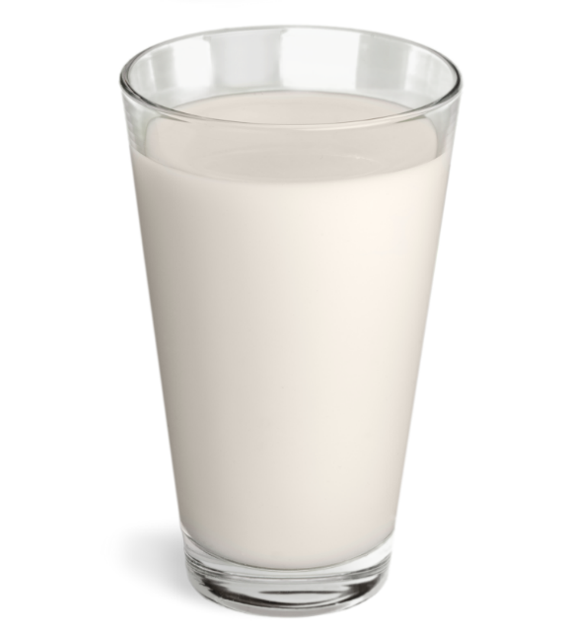
frisch
Notes:
fresh

Slide 10

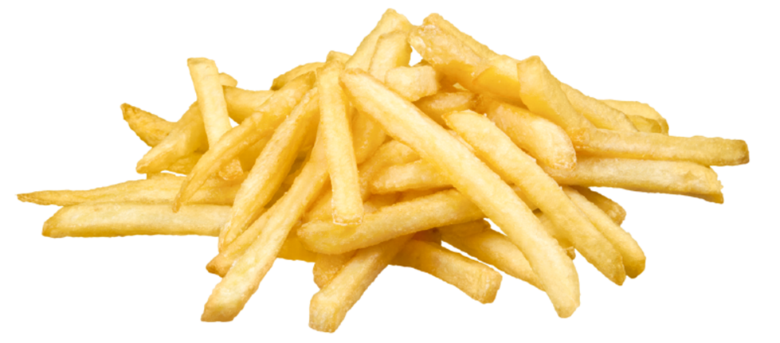
ungesund
Notes:
unhealthy

Slide 11
Let’s make sentences using adjectives

Slide 12
Examples
Ich esse gern Schokolade. Schokolade ist lecker.
Ich esse gern Brezeln. Brezeln sind salzig und lecker.
Ich esse nicht gern Currywurst. Currywurst ist eklig.
Ich esse nicht gern Gemüse. Gemüse sind eklig.

Slide 13
Fill in the correct word – ist or sind

Slide 14
Sauerkraut (1 of 2)
Ich esse gern Sauerkraut. Sauerkraut gesund.

Slide 15

Schnitzel
Ich esse gern Schnitzel. Schnitzel lecker.

Slide 16
Sauerkraut (2 of 2)
Ich esse gern Sauerkraut. Sauerkraut sauer und gesund.

Slide 17
Döner
Ich esse gern Döner. Döner lecker.

Slide 18
Gemüse
Ich esse gern Gemüse. Gemüse eklig.

Slide 19
Obst
Ich esse gern Obst. Obst frisch und gesund.

Slide 20
Wasser
Ich trinke gern Wasser. Wasser gesund.

Slide 21
Pommes frites
Ich esse gern Pommes frites. Pommes frites ungesund und lecker.

Slide 22
Eis
Ich esse gern Eis. Eis süß.

Slide 23
Lebkuchen
Ich esse nicht gern Lebkuchen. Lebkuchen würzig.

Slide 24
Eier
Ich esse nicht gern Eier. Eier gesund und eklig.

Slide 25
Apfelschorle
Ich trinke gern Apfelschorle. Apfelschorle gesund und lecker.

Slide 26
Frankfurter
Ich esse nicht gern Frankfurter. Frankfurter eklig.

Slide 27
Copyright
© State of New South Wales (Department of Education), 2024
The copyright material published in this resource is subject to the Copyright Act 1968 (Cth) and is owned by the NSW Department of Education or, where indicated, by a party other than the NSW Department of Education (third-party material).
Copyright material available in this resource and owned by the NSW Department of Education is licensed under a Creative Commons Attribution 4.0 International (CC BY 4.0) licence.
This licence allows you to share and adapt the material for any purpose, even commercially.
Attribution should be given to © State of New South Wales (Department of Education), 2024.
Material in this resource not available under a Creative Commons licence:
the NSW Department of Education logo, other logos and trademark-protected material
material owned by a third party that has been reproduced with permission. You will need to obtain permission from the third party to reuse its material.
Links to third-party material and websites
Please note that the provided (reading/viewing material/list/links/texts) are a suggestion only and implies no endorsement, by the New South Wales Department of Education, of any author, publisher, or book title. School principals and teachers are best placed to assess the suitability of resources that would complement the curriculum and reflect the needs and interests of their students.
If you use the links provided in this document to access a third-party's website, you acknowledge that the terms of use, including licence terms set out on the third-party's website apply to the use which may be made of the materials on that third-party website or where permitted by the Copyright Act 1968 (Cth). The department accepts no responsibility for content on third-party websites.
Notes:
Slide not shared

