Slide 1
I’m sick
Stage 2 – Italian

Slide 2
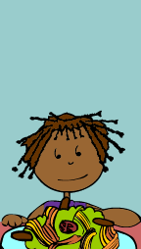
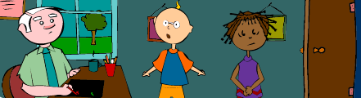
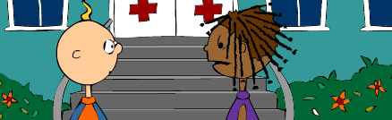
Part 1
Go to the nurse
She’s sick
I’ve a sore stomach
I’m hungry
Let’s go to the nurse
I’m sick. I ate too much spaghetti

Slide 3
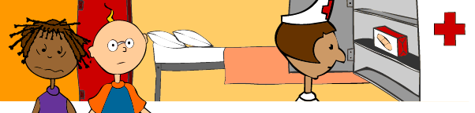
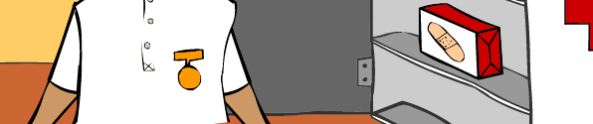
Part 2
Nurse, she’s sick.
You’re sick?
Let’s see

Slide 4
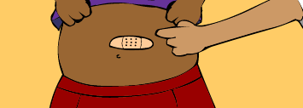
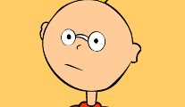
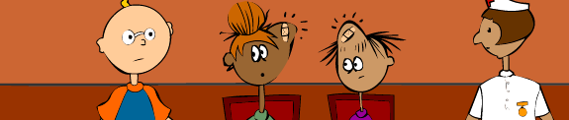
Part 3
Here’s a plaster.
What? A plaster?
In another room
She has a sore ear. And he has a headache.
How are they?

Slide 5
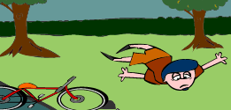
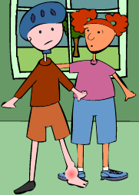
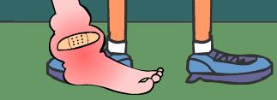
Part 4
I fell off my bike. I have a swollen foot. Ow!
What happened Bobby?
Let’s go to the nurse
Ouch! That hurts
Here’s a plaster

Slide 6


Part 5
There’s only plasters. There is no medicine. Let’s go!
Okay kids. I’ll call now.

Slide 7

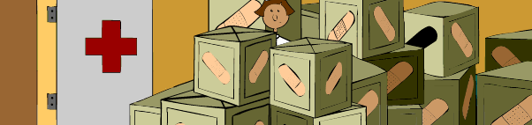
Part 6
A truck arrives at the school
Great. The plasters are here.

Slide 8
Copyright
© State of New South Wales (Department of Education), 2024
The copyright material published in this resource is subject to the Copyright Act 1968 (Cth) and is owned by the NSW Department of Education or, where indicated, by a party other than the NSW Department of Education (third-party material).
Copyright material available in this resource and owned by the NSW Department of Education is licensed under a Creative Commons Attribution 4.0 International (CC BY 4.0) licence.
This licence allows you to share and adapt the material for any purpose, even commercially.
Attribution should be given to © State of New South Wales (Department of Education), 2023.
Material in this resource not available under a Creative Commons licence:
the NSW Department of Education logo, other logos and trademark-protected material
Material owned by a third party that has been reproduced with permission. You will need to obtain permission from the third party to reuse its material.
Links to third-party material and websites
Please note that the provided (reading/viewing material/list/links/texts) are a suggestion only and implies no endorsement, by the New South Wales Department of Education, of any author, publisher, or book title. School principals and teachers are best placed to assess the suitability of resources that would complement the curriculum and reflect the needs and interests of their students.
If you use the links provided in this document to access a third party’s website, you acknowledge that the terms of use, including licence terms set out on the third-party’s website apply to the use which may be made of the materials on that third-party website or where permitted by the Copyright Act 1968 (Cth). The department accepts no responsibility for content on third-party websites.

