Slide 1
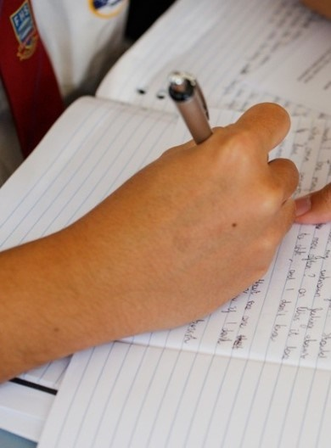
Poetic purpose
‘Resource 2 – ‘The Black Rat’ recording
Notes:
Included in this PowerPoint is a reading of the poem. Aligned with each stanza of the poem ‘The Black Rat’ by Iris Clayton is an image to support the ideas expressed in the poem.

Slide 2

‘The Black Rat’
by Iris Clayton
Notes:
Iris Clayton’s poem written in 1988, ‘The Black Rat’ has been reproduced and made available for copying and communication by the NSW Department of Education for its educational purposes. This has been made possible as permission has been granted by Narelle Urquhart (the daughter of Iris Clayton). This resource and the copy of the poem is licensed up until October 2024. We are very grateful for this support and collaboration.

Slide 3
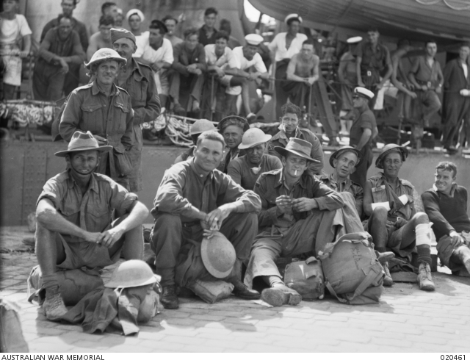
Stanza 1
He lived in a tin hut with a hard dirt floor.
He had bags sewn together that was his door.
He was a Rat of Tobruk until forty five,
He was one of the few that came back alive.
Halmarick C (1941) unnamed [photograph], The Australian War Memorial, Australian War Memorial website, accessed 27 October 2023.
Notes:
Halmarick. C. T. (1941) Men Of The 24th Infantry Brigade. Australian War Memorial. Image from: https://www.awm.gov.au/collection/C4844. Date accessed: 11/10/2021

Slide 4
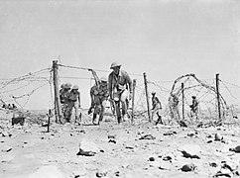
Stanza 2
Battered and scarred he fought for this land,
And on his return they all shook his hand.
The price of fighting for the freedom of man
Did not make any difference to this Blackman.
Fisher T (1941) A patrol from the 2/13th Infantry Battalion making its way through a gap in the barbed wire [photograph], The Australian War Memorial, Australian War Memorial website, accessed 27 October 2023.
Notes:
Unknown. (1941) A Patrol From The 2/13th Infantry Battalion Making Its Way Through A Gap In The Barbed Wire Entanglements Protecting Its Unit Position. Image from: https://www.awm.gov.au/collection/020780. Date accessed: 11/10/2021

Slide 5
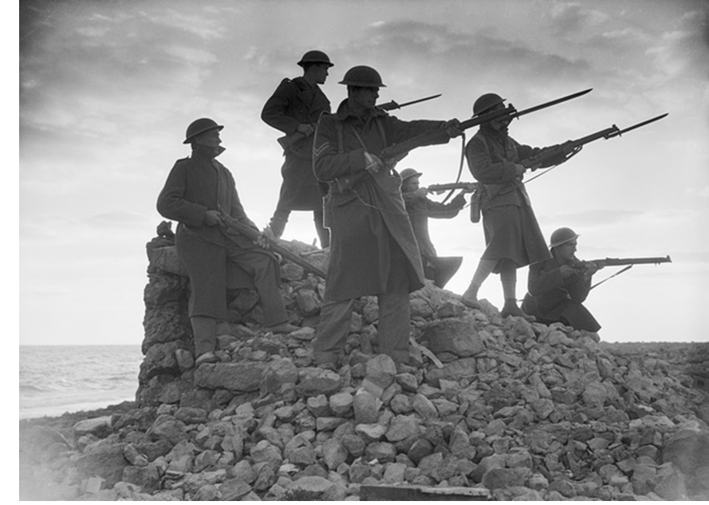
Stanza 3
He returned to the outback, no mates did he find.
If he had a beer he was jailed and then fined.
He sold all his medals he once proudly wore:
They were of no use to him any more.
Hurley F (1941) unnamed [photograph], The Australian War Memorial, Australian War Memorial website, accessed 27 October 2023.

Slide 6
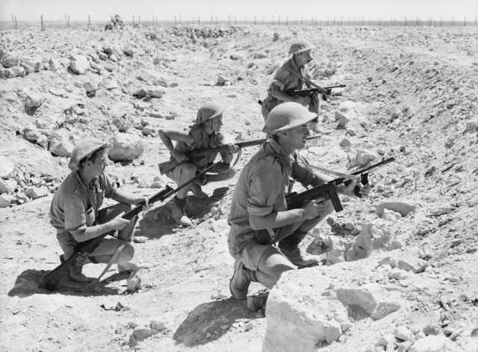
Stanza 4
Confused and alone he wandered around,
Looking for work though none could be found.
The Anzac marches he badly neglected,
Would show to his comrades how he was rejected.
Fisher T (1941) A small patrol from the 2/13th Infantry Battalion waiting in a tank ditch for a favourable [photograph], The Australian War Memorial, Australian War Memorial website, accessed 27 October 2023.

Slide 7
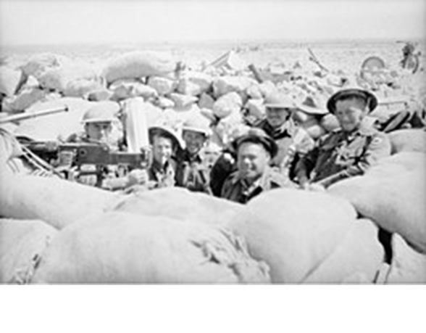
Stanza 5
He fought for this land so he could be free.
Yet he could not vote after his desert melee.
And those years in the desert they really took their toll,
He went there quite young and he came home so old.
Cumpston J (1941) unnamed [photograph], The Australian War Memorial, Australian War Memorial website, accessed 27 October 2023.
Notes:
Hurley. J. F. (1941) Defenders of Tobruk. Australian War Memorial. Image from: https://www.awm.gov.au/collection/C29080. Date accessed: 11/10/2021

Slide 8
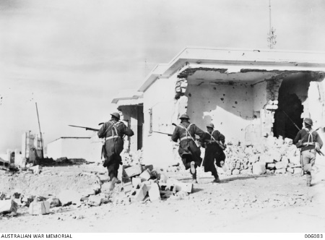
Stanza 6
This once tall man came from a proud Black tribe,
Died all alone – no one at his side.
Unknown British Official Photographer (c1940) unnamed [photograph], The Australian War Memorial, Australian War Memorial website, accessed 27 October 2023.
Notes:
Unknown. (1941) Troops Rushing Through The Streets Of Ruined Bardia In Search Of Any Stray Enemy. Australian War Memorial. Image from: https://www.awm.gov.au/collection/C27864. Date accessed: 11/10/2021

Slide 9
References – part 1
This presentation contains NSW Curriculum and syllabus content. The NSW Curriculum is developed by the NSW Education Standards Authority. This content is prepared by NESA for and on behalf of the Crown in the right of the State of New South Wales. The material is protected by Crown copyright.
Please refer to the NESA Copyright Disclaimer for more information https://educationstandards.nsw.edu.au/wps/portal/nesa/mini-footer/copyright.
NESA holds the only official and up-to-date versions of the NSW Curriculum and syllabus documents. Please visit the NSW Education Standards Authority (NESA) website https://educationstandards.nsw.edu.au/wps/portal/nesa/home and the NSW Curriculum website https://curriculum.nsw.edu.au.
Clayton, Iris (1988) ‘The Black Rat’ has been reproduced and made available for copying and communication by NSW Department of Education for its educational purposes. This has been made possible as permission has been granted by Narelle Urquhart (the daughter of Iris Clayton). This resource containing the copy of the poem is licensed up until October 2024. Accessed August 2023. We are very grateful for this support and collaboration.
Cumpston J (1941) unnamed [photograph], The Australian War Memorial, Australian War Memorial website, accessed 27 October 2023.
Fisher T (1941) A patrol from the 2/13th Infantry Battalion making its way through a gap in the barbed wire [photograph], The Australian War Memorial, Australian War Memorial website, accessed 27 October 2023.
Fisher T (1941) A small patrol from the 2/13th Infantry Battalion waiting in a tank ditch for a favourable [photograph], The Australian War Memorial, Australian War Memorial website, accessed 27 October 2023.

Slide 10
References – part 2
Halmarick C (1941) unnamed [photograph], The Australian War Memorial, Australian War Memorial website, accessed 27 October 2023.
Hurley F (1941) unnamed [photograph], The Australian War Memorial, Australian War Memorial website, accessed 27 October 2023.
Unknown British Official Photographer (c1940) unnamed [photograph], The Australian War Memorial, Australian War Memorial website, accessed 27 October 2023.

Slide 11
Copyright
© State of New South Wales (Department of Education), 2023
The copyright material published in this resource is subject to the Copyright Act 1968 (Cth) and is owned by the NSW Department of Education or, where indicated, by a party other than the NSW Department of Education (third-party material).
Copyright material available in this resource and owned by the NSW Department of Education is licensed under a Creative Commons Attribution 4.0 International (CC BY 4.0) licence.
This licence allows you to share and adapt the material for any purpose, even commercially.
Attribution should be given to © State of New South Wales (Department of Education), 2023.
Material in this resource not available under a Creative Commons licence:
the NSW Department of Education logo, other logos and trademark-protected material
Material owned by a third party that has been reproduced with permission. You will need to obtain permission from the third party to reuse its material.
Links to third-party material and websites
Please note that the provided (reading/viewing material/list/links/texts) are a suggestion only and implies no endorsement, by the New South Wales Department of Education, of any author, publisher, or book title. School principals and teachers are best placed to assess the suitability of resources that would complement the curriculum and reflect the needs and interests of their students.
If you use the links provided in this document to access a third party’s website, you acknowledge that the terms of use, including licence terms set out on the third-party’s website apply to the use which may be made of the materials on that third-party website or where permitted by the Copyright Act 1968 (Cth). The department accepts no responsibility for content on third-party websites.

