Slide 1
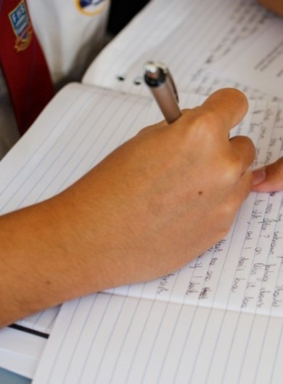
Poetic purpose
Resource 6 – ‘The Black Rat’ – context of the poem
Notes:
Included in this PowerPoint are the images and commentary from ‘The Black Rat,’ resource 6 – context of the poem. The commentary has been recorded.

Slide 2
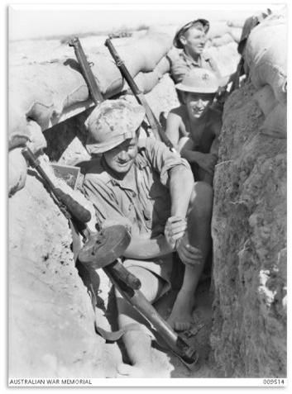

The Rats of Tobruk
1941
Silk G (1941) unnamed [photograph], The Australian War Memorial, Australian War Memorial website, accessed 27 October 2023.
Notes:
'The Rats of Tobruk' refers to the Australian, British and Indian soldiers who defended the port city of Tobruk from German attack. They are called rats because an English traitor, Lord Haw Haw (William Joyce) would broadcast by radio messages supporting the Germans and trying to warn the Australian soldiers that their efforts were for nothing and they would be crushed by the Africa Korps. These kinds of broadcasts were known as Propaganda.
Because the Australian soldiers were in 'dug in' trenches and bunkers, Lord Haw Haw said they were like 'Rats'. The Australians took that as a compliment and labelled themselves as the 'Rats of Tobruk'.

Slide 3
Iris Clayton
‘The Black Rat’
Cecil served in the 2/13th Battalion in Tobruk, Libya.
Cecil fought and was injured during the major battles at El Alamein.
Notes:
The poem ‘The Black Rat’ is about Cecil Clayton who is the father of the poet, Iris Clayton.
He served in the 2/13th Battalion in Tobruk, Libya. This was the place where he spent 8 months being bombed and attacked by the Afrika Korps. There are some interesting facts about Cecil's experience during the war. His battalion was the only group that was evacuated overland as their ship had been blown up. Cecil also fought and was injured during the major battles at El Alamein in 1942. Records show that Cecil was seriously injured at El Alamein. The biggest of these battles commenced on 23 October and Cecil was wounded in action on 29 October. The wounds were to his left arm and chest. owing his return to Australia, Cecil's life did not run smoothly. To share his experience, his daughter Iris wrote ‘The Black Rat’ to describe his life and what happened to him upon his return from war.
Graham M, Moseley F (2018) The Lost Story of Cecil: From the frontlines of WW2 to a hostile home front, Petaurus Education Group Inc, Wirraminnia Environmental Education Centre website.
Relevant links:
Sharing Cultural Stories

Slide 4
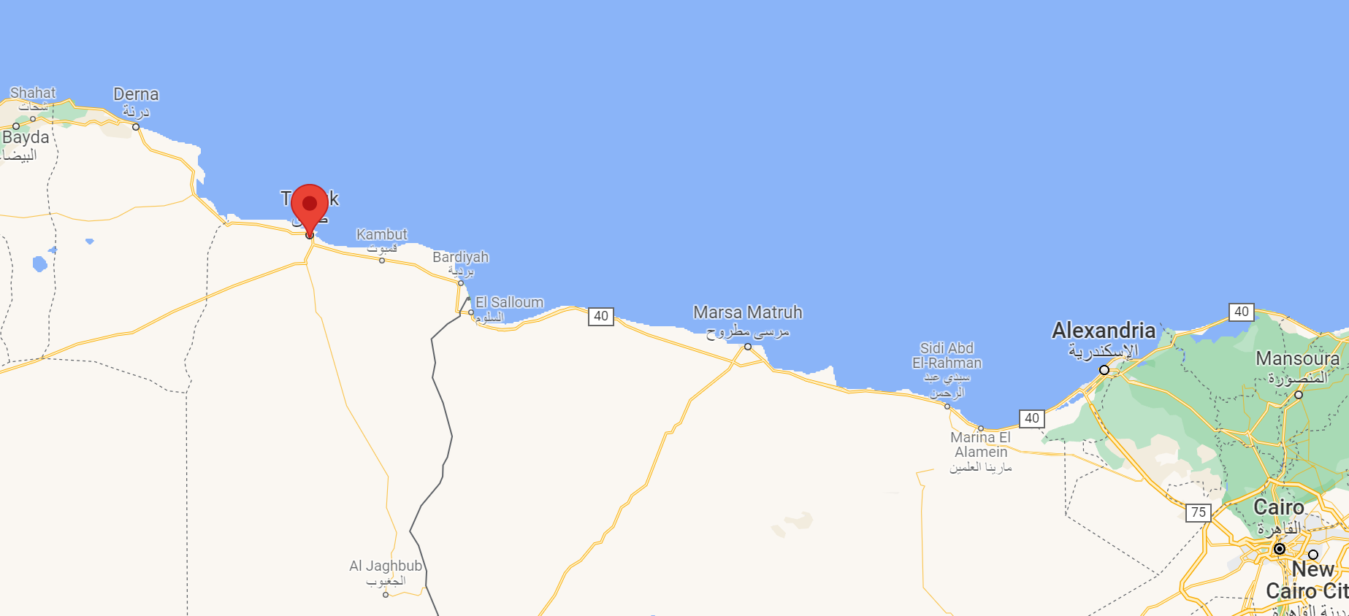
North Africa – WWII – part 1
Tobruk
‘Map of Tobruk, Libya by Google Maps is licensed under Google Maps/Google Earth Additional Terms of Service.
Notes:
Tobruk
Looking at the map, Tobruk is located in Libya in Northern Africa. It is a coastal town known for its deep-water harbour. It was considered perfect for troop and supply ships to anchor. The Germans needed this port to help them supply their advance toward Egypt. And so, the attack began. The Australian War memorial provides a summary of events:
'Between April and August 1941 around 14,000 Australian soldiers were besieged in Tobruk by a German–Italian army commanded by General Erwin Rommel. The garrison, commanded by Lieutenant General Leslie Morshead, consisted of the 9th Division (20th, 24th, and 26th Brigades), the 18th Brigade of the 7th Division, along with four regiments of British artillery and some Indian troops.'

Slide 5
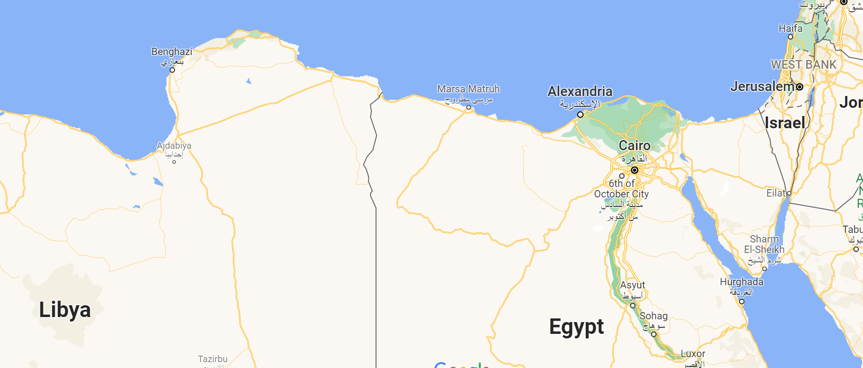

North Africa – WWII – part 2
Tobruk – 1941
El Alamein - 1942
‘Map of Tobruk, Libya’ by Google Maps is licensed under Google Maps/Google Earth Additional Terms of Service.
Notes:
Cecil was stationed in Tobruk in early 1941 and later fought at El Alamein in 1942. If you look carefully at the map, it shows the 2 places in North Africa where they are located. Tobruk and El Alamein were two very important battles that occurred between British and German forces in 1941-42. In both battles, the German advance was stopped and their plans were disrupted.

Slide 6
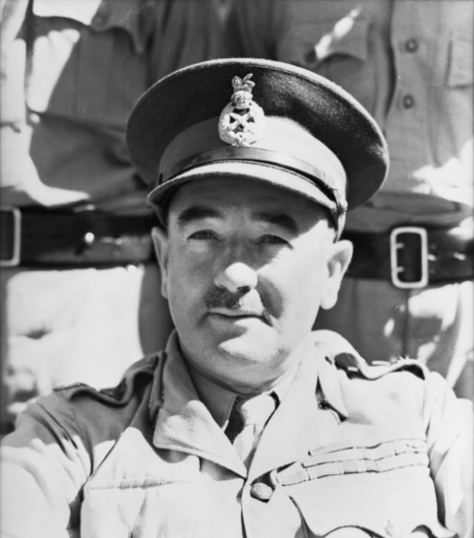
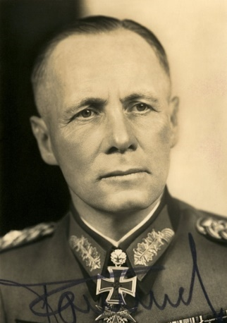
The Rats of Tobruk – 1941 – the protagonists
Context
Lt General Leslie Morshead (Australia)
General Field Marshall Erwin Rommel The Desert Fox (Germany)
Stuckey N (n.d.) unnamed [photograph], The Australian War Memorial, Australian War Memorial website, accessed 27 October 2023.
Hoffman H (n.d.) unnamed [Photograph], The Australian War Memorial, Australian War Memorial website, accessed 27 October 2023.
Notes:
The Protagonists
On this slide, we are introduced to the 2 leaders who fought against each other at Tobruk. The Australian leader was Lt General Leslie Morshead. He fought in World War 1 and not long after World War 2 commenced, he was asked to command the Australian 9th Division that were eventually based in Tobruk.
On the right is the German leader, General Field Marshall Erwin Rommel, known as The Desert Fox, because of his skill in tactics and attack. He was also a World War 1 soldier and by World War 2, he was considered one of the finest generals in the German army.

Slide 7
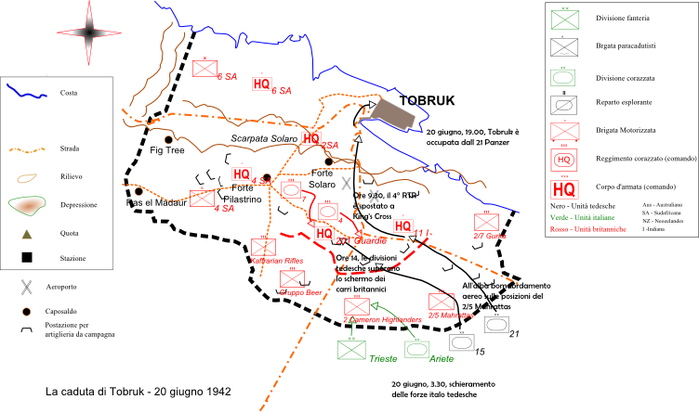
The Rats of Tobruk – 1941 – part 1
La caduta di Tobruk – 20 giugno 1942’ by Claudio Nardi (Klaudio) is licensed under CC BY-SA 3.0.
Notes:
Let's take a closer look at the battlefield map of Tobruk. The Allies (Australians, Indians and some British) built a semi-circle of defences around the town. They had 2 key lines of defence. Can you see the black dotted line which was the first line of defence? Behind this was the Red Line which was used as the support line. The Australians had built bunkers and trenches to protect themselves from attack. The problem for the German Afrika Korps was beyond the Black Line – it was flat and largely provided no cover for their soldiers to attack. The Australians could easily see the enemy approaching.

Slide 8
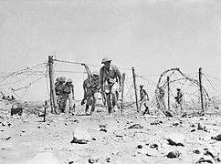
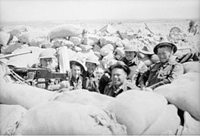
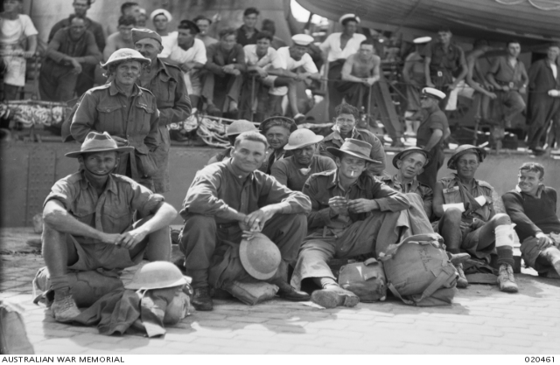
The Rats of Tobruk – 1941 – part 2
“He lived in a tin hut with a hard dirt floor.
He had bags sewn together that was his door.
He was a Rat of Tobruk…” (Clayton, 1988)
Unknown. (1941) A Patrol From The 2/13th Infantry Battalion Making Its Way Through A Gap In The Barbed Wire Entanglements Protecting Its Unit Position. Image from: https://www.awm.gov.au/collection/020780. Date accessed: 11/10/2021
Cumpston. J. S. (1941) Australian Troops Of The 2/48th Australian Infantry Battalion Manning A Defensive Post, In The Salient Near The South Acroma Road. Australian War Memorial. Image from: https://www.awm.gov.au/collection/020073. Date accessed: 11/10/2021
Halmarick. C. T. (1941) Men Of The 24th Infantry Brigade. Australian War Memorial. Image from: https://www.awm.gov.au/collection/C4844. Date accessed: 11/10/2021
Notes:
The Rats of Tobruk dug slit trenches, laid barbed-wire, created anti-tank ditches that were hidden from the enemy and they re-used the artillery and cannon left behind by the Italians to fire back at the Afrika Korps.

Slide 9
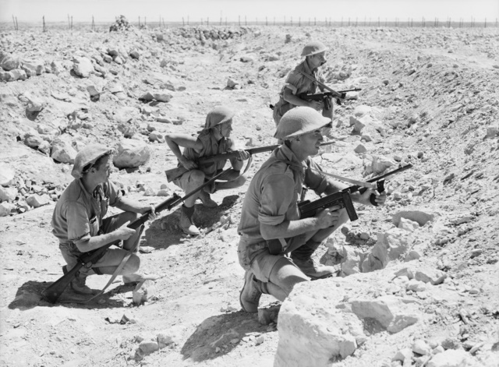
The Rats of Tobruk – 1941 – part 3
“Battered and scarred he fought for this land,
And on his return they all shook his hand.”
(Clayton, 1988)
Unknown. (1941) Tobruk, Libya. 1941-09-08. A Small Patrol From The 2/13th Infantry Battalion Waiting In A Tank Ditch For A Favourable Opportunity To Go Further Ahead Into "No- Man's- Land“. Australian War Memorial. Image from: https://www.awm.gov.au/collection/C5143. Date accessed: 11/10/2021
Notes:
All these defences were underestimated by the Afrika Korps, which led to their ill-fated ‘Easter Attack’. The German soldiers had experienced incredible success throughout Europe and so far, in North Africa. Their plans to take Egypt and secure the Suez Canal were largely moving forward with very little opposition. A new strategy by the Australians to let the tanks through their lines to then attack the soldiers behind, created confusion for the German soldiers who had no protection from the tanks. Isolated, the tanks were then attacked by artillery fire at close range. The attack was repelled.

Slide 10
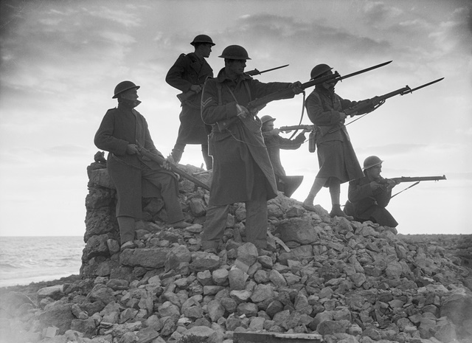
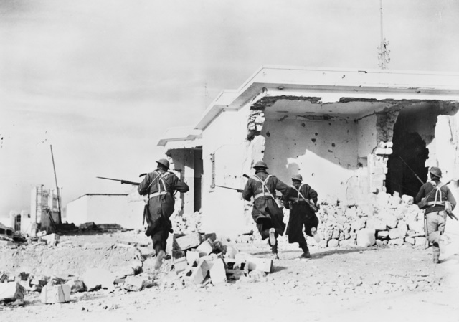
The Rats of Tobruk – 1941 – part 4
Hurley. J. F. (1941) Defenders of Tobruk. Australian War Memorial. Image from: https://www.awm.gov.au/collection/C29080. Date accessed: 11/10/2021
Unknown. (1941) Troops Rushing Through The Streets Of Ruined Bardia In Search Of Any Stray Enemy. Australian War Memorial. Image from: https://www.awm.gov.au/collection/C27864. Date accessed: 11/10/2021
Notes:
Over 8 months, the attacking German soldiers experienced a relentless number of night patrol attacks by the Australians. The Australians had made the decision to ensure that while they were defending their position, they could not let the enemy settle in theirs. Many patrols and night attacks destroyed enemy equipment and created fear for the German soldiers. The Germans also tried to attack the defensive lines of the Australians.

Slide 11
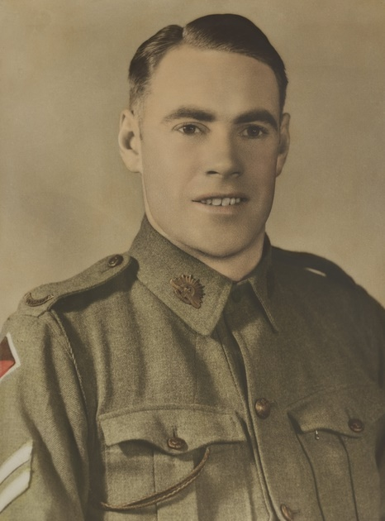
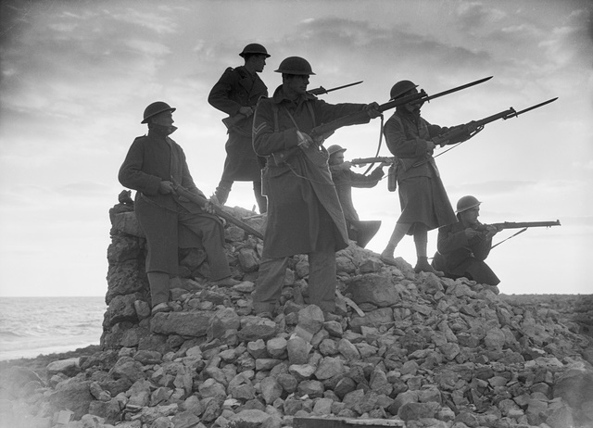

The Rats of Tobruk – 1941 – part 5
Hurley. J. F. (1941) Defenders of Tobruk. Australian War Memorial. Image from: https://www.awm.gov.au/collection/C29080. Date accessed: 11/10/2021
Unknown. (1941) Troops Rushing Through The Streets Of Ruined Bardia In Search Of Any Stray Enemy. Australian War Memorial. Image from: https://www.awm.gov.au/collection/C27864. Date accessed: 11/10/2021
Unknown. (1941) Corporal John Hurst 'Jack' Edmondson. Australian War Memorial. Image from: https://www.awm.gov.au/collection/P10676284. Date accessed: 11/10/2021
Notes:
Pictured in the centre of this slide, Jack Edmondson was a Corporal at Tobruk and won the Victoria Cross for his bravery. An account of his action is as follows: 'In April 1941 German infantry breached the defences at Tobruk, establishing machine-guns, mortars, and field-guns. A seven-man section, including Edmondson, charged the position. Although wounded in the neck and stomach, Edmondson continued to advance under heavy fire, killing one German with his bayonet. He later killed another two Germans, saving the life of his platoon commander, but he succumbed to his wounds soon after the German attack was defeated. His citation noted that Edmondson's actions during the operation "were outstanding for resolution, leadership and conspicuous bravery'. https://www.awm.gov.au/collection/P10676284

Slide 12
The Rats of Tobruk – 1941 – part 6
'He fought for this land so he could be free.'
(Clayton 1988)
Unknown British Official Photographer (c1940) unnamed [photograph], The Australian War Memorial, Australian War Memorial website, accessed 27 October 2023.
Notes:
By October 1941, the Rats had been relieved by British soldiers. They were shipped out for a well-deserved rest. They had repelled the Afrika Korps and delayed and disrupted their plans to attack Egypt. The Rats had destroyed much of the enemyies' resources, tanks, weapons and soldiers. Sadly, in war, many make the supreme sacrifice and nearly 750 Australian soldiers made that sacrifice. Many soldiers were buried in Tobruk and their graves are looked after by the Australian Government to this day. Cecil Clayton and 2/13th Battalion escaped Tobruk overland to battle the Germans at El Alamein the following year.

Slide 13
References – part 1
This presentation contains NSW Curriculum and syllabus content. The NSW Curriculum is developed by the NSW Education Standards Authority. This content is prepared by NESA for and on behalf of the Crown in the right of the State of New South Wales. The material is protected by Crown copyright.
Please refer to the NESA Copyright Disclaimer for more information https://educationstandards.nsw.edu.au/wps/portal/nesa/mini-footer/copyright.
NESA holds the only official and up-to-date versions of the NSW Curriculum and syllabus documents. Please visit the NSW Education Standards Authority (NESA) website https://educationstandards.nsw.edu.au/wps/portal/nesa/home and the NSW Curriculum website https://curriculum.nsw.edu.au.
Cumpston J (1941) unnamed [photograph], The Australian War Memorial website, accessed 27 October 2023. Licenced by Public Domain CC0.
Fisher T (1941) A patrol from the 2/13th Infantry Battalion making its way through a gap in the barbed wire [photograph], The Australian War Memorial website, accessed 27 October 2023. Licenced by Public Domain CC0.
Fisher T (1941) A small patrol from the 2/13th Infantry Battalion waiting in a tank ditch for a favourable [photograph], The Australian War Memorial website, accessed 27 October 2023. Licenced by Public Domain CC0.
Halmarick C (1941) unnamed [photograph], The Australian War Memorial website, accessed 27 October 2023. Licenced by Public Domain CC0.

Slide 14
References – part 2
Hoffman H (n.d.) unnamed [photograph], The Australian War Memorial website, accessed 27 October 2023. Licenced by Public Domain CC0.
Hurley F (1941) unnamed [photograph], The Australian War Memorial website, accessed 27 October 2023. Licenced by Public Domain CC0.
‘Map of Tobruk, Libya’, by Google Maps is licensed under Google Maps/Google Earth Additional Terms of Service.
Nardi C (2007) La caduta di Tobruk – 20 giugno 1942 [digitally rendered map], Wiki Media Commons website, accessed 27 October 2023. Licenced by Creative Commons.
Silk G (1941) unnamed [photograph], The Australian War Memorial, Australian War Memorial website, accessed 27 October 2023. Licenced by Public Domain CC0.
Stuckey N. B (n.d.) unnamed [photograph], The Australian War Memorial website, accessed 27 October 2023. Licenced by Public Domain CC0.
Unknown (1940) unnamed [photograph], The Australian War Memorial website, accessed 27 October 2023. Licenced by Public Domain CC0.
Unknown British Official Photographer (c1940) unnamed [photograph], The Australian War Memorial website, accessed 27 October 2023. Licenced by Public Domain CC0.

Slide 15
Copyright
© State of New South Wales (Department of Education), 2023
The copyright material published in this resource is subject to the Copyright Act 1968 (Cth) and is owned by the NSW Department of Education or, where indicated, by a party other than the NSW Department of Education (third-party material).
Copyright material available in this resource and owned by the NSW Department of Education is licensed under a Creative Commons Attribution 4.0 International (CC BY 4.0) licence.
This licence allows you to share and adapt the material for any purpose, even commercially.
Attribution should be given to © State of New South Wales (Department of Education), 2023.
Material in this resource not available under a Creative Commons licence:
the NSW Department of Education logo, other logos and trademark-protected material
Material owned by a third party that has been reproduced with permission. You will need to obtain permission from the third party to reuse its material.
Links to third-party material and websites
Please note that the provided (reading/viewing material/list/links/texts) are a suggestion only and implies no endorsement, by the New South Wales Department of Education, of any author, publisher, or book title. School principals and teachers are best placed to assess the suitability of resources that would complement the curriculum and reflect the needs and interests of their students.
If you use the links provided in this document to access a third party’s website, you acknowledge that the terms of use, including licence terms set out on the third-party’s website apply to the use which may be made of the materials on that third-party website or where permitted by the Copyright Act 1968 (Cth). The department accepts no responsibility for content on third-party websites.

