Slide 1
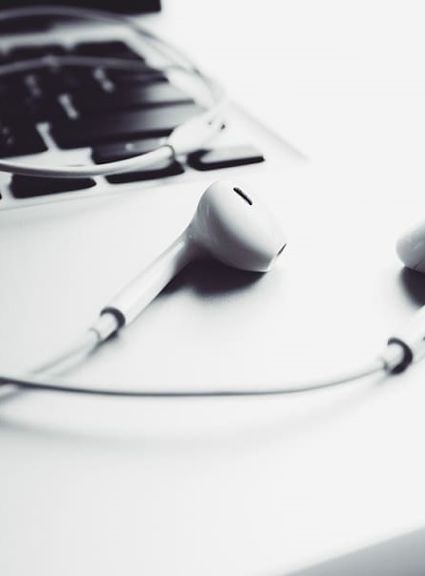
Writing about music in Stage 6
Module 3 – analysing Music 1 student samples
Pxfuel (2023) earphones on a laptop [image], accessed 25/9/2023

Slide 2
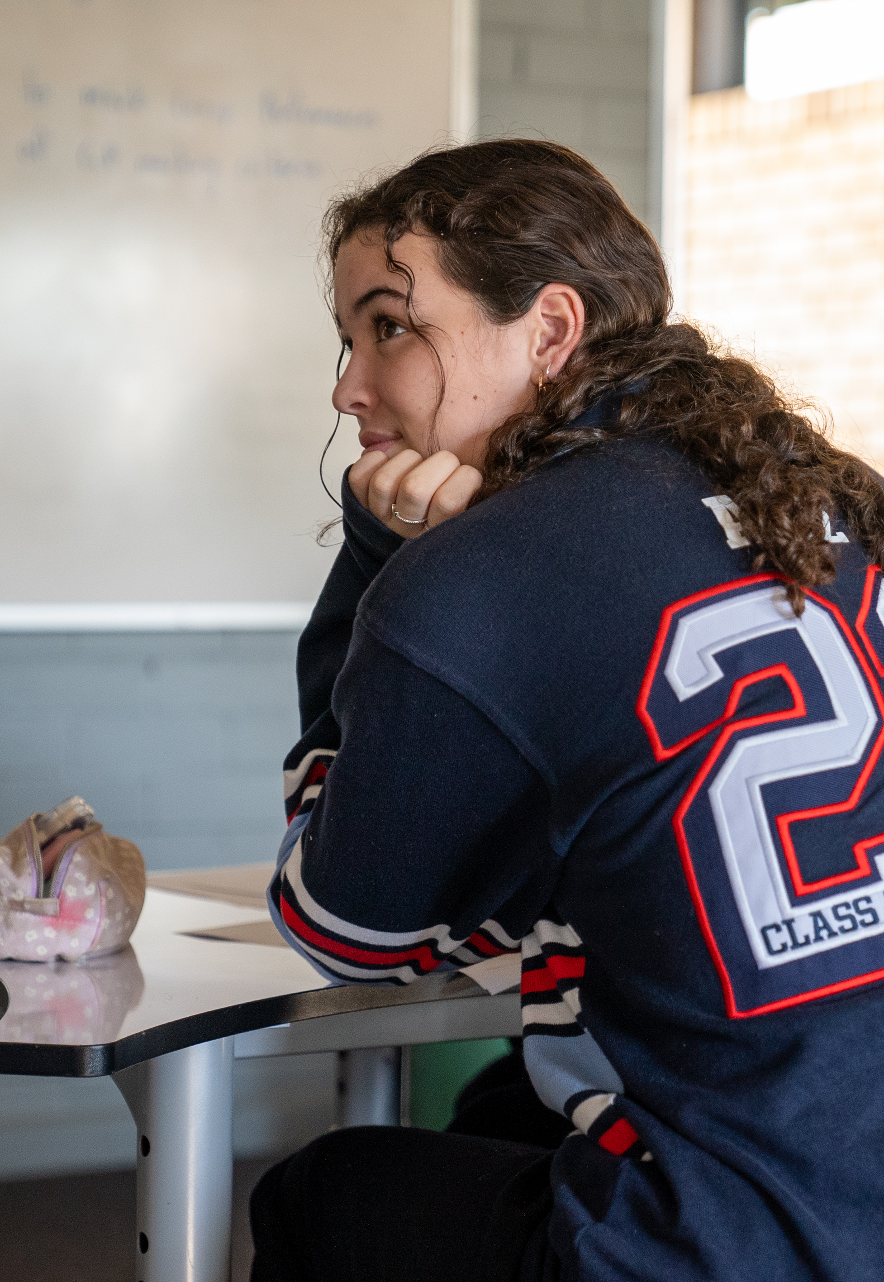
Contents
Module 1 – unpacking the Music 1 aural skills paper
Items | Slide number
Introduction | 3
Sample question A | 4
Sample question B | 5
Sample responses question A | 7
Sample responses question B | 15
Extension activity | 23
References | 24

Slide 3
Introduction
This module will unpack a range of Music 1 aural skills examination student responses. Students will learn how to apply the HSC aural skills marking criteria to each response. The following learning sequence can be applied to question A and question B:
Listen to the audio links provided on slide 4 and slide 5 and write an individual response.
Discuss the answers as a class.
‘Practice mark’ the 3 sample responses provided using the Music 1 aural skills marking criteria. This can be done in pairs or individually.
As a class, discuss the strengths and weaknesses of each sample according to the marking criteria.
Reveal the comments provided and consider a mark range for each sample.
3

Slide 4
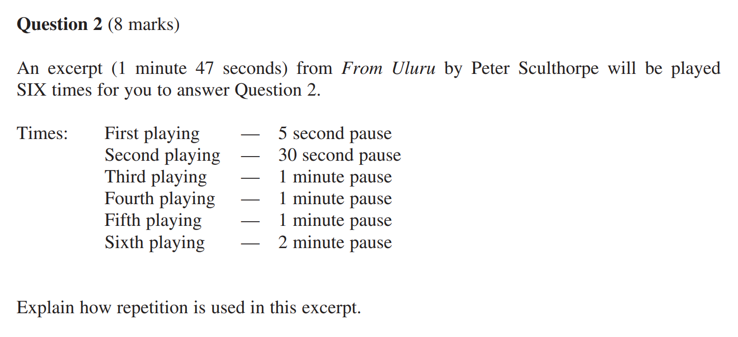
Sample question A
This question is from the Music 1 2022 HSC exam pack aural skills examination.
Access the audio file using the link below.
'From Uluru' by Peter Sculthorpe (00:00 - 01:47) accessed 4/8/2023.
Listen to the audio link provided and write an individual response to each question. Discuss the answers as a class.
Music 1 2022 HSC exam pack © NSW Education Standards Authority (NESA) for and on behalf of the Crown in right of the State of New South Wales, 2022.

Slide 5
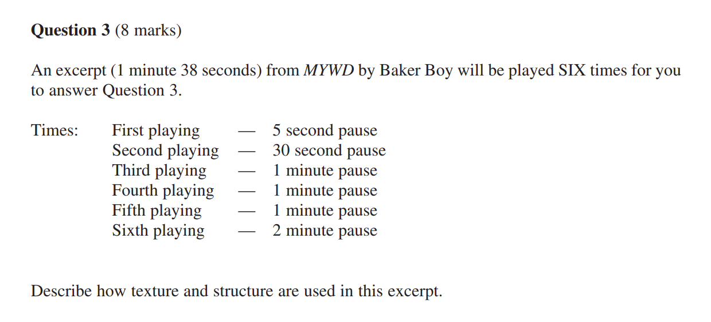
Sample question B
This question is from the Music 1 2022 HSC exam pack aural skills examination.
Access the audio file using the link below:
‘MYWD’ by Baker Boy (1:55–3:38).
Listen to the audio link provided and write an individual response to each question. Discuss the answers as a class.
Music 1 2022 HSC exam pack © NSW Education Standards Authority (NESA) for and on behalf of the Crown in right of the State of New South Wales, 2022.

Slide 6
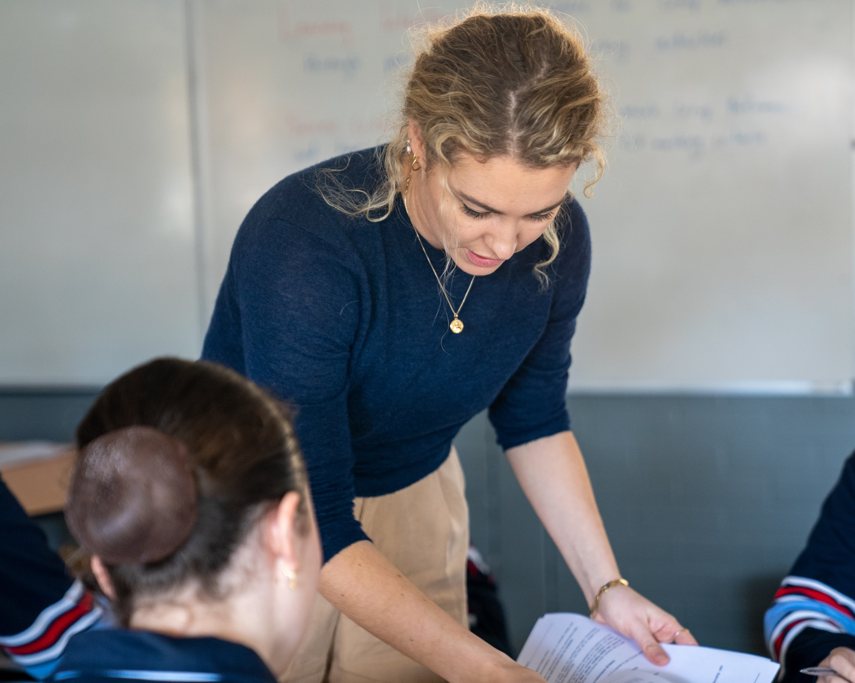
Sample responses
The sample responses can be downloaded from the Writing about music in Stage 6 Music 1 – aural skills webpage.
Question A
Sample 1A
Sample 2A
Sample 3A
Question B
Sample 1B
Sample 2B
Sample 3B

Slide 7
Sample responses question A

Slide 8
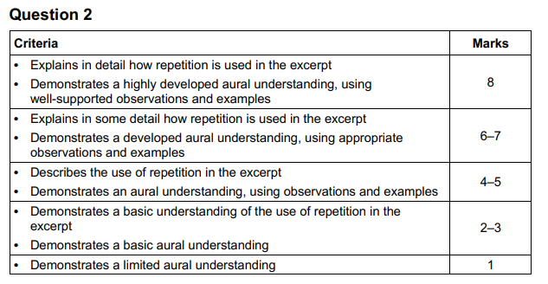
Question A – marking criteria
Here is the marking criteria for question A. Discuss as a class.
Music 1 2022 HSC exam pack © NSW Education Standards Authority (NESA) for and on behalf of the Crown in right of the State of New South Wales, 2022.
8

Slide 9
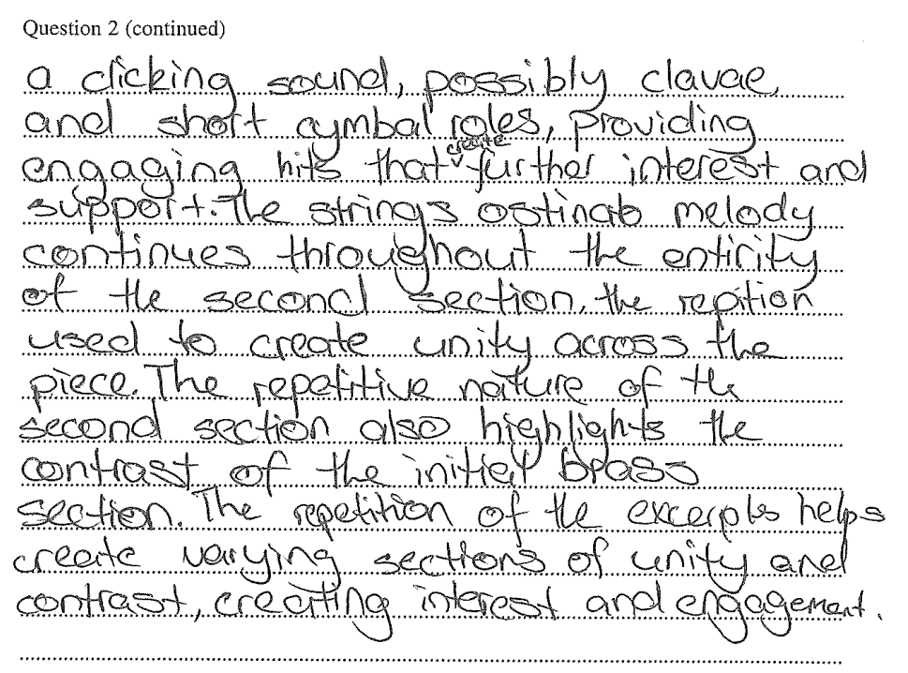
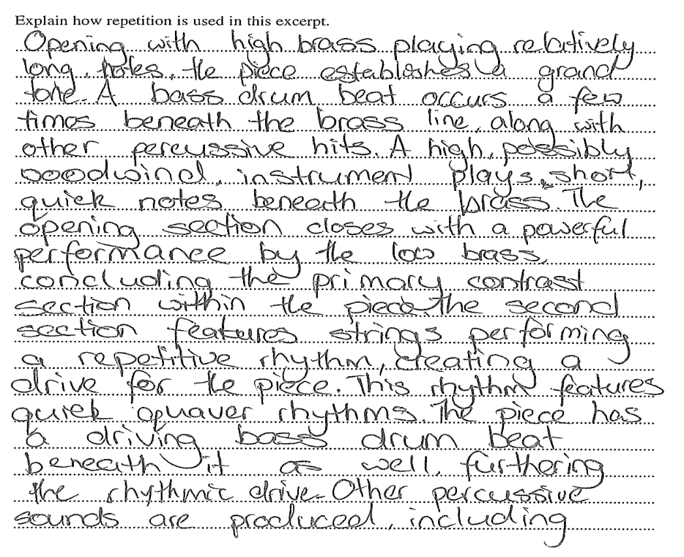
Sample 1A
Question A (8 marks)
Music 1 2022 HSC exam pack © NSW Education Standards Authority (NESA) for and on behalf of the Crown in right of the State of New South Wales, 2022.

Slide 10
Sample 1A – marking guideline annotations
This response contains some detail through musical observations, incorporating metalanguage, such as ‘quick quaver rhythms’. The sequence of musical events is evident through the structure of the response, such as ‘the opening section closes with a powerful performance by the low brass...’. Evidence of analysing layers of sound is observed, such as ‘woodwind instrument plays short quick notes beneath the brass’. The rhythmic features are descriptive, however, can be quite generalised. These could have further clarification, such as representation through notation to support the statement. The tone colour references are clear, however, these could be deepened through a description of the timbre and its effect on the excerpt. The musical observations have slight references to unity and contrast as a connecting feature to repetition.
Overall, this response demonstrates some detail of musical knowledge that could be further developed through more detailed descriptions of each point, as well as graphic representation of sound.

Slide 11
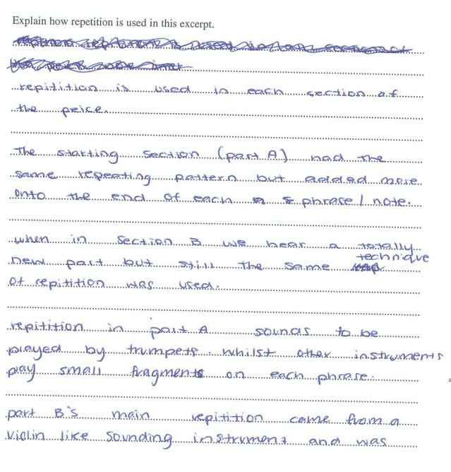
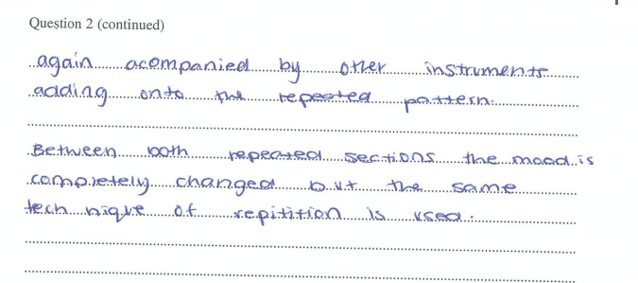
Sample 2A
Question A (8 marks)
Music 1 2022 HSC exam pack © NSW Education Standards Authority (NESA) for and on behalf of the Crown in right of the State of New South Wales, 2022.

Slide 12
Sample 2A – marking guideline annotations
The sections are outlined, and repetition is identified through a general statement which portrays aural understanding. The response describes the use of repetition in the excerpt through broad, generalised statements. The instrument that performs the musical material in each section is identified but without further clarification.
Repetition is being recognised throughout the response such as ‘when in section B we hear a totally new part but still the same technique of repetition was used’. This could be supported by more musical detail including more specific music metalanguage about the musical features. The description of the trumpets and melodic fragments is clear, however, it could be supported by deeper concept analysis.
Overall, the response portrays the use of repetition and an aural understanding, though each point could be expanded upon and supported by further musical knowledge and observations.

Slide 13
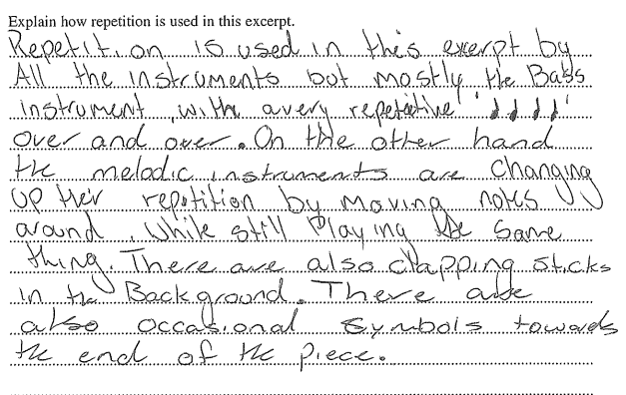
Sample 3A
Question A (8 marks)
Music 1 2022 HSC exam pack © NSW Education Standards Authority (NESA) for and on behalf of the Crown in right of the State of New South Wales, 2022.

Slide 14
Sample 3A – marking guideline annotations
The response contains a basic understanding of the use of repetition in the excerpt, mainly through generalised musical observations. For example, ‘repetition is used by all instruments’. Some observations display a basic aural understanding with little reference to the location of the feature. For example, ‘occasional cymbals towards the end of the piece’. There are some musical observations, such as ‘clapping sticks in the background’, however descriptions tend to not go beyond tone colour features. The brevity of the response also contributes to the basic impression. The response could be improved by a more specific reference to a wider range of concepts of music and where in the piece these musical features occur.

Slide 15
Sample responses question B

Slide 16
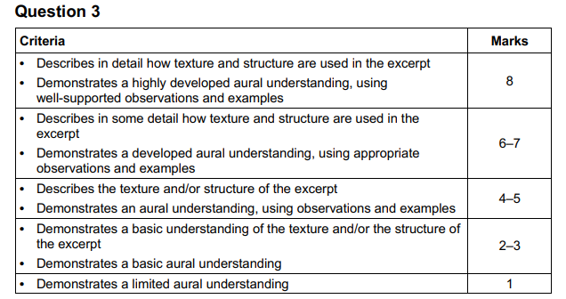
Question B – marking criteria
Here is the marking criteria for question B. Discuss as a class.
Music 1 2022 HSC exam pack © NSW Education Standards Authority (NESA) for and on behalf of the Crown in right of the State of New South Wales, 2022.

Slide 17
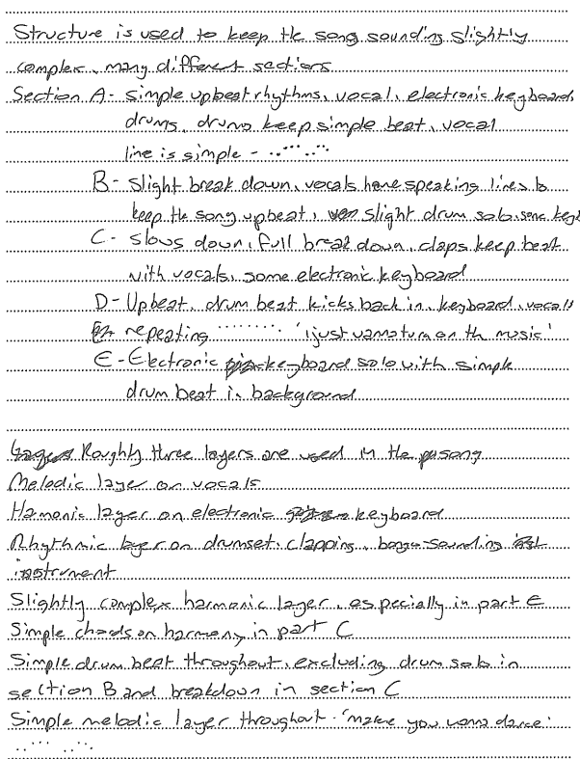
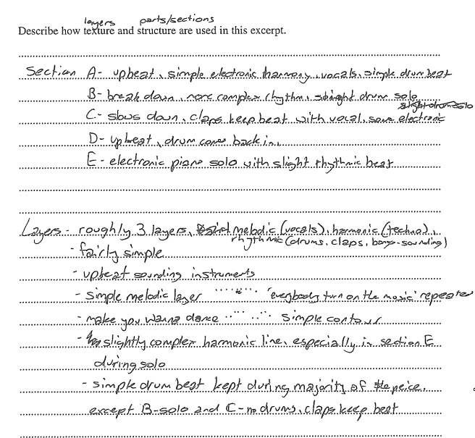
Sample 1B
Question B (8 marks)
Music 1 2022 HSC exam pack © NSW Education Standards Authority (NESA) for and on behalf of the Crown in right of the State of New South Wales, 2022.

Slide 18
Sample 1B – marking guideline annotations
The response is detailed and outlines the layers and structure through musical observations. Some examples such as ‘more complex rhythms: straight drum solo’ provide detail, however, some observations are more generalised such as ‘simple contour’ and require further musical detail. This was otherwise a good point on the melodic aspect of the layer.
The response has a clear structure outlined at the beginning to notify the marker where the musical features occur. Roles are identified briefly, such as ‘melodic layer on vocals; harmonic layer on electronic keyboard…’ however these could be explored more. Some strong observations require further clarification to support the point, such as ‘slightly complex harmonic line’. Tone colour references mostly lead the response. Graphic notation is understandable, though could be clearer, for example, lines rather than dots.
Overall, this demonstrates a developed aural understanding with further clarification required to fully support all musical points and observations.

Slide 19
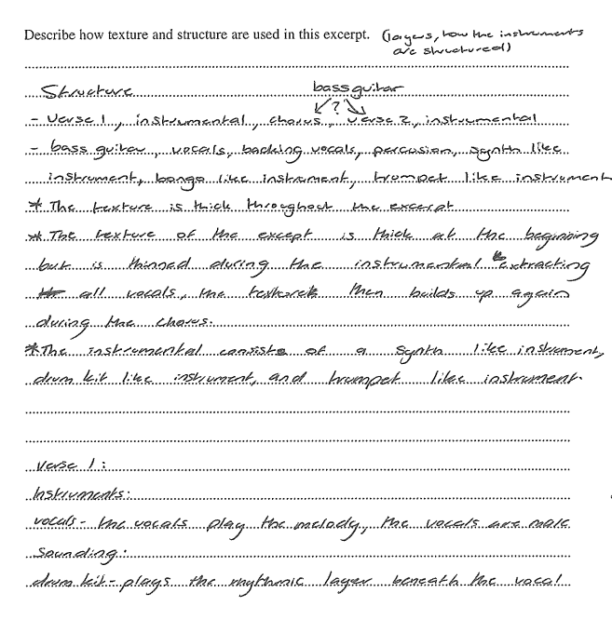
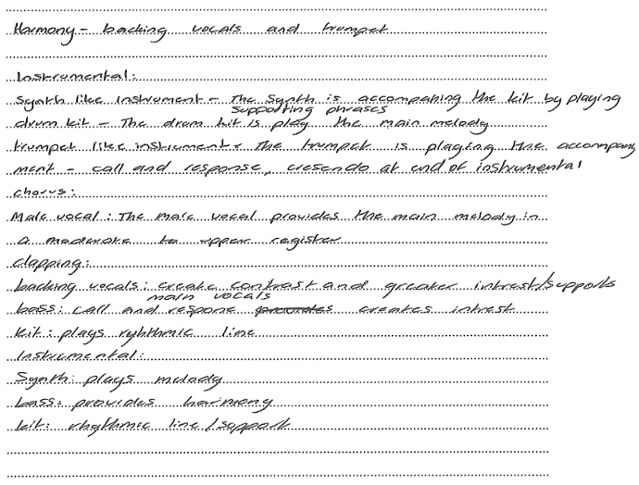
Sample 2B
Question B (8 marks)
Music 1 2022 HSC exam pack © NSW Education Standards Authority (NESA) for and on behalf of the Crown in right of the State of New South Wales, 2022.

Slide 20
Sample 2B – marking guideline annotations
A strong start to the response is provided with the references to performing media and structure, however, the response remained in a list-like manner. A competent aural understanding is portrayed through knowledge of the texture and structure, though points were often generalised. For example, ‘the vocals play the melody, the vocals are male sounding’.
Examples to support the musical observations are used, though further exploration is needed. For example, ‘call and responses, crescendo at the end of instrumental’, are 2 points in the one sentence that could be detailed further and linked to the concept to which it refers. Identification of the roles of the layers is clear throughout the response, however, more detail about the density/phonic in each section is needed. Overall, an aural understanding is portrayed, though tended to be list-like in presentation.

Slide 21
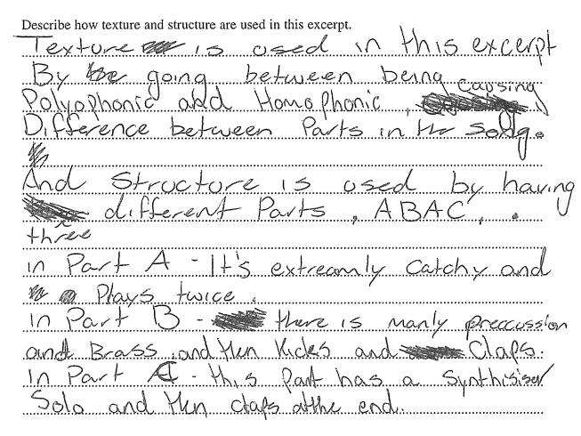
Sample 3B
Question B (8 marks)
Music 1 2022 HSC exam pack © NSW Education Standards Authority (NESA) for and on behalf of the Crown in right of the State of New South Wales, 2022.

Slide 22
Sample 3B – marking guideline annotations
The response gives a basic impression due to the brevity of statements and observations, such as ‘difference between parts in the song’. There is an attempt to outline the texture type, however, there are some incorrect observations, such as ‘polyphonic’. The response does show an observation of sections; however, these are quite general and don’t provide any further explanation of the ‘ABAC’ outlined structure.
Some general comments, such as ‘extremely catchy’, require musical detail and specific metalanguage. A basic aural understanding is observed in a list-like response. For example, ‘there is mainly percussion and brass and then kicks and claps’. Further concept exploration is needed.

Slide 23
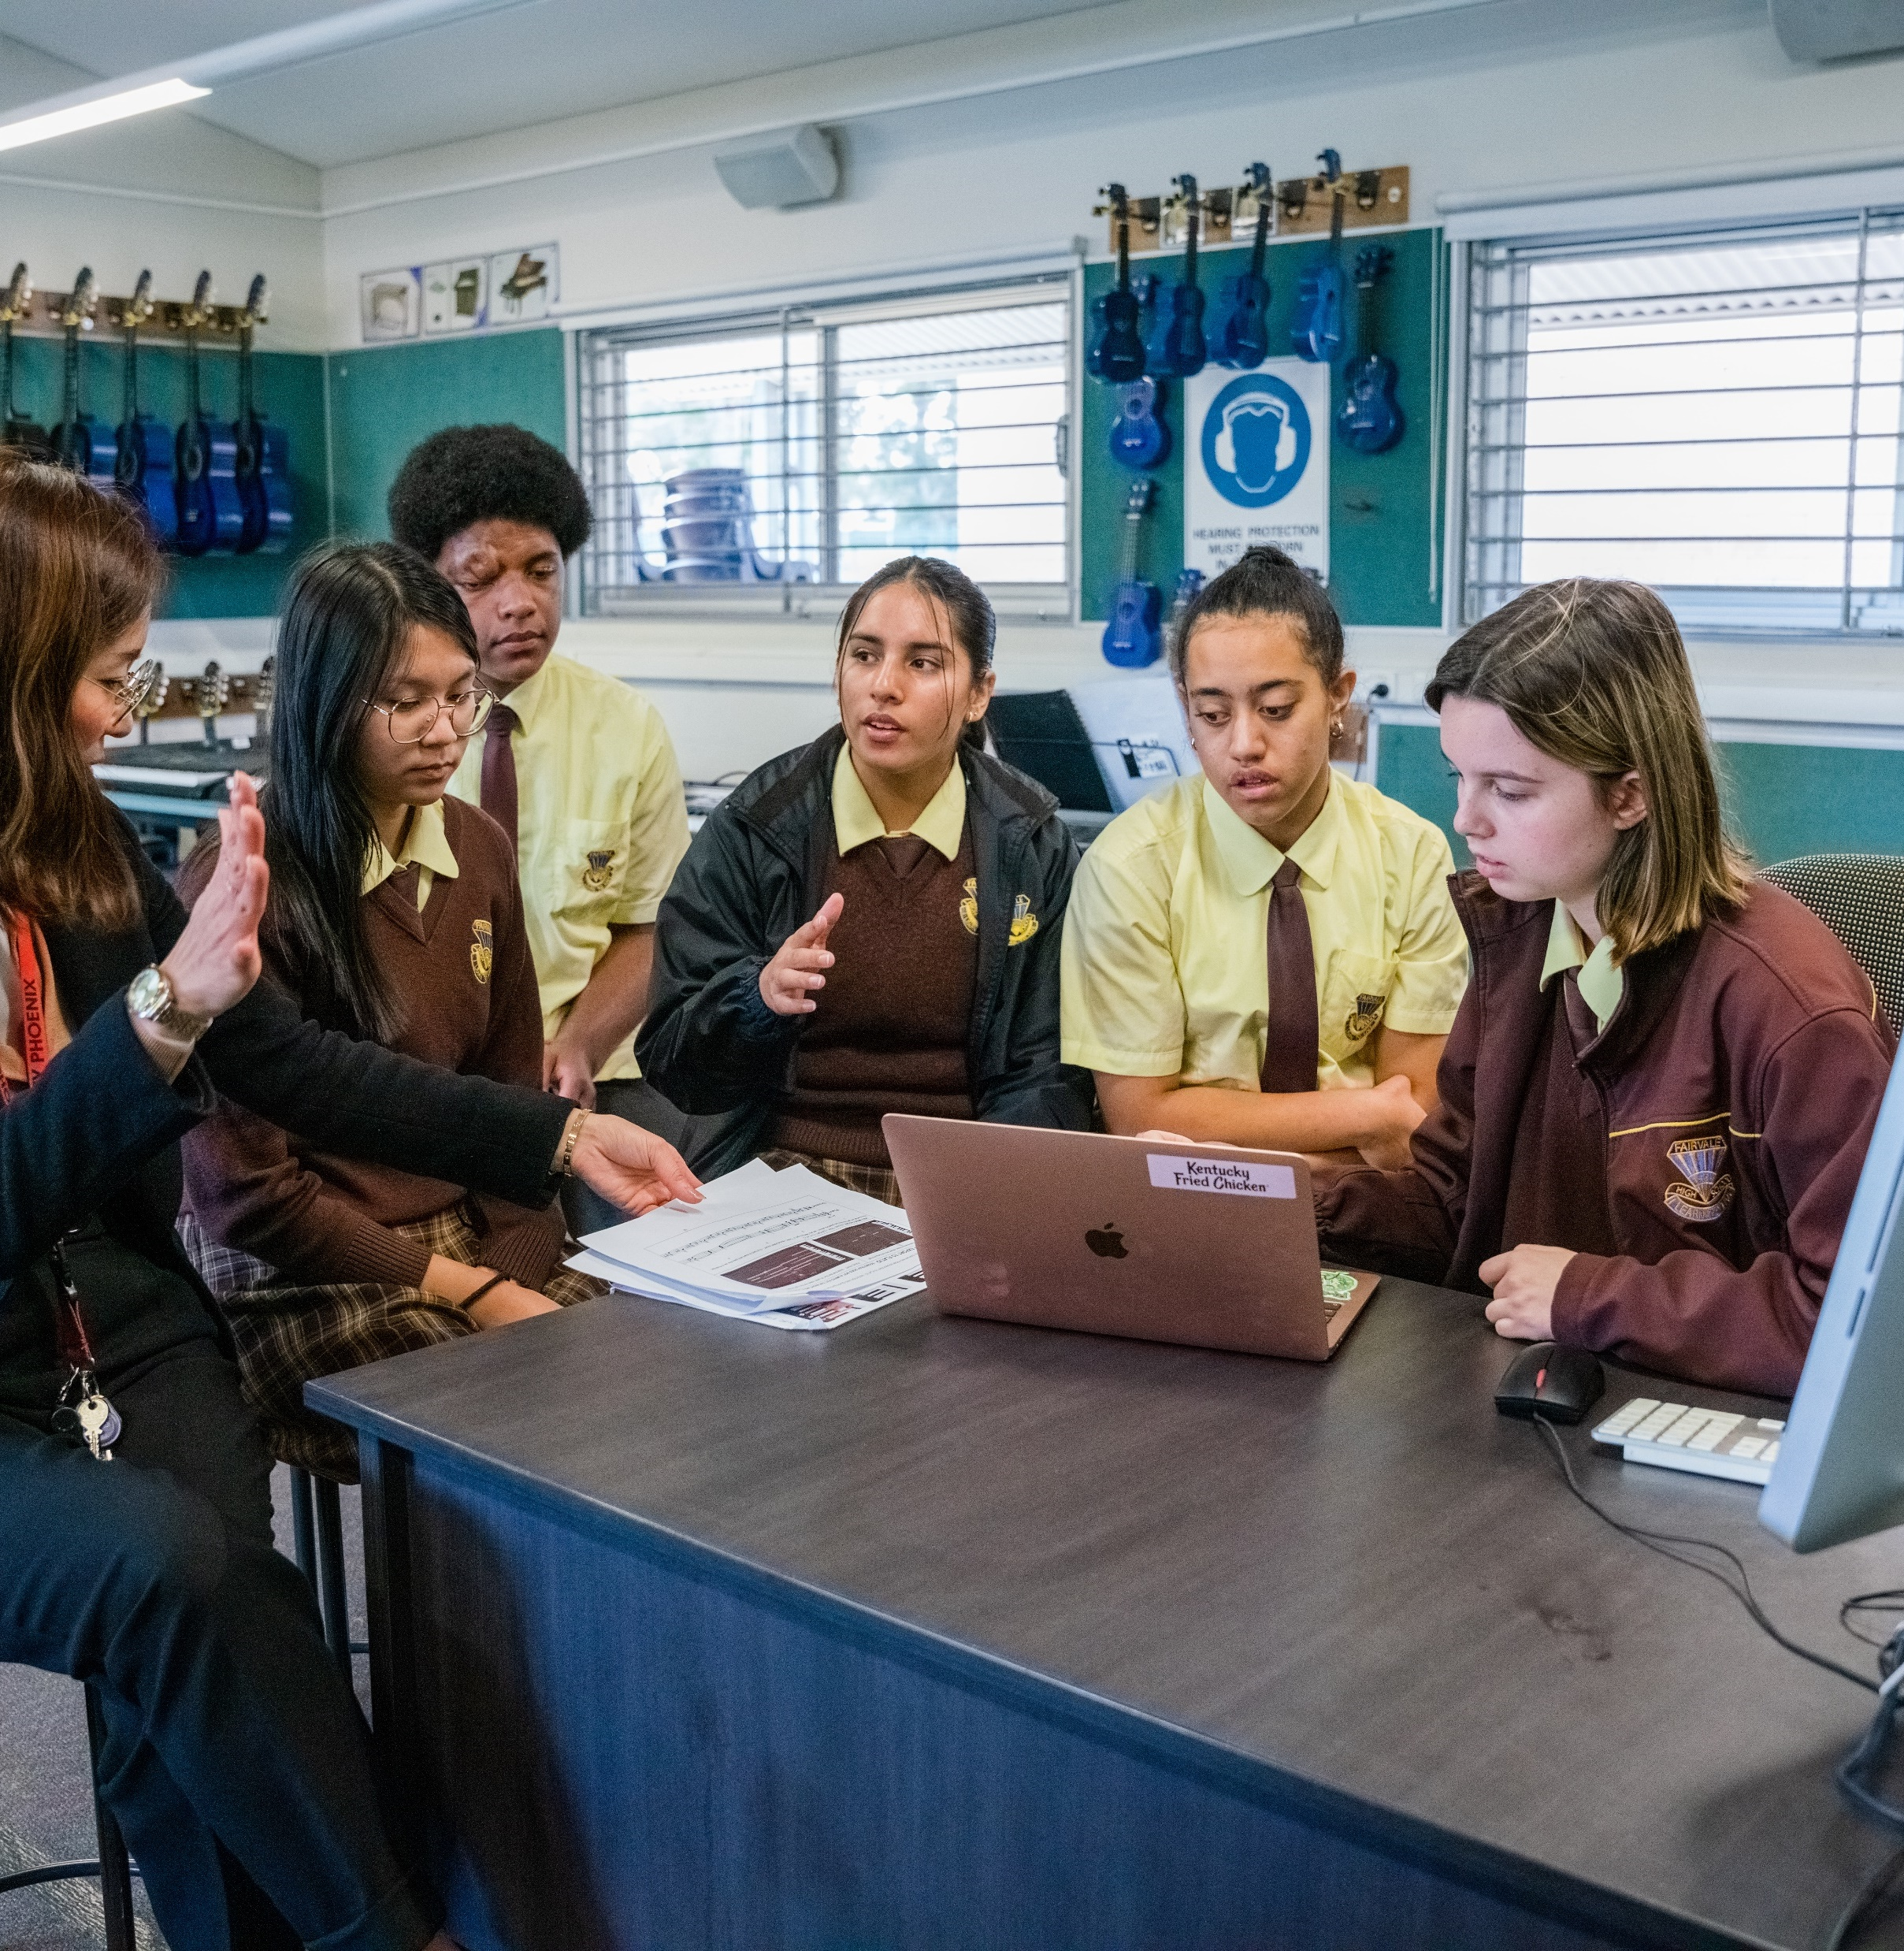
Extension activity
Reflecting on each sample response, apply the feedback given in each of the marking guideline annotations and rework each response to improve the level of achievement.

Slide 24
References
This presentation contains NSW Curriculum and syllabus content. The NSW Curriculum is developed by the NSW Education Standards Authority. This content is prepared by NESA for and on behalf of the Crown in the right of the State of New South Wales. The material is protected by Crown copyright.
Please refer to the NESA Copyright Disclaimer for more information https://educationstandards.nsw.edu.au/wps/portal/nesa/mini-footer/copyright.
NESA holds the only official and up-to-date versions of the NSW Curriculum and syllabus documents. Please visit the NSW Education Standards Authority (NESA) website https://educationstandards.nsw.edu.au/wps/portal/nesa/home and the NSW Curriculum website https://curriculum.nsw.edu.au.
Creative arts 11–12 © Syllabus NSW Education Standards Authority (NESA) for and on behalf of the Crown in right of the State of New South Wales, 2024.
Adelaide Symphony Orchestra (31 August 2021) ‘From Uluru’ [video], Adelaide Symphony Orchestra, YouTube, accessed 4 August 2023.
Baker Boy (15 October 2021) ‘Baker Boy – MYWD’ [video], Baker Boy, YouTube, accessed 18 October 2023.
NSW Education Standards Authority (NESA) (2023) Music 1 2022 HSC exam pack, NESA website, accessed 18 October 2023.

Slide 25
Copyright
© State of New South Wales (Department of Education), 2023
The copyright material published in this resource is subject to the Copyright Act 1968 (Cth) and is owned by the NSW Department of Education or, where indicated, by a party other than the NSW Department of Education (third-party material).
Copyright material available in this resource and owned by the NSW Department of Education is licensed under a Creative Commons Attribution 4.0 International (CC BY 4.0) licence.
This licence allows you to share and adapt the material for any purpose, even commercially.
Attribution should be given to © State of New South Wales (Department of Education), 2024.
Material in this resource not available under a Creative Commons licence:
the NSW Department of Education logo, other logos and trademark-protected material
Material owned by a third party that has been reproduced with permission. You will need to obtain permission from the third party to reuse its material.
Links to third-party material and websites
Please note that the provided (reading/viewing material/list/links/texts) are a suggestion only and implies no endorsement, by the New South Wales Department of Education, of any author, publisher, or book title. School principals and teachers are best placed to assess the suitability of resources that would complement the curriculum and reflect the needs and interests of their students.
If you use the links provided in this document to access a third party’s website, you acknowledge that the terms of use, including licence terms set out on the third-party’s website apply to the use which may be made of the materials on that third-party website or where permitted by the Copyright Act 1968 (Cth). The department accepts no responsibility for content on third-party websites.

