Slide 1

Writing about music in Stage 6
Module 2 – Music 1 aural skills analysis
‘earphones on a laptop’ by pxfuel is licensed under the pxfuel Terms Of Use.
Notes:
Image from: https://www.pxfuel.com/en
/free-photo-xzgqf

Slide 2

Contents
Module 2 – Music 1 aural skills analysis
Items | Slide number
Introduction | 3
Structuring your response | 4
Macro – answering the question | 5
Framework 1 – HITMODE | 6
Micro – components of the answer | 26
Framework 2 – What? Where? Who? Why? | 27
Aural skills tips and resources | 33

Slide 3
Introduction
Answering an aural skills question can be daunting, however, using scaffolds can help to guide your response. In this module, we are going to look at 2 different frameworks you could use to respond to an HSC Music 1 aural skills question:
HITMODE
This acronym can be used to structure the entire aural written response. (Macro)
What, Where, Who, Why
This framework can be used to achieve detailed musical observations in an aural skills written response. (Micro)

Slide 4
Structuring your response
Provide a well organised and structured response.
Responses in the Music 1 aural skills written paper can be structured in many ways. The structure of a response will depend on the excerpt. Ways to structure a response may include the use of:
extended dot points
paragraphs
columns (especially when doing a comparative analysis)
concept headings
structure headings in chronological order.

Slide 5

Macro
Answering the question

Slide 6
Framework 1
HITMODE
HITMODE is a framework that can be used when responding to aural skills questions. This method is to be followed in sequence to achieve a final response. The following slides will unpack each area of HITMODE.
H | Highlight
I | Interpret
T | Topic sentence
M | Metalanguage
O | Organise
D | Detail
E | End your answer

Slide 7
Highlight – verbs
An HSC Music 1 aural skills question will begin with a verb. This verb will ask you to expand on the concept(s) of music in the excerpt. Highlight the important verbs in the question.
Highlight
What are the important verbs?
  Verbs may include:
  outline
  explore
  describe
  explain
  analyse
  compare.

Slide 8
Verb definitions
HSC examination papers use words from the ‘Glossary of key words’ found on the NESA website. Definitions are provided below for the words that are commonly used in the HSC Music 1 aural skills written paper.
Highlight
What are the important verbs?
Outline – indicate the main features.
Explore – to look into closely; examine.
Describe – provide characteristics and features.
Explain – make the relationships between things evident; provide why and/or how.
Analyse – identify components and the relationship between them.
Compare – show how things are similar or different.
A Glossary of Key Words | NSW Education Standards © NSW Education Standards Authority (NESA) for and on behalf of the Crown in right of the State of New South Wales, 2021.

Slide 9
Highlight – the concept(s) of music
An HSC Music 1 aural skills question will outline the concept(s) of music to be discussed. Highlight the concept focus for the response.
Highlight
What are the important concepts?
Duration
Pitch
Tone colour
Texture
Structure
Dynamics and expressive techniques

Slide 10
Highlight example
Describe the layers of sound in the excerpt.
Describe – provide characteristics and features (verb)
Layers of sound to be identified in the excerpt (concept of music)

Slide 11
Interpret
An HSC Music 1 aural skills question will focus on one or more of the 6 concepts of music to be analysed. However, there are some words in the questions that may require you to ‘interpret’ which concept(s) are being asked.
Interpret
What am I being asked to do?
Some examples can include:
tension – all concepts
climax – all concepts
unity and/or contrast – all concepts
comparison – all concepts
layers – texture
style – all concepts.

Slide 12
How can I interpret an aural question?
Describe the layers of sound in the excerpt.
Layers refers to the concept of texture

Slide 13
Topic sentence
The start of your response should answer the question, and a topic sentence is a way to outline what you plan to discuss. The topic sentence displays the overall focus of the response.
Topic sentence
What will your response
focus on?
A topic sentence serves as an introductory statement to outline the purpose of the analysis.

Slide 14
How to write a topic sentence
Topic sentence
What will your response
focus on?
Consider the topic sentence as an introduction to what you are going to be expanding on in your answer. It is not necessary to write it first. You may like to leave space at the beginning of your response and come back to it later. Use the steps below to write your topic sentence:
Leave 3 or 4 lines at the start of your page.
Listen to the excerpt and write your concept observations in extended point form.
When you have finished, go to the top of your page and write a brief answer to the question with what you have observed in general terms in your beginning or topic sentence.
Note that you may write your topic sentence first, but it will not have many features of the concepts as you have not answered the question yet.

Slide 15
What does a topic sentence look like in an aural response?
Topic sentence example
HSC Music 1
aural skills
Q3 2019
The excerpt uses predominantly electronic tone colours within a homophonic texture that is mostly moderate in density.
or
The use of technology has affected the tone colour and texture through the extensive use of electronic sound sources and layering of samples.
Describe how the use of technology has affected tone colour and texture in this excerpt.
Music 1 HSC exam papers © NSW Education Standards Authority (NESA) for and on behalf of the Crown in right of the State of New South Wales, 2021.
Notice how the second example is directly answering the question first, and then expanding.
Notes:
Reference NESA

Slide 16
Metalanguage (1 of 2)
Metalanguage is the specific language used in a subject. In music, this consists of music terminology and ways to describe music. The metalanguage that is applicable to the HSC Music 1 aural skills exam is the 6 concepts of music.
Metalanguage
The concepts of music
Duration
Pitch
Tone colour
Texture
Structure
Dynamics and expressive techniques

Slide 17
Metalanguage (2 of 2)
What does the Music 1 Stage 6 Syllabus (2009) say about the concepts of music?
Metalanguage
The concepts of music
Duration refers to the lengths of sounds and silences in music and includes the aspects of beat, rhythm, metre, tempo, pulse rates and absence of pulse.
Pitch refers to the relative highness and lowness of sounds. Important aspects include high, low, higher and lower pitches, direction of pitch movement, melody, harmony, indefinite and definite pitch.
Dynamics refer to the volume of sound. Important aspects include the relative softness and loudness of sound, change of loudness (contrast), and the emphasis on individual sounds (accent).
Expressive techniques refers to the musical detail that articulates a style or interpretation of a style.
Tone colour refers to that aspect of sound that allows the listener to identify the sound source or combinations of sound sources.
Texture results from the way voices and/or instruments are combined in music.
Structure refers to the idea of design or form in music. In organising sound, the concepts of duration, dynamics, pitch and tone colour are combined in some way for a particular purpose. Structure relates to the ways in which music sounds the same (or similar) and/or different.
Music 1 Stage 6 Syllabus © NSW Education Standards Authority (NESA) for and on behalf of the Crown in right of the State of New South Wales, 2009.

Slide 18
What metalanguage do I use in an aural response?
HSC Music 1 aural skills Q1 2022
Describe how pitch is used in this excerpt.
Concept of music | Concept features to focus on | Brief observations (from early playings of the excerpt)
Pitch | This could include: tonality melody harmony. | Observations could include: major tonality piano low and high registers male singer sings in high register some unpitched sounds, sounds like wind, as well as a high shimmering sound harmony is mainly the bass of the piano (wave contour), as well as backing vocalists.
Map out the concept features to analyse and a brief observation of each.
Music 1 HSC exam papers © NSW Education Standards Authority (NESA) for and on behalf of the Crown in right of the State of New South Wales, 2021.

Slide 19
Organise
It is important that you organise your musical observations in a structured manner. The organisation of analysis points can differ, according to the excerpt or concept focus.
Organise
Organise your points
Responses can be organised in the following ways:
texture graphs or tables
columns
macro structure outline – for example, verse or chorus form
concept subheadings.
Notes:
Sections; texture map; macro structure… verse/chorus form…

Slide 20
How can I organise my points in an aural response?
Sound sources | Section A (introduction) | Section B (verse 1) | Section C (verse 2)
Piano | High register repeated ostinato. | Ostinato continues but varied a little. | Ostinato continues, though doubled in the bass.
Cello |  | Low sustained notes. | Low sustained notes.
Female voice |  | Voice enters using a high register singing the beginning part of the piano ostinato. | Same melody as verse 1, though the last line is varied and sung an octave higher.
Texture table

Slide 21
Detail
Detail in a response refers to the specific components of the concept(s) of music, documented in musical terms, descriptions or notation.
Detail
To achieve higher results, the musical observations must be detailed. High level answers consist of a deep analysis of the concept(s) being asked and may include specific metalanguage to support each point.

Slide 22
What amount of detail do I need to achieve a high-level response?
Introduction/Section A
The excerpt begins with a cello line playing a 3-note ostinato that is introduced, and later acts as a harmony. This melodic ostinato then transforms into a harmonic ostinato in the B section now providing a harmonic role. The ostinato is heard twice, with a held note to end the introduction. The texture is thin and monophonic in this section.
Section B
The piano is introduced playing the melody softly in its high register which contributes to the thin texture. The contour of the melody is 3 ascending melodic fragments, moving into a wave shaped melody while the cello continues the ostinato. The texture type is homophonic with the entire melody played 3 times.
Section C
The ostinato continues in the cello part, with an added drum beat placed on the first beat of the bar. The violins (high strings) are playing the main ostinato from the introduction, though an octave higher. The cello then changes to playing staccato notes on every beat and the piano continues to play a melody consisting of 4 phrases in the middle register with an added bass line in the left hand. The texture is thick and homophonic.
Music metalanguage and where the musical feature is heard in the excerpt

Slide 23
End
The concluding sentence is like the topic sentence in nature but written at the end of your answer to help further summarise the analysis points.
End
End your answer
A final concluding sentence which summarises your points and links to the question.
Notes:
Could be the same or similar to topic sentence

Slide 24
What does a concluding sentence look like in an aural response?
HSC Music 1 aural skills Q3 2019
Concluding sentence example
Through the use of predominantly synthesised tone colours and electronic techniques, the use of technology has contributed to the dense layering of sound and homophonic texture as seen throughout the excerpt.
or
The use of technology has significantly affected the tone colour and texture in this excerpt. Through extensive use of synthesized sounds and manipulation of the sound sources using electronic techniques, the thick texture is maintained throughout the excerpt.
Describe how the use of technology has affected tone colour and texture in this excerpt.
Music 1 HSC exam papers © NSW Education Standards Authority (NESA) for and on behalf of the Crown in right of the State of New South Wales, 2021.
Notice how these examples differ from the topic sentences as seen on slide 15 through the evaluation of specific musical observations in the excerpt.
Notes:
Reference NESA

Slide 25
How can I apply HITMODE to a past HSC question?
Activity – select any audio excerpt of your choice and answer the question using the table below.
H | I | T | M | O | D | E
Write the important terms. | Which concept(s) am I analysing? | Listen to the excerpt and write a topic sentence. | What metalanguage could I use? | How can I organise or structure my points in my response? | Add detail to your analysis points. | End your answer with a concluding sentence that summarises your points and answers the question.
HSC Music 1 aural skills Q1 2022
Describe how pitch is used in this excerpt.
Music 1 HSC exam papers © NSW Education Standards Authority (NESA) for and on behalf of the Crown in right of the State of New South Wales, 2021.
Notes:
Reference NESA

Slide 26
Micro
Components of the answer

Slide 27
Framework 2 – What? Where? Who? Why?
What? Where? Who? Why? is a framework that can be used to achieve detailed musical observations in an aural skills written response.
What?
Where?
Who?
Why?
What is the musical observation?
Where in the piece does this occur?
Who is playing it?
Why is it being used?

Slide 28
What? Where? Who? Why?
This framework can be used for each musical observation that is identified in an excerpt.
What?
State the musical observation.
Where?
Identify the section the specific examples occur.
Who?
Identify the instrument(s)/voice(s)/sound source(s).
Why?
What is its purpose or effect? Identify any other concepts that support the observation.

Slide 29
Let’s break it down... (1 of 2)
Example 1
What?
State the musical observation.
The texture is thick.
Where?
Identify specific examples.
The texture is thick at the beginning of the chorus.
Who?
Identify the instrument/voice/sound source.
The texture is thick at the beginning of the chorus due to the addition of the male backing vocals.
Why?
What is its purpose or effect? Identify any other concepts that support the observation.
The texture is thick at the beginning of the chorus due to the addition of the male backing vocals singing loud, long, sustained notes in harmony with the lead vocals. This contributes to the climax as the phrase crescendos.

Slide 30
Unpacking the ‘why’
‘Why’ is made up of 2 components:
Stating the purpose or effect of the musical observation – this won’t necessarily be used for every musical observation but could be used at the end of a paragraph or section of information.
Identifying other musical concepts that support the observation – this should be done regularly throughout the response.
Other possible answers to ‘why’ could include:
to create unity or contrast
to create interest
to contribute to the tension or climax
to provide propulsion or momentum
to strengthen the… groove, bass line, melody, harmonic progression, and so on
to enhance the…
to serve as a structural device
to thicken or thin the texture.

Slide 31
Let’s break it down... (2 of 2)
Example 2
What?
State the musical observation.
There is a riff.
Where?
Identify specific examples.
The intro begins with a riff.
Who?
Identify the instrument/voice/sound source.
The intro begins with a riff played by the bass guitar.
Why?
What is its purpose or effect? Identify any other concepts that support the observation.
The intro begins with a riff played by the bass guitar which consists of crotchets and quavers played on the offbeat. This is doubled by the electric guitar in bar 3 and accompanied by the drums playing a driving rock beat, which creates rhythmic momentum.

Slide 32
Rainbow editing
Key:
What?
Where?
Who?
Why?
Rainbow editing can be used to highlight the what, where, who, why in a written response. You can use rainbow editing to ensure that your response includes the detail required.
Example question: describe the tone colour in this excerpt.
Sample response:
A section​
The piece begins with a dark tone colour due to the minor key, low guitar strumming and synthesised backing over a repeated chord pattern.
The timbre of the viola melody is warm and resonant due to the low register, and contrasts with the piano which answers in a brighter tone colour.
Electronic fills contribute to the eerie tone colour in the opening. ​
B section​
The middle section shifts to a brighter tone colour achieved by the combination of strings and piano on the melody line.
The guitar rhythm is percussive and metallic due to the repeated strumming pattern used.
The descending and clear solo piano contrasts with a shimmering synthesised effect that transitions to the last section.
A crescendo leads to a lush colour due to the textural thickness in the strings, rhythmic complexity and increased volume. The solo piano again creates contrast in tone colour. ​
Coda​
The excerpt ends with dark, scratchy and eerie tone colours created by the chords from the piano contrasted with the metallic sounds.

Slide 33

Aural skills tips and resources

Slide 34
Mnemonics
Mnemonics can be used to help memorise the components to be identified in each concept of music. Can you create your own mnemonics for the concepts of music?
Mnemonic examples
Concept of music | Mnemonic | Components to be discussed
Tone colour | Performing media rocks to dance | Performing media, roles, timbre, describe. (PMRTD)
Pitch | Rarely are dull conductors musically dynamic | Melody: (RADCMD) Range, arrangement, devices, contour, movement, definite/indefinite Harmony: (RADCMD) Rhythm, accompaniment, devices, chord structure, modulation, dissonant/consonant
Explore the NSW DoE Creative cast podcast ’Mnemonics in music‘ for further ideas.

Slide 35
What if I don’t know the name of an instrument used in the excerpt?
Tone colour
If you don’t know the name of a particular instrument or sound source, you can:​
use terms according to how the sound is produced, for example: chordophone, membranophone, idiophone, aerophone, electrophone​. This is particularly useful in music from cultures you are not familiar with
describe the instrument family, for example: woodwind, string, brass, percussion, electronic
attempt to identify the instrument using the term ‘flute-like instrument’ or similar
if it is an electronic piece, you can use terms like ‘synthesised trumpet’.

Slide 36
Electronic music terminology
Electronic music devices or techniques are often used to manipulate the concepts of music. Consider how their application can change the tone colour, texture, pitch or dynamics and expressive techniques in a piece of music.
Synthesised sound – the electronic generation of sound where no acoustic source is used.
Sampling – the use of recorded sounds to add layers or generate new musical material.
Delay – the repeat of a sound to create ‘echoes’ which can fade out.
Looping – when a fragment or section of sound is repeated identically to provide additional layers to the texture.
Reverb – an effect used to simulate an acoustic space.
Distortion – an effect where sound is manipulated to thicken the tone, often resulting in an abrasive timbre.
Bit crushing – a digital effect that degrades the original sound by reducing its resolution (similar to a pixelated image). Its distinctive tone can sound like a corrupted audio file.
Synth pad – a sustained synthesized sound or chord, used as a harmonic and textural layer.
Auto tune – an effect where the pitch of an instrument/voice is manipulated to sound ‘in tune’. This can create an unnatural vocal timbre.
Octave shifting/pitch shifting – the manipulation of a sound up or down an octave or to a different pitch.
Vocoder – a synthesiser that generates timbres and pitches based on the audio input (usually vocals). It can harmonise the voice or make the voice sound ‘robotic’.
Filtering – filters are used to remove specific frequency content from a sound, manipulating its timbre.
Filter sweep – where the frequencies being filtered out are swept from high to low or low to high, causing a change in brightness through time. This can often be identified as a ‘whoosh’ during a transition in the music.
Bass drop or beat drop – a thinner, lighter texture followed by a pause in the percussion, and then the re-introduction of percussion accompanied by a heavy bass line. It is used as a structural device or to build tension.

Slide 37
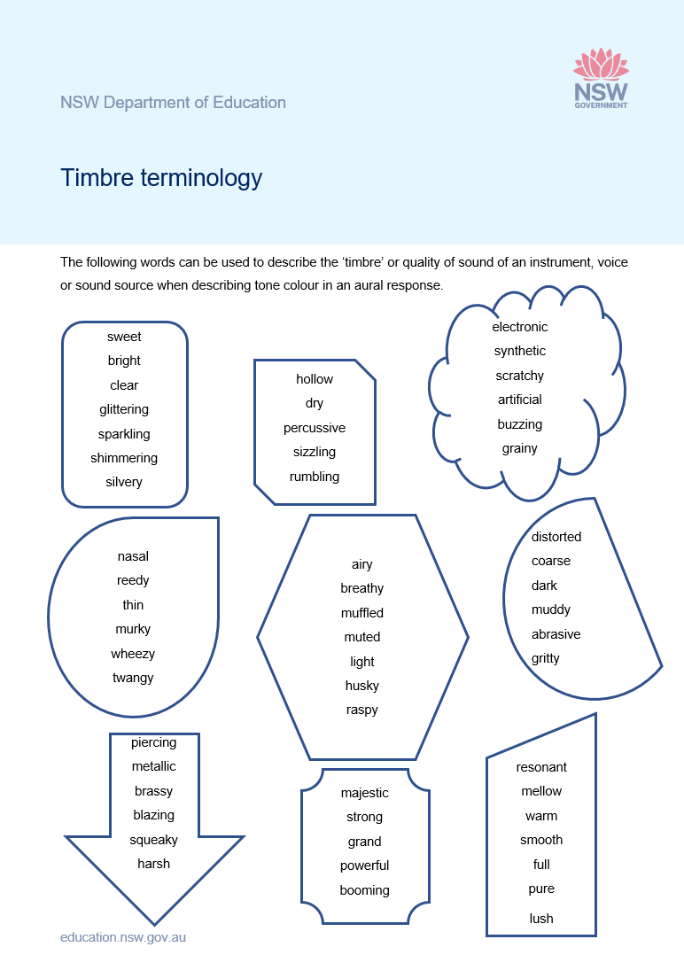
Tone colour – timbre terminology
The timbre terminology words can be used to describe the ‘timbre’ or quality of sound of an instrument, voice or sound source when describing tone colour in an aural response.
Download the ‘Timbre terminology’ resource (DOCX 234 KB).

Slide 38
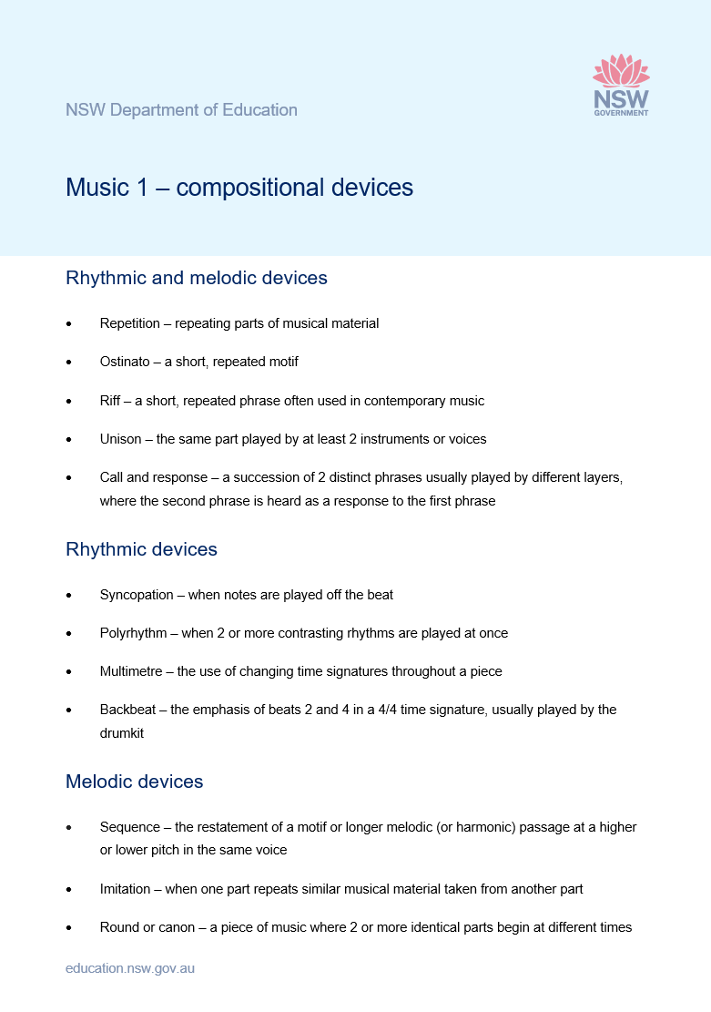
Compositional devices
Access the ‘Music 1– compositional devices’ resource (DOCX 220 KB) to reference when analysing a piece of music.

Slide 39
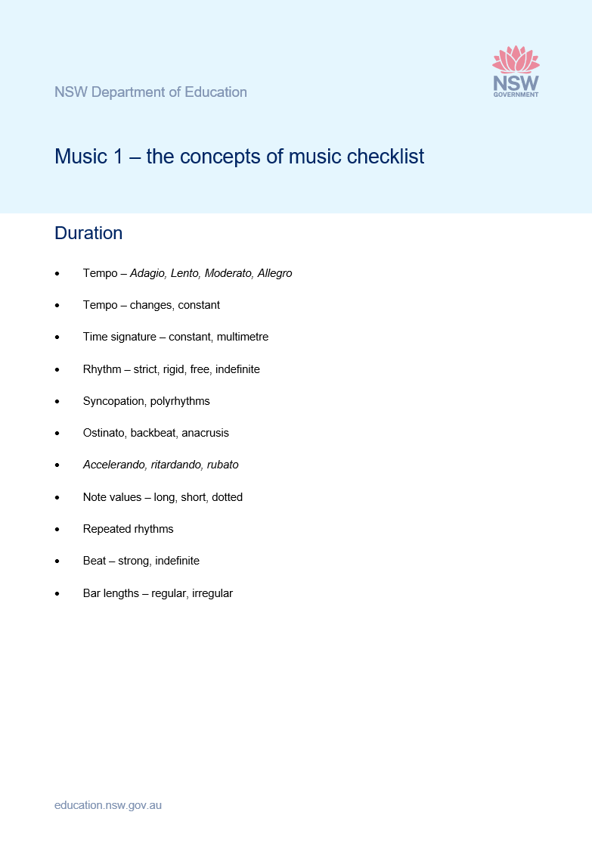
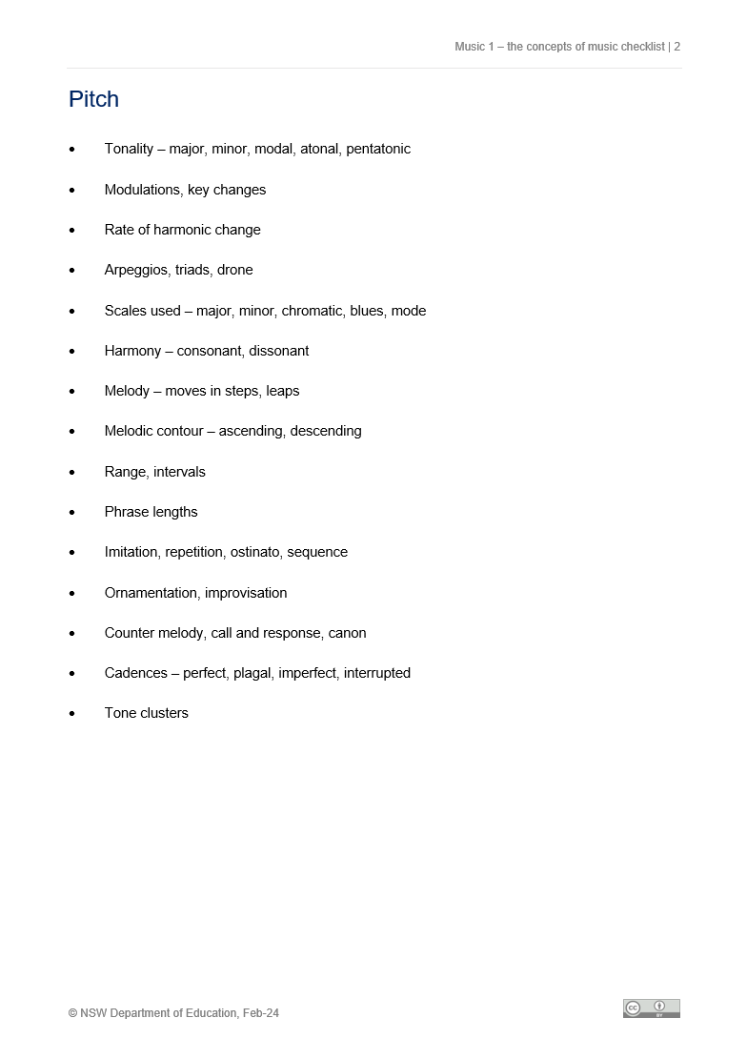
The concepts of music checklist
The concepts of music checklist can be used for reference when analysing a piece of music.
Download the Music 1 concepts of music checklist (DOCX 221 KB).

Slide 40
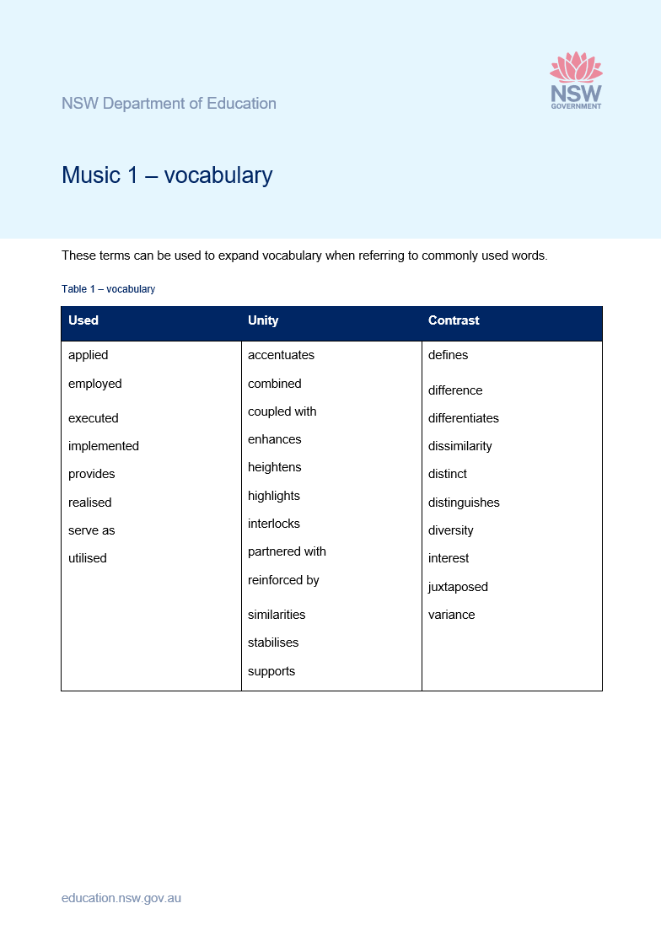
Vocabulary
These terms can be used to expand vocabulary when referring to commonly used words.
Download the ‘Music 1 vocabulary’ resource (DOCX 216 KB).

Slide 41
References
This presentation contains NSW Curriculum and syllabus content. The NSW Curriculum is developed by the NSW Education Standards Authority. This content is prepared by NESA for and on behalf of the Crown in the right of the State of New South Wales. The material is protected by Crown copyright.
Please refer to the NESA Copyright Disclaimer for more information https://educationstandards.nsw.edu.au/wps/portal/nesa/mini-footer/copyright.
NESA holds the only official and up-to-date versions of the NSW Curriculum and syllabus documents. Please visit the NSW Education Standards Authority (NESA) website https://educationstandards.nsw.edu.au/wps/portal/nesa/home and the NSW Curriculum website https://curriculum.nsw.edu.au.
Creative arts 11–12 © Syllabus NSW Education Standards Authority (NESA) for and on behalf of the Crown in right of the State of New South Wales, 2024.

Slide 42
Copyright
© State of New South Wales (Department of Education), 2023
The copyright material published in this resource is subject to the Copyright Act 1968 (Cth) and is owned by the NSW Department of Education or, where indicated, by a party other than the NSW Department of Education (third-party material).
Copyright material available in this resource and owned by the NSW Department of Education is licensed under a Creative Commons Attribution 4.0 International (CC BY 4.0) licence.
This licence allows you to share and adapt the material for any purpose, even commercially.
Attribution should be given to © State of New South Wales (Department of Education), 2023.
Material in this resource not available under a Creative Commons licence:
the NSW Department of Education logo, other logos and trademark-protected material
Material owned by a third party that has been reproduced with permission. You will need to obtain permission from the third party to reuse its material.
Links to third-party material and websites
Please note that the provided (reading/viewing material/list/links/texts) are a suggestion only and implies no endorsement, by the New South Wales Department of Education, of any author, publisher, or book title. School principals and teachers are best placed to assess the suitability of resources that would complement the curriculum and reflect the needs and interests of their students.
If you use the links provided in this document to access a third party’s website, you acknowledge that the terms of use, including licence terms set out on the third-party’s website apply to the use which may be made of the materials on that third-party website or where permitted by the Copyright Act 1968 (Cth). The department accepts no responsibility for content on third-party websites.

