Slide 1

Writing about music in Stage 6
Module 1 – unpacking the Music 1 aural skills paper
‘earphones on a laptop’ by pxfuel is licensed under the pxfuel Terms Of Use.

Slide 2
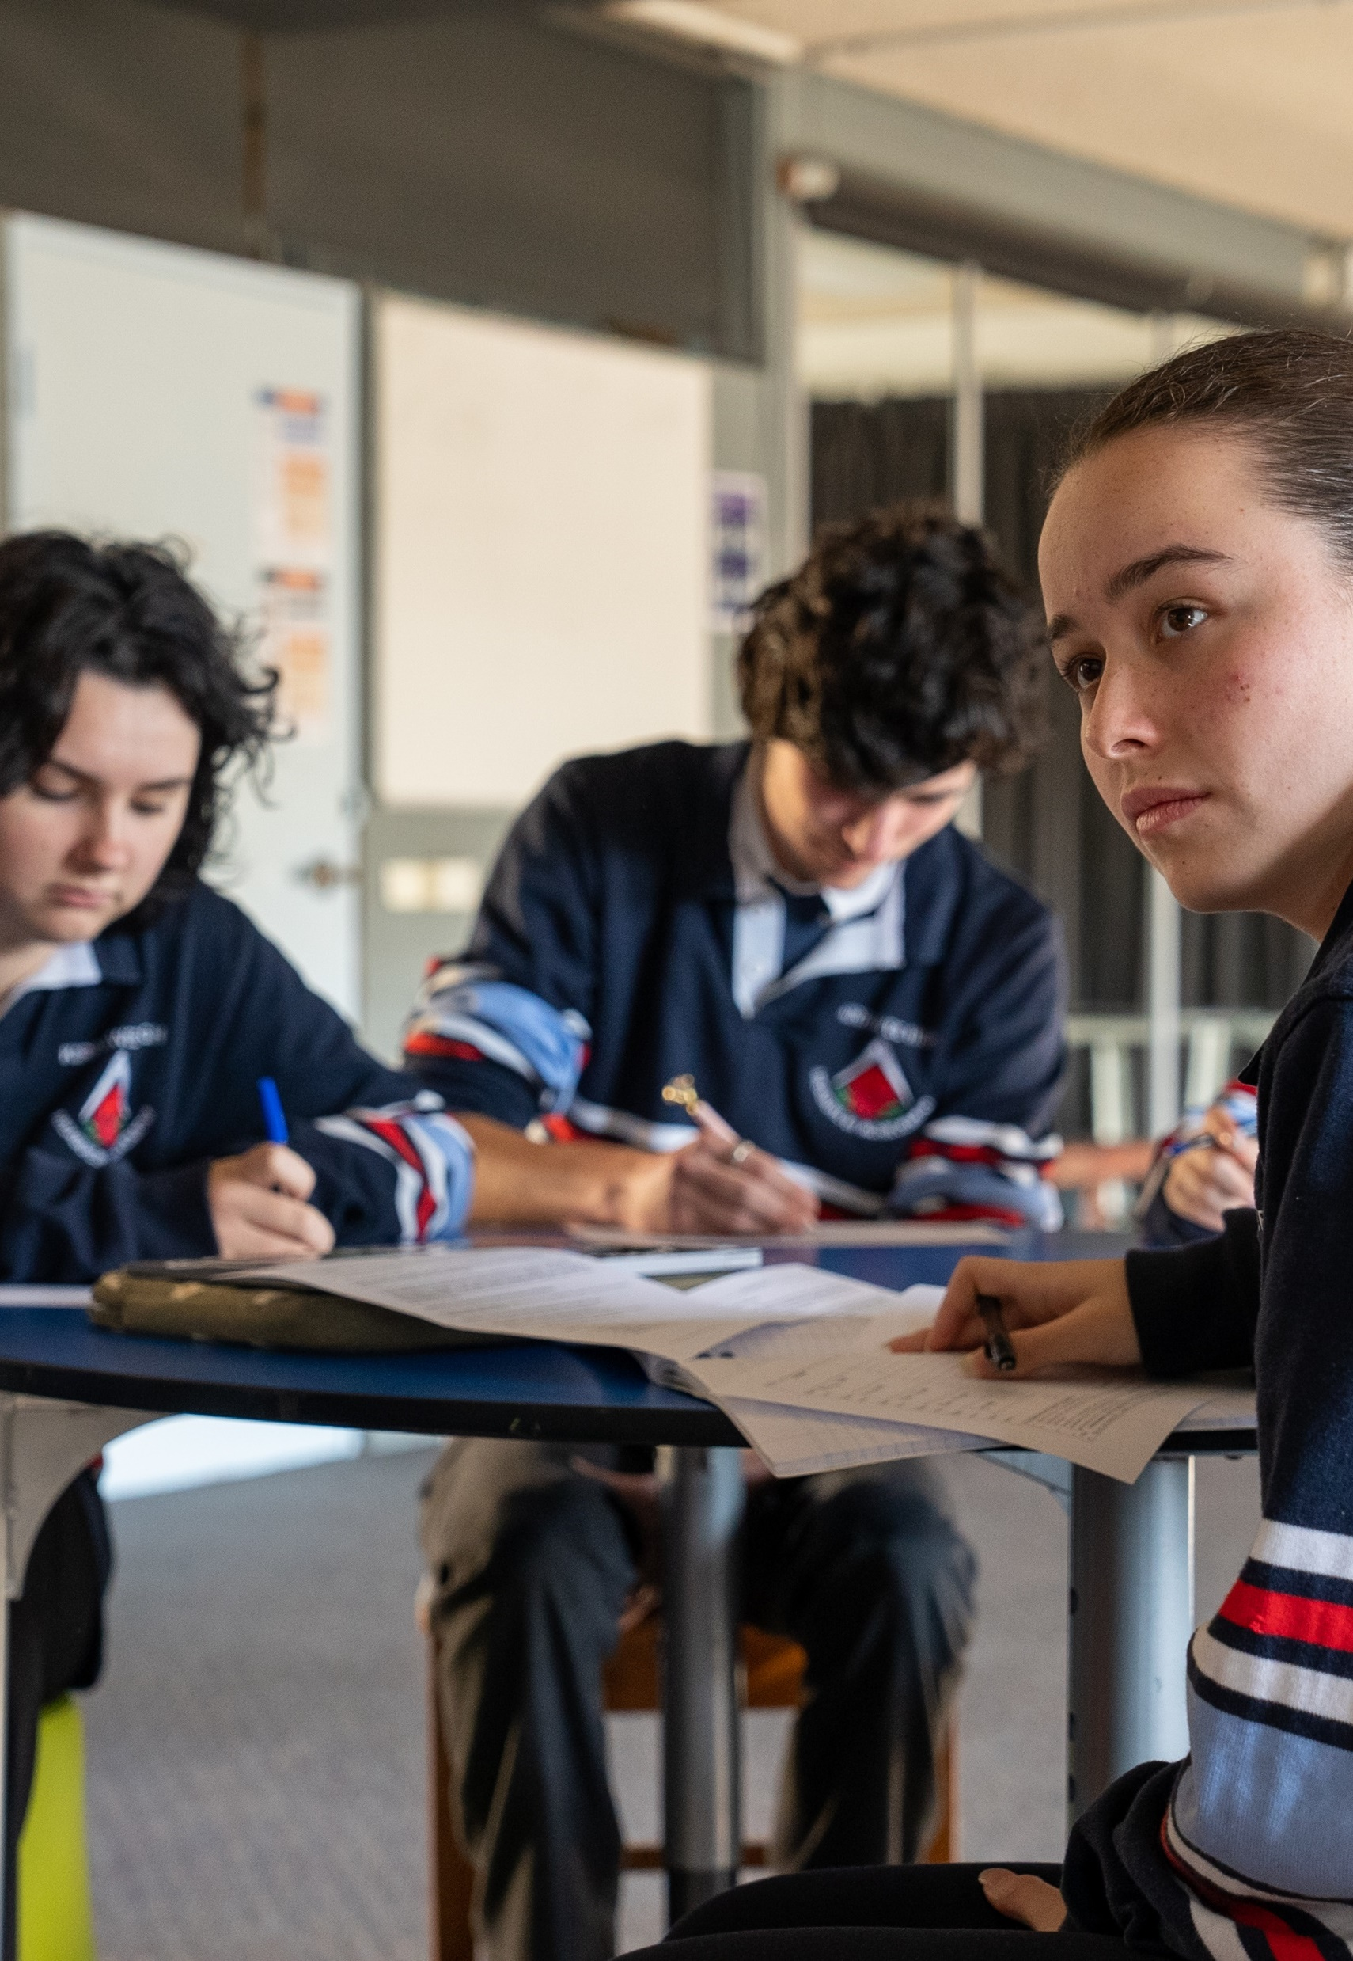
Contents
Module 1 – unpacking the Music 1 aural skills paper
Items | Slide number
The Music 1 aural skills paper | 3
Do you know what the paper contains? | 4
Question examples | 5
Types of questions | 6
What creates ... | 7
What genres or styles of music are used in the paper? | 8
Activities | 9
Tips for the aural examination | 10

Slide 3
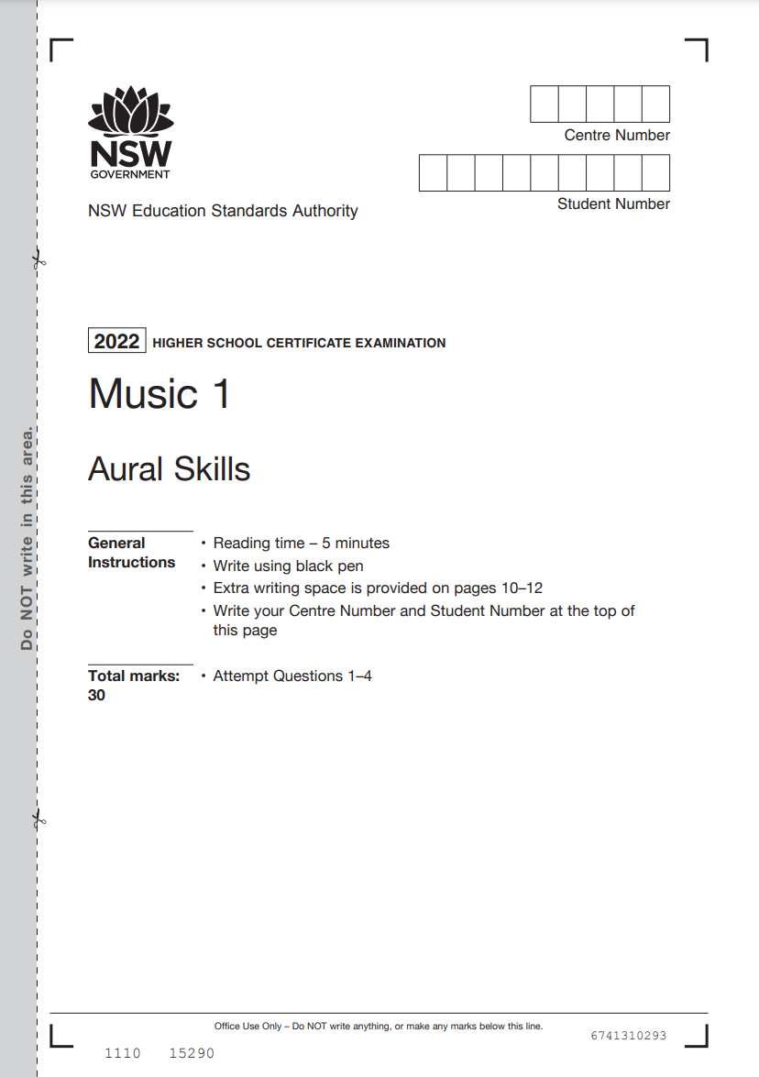
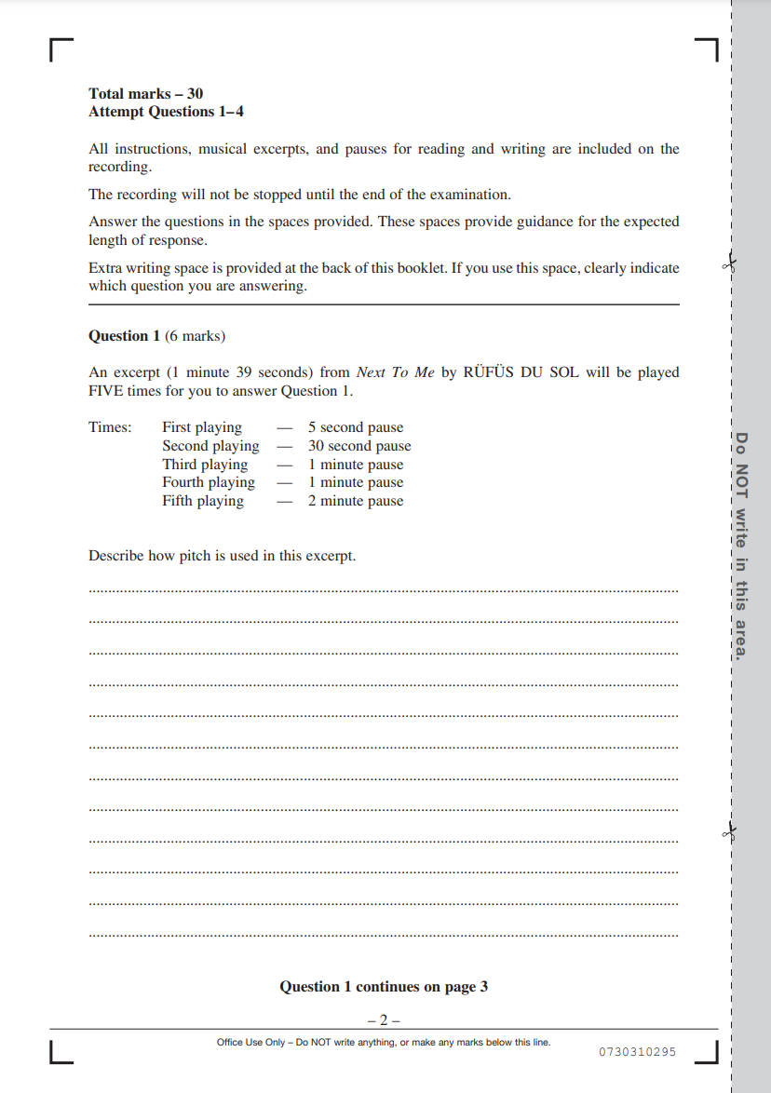
The Music 1 aural skills paper
Past HSC Music 1 aural skills papers can be accessed from the NESA website. Take some time to review some past HSC Music 1 papers to familiarise yourself with the paper.
NESA HSC past exam papers © NSW Education Standards Authority (NESA) for and on behalf of the Crown in right of the State of New South Wales, 2021.

Slide 4
Do you know what the paper contains?
There are 4 questions.
The aural skills written examination is worth 30 marks.
Each question will ask you to analyse the excerpt according to a particular concept(s) of music or point of discussion such as tension, interest, contrast or unity.
For each question, the musical excerpt will be played 4–6 times, with time in between each playing.
Question 1 is out of 6 marks.
Some questions may contain a comparative analysis between 2 different pieces.
Questions will relate to musical excerpts reflecting the range of topics offered for study.
Questions 2–4 are out of 8 marks each.

Slide 5
Question examples
Take a moment to reflect on some questions from past HSC papers
Describe the structure of this excerpt, with reference to its performing media.
Explore the use of dynamics and expressive techniques, and tone colour in this excerpt.
Explain how tension is created in this excerpt.
Analyse how musical interest is achieved in this excerpt. In your answer, make reference to duration and one other concept of music.
Explain how duration is used in this excerpt.
Explore the use of pitch and dynamics and expressive techniques in this excerpt.
Describe how the use of technology has affected tone colour and texture in this excerpt.
Analyse the use of both unity and contrast in this work.
NESA HSC past exam papers © NSW Education Standards Authority (NESA) for and on behalf of the Crown in right of the State of New South Wales, 2021.

Slide 6
Types of questions
There are a range of different types of questions found in the aural skills HSC paper.
Single concept | Multiple concepts | Unity, contrast, variety and interest | Tension | Comparative analysis
These questions are based on a single concept of music. | These questions refer to more than one concept of music or how 2 concepts relate to each other. | These questions refer to what stays the same and what changes in the music. | These questions are based on what causes a build and/or release in the music. | These questions require identification of the similarities and differences between 2 versions of the same piece.
Example | Example | Example | Example | Example
Explain how duration is used in this excerpt. | Explore the use of dynamics and expressive techniques, and tone colour in this excerpt. | Analyse the use of both unity and contrast in this work. | Explain how tension is created in this excerpt. | Compare how tone colour is explored in the 2 versions of ‘Passepied’ by Debussy. Version one is performed by the Punch Brothers. Version 2 is performed by Super Swing Machine.

Slide 7
What creates…
What should you discuss if the question is based on unity, contrast, interest, climax or tension?
Unity
Contrast
Interest
Climax
Tension
Refer to all concepts of music.
For example:
What are the musical features that remain the same between sections?
Are any of the instruments using rhythmic unison or doubling?
Are there any recurring sections, phrases or repetition?
Refer to all concepts of music. For example:
What musical features change between sections?
What can you hear that is different from the previous section?
What are some contrasting features that occur simultaneously?
Consider all concepts of music. For example:
Identify musical features which are unique or of interest.
Refer to what musical features create contrast.
Consider all concepts of music. For example:
thickening of texture
crescendo dynamic
thickening of harmony or extremes of pitch
accentuated articulation, shortening of note values
accelerando of tempo.
Consider all concepts of music. For example:
dissonant harmony
juxtaposed pitches
increase in rhythmic propulsion
extremes or changes in dynamic, tone colour or duration elements.

Slide 8
What genres or styles of music are used in the paper?
The genres or styles of music found in the Music 1 aural skills paper are representative of the topics studied in the Stage 6 Music 1 course . If you examine the data of the music excerpts found in past HSC papers from 2013–2022, you can see that a wide variety of genres or styles are evident.
It is important to note that many subgenres within each style are evident. For example, in excerpts that used popular music, subgenres such as dance/electronic, alternative/indie and hip hop were included. In the classical examples, this included romantic music and 20th century art music.
Analysing music from a wide variety of styles and genres is essential in preparing for the aural skills examination. It develops familiarity with the language used in each style or genre and supports a breadth of musical knowledge and understanding, so you are prepared for the aural skills examination.
NESA HSC past exam papers © NSW Education Standards Authority (NESA) for and on behalf of the Crown in right of the State of New South Wales, 2021.

Slide 9
Activities
Access the NESA Music 1 HSC aural skills past paper examinations and complete the activities below to get to know the HSC Music 1 past papers
Activity 1 Goose chase | Activity 2 Comparative activity | Activity 3 Engaging with the marking guidelines | Activity 4 Self-reflection | Activity 5 Student as teacher
Find a question that: refers to tone colour refers to duration refers to performing media refers to unity and/or contrast. | Write down question 1 from 3 different papers. Are there any similarities or differences between the questions? Repeat this exercise for questions 2 to 4. | Access an example of past paper marking guidelines. Identify the marking rubrics for each question and highlight the key distinguishing words in each mark range. Which words feature in the A, B, C, D and E mark ranges? | Access the most recent Music 1 HSC exam pack and scroll down to ‘HSC marking feedback’. Select ‘feedback on written examination’ and access the ‘general feedback’. Highlight the points that you are already doing and make a note of the points that you are not yet using for future goal setting. | Create your own HSC Music 1 aural skills question and marking guidelines. You must include: a musical excerpt(s) a carefully considered question that addresses the concept(s) of music and is applicable to the excerpt a marking rubric suggested answers.

Slide 10
Tips for the aural examination
You are strongly encouraged to:​
read all the questions and note the number of times that each excerpt will be played to prepare your answer during reading time
use the given time wisely and make notes in the first playing, especially the structure of the excerpt
write in extended point form and avoid a ‘shopping list’ response
answer the question and support the argument with concise, extensive, accurate and relevant musical observations​
display highly developed aural skills and discuss the concepts of music in detail using subject-specific language
notate rhythms, draw pitch contour or create texture graphs where appropriate
always state where in the excerpt you can hear your musical observation
avoid non-essential material such as personal observations.​

Slide 11
References
This presentation contains NSW Curriculum and syllabus content. The NSW Curriculum is developed by the NSW Education Standards Authority. This content is prepared by NESA for and on behalf of the Crown in the right of the State of New South Wales. The material is protected by Crown copyright.
Please refer to the NESA Copyright Disclaimer for more information https://educationstandards.nsw.edu.au/wps/portal/nesa/mini-footer/copyright.
NESA holds the only official and up-to-date versions of the NSW Curriculum and syllabus documents. Please visit the NSW Education Standards Authority (NESA) website https://educationstandards.nsw.edu.au/wps/portal/nesa/home and the NSW Curriculum website https://curriculum.nsw.edu.au.
Music 11–12 © Syllabus NSW Education Standards Authority (NESA) for and on behalf of the Crown in right of the State of New South Wales, 2024.

Slide 12
Copyright
© State of New South Wales (Department of Education), 2023
The copyright material published in this resource is subject to the Copyright Act 1968 (Cth) and is owned by the NSW Department of Education or, where indicated, by a party other than the NSW Department of Education (third-party material).
Copyright material available in this resource and owned by the NSW Department of Education is licensed under a Creative Commons Attribution 4.0 International (CC BY 4.0) licence.
This licence allows you to share and adapt the material for any purpose, even commercially.
Attribution should be given to © State of New South Wales (Department of Education), 2024.
Material in this resource not available under a Creative Commons licence:
the NSW Department of Education logo, other logos and trademark-protected material
Material owned by a third party that has been reproduced with permission. You will need to obtain permission from the third party to reuse its material.
Links to third-party material and websites
Please note that the provided (reading/viewing material/list/links/texts) are a suggestion only and implies no endorsement, by the New South Wales Department of Education, of any author, publisher, or book title. School principals and teachers are best placed to assess the suitability of resources that would complement the curriculum and reflect the needs and interests of their students.
If you use the links provided in this document to access a third party’s website, you acknowledge that the terms of use, including licence terms set out on the third-party’s website apply to the use which may be made of the materials on that third-party website or where permitted by the Copyright Act 1968 (Cth). The department accepts no responsibility for content on third-party websites.

