Slide 1
Las actividades
Activities
NSW Department of Education

Slide 2
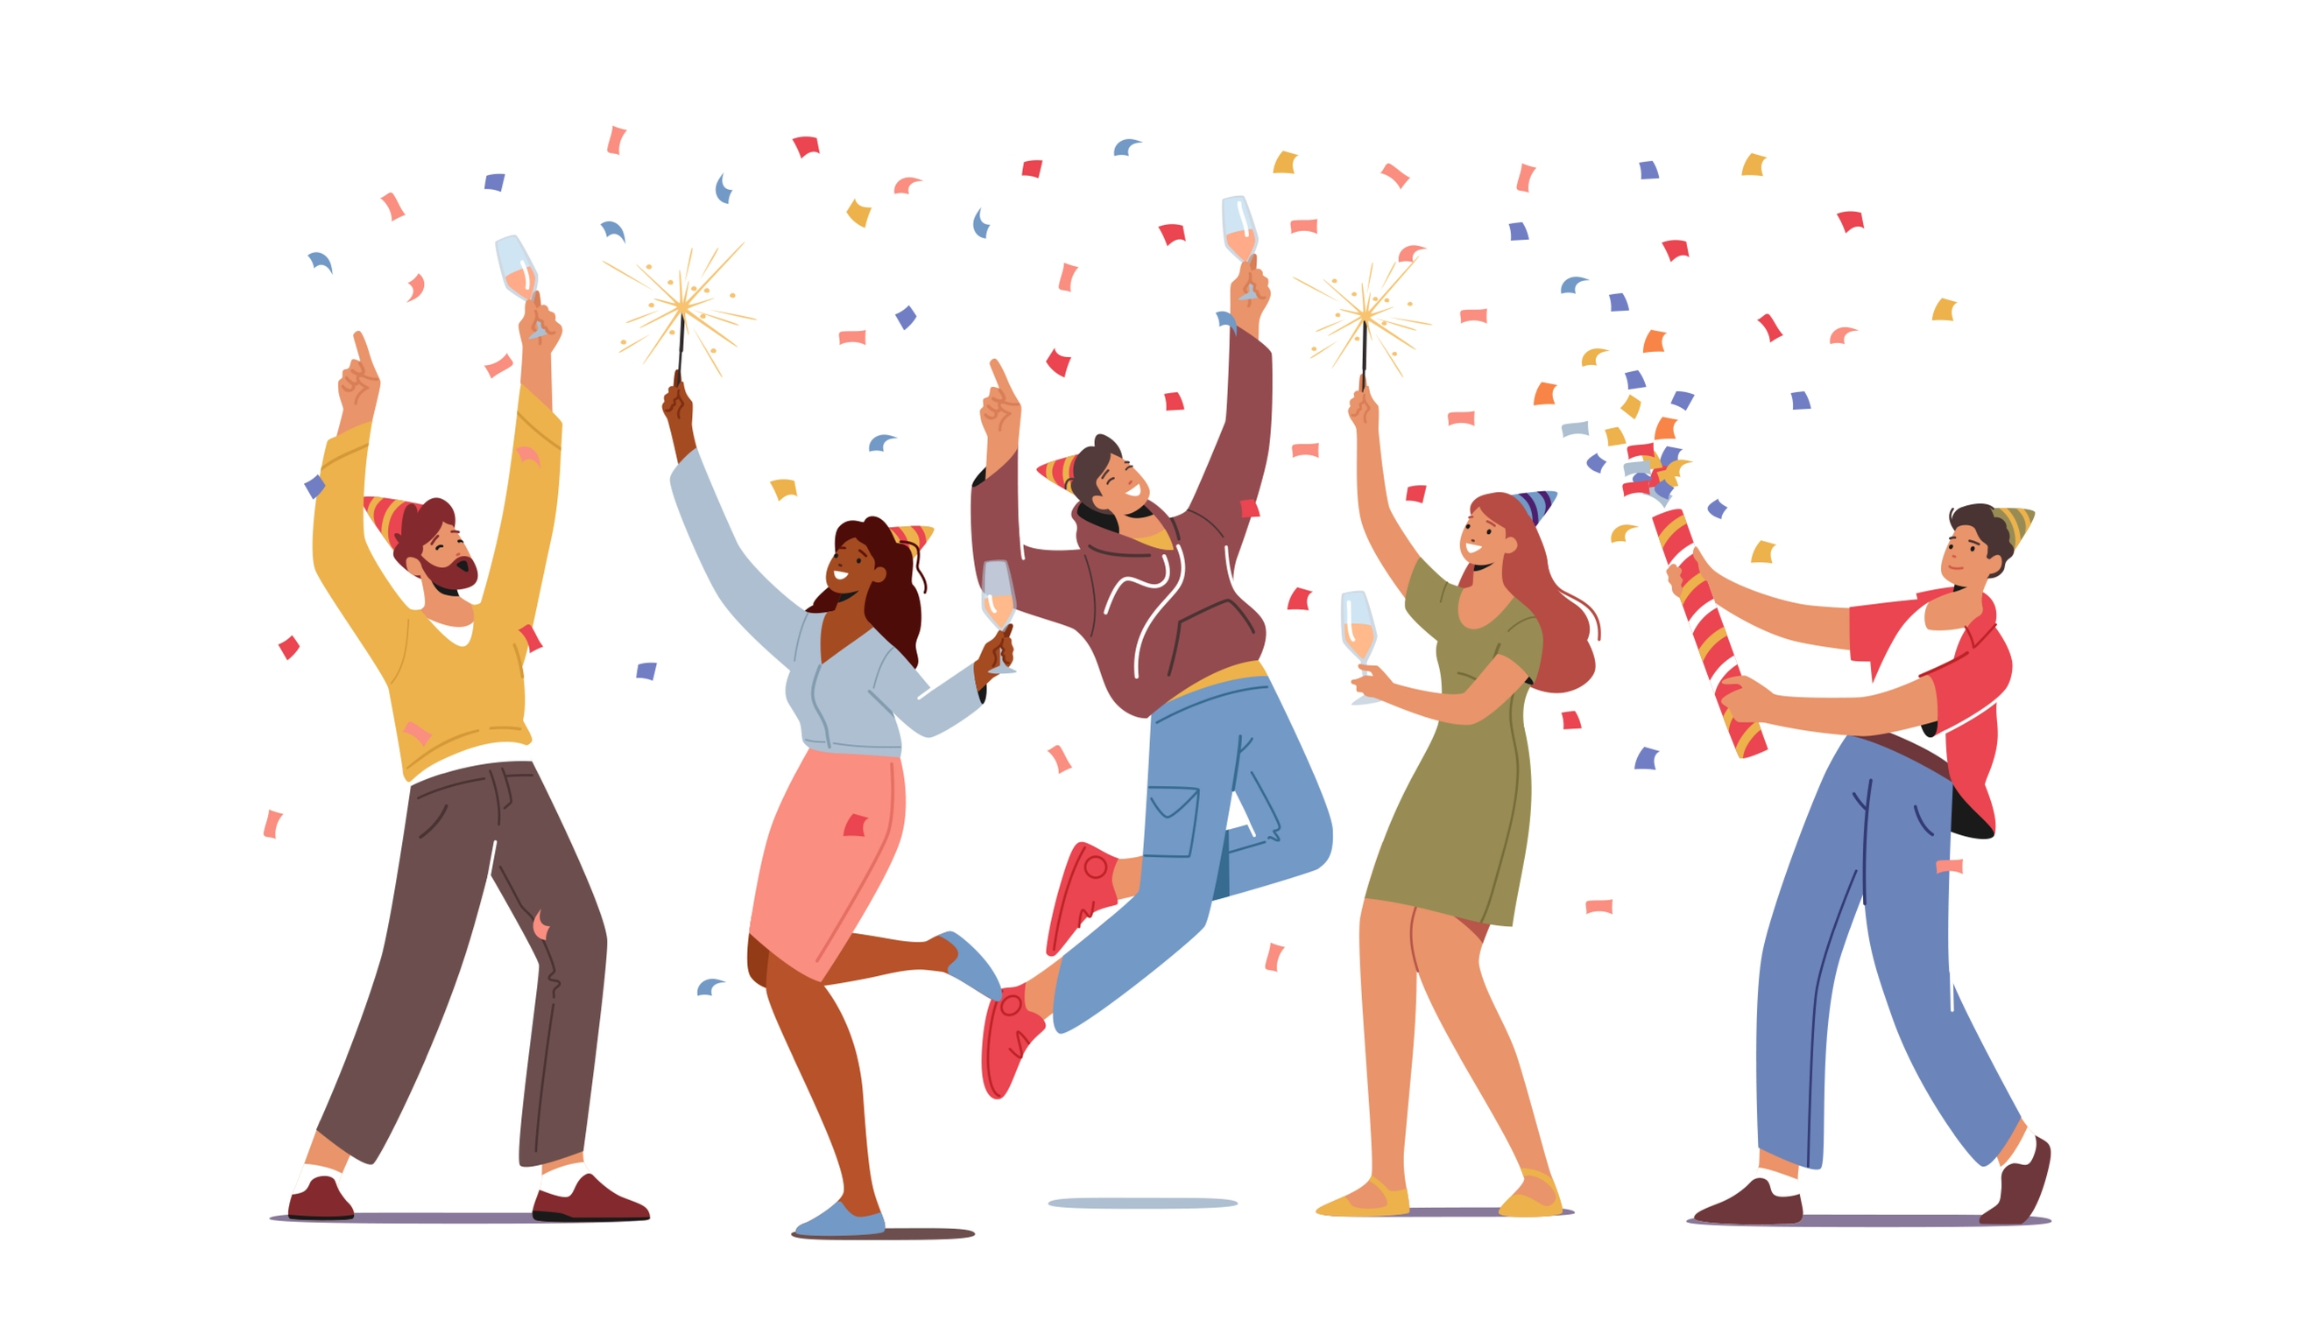
Celebrar
Notes:
celebrar: to celebrate

Slide 3

Bailar
Notes:
bailar: to dance

Slide 4
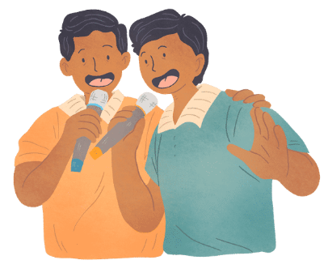
Cantar
Notes:
cantar: to sing

Slide 5
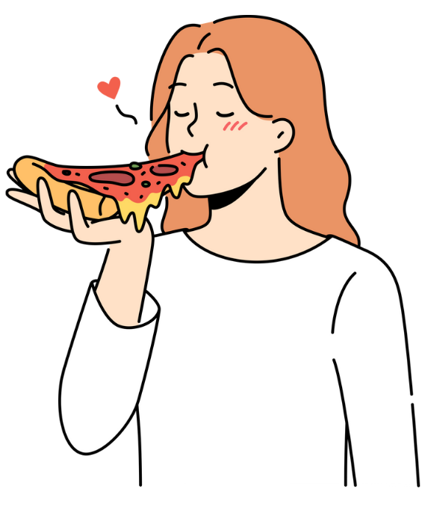
Comer
Notes:
comer: to eat

Slide 6
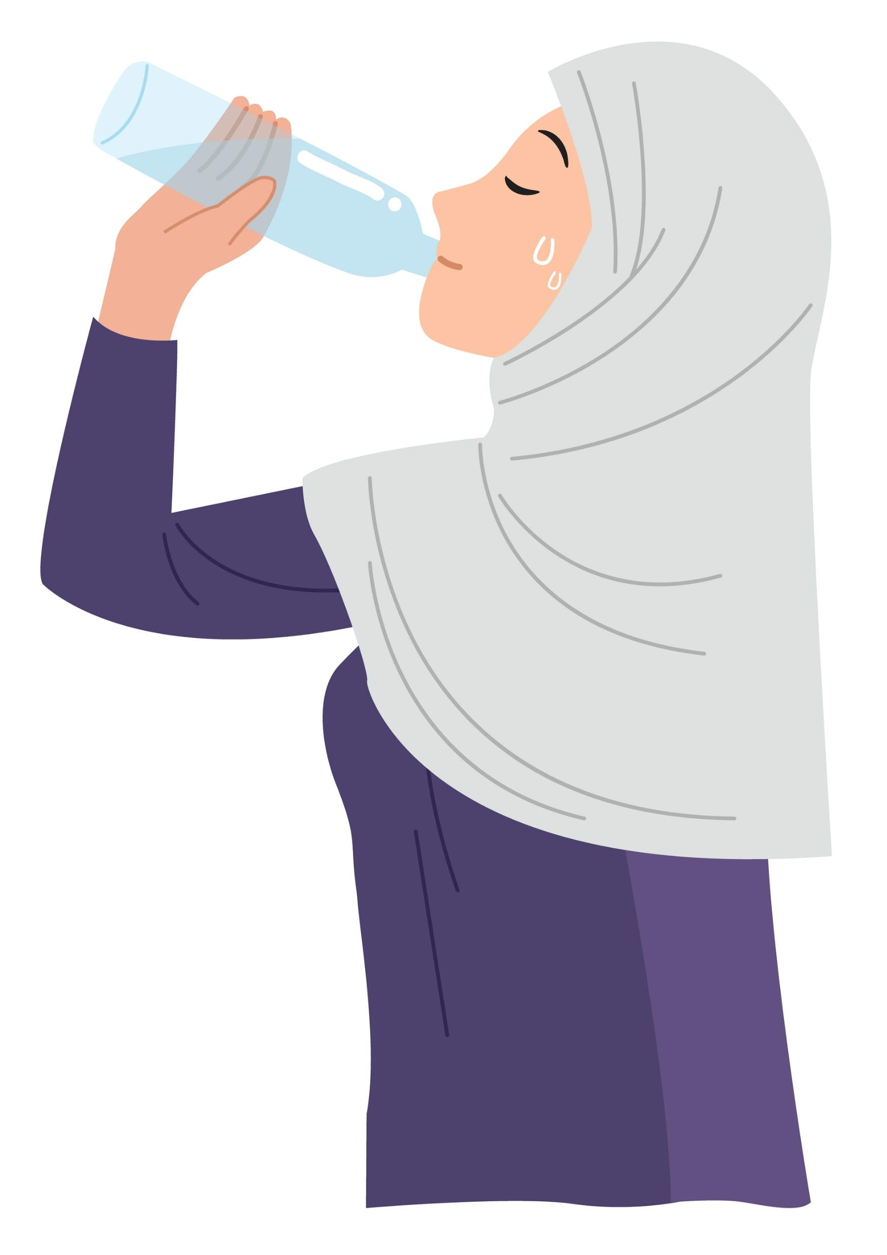
Beber
Notes:
beber: to drink

Slide 7
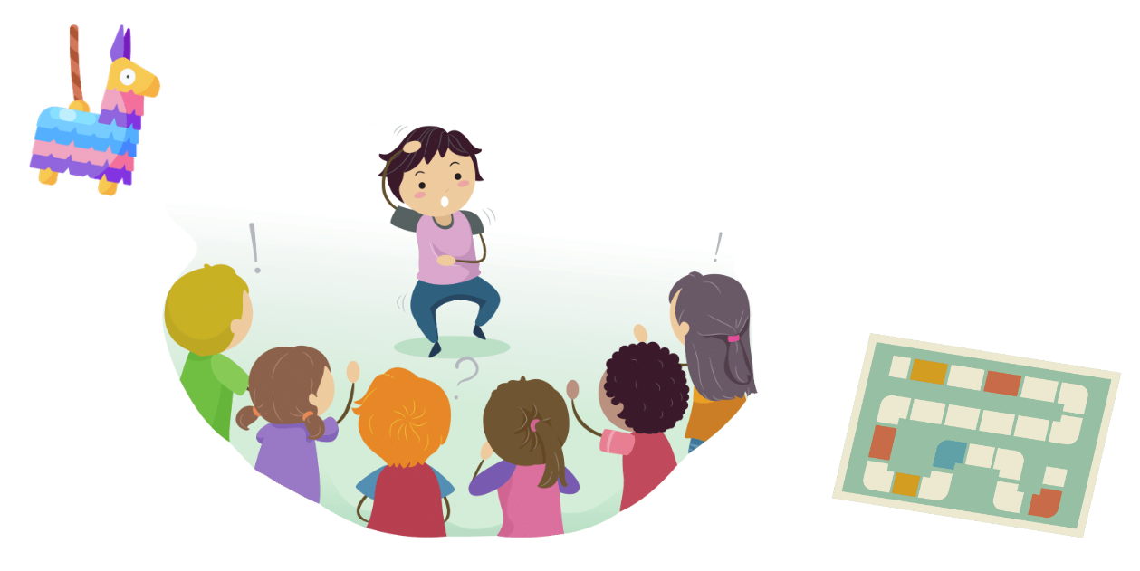
Jugar a juegos
Notes:
jugar a juegos: to play games

Slide 8
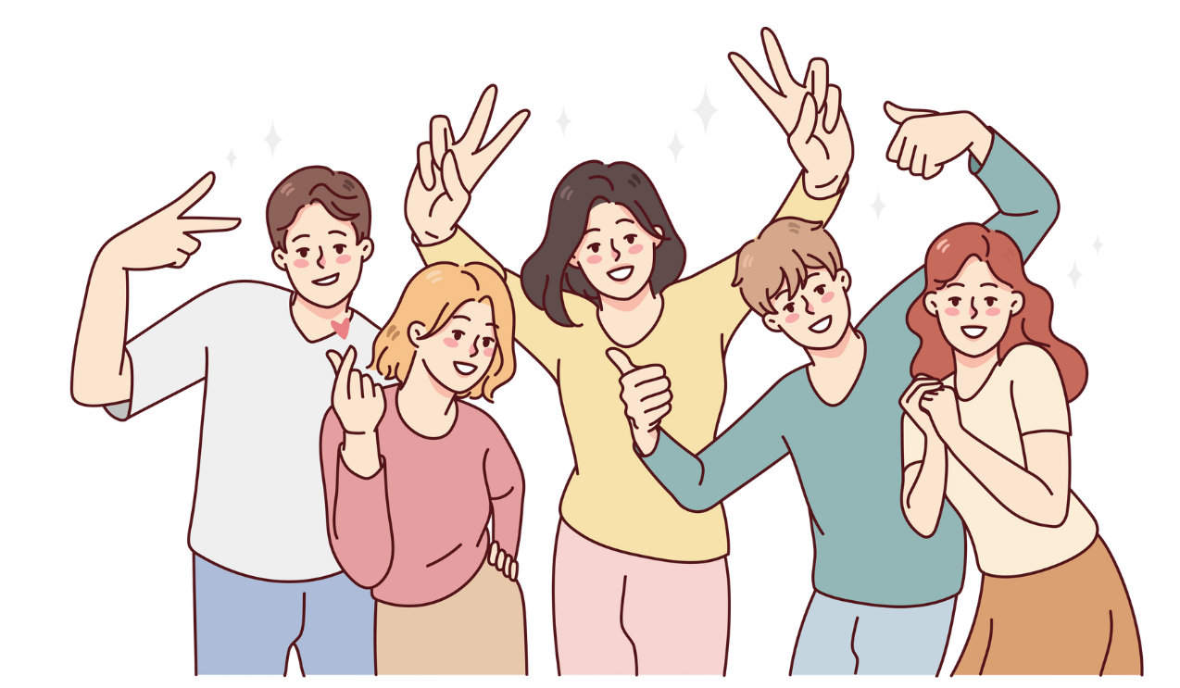
Pasarlo bien
Notes:
pasarlo bien: have a great time
To conjugate – (yo) lo paso bien, (tú) lo pasas bien and so on.

Slide 9
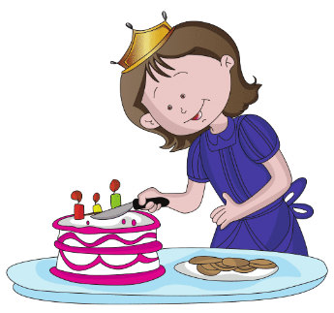
Cortar la torta
Notes:
cortar la torta: cut the cake

Slide 10
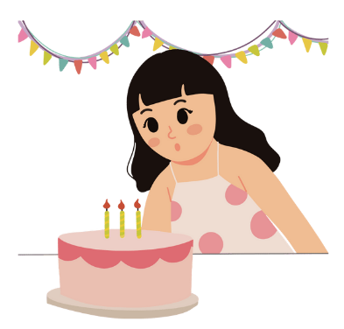
Soplar las velas
Notes:
soplar las velas: blow out the candles

Slide 11
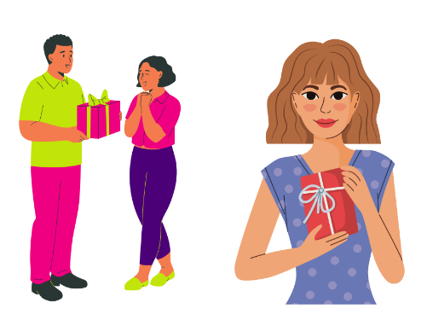
Llevar/recibir regalos
Notes:
llevar/recibir regalos: to bring/receive presents

Slide 12

Ver fuegos artificiales
Notes:
ver fuegos artificiales: watch fireworks

Slide 13
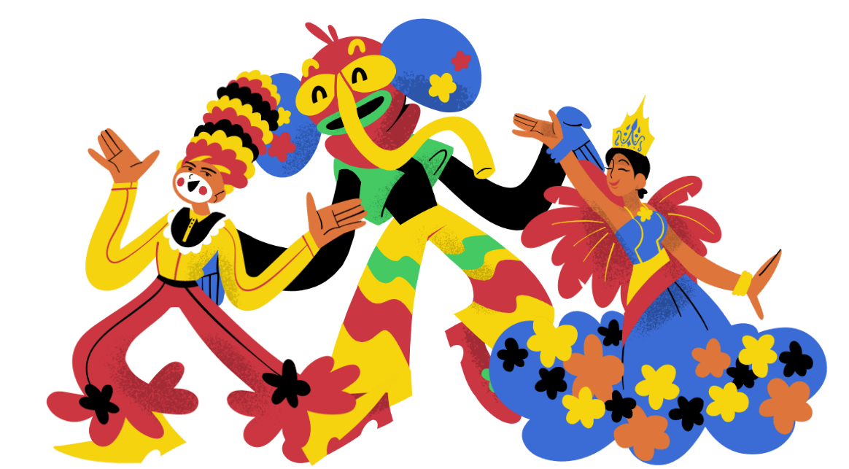
Ver el desfile
Notes:
ver el desfile: watch the parade

Slide 14
Copyright
© State of New South Wales (Department of Education), 2023
The copyright material published in this resource is subject to the Copyright Act 1968 (Cth) and is owned by the NSW Department of Education or, where indicated, by a party other than the NSW Department of Education (third-party material).
Copyright material available in this resource and owned by the NSW Department of Education is licensed under a Creative Commons Attribution 4.0 International (CC BY 4.0) licence.
This licence allows you to share and adapt the material for any purpose, even commercially.
Attribution should be given to © State of New South Wales (Department of Education), 2023.
Material in this resource not available under a Creative Commons licence:
the NSW Department of Education logo, other logos and trademark-protected material
Material owned by a third party that has been reproduced with permission. You will need to obtain permission from the third party to reuse its material.
Links to third-party material and websites
Please note that the provided (reading/viewing material/list/links/texts) are a suggestion only and implies no endorsement, by the New South Wales Department of Education, of any author, publisher, or book title. School principals and teachers are best placed to assess the suitability of resources that would complement the curriculum and reflect the needs and interests of their students.
If you use the links provided in this document to access a third party’s website, you acknowledge that the terms of use, including licence terms set out on the third-party’s website apply to the use which may be made of the materials on that third-party website or where permitted by the Copyright Act 1968 (Cth). The department accepts no responsibility for content on third-party websites.

Slide 15

© State of New South Wales (Department of Education) 2023

