Slide 1
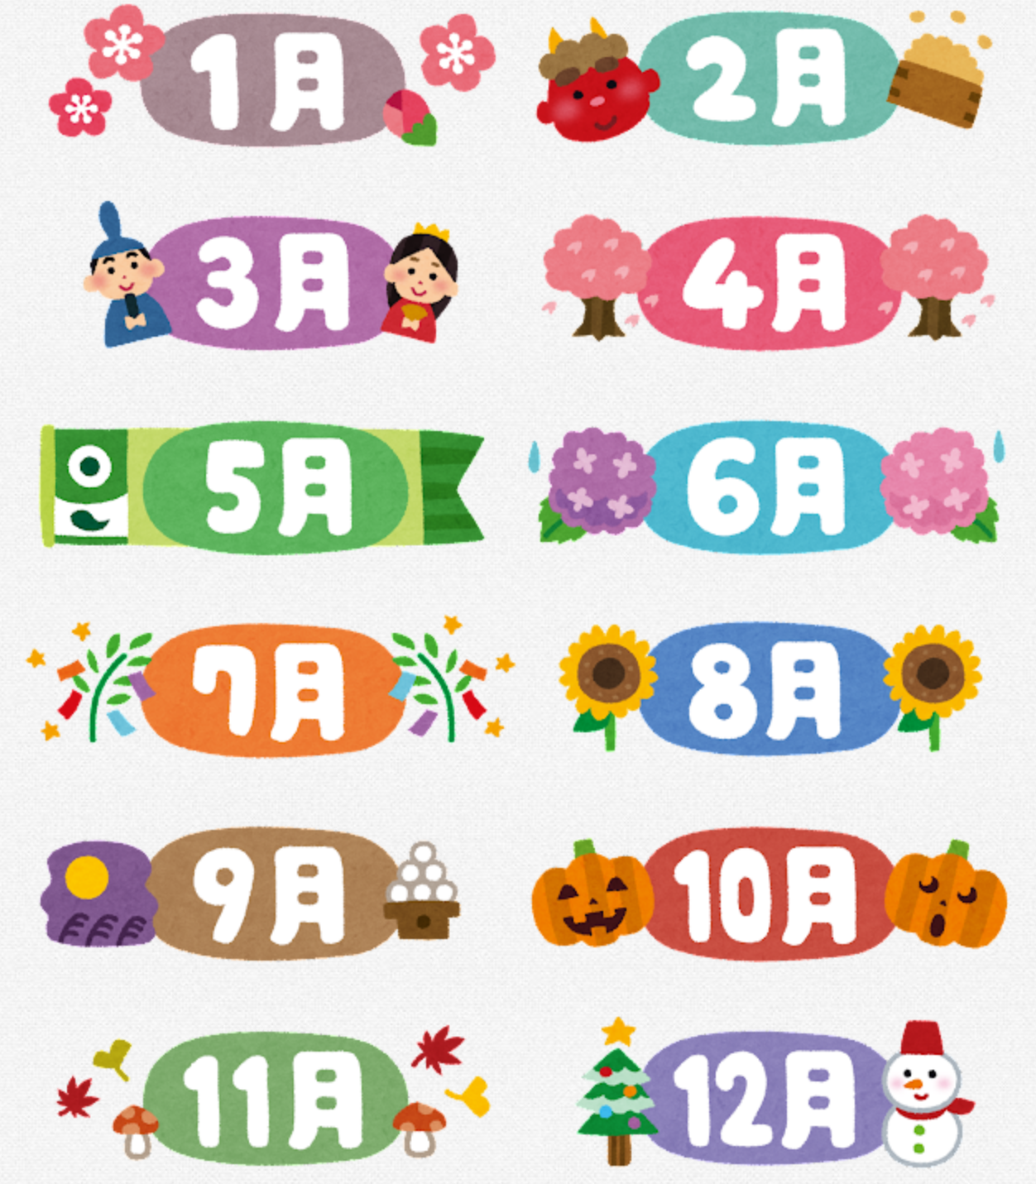
Japanese festivals and seasonal events
NSW Department of Education
Notes:
Images licensed under Irasutoya license

Slide 2
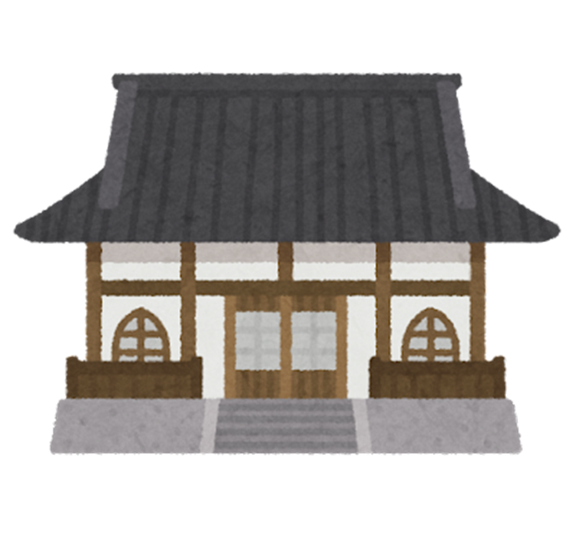
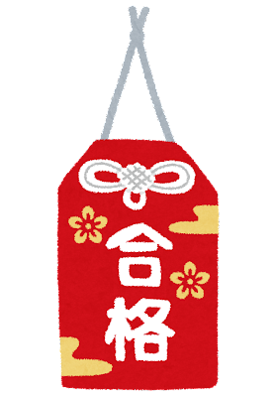
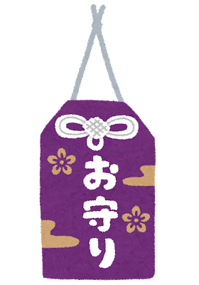
おまもり を かいます。
Notes:
Images licensed under Irasutoya license

Slide 3

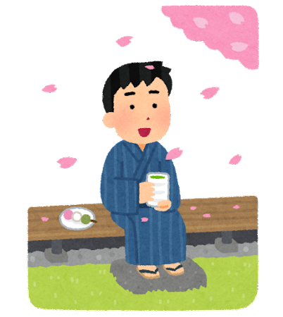
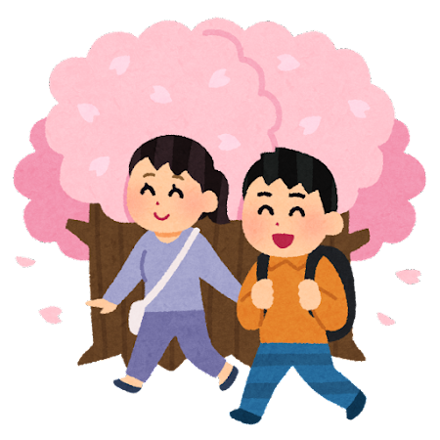

さくら を みます。
Notes:
Images licensed under Irasutoya license

Slide 4

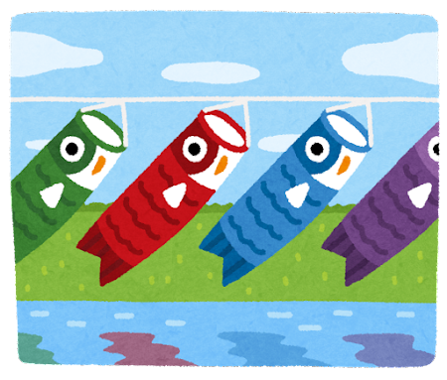

こいのぼり を みます。
Notes:
Images licensed under Irasutoya license

Slide 5
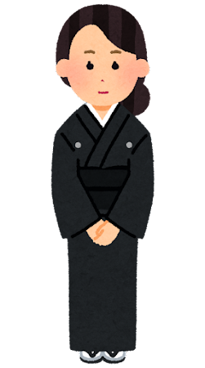
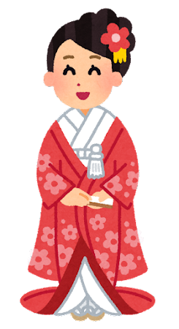
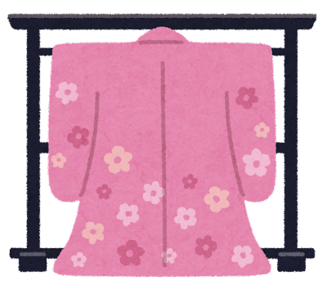
きもの を きます。
Notes:
Images licensed under Irasutoya license

Slide 6
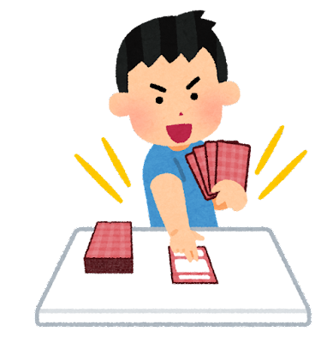
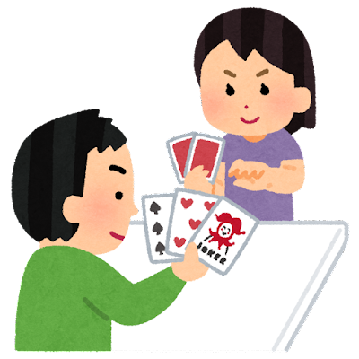
トランプ を します。
Notes:
Images licensed under Irasutoya license

Slide 7
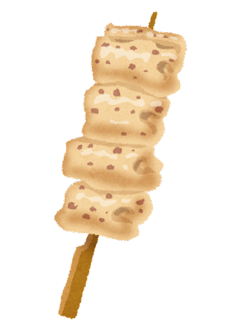
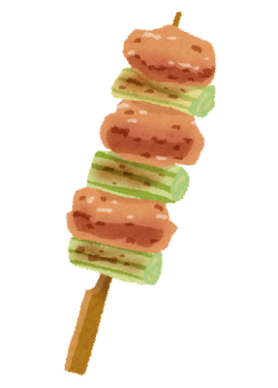

やきとり を たべます。
Notes:
Images licensed under Irasutoya license

Slide 8

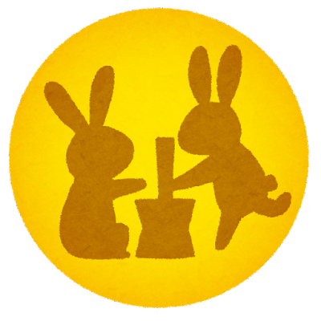
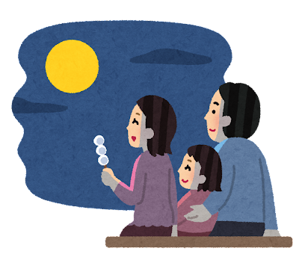
つき を みます。
Notes:
Images licensed under Irasutoya license

Slide 9
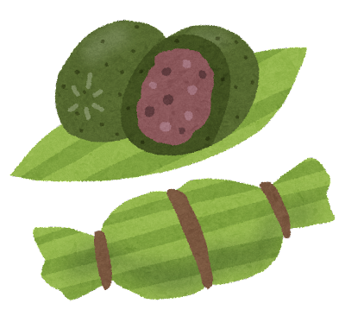
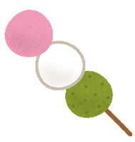


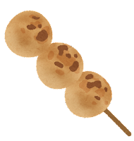
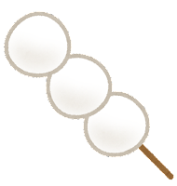


だんご を たべます。
Notes:
Images licensed under Irasutoya license

Slide 10
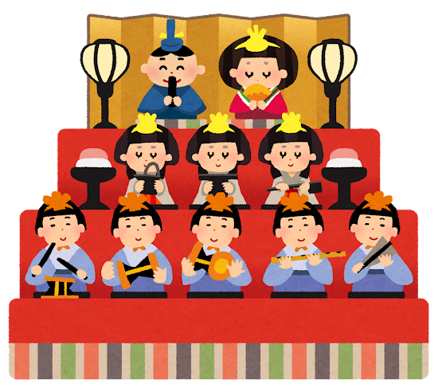
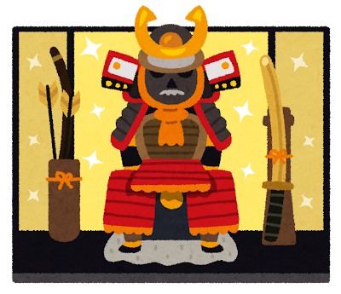
にんぎょう を みます。
Notes:
Images licensed under Irasutoya license

Slide 11


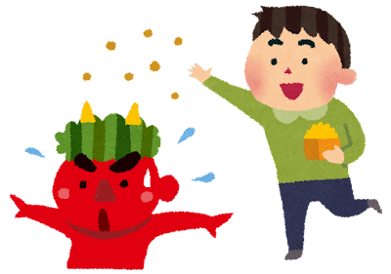
まめまき を します。
Notes:
Images licensed under Irasutoya license

Slide 12

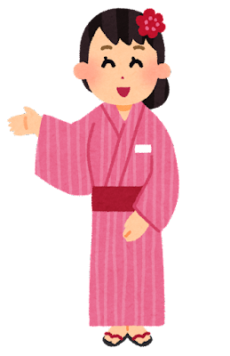
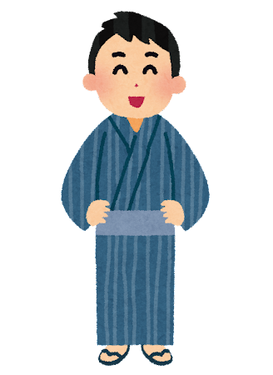
ゆかた を かいます。
Notes:
Images licensed under Irasutoya license

Slide 13

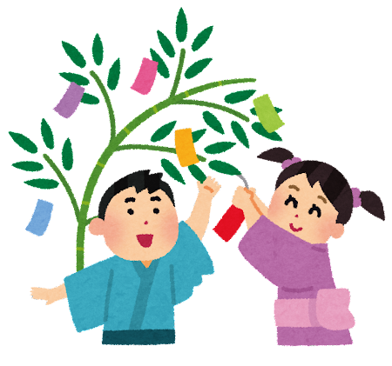
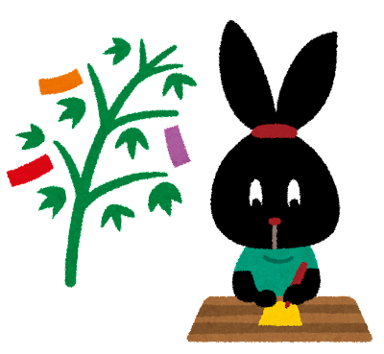
たんざく を かきます。
Notes:
Images licensed under Irasutoya license

Slide 14


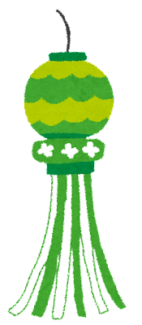
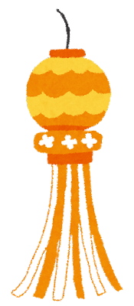
ふきながし を みます。
Notes:
Images licensed under Irasutoya license

Slide 15
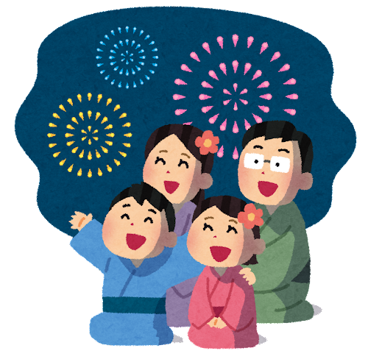
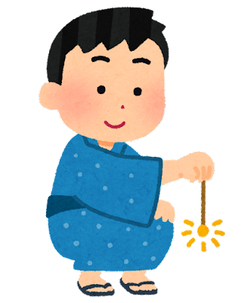
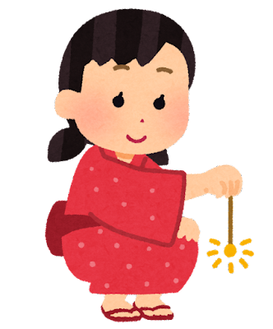
はなび を みます。
Notes:
Images licensed under Irasutoya license

Slide 16
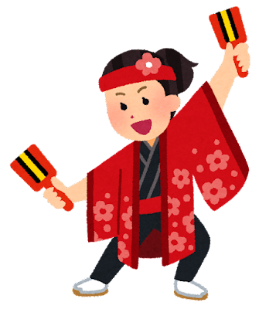
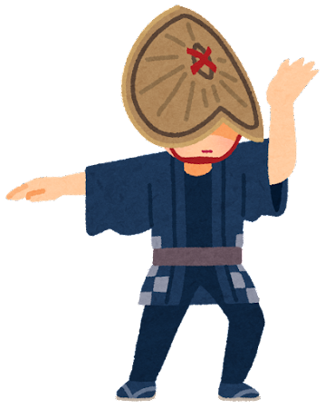
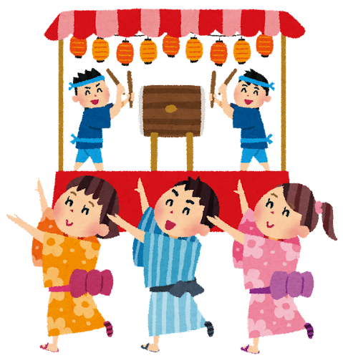
ぼんおどり を します。
Notes:
Images licensed under Irasutoya license

Slide 17

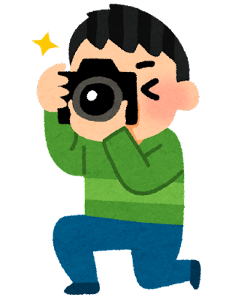
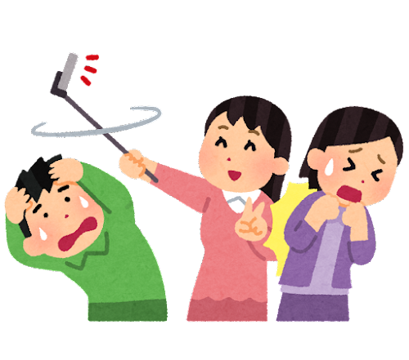
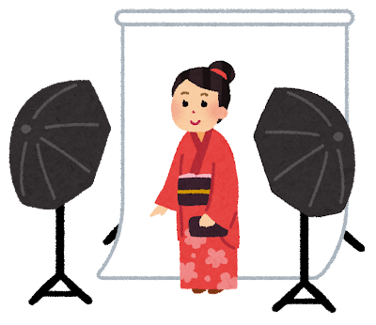
しゃしん を とります。
Notes:
Images licensed under Irasutoya license

Slide 18
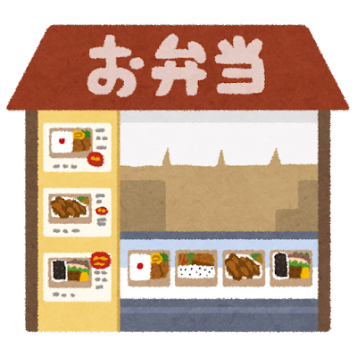


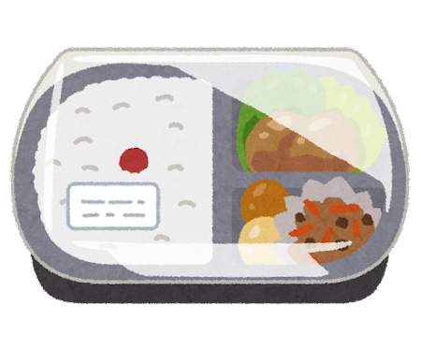
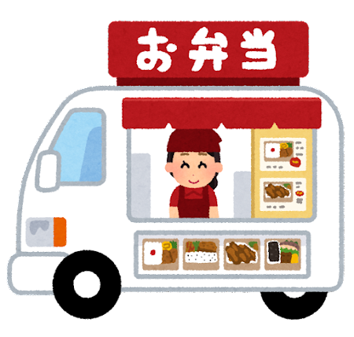
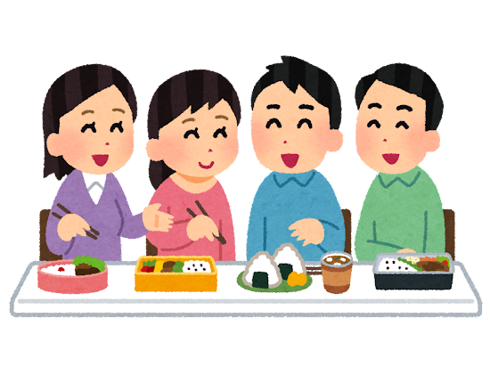
おべんとう を たべます。
Notes:
Images licensed under Irasutoya license

Slide 19




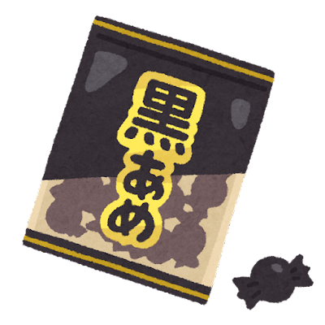

あめ を たべます。
Notes:
Images licensed under Irasutoya license

Slide 20


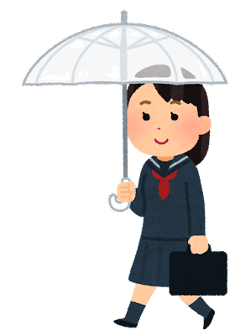
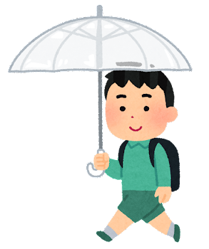

かさ を かいます。
Notes:
Images licensed under Irasutoya license

Slide 21
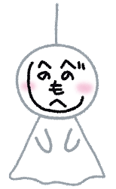
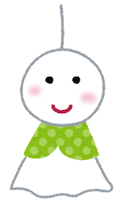
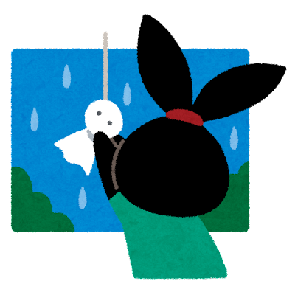


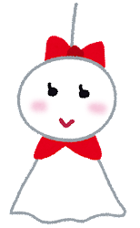

てるてるぼうず を つくります。
Notes:
Images licensed under Irasutoya license

Slide 22
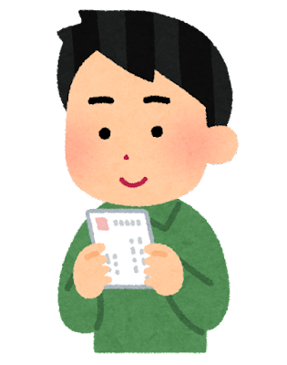





ねんがじょう を かきます。
Notes:
Images licensed under Irasutoya license

Slide 23
Copyright
© State of New South Wales (Department of Education), 2023
The copyright material published in this resource is subject to the Copyright Act 1968 (Cth) and is owned by the NSW Department of Education or, where indicated, by a party other than the NSW Department of Education (third-party material).
Copyright material available in this resource and owned by the NSW Department of Education is licensed under a Creative Commons Attribution 4.0 International (CC BY 4.0) licence.
This license allows you to share and adapt the material for any purpose, even commercially.
Attribution should be given to © State of New South Wales (Department of Education), 2023.
Material in this resource not available under a Creative Commons license:
the NSW Department of Education logo, other logos and trademark-protected material
Material owned by a third party that has been reproduced with permission. You will need to obtain permission from the third party to reuse its material.
Links to third-party material and websites
Please note that the provided (reading/viewing material/list/links/texts) are a suggestion only and implies no endorsement, by the New South Wales Department of Education, of any author, publisher, or book title. School principals and teachers are best placed to assess the suitability of resources that would complement the curriculum and reflect the needs and interests of their students.
If you use the links provided in this document to access a third party’s website, you acknowledge that the terms of use, including licence terms set out on the third-party’s website apply to the use which may be made of the materials on that third-party website or where permitted by the Copyright Act 1968 (Cth). The department accepts no responsibility for content on third-party websites.

Slide 24

© State of New South Wales (Department of Education) 2023

