Slide 1
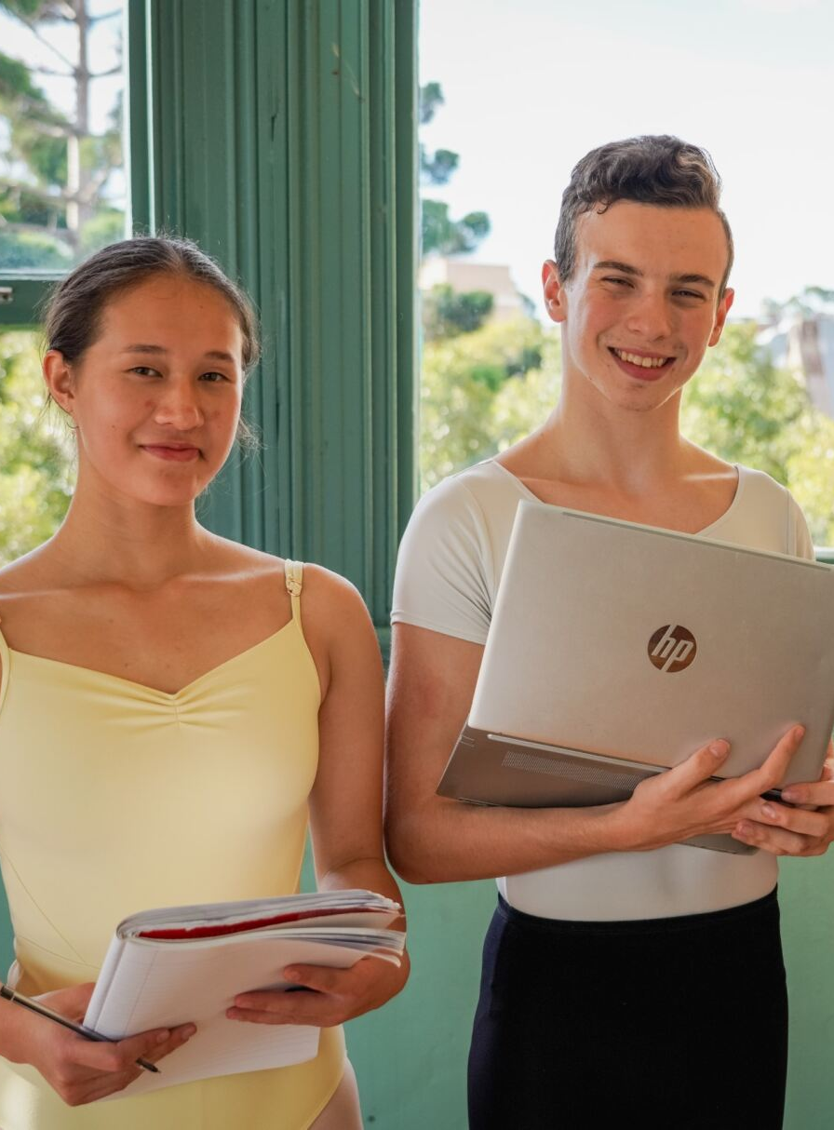
Major study dance and technology
Film and video introduction and overview

Slide 2
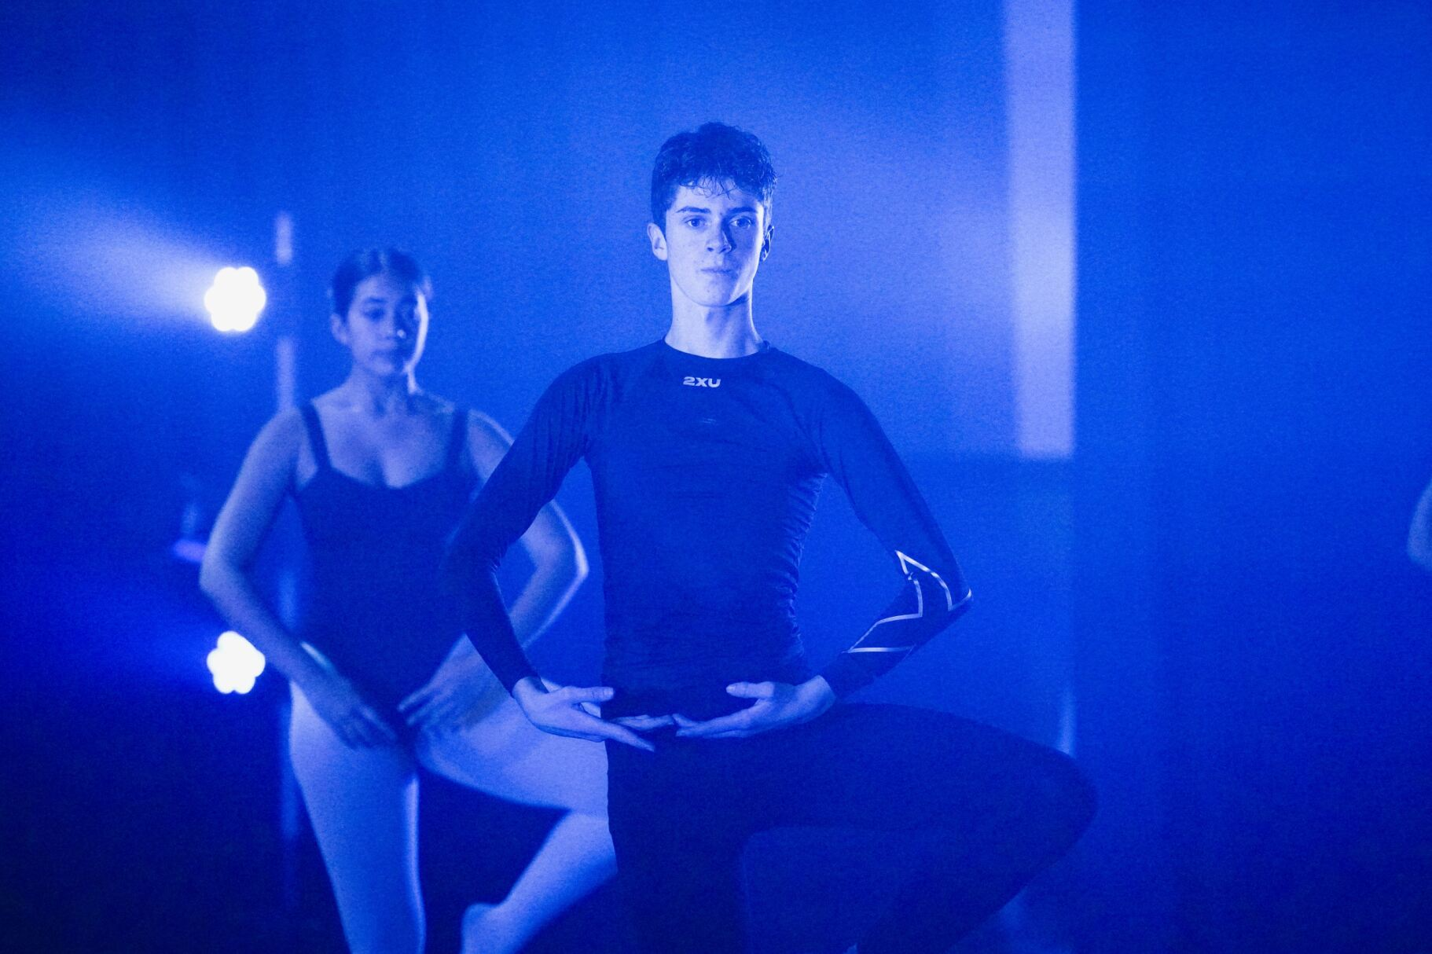
Contents
Major study dance and technology – film and video | Slide number
Introduction | 3
Choreography for 2 or 3 dancers | 5
The use of film and video to create dance works | 7
Unpacking the content points | 9

Slide 3
Introduction
In major study dance and technology – film and video, you will be required to:
create and choreograph a work of 4–6 minutes duration for 2–3 dancers
film and edit the work
present the filmed and edited choreographed work
submit a 300-word rationale for the project
elaborate on the rationale for up to 12 minutes, physically and orally demonstrating your applied knowledge and understanding of the compositional process.
You are not to perform in your own film/video as this major study option is focused on your work behind the camera.
A ‘dance’ and a ‘work’ are differentiated in terms of context/intent. A ‘work’ is a coherent organisation of phrases and sections driven by thematic considerations that create a unified whole.
Dance Stage 6 Syllabus © NSW Education Standards Authority (NESA) for and on behalf of the Crown in right of the State of New South Wales, 2009.
Dance Stage 6 Assessment and Reporting © NSW Education Standards Authority (NESA) for and on behalf of the Crown in right of the State of New South Wales, 2021.

Slide 4
Outcomes
H1.1 understands dance from artistic, aesthetic and cultural perspectives through movement and in written and oral form
H1.2 performs, composes and appreciates dance as an artform
H1.3 appreciates and values dance as an artform through the interrelated experiences of performing, composing and appreciating dances
H1.4 acknowledges and appreciates the relationship of dance and other media
H3.1 identifies and selects the appropriate elements of composition/choreography in response to a specific concept/intent
H3.2 demonstrates the use of the elements of composition/choreography in a personal style in response to a specific concept/intent
H3.3 recognises and values the role of dance in achieving individual expression
H3.4 explores, applies and demonstrates the combined use of compositional principles and technological skills in a personal style in response to a specific concept/intent
Dance Stage 6 Syllabus © NSW Education Standards Authority (NESA) for and on behalf of the Crown in right of the State of New South Wales, 2009.

Slide 5

Choreography for 2 or 3 dancers
1
Area of study 1

Slide 6
Area of study 1 (1 of 2)
Overview
In choreographing movement for 2 or 3 dancers, you are to demonstrate the ability to compose and organise movement in a personal style based on a concept/intent. This should be physically demonstrated in the ‘work’ and stated in the rationale.
To best approach the choreography for the work, you should apply your knowledge of the compositional process as outlined in the Dance Stage 6 Syllabus areas of study, including:
manipulation of the elements of dance as they relate to dance choreography
generating movement as it relates to dance choreography
organising the movement as it relates to dance choreography
organising the work (form/structure).
Dance Stage 6 Assessment and Reporting © NSW Education Standards Authority (NESA) for and on behalf of the Crown in right of the State of New South Wales, 2021.
Dance Stage 6 Syllabus © NSW Education Standards Authority (NESA) for and on behalf of the Crown in right of the State of New South Wales, 2009.

Slide 7

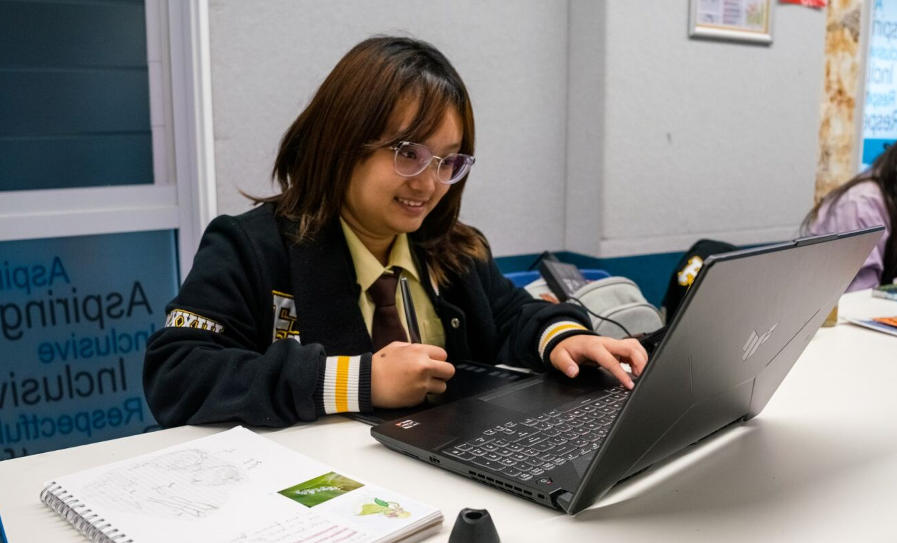
Area of study 1 (2 of 2)
Overview continued
It is important to consider the filming and editing techniques that could be used to support your concept/intent throughout the choreographic process.
In this module, syllabus content related to this area of study will be marked with the blue logo in the top right hand corner.

Slide 8

The use of film and video to create dance works
2
Area of study 2

Slide 9
Area of study 2 (1 of 2)
Overview
In using film/video to create a dance work for 2 or 3 dancers, you are to film movement in a personal style based on a concept/intent. You will also need to organise and edit the work to support the concept/intent demonstrated in the movement and stated in the rationale. This is to be done in conjunction with any additional considerations that may arise from the intent of the work, within the context of the study of dance as an artform in the film medium.
To use film/video to create a dance work, apply your understanding of:
the types and functions of dance on film/video
a study of examples
choreographic considerations
filming and editing considerations
additional considerations that arise from the intent of the work.
Dance Stage 6 Assessment and Reporting © NSW Education Standards Authority (NESA) for and on behalf of the Crown in right of the State of New South Wales, 2021.
Dance Stage 6 Syllabus © NSW Education Standards Authority (NESA) for and on behalf of the Crown in right of the State of New South Wales, 2009.

Slide 10
Area of study 2 (2 of 2)
Overview
Additional considerations that may arise from the intent of the work include manipulating simple and appropriate setting, costumes and/or props for 2 or 3 dancers and the appropriate choice of accompaniment/non-accompaniment.
In this module, syllabus content related to this area of study will be marked with the pink logo in the top right hand corner.
Dance Stage 6 Assessment and Reporting © NSW Education Standards Authority (NESA) for and on behalf of the Crown in right of the State of New South Wales, 2021.

Slide 11
Unpacking the content points
3
Information and activities for content points across both areas of study

Slide 12
Analysis of the types and functions of dance on film/video
There are many ways to document dance on film, all of which have a different purpose or function. Dance can be:
filmed for archival or restaging purposes
recreated for film/video entertainment
choreographed for film/video
fused with the film/video medium (film/video and dance are used to enhance each other)
recorded as part of a video clip to enhance musical performance.
For your major study film and video, you will be required to choreograph dance specifically for the film/video medium. This means that the movement is filmed and edited in a way that further supports a concept/intent.
Dance Stage 6 Syllabus © NSW Education Standards Authority (NESA) for and on behalf of the Crown in right of the State of New South Wales, 2009.

Slide 13

A study of examples
Type of dance film | Example | Features/considerations
Documentary footage | Bangarra Dance Theatre’s Rekindling series (5:21) | Can be used for historical documentary, teaching or marketing purposes.
Staged dance recreated for television broadcast | Disney's NEWSIES Performs on "The View" - Now on Broadway! (4:03) | Can be used to meet wider audiences. May be altered to suit a television audience. Consider the choreographers role in selecting, refining and editing their work for television. How might their intent be changed when accommodating this type of audience?
Musicals and filmed adaptations of stage musicals | Steven Spielberg’s ‘West Side Story’ (2021) adaptation | Allows for illusions and special effects. May change the contribution of dance to the narrative. Consider the relationship of dance elements, musical elements and character. How might the choreographic elements and style be altered for television?
Dance films | Sue Healey’s 'Fine Line’ (2004) | Created to focus on the movement and to extend the communication of the intention through the film medium.

Slide 14
Activity 1 (1 of 3)
A study of examples
Watch a range of dance film examples and take notes in your process diary about their distinguishing features such as:
        setting
        music
        lighting
        costume
        camera movement
        editing techniques
        style.

Slide 15
Activity 1 (2 of 3)
A study of examples
Select one of the dance film examples you watched. Analyse the work to answer the questions below in your process diary. Provide examples from the work to support your ideas.
        How was the concept/intent and the structure of the work strengthened using the film/video medium?
        How were film techniques used to frame bodies and movement?
        How was the manipulation of the elements of dance enhanced using editing techniques?
        List filming and editing techniques that were used to support the choreographer's communication of the concept/intent? Were there any filming and editing techniques that detracted from the theme or narrative?
        Were filming and editing techniques used to exaggerate sensory elements of the work? How did this contribute to the successful communication of the concept/intent?

Slide 16
Activity 1 (3 of 3)
A study of examples
        How did the use of the film medium allow the choreographer to control the audience's gaze and interpretation of the work?
Using a selected paragraph structure, write an extended response answering the question below. Use relevant examples from your selected dance film example to support your response.
        How did the choreographer use filming and editing techniques to enhance the communication of their concept/intent.

Slide 17
Additional considerations that arise from the intent of the work
When creating a dance film, there are additional aspects that need to be considered to best communicate your concept/intent. For the film, you must choreograph movement for 2 or 3 dancers. When generating your concept/intent, you need to select subject matter that will work for 2–3 dancers and decide if 2 or 3 dancers will best facilitate this.
When choreographing for 2–3 dancers, you need to create relationships between the dancers. This can be done through movement (touching, lifting, responding, mirroring, unison), using choreographic devices (canon, formations, spatial relationships) and editing.
Other considerations, which are not compulsory, include the use of simple costumes and props and choice of accompaniment.

Slide 18

Generating movement as it relates to dance choreography
Stimulus material
Once you understand the purpose of dance film and different ways dance on film/video can be approached, It is time to start generating your movement.
Firstly, you need to engage with different types of stimuli to explore ideas that could form a concept/intent for your dance film. Types of stimuli you could explore include:
visual (see)
tactile (touch)
auditory (hear)
kinaesthetic (movement based)
ideational (an idea).
Keep in mind, ideas that would work for a core composition may not work here. You need to ensure that the concept/intent is appropriate for 2–3 dancers and that you can generate ideas on how to enhance it using film and editing techniques.

Slide 19
Generating movement as it relates to dance choreography continued
Concept/intent
Once you have an appropriate concept/intent you should begin to generate movement that is relevant to it. Generating movement includes practices of:
abstraction
exploration/improvisation
reflection/evaluation
selection and refinement.
You will continuously repeat these practices throughout the compositional process to explore your work’s themes through improvisation.
You should be using abstract movement to represent your concept/intent and the elements of dance as symbols to illustrate your thematic consideration.
You will regularly select and refine your movement based on reflection and evaluation.
Dance Stage 6 Syllabus © NSW Education Standards Authority (NESA) for and on behalf of the Crown in right of the State of New South Wales, 2009.

Slide 20
Activity 2 (1 of 2)
Generating movement as it relates to dance choreography
Research a range of stimuli and record your ideas in your process diary.
Brainstorm a range of possible themes and concepts generated by each stimulus.
Select the themes or concepts that spark movement ideas for you. Improvise movement that represents each of these themes/concepts.
Reflect on your process of improvisation in your process diary to evaluate which themes/concepts could be successful. Consider:
        Is the concept/theme appropriate for a dance film featuring 2–3 dancers?
        Does creating movement for this theme/concept come naturally? Does my personal style compliment the theme/concept?
        Can the theme/concept be abstracted successfully to be represented by movement.
        Could abstract movement used to represent this theme/concept be manipulated successfully?

Slide 21
Activity 2 (2 of 2)
Generating movement as it relates to dance choreography
Select your preferred concept/theme. Develop your ideas to generate a clear and explicit concept/intent.
Select the abstract movements you generated that most successfully represent your preferred concept/theme. Refine these movements to best portray your concept/intent.

Slide 22
Manipulation of the elements of dance as they relate to choreography
Once you have selected abstract movements that best communicate your concept/intent, you can begin to explore manipulation. The best way to manipulate movement is through variation in the application of the elements of dance. The elements of dance related to major study dance and technology – film and video are listed in the table below.
Space | Time | Dynamics
level geometry of space (direction, dimension, plane) shape floor pattern design in space personal space active space performance space | tempo duration momentum regular/irregular accent metre natural rhythms stillness | release of energy weight/force
Dance Stage 6 Syllabus © NSW Education Standards Authority (NESA) for and on behalf of the Crown in right of the State of New South Wales, 2009.

Slide 23
Activity 3
Manipulating the elements of dance as they relate to dance choreography
Select 3 abstract movements you devised in Activity 2 – generating movement.
Transition these together to create a short phrase of movement.
Change the level, direction and dimension of the movement phrase. Experiment with locomoting parts of the phrase and performing it on the spot (non-locomotor).
Play with the timing of the movement phrase, altering the tempo and duration at different intervals. Find a moment of stillness.
Apply different levels of energy, weight and/or force to change the dynamics of the movement. The quality could be swinging, suspended, sustained, percussive, vibratory and/or collapsing.
Record 3–5 different variations of your movement phrase.
Reflect on your manipulation of the elements of dance by evaluating the different variations of the original phrase of movement. Document your ideas in your process diary.
Select the movements/phrases that best represent your concept/intent.

Slide 24

Organising the work
formal structures
Now that you have selected a concept/intent, you may find it beneficial to consider how you will structure your work.
Your concept/intent should develop throughout the work, and it should have a clear beginning, middle and end (even if it is a non-narrative structure). As the work progresses, the manipulation of your motif and subsequent movement phrases should evolve to tell the story.
Revise the types of formal structures listed on the right. Evaluate which formal structure would best support the communication of your concept/intent. Record your thoughts in your process diary.
Formal structures:
Binary (AB)
Ternary (ABA)
Rondo (ABABA or ABACA)
Arch (ABCBA)
Narrative (ABCD)
Theme and variation (A1A2A3)
Blom and Chaplin (1982) The Intimate Act of Choreography, University of Pittsburgh Press (p 95).

Slide 25
Organising the movement as it relates to dance choreography
Organising the movement has 3 aspects, motif, phrase and motif into phrase.
Motif
The Stage 6 dance syllabus defines motif as ‘the earliest stage of development of a theme or composition; a movement starting point which gives the first element of form to the dance/work’.
Motif can be a shape, movement, or phrase of movements that distils the essence of the work’s concept/intent. A work can have multiple motifs to express the concept/intent. Most importantly, each motif should develop throughout the sections of the concept/intent. Your motif/s should be able to be manipulated in a variety of ways to reflect the work’s development, rather than being repeated in its original form.
Phrase
A phrase is ‘a brief sequence of related movements that make up the smallest and simplest unit of dance form’. Phrases make up the internal structure of a work and are generated by manipulating the motif/s. Like the external formal structure of a work, each phrase should have a beginning, middle and end, developing as the work progresses.
Dance Stage 6 Syllabus © NSW Education Standards Authority (NESA) for and on behalf of the Crown in right of the State of New South Wales, 2009.

Slide 26
Organising the movement as it relates to dance choreography continued
Motif into phrase
Motif into phrase occurs through the process of manipulation. This can be done by altering the application of the elements of dance to the movement motif/s and using other forms of manipulation, including:
the elements of dance
retrograde – performing the movement backwards
inversion – performing the movement upside down
instrumentation – performing the movement with a different body part or having another dancer perform it
background – changing parts of the body that are not central to the motif/s
embellishment – add other movements to develop the motif/s
fragmentation – use only part of the motif.
Blom and Chaplin (1982) The Intimate Act of Choreography, University of Pittsburgh Press (p 102).

Slide 27
Activity 4 (1 of 2)
Organising the movement as it relates to dance choreography
Refine the movements you created in step 8 of Activity 3 – manipulating the elements of dance to become your motif/s.
Manipulate your motif/s to create a phrase or short sequence of movement to represent each section of your work. Consider how you can manipulate the movement to show the development of your concept/intent throughout each section.
Record your completed phrases/sequences.
Reflect on your manipulation of the elements of dance by evaluating the different variations of the original motif/s. Document your thoughts in your process diary.
Create a table in your process diary, with a column for each section of your work and a row for each element of dance. Record ways you could manipulate the elements of dance to represent the development of your concept/intent across the sections of your work. An example has been completed on the next slide.

Slide 28
Activity 4 (2 of 2)
Organising the movement as it relates to dance choreography
Elements of dance | Section 1 | Section 2
Space | diagonal floor pattern active space high level | medium to low levels non-locomotor movement downstage right corner travel back down the diagonal
Time | slow tempo | builds in tempo accented movement
Dynamics | sustained dynamic low exertion of force control | slashing swinging percussive higher exertion of force
Generate phrases/sequences of movement for 2–3 dancers that use the elements of dance you have chosen to represent each section. Continue to refer to and refine these lists throughout the choreographic process.

Slide 29
Choreographic considerations
Choreographic considerations are the different dance (movement), visual and aural elements that you need to think about when filming your raw footage. Examples are outlined in the table below.
Dance elements | Visual and aural elements
emphasising body parts framing – following locomotor and aerial work spatial patterns – floor patterns, groupings and formations framing shapes capturing and emphasising dynamic elements | use and production of sound and music setting and/or spaces costuming and makeup lighting the performers using lighting to define the space
These elements should be carefully planned and evaluated before filming begins to ensure that the choices you make work to enhance your movement and support your concept/intent. It is helpful to keep these aspects in mind when choreographing your phrases, sequences and sections.
Dance Stage 6 Syllabus © NSW Education Standards Authority (NESA) for and on behalf of the Crown in right of the State of New South Wales, 2009.

Slide 30
Activity 5 (1 of 4)
Choreographic considerations
Identify if there are any body parts that need to be emphasised to aid the communication of your concept/intent. This could be done to highlight parts of your motif, gestures or dancer expressions. Create a storyboard that features these moments and demonstrates how the body parts will be framed by the camera. Log in to your free Canva account using your @education.nsw.gov.au credentials.
Consider how you will use the camera to capture the movement of 2–3 dancers, particularly when following locomotor movement and aerial work. Make a list of equipment you will need to accomplish this. Your list may include cameras, lights, sound equipment, tripods and stabilisation devices. Cross check your list with the equipment you have available to you. If you do not have access to the equipment needed, refine your approach to filming and alter the equipment list.
Throughout your choreography for 2–3 dancers, you will have used spatial patterns to create relationships between the dancers and to reinforce your concept/intent. Investigate how you can use the camera to best capture floor patterns, groupings and formations. Experiment by filming your dancers using different camera movement, camera angles and shot types. Record your findings in your process diary.

Slide 31
Activity 5 (2 of 4)
Choreographic considerations
The composition of your footage will impact how the audience interprets the concept/intent. Begin to put together a shot list that documents each shot you intend to record on filming day. This can be extended and changed as you refine your choreography. Creating storyboards and filming draft raw footage will help with your planning.
Capturing dynamic elements in raw footage can be difficult. Using editing techniques in post-production can emphasise your choreographic choices. Investigate the editing software you have access to. Create a list of editing techniques you could use to emphasise the dynamics of your dancers’ movement and your concept/intent.
Throughout your film, there are a range of sounds you can use to emphasise your concept/intent, not just music. To create the accompaniment, you can use a range of sound effects, ambient sound, and music. By now you will have likely selected music for your dancers to work with. If you are using multiple tracks, you may wish to edit them to create one track for ease of rehearsal with your dancers. Consult your shot list/storyboards and annotate them to include information on the type of sound that is to accompany the choreography.

Slide 32
Activity 5 (3 of 4)
Choreographic considerations
You may use a range of settings and spaces when filming your movement to support the communication of your concept/intent. When planning the settings/spaces you are going to use for filming there are a range of aspects you need to consider. Conduct site visits of the settings/spaces you are thinking of using to assess their appropriateness and make notes in your process diary. Things to review include, but are not limited to:
        dancer safety
        lighting/sound and how ambient lighting may change throughout filming
        availability and access
        encroachment on public privacy
        background objects that may change throughout the filming process or intrude on the framing of your shot.

Slide 33
Activity 5 (4 of 4)
Choreographic considerations
Your selection of costuming and makeup should be directly related to your concept/intent. Your choices should also be appropriate for the intended audience and allow the dancers to move freely and comfortably. Create a moodboard that displays possible costume and makeup options. This could include images of styles, colours and patterns. Begin to investigate access to these costumes/makeup and assess the cost. Log in to your free Canva account using your @education.nsw.gov.au credentials.
Lighting can be used to highlight the performers and to define the space. Lighting requirements will depend on the setting/space and how you intend to communicate your concept/intent. You could use lighting to spotlight dancers, colour the space and create shapes and patterns in the space. Investigate the lighting/lighting effects that you have access to and consider the settings in which they could be used. Can the lighting you have selected be easily transported and powered on location? Experiment with this lighting and ensure you know how to use it safely before your shoot day/s. If you do not have access to professional lighting, think about how ambient lighting, torches and reflection could be used to your advantage. Record your thoughts and plans in your process diary. Visit The Arts Unit to learn the basics of lighting.

Slide 34
Organising the work (form/structure)
The aspects of organising the work include:
sequencing
transition
repetition
variation and contrast
formal structures
unity
appraisal and evaluation.
You may have noticed that these aspects are the same as those used to organise your core composition. However, how you interact with these aspects will be different for major study dance and technology – film and video. This time, you can utilise film and editing techniques to help you organise the work.
Dance Stage 6 Syllabus © NSW Education Standards Authority (NESA) for and on behalf of the Crown in right of the State of New South Wales, 2009.

Slide 35
Organising the work (form/structure) continued
For major study dance and technology – film and video, the choreography you compose does not necessarily need to be a completed dance. Movement phrases, sequences and sections can be transitioned together in post-production. Filming chucks of movement in isolation will allow you to play with sequencing and repetition when editing your work.
This also means that the movement you create does not necessarily need to add up to 4–6 minutes in duration. You can use multiple shots of the same movement, cutaways and the use of effects such as slow motion will all come together to make up the required duration of your work. Keep in mind, the use of repetition and effects should be integral to communicating your concept/intent.
If relevant, a motif can also be developed from the way you organise the dance using film and editing techniques.

Slide 36
Activity 6
Organising the work (form and structure)
Copy the table below into your process diary. Record how you have used/plan to use each aspect of organising the work in the movement you have composed for 2–3 dancers, and in production and post-production. In the appraisal and evaluation column, make notes on how your choices communicate your concept/intent. An example has been completed for you.
Aspect | In the movement | In production and post-production | Appraisal and evaluation
Sequencing | short phrases sequences in isolation | fast cuts repetition of shots glitching effects | effectively communicates confusion
Transition
Repetition
Variation and contrast
Formal structures
Unity

Slide 37
Filming and editing considerations
Filming and editing considerations refer to the ways you can use the camera and how you can edit your film. Examples are outlined in the table below.
Using the camera | Editing
focus, zoom, fade, tilt, pan angle, height and range of shot cropping manipulating camera movement | digital and analogue (using videotape) systems conventional editing techniques using effects
These elements should be carefully planned and evaluated before filming begins to ensure that the choices you make, work to enhance your movement and support your concept/intent. It is helpful to keep these aspects in mind when refining the choreography of your phrases, sequences and sections.
Dance Stage 6 Syllabus © NSW Education Standards Authority (NESA) for and on behalf of the Crown in right of the State of New South Wales, 2009.

Slide 38
Activity 7 (1 of 2)
Filming and editing considerations
Experiment with filming 4–6 key phrases of movement as a draft. Refer to your storyboards and shot list to reference how you planned to use the camera in these shots.
Save your draft raw footage as you film. It is recommended that you save all your raw footage in multiple places, including a shared drive that can be accessible on any device and shared with your teacher.
Review the draft raw footage, taking note of how successful you were at capturing the movement and how clearly the concept/intent is communicated. Make notes in your process diary.
Refine your storyboard/shot list to reflect how the camera could be used to better capture the movement and communicate your concept/intent.
Capture a second round of draft footage by re-filming your 4–6 key phrases, manipulating the camera in a different way. Consider how changes in the lighting and mise èn scene could create continuity issues when the raw footage from your first and second draft is edited together.
Repeat the steps above until you have successfully captured the movement in a way that clearly communicates the concept/intent.

Slide 39
Activity 7 (2 of 2)
Filming and editing considerations
Import the successful raw footage for the 4–6 key phrases you have been experimenting with into your editing software. Explore different ways you can edit the footage using conventional techniques and editing effects.
Create 3 different versions of edited footage.
In your process diary, write an appraisal that compares how successful each version is in communicating your concept/intent.
Film the final raw footage for your whole work. This may need to be completed across a number of days and locations.
Organise your work by editing your dance film in a way that enhances your concept/intent. Schedule regular check ins with your teacher to receive feedback on your progress.
Review NESA’s information on assessment and reporting and discuss options for screening your work in the examination space with your teacher.

Slide 40

Well done!
You have now completed the major study dance and technology – film and video introduction and overview.
Best wishes for completing your major study work and the dance HSC.

Slide 41
References
This presentation contains NSW Curriculum and syllabus content. The NSW Curriculum is developed by the NSW Education Standards Authority. This content is prepared by NESA for and on behalf of the Crown in the right of the State of New South Wales. The material is protected by Crown copyright.
Please refer to the NESA Copyright Disclaimer for more information https://educationstandards.nsw.edu.au/wps/portal/nesa/mini-footer/copyright.
NESA holds the only official and up-to-date versions of the NSW Curriculum and syllabus documents. Please visit the NSW Education Standards Authority (NESA) website https://educationstandards.nsw.edu.au/wps/portal/nesa/home and the NSW Curriculum website https://curriculum.nsw.edu.au.
Dance Stage 6 Syllabus © NSW Education Standards Authority (NESA) for and on behalf of the Crown in right of the State of New South Wales, 2009.
Dance Stage 6 Course prescriptions © NSW Education Standards Authority (NESA) for and on behalf of the Crown in right of the State of New South Wales, 2021.
Bangarra Dance Theatre (2022) Rekindling 2022 [YouTube], accessed 22/08/23.
Disney on Broadway (2012) Disney's NEWSIES Performs on "The View" - Now on Broadway! [YouTube], accessed 10/10/23.
NSW Department of Education (2023) Writing about dance in Stage 6 [website], accessed 02/08/2023.
NSW Department of Education (2023) HSC Dance Google site [website], accessed 02/08/2023.
Blom and Chaplin (1982) The Intimate Act of Choreography, University of Pittsburgh Press (p 102).
Canva (2020) Storyboard Templates [website], accessed 01/09/23.
NSW Department of Education (2023) CApture [website], accessed 02/08/2023.
Canva (2020) Moodboard Templates [website], accessed 01/09/23.
The Arts Unit (2021) Lighting [website], accessed 05/10/23.

Slide 42
Copyright

