Slide 1
Instructions for use
This resource is not a teaching and learning program. It should be used in conjunction with the program and teacher resource Software Engineering 11–12 – Software automation.
Classroom teachers are encouraged to add and adapt slides as required to meet the needs of their students.
Save a copy of the file to make changes to the slide deck. Go to File > Download a Copy (this downloads a copy to the computer to edit in the PowerPoint app).
To convert the PowerPoint to Google Slides
  Upload the file into Google Drive and open it.
  Go to File > Save as Google Slides.
  (Note: conversion may cause formatting changes in the slides.)

Slide 2

Software automation
Software Engineering 11–12

Slide 3
Learning intentions and success criteria
We are learning to
understand the use of regression algorithms in programming for automation
identify and apply Python frameworks in programming for automation.
We can
install and use Python frameworks
explain how libraries work to implement linear regression algorithms.
Notes:
Notes for teachers:
Learning intentions and success criteria are best co-constructed with students. Adapt the learning intention as required and add matching success criteria.
For more information See ⁠AITSL or the NSW Department of Education explicit teaching strategies, ⁠Sharing learning intentions and ⁠Sharing success criteria
LISC is not necessarily presented at the beginning of the lesson. Teacher needs to consider most effectual time to introduce
LISC should be revisited during the lesson to support students' evaluation of their learning

Slide 4
Programming for automation

Slide 5
Programming for automation (1) (2)
Course specifications – Regression algorithms
‘Linear regression and polynomial regression algorithms are used to predict values in a continuous range, such as integers.
These regression algorithms are used for machine learning.
Logistic regression is used for classification problems.
Students should know how to design programs which use and apply these algorithms but are not expected to implement (or code) these complex algorithms.
The following Python code represents linear regression using NumPy and Scikit-learn machine learning frameworks’
– NESA Course specifications

Slide 6
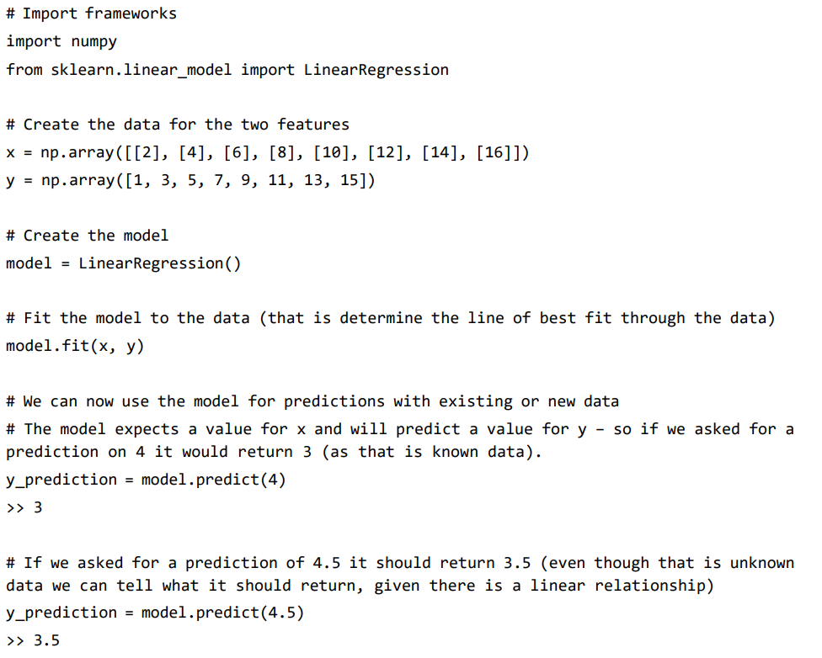

Title
  numpy is imported for handling numerical data and arrays.
  LinearRegression is imported from sklearn.linear_model to create the
  linear regression model.
  x is a 2D numpy array representing the independent variable (feature).
  y is a 1D numpy array representing the dependent variable (target).
  An instance of the LinearRegression model is created
  The .fit() method trains the model using the data. It calculates the line of best fit for the given data.
The code attempts to predict values using the model.predict() method.
Notes:
Note: In this code sample, there is a slight error in the prediction lines.
The model.predict() method expects an input array with the same shape as the training data.
So, to predict for a single value like 4 or 4.5, you should provide it in the form of a 2D array.
Correct usage:
y_prediction = model.predict(np.array([[4]]))
This predicts the output for x = 4, which should correctly return 3.
y_prediction = model.predict(np.array([[4.5]]))
This predicts the output for x = 4.5, which should return 3.5, even though this specific value wasn't in the original dataset.
The model infers this based on the linear relationship it has learned.

Slide 7
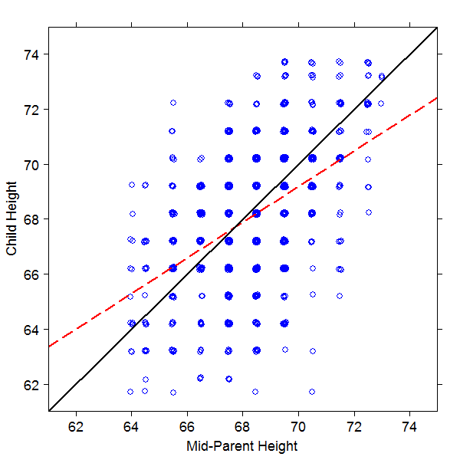
What is regression? (1)
Historical Origin
The concept of regression dates back to the late 19th century when the statistician Francis Galton studied the relationship between the heights of parents and their children.
He observed that children of tall parents tended to be tall, but not as tall as their parents, and vice versa for short parents.
He called this phenomenon "regression to the mean," meaning that the offspring's heights tended to move closer to the average height of the population
A reproduction of Galton’s plot of Child Height versus Mid-Parent Height.

Slide 8
What is regression? (2)
Regression definition
In this context, ‘regression’ refers to the idea that there is a tendency for extreme values (like very tall or very short individuals) to be closer to the average (mean) on subsequent measurements or observations.
Regression captures the idea of predicting an outcome that tends to revert (or ‘regress’) towards a central value or mean.

Slide 9
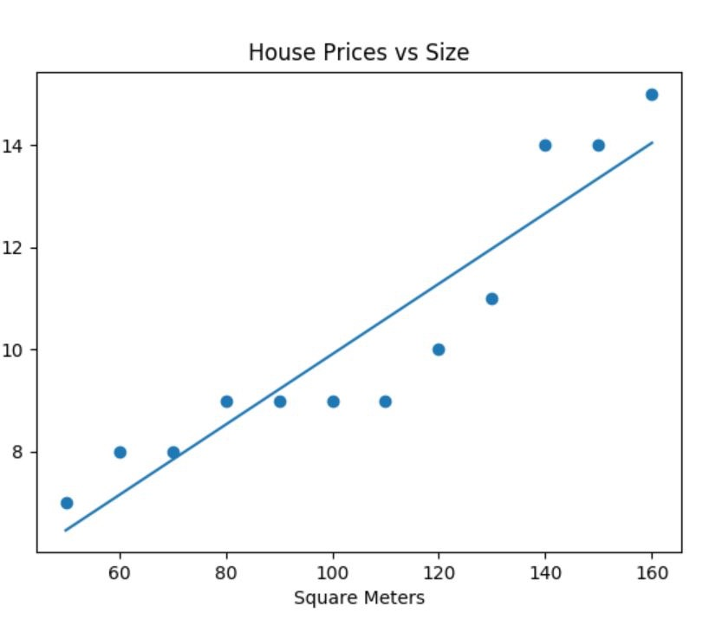
What is a regression algorithm? (1)
How they work
Regression algorithms are statistical methods used to model and analyse the relationship between a dependent variable (the outcome you want to predict) and one or more independent variables (the factors you think influence that outcome). For example, in a simple linear regression, you might model how the price of a house (dependent variable) is influenced by its size (independent variable).
Can you think of other examples?
Notes:
Example #1 - Predicting the Popularity of Social Media Posts.
Example #2 - Predicting Exam Scores Based on Study Time.
Example #4 - Forecasting Sales for a Business.
Example #5 - Predicting Sports Performance.

Slide 10
What is a regression algorithm? (2)
How do they work?
The main goal of regression algorithms is to predict the value of the dependent variable based on the independent variables.
They do this by fitting a line or curve (in the case of linear regression, it's a straight line) through the data points in such a way that it best represents the relationship between the variables.

Slide 11
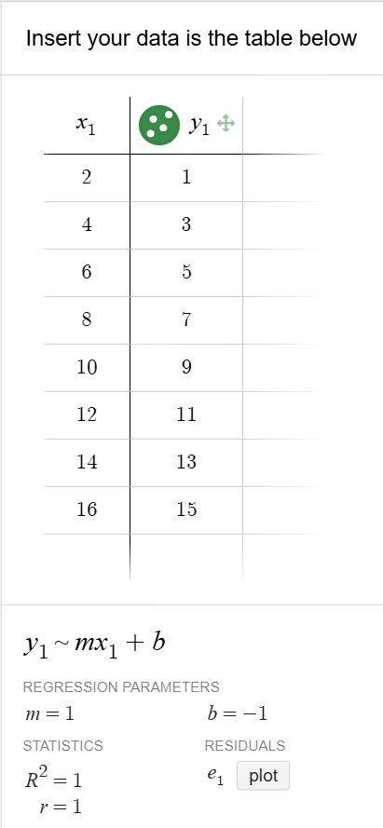
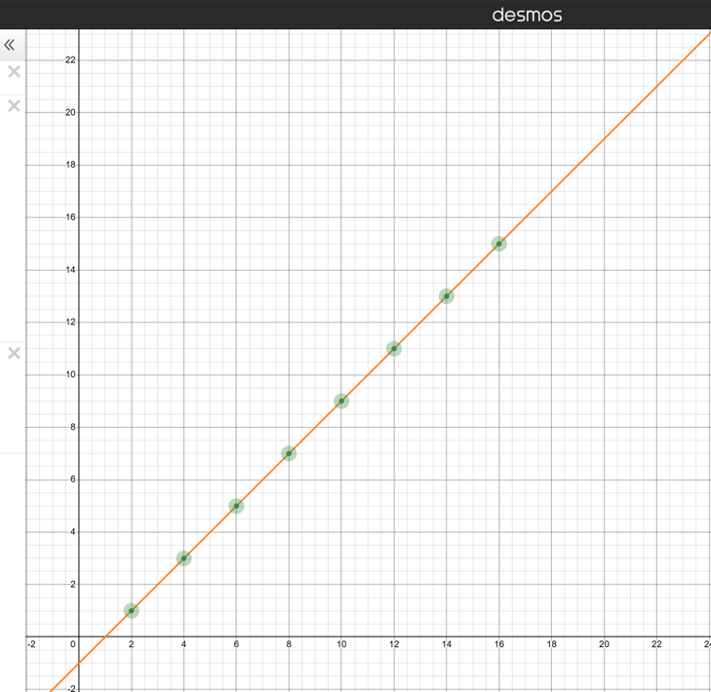
Linear Regression
Example in Desmos
Insert your data in the table below
Extension – Watch the video
How to Calculate a Simple Linear Regression by Hand
Use the data sets provided by the Course Specifications and confirm their results.
Notes:
Desmos example of linear regression using the data set provide by the Course specifications. Students can confirm the results by following the video and using

Slide 12
Importing frameworks (1)
What is the sklearn.linear_model?
The sklearn.linear_model is a module within the larger library known as scikit-learn.
Scikit-learn is often abbreviated as sklearn.

Slide 13
Importing frameworks (2)
What is the Scikit-learn (`sklearn`) library?
Scikit-learn is a comprehensive library for machine learning in Python.
It provides a wide range of tools for building and evaluating machine learning models, including:
classification
regression
clustering
and others...

Slide 14
Importing frameworks (3)
What are libraries
  A library is a collection of multiple modules that provide a set of functionalities.
  Instead of building everything from scratch, software engineers use libraries to access pre-written code that solves common problems. Popular Python libraries include:
  NumPy for numerical computations
  Pandas for data manipulation
  Matplotlib for data visualisation
  To use a library, you need to install it (if it's not part of the standard Python installation) and then import the specific modules or functions you need.
  For example – import numpy as np allows you to use NumPy's powerful features for handling arrays and numerical calculations.

Slide 15
Importing frameworks (4)
What are modules?
A module is a file containing Python code that can define functions, classes, and variables.
When you import modules into a program, you are essentially bringing in pre-written code.
Its important to remember that this pre-written code contains various functionalities, including algorithms and data structures.
These were studied during the Programming fundementals focus area in Year 11.
The sklearn.linear_model module contains algorithms that implement mathematical procedures to calculate the best-fitting line based on the input data.
The data structures include the arrays or matrices that hold the training data.

Slide 16
What’s ‘inside’ the sklearn.linear_model?
‘under the bonnet’
The Linear Regression model in scikit-learn uses Ordinary Least Squares (OLS) to find the parameters (slope and intercept) that minimise the sum of squared residuals (the differences between observed and predicted values).
After fitting, the model has learned a linear equation y = mx + c, where m is the slope and c is the intercept.
        (This is where model coefficients are used. They are numerical values that represent the relationship between your input features and the output prediction in a regression model.)
To predict, the model uses the calculated slope and intercept to estimate the value of y for any given x.

Slide 17
Programming for automation (2)
Applying Machine Learning Examples
Demonstrations
OOP Linear Regression Implementation
OOP Multiple Feature Linear Regression Implementation
OOP Polynomial Linear Regression Implementation
OOP Logistic Regression Implementation
OPP K-Nearest Neighbour Implementation
OOP Neural Network Linear Regression Implementation
OOP Neural Network Image Classification Implementation
Decision Trees Image Classification Implementation

Slide 18
References (1)
This presentation contains NSW Curriculum and syllabus content. The NSW Curriculum is developed by the NSW Education Standards Authority. This content is prepared by NESA for and on behalf of the Crown in the right of the State of New South Wales. The material is protected by Crown copyright.
Please refer to the NESA Copyright Disclaimer for more information https://educationstandards.nsw.edu.au/wps/portal/nesa/mini-footer/copyright.
NESA holds the only official and up-to-date versions of the NSW Curriculum and syllabus documents. Please visit the NSW Education Standards Authority (NESA) website https://educationstandards.nsw.edu.au/wps/portal/nesa/home and the NSW Curriculum website https://curriculum.nsw.edu.au.
Software Engineering 11–12 Syllabus © NSW Education Standards Authority (NESA) for and on behalf of the Crown in right of the State of New South Wales, 2022.
Software Engineering 11–12 Course Specifications © NSW Education Standards Authority (NESA) for and on behalf of the Crown in right of the State of New South Wales, 2022.
NESA (NSW Education Standards Authority) (2022) ‘Year 12 – Teaching advice for Software automation: Why is it important?’, Software Engineering 11–12 Syllabus: Content, NESA website, accessed 19 November 2024.
NESA (2024) ‘HSC Software Engineering Familiarisation’, Familiarisation questions, HSC Online Examinations, accessed 19 November 2024.
Jones B (2025) https://github.com/TempeHS/Machine_Learning_OOP_Implementation_Examples
Desmos Linear Regression interactive website graph calculator
Storage D (2019) How to Calculate a Simple Linear Regression by Hand [video] YouTube

Slide 19
Copyright
© State of New South Wales (Department of Education), 2025
The copyright material published in this resource is subject to the Copyright Act 1968 (Cth) and is owned by the NSW Department of Education or, where indicated, by a party other than the NSW Department of Education (third-party material).
Copyright material available in this resource and owned by the NSW Department of Education is licensed under a Creative Commons Attribution 4.0 International (CC BY 4.0) license.
This license allows you to share and adapt the material for any purpose, even commercially.
Attribution should be given to © State of New South Wales (Department of Education), 2025.
Material in this resource not available under a Creative Commons license:
the NSW Department of Education logo, other logos and trademark-protected material
material owned by a third party that has been reproduced with permission. You will need to obtain permission from the third party to reuse its material.
Links to third-party material and websites
Please note that the provided (reading/viewing material/list/links/texts) are a suggestion only and implies no endorsement, by the New South Wales Department of Education, of any author, publisher, or book title. School principals and teachers are best placed to assess the suitability of resources that would complement the curriculum and reflect the needs and interests of their students.
If you use the links provided in this document to access a third-party’s website, you acknowledge that the terms of use, including licence terms set out on the third-party’s website apply to the use which may be made of the materials on that third-party website or where permitted by the Copyright Act 1968 (Cth). The department accepts no responsibility for content on third-party websites.

