Slide 1
Instructions for use
This resource is not a teaching and learning program. It should be used in conjunction with the program and teacher resource Data science – Enterprise Computing 11–12 – Activity 41.
Classroom teachers are encouraged to add and adapt slides as required to meet the needs of their students.
Save a copy of the file to make changes to the slide deck. Go to File > Download a Copy (this downloads a copy to the computer to edit in the PowerPoint app).
To convert the PowerPoint to Google Slides:
  Upload the file into Google Drive and open it.
  Go to File > Save as Google Slides.
  (Note – conversion may cause formatting changes in the slides.)
Notes:
Additional note:
Collect the curated data sets from the TAS SWSR for use in the challenges.

Slide 2

Data Hack High
Enterprise Computing 11–12
Data science

Slide 3
Challenges
1
Netball courts challenge – Netball NSW
2
EV road trip challenge – Net Zero
3
Vaping data challenge – NSW Health
4
Hot schools challenge – Western Sydney University
5
Optimal learning environment challenge – Oracle
Notes:
Teacher notes:
Ctrl + click the challenge numbers to go to specific challenges.
The students can choose which challenge they undertake or can be assigned in groups to work through different challenges.
Interactive features can be viewed in slide show.

Slide 4

Netball courts challenge
Netball NSW
Enterprise Computing 11–12
Data science

Slide 5
Learning intentions and success criteria
We are learning to:
understand the demographics and travel patterns of netball participants in NSW
analyse and interpret geo-targeted census data for marketing effectiveness
develop strategies to increase participation and optimise facility locations.
We can:
identify and describe travel distances of netball participants
compare and contrast netball participation with other sports within LGAs
propose data-driven recommendations for facility placement and marketing strategies.
Notes:
Notes for teachers:
Learning intentions and success criteria are best co-constructed with students. Adapt the learning intention as required and add matching success criteria.
For more information see ⁠AITSL or the NSW Department of Education explicit teaching strategies, ⁠Sharing learning intentions and ⁠Sharing success criteria.
LISC is not necessarily presented at the beginning of the lesson. Teacher needs to consider most effectual time to introduce.
LISC should be revisited during the lesson to support students' evaluation of their learning.

Slide 6
Where is my nearest court?
Netball NSW
Netball NSW would like to understand where people are travelling from and how far they are travelling to participate, whilst also looking at geo-targeted census data to increase effectiveness of marketing campaigns across available programs.
Your challenge is using data to understand how far people will travel to play netball in NSW.
The ultimate goal being to grow participation in netball and ensure facilities are in locations where they are most needed.

Slide 7
Netball NSW Challenge (1)
Demographics of data
As part of the challenge, students consider and report on a specific user group for their data story.
The data is grouped by demographics of the Local Government Area (LGA) or association with the following age groups:
NetSetGo: ages 5 to 9
Junior: ages 10 to 14
Senior: ages 15 to 34
Masters: ages over 35.

Slide 8
Netball NSW Challenge (2)
Discovery questions
What sports are most played within the LGA?
How do other sporting associations in the LGA compare to the netball association?
What are the top 10 postcodes of participants within this association?
How far are people travelling to play netball?
What other LGAs are participants coming from?
Extension:
What private provider organisations are offering netball within the LGA and what potential impact could this having on Netball NSW association growth?

Slide 9
Netball NSW Challenge (3)
The background numbers
NSW has 114 affiliated netball associations spread across the State, with 114,000 registered participants.
Questions:
What is the average number of registered participants per association?
How does that compare with other sports?
How are the locations of the 114 affiliated netball associations determined?
Do participants (players, coaches, umpires and administrators) have to participate at their local association?
Notes:
A1: 114,000 / 114 = 1,000.
A2: These affiliated association are determined by the location of council-owned facilities and infrastructure.
A3: Participants do not have to participate at their local association, and we know that some travel greater distances to access different association competitions.

Slide 10
Netball NSW Challenge (4)
Using filters, sort and functions to investigate data
Examine the Netball NSW data and answer the following questions:
How many students from your high school play netball?
How many students from your ‘old’ primary school play netball?
Which netball associations are they in?
Which clubs do they play for?
Which schools have the most netball players?
Which have the least?
Which netball associations are nearest to your school?

Slide 11
Netball NSW Challenge (5)
Using filters, sort and functions to investigate data
Which netball associations have the most players in each of the following categories?
        NetSetGO: ages 5–9, Junior: ages 10–14 , Senior: ages 15–34 , Masters: over 35s.
Which associations have the least?
Which are growing? (according to the new to club field)
What other patterns can you find?
        When are the seasonal competitions?
        What time of the day do most participants play?
        Are the courts being used efficiently?

Slide 12
Netball NSW Challenge (6)
Useful links to support the challenge
In addition to the master set of data, the following links can assist in providing additional data or skills to support the challenge:
NSW Planning Portal
Census data
NSW postcodes
Calculating distance between 2 latitude and longitude points.

Slide 13
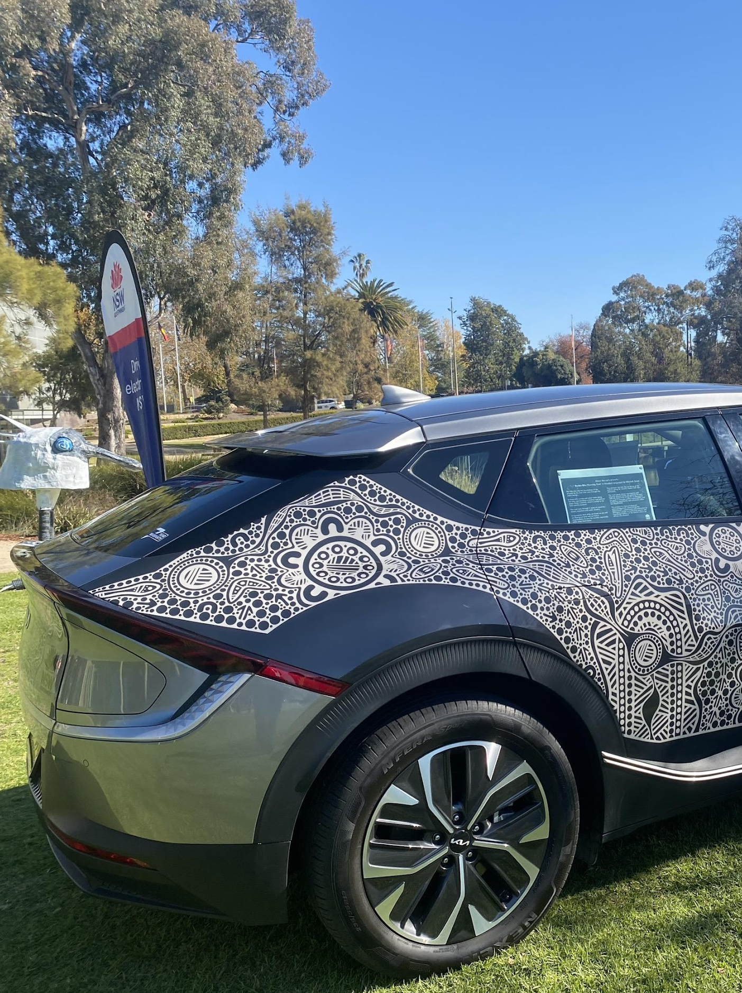
EV road trip challenge
Net Zero
Enterprise Computing 11–12
Data science

Slide 14
Learning intentions and success criteria (Net Zero)
We are learning to:
plan a sustainable road trip using a Battery Electric Vehicle (BEV)
analyse the efficiency and practicality of using BEVs for long-distance travel
understand the environmental impact of electric vehicles compared to traditional vehicles.
We can:
design a detailed route over 1,000 km, including charging stops and activities
calculate charging times and costs accurately based on BEV specifications
present a comprehensive road trip plan with data on emissions and cost savings.
Notes:
Notes for teachers:
Learning intentions and success criteria are best co-constructed with students. Adapt the learning intention as required and add matching success criteria.
For more information see ⁠AITSL or the NSW Department of Education explicit teaching strategies, ⁠Sharing learning intentions and ⁠Sharing success criteria.
LISC is not necessarily presented at the beginning of the lesson. Teacher needs to consider most effectual time to introduce.
LISC should be revisited during the lesson to support students' evaluation of their learning.

Slide 15
Net Zero Transport Team
EV Road trip
Design a route for a road trip of at least 1,000 kms within NSW.​
Select a Battery Electric Vehicle (BEV)​ you will use for the trip and investigate the stops you want to make and where to charge the vehicle, all whilst having a fun and enjoyable trip in a zero tail-pipe emission vehicle.
Select a BEV.
Decide on a destination (round trip needs to be >1,000km)​.
Plan a route, your activities and charging along the way​.
Tell the story of your BEV road trip using the data you have collected and calculated.

Slide 16
What is a BEV?
Several types of cars that are described as ‘EVs’
  Battery Electric Vehicles (BEV)
  100% powered by electricity from a battery.
Hybrid
  Filled up with liquid fuel but uses regenerative power to produce electricity and charge a small battery to power the car at low speed (increases fuel efficiency).
  Hydrogen fuel cell vehicles (FCEV)
  Powered by hydrogen which is converted to electricity.
  Plug-In Hybrid (PHEV)
  Powered by liquid fuel and has a small battery with a range of about 40 to 50 kilometres.

Slide 17
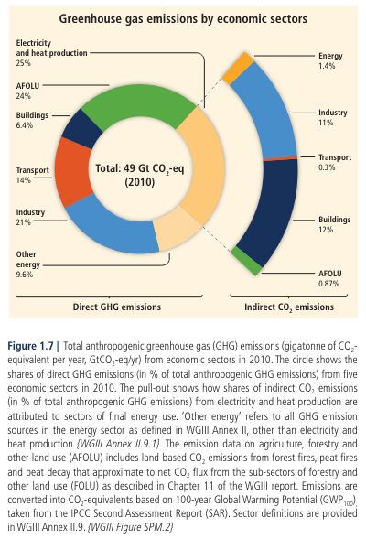
Why choose an EV?
Greenhouse gas emissions
The IPCC Climate Change Report shows that human activities, principally through emissions of greenhouse gases, have unequivocally caused global warming, with global surface temperature reaching 1.1°C above 1850–1900 in 2011–2020.
Light vehicles account for 11% of Australia’s
greenhouse gas emissions.
Activity: Compare vehicles with the Green Vehicle Guide.
'Greenhouse gas emissions' by IPCC, is licensed under a Creative Commons Attribution 4.0 International (CC BY 4.0) license.
Notes:
Source: IPCC, 2014: Climate Change 2014: Synthesis Report. Contribution of Working Groups I, II and III to the Fifth Assessment Report of the Intergovernmental Panel on Climate Change [Core Writing Team, R.K. Pachauri and L.A. Meyer (eds.)]. IPCC, Geneva, Switzerland, 151 pp.

Slide 18
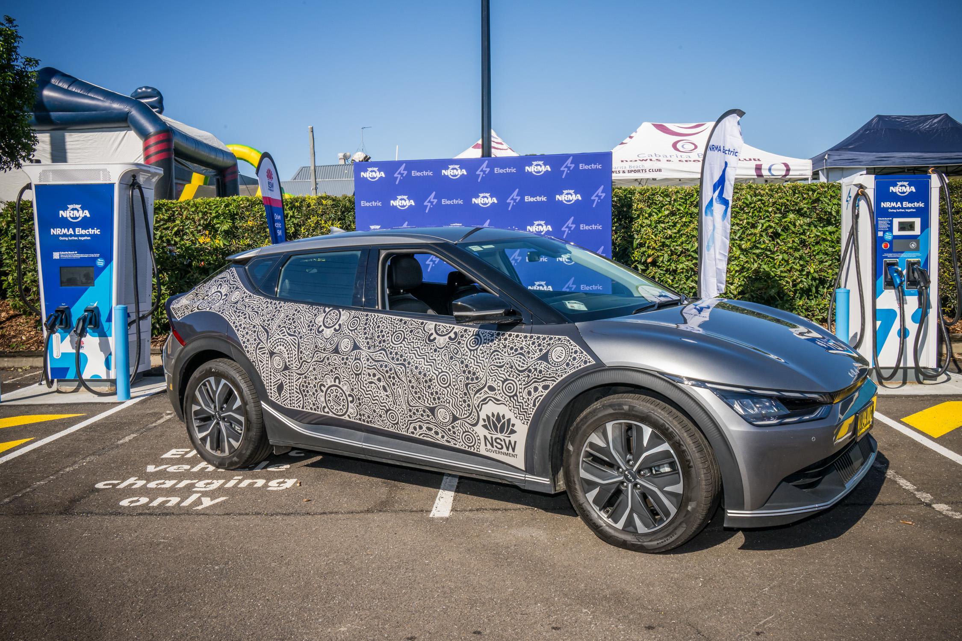
Vehicle data
EV Road trip
Choose your Battery Electric Vehicle suitable for the trip and passengers from the VESR website.
Identify the:
make and model
charging port/plug type (CCS/Type 2 or CHAdeMO)
size of the battery
WLTP km range of the car
maximum kW power it can charge at.

Slide 19
EV Road trip Challenge (1)
Some basic calculations
Battery size (kWh) / charger power (kW) = charging time (hrs)
EV range: use 80% of the WLTP (Worldwide harmonised Light-duty vehicles Testing Protocol) range as the realistic kilometre range of your EV.
DC Charging (Direct Current/Fast): find your maximum DC charging rate. DC chargers slow down their charging speed at 80% battery charge to protect the EV battery. This does NOT need to be considered in your charge time calculations for this challenge. EV drivers tend to only charge to 80% if another car is waiting for them to leave so that they can also use the charger.
Assume all AC chargers (Alternating Current/Slower) will charge your car at the power they are identified at, for example 7kW, 11kW and 22kW.

Slide 20
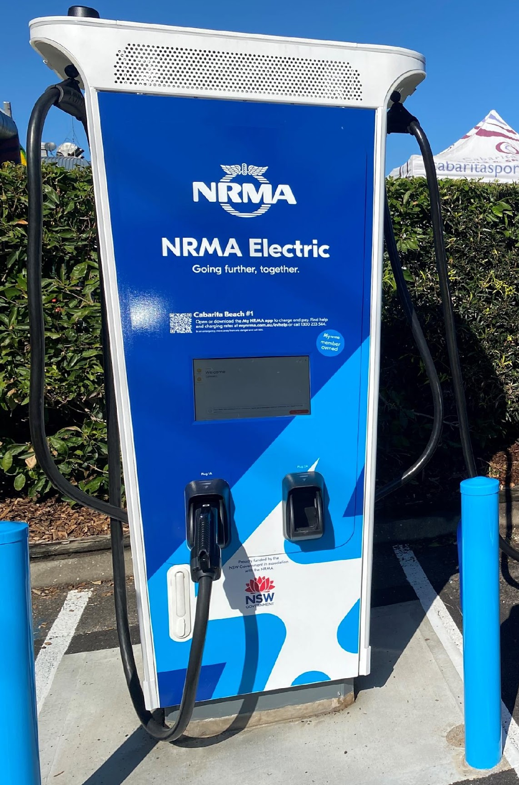
EV Road trip Challenge (2)
Calculations, assumptions and hints you will need
DC charging
Note that if you are using a charger that has a higher power (kW) than the maximum charging power you have identified for your EV, you should only use that number in your calculations.
For example, a car with make power of 80kW plugged into a 100kW charger will only charge that car at 80kW.
AC charging
Assume all AC chargers will charge your car at the power they are identified at. For example 7kW, 11kW and 22kW.

Slide 21
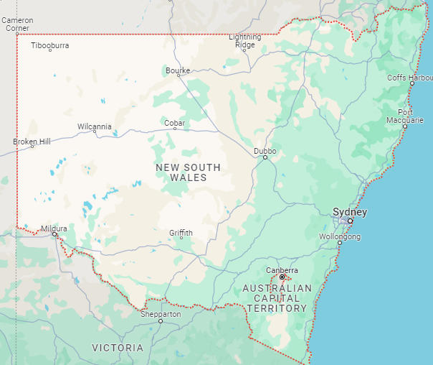
EV Road trip Challenge (3)
Plan your trip
Explain the activity you will do at that stop. Include the time of day and length of stay. An example may be lunchtime at a local café for one hour or go to the toilet and grab a drink for 15 minutes. Your times must be reasonable for the activity, and those amenities must exist at that location.
Identify the EV charger type (AC or DC) you will stop at if you want to charge.
Define how much charge you will want to have (kWh) and how long that will take you with that charger and the cost (if you need to pay, some chargers are free!).
Map data by Google.

Slide 22
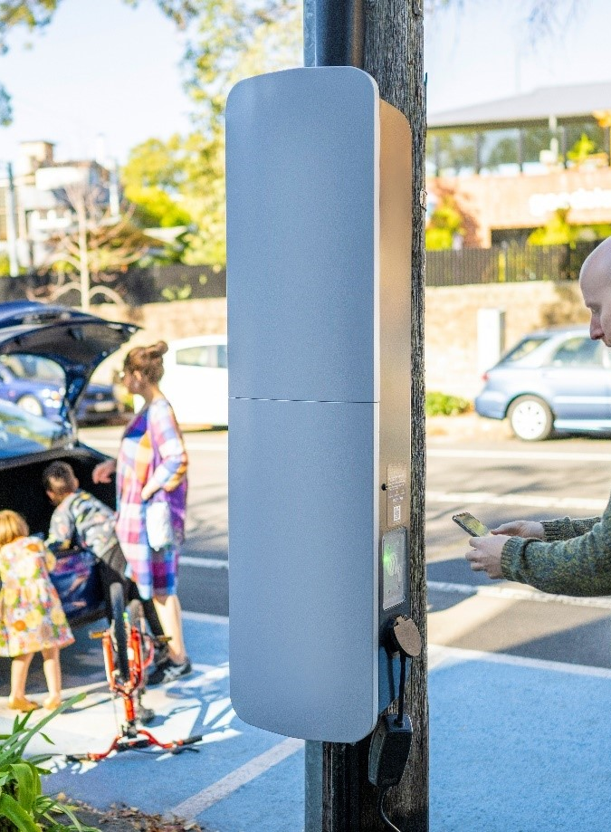
EV Road trip Challenge (4)
Search for EV charging stations
Two websites to assist in searching for EV charging stations on your road trip:
PlugShare
Google Maps

Slide 23
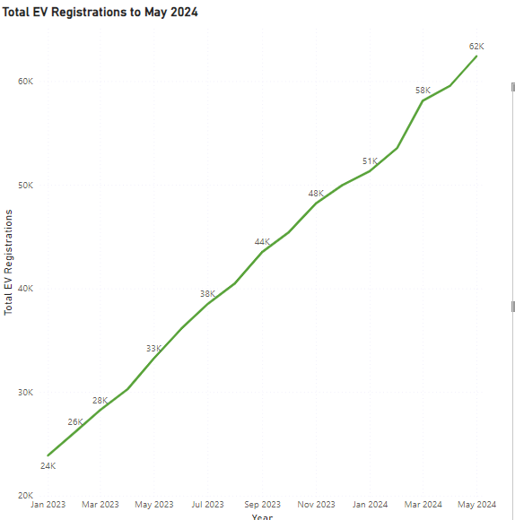
EV Road trip Challenge (5)
Additional activities
For either your main destination in the road trip or your starting location, find the number of Battery Electric Vehicles in that Local Government Authority from the Transport for NSW website and provide a graph of the total number of total EVs registered per month from January 2023 to the current available information.
Design the graph to provide clear information to your audience.
Using the VESR website calculate the emissions (C02 (g/km)) of a similar size internal combustion engine (ICE) vehicle for that same trip length and the cost of the trip if diesel/petrol fuel is $2 per litre.
Out of 7,226,440 vehicles in NSW

Slide 24

Vaping data challenge
NSW Health
Enterprise Computing 11–12
Data science

Slide 25
Learning intentions and success criteria (NSW Health)
We are learning to:
investigate the health impacts and prevalence of vaping among young people
analyse datasets to identify trends and correlations in vaping behaviour
develop evidence-based solutions to reduce youth vaping.
We can:
interpret and visualise data showing the rise in vaping among different age groups
identify harmful chemicals in vape products and their health impacts
propose actionable solutions to address youth vaping, supported by data analysis.
Notes:
Notes for teachers:
Learning intentions and success criteria are best co-constructed with students. Adapt the learning intention as required and add matching success criteria.
For more information see ⁠AITSL or the NSW Department of Education explicit teaching strategies, ⁠Sharing learning intentions and ⁠Sharing success criteria.
LISC is not necessarily presented at the beginning of the lesson. Teacher needs to consider most effectual time to introduce.
LISC should be revisited during the lesson to support students' evaluation of their learning.

Slide 26
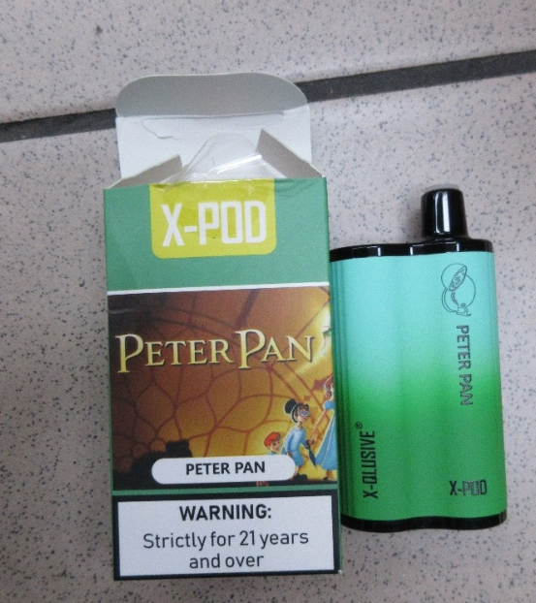
Every vape is a hit to your health
NSW Health
How can you use data to create a picture of the risks to young people in NSW associated with e-cigarette use?
How can you propose solutions to address the problem of youth vaping at a high school level?

Slide 27
Why we care about young people vaping
NSW Health
E-cigarette users are exposed to chemicals and toxins that have the potential to cause harm.
The aerosol inhaled can contain over 200 chemicals. Some of these chemicals have been shown to be harmful to health and can cause cancer, heart disease and lung damage.
Many e-cigarettes contain high concentrations of nicotine. Regular nicotine consumption by young people can result in changes to brain development, impaired attention, learning and memory, mood changes and the potential to worsen stress and increase depression and anxiety.
Nicotine is highly addictive and regular use in adolescence can increase the risk of nicotine dependence and other substance use later in life.
Other known health harms associated with vaping include throat irritation, breathlessness, cough, dizziness, headaches, nausea and lung damage.
Rechargeable vapes have been known to explode, causing serious burns and trauma.
Notes:
What we do know is that:
E-cigarette users are exposed to chemicals and toxins that have the potential to cause harm.
The aerosol inhaled can contain over 200 chemicals. Some of these chemicals have been shown to be harmful to health and can cause cancer, heart disease and lung damage.
Many e-cigarettes contain high concentrations of nicotine.
Regular nicotine consumption by young people can result in changes to brain development, impaired attention, learning and memory, mood changes and the potential to worsen stress and increase depression and anxiety.
Nicotine is highly addictive and regular use in adolescence can increase the risk of nicotine dependence and other substance use.
Other known health harms associated with vaping include throat irritation, breathlessness, cough, dizziness, headaches, nausea and lung damage.
There have been documented cases of vapes exploding, causing serious burns and trauma.

Slide 28
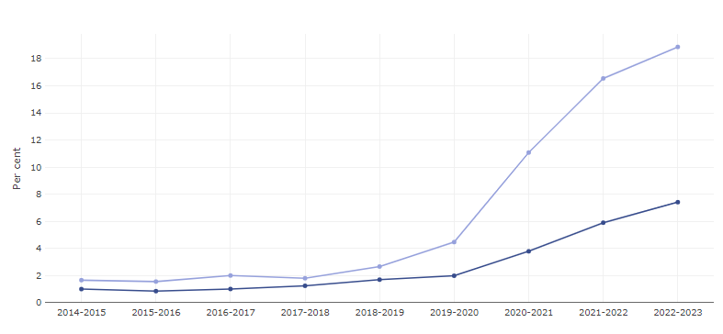
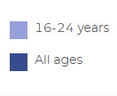
Current e-cigarette use in NSW by age
NSW Health
18.9% of 16-24 year olds were current vapers in 2022-23
4.5% of 16-24 year olds were current vapers in 2019-20
Notes:
This graph shows the current (daily or occasional) e-cigarette use by young people aged 16-24 years compared to the general adult population aged 16+.
In contrast to smoking, e-cigarette use is increasing in all age groups, but most rapidly in those aged 16-24 years.
Current e-cigarette use among 16-24 year olds has tripled to 16.5% in 2021/22 from 4.5% in 2019/20.
This compares to 5.9% of all adults aged 16+ currently using e-cigarettes in 2022.

Slide 29
Your datasets
NSW Health
NSW e-cigarette analysis project | NSW population health survey
Aim: To increase our understanding of the nature of e-cigarette products currently on the market in NSW To find out how much of the youth vaping in NSW is nicotine vaping To identify any trends in nicotine vape manufacturing and selling Method: 750 e-cigarette devices were tested for nicotine and other potentially harmful substances. Samples were sourced from high schools in the greater Sydney region (322 products) and from retailers throughout NSW (428 products). | Conducted every year Survey of 13,000 people from all over NSW Gathering data on all sorts of health indicators: – How much you smoke/vape – How much water you drink – How much exercise you get, and what type – Whether you use insect repellent – What sort of toothpaste you use Also collects all sorts of demographic data, which makes the other data more informative
Notes:
NSW commissioned the University of Wollongong to undertake detailed analysis of 750 vape products seized from retailers (n=428 products) and confiscated by schools in Sydney (n=322) over the 2022-2023 period.
Key findings of this study, focussing on those products donated by schools:
The majority of products contained nicotine (98%) and a wide range of flavourings and other chemicals whose chronic inhalational safety is not known.
potentially to lead to nicotine poisoning or dependence, particularly where products are used excessively.
The majority of products containing nicotine did not list nicotine on the ingredients.
Products with identical packaging were found to both contain nicotine and be nicotine-free - impossible for users to know what they are vaping.
Testing identified many other chemicals not listed in the ingredients
preliminary advice indicates the concentrations of flavour chemicals detected in these devices were hundreds of times higher than those reported in food and cosmetics.
The safety of inhaling flavour chemicals, rather than ingesting through food, has not been established.
A proportion of devices that were tested were found to contain chemicals that are known to cause harm to health, including ethylene glycol, acetoin, benzaldehyde, and cinnamaldehyde – some of these chemicals are banned from legal nicotine vapes by the TGA under Therapeutic Goods Order (TGO) 110.
23% of devices that were obtained from schools (all of which were disposable) were found to have been tampered with, likely either to refill with purchased e-liquid or an attempt to recharge the non-rechargeable battery. This can increase the risk of burns as a result of device explosion or nicotine poisoning. E-cigarette users should not tamper with devices.
This study only sampled 750 devices over a particular period of time - e-cigarette market is ever evolving and any number of contaminants or harmful chemicals could be in the constituents – over 200 chemicals have been documented in other studies as being in aerosol.

Slide 30
The Centre for Population Health (1)
Looking at the master data set
Youth vaping has risen rapidly in NSW, with the number of 16 to 24 year olds who report having vaped rising from 15.5% in 2017/18 to 43.2% in 2021/22.
How can this rise be best shown using data visualisation?
The dataset provided contains the results of a recent chemical analysis study of 750 e-cigarettes.
322 of these were taken from students at high schools throughout Sydney and represent the types of devices that high school students are using. The other 428 were seized from illegal e-cigarette retailers.
The devices were tested for concentration of nicotine and a range of other chemicals that are known to be harmful if inhaled and have been banned from use in legal prescription e-cigarettes in Australia.

Slide 31
The Centre for Population Health (2)
Using filters, sort and functions to investigate data
What is the attraction for young people to vape? Consider the marketing of flavours present in the dataset.
Are there any patterns or trends in the data around types of devices, flavours and schools?
Which brands contain the highest nicotine content? Consider merging the 2 spreadsheet sheets or using VLOOKUP.
Ethylene glycol is the main chemical component of antifreeze in engine coolant systems and can cause significant health effects. Which vapes contain ethylene glycol?
What conclusions can you draw about the vaping habits of young people, and the potential health impacts?

Slide 32
The Centre for Population Health (3)
Using filters, sort and functions to investigate data
What does the data show about the increase of vape use in different age groups?
What factors could explain the increase of vape use in different age groups?
What differences are there in vaping use between the sexes?
What differences are there in current user vaping and ever used vaping between the sexes?
What is the role of social media in the promotion of vapes?
Match the timelines of vape use and social media promotion.

Slide 33
The Centre for Population Health (4)
Useful data sets to support the challenge
Health Stats NSW
Health Stats NSW – E-cigarette use (vaping)
NSW Public Schools Master Dataset
Datareportal – Global Social Media Statistics
National Library of Medicine - E-Cigarette Promotion on Twitter in Australia
Google Trends – Electronic cigarette Australia
Google Trends – Electronic cigarette worldwide

Slide 34
The Centre for Population Health (5)
Research
Solutions will be informed by evidence from analysis of the data and could include: policy making decisions, advertising campaigns, infographics or technical solutions.
Journal article - Electronic cigarette social norms among adolescents in New South Wales, Australia.
Journal article - Vaping product access and use among 14–17-year-olds in New South Wales: a cross-sectional study.
Our Vaping Toolkit – includes information on health harms of vaping.

Slide 35

Hot schools challenge Western Sydney University
Enterprise Computing 11–12
Data science

Slide 36
Learning intentions and success criteria
(Western Sydney University)
We are learning to:
organise Excel spreadsheets for data analysis
apply analysis functions in Excel to interrogate environmental data
connect air temperature measurements with materiality of a location.
We can:
understand how structures, surfaces, material, colours and the absence or presence of vegetation influence air temperature
realise that vegetation, especially the shade of trees, helps to reduce the temperature
integrate cooling elements in design solutions.
Notes:
Notes for teachers:
Learning intentions and success criteria are best co-constructed with students. Adapt the learning intention as required and add matching success criteria.
For more information see ⁠AITSL or the NSW Department of Education explicit teaching strategies, ⁠Sharing learning intentions and ⁠Sharing success criteria.
LISC is not necessarily presented at the beginning of the lesson. Teacher needs to consider most effectual time to introduce.
LISC should be revisited during the lesson to support students' evaluation of their learning.

Slide 37
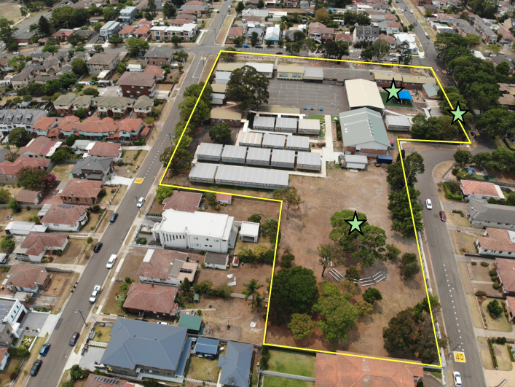
Investigating summer microclimates at a public school (1)
Professor Sebastian Pfautsch – Urban Transformations Research Centre – Western Sydney University
This challenge uses air temperature data recorded at a public school in the central region of Greater Sydney.
The school covers 1.8 hectares of various configuration – 27% buildings, 32% impervious surfaces and 41% open space with pervious surfaces.
The data used was recorded during record-breaking heat at the beginning of January 2020. Three data streams are provided that were recorded at different locations.
Figure 1: The school area (inside the yellow line) and the location of the temperature loggers (green stars).

Slide 38
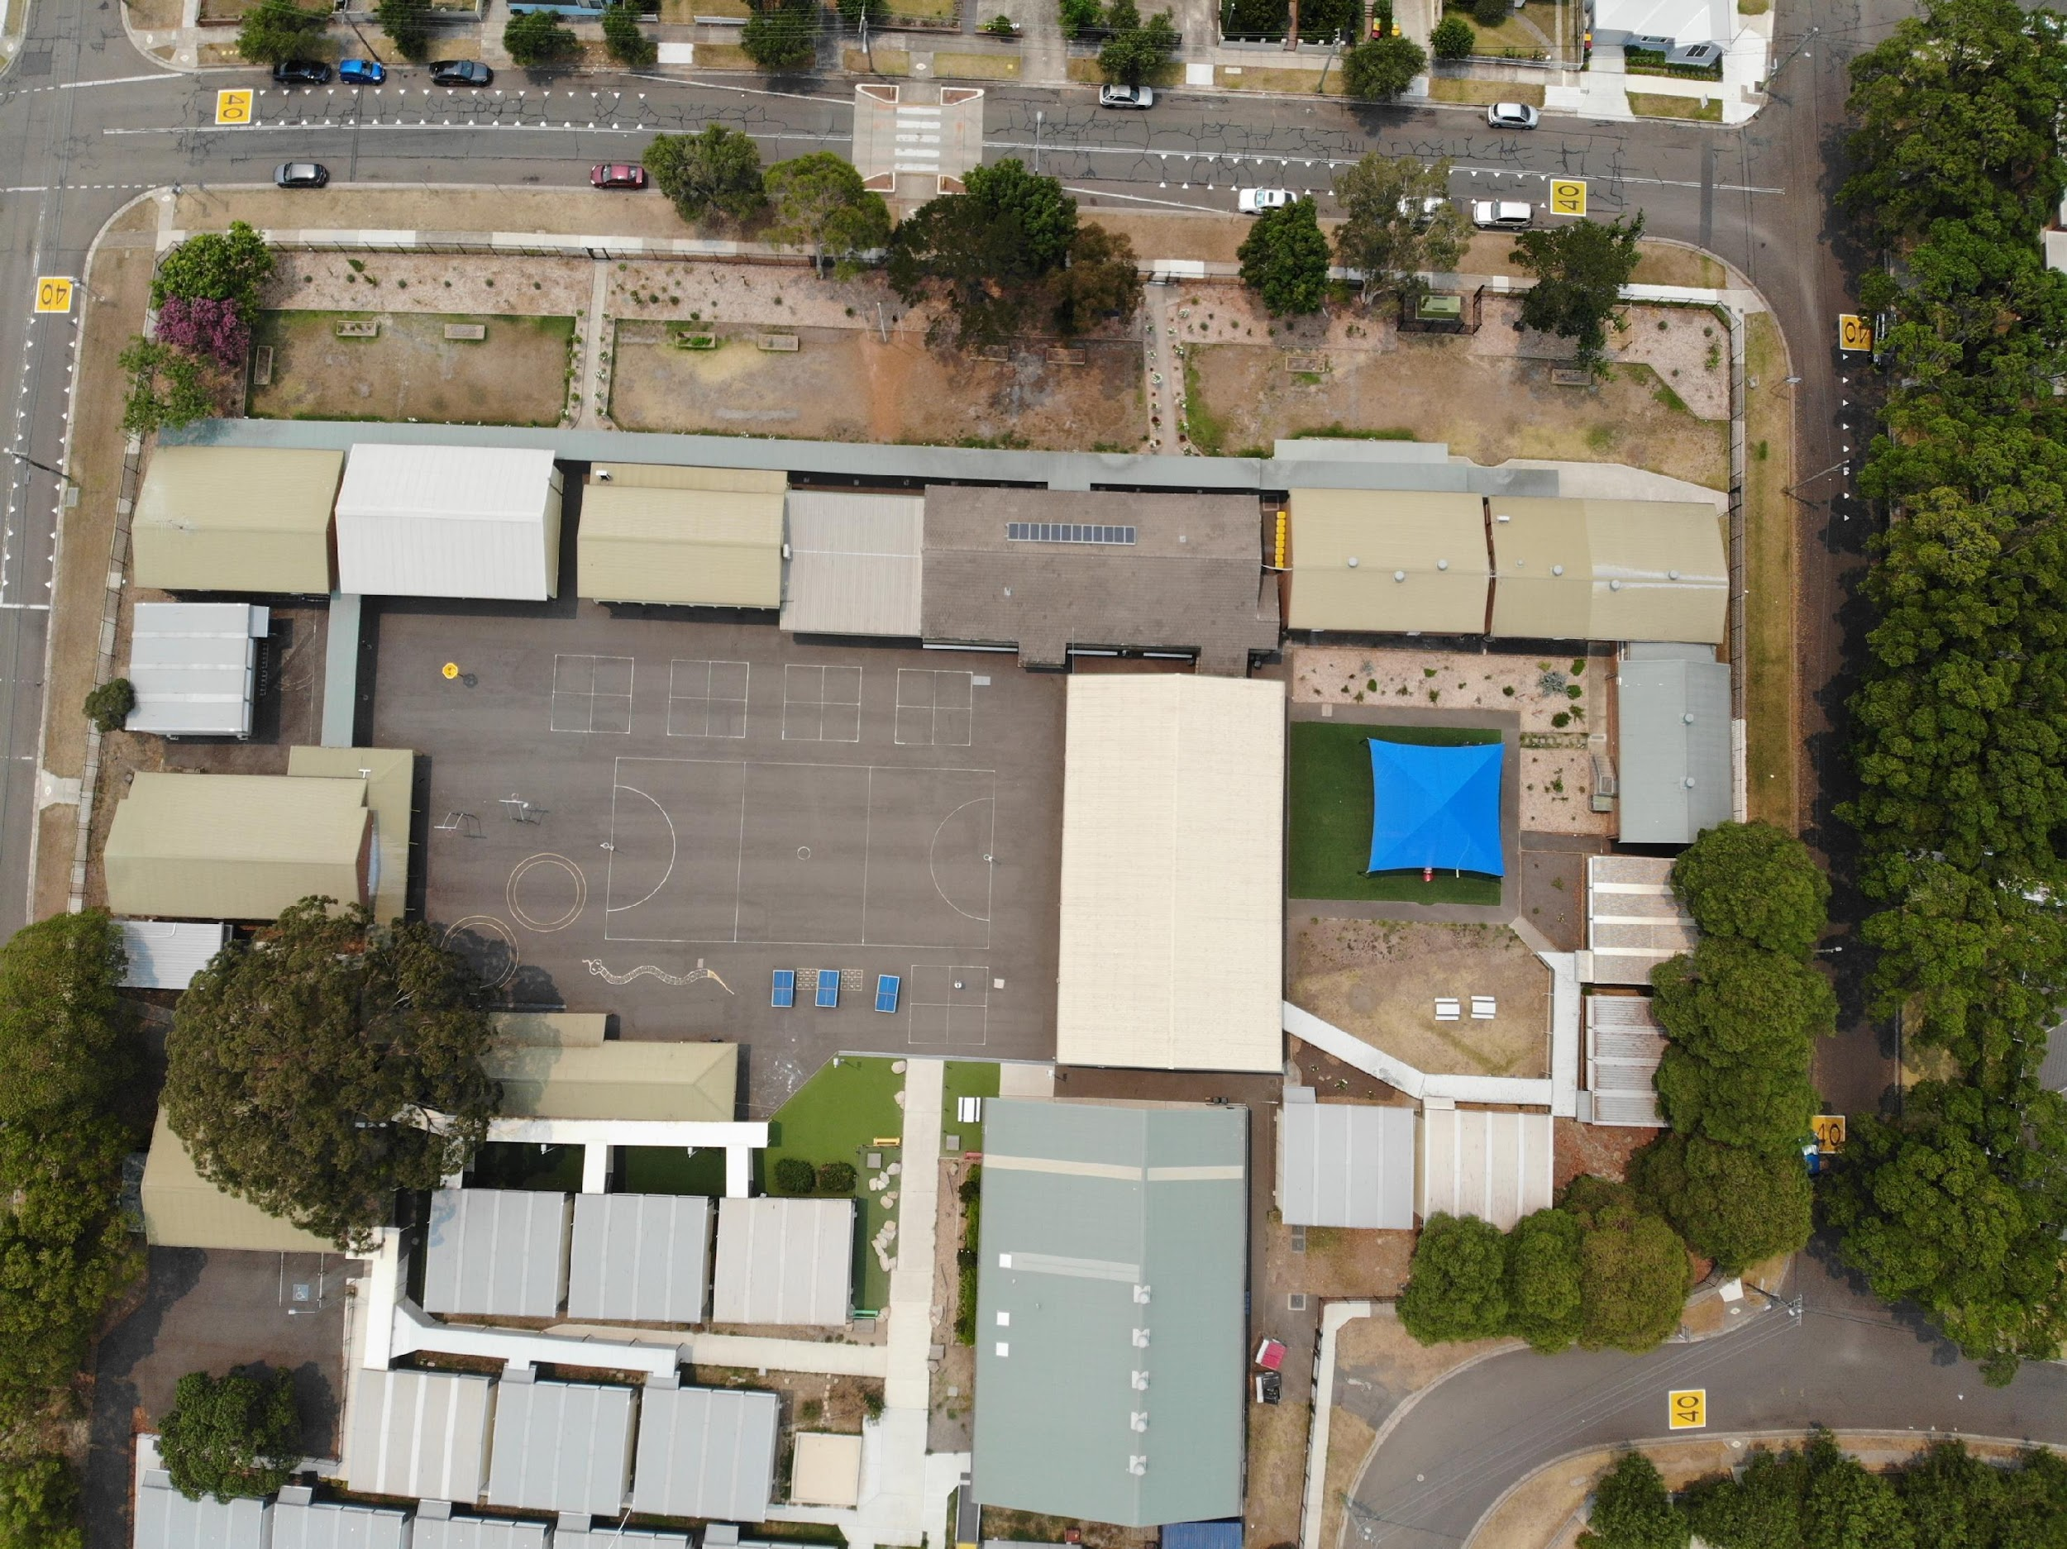
Investigating summer microclimates at a public school (2)
Professor Sebastian Pfautsch – Urban Transformations Research Centre – Western Sydney University
Students are provided with additional materials (infrared images) to assign the right data stream to a location and then interrogate the data to understand the impacts of surface materials, tree shade and landscape design to develop solutions that will help keep school yards cooler during heatwaves.

Slide 39

Investigating summer microclimates at a public school (3)
Professor Sebastian Pfautsch – Urban Transformations Research Centre – Western Sydney University
Where are the buildings and how are they oriented?
How would the shadows of buildings and other tall structures like trees move during the day?
What is shaded and what is receiving full sun?

Slide 40
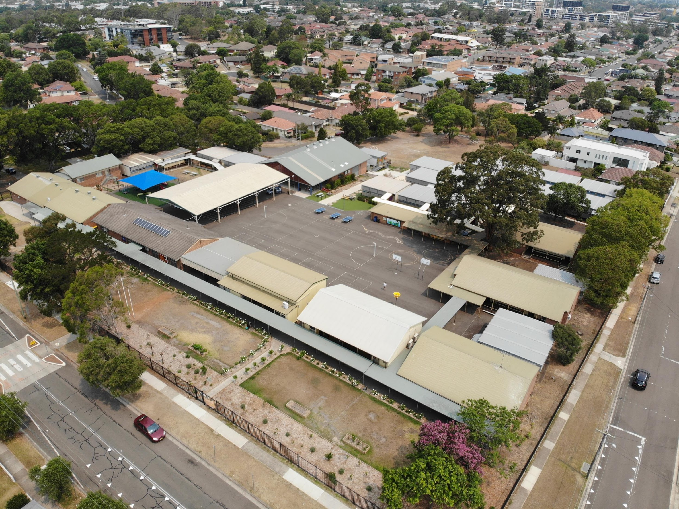
Investigating summer microclimates at a public school (4)
Professor Sebastian Pfautsch – Urban Transformations Research Centre – Western Sydney University
What types of surface materials are used?
Where are hard, impervious surfaces?
Where are soft, pervious surfaces?
Where is shade and where is no protection from the sun?

Slide 41
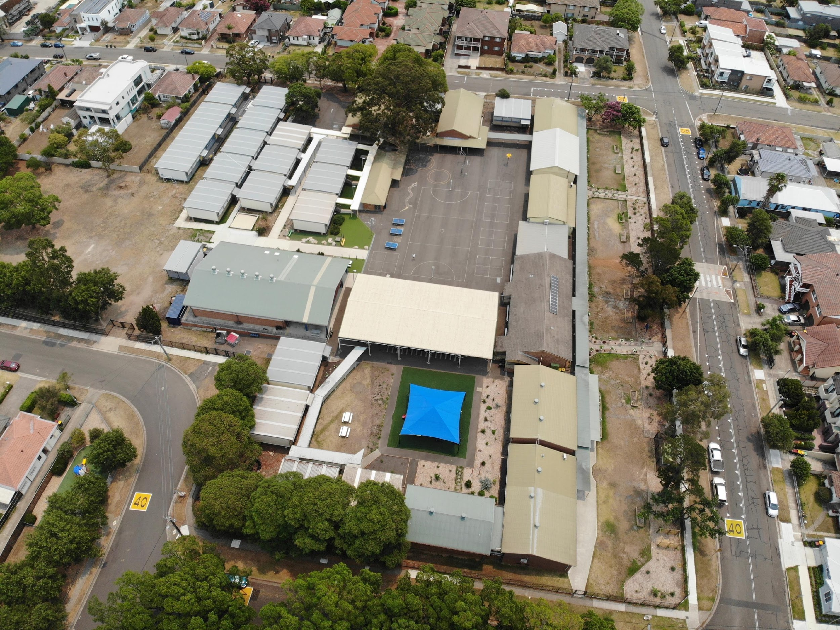
Images of the school (1)
Professor Sebastian Pfautsch – Urban Transformations Research Centre – Western Sydney University
Where are garden beds, shrubs and trees?
How is the school yard configured?
What materials are used for walkways?
What materials are used to provide protection from the sun?

Slide 42
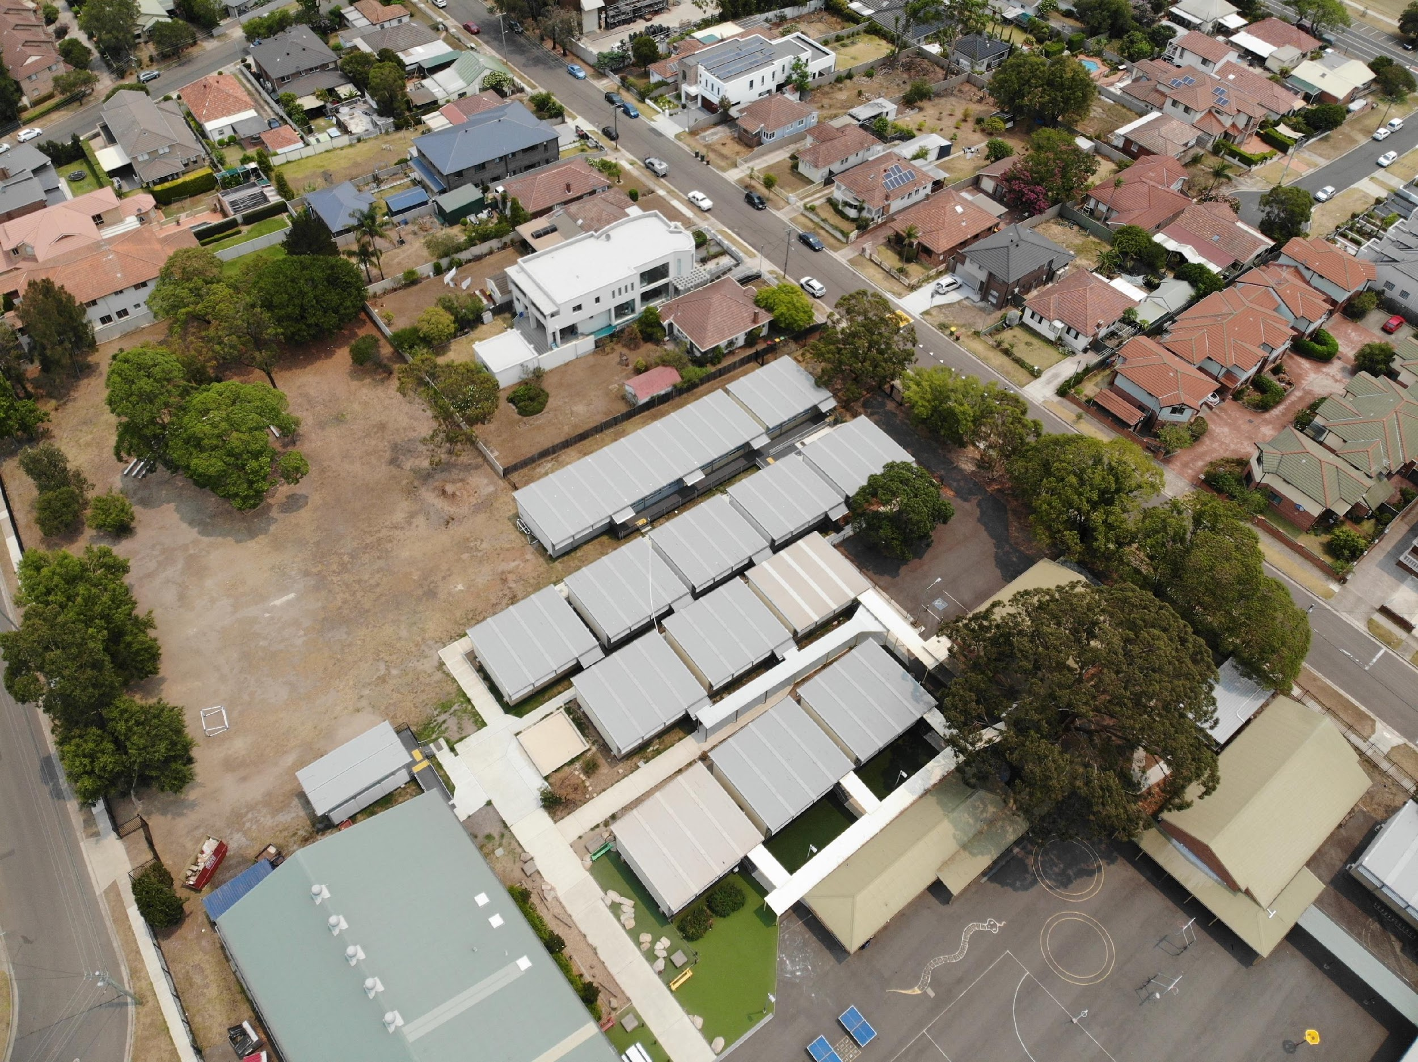
Images of the school (2)
Professor Sebastian Pfautsch – Urban Transformations Research Centre – Western Sydney University
Where are single trees or groves of trees?
Can you imagine how wind from the south can blow through the school to blow heated air out?
Where would wind be blocked?

Slide 43
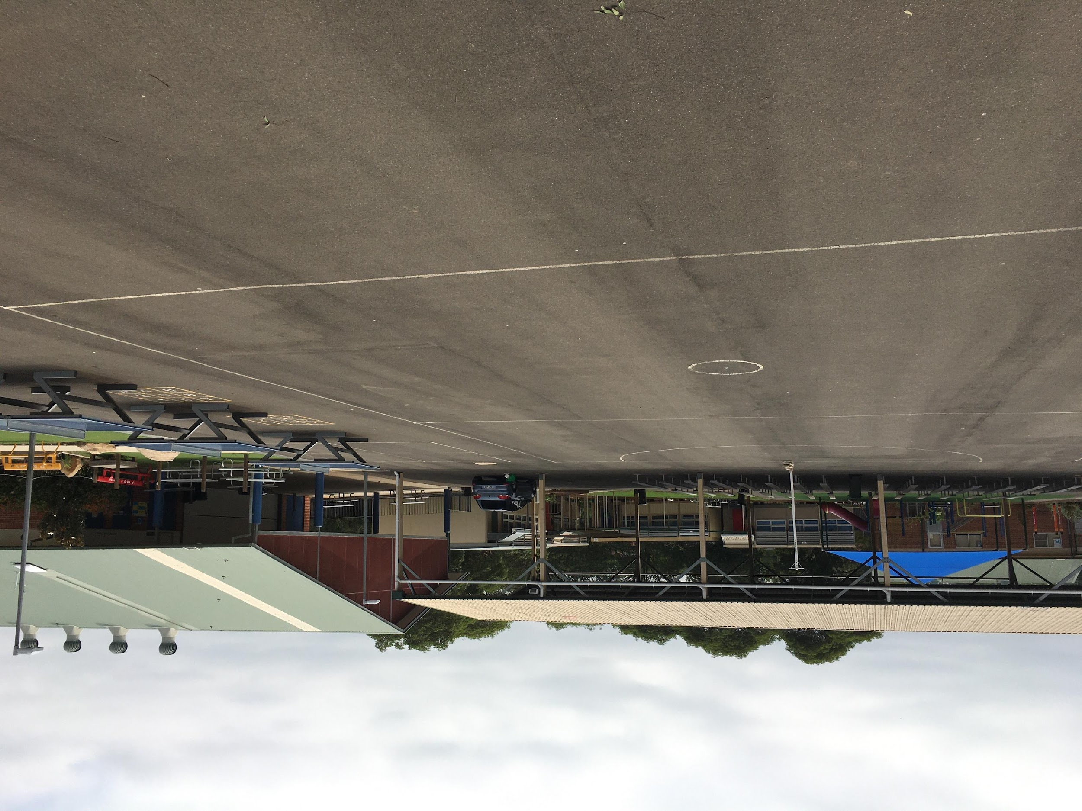
Images of the school (3)
Professor Sebastian Pfautsch – Urban Transformations Research Centre – Western Sydney University

Slide 44
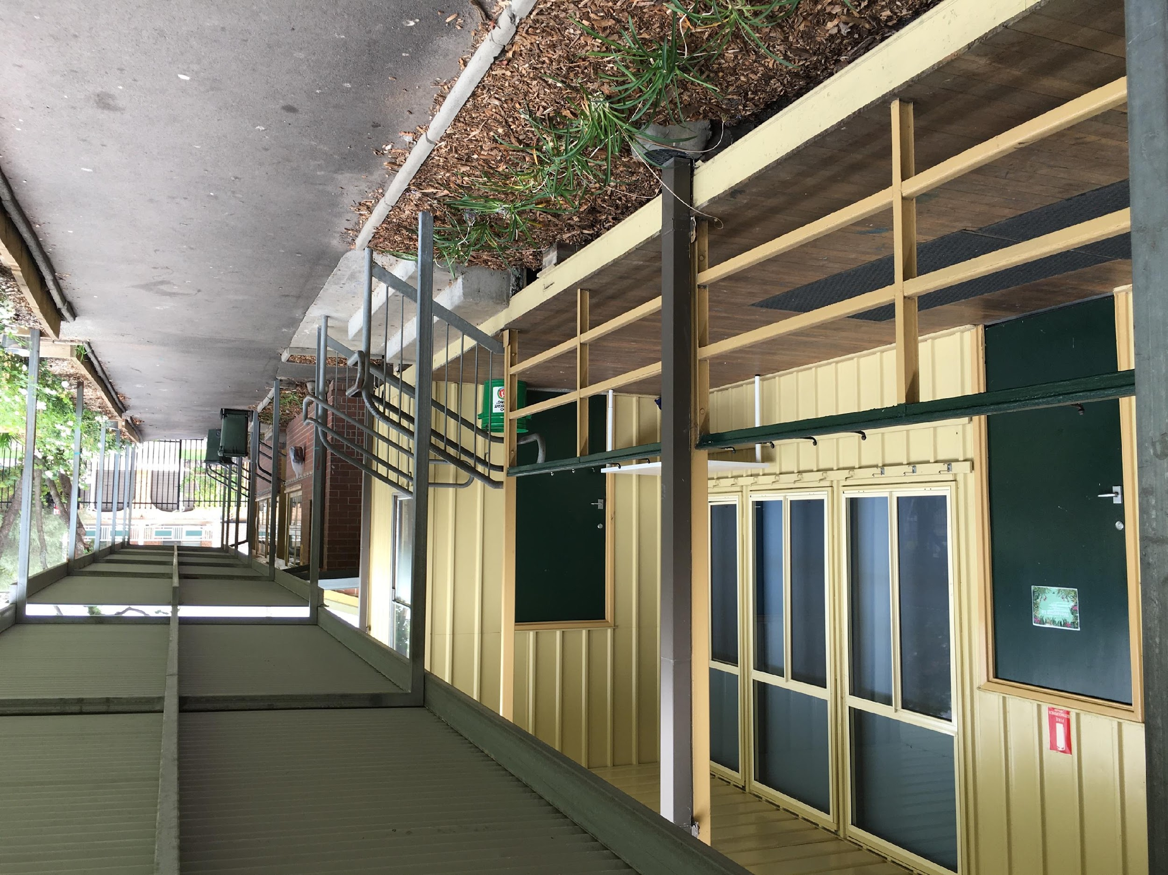
Images of the school (4)
Professor Sebastian Pfautsch – Urban Transformations Research Centre – Western Sydney University

Slide 45
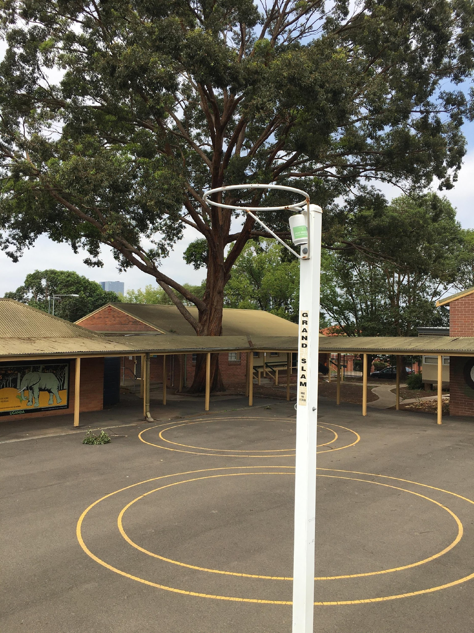
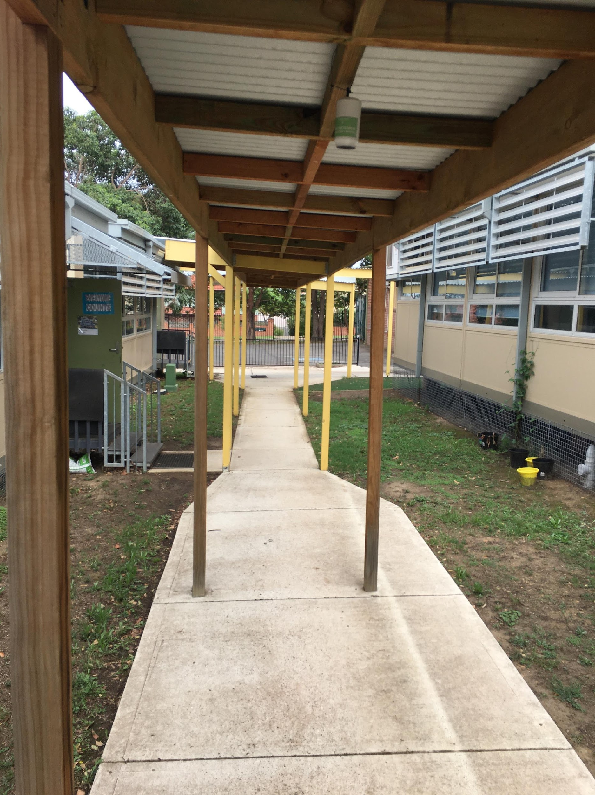
Images of the school (5)
Professor Sebastian Pfautsch – Urban Transformations Research Centre – Western Sydney University

Slide 46
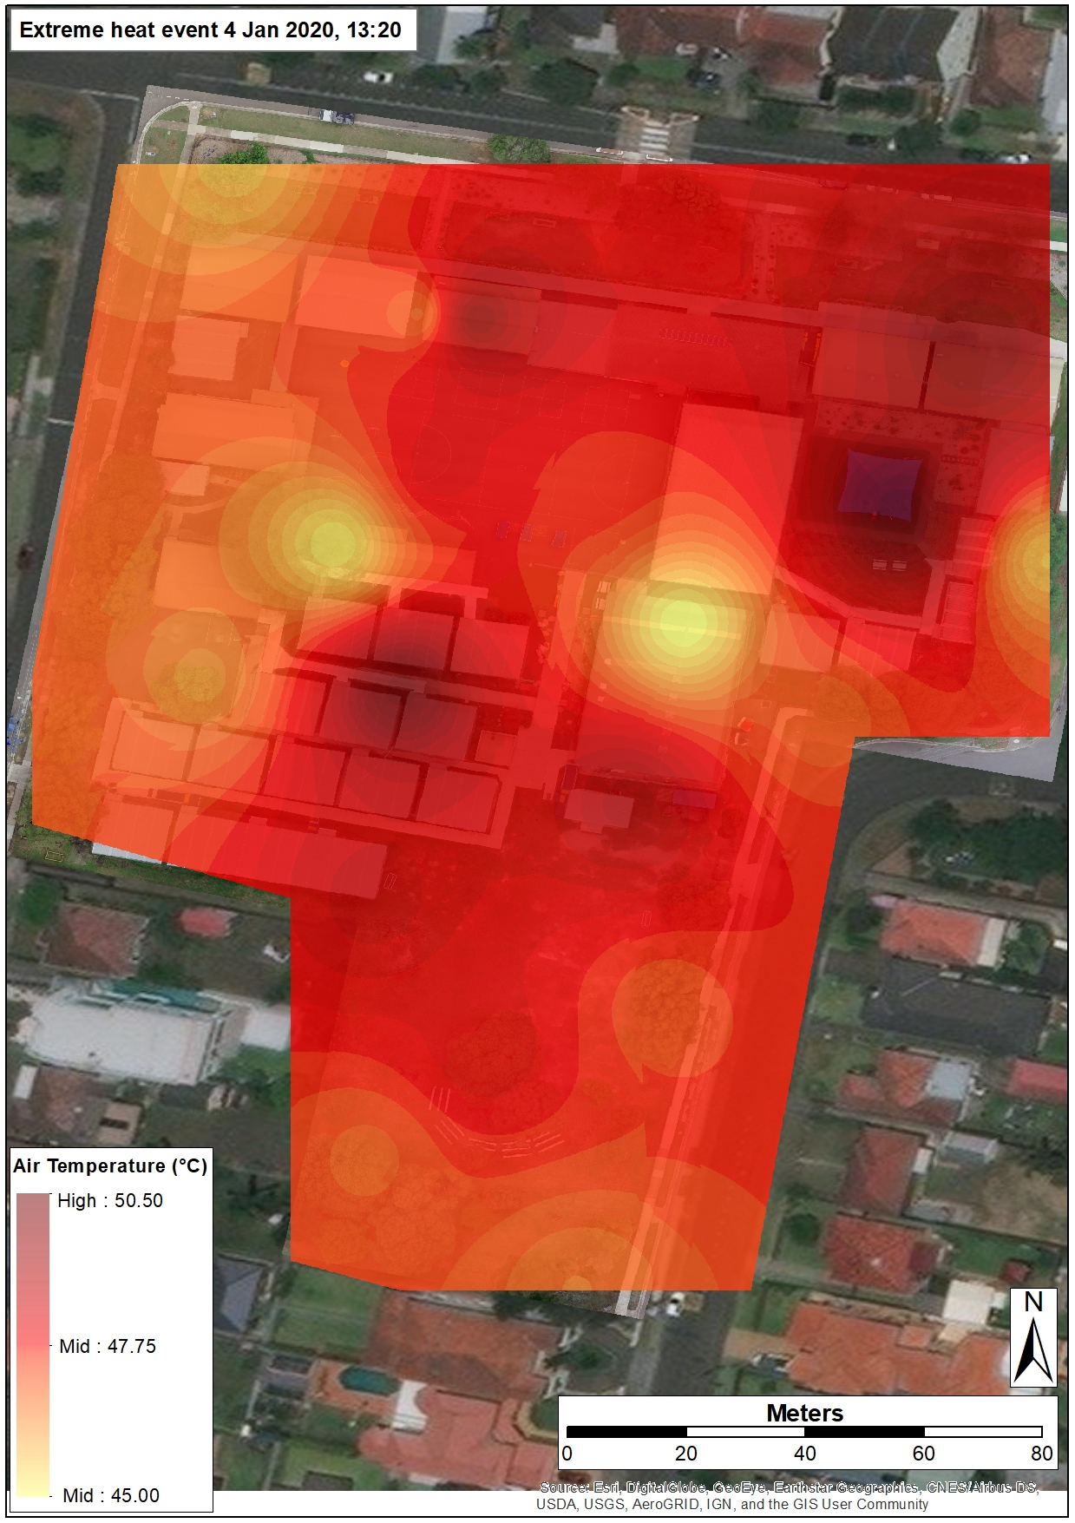
Air temperature variation during the heatwave
Professor Sebastian Pfautsch – Urban Transformations Research Centre – Western Sydney University

Slide 47
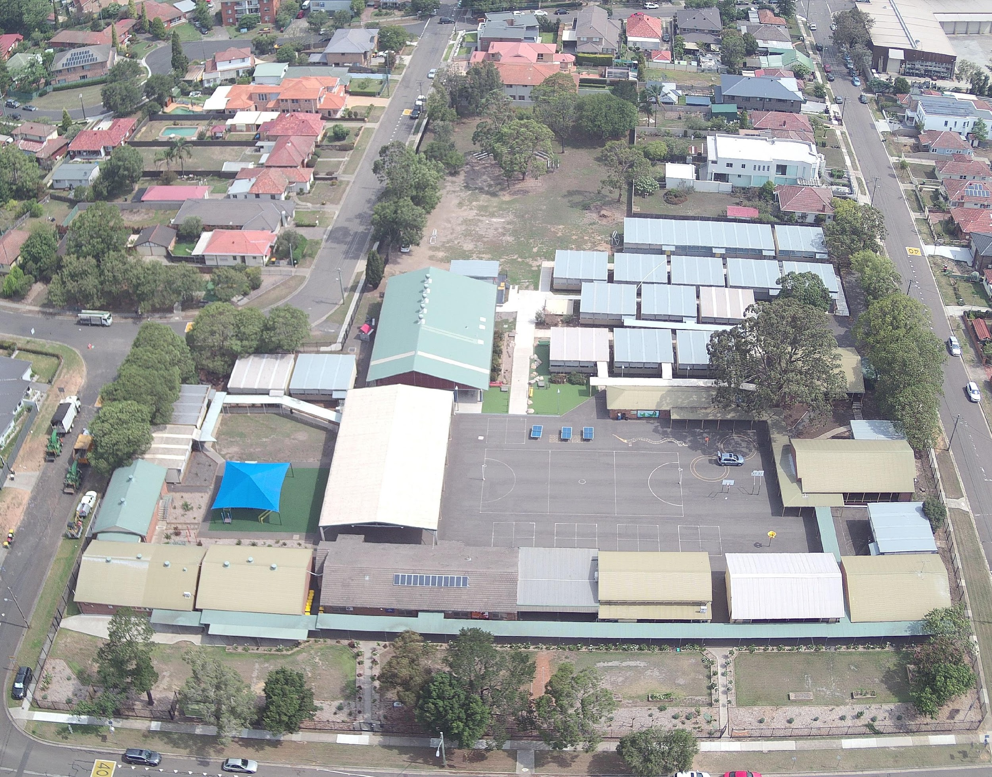
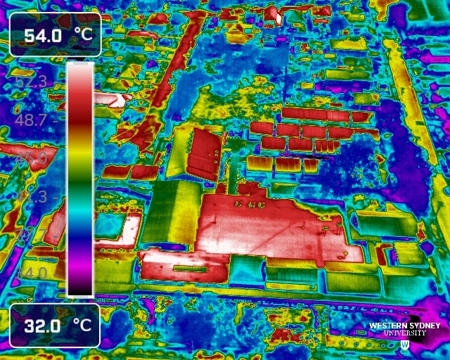
Overview 1
Professor Sebastian Pfautsch – Urban Transformations Research Centre – Western Sydney University

Slide 48
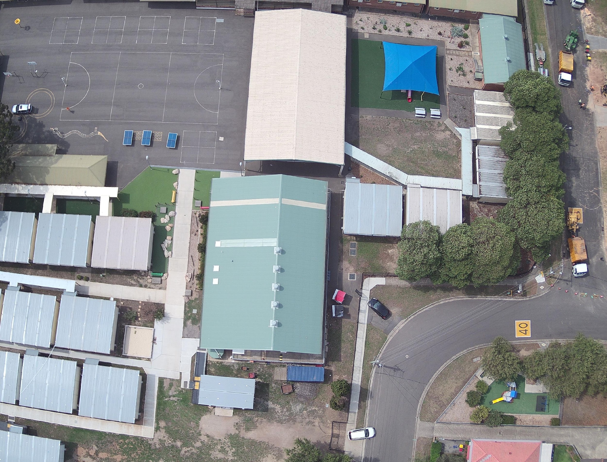
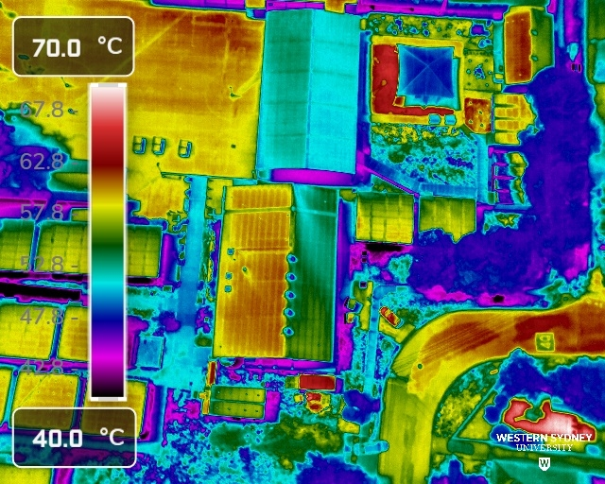
Overview 2
Professor Sebastian Pfautsch – Urban Transformations Research Centre – Western Sydney University

Slide 49
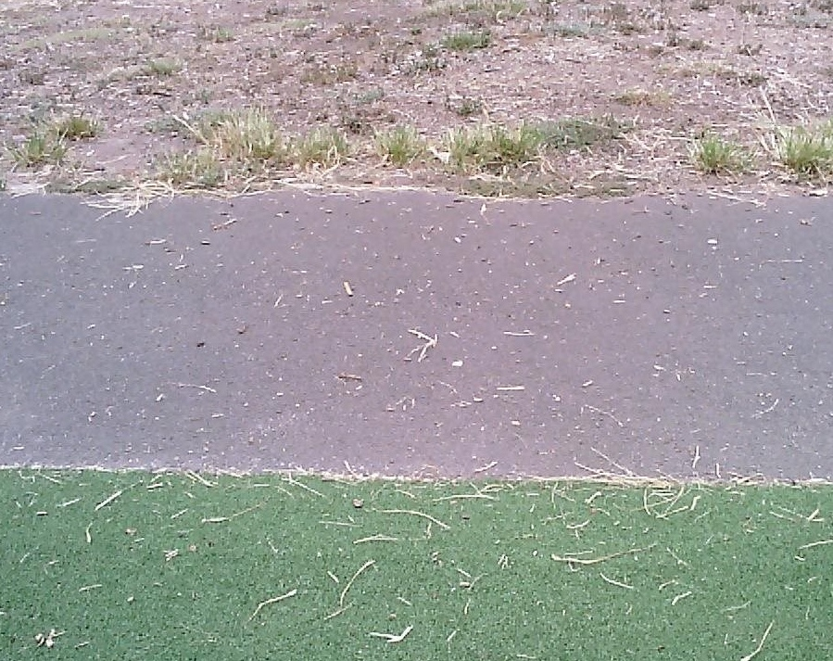
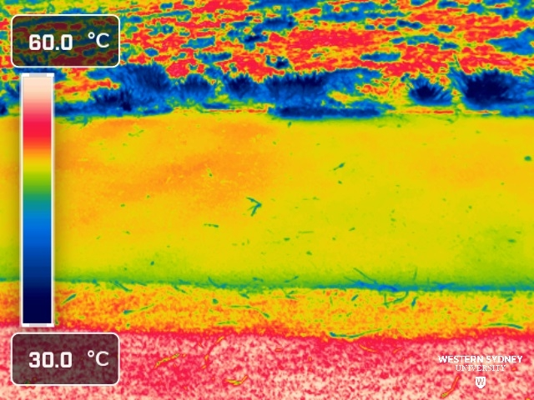
Surface types
Professor Sebastian Pfautsch – Urban Transformations Research Centre – Western Sydney University

Slide 50
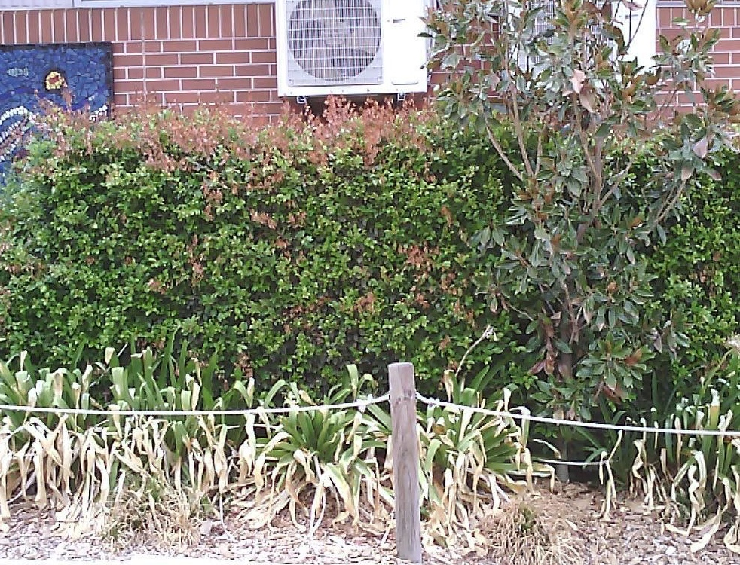
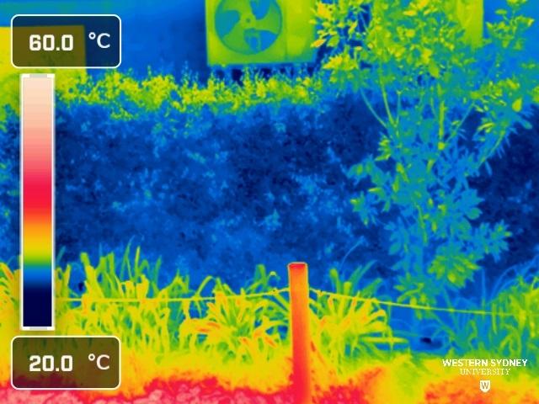
Vegetation
Professor Sebastian Pfautsch – Urban Transformations Research Centre – Western Sydney University

Slide 51
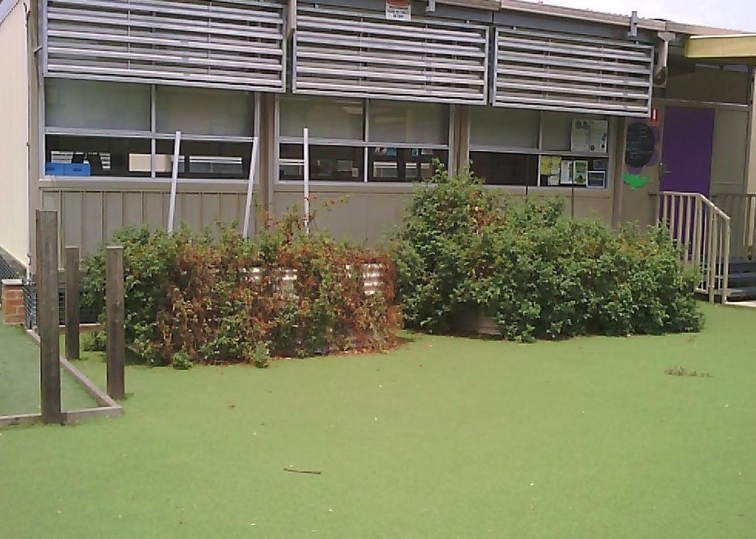
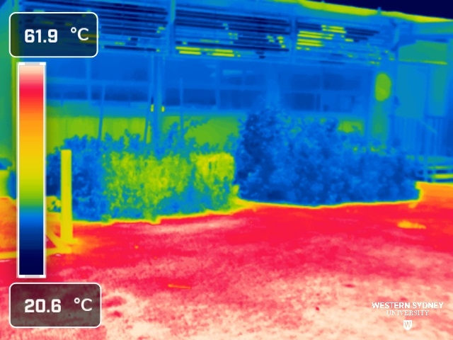
Synthetic grass and planter boxes
Professor Sebastian Pfautsch – Urban Transformations Research Centre – Western Sydney University

Slide 52
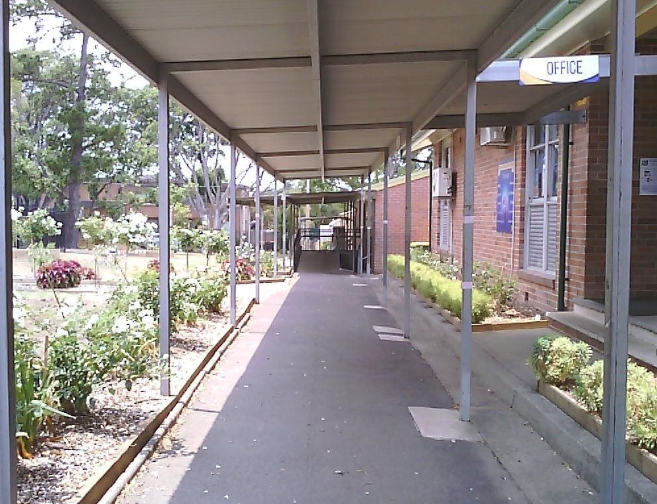
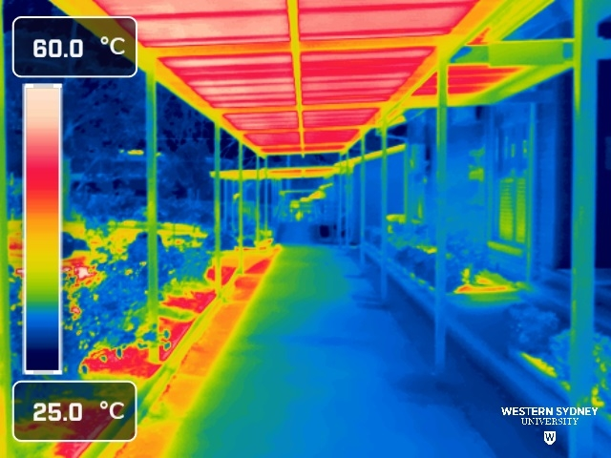
Shaded walkway under hot roof
Professor Sebastian Pfautsch – Urban Transformations Research Centre – Western Sydney University

Slide 53
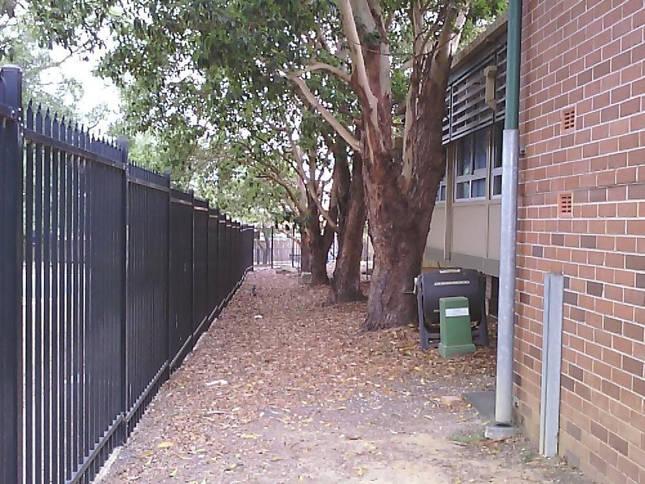
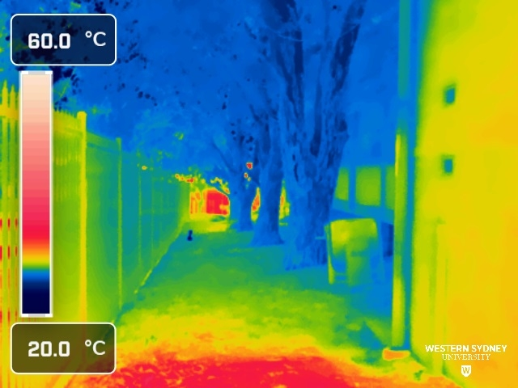
The grove
Professor Sebastian Pfautsch – Urban Transformations Research Centre – Western Sydney University

Slide 54
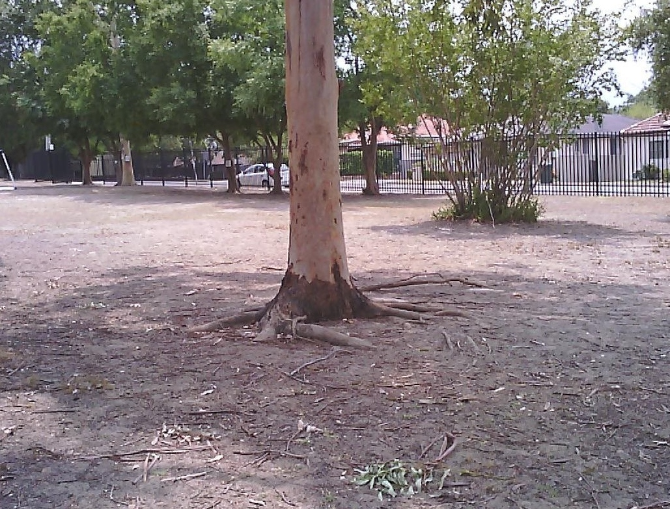
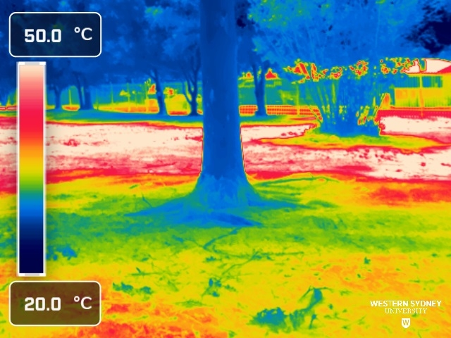
Tree shade and bare soil
Professor Sebastian Pfautsch – Urban Transformations Research Centre – Western Sydney University

Slide 55
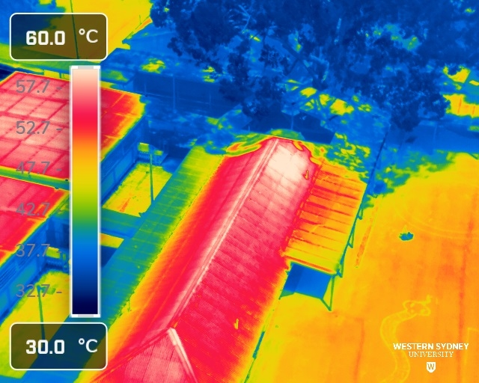
Surface cooling by tree shade
Professor Sebastian Pfautsch – Urban Transformations Research Centre – Western Sydney University

Slide 56
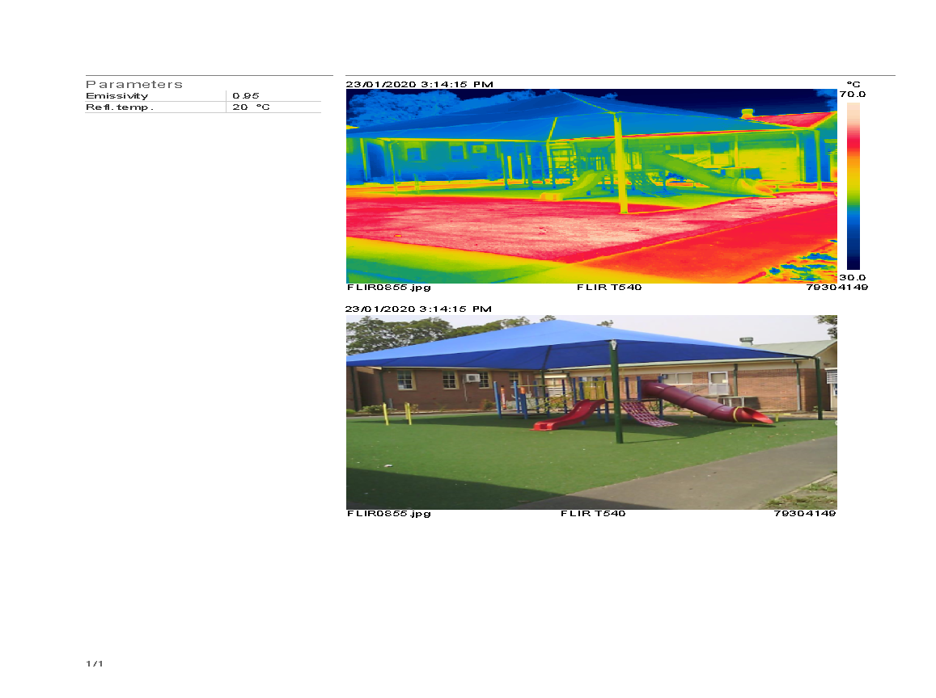

The playground (1)
Professor Sebastian Pfautsch – Urban Transformations Research Centre – Western Sydney University

Slide 57
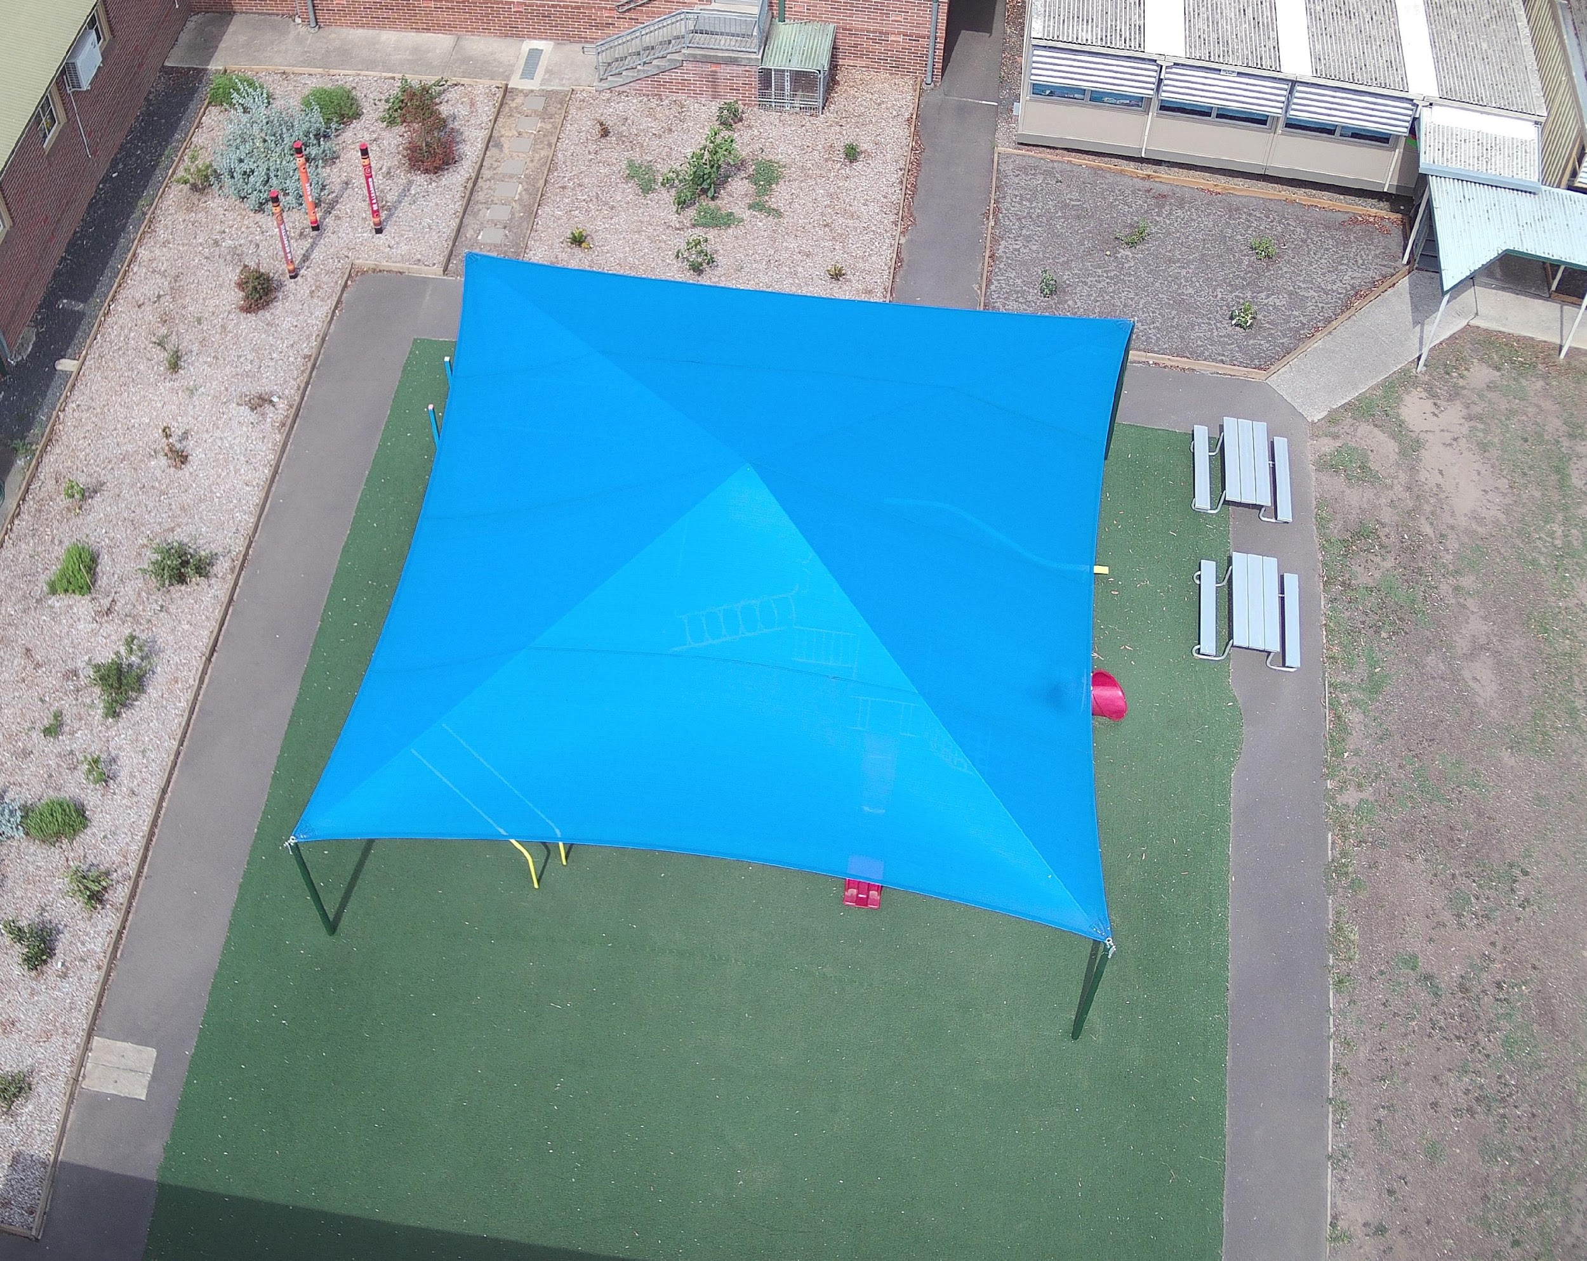
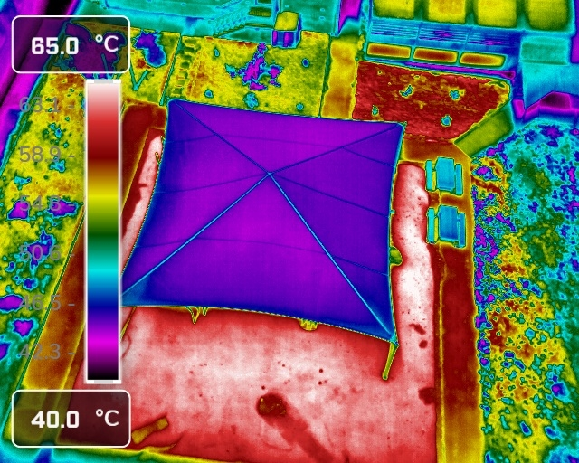
The playground (2)
Professor Sebastian Pfautsch – Urban Transformations Research Centre – Western Sydney University

Slide 58
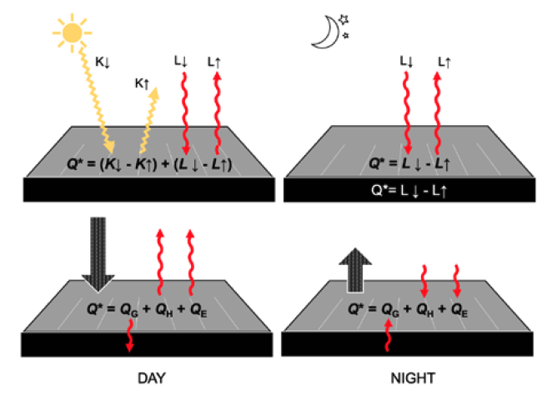
Surface energy balance (1)
Unshaded asphalt during the day and night
The surface energy balance of a conventional unshaded asphalt surface during the day (left) and night (right).
During the day, the energy available at the surface (Q*) is the sum of the difference between the fluxes of shortwave (K) and longwave radiation (L).
The incoming shortwave radiation (K↓) is reflected from the surface (K↑), while the incoming longwave radiation (L↓) is
re-emitted from the surface (L↑).
The (K↓- K↑) and (L↓- L↑) indicate the portion of the energy that was retained by the material (Q*). The Q* is explained by 3 heat fluxes: ground (QG), sensible (QH) and latent heat (QE).

Slide 59
Surface energy balance (2)
Unshaded asphalt during the day and night
As the surface warms in the daytime, a small portion of the energy is transferred into the ground (QG), and the remaining fluxes heat the air (QH) and water (QE) in the atmosphere.
At night, L continues to affect the site microclimate, with the Q* depending on the difference between L↓ and L↑. The L↓ absorbed by the surface during the day is emitted back, with the contribution of longwave radiation from the built environment that also re-emits from the surface.
As the surface cools due to radiative cooling with the release of QG from the ground, the sensible (QH) and latent heat (QE) warms the asphalt surface. Modified from Oke (1987).

Slide 60
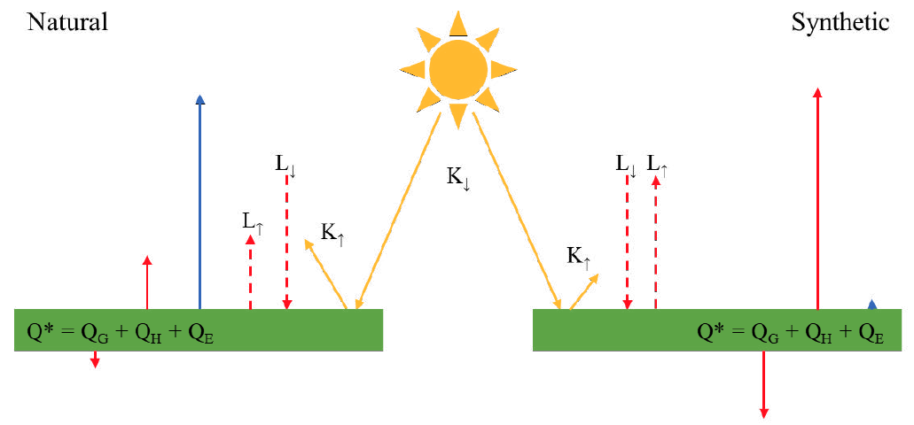
Surface energy balance (3)
Natural vs synthetic grass
The daytime energy balance of well-watered natural (left) and dry synthetic turf (right) is shown. The same abbreviations as for the asphalt surface energy balance apply here.
Natural turf reflects approximately 10 times more solar energy than synthetic turf (Devitt et al. 2007; Golden 2021), due to the reflection of a significant proportion of incoming shortwave (K↑) with less longwave radiation (L↑).
As most absorbed energy is used for photosynthesis, a small amount is lost as sensible (QH) and ground heat flux (QG). Given the water content under natural turf is high, the largest component of the energy balance in natural turf is latent heat flux (for example transpiration cooling or QE).

Slide 61
Surface energy balance (4)
Natural vs synthetic grass
Even with the continuous rise of solar radiation, natural turf maintains low surface temperatures due to the cooling by transpiration, high water content, and low thermal mass. In contrast, synthetic turf reflects less and absorbs more incoming solar radiation than natural turf.
A proportionate amount of incoming longwave radiation is emitted back into the environment. A portion of the absorbed energy is lost into the ground, and it can be as large as combined soil and sensible heat fluxes of natural turf. The largest component of the energy balance of synthetic turf is sensible heat flux, which can be similar to the latent heat flux of natural turf. Without natural moisture within the synthetic turf structure, latent heat flux does not exist (unless irrigated).

Slide 62
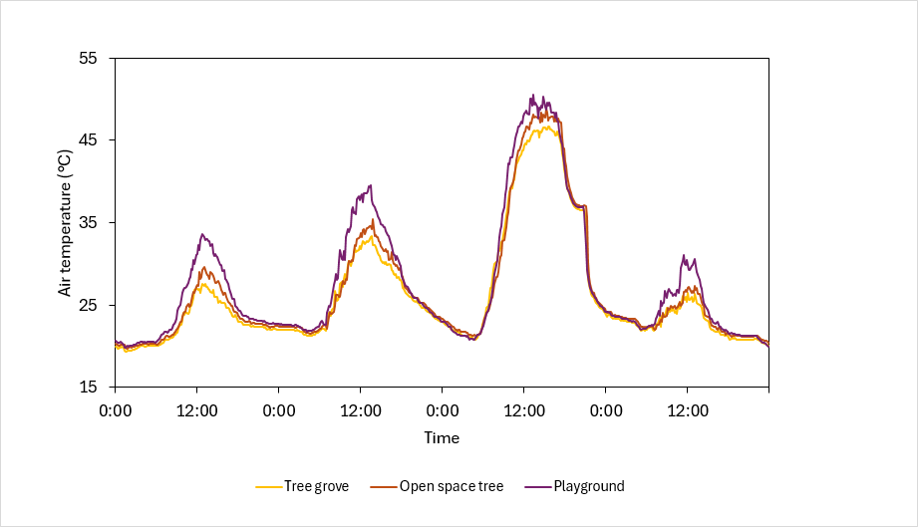
Hot School Questions (1)
Using filters, sort and functions to investigate data
What do you see in the line graph?
What do you think are the reasons that lead to the way that the data looks?
Use the ‘filter’ function in Excel to determine when the air temperatures among the 3 locations are the least different and explain the reason.
How many times (in 10-minute intervals) were the air temperatures the same among the 3 times?

Slide 63
Hot School Questions (2)
Using filters, sort and functions to investigate data
Heatwaves in Western Sydney usually end when the ‘Southerly Buster’ arrives.
The Southerly Buster is a very strong wind from the southwest that blows the hot air out of Western Sydney to the northeast and out to the Pacific Ocean.
When the wind arrives, air temperatures drop very fast.
In our example, this happened during the early evening of 4 January. Identify the 60-minute time interval between 17:00 and 22:00 at which the temperature dropped the fastest.
When and by how much did the temperature drop at each of the 3 locations?

Slide 64
Hot School Questions (3)
Using filters, sort and functions to investigate data
Now that you are more familiar with microclimates at each of the 3 sites, it is time to assign the locations to the physical places in the school.
You can see 3 stars that mark the locations. From Questions 1 and 2, you have learned that there is one very hot location, one that is not so hot, and one that is in between the 2.
Can you identify which location is #1, #2 and #3?
Explain briefly what made you assign each air temperature dataset to the location.

Slide 65
Hot School Questions (4)
Using filters, sort and functions to investigate data
Analyse the school photographs and look at the different surfaces.
Make a list of the surface materials you can see across the school.
Group them into natural and engineered/manufactured surfaces and rank them from the hottest to the coolest surfaces in both categories.
You should have at least 3 surface types in a single category.
What is the hottest and what is the coolest surface in the school?
How many rainwater tanks does the school have?
To answer this question, you must enlarge the images from the school as much as possible.

Slide 66
Hot School Questions (5)
Using filters, sort and functions to investigate data
Knowing that vegetation like grass, shrubs and trees can keep surfaces and the air cool, for what could the rainwater be used to amplify surface and air cooling?
Where in the school would the use of rainwater bring the greatest thermal benefits?
Let’s redesign the playground area, applying your newly gained knowledge about microclimates and what makes things hot and what keeps them cool.
Describe what design modifications you would suggest to the school management to make the playground area cooler?
What else can the school change to make the entire place less hot in summer?

Slide 67

Optimal learning environment challenge
Oracle
Enterprise Computing 11–12
Data science

Slide 68
Learning intentions and success criteria (Oracle)
We are learning to:
explore the factors that contribute to an optimal learning environment
analyse data on indoor environmental quality (IEQ) and its impact on student performance
develop strategies to improve the learning environment based on data insights.
We can:
identify key IEQ factors that affect learning and propose improvements
analyse and interpret data from various schools to determine the impact of IEQ
recommend practical changes to enhance the learning environment based on data analysis.
Notes:
Notes for teachers:
Learning intentions and success criteria are best co-constructed with students. Adapt the learning intention as required and add matching success criteria.
For more information see ⁠AITSL or the NSW Department of Education explicit teaching strategies, ⁠Sharing learning intentions and ⁠Sharing success criteria.
LISC is not necessarily presented at the beginning of the lesson. Teacher needs to consider most effectual time to introduce.
LISC should be revisited during the lesson to support students' evaluation of their learning.

Slide 69
Cold
Just Right
Hot
How does this room feel to you?
Bright
Dark
Noisy
Stuffy

Slide 70
Can your classroom make or break your learning? (1)
Optimal learning environment – Oracle
There’s a strong correlation between the Indoor Environmental Quality (IEQ) of a room and its impact on learning.
IEQ factors include:
temperature
humidity
ventilation
acoustics
lighting.
However, schools are a complex setting and there's more to the story.

Slide 71
Can your classroom make or break your learning? (2)
Optimal learning environment – Oracle
How can we collect and analyse data to understand and improve the optimal environment for student learning?
Let’s explore beyond the obvious and reflect on the following questions:
What really constitutes an ideal learning environment?
How do the various elements of IEQ affect students' ability to focus and excel?
What other factors or variables (beyond IEQ) are there that impact whether a learning environment ideal?

Slide 72
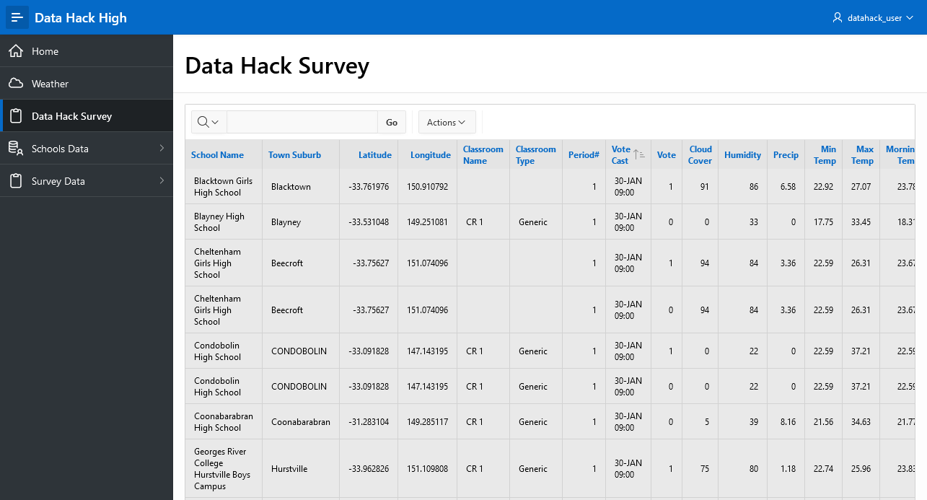
Accessing the data
Optimal learning environment – Oracle
Use the following link:
Apex Oracle
Username: datahack_user
Password: DataHack2024!

Slide 73
Diving in the data
Optimal learning environment – Oracle
Ready to be a data detective?
Examine the datasets and look at the:
26 schools
1 classroom (in each school)
22 to 30 desks based on school size
5 periods
280,000+ records
+ Weather from February to May for 26 schools (weekdays)

Slide 74
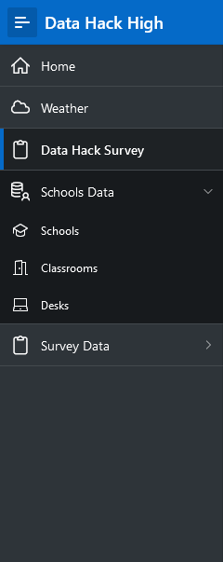

Accessing the data (1)
Optimal learning environment – Oracle
1
1
Click here to bring up the Side Menu.
2
Click here to access the Weather Data.
2
Click here to access All Data (joined).
3
3
4
Click here to reveal the Schools Data tables (Schools, Classrooms, Desks).
4
5
Click here to reveal the Survey Data tables (Schools, Classrooms, Desks).
5

Slide 75
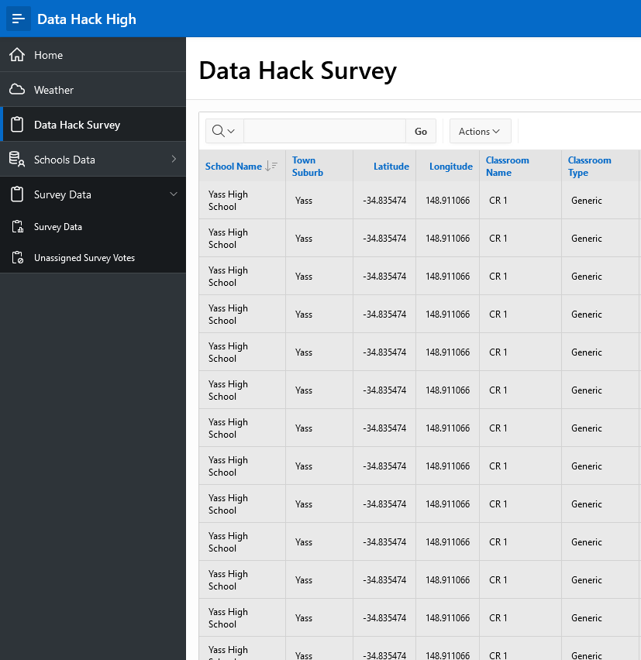
Accessing the data (2)
Optimal learning environment - Oracle
1
Click the Actions Button to access actions you can do with the data.
Below are some common functions you can use.
Columns – show or hide columns in the report.
Filter – filter the displayed data.
Download – download the data to manipulate outside of APEX. (CSV, Excel)
1

Slide 76
Assumptions
Optimal learning environment – Oracle
Vote is Comfortable (1) or Uncomfortable (0).
Air conditioner is located at the front-centre of the classroom.
Classrooms have the same layout (3 variants).

Slide 77
Classroom layout variant 1 – 30 seats
Optimal learning environment – Oracle
AC UNIT
Left
Centre
Right
1
2
3
4
5
6
Front
7
8
9
10
11
12
13
14
15
Middle
16
17
18
19
20
21
22
23
24
Rear
25
26
27
28
29
30

Slide 78
Classroom layout variant 1 – 24 seats
Optimal learning environment – Oracle
AC UNIT
Left
Centre
Right
1
2
3
Front
4
5
6
7
8
9
10
11
12
Middle
13
14
15
16
17
18
19
20
21
Rear
22
23
24

Slide 79
Classroom layout variant 1 – 22 seats
Optimal learning environment – Oracle
AC UNIT
Left
Centre
Right
1
2
3
Front
4
5
6
7
8
9
10
11
12
Middle
13
14
15
16
17
18
19
20
21
Rear
22

Slide 80
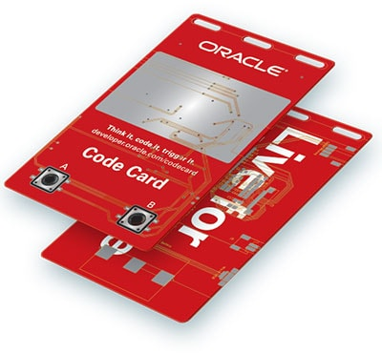
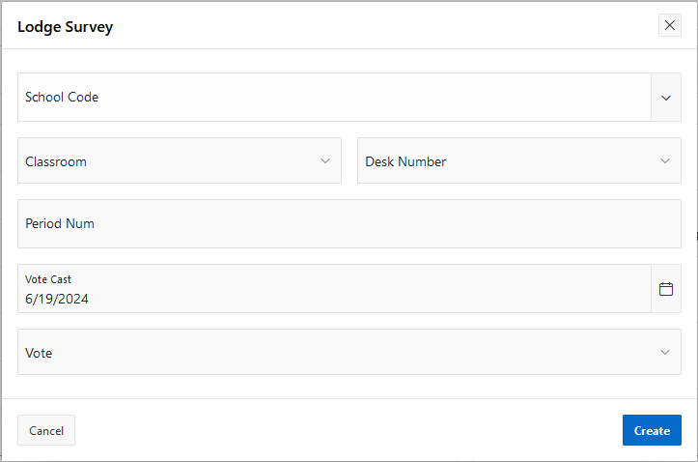
How could we collect the data?
Optimal learning environment – Oracle
Code Cards
E-ink display
2 Buttons
Wi-Fi Connection
Simple Form
Apex
Google
Microsoft

Slide 81



What could you do with the data?
Optimal learning environment – Oracle
Simple
Intermediate
Challenging
Visualise data
Heatmap
Histogram
Bar Chart
Look at the datasets separately
Classroom
Weather
Sentiment (Votes)
Explore linkages
+ other data
Classroom + Weather
Class Results

Slide 82

82

Slide 83
References (1)
This presentation contains NSW Curriculum and syllabus content. The NSW Curriculum is developed by the NSW Education Standards Authority. This content is prepared by NESA for and on behalf of the Crown in the right of the State of New South Wales. The material is protected by Crown copyright.
Please refer to the NESA Copyright Disclaimer for more information https://educationstandards.nsw.edu.au/wps/portal/nesa/mini-footer/copyright.
NESA holds the only official and up-to-date versions of the NSW Curriculum and syllabus documents. Please visit the NSW Education Standards Authority (NESA) website https://educationstandards.nsw.edu.au/wps/portal/nesa/home and the NSW Curriculum website https://curriculum.nsw.edu.au.
Enterprise Computing 11–12 Syllabus © NSW Education Standards Authority (NESA) for and on behalf of the Crown in right of the State of New South Wales, 2022.
Enterprise Computing 11–12 Course Specifications © NSW Education Standards Authority (NESA) for and on behalf of the Crown in right of the State of New South Wales, 2022.
Australia Post (n.d.) Find a postcode [website], accessed 7 August 2024.
Australian Bureau of Statistics (n.d.) Census [website], accessed 7 August 2024.
Australian Government Department of Infrastructure, Transport, Regional Development and Communications (n.d.) Green Vehicle Guide [website], accessed 7 August 2024.
Datareportal (n.d.) Global Social Media Statistics [website], accessed 7 August 2024.
Google (n.d.) Google Maps [website], accessed 7 August 2024.

Slide 84
References (2)
This presentation contains NSW Curriculum and syllabus content. The NSW Curriculum is developed by the NSW Education Standards Authority. This content is prepared by NESA for and on behalf of the Crown in the right of the State of New South Wales. The material is protected by Crown copyright.
Please refer to the NESA Copyright Disclaimer for more information https://educationstandards.nsw.edu.au/wps/portal/nesa/mini-footer/copyright.
NESA holds the only official and up-to-date versions of the NSW Curriculum and syllabus documents. Please visit the NSW Education Standards Authority (NESA) website https://educationstandards.nsw.edu.au/wps/portal/nesa/home and the NSW Curriculum website https://curriculum.nsw.edu.au.
Google Trends (n.d.) Electronic cigarette Australia [website], accessed 7 August 2024.
Google Trends (n.d.) Electronic cigarette worldwide [website], accessed 7 August 2024.
Intergovernmental Panel on Climate Change (2014) Climate Change 2014: Synthesis Report. Contribution of Working Groups I, II and III to the Fifth Assessment Report of the Intergovernmental Panel on Climate Change [website], accessed 7 August 2024.
Liang Y, Zheng X and Zeng DD (2017) E-Cigarette Promotion on Twitter in Australia: Content Analysis, Journal of Medical Internet Research, 19(10), e365. doi:10.2196/jmir.8221
Mills B and Muriuki A (2018) Electronic cigarette social norms among adolescents in New South Wales, Australia, Health Education Journal, 77(7), 791–802. doi:10.1177/0017896918779051
NSW Government (n.d.) NSW Planning Portal [website], accessed 7 August 2024.

Slide 85
References (3)
This presentation contains NSW Curriculum and syllabus content. The NSW Curriculum is developed by the NSW Education Standards Authority. This content is prepared by NESA for and on behalf of the Crown in the right of the State of New South Wales. The material is protected by Crown copyright.
Please refer to the NESA Copyright Disclaimer for more information https://educationstandards.nsw.edu.au/wps/portal/nesa/mini-footer/copyright.
NESA holds the only official and up-to-date versions of the NSW Curriculum and syllabus documents. Please visit the NSW Education Standards Authority (NESA) website https://educationstandards.nsw.edu.au/wps/portal/nesa/home and the NSW Curriculum website https://curriculum.nsw.edu.au.
NSW Health (n.d.) Health Stats NSW [website], accessed 7 August 2024.
NSW Health (n.d.) Vaping and e-cigarettes [website], accessed 7 August 2024.
NSW Health (n.d.) Our Vaping Toolkit [website], accessed 7 August 2024.
Oke, T. R. (1987) Boundary layer climates (2nd ed.), Methuen.
Oracle (n.d.) Oracle APEX [website], accessed 7 August 2024.
Plugshare (n.d.) EV Charging Stations Map [website], accessed 7 August 2024.
Transport for NSW (n.d.) Electric Vehicles [website], accessed 7 August 2024.
White V, Williams T and Wakefield M (2019) Vaping product access and use among 14-17-year-olds in New South Wales: a cross-sectional study, Australian and New Zealand Journal of Public Health, 43(6), 542–548. doi:10.1111/1753-6405.12947

Slide 86
Copyright
© State of New South Wales (Department of Education), 2024
The copyright material published in this resource is subject to the Copyright Act 1968 (Cth) and is owned by the NSW Department of Education or, where indicated, by a party other than the NSW Department of Education (third-party material).
Copyright material available in this resource and owned by the NSW Department of Education is licensed under a Creative Commons Attribution 4.0 International (CC BY 4.0) licence.
This licence allows you to share and adapt the material for any purpose, even commercially.
Attribution should be given to © State of New South Wales (Department of Education), 2024.
Material in this resource not available under a Creative Commons licence:
the NSW Department of Education logo, other logos and trademark-protected material
Material owned by a third party that has been reproduced with permission. You will need to obtain permission from the third party to reuse its material.
Links to third-party material and websites
Please note that the provided (reading/viewing material/list/links/texts) are a suggestion only and implies no endorsement, by the New South Wales Department of Education, of any author, publisher, or book title. School principals and teachers are best placed to assess the suitability of resources that would complement the curriculum and reflect the needs and interests of their students.
If you use the links provided in this document to access a third party’s website, you acknowledge that the terms of use, including licence terms set out on the third-party’s website apply to the use which may be made of the materials on that third-party website or where permitted by the Copyright Act 1968 (Cth). The department accepts no responsibility for content on third-party websites.

