Slide 1
Instructions for use
This resource is not a teaching and learning program. It should be used in conjunction with Software Engineering Stage 6 (Year 12) – sample program of learning – Programming for the web.
Classroom teachers are encouraged to add and adapt slides as required to meet the needs of their students.
Save a copy of the file to make changes to the slide deck. Go to File > Download a Copy (this downloads a copy to the computer to edit in the PowerPoint app).
To convert the PowerPoint to Google Slides:
  Upload the file into Google Drive and open it.
  Go to File > Save as Google Slides.
  (Note – conversion may cause formatting changes in the slides.)

Slide 2
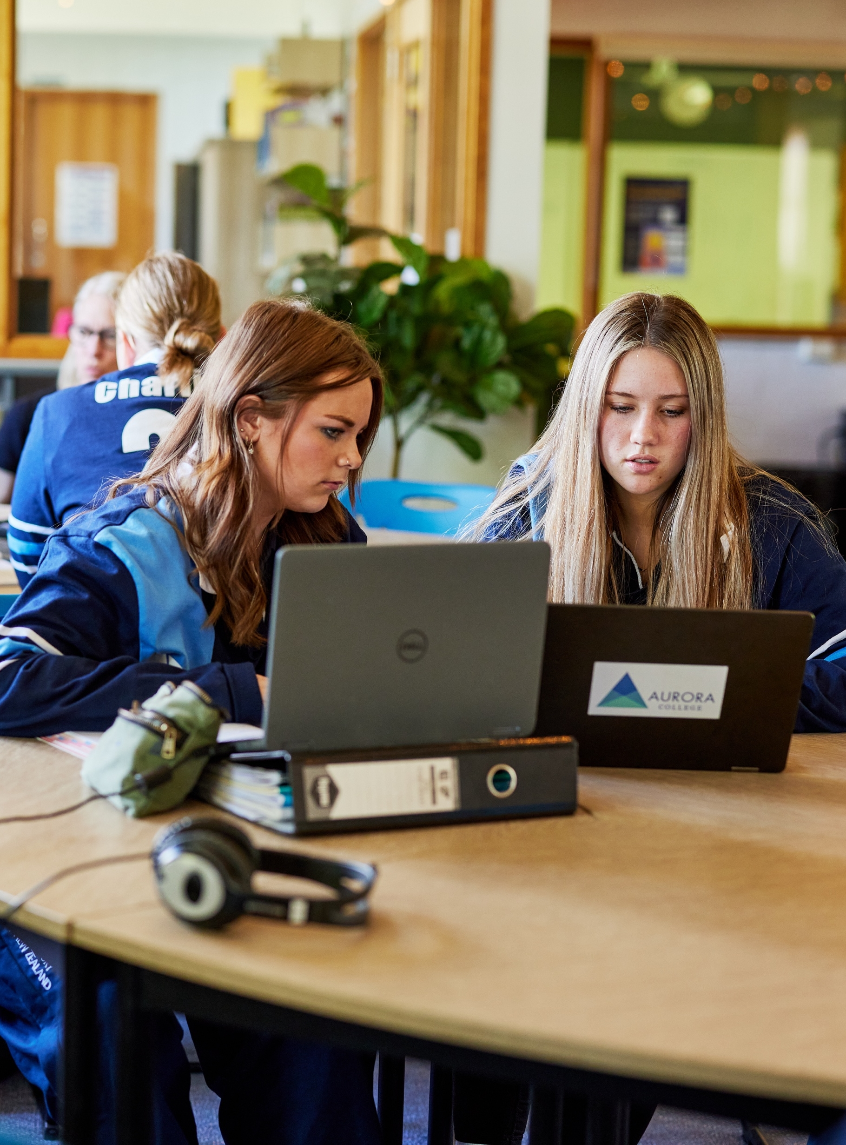
Programming for the web
Software Engineering 11–12 (Year 12)

Slide 3
Learning intentions and success criteria (1)
We are learning to:
differentiate between the internet and the web and define HTML, CSS and JavaScript
define a web server and describe the concept of cookies.
We can:
explain the fundamental differences between the internet and the web
describe the role of HTML in structuring web content and how CSS enhances the visual presentation of webpages and identify JavaScript as a programming language
compare and contrast client-side and server-side programming
recognise the usefulness of web browser developer tools and describe how cookies are used to store user data and enhance website functionality
identify security issues, such as data privacy, authentication and protection against cyber threats
interact with websites to understand their use in e-commerce.
Notes:
Notes for teachers:
Learning intentions and success criteria are best co-constructed with students. Adapt the learning intention as required and add matching success criteria.
For more information see ⁠AITSL or the NSW Department of Education explicit teaching strategies, ⁠Sharing learning intentions and ⁠Sharing success criteria.
LISC is not necessarily presented at the beginning of the lesson. Teacher needs to consider most effectual time to introduce.
LISC should be revisited during the lesson to support students' evaluation of their learning.

Slide 4
Learning intentions and success criteria (2)
We are learning to:
explain the processes for securing the web including technologies and practices to protect data transmission
authenticate users and servers
ensure privacy and integrity of information.
We can describe and explain:
Secure Sockets Layer (SSL) certificates, encryption algorithms, encryption keys, plain text and cipher text, authentication
authorisation, hash values, digital signatures.
Notes:
Notes for teachers:
Learning intentions and success criteria are best co-constructed with students. Adapt the learning intention as required and add matching success criteria.
For more information see ⁠AITSL or the NSW Department of Education explicit teaching strategies, ⁠Sharing learning intentions and ⁠Sharing success criteria.
LISC is not necessarily presented at the beginning of the lesson. Teacher needs to consider most effectual time to introduce.
LISC should be revisited during the lesson to support students' evaluation of their learning.

Slide 5
Learning intentions and success criteria (3)
We are learning to:
develop web applications using an appropriate scripting language
use shell scripts to make files and directories, and search for text in a text file.
We can:
apply version control when developing a web application
recognise the use of code libraries for front-end web development
manage the load times of web pages/applications
make files and directories and search for text in a text file.
Notes:
Notes for teachers:
Learning intentions and success criteria are best co-constructed with students. Adapt the learning intention as required and add matching success criteria.
For more information see ⁠AITSL or the NSW Department of Education explicit teaching strategies, ⁠Sharing learning intentions and ⁠Sharing success criteria.
LISC is not necessarily presented at the beginning of the lesson. Teacher needs to consider most effectual time to introduce.
LISC should be revisited during the lesson to support students' evaluation of their learning.

Slide 6
Learning intentions and success criteria (4)
We are learning to:
research, experiment with and evaluate the prevalence and use of web content management systems (CMS).
We can:
explain the use and development of open-source software in relation to web development
evaluate the prevalence and use of web content management systems (CMS).
Notes:
Notes for teachers:
Learning intentions and success criteria are best co-constructed with students. Adapt the learning intention as required and add matching success criteria.
For more information see ⁠AITSL or the NSW Department of Education explicit teaching strategies, ⁠Sharing learning intentions and ⁠Sharing success criteria.
LISC is not necessarily presented at the beginning of the lesson. Teacher needs to consider most effectual time to introduce.
LISC should be revisited during the lesson to support students' evaluation of their learning.

Slide 7
Learning intentions and success criteria (5)
We are learning to:
recognise and explain the difference between Object-Relational Mapping (ORM) to SQL
recognise the benefits of collaboration during web development.
We can:
identify and apply ORM
identify and describe a web server request
apply design and user interface (UI) and user experience (UX) principles of font, colour, audio, video and navigation
develop a UI that considers accessibility and inclusivity.
Notes:
Notes for teachers:
Learning intentions and success criteria are best co-constructed with students. Adapt the learning intention as required and add matching success criteria.
For more information see ⁠AITSL or the NSW Department of Education explicit teaching strategies, ⁠Sharing learning intentions and ⁠Sharing success criteria.
LISC is not necessarily presented at the beginning of the lesson. Teacher needs to consider most effectual time to introduce.
LISC should be revisited during the lesson to support students' evaluation of their learning.

Slide 8
Learning intentions and success criteria (6)
We are learning to:
confidently deliver an explanation of our PWA
demonstrate expertise in responding to questions and answers (Q&A) from peer assessment of our PWA.
We can:
deliver a PWA project to peers, teachers and/or clients.
Notes:
Notes for teachers:
Learning intentions and success criteria are best co-constructed with students. Adapt the learning intention as required and add matching success criteria.
For more information see ⁠AITSL or the NSW Department of Education explicit teaching strategies, ⁠Sharing learning intentions and ⁠Sharing success criteria.
LISC is not necessarily presented at the beginning of the lesson. Teacher needs to consider most effectual time to introduce.
LISC should be revisited during the lesson to support students' evaluation of their learning.

Slide 9
References
This presentation contains NSW Curriculum and syllabus content. The NSW Curriculum is developed by the NSW Education Standards Authority. This content is prepared by NESA for and on behalf of the Crown in the right of the State of New South Wales. The material is protected by Crown copyright.
Please refer to the NESA Copyright Disclaimer for more information https://educationstandards.nsw.edu.au/wps/portal/nesa/mini-footer/copyright.
NESA holds the only official and up-to-date versions of the NSW Curriculum and syllabus documents. Please visit the NSW Education Standards Authority (NESA) website https://educationstandards.nsw.edu.au/wps/portal/nesa/home and the NSW Curriculum website https://curriculum.nsw.edu.au.
Software Engineering 11–12 Syllabus © NSW Education Standards Authority (NESA) for and on behalf of the Crown in right of the State of New South Wales, 2022.

Slide 10
Copyright
© State of New South Wales (Department of Education), 2024
The copyright material published in this resource is subject to the Copyright Act 1968 (Cth) and is owned by the NSW Department of Education or, where indicated, by a party other than the NSW Department of Education (third-party material).
Copyright material available in this resource and owned by the NSW Department of Education is licensed under a Creative Commons Attribution 4.0 International (CC BY 4.0) license.
This license allows you to share and adapt the material for any purpose, even commercially.
Attribution should be given to © State of New South Wales (Department of Education), 2024.
Material in this resource not available under a Creative Commons license:
the NSW Department of Education logo, other logos and trademark-protected material
Material owned by a third party that has been reproduced with permission. You will need to obtain permission from the third party to reuse its material.
Links to third-party material and websites
Please note that the provided (reading/viewing material/list/links/texts) are a suggestion only and implies no endorsement, by the New South Wales Department of Education, of any author, publisher, or book title. School principals and teachers are best placed to assess the suitability of resources that would complement the curriculum and reflect the needs and interests of their students.
If you use the links provided in this document to access a third-party’s website, you acknowledge that the terms of use, including licence terms set out on the third-party’s website apply to the use which may be made of the materials on that third-party website or where permitted by the Copyright Act 1968 (Cth). The department accepts no responsibility for content on third-party websites.

