Slide 1
Instructions for use
This resource is not a teaching and learning program. It should be used in conjunction with (Insert unit name and link).
Classroom teachers are encouraged to add and adapt slides as required to meet the needs of their students.
Save a copy of the file to make changes to the slide deck. Go to File > Download a Copy (this downloads a copy to the computer to edit in the PowerPoint app).
To convert the PowerPoint to Google Slides:
  Upload the file into Google Drive and open it.
  Go to File > Save as Google Slides.
  (Note – conversion may cause formatting changes in the slides.)

Slide 2
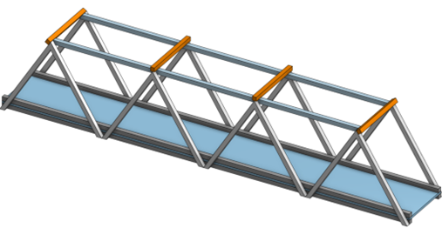
Bridging the Gap
Engineering Technology – Stage 5
Term X
Structures – focus area

Slide 3
Engineers Work

Slide 4
Learning intentions and success criteria (1)
We are learning to
Understand the role of engineers in solving real-world problems
Explore real projects that civil engineers design and build
We can
describe at least 3 projects a civil engineer might work on
collaborate with peers to brainstorm ideas and respond in writing
Identify different types of engineering fields, especially civil engineering
Notes:
Notes for teachers:
Learning intentions and success criteria are best co-constructed with students. Adapt the learning intention as required and add matching success criteria.
For more information See ⁠AITSL or the NSW Department of Education explicit teaching strategies, ⁠Sharing learning intentions and ⁠Sharing success criteria
LISC is not necessarily presented at the beginning of the lesson. Teacher needs to consider most effectual time to introduce
LISC should be revisited during the lesson to support students' evaluation of their learning

Slide 5
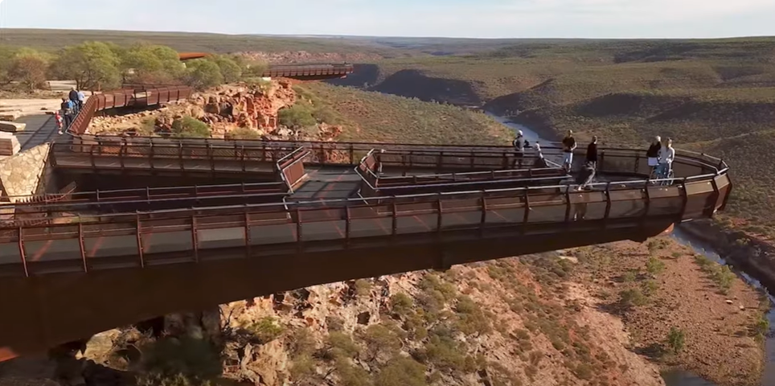
What is Engineering? (1)
Video – ‘Engineering Making Life Happen’ (00:30)

Slide 6
What is Engineering? (2)
Video – ‘Engineering Making life Happen’ (00:30)
Class discussion:
In your own words, what is engineering?
List 3 things engineers do in their work.
1.
2.
3.
Why is problem solving important for engineers?

Slide 7
What is Engineering? (3)
Types of Engineering
Match each type of engineer with what they design or build?
Type of Engineer | What they work on
Civil Engineer | Test and maintain aircraft
Mechanical Engineer | b. Electronic circuits, robotics
Electrical Engineer | c. Engines, machines, mechanical systems
Aeronautical Engineer | d. Roads, bridges, tunnels

Slide 8
What is Engineering? (4)
Types of Engineering
Match each type of engineer with what they design or build?
Answer
Type of Engineer | What they work on
Civil Engineer | Roads, bridges, tunnels
Mechanical Engineer | Engines, machines, mechanical systems
Electrical Engineer | Electronic circuits, robotics
Aeronautical Engineer | Test and maintain aircraft

Slide 9
What is Engineering? (5)
Project | Impact
Highway expansion
Desalination plant
Flood levee system
Bicycle lane networks
Bridge rehabilitation/ maintenance projects
Green roofs on public buildings
Real-world examples of Civil Engineering
Civil Engineers help plan and build infrastructure.
For each of the following projects suggest how they may impact our society.

Slide 10
What is Engineering? (6)
Project | Impact
Highway expansion | Reduces traffic congestion and travel time. Boosts economic activity by improving freight movement. May disrupt local ecosystems or communities during construction
Desalination plant | Provides clean drinking water in drought-prone areas. Supports population growth and agriculture. High energy use and environmental concerns around brine disposal
Flood levee system | Protects homes and businesses from flood damage. Increases land value and safety in flood-prone zones. May alter natural water flow and affect wildlife habitats
Bicycle lane networks | Promotes healthy lifestyles and reduces car use. Lowers emissions and traffic congestion. Requires careful integration with existing roads
Bridge rehabilitation/ maintenance projects | Extends lifespan of critical transport links. Improves safety and reduces maintenance costs. May disrupt traffic during upgrades
Green roofs on public buildings | Improves insulation and reduces energy costs. Enhances biodiversity and urban aesthetics. May have higher initial costs and structural requirements
Real-world examples of Civil Engineering
Civil Engineers help plan and build infrastructure.
For each of the following projects suggest how they may impact our society.
Suggested impacts

Slide 11

What is Engineering? (7)
Discussion and Reflection
What is one structure you see every day that a civil engineer helped design?
Can you describe it.
Would you like to work as an engineer? Why or why not?

Slide 12
Engineering Structures

Slide 13
Learning intentions and success criteria (2)
We are learning to
recognise and describe basic structural elements used in engineering (beams, columns, arches, trusses).
We can
identify examples of beams and columns in our classroom and school surroundings
describe what makes a beam different from a column
recognise arches and trusses through teacher-presented examples
record real-world examples of beams, columns, arches and trusses in a table.
Notes:
Notes for teachers:
Learning intentions and success criteria are best co-constructed with students. Adapt the learning intention as required and add matching success criteria.
For more information See ⁠AITSL or the NSW Department of Education explicit teaching strategies, ⁠Sharing learning intentions and ⁠Sharing success criteria
LISC is not necessarily presented at the beginning of the lesson. Teacher needs to consider most effectual time to introduce
LISC should be revisited during the lesson to support students' evaluation of their learning

Slide 14

Engineering Structures (1)
Introduction
‘Explore around your classroom or school. What parts of the building do you think are holding it up?’
Activity:
Identify examples of structural columns and
beams in your classroom.

Slide 15


Engineering Structures (2)
Introduction
‘Explore around your classroom or school. What parts of the building do you think are holding it up?’
Beam
Column or post
Activity:
Identify examples of structural columns and
beams in your classroom.
Post and beam

Slide 16


Engineering Structures (3)
Other basic structures, arches and trusses These can be more difficult to locate.
Arch
Truss

Slide 17
Engineering Structures (4)
Structure type | Real world example | Diagram or image
Beam | e.g. Pedestrian walkway over a highway
Column | e.g. tower or post holding up a roof
Arch | e.g. old stone bridge or cathedral doorway
Truss | e.g. typical gable roof of a house
These simple engineered concepts have been used in a wide range of man-made structures
Activity:
Provide a real-world example of the structure and provide an image where it is commonly used:

Slide 18
Forces

Slide 19
Learning intentions and success criteria (3)
We are learning to
identify different types of forces and describe how they act on materials and structures.
We can
give examples of situations where objects are pulled, squashed or twisted
describe tension, compression and torsion using correct terminology
match each force with a real-world example
complete sentence starters to explain tensile, compressive and torsional forces.
Notes:
Notes for teachers:
Learning intentions and success criteria are best co-constructed with students. Adapt the learning intention as required and add matching success criteria.
For more information See ⁠AITSL or the NSW Department of Education explicit teaching strategies, ⁠Sharing learning intentions and ⁠Sharing success criteria
LISC is not necessarily presented at the beginning of the lesson. Teacher needs to consider most effectual time to introduce
LISC should be revisited during the lesson to support students' evaluation of their learning

Slide 20
Forces (1)
What is a force?
Activity – name situations where objects get pulled, squashed or twisted.
Forces | Situations
Pulled
Squashed
Twisted

Slide 21
Forces (2)
What is a force?
Activity – name situations where objects get pulled, squashed or twisted.
Forces | Situations
Pulled | Towing a car Cables in a crane when lifting objects Tug of war rope Guitar strings
Squashed | Foundations in a house or building Sole of your shoe when standing Legs of a table Squeezing toothpaste from a tube
Twisted | Turning a screwdriver Steering column in a car Skateboard deck when turning Drill bits
Suggested answers

Slide 22



Forces (3)
Types of forces
using the diagrams provided, complete the sentences detailing the differences between tensile (tension), compressive (compression) and Torsional (torsion) forces.
Tensile forces are forces that…
Compressive forces are forces that…
Torsional forces are forces that…

Slide 23
How is a Force measured?

Slide 24
Learning intentions and success criteria (4)
We are learning to
We are learning how to measure forces using Newton’s Second Law of Motion and apply this to engineering structures.
We can
recall what a force is and identify its effect on objects
state and use the formula F = ma
explain what each part of the formula represents, and the units used (N, kg, m/s²)
calculate the force of gravity acting on a mass
apply this knowledge to an engineering example (e.g. post and beam).
Notes:
Notes for teachers:
Learning intentions and success criteria are best co-constructed with students. Adapt the learning intention as required and add matching success criteria.
For more information See ⁠AITSL or the NSW Department of Education explicit teaching strategies, ⁠Sharing learning intentions and ⁠Sharing success criteria
LISC is not necessarily presented at the beginning of the lesson. Teacher needs to consider most effectual time to introduce
LISC should be revisited during the lesson to support students' evaluation of their learning

Slide 25
How is a force measured? (1)
In the world around us, forces are constantly at play, as we have already discovered.
A force is simply a push, pull or twist that can cause an object to move, stop, change direction, or change shape.
To understand how much force is acting on an object, scientists use a simple but powerful formula:
Force = mass x acceleration
or
F = ma

Slide 26
How is a force measured? (2)
F = ma
This equation comes from Newton’s Second Law of Motion, and it tells us how force is related to motion.
Let’s break it down:
• F stands for Force, measured in Newtons (N)
• m stands for Mass, measured in kilograms (kg)
• a stands for Acceleration, measured in metres per second squared (m/s²)
So, the force acting on an object depends on how heavy it is and how quickly it’s speeding up or
slowing down.

Slide 27
How is a force measured? (3)
F = ma
This equation comes from Newton’s Second Law of Motion, and it tells us how force is related to motion.
Let’s break it down:
• F stands for Force, measured in Newtons (N)
• m stands for Mass, measured in kilograms (kg)
• a stands for Acceleration, measured in metres per second squared (m/s²)
So, the force acting on an object depends on how heavy it is and how quickly it’s speeding up or
slowing down.

Slide 28
How is a force measured? (4)
F = ma
Examples:
1. What is the force if an object with a mass of 2 kg, accelerates at 3 m/s², the force is:
F = 2 × 3 = 6 N
That means a force of 6 Newtons is needed to make a 2kg object accelerate at the rate of 3m/s².
2. Another example, what is the force needed to accelerate a 4 kg object 3 m/s²?
F = 4 × 3 = 12 N
That means a force of _______ is needed to make an_______object accelerate at the rate of _______.
3. What is the force needed to accelerate a 6 kg object at 1.5 m/s²?
F = ___ × ____ =
That means a force of _____________________________________________________.

Slide 29
How is a force measured? (5)
F = ma
Independent practice
A 10 kg object accelerates at 2 m/s². What is the force?
A 2.5 kg object accelerates at 5 m/s². What is the force?
A 7 kg object accelerates at 3 m/s². What is the force?
A 4 kg object accelerates at 0.5 m/s². What is the force?

Slide 30

Gravity and Force (1)
Let’s Talk about Gravity
Gravity is the invisible force that pulls everything toward the Earth. It’s why apples fall from trees, why people and objects stay on the ground, and why buildings need strong foundations. In engineering, gravity is one of the most important forces to consider especially when designing structures that must safely support weight.
To understand how gravity affects structures, we again use the formula: F = ma

Slide 31
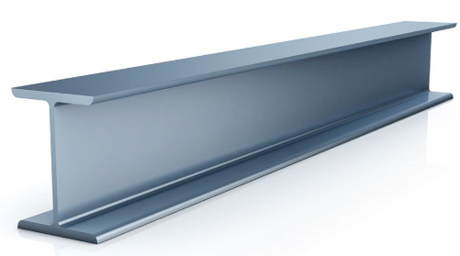
Gravity and Force (2)
Let’s Talk about Gravity
When we talk about gravity, the acceleration is always approximately 9.8 m/s².
That’s how fast objects accelerate toward Earth when dropped.
F = ma
So, if a beam weighs 50 kg, the force of gravity acting on it is:
F = 50 × 9.8 = 490 N
That means the beam is exerting 490 Newtons of downward force on whatever is supporting it.

Slide 32
Gravity and Force (3)
Let’s Talk about Gravity
So, if a beam weighs 50 kg, the force of gravity acting on it is:
F = 50 × 9.8 = 490 N
That means the beam is exerting 490 Newtons of downward force on
whatever is supporting it.
F = ma
Note
To simplify our calculations instead of using 9.8m/s² we can use 10m/s²
For example, using the previous example:
If a beam weighs 50 kg, the force of gravity acting on it is:
F = 50 × 10 = 500 N

Slide 33
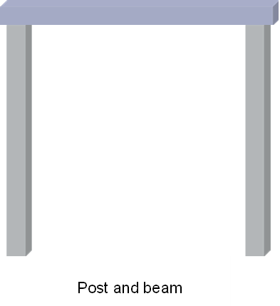
Gravity and Force (4)
Engineering Example – Post and Beam Construction
In a simple structure: The beam spans across the top and holds weight (like a roof).
The posts stand vertically and support the beam.
Gravity pulls the beam downward.
Engineers must calculate the force the beam exerts so they can choose materials strong enough for the posts and beam to resist that force.

Slide 34
Gravity and Force (5)
Engineering Example – Post and Beam Construction
Engineers must calculate the force the beam exerts so they can choose materials strong enough for the posts and beam to resist that force.
For example: A timber beam weighs 60 kg.
Q: What force does it exert due to gravity?
F=?
a = 10m/s²
m = 60kg
A: F = 60 × 10 = 600 N
That means each post must help support 600 Newtons of downward force!

Slide 35
Gravity and Force (6)
Engineering Example – Post and Beam Construction
Engineers must calculate the force the beam exerts so they can choose materials strong enough for the posts and beam to resist that force.
For example: A timber beam weighs 60 kg.
Q: What force does it exert due to gravity?
F=?
a = 10m/s²
m = 60kg
A: F = 60 × 10 = 600 N
That means each post must help support 600 Newtons of downward force!

Slide 36
Mass vs Weight
What’s the Difference?

Slide 37
Learning intentions and success criteria (5)
We are learning to
distinguish the difference between mass and weight, and why this is important in engineering.
We can
• define mass and weight, and explain how they are different
• describe mass as a scalar quantity and weight as a vector quantity
• calculate the weight of an object on Earth and compare it to its weight on the Moon
• explain why the same mass has a different weight depending on gravity
• apply mass vs. weight understanding to an engineering structure.
Notes:
Notes for teachers:
Learning intentions and success criteria are best co-constructed with students. Adapt the learning intention as required and add matching success criteria.
For more information See ⁠AITSL or the NSW Department of Education explicit teaching strategies, ⁠Sharing learning intentions and ⁠Sharing success criteria
LISC is not necessarily presented at the beginning of the lesson. Teacher needs to consider most effectual time to introduce
LISC should be revisited during the lesson to support students' evaluation of their learning

Slide 38
Mass vs Weight (1)
Mass
Mass is the amount of matter in an object.
It’s measured in kilograms (kg).
Mass does not change depending on location—whether you're on Earth, the Moon, or Mars, your mass stays the same.
It’s a scalar quantity, meaning it has size but no direction.

Slide 39
Mass vs Weight (2)
Weight
Weight is the force of gravity acting on that mass.
It’s measured in Newtons (N).
Weight depends on gravity, so it changes depending on where you are. For example, you weigh less on the Moon than on Earth.
It’s a vector quantity, meaning it has both size and direction (always pulling downward).

Slide 40
Mass vs Weight (3)
Mass vs Weight
A steel beam has a mass of 100 kg. Its weight on Earth is:
F = 100 × 10 = 1000 N
That means the beam exerts 1000 Newtons of downward force due to gravity.

Slide 41
Mass vs Weight )4)
Why It Matters in Engineering
In engineering design and construction, engineers need to know:
• The mass of materials to transport and assemble them.
• The weight to calculate how much force the structure must support.
Understanding the difference helps ensure buildings are safe, stable, and built to last.

Slide 42
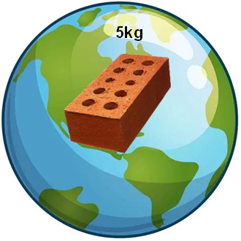
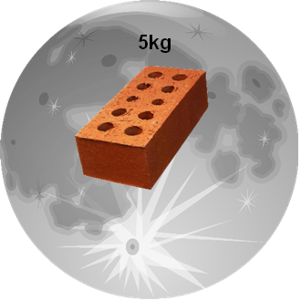
Mass vs Weight (5)
Why it matters in Engineering
Activity – consider two identical bricks – one on Earth and one on the Moon.
Both bricks have a mass of 5kg
On earth weight = 5 x 10 = 50N
On the moon weight = 5 x 1.6 = 8N
‘Why does the same brick weigh less on the Moon even though its mass hasn’t changed?’

Slide 43
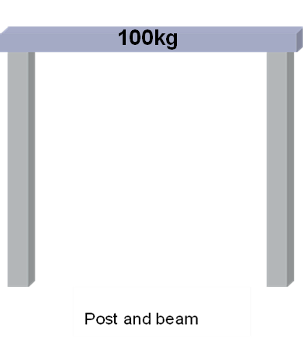
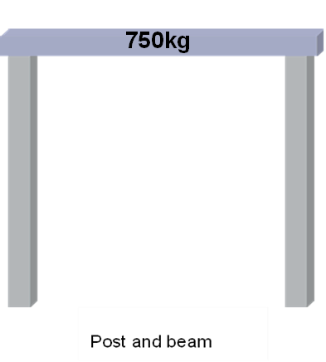
Mass vs Weight (6)
Why It Matters in Engineering
Activity – lets now reconsider our simple post and beam frame.
If the beam has a mass of 100kg, how much force does each post need to support if there are two of them?
100 x 10 = 1000N
Divide by the no. posts
Answer: 500N in each post.
750 x 10 = 7500N
Divide by the no. posts
Answer: 3750N in each post.

Slide 44
Mass vs Weight (7)
Why It Matters in Engineering
Activity – fill in the blanks
Word bank
Force | Effect | Kilograms | gravity | 100
Mass is measured in __________ and does not change based on location.
Weight is the __________ of gravity acting on mass.
The formula to calculate weight force is mass multiplied by __________.
A 10 kg object exerts __________ Newtons on Earth.
In a post-and-beam structure, the posts must resist the __________ caused by the beam’s weight.

Slide 45
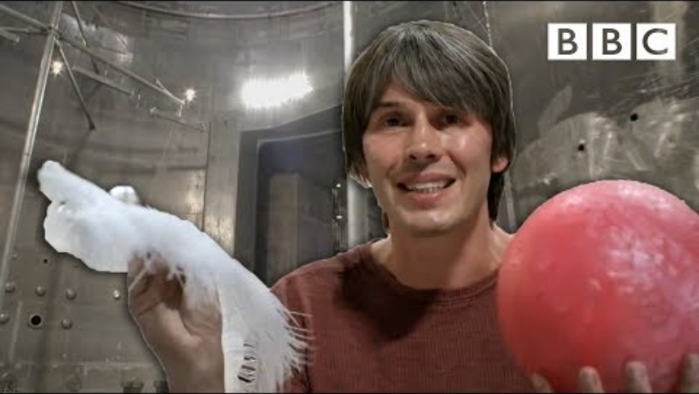
Mass vs Weight (8)
Why It Matters in Engineering
Video – Feather vs. Bowling Ball
Brian Cox visits the world's biggest vacuum | Human Universe - BBC

Slide 46
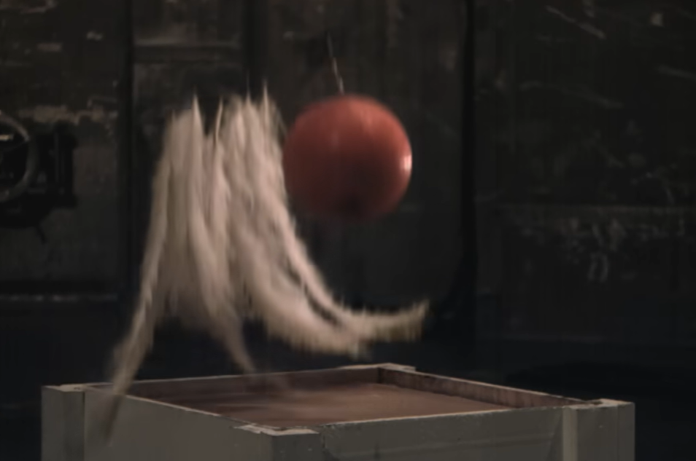
Mass vs Weight (9)
Why It Matters in Engineering
Video – Feather vs. Bowling Ball
'What caused the bowling ball and feather to hit the ground at the same time?'
Brian Cox visits the world's biggest vacuum | Human Universe - BBC

Slide 47
Paper Tower Sprint
(practical challenge)

Slide 48
Learning intentions and success criteria (6)
We are learning to
understand how teamwork, design choices, and material use affect the success of a structure.
We can
design and build a free-standing tower using limited materials
test our structure against set criteria (height and stability)
reflect on what worked well and what could be improved in our design and teamwork
Notes:
Notes for teachers:
Learning intentions and success criteria are best co-constructed with students. Adapt the learning intention as required and add matching success criteria.
For more information See ⁠AITSL or the NSW Department of Education explicit teaching strategies, ⁠Sharing learning intentions and ⁠Sharing success criteria
LISC is not necessarily presented at the beginning of the lesson. Teacher needs to consider most effectual time to introduce
LISC should be revisited during the lesson to support students' evaluation of their learning

Slide 49

Paper Tower Sprint (1)
Build the tallest free-standing tower possible.
Materials – 10 sheets of A4 paper + 300mm of masking tape.
Tower must stand unsupported for 10 seconds to qualify.

Slide 50
Paper Tower Sprint (2)
Work in groups of 3–4 to design and construct a tower within 20 minutes.
20-minute count down timer
'How can you fold or roll the paper to make it stronger?'
'How are you managing your tape use?'
'How tall can you build while still keeping stability?'

Slide 51

Paper Tower Sprint (3)
Work in groups of 3–4 to design and construct a tower within 20 minutes.
'How can you fold or roll the paper to make it stronger?'
'How are you managing your tape use?'
'How tall can you build while still keeping stability?'

Slide 52
Paper Tower Sprint (4)
Reflection
What worked well in your design?
How well did your team manage the resources?
If you did it again, what would you change?

Slide 53
Engineering Materials

Slide 54
Learning intentions and success criteria (7)
We are learning to
classify engineering materials into categories to understand their properties and uses.
We can
• classify everyday items into metal and non-metal groups
• describe the major categories of engineering materials (metals, ceramics, polymers, composites, natural materials, elastomers)
• give examples of each material type and their common properties
• explain why classification helps engineers select the right material for a job.
Notes:
Notes for teachers:
Learning intentions and success criteria are best co-constructed with students. Adapt the learning intention as required and add matching success criteria.
For more information See ⁠AITSL or the NSW Department of Education explicit teaching strategies, ⁠Sharing learning intentions and ⁠Sharing success criteria
LISC is not necessarily presented at the beginning of the lesson. Teacher needs to consider most effectual time to introduce
LISC should be revisited during the lesson to support students' evaluation of their learning

Slide 55
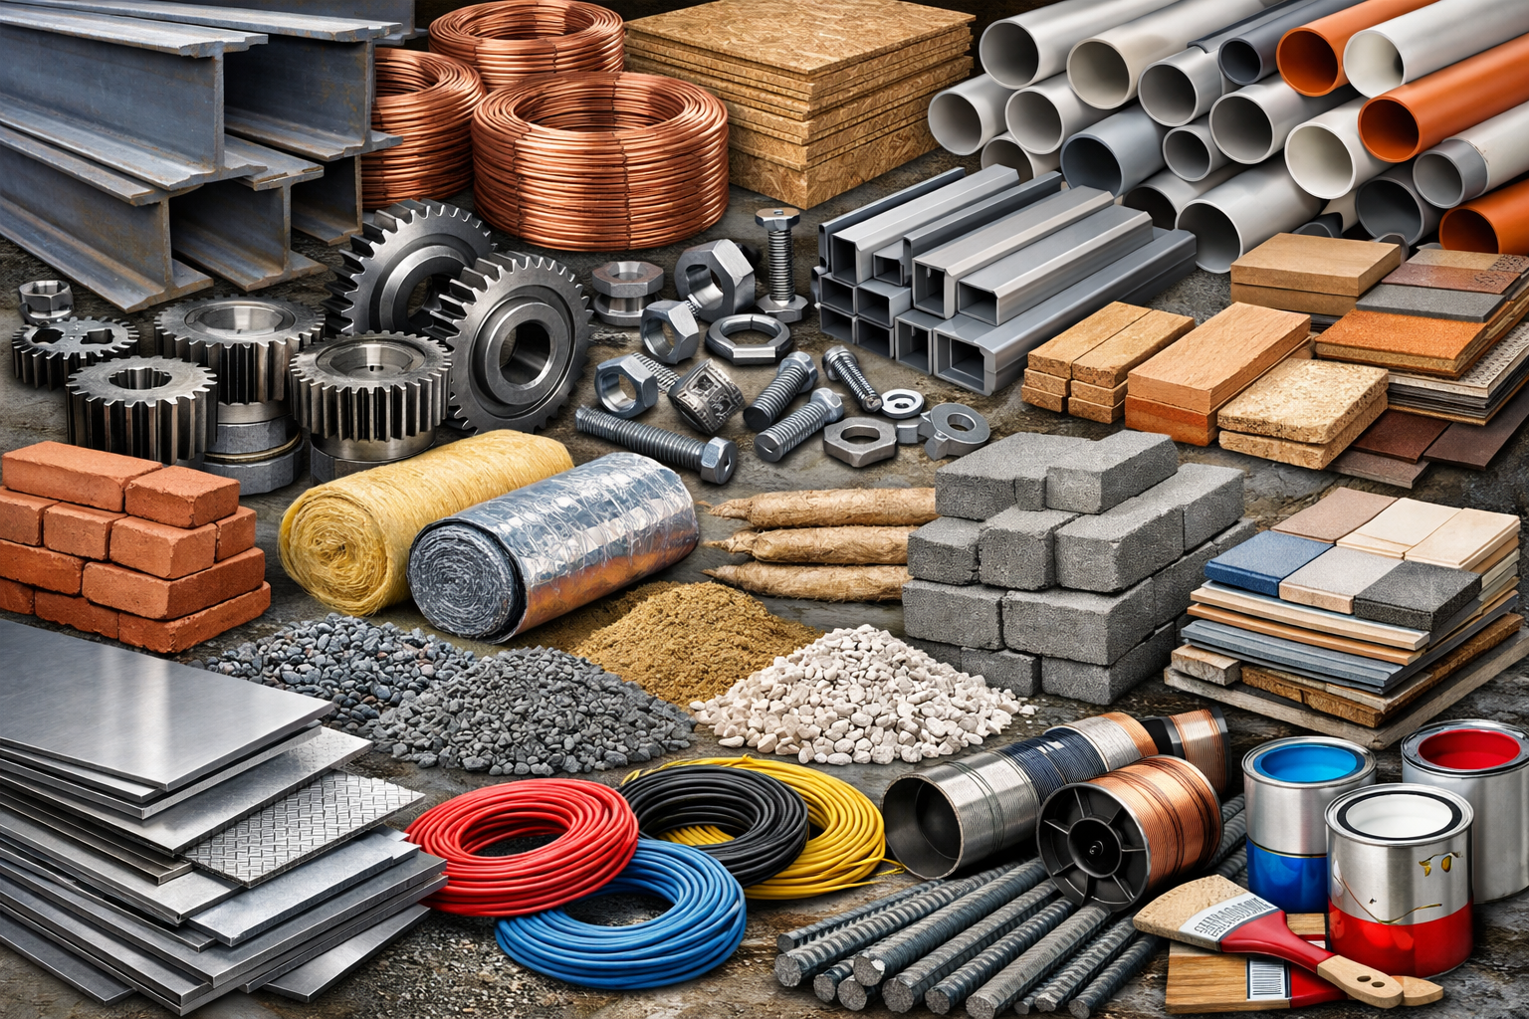
Engineering Materials (1)
‘Because there are so many types of materials, engineers and designers need a way to make sense of them. To do this, we classify materials into categories based on their properties and where they come from. This helps us choose the right material for the right job.’

Slide 56
Engineering Materials (2)
Activity
Identify 5 items/ products used getting ready for school today.
Then classify whether they were primarily made from either metals or non-metals.
Item /product | Metal | Non-metal
Toothbrush
Toaster
Keys
Clothes
Footpath

Slide 57
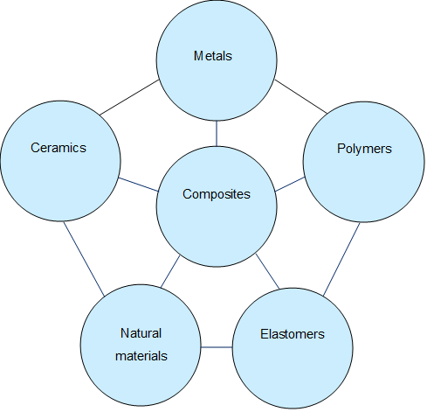
Engineering Materials (3)
Classifications
Engineering materials can be further classified into the following areas.

Slide 58

Engineering Materials (4)
Definitions and examples
Metals
Definition
Metals are hard, shiny materials that conduct heat and electricity well. They are usually strong and can be shaped or welded.
Common Properties
Strong/ tough
Malleable and Ductile (can be stretched and drawn into shape)
Conductive
Often recyclable
Examples
Steel – used in buildings and bridges
Aluminium – used in aircraft and cans
Copper – used in wires and plumbing

Slide 59

Engineering Materials (5)
Definitions and examples
Polymers
Definition
Polymers are materials made from long chains of molecules. Most plastics are polymers. They are usually lightweight and resistant to corrosion.
Common Properties
Lightweight
Flexible or rigid
Can be moulded into shapes
Some are recyclable
Examples
Polyethylene – used in plastic bags and bottles
PVC – used in pipes and window frames
Acrylic – used in signs and display cases

Slide 60

Engineering Materials (6)
Definitions and examples
Ceramics
Definition
Ceramics are hard, brittle materials made by heating natural substances. They can withstand high temperatures and are often used for insulation.
Common Properties
Very hard
Brittle (can break easily)
Heat resistant
Electrical insulators
Examples
Porcelain – used in sinks and toilets
Glass – used in windows and bottles
Bricks – used in construction

Slide 61
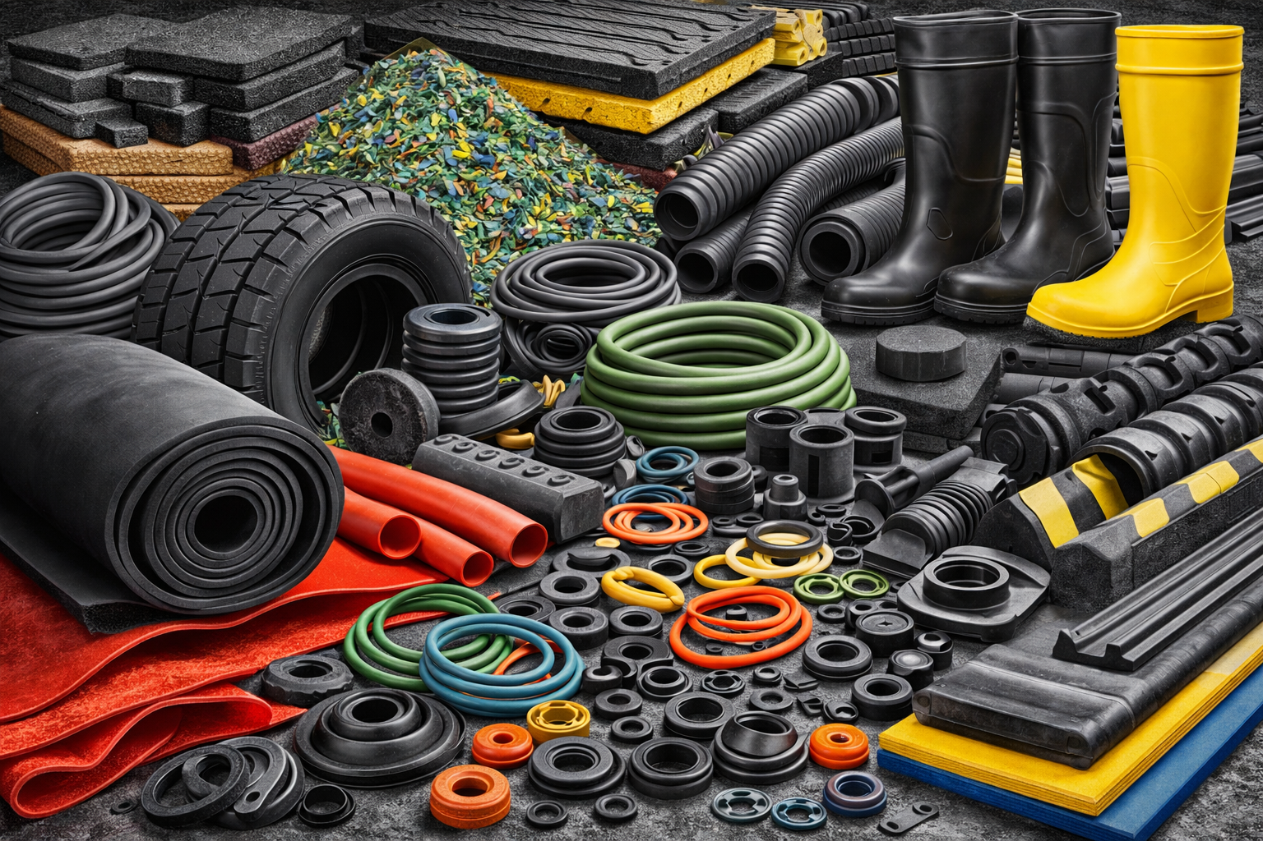
Engineering Materials (7)
Definitions and examples
Elastomers
Definition
Elastomers are stretchy materials that return to their original shape after being stretched or squashed.
Common Properties
Flexible
Elastic (can stretch and return)
Water resistant
Examples
Rubber – used in tyres and seals
Silicone – used in kitchenware and medical products
Foam rubber – used in cushions and sports gear

Slide 62
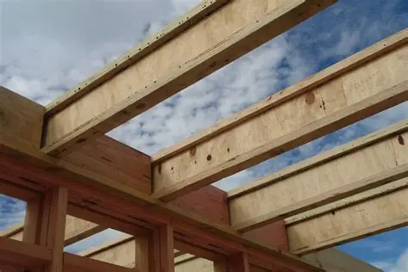
Engineering Materials (8)
Definitions and examples
Natural Materials
Definition:
Natural materials come directly from plants, animals, or the earth. They are often biodegradable and used in traditional construction.
Common Properties:
Naturally occurring
Renewable (with exceptions)
Biodegradable
Examples:
Wood – used in building and furniture
Cotton – used in textiles
Leather – used in clothing and tools

Slide 63
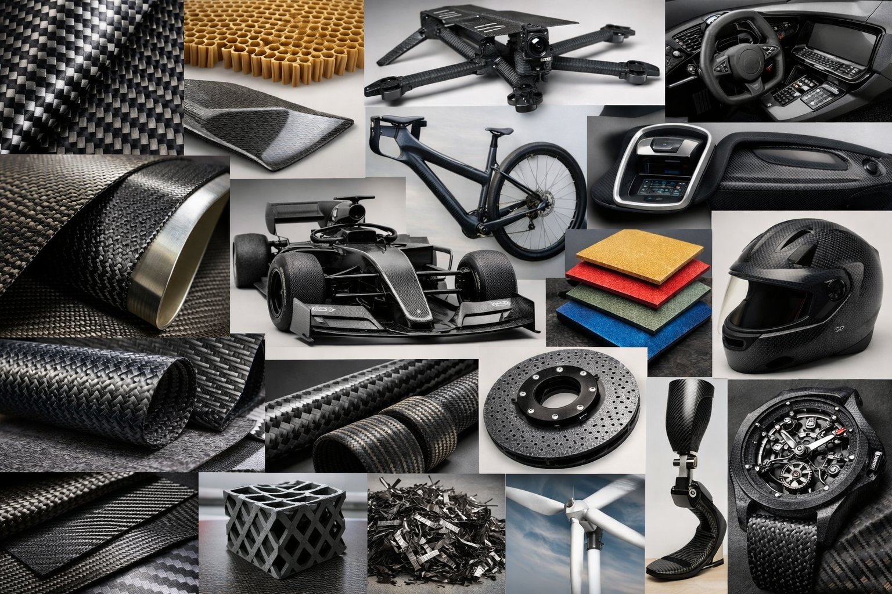
Engineering Materials (9)
Definitions and examples
Composites
Definition:
Composites are made by combining two or more different materials to create something stronger or more useful than the parts alone.
Common Properties:
Strong and lightweight
Designed for specific purposes
Can be more expensive to produce
Examples:
Fibreglass – plastic reinforced with glass fibres (used in boats, car panels)
Carbon fibre – carbon threads in resin (used in bikes, aircraft, sports equipment)
Reinforced concrete – concrete with steel bars (used in buildings and bridges)

Slide 64
Engineering properties of materials

Slide 65
Learning intentions and success criteria (8)
We are learning to
investigate key properties of materials (mechanical, physical, manufacturing, and environmental)
Investigate how engineers use these properties to select the right material for a job.
We can
describe the difference between mechanical, physical, manufacturing and environmental properties
match properties to materials with supporting examples
identify real-world items that demonstrate specific material properties
use correct engineering vocabulary when describing properties.
Notes:
Notes for teachers:
Learning intentions and success criteria are best co-constructed with students. Adapt the learning intention as required and add matching success criteria.
For more information See ⁠AITSL or the NSW Department of Education explicit teaching strategies, ⁠Sharing learning intentions and ⁠Sharing success criteria
LISC is not necessarily presented at the beginning of the lesson. Teacher needs to consider most effectual time to introduce
LISC should be revisited during the lesson to support students' evaluation of their learning

Slide 66

Engineering Materials (10)
Engineering Properties of materials
Engineers choose materials based on their properties. These properties affect how the material performs in real-world situations like bridges, buildings, tools, or machines.

Slide 67
Engineering Materials (11)
Mechanical Properties
How a material responds to forces.
Property | Description | Example
Strength | The ability to withstand a force without breaking. | Steel is strong in tension and compression.
Hardness | Resistance to scratching, denting or cutting. | Ceramic tiles are very hard.
Toughness | Ability to absorb energy without breaking. | Bike helmets use tough plastics.
Brittleness | Breaks or cracks easily without much deformation. | Glass and ceramics are brittle.
Ductility | Can be stretched into wire without breaking. | Copper is highly ductile
Malleability | Can be hammered or rolled into thin sheets. | Aluminium foil is malleable.
Elasticity | Can return to original shape after being stretched. | Rubber bands are elastic.

Slide 68
Engineering Materials (12)
Physical Properties
Property | Description | Example
Density | Mass per unit volume — how heavy it feels for its size. | Lead is denser than aluminium.
Melting Point | The temperature at which a solid turns to liquid. | Metals have high melting points.
Thermal Conductivity | Ability to transfer heat. | Copper pans heat up quickly.
Electrical Conductivity | Ability to carry electric current. | Metals like copper are good conductors.

Slide 69
Engineering Materials (13)
Manufacturing and environmental properties
Property | Description | Example
Workability | How easy it is to cut, shape, join or finish. | Timber is easy to saw and sand.
Sustainability | Can the material be recycled or sourced responsibly? | Bamboo is a sustainable material.
Disposability | How easy and safe it is to dispose of. | Bioplastics break down in compost.
Availability | How easy it is to get or purchase. | Steel is widely available.
Cost | How expensive the material is to buy and work with. | Titanium is expensive.
Safety | How safe the material is to use (non-toxic, low fire risk, etc.) | Food-grade plastics are safe.

Slide 70
Engineering Materials (14)
Activity – match the property
Property | Description
A. Ductility | 1. Can return to its original shape after being stretched
B. Hardness | 2. Can be stretched into a wire without breaking
C. Elasticity | 3. Can be hammered into sheets
D. Brittleness | 4. Breaks easily without bending
E. Malleability | 5. Resists scratching or denting

Slide 71
Engineering Materials (15)
Activity – property Hunt
Find an item in your classroom, school or home that matches each property. Fill in the table with what you find:
Property | Item found | Justification | Image
Conductivity
Strength
Brittleness
Toughness
Elasticity

Slide 72
Engineering Materials (16)
Activity – Complete the following sentences
brittle
tough
malleable
conductor
sustainable
dense
elastic
ceramic
corrosion
ductile
Fill in the blanks using the missing keywords from the box:
Metals like copper are __________, meaning they can be drawn into wire.
Rubber bands are __________ because they stretch and return to shape.
Glass is a __________ material – it can break easily if dropped.
Stainless steel is resistant to __________, so it doesn’t rust easily.
Clay, bricks, and porcelain are all types of __________ materials.
Aluminium is less __________ than steel, which makes it lighter to use.
Wood and bamboo are considered __________ materials because they are renewable.
A __________ material allows electricity or heat to pass through it.
A hammer is made from a __________ material so it can absorb impacts.
Gold is very __________ and can be flattened into thin sheets.

Slide 73
How materials are used in Structures

Slide 74
Learning intentions and success criteria (9)
We are learning to
apply our understanding of material properties to select appropriate materials for different parts of an engineered structure.
We can
suggest suitable materials for different parts of a pedestrian bridge
justify our choices by referring to relevant material properties
research a real-world structure and identify the materials used
explain why the chosen materials were appropriate for that structure
Notes:
Notes for teachers:
Learning intentions and success criteria are best co-constructed with students. Adapt the learning intention as required and add matching success criteria.
For more information See ⁠AITSL or the NSW Department of Education explicit teaching strategies, ⁠Sharing learning intentions and ⁠Sharing success criteria
LISC is not necessarily presented at the beginning of the lesson. Teacher needs to consider most effectual time to introduce
LISC should be revisited during the lesson to support students' evaluation of their learning

Slide 75
Engineering Materials (17)
How Materials Are Used in Structures
Part A – engineering scenario
Choose 3 different materials to use in your design and
explain why:
You are designing and engineering a new pedestrian bridge for a public park. The bridge must:
Be strong and durable
Be weather resistant
Be safe to walk on in all weather
Part of the bridge | Material Selected | Why it is a good choice
Walkway surface
Handrails
Supporting beams

Slide 76
Engineering Materials (18)
How Materials Are Used in Structures
Part B – real-world examples
Select one existing structure (e.g. bridge, stadium, tower) and research the types of materials used in its construction. Paste an image of the structure and record your findings below:
Name of Structure: ___________________________
Location: ___________________________________
Main Materials Used:
_________________________________________
_________________________________________
_________________________________________
Suggest why were these materials chosen?
___________________________________________
___________________________________________

Slide 77
Engineering Materials (19)
How Materials Are Used in Structures
Part B – real-world examples
Select one existing structure (e.g. bridge, stadium, tower) and research the types of materials used in its construction. Paste an image of the structure and record your findings below:
Name of Structure: ___________________________
Location: ___________________________________
Main Materials Used:
_________________________________________
_________________________________________
_________________________________________
Suggest why were these materials chosen?
___________________________________________
___________________________________________

Slide 78
Materials Testing

Slide 79
Learning intentions and success criteria (10)
We are learning to
Understand how engineers test materials to determine their properties.
Understand how engineers decide if materials are suitable for structural use.
We can
describe common material testing methods (tensile, compression, hardness, impact)
explain why engineers test materials before building with them
participate in designing and carrying out a simple material test
record and share results of material tests and compare across groups.
Notes:
Notes for teachers:
Learning intentions and success criteria are best co-constructed with students. Adapt the learning intention as required and add matching success criteria.
For more information See ⁠AITSL or the NSW Department of Education explicit teaching strategies, ⁠Sharing learning intentions and ⁠Sharing success criteria
LISC is not necessarily presented at the beginning of the lesson. Teacher needs to consider most effectual time to introduce
LISC should be revisited during the lesson to support students' evaluation of their learning

Slide 80
Engineering Materials (20)
Materials Testing
‘How do engineers find out what a material can do?’

Slide 81

Engineering Materials (21)
Materials Testing
‘How do engineers find out what a material can do?’
Engineers perform materials testing to measure things like strength, flexibility, brittleness and toughness amongst many other materials properties.
Common material tests include:
Tensile Tests – Pulling to see how much stretch or break force
Compression Tests – Squashing to see resistance
Hardness Tests – Scratching or indentation
Impact Tests – Striking to test toughness

Slide 82

Engineering Materials (22)
Materials Testing
Understanding The Different Mechanical Properties Of Engineering Materials. (10:08)

Slide 83
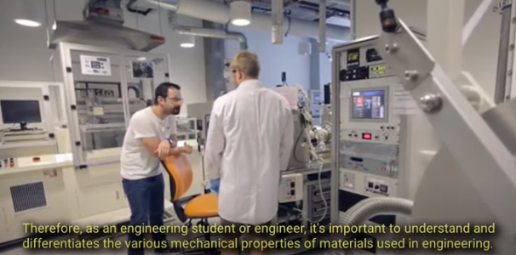
Engineering Materials (23)
Materials Testing
What types of materials are tested in the video?
What happens to each material as more force is applied?
What is meant by 'tensile strength'?
Why do some materials snap, while others stretch or deform first?
What surprised you most about the results?
Understanding The Different Mechanical Properties Of Engineering Materials.

Slide 84
Engineering Materials (24)
Materials Testing – activity
How do we find out about a Materials Properties?
Divide the class up into groups of 4 or 5.
Each group will be given samples of wood, metal, plastic, rubber, ceramic tile and a piece of foam
Each group is to be assigned or select a material property to test. Such as hardness, brittleness, flexibility, workability, toughness etc.
The groups are to research and design a suitable method of testing the material property.
Each group is to demonstrate the testing process to the rest of the class.
The results are to be collated for each group and a report produced containing the rank order for each material.

Slide 85
Engineering Materials (25)
Materials Testing – activity
How do we find out about a Materials Properties?
Reflection
Based on what you tested, which material would you recommend for building a chair, a phone case, or a sports shoe? Why?

Slide 86
Built for purpose

Slide 87
Learning intentions and success criteria (11)
We are learning to
examine Aboriginal and Torres Strait Islander engineered structures, how materials were used for specific purposes
determine why these designs are sustainable.
We can
identify examples of Aboriginal engineered structures and their uses
describe the materials used and the properties that made them suitable
compare structures from different regions and explain their differences
reflect on why Indigenous engineering knowledge is important today
apply our understanding to design a simple shelter for a given environment.
Notes:
Notes for teachers:
Learning intentions and success criteria are best co-constructed with students. Adapt the learning intention as required and add matching success criteria.
For more information See ⁠AITSL or the NSW Department of Education explicit teaching strategies, ⁠Sharing learning intentions and ⁠Sharing success criteria
LISC is not necessarily presented at the beginning of the lesson. Teacher needs to consider most effectual time to introduce
LISC should be revisited during the lesson to support students' evaluation of their learning

Slide 88
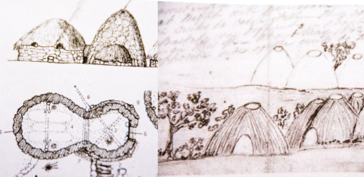
Aboriginal Engineered Structures (1)
Activity – built for purpose
Part a
Class discussion – Revisit what engineers do (solve problems using materials, forces and design).
Students access – https://deadlystory.com/page/culture/Life_Lore/Science/Engineering

Slide 89
Aboriginal Engineered Structures (2)
Activity – built for purpose
Part a
In pairs or small groups, read and explore the information contained on the website.
Focus on the sections:
Stone houses and aquaculture (Budj Bim – Gunditjmara)
Shelters and materials
Tools and environmental engineering
Students use the website to find 3 examples of Aboriginal structures.
Fill out:
Structure Name
Location / region
What materials were used?
What properties made those materials suitable?
Was the structure temporary or permanent?
Students access – https://deadlystory.com/page/culture/Life_Lore/Science/Engineering

Slide 90
Aboriginal Engineered Structures (3)
Activity – built for purpose
Part a
Structure / example | Region | Purpose / Use | Materials used | Properties of the materials
Stone Hut | Gunditjmara | For permanent village living, protection from cold | Basalt rocks | Heavy, strong, insulative
Willam | Wurundjeri | Seasonal shelter, fast to build, kept people dry | Bark, sticks, fire pit | Lightweight, water resistant
Mia-mia | Wiradjuri | Built for cold seasons, semi-permanent | Tree branches, bark, leaves | Weatherproof, fits family
Students access – https://deadlystory.com/page/culture/Life_Lore/Science/Engineering

Slide 91
Aboriginal Engineered Structures (4)
Activity – built for purpose
Part b
Structure / example | Region | Purpose / Use | Materials used | Properties of the materials
Stone Hut | Gunditjmara | For permanent village living, protection from cold | Basalt rocks | Heavy, strong, insulative
Willam | Wurundjeri | Seasonal shelter, fast to build, kept people dry | Bark, sticks, fire pit | Lightweight, water resistant
Mia-mia | Wiradjuri | Built for cold seasons, semi-permanent | Tree branches, bark, leaves | Weatherproof, fits family
Students access – https://deadlystory.com/page/culture/Life_Lore/Science/Engineering
Write a short paragraph comparing two structures from different regions.

Slide 92
Aboriginal Engineered Structures (5)
Activity – built for purpose
Part c – whole-class reflection
'What makes these designs smart and sustainable?'
'Why is understanding Indigenous engineering important today?'
'Can you think of modern designs inspired by these ideas?'
Students access – https://deadlystory.com/page/culture/Life_Lore/Science/Engineering

Slide 93
Aboriginal Engineered Structures (6)
Activity – built for purpose
Part d
Think like an engineer:
Design a shelter for a hot, dry place using only natural materials.
What would you choose and why?'
Students access – https://deadlystory.com/page/culture/Life_Lore/Science/Engineering

Slide 94
Sustainability in Structural Materials

Slide 95
Learning intentions and success criteria (12)
We are learning to
investigate what makes a material sustainable.
Investigate how engineers consider environmental, social, and economic impacts when selecting materials for structures.
We can
identify key sustainability factors that influence material choice
classify structural materials (metals, polymers, timber, concrete) using plain-English sustainability descriptions
evaluate materials for environmental impact and durability
justify a material choice for a small footbridge based on sustainability considerations
participate in a discussion about trade-offs in engineering material choices.
Notes:
Notes for teachers:
Learning intentions and success criteria are best co-constructed with students. Adapt the learning intention as required and add matching success criteria.
For more information See ⁠AITSL or the NSW Department of Education explicit teaching strategies, ⁠Sharing learning intentions and ⁠Sharing success criteria
LISC is not necessarily presented at the beginning of the lesson. Teacher needs to consider most effectual time to introduce
LISC should be revisited during the lesson to support students' evaluation of their learning

Slide 96
Engineering Materials (26)
Sustainability in structural materials
What makes a material environmentally friendly?
Have you seen examples of sustainable construction in your area?
Why might sustainability matter in civil engineering?

Slide 97
Engineering Materials (27)
Sustainability in structural materials
Key factors that affect sustainability in materials
Sustainability factor | Sustainability considerations
Resource Extraction | How it is mined, harvested or sourced
Energy Use (Embodied Energy) | How much energy is used to produce/process it
Durability and Lifespan | How long it lasts before needing replacement
Recyclability | Can it be reused or recycled after use?
Waste and Pollution | Does it create pollution during production or disposal?
Transport Impact | How far does it travel? What are the fuel/ transport costs?

Slide 98
Engineering Materials (28)
Sustainability factor | Sustainability considerations
Resource Extraction | How it is mined, harvested or sourced
Energy Use (Embodied Energy) | How much energy is used to produce/process it
Durability and Lifespan | How long it lasts before needing replacement
Recyclability | Can it be reused or recycled after use?
Waste and Pollution | Does it create pollution during production or disposal?
Transport Impact | How far does it travel? What are the fuel/ transport costs?
Sustainability in structural materials
Activity – materials analysis
Work in groups to research and discuss four key material types used in structures:
Metals including metal alloys
Polymers
Timber
Concrete

Slide 99
Engineering Materials (29)
Sustainability in structural materials
Activity – using your research complete the following table.
Material | Sustainability/ advantages | Environmental impact | Options for more sustainable practices
Metals, including metal alloys | Long-lasting, recyclable | High energy to extract/refine (e.g. steel, aluminium) | Use recycled metal, green steel, local sourcing
Timber | Renewable, low embodied energy, absorbs carbon | Deforestation risk, habitat loss | Use sustainably harvested timber (FSC), local species
Concrete | Durable, fire resistant, readily available | High CO₂ emissions from cement production | Use alternative fillers such as fly ash, green cement, recycled aggregate, local sourcing
Polymers | Lightweight, cheap, can be moulded easily | Made from petroleum, generally not biodegradable | Use bio-based or recycled plastics, avoid single-use items

Slide 100
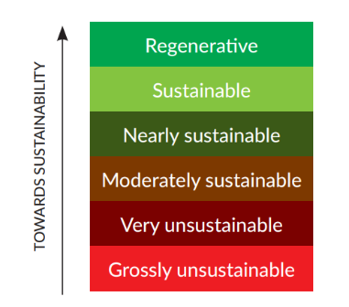
Engineering Materials (30)
Sustainability in structural materials
Activity – Now apply the ‘plain English’ descriptions used by Engineers Australia.
Material | Sustainability/ advantages | Environmental impact | Options for more sustainable practices
Metals, including metal alloys | Long-lasting, recyclable | High energy to extract/refine (e.g. steel, aluminium) | Use recycled metal, green steel, local sourcing
Timber | Renewable, low embodied energy, absorbs carbon | Deforestation risk, habitat loss | Use sustainably harvested timber (FSC), local species
Concrete | Durable, fire resistant, readily available | High CO₂ emissions from cement production | Use alternative fillers such as fly ash, green cement, recycled aggregate, local sourcing
Polymers | Lightweight, cheap, can be moulded easily | Made from petroleum, generally not biodegradable | Use bio-based or recycled plastics, avoid single-use items
'plain English' descriptions sourced from Engineers Australia – Implementing Sustainability: Principles and Practice

Slide 101
Engineering Materials (31)
Sustainability in structural materials
Activity – Now apply the ‘plain English’ descriptions used by Engineers Australia.
Material | Description
Metals, including metal alloys | Moderately sustainable
Timber | Sustainable
Concrete | Very sustainable
Polymers | Very sustainable
'plain English' descriptions sourced from Engineers Australia – Implementing Sustainability: Principles and Practice

Slide 102
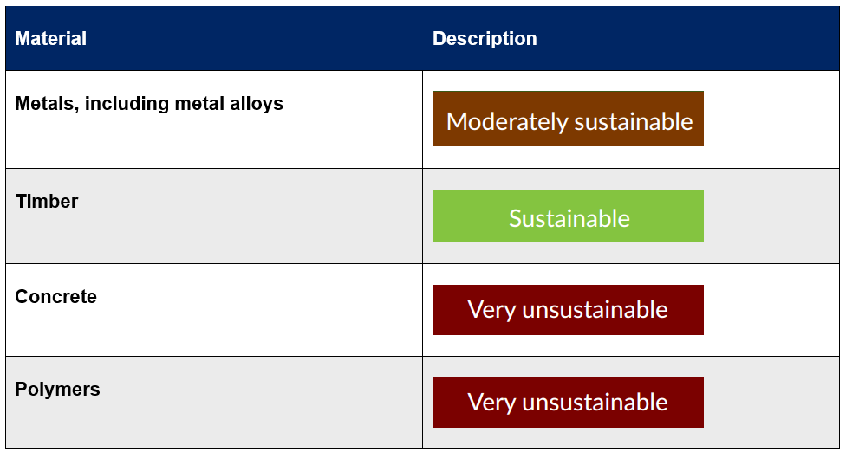
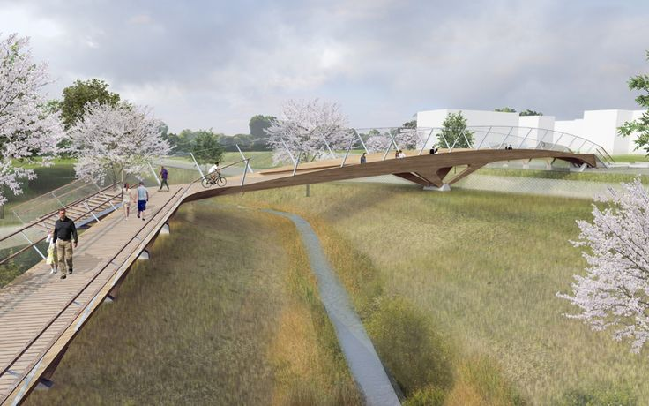
Engineering Materials (32)
Sustainability in structural materials
Activity
Imagine you are engineering a small footbridge over a creek.
Which main material would you choose to construct the bridge.
.
Write a short response or diagram justifying their decision based on the following considerations:
Environmental impact
Local material availability
Durability and longevity
Community use and visual impact

Slide 103

Engineering Materials (33)
Sample answer:
I would choose timber as the main material for my footbridge because it is a renewable resource that can be harvested in a way that protects the environment.
If sourced from sustainably managed forests, timber has a lower environmental impact than concrete or steel, especially in terms of energy used to produce it. Timber also has the benefit of storing carbon, which helps reduce greenhouse gas emissions over time. It is lightweight, easy to work with, and can be replaced or repaired more easily than some other materials.
Using timber supports local industries and communities, especially if the wood is sourced from nearby areas, which reduces transport pollution. If the timber is certified (like FSC), and the structure is designed to be durable and weather resistant, I think it's a smart and sustainable choice for a small bridge.
Sustainability in structural materials
Activity
Imagine you are engineering a small footbridge over a creek.
Which main material would you choose to construct the bridge.

Slide 104

Engineering Materials (34)
Sustainability in structural materials
Activity – Class debate/ discussion topic
‘Would you rather use a high environmental impact material that lasts 100 years, or a sustainable one that needs replacing every 25 years?’

Slide 105
Beams, a closer look

Slide 106
Learning intentions and success criteria (13)
We are learning to
investigate beams, the loads they carry, and the forces acting on them
understand how engineers choose materials and shapes for safe and efficient structures.
We can
explain what a beam is and give real-world examples
describe different types of loads (point load, distributed load, dynamic load)
identify forces acting on beams (bending, shear, tension, compression)
answer comprehension questions showing understanding of how engineers choose beam materials
predict and observe how beams behave under different loading and orientations.
Notes:
Notes for teachers:
Learning intentions and success criteria are best co-constructed with students. Adapt the learning intention as required and add matching success criteria.
For more information See ⁠AITSL or the NSW Department of Education explicit teaching strategies, ⁠Sharing learning intentions and ⁠Sharing success criteria
LISC is not necessarily presented at the beginning of the lesson. Teacher needs to consider most effectual time to introduce
LISC should be revisited during the lesson to support students' evaluation of their learning

Slide 107

Beams, a closer look (1)
Ever since the first tree fell across a stream, people have found ways to bridge the gap between two places. That fallen tree, simple as it may seem, is one of the earliest examples of a beam. It spans across two supports and carries a load. Just like the bridges, buildings and walkways we use every day.

Slide 108
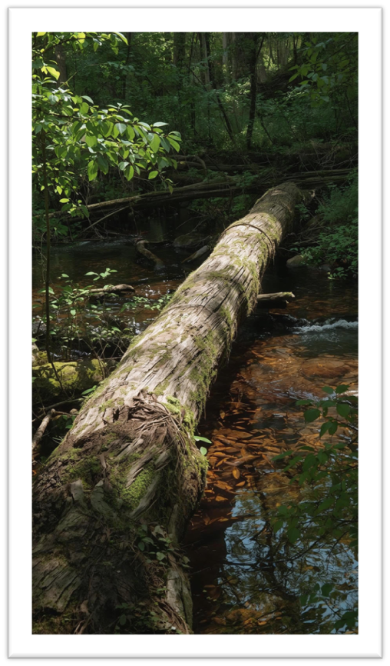
Beams, a closer look (2)
Understanding Loads and forces in Beam Design
Activity – students read the following passage and answer the corresponding questions
For engineers, choosing the right material for a beam isn’t just about picking something strong. It’s about understanding the forces acting on the beam and the type of load it needs to support.
A beam in a bridge might need to hold up the weight of cars and trucks. A beam in a roof might only need to support tiles and occasional rainwater. Each situation is different and so is the best material for the job.
To make a smart choice, engineers must first identify:
What type of load is being applied (point load, evenly distributed, dynamic)?
Where the supports are located and how far a part they are.
What kind of forces will occur in the beam (bending, shear, tension, compression)?
What material properties are needed — strength, stiffness, flexibility, resistance to corrosion?
Only by understanding the forces at play can engineers select a material that will be safe, efficient and long-lasting in the real world.

Slide 109
Beams, a closer look (3)
Understanding Loads and forces in Beam Design
Activity – students read the following passage and answer the corresponding questions
For engineers, choosing the right material for a beam isn’t just about picking something strong. It’s about understanding the forces acting on the beam and the type of load it needs to support.
A beam in a bridge might need to hold up the weight of cars and trucks. A beam in a roof might only need to support tiles and occasional rainwater. Each situation is different and so is the best material for the job.
To make a smart choice, engineers must first identify:
What type of load is being applied (point load, evenly distributed, dynamic)?
Where the supports are located and how far apart they are.
What kind of forces will occur in the beam (bending, shear, tension, compression)?
What material properties are needed — strength, stiffness, flexibility, resistance to corrosion?
Only by understanding the forces at play can engineers select a material that will be safe, efficient and long-lasting in the real world.
Questions
Why can’t engineers just choose the strongest material every time they design a beam?
List two different situations mentioned in the text where beams are used.
What are three types of forces that can act on a beam?
What is a ‘point load’ compared to a ‘distributed load’?
In your own words, explain why understanding forces helps engineers choose the best material.

Slide 110
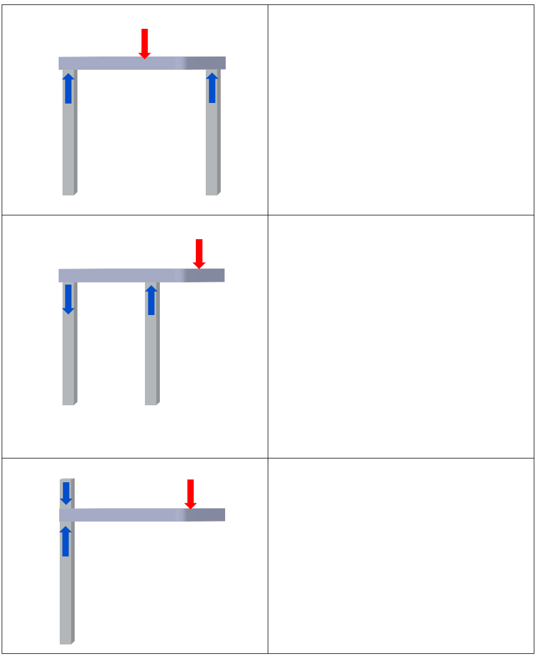
Beams, a closer look (4)
Common loading of beams
Activity
Here are common loading scenarios to consider. The forces are indicated by the red arrows. The reaction forces are blue. For each example sketch the direction the beam will flex or distort.

Slide 111
Stress

Slide 112
Learning intentions and success criteria (14)
We are learning to
understand what stress means in engineering
Investigate how the same force can create different stresses depending on the area it acts on.
We can
define stress in engineering terms
recall and use the formula to calculate Stress in an object
identify the units used in stress calculations (Pa, N, m²)
explain, with examples, how the same force applied over a smaller area increases stress
describe different types of stress (tensile, compressive, torsional, shear).
Notes:
Notes for teachers:
Learning intentions and success criteria are best co-constructed with students. Adapt the learning intention as required and add matching success criteria.
For more information See ⁠AITSL or the NSW Department of Education explicit teaching strategies, ⁠Sharing learning intentions and ⁠Sharing success criteria
LISC is not necessarily presented at the beginning of the lesson. Teacher needs to consider most effectual time to introduce
LISC should be revisited during the lesson to support students' evaluation of their learning

Slide 113
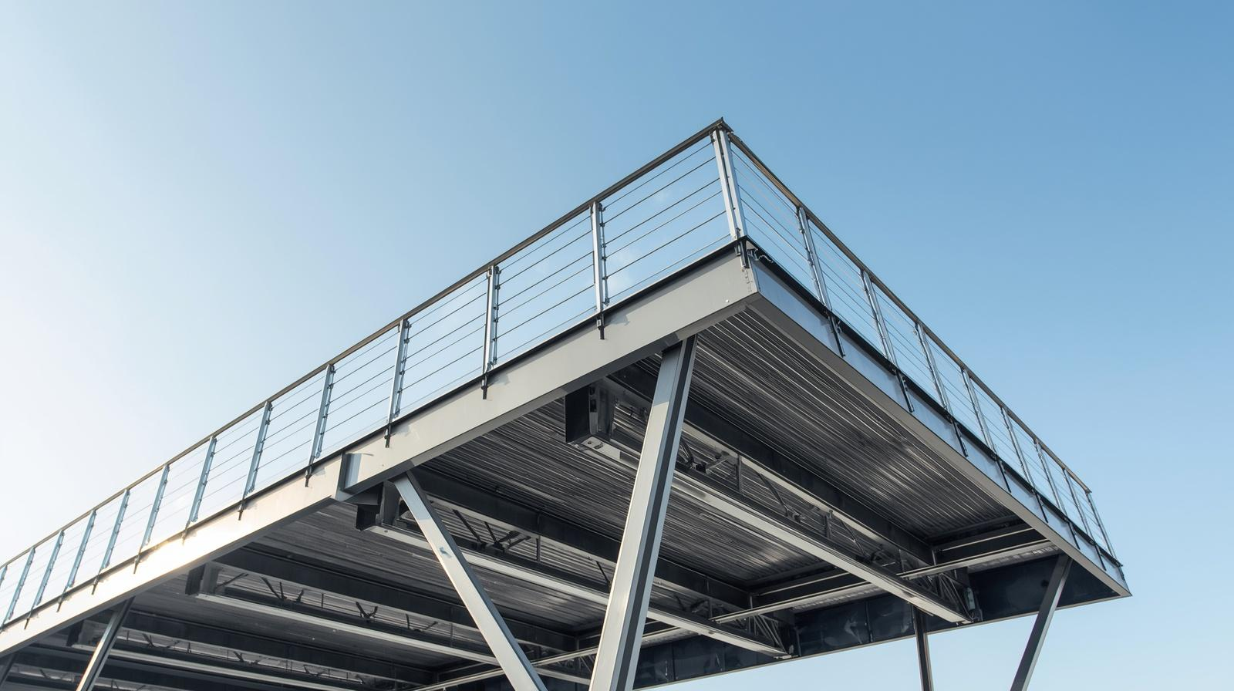

Stress (1)
Definition – stress is the materials internal reaction to an externally applied force.
For example, stress is the internal force within the beam material resisting the load.
Stress is calculated by dividing the external force (or load) by the area it is applied to.
$$stress =\frac{Load}{Area}$$
The basic units used in stress calculations are:
Stress – Pascal (Pa)
Load – Newton (N)
Area – square metre (m2)
1 Pa = 1 N / m2

Slide 114
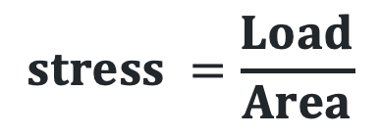
Stress (2)
$$stress =\frac{Load}{Area}$$
Teacher demonstration
Show two objects – one wide (e.g. book) and one narrow (e.g. pencil) and push them into a sponge or soft surface with the same force .
‘Which one leaves a deeper mark?’
Illustrates the concept that same force over smaller area = more stress.

Slide 115

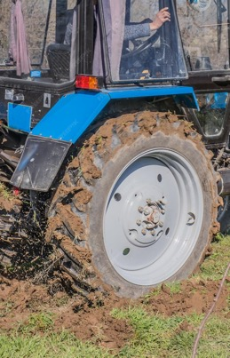

Stress (3)
$$stress =\frac{Load}{Area}$$
Student Activity
Students think-pair-share real world examples that help illustrate the concept of the same force applied over a smaller area create more stress.
Examples:
A person wearing stiletto heels walking on timber floorboards is more likely to dent or damage the floor compared to if that same person was wearing work boots, because the force is concentrated on a much smaller area.
Cutting a tomato with a sharp knife easily slices through, but using a spoon (same hand force, larger area) squashes the tomato — the knife applies more stress to a smaller surface.
A person walking in snow with regular boots sinks in, but with snowshoes they stay on the surface — the same weight is spread over a larger area, reducing stress on the snow.
A nail with a sharp point enters wood easily when hit with a hammer because the point concentrates force, while a blunt-ended rod (same force, wider tip) would just bounce off.
A motorbike with narrow tyres can sink into soft ground more than a tractor with wide tyres, even if the tractor is heavier, because its weight is spread across a larger contact area.

Slide 116

Stress (4)
$$stress =\frac{Load}{Area}$$
Types of stress
If a material is subjected to external compressive forces, then compressive stress will be created in the material.
Similarity if a material is subjected to tensile, torsional or shear forces then the corresponding stress will be created in the material.

Slide 117
Tension and Compression at the same time

Slide 118
Learning intentions and success criteria (15)
We are learning to
explain how beams under load experience both tension and compression.
Investigate why engineers must design structures to withstand both forces.
We can
explain what happens to a beam when it sags under load
identify which part of a beam is in tension and which part is in compression
describe the neutral axis and why it has zero stress
explain why engineers must consider both tension and compression in structural design.
Notes:
Notes for teachers:
Learning intentions and success criteria are best co-constructed with students. Adapt the learning intention as required and add matching success criteria.
For more information See ⁠AITSL or the NSW Department of Education explicit teaching strategies, ⁠Sharing learning intentions and ⁠Sharing success criteria
LISC is not necessarily presented at the beginning of the lesson. Teacher needs to consider most effectual time to introduce
LISC should be revisited during the lesson to support students' evaluation of their learning

Slide 119
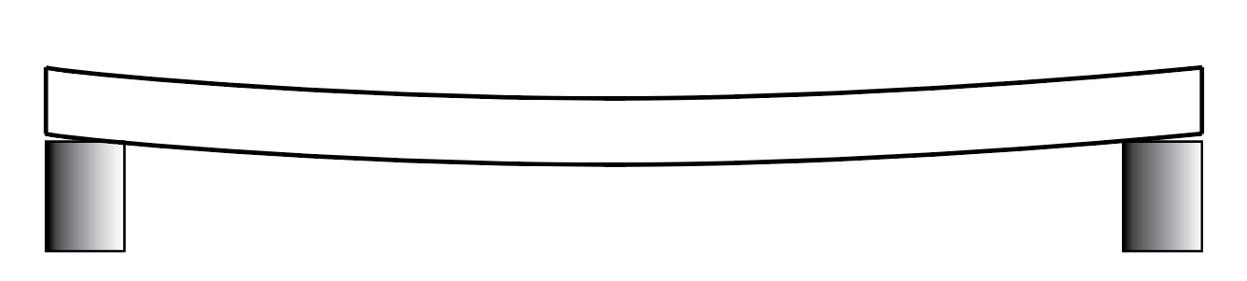
Stress (5)
$$stress =\frac{Load}{Area}$$
Tension and Compression at the same time
As we know. When a beam that is supported at both ends is loaded up, the beam will tend to sag down in the middle.

Slide 120
Stress (6)
$$stress =\frac{Load}{Area}$$
Tension and Compression at the same time.
When material bends, it experiences both tension and compression simultaneously.
For example, when the load is applied on a beam, its bottom part experiences tension and its top part experience compression.
While a layer called the neutral axis runs along the middle of the beam, surprisingly, it experiences zero stresses during bending.
compression
tension

Slide 121
Stress (7)
$$stress =\frac{Load}{Area}$$
Tension and Compression at the same time.
If we built a structure with a material that can’t handle tension and compressive forces, then the structure may collapse.
Hence all structures must be designed with materials that can handle the range forces acting upon them.
Tension and compression forces are existing in all the structures. An engineer must design a structure able to withstand these forces without failing.
compression
tension

Slide 122
Introducing the I beam

Slide 123
Learning intentions and success criteria (16)
We are learning to
Identify an I-beam.
Understand why it is widely used in engineering, and how its design helps resist different forces.
We can
describe the shape and main parts of an I-beam (flanges and web)
explain which forces are resisted by the flanges and the web
identify the advantage of an I-beam over a solid steel beam
label a diagram of an I-beam correctly
describe the weaknesses of an I-beam and how engineers address them.
Notes:
Notes for teachers:
Learning intentions and success criteria are best co-constructed with students. Adapt the learning intention as required and add matching success criteria.
For more information See ⁠AITSL or the NSW Department of Education explicit teaching strategies, ⁠Sharing learning intentions and ⁠Sharing success criteria
LISC is not necessarily presented at the beginning of the lesson. Teacher needs to consider most effectual time to introduce
LISC should be revisited during the lesson to support students' evaluation of their learning

Slide 124
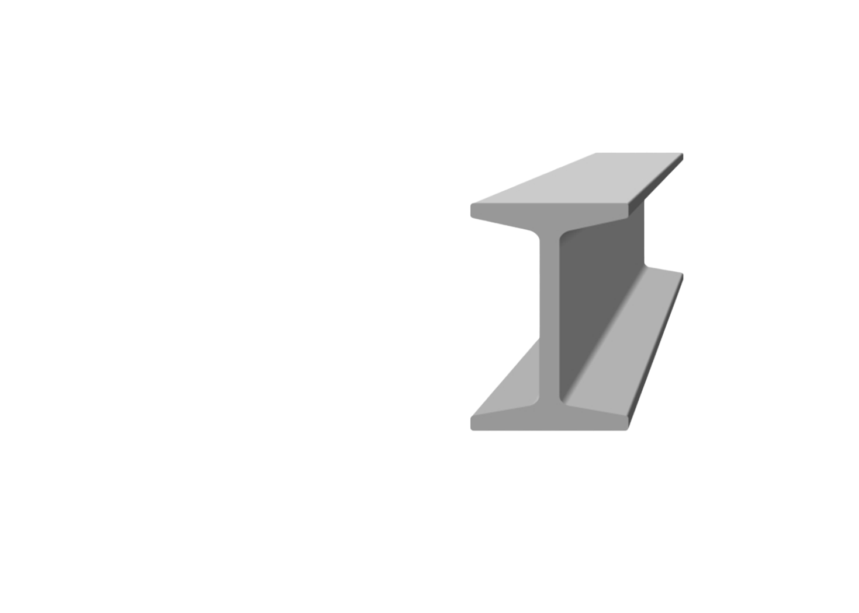
Stress (8)
$$stress =\frac{Load}{Area}$$
Introducing the I beam
Activity – read the passage below and answer the questions.
What Is an I-Beam?
When engineers need to design something like a bridge, skyscraper, or even an open plan house they often use a special type of beam called an I-beam. It's named after its shape: a long, straight piece of metal that looks like a capital letter 'I' when viewed from the end.
The top and bottom parts of the I (called the flanges) resist compression and tension, the two main forces acting on a beam when it bends. The vertical middle section (called the web) holds the flanges together and helps resist shear forces.
The I-beam gives maximum strength with minimum weight (a good strength to weight ratio). Instead of using a solid block of steel, the I-beam removes material from the centre (where it contributes the least to strength) and keeps it in the areas that matter most — the top and bottom.
Because of this, I-beams:
Use less material (which saves cost and weight)
Can span long distances without bending too much
Are easy to work with and widely available

Slide 125
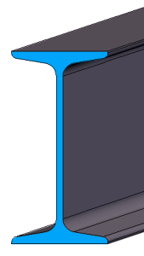
Stress (9)
$$stress =\frac{Load}{Area}$$
Introducing the I beam
1. Why is it called an I-beam?
2. What are the names of the two main parts of an I-beam?
______________ (top and bottom)
______________ (middle)
3. What types of forces do the flanges resist?
What is the main advantage of using an I-beam instead of a solid steel beam?
Why is the centre (web) thinner than the top and bottom?
6. Label the following parts of the I-beam.
  top flange
  web
  bottom flange

Slide 126

Stress (10)
$$stress =\frac{Load}{Area}$$
I beam weakness
Watch the first part of the video ‘The Critical Weakness of the I-Beam’, @TheEngineeringHub to see the limitations of I-beams and some of the methods engineers have developed to work with these limitations.

Slide 127
Introducing Trusses

Slide 128
Learning intentions and success criteria (17)
We are learning to
understand what trusses are and why engineers use them.
Investigate how their triangular design helps distribute forces more efficiently than solid beams.
We can
describe what a truss is and why engineers use it
explain why triangles are the strongest structural shape
compare how squares and triangles behave under load
explain how trusses reduce bending in beams by spreading forces
Notes:
Notes for teachers:
Learning intentions and success criteria are best co-constructed with students. Adapt the learning intention as required and add matching success criteria.
For more information See ⁠AITSL or the NSW Department of Education explicit teaching strategies, ⁠Sharing learning intentions and ⁠Sharing success criteria
LISC is not necessarily presented at the beginning of the lesson. Teacher needs to consider most effectual time to introduce
LISC should be revisited during the lesson to support students' evaluation of their learning

Slide 129
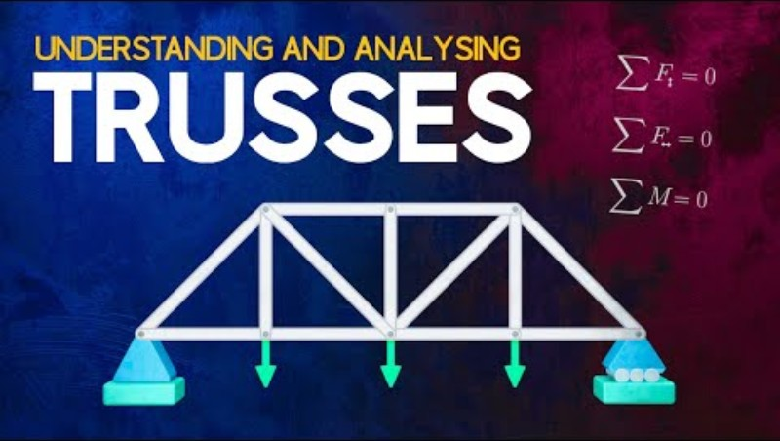
Trusses (1)
Introducing Trusses
A truss, that familiar triangle-filled structure, is just a smarter, more efficient kind of beam. It spreads forces like tension and compression in ways that allow engineers to build lighter, stronger and longer-spanning structures.
Watch ’Understanding and Analysing Trusses’ @TheEfficentEngineer video and answer the following questions.

Slide 130
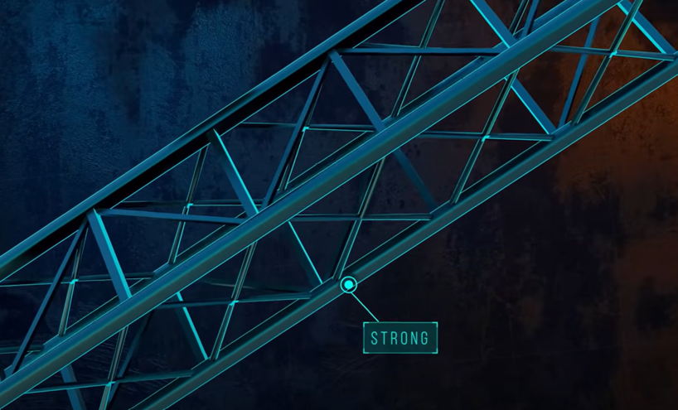
Trusses (2)
Introducing Trusses
Questions
Why do engineers use trusses in structures?
What shape is the key to a strong truss structure? Why?
What happens to a square structure under load compared to a triangle
How does changing the truss design affect the amount of force in each member?
Understanding and Analysing Trusses (17:40)

Slide 131
Trusses (3)
Introducing Trusses
Reflection Questions
Why do you think bridges and roofs often use trusses instead of solid beams?
In your own words, explain how a truss reduces bending in a beam.
Understanding and Analysing Trusses (17:40)

Slide 132
Why are Triangles a strong shape?

Slide 133
Learning intentions and success criteria (18)
We are learning to
understand why triangles are used so often in engineering and construction.
Investigate how they provide stability by distributing forces.
We can
describe how forces travel through a triangle
explain why a triangle holds its shape under load, while a square deforms
demonstrate and record how triangle and square frames respond to forces
explain how bracing improves stability in structures
identify real-world examples where triangles are used for strength and stability.
Notes:
Notes for teachers:
Learning intentions and success criteria are best co-constructed with students. Adapt the learning intention as required and add matching success criteria.
For more information See ⁠AITSL or the NSW Department of Education explicit teaching strategies, ⁠Sharing learning intentions and ⁠Sharing success criteria
LISC is not necessarily presented at the beginning of the lesson. Teacher needs to consider most effectual time to introduce
LISC should be revisited during the lesson to support students' evaluation of their learning

Slide 134
Trusses (4)
Why are triangles a strong shape?
When engineers design things like bridges or towers, they need to make sure the structure can hold up under weight. This means it shouldn’t collapse or bend when a force is applied — like cars driving over a bridge or wind pushing on a roof.
One shape that helps structures stay strong is the triangle. But why are triangles used so often in construction?
load
compression
compression
tension

Slide 135
Trusses (5)
Why are triangles a strong shape?
Let’s look at what happens when a force is applied to a triangle
When a load (force) pushes down on one corner of a triangle, the force travels along the sides. The two angled sides of the triangle are pushed in — this is called compression. The bottom side is pulled outwards — this is called tension.
Triangles are special because they don’t change shape easily under force. This makes them a smart and stable choice for engineers when building safe, strong structures like trusses and bridges.
load
compression
compression
tension

Slide 136
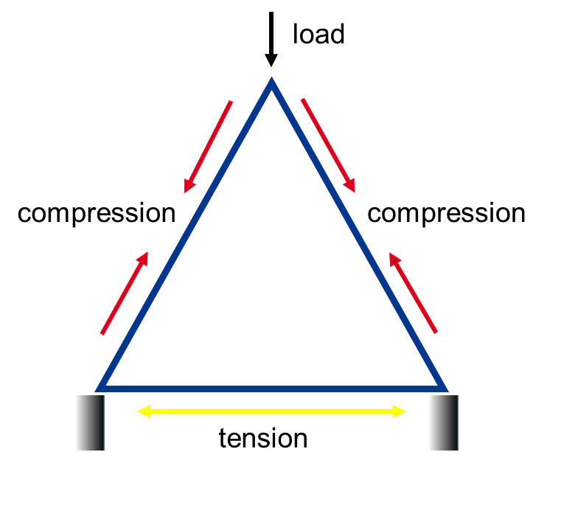
Trusses (6)
Activity – comparing force application on square vs triangle frames
Investigate and compare the structural stability and force response of square and triangular frames when external forces are applied, to understand stress distribution and shape stability in engineering design.
Materials
Thin wooden sticks or straws (all cut to equal lengths, e.g., 150mm)
Small connectors (thumb tacks or pins)
Weights (small masses or bags of sand) or a force gauge
Clamps or fixed supports (optional)
Ruler or protractor
Paper and pen for notes and sketches

Slide 137

Trusses (7)
Activity – comparing force application on square vs triangle frames
Investigate and compare the structural stability and force response of square and triangular frames when external forces are applied, to understand stress distribution and shape stability in engineering design.
Instructions – students prepare two frames:
Square frame – Connect four sticks to form a square.
Triangle frame – Connect three sticks to form an equilateral triangle.
Ensure all joints are secured but allow some movement as a pinned joint.

Slide 138
Trusses (8)
Activity – comparing force application on square vs triangle frames
Apply Forces
Place each frame on a flat surface.
Apply a gentle horizontal force at one corner of the square frame and observe deformation (does it easily change shape?).
Apply a gentle shear force (two forces applied in opposite directions) at the top and bottom of the square frame.
Repeat both processes for the triangle frame.
Observe how each frame reacts — note any deformation.
Record the observations for each frame under load.

Slide 139
Trusses (9)
Activity – comparing force application on square vs triangle frames
Group Discussion
Why did the square frame deform more easily?
Why is the triangle more stable under the same forces?
How does this relate to stress distribution within the shapes?
Discuss real-world applications where triangles provide structural stability (e.g., bridges, roof trusses).

Slide 140
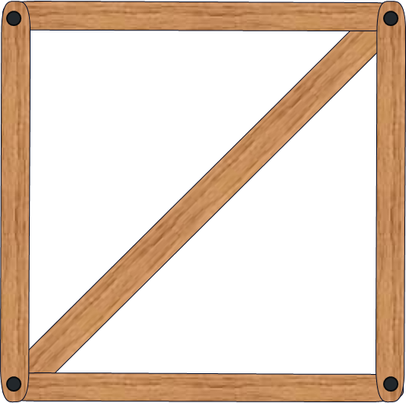
Trusses (10)
Activity – comparing force application on square vs triangle frames
Optional
Add diagonal bracing inside the square frame to form two triangles and repeat the tests. Observe if or how this improves stability.

Slide 141
Trusses (11)
Activity – comparing force application on square vs triangle frames
Assessment Questions
1. Why does a square frame deform more easily under force compared to a triangle?
2. What is the significance of internal forces such as tension and compression in maintaining the stability of a triangle frame?
3. How does adding diagonal bracing to a square frame affect its stability? Explain why this is effective.

Slide 142
Types of Trusses

Slide 143
Learning intentions and success criteria (19)
We are learning to
identify three common truss designs (Warren, Howe, and Pratt), their key features
Investigate when engineers use each type in real-world structures.
We can
identify the key features of Warren, Howe, and Pratt trusses
describe the main forces acting in each truss design
match truss types to appropriate applications (railway bridge, roof, pedestrian bridge)
sketch and label tension and compression members in each truss
explain why understanding forces is important for truss selection and design.
Notes:
Notes for teachers:
Learning intentions and success criteria are best co-constructed with students. Adapt the learning intention as required and add matching success criteria.
For more information See ⁠AITSL or the NSW Department of Education explicit teaching strategies, ⁠Sharing learning intentions and ⁠Sharing success criteria
LISC is not necessarily presented at the beginning of the lesson. Teacher needs to consider most effectual time to introduce
LISC should be revisited during the lesson to support students' evaluation of their learning

Slide 144
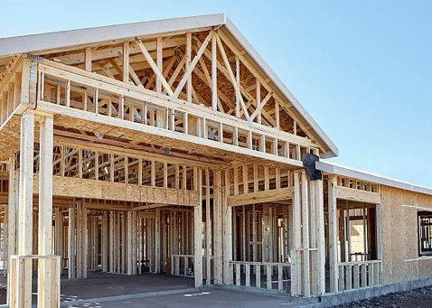

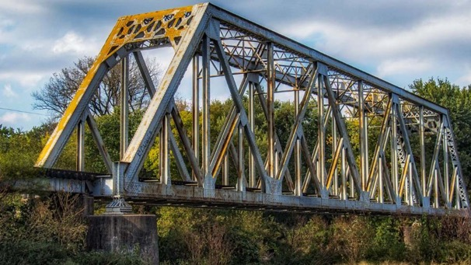
Types of Trusses (1)
There are an infinite number of truss shapes, but some have become more common because they are efficient, reliable, and relatively easy to build.
What are some places you’ve seen trusses used?

Slide 145

Types of Trusses (2)
Warren Truss
Consists of equilateral or isosceles triangles.
Load is distributed evenly.
Members alternate between tension and compression.
Efficient for uniform loads

Slide 146
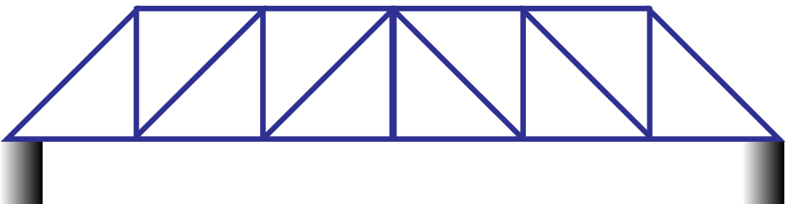
Types of Trusses (3)
Howe Truss
Diagonals face inwards from the top.
Vertical members = tension
Diagonal members = compression
Strong under heavy vertical loads (often used in railroad bridges).

Slide 147
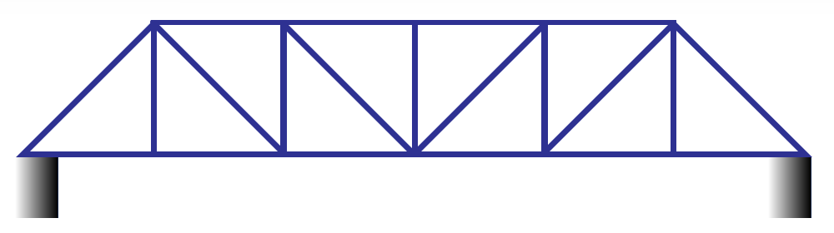
Types of Trusses (4)
Pratt Truss
Diagonals face outwards from the top.
Vertical members = compression
Diagonal members = tension
Efficient for longer spans and variable loads.

Slide 148
Types of Trusses (5)
Activity – truss comparison table
Truss Type | Key Features | Suitable for | Main forces | Examples
Warren | Even triangles, alternating members in tension and compression | Uniform loads | Tension and compression alternating throughout the truss | Roofs, short bridges
Howe | Diagonals inward, verticals in tension | Heavy downward loads | Compression in diagonals | Railway bridges
Pratt | Diagonals outward, verticals in compression | Long spans, changing loads | Tension in diagonals | Pedestrian bridges, towers

Slide 149
Types of Trusses (6)
Truss Type | Key Features | Suitable for | Main forces | Examples
Warren | Even triangles, alternating members in tension and compression | Uniform loads | Tension and compression alternating throughout the truss | Roofs, short bridges
Howe | Diagonals inward, verticals in tension | Heavy downward loads | Compression in diagonals | Railway bridges
Pratt | Diagonals outward, verticals in compression | Long spans, changing loads | Tension in diagonals | Pedestrian bridges, towers
Activity – truss comparison table
Sketch each truss and use colour coding (e.g. red for compression, blue for tension).
Questions
Which truss would you choose for a railway bridge and why?
Which truss might work best for a lightweight roof frame?
Why is understanding tension and compression important in choosing a truss design?

Slide 150
Introduction to Engineering Drawing

Slide 151
Learning intentions and success criteria (20)
We are learning to
understand why engineering drawings are important
understand how they act as the universal language of engineers
understand why standards like AS 1100 exist.
We can
explain why engineering drawings are used instead of freehand sketches
describe how drawings communicate shape, size, dimensions, and materials
explain the purpose of AS 1100 standards and why drawings must follow rules
discuss what could go wrong if engineers used different drawing rules.
Notes:
Notes for teachers:
Learning intentions and success criteria are best co-constructed with students. Adapt the learning intention as required and add matching success criteria.
For more information See ⁠AITSL or the NSW Department of Education explicit teaching strategies, ⁠Sharing learning intentions and ⁠Sharing success criteria
LISC is not necessarily presented at the beginning of the lesson. Teacher needs to consider most effectual time to introduce
LISC should be revisited during the lesson to support students' evaluation of their learning

Slide 152
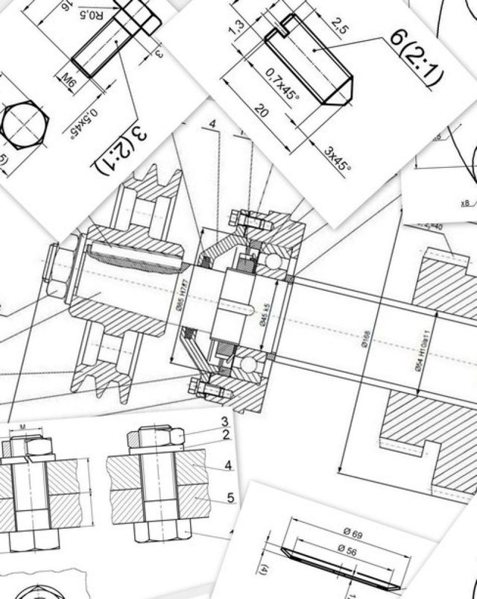
Introduction to engineering drawing (1)
Engineering drawing is the universal language of engineers. Before a bridge, machine, or product is manufactured, it must first be drawn and communicated to the construction team. A well-prepared drawing allows ideas to be shared, tested, and constructed accurately. Unlike freehand sketches, technical drawings follow strict standards so that engineers and builders anywhere in the world can understand the same design. These drawings show more than just the shape of an object, but also its dimensions, materials, and how it fits with other parts. In this way, drawings 'bridge the gap' between an idea and the finished product, ensuring that a design can be built safely, efficiently, and exactly as intended.

Slide 153

Introduction to engineering drawing (2)
Drawing Standards - AS 1100
For engineering drawings to be understood anywhere in the world, they must follow a common set of rules. Without standards, every engineer or company might draw things differently, leading to mistakes, delays, or unsafe products. In Australia, we use the AS 1100 drawing standards, which ensure that all technical drawings follow the same conventions for line types, dimensioning, scales, and projections. These standards align with international conventions, meaning that a drawing prepared here can be interpreted correctly in any country. This universal 'language of drawing' allows engineers, manufacturers, and builders across the globe to collaborate and produce accurate, reliable designs.
Image from Store | Standards Australia Store

Slide 154
Introduction to engineering drawing (3)
Drawing Standards - AS 1100
Task – Students discuss with a partner:
What problems might happen if every country or engineer used their own style of drawing?
Why is it so important for bridge designs to be universally accessible?
Image from Store | Standards Australia Store

Slide 155
Orthogonal Projection

Slide 156
Learning intentions and success criteria (21)
We are learning to
understand what orthogonal projection is, why it is used in engineering drawing
examine how multiple views communicate accurate information for manufacture.
We can
define orthogonal (orthographic) drawing and explain its purpose
describe the main rules of AS 1100 (third-angle projection, line types, dimensioning, hidden detail)
explain why multiple views are needed to show true length and detail
identify examples where one view is not enough to describe an object.
Notes:
Notes for teachers:
Learning intentions and success criteria are best co-constructed with students. Adapt the learning intention as required and add matching success criteria.
For more information See ⁠AITSL or the NSW Department of Education explicit teaching strategies, ⁠Sharing learning intentions and ⁠Sharing success criteria
LISC is not necessarily presented at the beginning of the lesson. Teacher needs to consider most effectual time to introduce
LISC should be revisited during the lesson to support students' evaluation of their learning

Slide 157
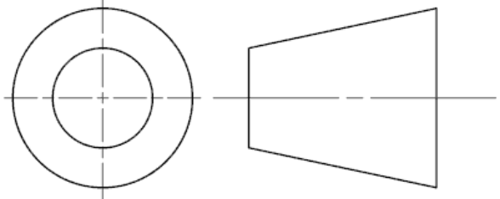
Introduction to engineering drawing (4)
Orthogonal Projection
Orthogonal (or orthographic) drawing is a method of showing a 3D object in 2D views.
It is the industry standard for communicating exact shapes, sizes, and details.
In Australia, third-angle projection is the system used as per Australian Standards (AS 1100).
Symbol for third angle projection

Slide 158
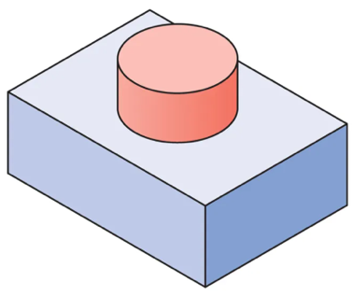
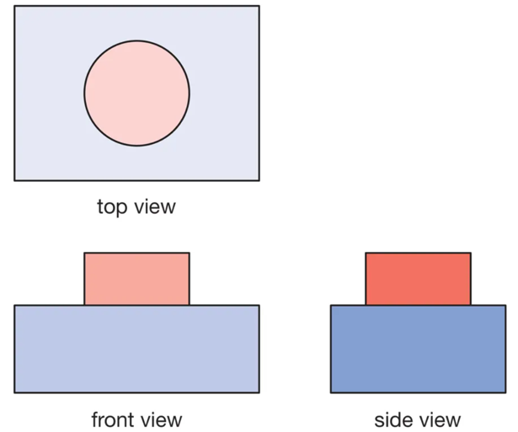
Introduction to engineering drawing (5)
Why use Orthogonal Projection?
Pictorial drawings (like isometric) show what an object looks like, but they are often not precise enough for manufacture.
Orthogonal drawings provide accurate measurements and clear details needed to build a product.
A minimum of two views (front + top) are required, but usually three views (front, top and side).
Each view is aligned or projected from each other. Normally the top and side views are projected from the front view.
View details:
Front view – main shape and detail.
Top view – shows width and depth.
Side view – shows height and depth
Pictorial – Isometric drawing

Slide 159
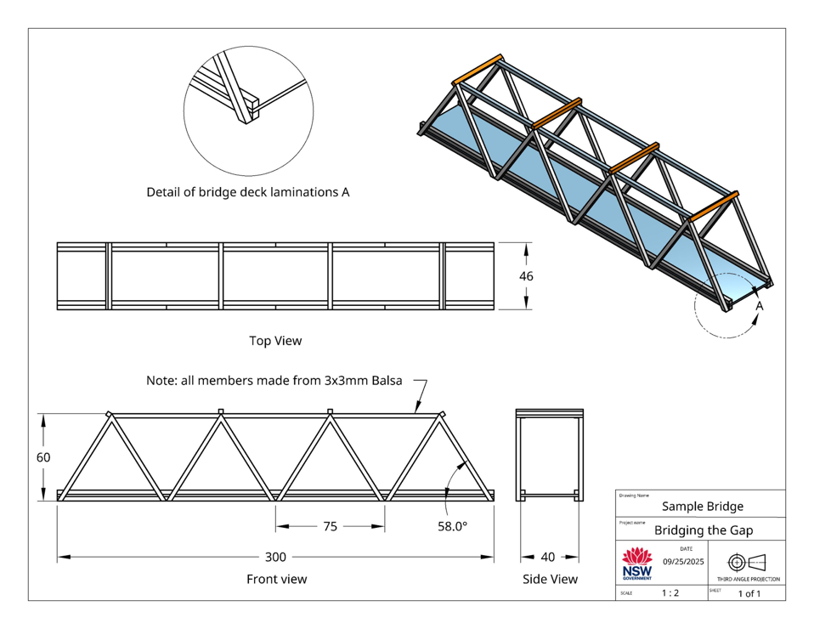
Introduction to engineering drawing (6)
Orthogonal drawing rules and standards (AS 1100)
Third-angle projection symbol must be shown.
Views are aligned horizontally and vertically.
Hidden detail is shown with dashed lines.
Centre lines mark symmetry and holes.
Dimensioning shows real-world size, not the scaled drawing size.
Line types must follow standard (thick outlines, thin construction, dashed for hidden).

Slide 160
Introduction to engineering drawing (7)
Orthogonal drawing rules and standards (AS 1100)
Example (Bridge Application)
A truss bridge drawn pictorially in 3D shows its general shape.
Orthogonal drawings break it down into front, top and side views, with each member shown in true length and can be dimensioned.
This allows accurate cutting of materials and assembly.

Slide 161
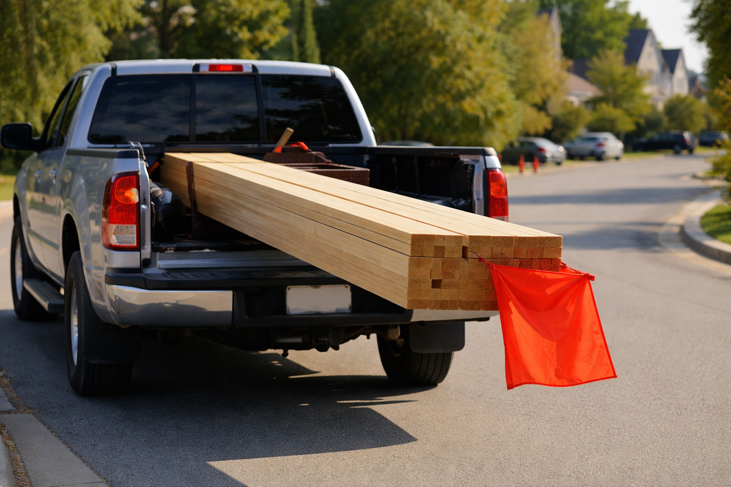
Introduction to engineering drawing (8)
Why do we need to have more than one view?
Activity – referring to the image
Answer the questions
From behind the vehicle, how do we know how long the timber sticks out?
Why is there a flag on the end of the timber?
Identify 2 other examples of objects or situations where more than one view is required.

Slide 162
Orthogonal Drawing Exercises

Slide 163
Learning intentions and success criteria (22)
We are learning to
produce accurate orthogonal drawings by hand, following engineering drawing standards (AS 1100).
We can
Set up a drawing sheet correctly with title block and border
use drawing equipment accurately (T-square, set square, mechanical pencil)
project top and side views from the front view using projection lines
label each view appropriately (Front, Top, Side)
(extension) apply correct dimensioning standards.
Notes:
Notes for teachers:
Learning intentions and success criteria are best co-constructed with students. Adapt the learning intention as required and add matching success criteria.
For more information See ⁠AITSL or the NSW Department of Education explicit teaching strategies, ⁠Sharing learning intentions and ⁠Sharing success criteria
LISC is not necessarily presented at the beginning of the lesson. Teacher needs to consider most effectual time to introduce
LISC should be revisited during the lesson to support students' evaluation of their learning

Slide 164
Orthogonal projection introductory exercises
The following CAD drawings can be used as a series of introductory manual orthogonal drawing exercises.
Manual drawing equipment is required for these activities, including:
Drawing boards and T squares
Set squares
0.5 mechanical pens (preferred) or sharp 2b pencils
Method of attaching drawing sheet to the board - tape or drawing board clips (preferred)
Points to consider for each sheet when delivering and demonstrating the introductory exercises are:
Title bock and page border
Setting out, providing a start point to ensure the object views fit appropriately on the page and are spaced evenly
Projecting the top and side views from the front view
Labelling each view
(optional) dimensioning standards

Slide 165
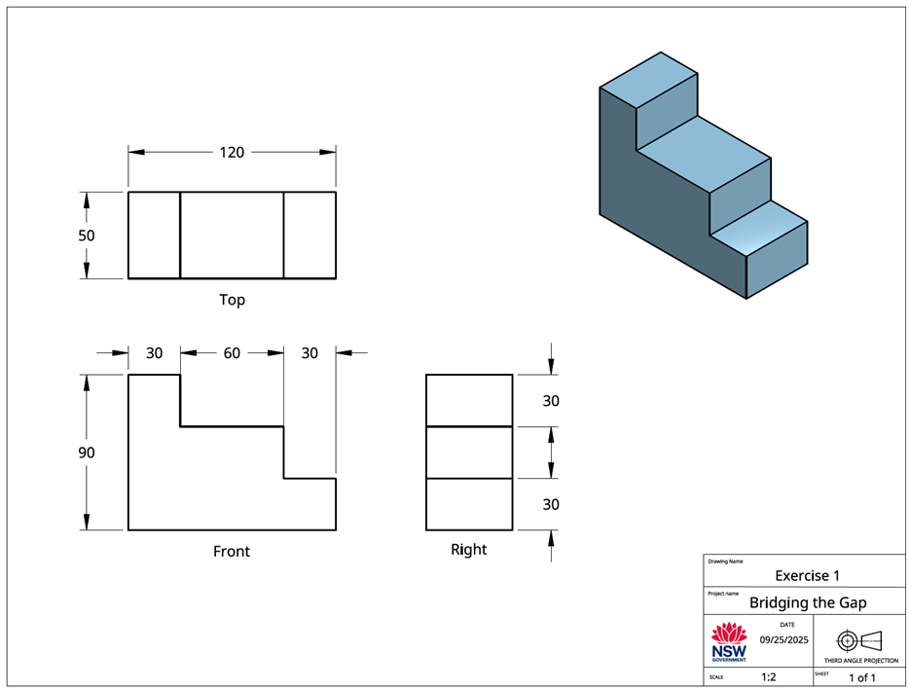
Ex 1

Slide 166
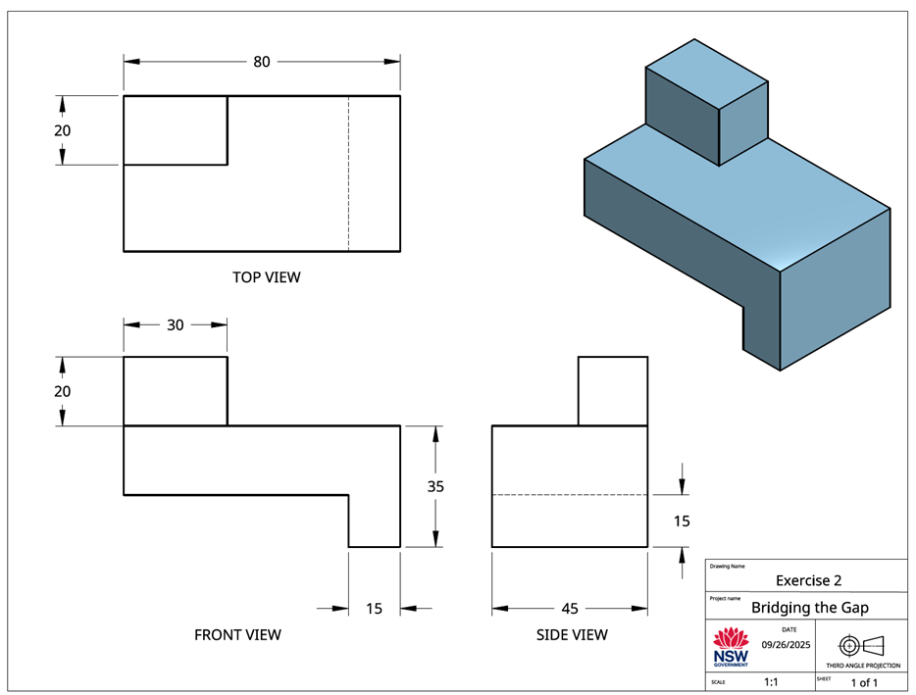
Ex 2

Slide 167
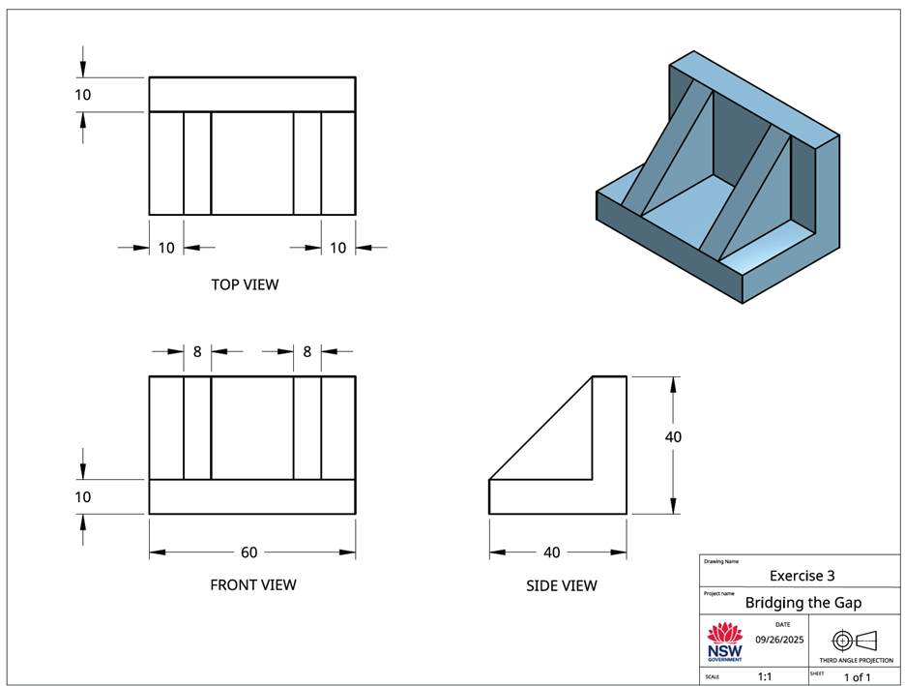
Ex 3

Slide 168
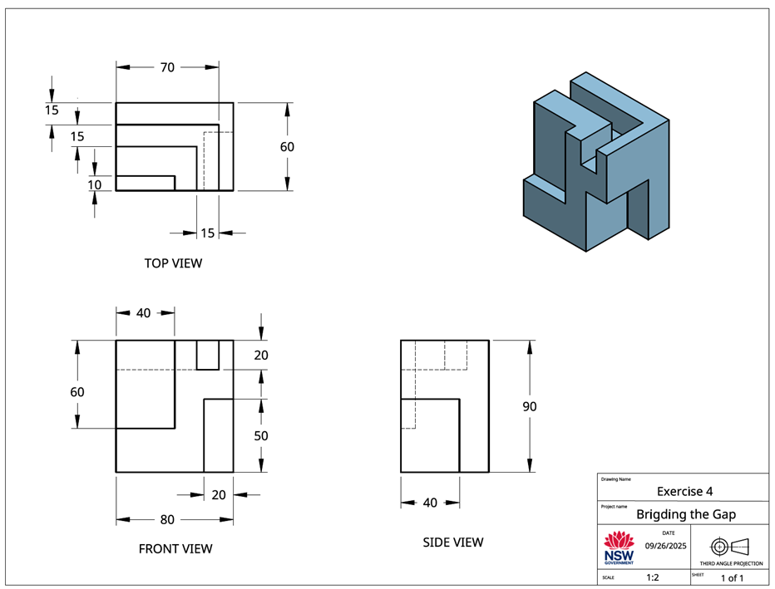
Ex 4

Slide 169
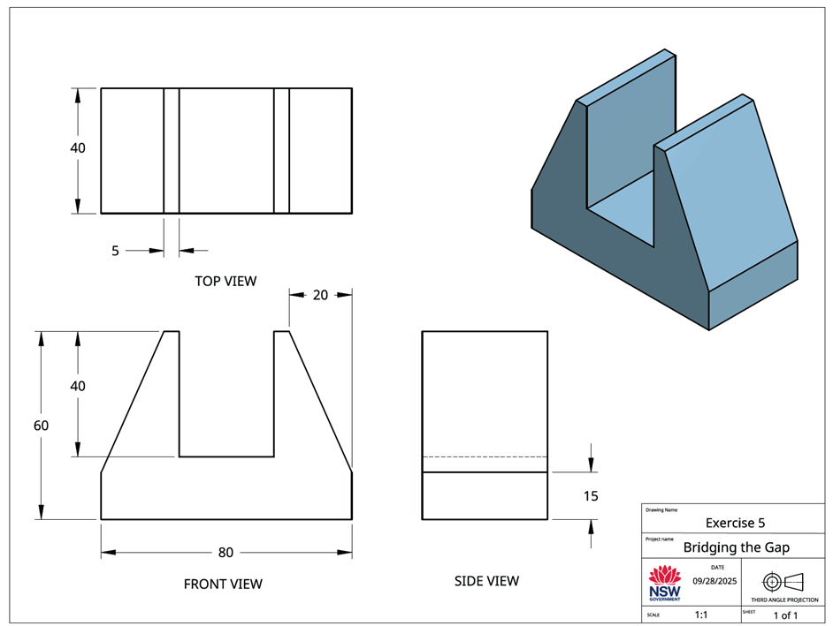
Ex 5

Slide 170
‘Bridging the Gap’
Task introduction and Research

Slide 171
Learning intentions and success criteria (23)
We are learning to
investigate truss bridge designs and identify their advantages to inform our own design work.
We can
describe the key features of common trusses such as Warren, Pratt, and Howe trusses
recognise advantages and disadvantages of different truss designs
explain why trusses are used in real bridges.
Notes:
Notes for teachers:
Learning intentions and success criteria are best co-constructed with students. Adapt the learning intention as required and add matching success criteria.
For more information See ⁠AITSL or the NSW Department of Education explicit teaching strategies, ⁠Sharing learning intentions and ⁠Sharing success criteria
LISC is not necessarily presented at the beginning of the lesson. Teacher needs to consider most effectual time to introduce
LISC should be revisited during the lesson to support students' evaluation of their learning

Slide 172
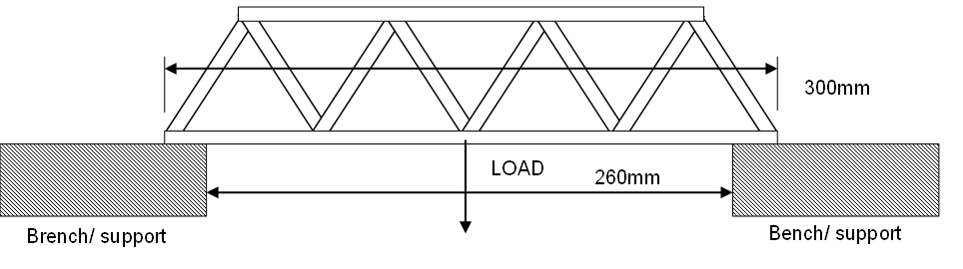
‘Bridging the gap’ assessment task (1)
Students are to design, construct, and test a model truss bridge using 3mm x 3mm balsa wood and a standardised roadway section.

Slide 173
‘Bridging the gap’ assessment task (2)
Students are to design, construct, and test a model truss bridge using 3mm x 3mm balsa wood and a standardised roadway section.
Dimensions Total length 300mm
Span 260mm
Roadway 40mm x 1.5mm
Section of balsa 3 x 3mm
Materials 2 of 3 x 3mm square 915mm lengths of Balsa wood
1 of 300mm x 40mm x 1.5mm balsa wood (roadway)
Suitable balsa wood adhesive.

Slide 174
‘Bridging the gap’ (1)
Steps | Timing and student task details
Task introduction and research | Week 1 Review assessment outline Research different truss bridge designs (e.g., Warren, Pratt, Howe) Record key features and advantages
Design development | Week 2 Produce three design proposals (sketches with annotations) Consider efficient use of materials and strength-to-weight ratio
Design justification and final drawing | Week 3 Select the preferred design Write 1-page justification comparing proposals Produce A3 orthogonal drawing of final design
Construction | Week 5 Cut and assemble bridge from 3mm x 3mm balsa Ensure bridge matches drawing Apply safe work practices
Testing | Week 7 Record mass of completed bridge Participate in load testing Record maximum load and calculate strength-to-weight ratio
Evaluation and Report submission | Week 9–10 Analyse bridge failure points Suggest improvements to design for efficiency Compile testing data and final evaluation into short engineering report
This assessment task is designed to be delivered over 10 weeks. The following table provides a suggested breakdown own components and timing

Slide 175
‘Bridging the Gap’
Design Development

Slide 176
Learning intentions and success criteria (24)
We are learning to
generate and communicate multiple truss bridge design proposals.
We can
sketch at least three design proposals
annotate sketches with features, forces, and material use
consider efficiency and strength-to-weight ratio.
Notes:
Notes for teachers:
Learning intentions and success criteria are best co-constructed with students. Adapt the learning intention as required and add matching success criteria.
For more information See ⁠AITSL or the NSW Department of Education explicit teaching strategies, ⁠Sharing learning intentions and ⁠Sharing success criteria
LISC is not necessarily presented at the beginning of the lesson. Teacher needs to consider most effectual time to introduce
LISC should be revisited during the lesson to support students' evaluation of their learning

Slide 177

‘Bridging the gap’ (2)
Design Phase
Each student develops three different truss bridge design proposals. Note: The emphasis is on efficient use of materials and achieving a high strength-to-weight ratio, rather than maximum strength.
The design of the bridge must enable a small matchbox® car (or similar) to pass over your bridge.
Each sketch must contain annotations or labels indicating keys features.

Slide 178
‘Bridging the Gap’
Design Justification and Final Drawing

Slide 179
Learning intentions and success criteria (25)
We are learning to
justify design decisions and communicate a final bridge design using orthogonal drawing standards.
We can
select a preferred design based on evidence
write a 1-page justification comparing options
produce an accurate orthogonal drawing of the final design.
Notes:
Notes for teachers:
Learning intentions and success criteria are best co-constructed with students. Adapt the learning intention as required and add matching success criteria.
For more information See ⁠AITSL or the NSW Department of Education explicit teaching strategies, ⁠Sharing learning intentions and ⁠Sharing success criteria
LISC is not necessarily presented at the beginning of the lesson. Teacher needs to consider most effectual time to introduce
LISC should be revisited during the lesson to support students' evaluation of their learning

Slide 180
‘Bridging the gap’ (3)
Design Phase
Students justify the final design selection using engineering principles and comparisons with the other proposals.
Students produce an A3 orthogonal drawing (AS 1100 standards) of the selected bridge design, including overall and critical dimensions and annotations.
The scale of the drawing is to be 1:1, as this allows the possibility of photocopying the A3 drawing as a template for the bridge construction.

Slide 181
‘Bridging the Gap’
Bridge Construction

Slide 182
Learning intentions and success criteria (26)
We are learning to
safely construct our bridge according to the design drawings
We can
cut and assemble balsa accurately
apply safe work practices when using tools
ensure the finished bridge matches the drawing.
Notes:
Notes for teachers:
Learning intentions and success criteria are best co-constructed with students. Adapt the learning intention as required and add matching success criteria.
For more information See ⁠AITSL or the NSW Department of Education explicit teaching strategies, ⁠Sharing learning intentions and ⁠Sharing success criteria
LISC is not necessarily presented at the beginning of the lesson. Teacher needs to consider most effectual time to introduce
LISC should be revisited during the lesson to support students' evaluation of their learning

Slide 183
‘Bridging the gap’ (4)
Construction Phase
Students build the bridge model according to the final drawing.
Bridges must span 300mm with a minimum width of 40mm.
All bridges must be constructed only from 3mm x 3mm balsa and PVA glue.
Use the provided standard roadway section to maintain design and testing consistency. Refer to the images for guidance.
The bridge should be constructed in a manner similar to model aircraft construction, by cutting and pinning and glueing whilst overlaying the drawing.

Slide 184
‘Bridging the Gap’
Bridge Testing

Slide 185
Learning intentions and success criteria (27)
We are learning to
test our bridges and calculate strength-to-weight ratios.
We can
record mass of completed bridge in grams
record maximum load sustained in kilograms
calculate strength-to-weight ratio.
Notes:
Notes for teachers:
Learning intentions and success criteria are best co-constructed with students. Adapt the learning intention as required and add matching success criteria.
For more information See ⁠AITSL or the NSW Department of Education explicit teaching strategies, ⁠Sharing learning intentions and ⁠Sharing success criteria
LISC is not necessarily presented at the beginning of the lesson. Teacher needs to consider most effectual time to introduce
LISC should be revisited during the lesson to support students' evaluation of their learning

Slide 186
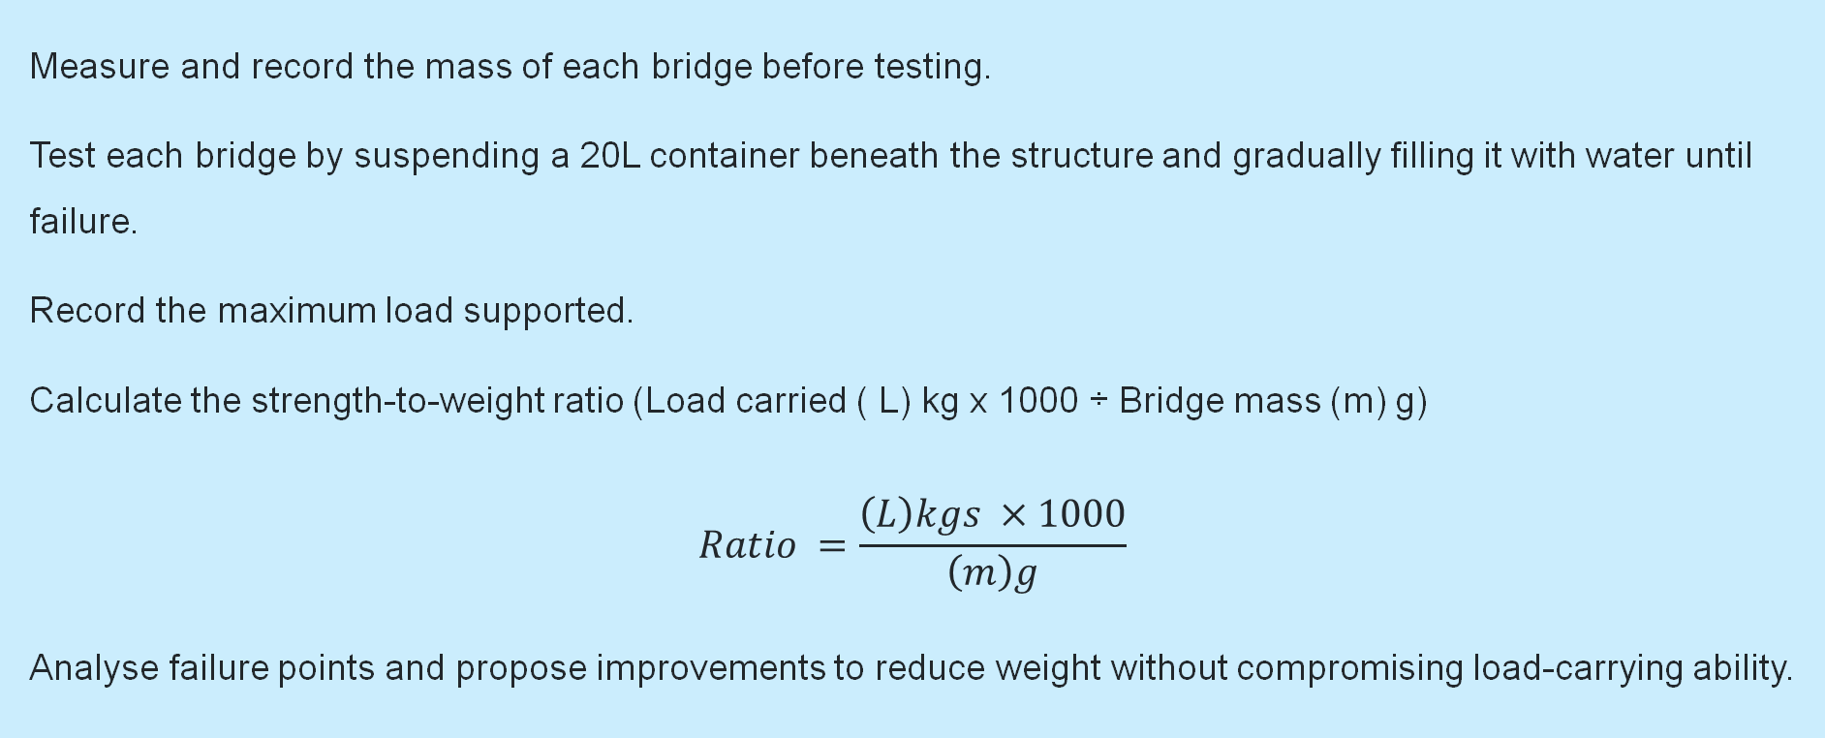
‘Bridging the gap’ (5)
Testing and Evaluation Phase
Measure and record the mass of each bridge before testing.
Test each bridge by suspending a 20L container beneath the structure and gradually filling it with water until failure.
Record the maximum load supported.
Calculate the strength-to-weight ratio (Load carried ( L) kg x 1000 ÷ Bridge mass (m) g)
$$Ratio =\frac{\left(L\right)kgs ×1000}{\left(m\right)g}$$
Analyse failure points and propose improvements to reduce weight without compromising load-carrying ability.

Slide 187
‘Bridging the Gap’
Evaluation and Engineering report

Slide 188
Learning intentions and success criteria (28)
We are learning to
evaluate our bridge design and testing results
use the results to compile an engineering report
We can
analyse failure points in our bridge
suggest improvements for efficiency and strength
compile testing data and evaluation into a report
submit a final engineering report.
Notes:
Notes for teachers:
Learning intentions and success criteria are best co-constructed with students. Adapt the learning intention as required and add matching success criteria.
For more information See ⁠AITSL or the NSW Department of Education explicit teaching strategies, ⁠Sharing learning intentions and ⁠Sharing success criteria
LISC is not necessarily presented at the beginning of the lesson. Teacher needs to consider most effectual time to introduce
LISC should be revisited during the lesson to support students' evaluation of their learning

Slide 189
‘Bridging the gap’ (6)
Submission details
Design sketches:
Three design proposals (A4 page sketches with annotations).
Final Design:
Final A3 orthogonal drawing to AS 1100 standards with title block.
Providing reasons for selecting final design.
Constructed bridge model:
Submitted prior to testing
Engineering report:
Justification (no more than 1 page) comparing and evaluating the three designs.
Details of the construction procedures undertaken in building the bridge
Testing data and truss evaluation documented

Slide 190
‘Bridging the gap’ (7)
What is the teacher looking for?
Safe use of tools, equipment and materials when designing, constructing and testing your bridge.
Clear communication of your ideas through labelled sketches, orthogonal drawings and correct use of engineering terms.
Evidence that you have investigated and compared different truss bridge designs to decide on the most efficient option.
A well-justified final design choice that explains why it is the best use of materials.
Accurate construction of your bridge that matches your final drawing.
Correct measurement and recording of the mass of your bridge and the maximum load it carries.
Accurate calculation of the strength-to-weight ratio.
An evaluation that explains, using engineering terminology, how your bridge performed, where it failed, and how it could be improved.
Consideration of how efficient use of materials relates to sustainability in engineering design.

Slide 191
‘Bridging the gap’ (8)
Student-facing rubric
Criteria | Limited | Basic | Sound | High | Outstanding
Safe work practices | Rarely follows safety instructions when using tools and materials. | Sometimes follows safety instructions but often needs reminders. | Usually follows safety instructions and uses tools safely | Consistently follows safety instructions with care and responsibility | Always demonstrates excellent safety awareness and sets a positive example for others
Design and communication | Produces few or unclear sketches with little explanation | Produces some sketches with limited detail and explanation. | Produces three clear sketches with some annotations | Produces three detailed sketches with clear annotations and correct use of terms | Produces three highly detailed designs with high quality sketches, clear annotations and precise engineering language
Bridge construction | Bridge is incomplete or poorly made and does not meet specifications. | Bridge is roughly made with several errors and only partly meets specifications | Bridge is complete, reasonably accurate and meets most specifications | Bridge is well made, accurate relative to the drawing and meets all specifications | Bridge is constructed with excellent accuracy and quality, closely matching the drawing and exceeding specifications
Testing and evaluation | Provides little or no testing data or reflection | Provides some testing data but with errors and limited reflection | Provides testing data and a basic evaluation of bridge performance | Provides accurate testing data and a clear evaluation, including some suggestions for improvement | Provides very accurate testing data and a detailed evaluation, clearly identifying failure points and suggesting realistic improvements for efficiency and sustainability
Sustainable design | Presents little or no reference to the importance of sustainable design | Presents some consideration to the importance of sustainable designs | Presents characteristics of sustainable considerations when designing engineered structures | Presents some understanding of the importance of sustainable design in engineering with examples | Presents a clear understanding of the importance of sustainable design in engineering with specific examples

Slide 192
‘Bridging the gap’ (9)
Sample student Engineering report format
Bridging the Gap Cover page
Include:
Report title
Your full name
Date
Class and teacher's name

Slide 193
‘Bridging the gap’ (10)
Sample student Engineering report format
Research
Identify and describe three truss designs (e.g., Warren, Pratt, Howe).
For each design, explain:
      Advantages
      Disadvantages
      A real-world example of its use.

Slide 194
‘Bridging the gap’ (11)
Sample student Engineering report format
Design development
Present your three proposed truss designs (one design per A4 page).
Include annotations and labels to explain structural features (e.g., tension members, compression members, joints).
Use correct engineering terminology.

Slide 195
‘Bridging the gap’ (12)
Sample student Engineering report format
Design justification and final drawing
Select the design you believe is most suitable for the challenge.
Provide a written justification:
Why is this design more efficient than your other two options?
How does it use materials effectively?
How can it be made satisfactorily?
Include your final A3 orthogonal drawing (AS1100 standard, with title block and basic dimensions).

Slide 196
‘Bridging the gap’ (13)
Sample student Engineering report format
Construction
Detail the construction procedures undertaken in building the bridge. Include:
Materials used
Adhesives
Basic assembly and construction procedures
Quality control checks (e.g. alignment, joint fit and symmetry)
Include labelled photos (if possible) to show key stages of construction.

Slide 197

‘Bridging the gap’ (14)
Sample student Engineering report format
Testing
Record:
Mass of the bridge in grams.
Maximum load supported in kgs
Strength to weight ratio calculation.
Strength to weight ratio.
$$Ratio =\frac{\left(L\right)kgs ×1000}{\left(m\right)g}$$
Present the results in a table format.

Slide 198
‘Bridging the gap’ (15)
Sample student Engineering report format
Analysis and Evaluation
Details of how the bridge performed.
Points to consider:
Did it support the predetermined maximum load?
Identify failure points, if any, and suggest improvements.
How could the design be improved?
How could the strength to weight ratio be improved?

Slide 199
‘Bridging the gap’ (16)
Sample student Engineering report format
Sustainability of engineered structures.
Write a brief statement outlining the importance of sustainable designs in engineering.
Consider:
Efficient use of materials
Environmental impacts
Longevity of structures

Slide 200
‘Bridging the gap’ (17)
Student checklist
A clear cover page with all required details.
Research section with three truss designs described and examples provided.
Three design proposals, clearly labelled with annotations.
A justification of your final design, with an orthogonal drawing included.
A construction section explaining materials, methods and quality control.
A testing section with bridge weight, load, and strength-to-weight ratio correctly calculated.
An analysis and evaluation that identifies performance, failure points and improvements.
A short statement on the sustainability of engineered structures.
Correct use of engineering terminology throughout.
Work is neat, well organised, and free of spelling/grammar errors.

Slide 201
References
This presentation contains NSW Curriculum and syllabus content. The NSW Curriculum is developed by the NSW Education Standards Authority. This content is prepared by NESA for and on behalf of the Crown in the right of the State of New South Wales. The material is protected by Crown copyright.
Please refer to the NESA Copyright Disclaimer for more information https://educationstandards.nsw.edu.au/wps/portal/nesa/mini-footer/copyright.
NESA holds the only official and up-to-date versions of the NSW Curriculum and syllabus documents. Please visit the NSW Education Standards Authority (NESA) website https://educationstandards.nsw.edu.au/wps/portal/nesa/home and the NSW Curriculum website https://curriculum.nsw.edu.au.
Engineering Technology 7–10 Syllabus © NSW Education Standards Authority (NESA) for and on behalf of the Crown in right of the State of New South Wales, 2024.
Brookhart SM (2018) ‘Appropriate Criteria: Key to Effective Rubrics’, Frontiers in Education, volume 3(22):1–12, doi:10.3389/feduc.2018.00022, accessed [14/05/2025].
CESE (Centre for Education Statistics and Evaluation) (2020) What works best: 2020 update, NSW Department of Education, accessed [08/08/2025].
CESE (2020) What works best in practice, NSW Department of Education, accessed [08/08/2025].

Slide 202
Copyright
© State of New South Wales (Department of Education), 2026
The copyright material published in this resource is subject to the Copyright Act 1968 (Cth) and is owned by the NSW Department of Education or, where indicated, by a party other than the NSW Department of Education (third-party material).
Copyright material available in this resource and owned by the NSW Department of Education is licensed under a Creative Commons Attribution 4.0 International (CC BY 4.0) license.
This license allows you to share and adapt the material for any purpose, even commercially.
Attribution should be given to © State of New South Wales (Department of Education), 2026.
Material in this resource not available under a Creative Commons license:
the NSW Department of Education logo, other logos and trademark-protected material
Material owned by a third party that has been reproduced with permission. You will need to obtain permission from the third party to reuse its material.
Links to third-party material and websites
Please note that the provided (reading/viewing material/list/links/texts) are a suggestion only and implies no endorsement, by the New South Wales Department of Education, of any author, publisher, or book title. School principals and teachers are best placed to assess the suitability of resources that would complement the curriculum and reflect the needs and interests of their students.
If you use the links provided in this document to access a third-party’s website, you acknowledge that the terms of use, including licence terms set out on the third-party’s website apply to the use which may be made of the materials on that third-party website or where permitted by the Copyright Act 1968 (Cth). The department accepts no responsibility for content on third-party websites.

